Slide 1
Exploring Britain
Boating South Part 4
Chapter 14
Through Cornwall to Lands End
9th August 2013 to 28th June 2014

Slide 2
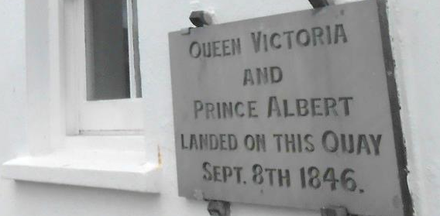
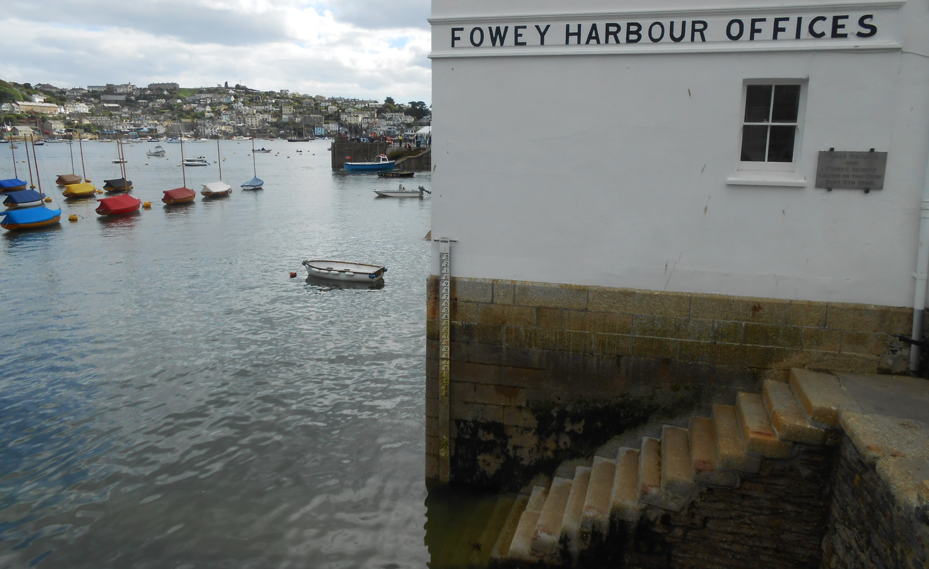
We have reached Cornwall and are in wonderful Fowey.

Slide 3
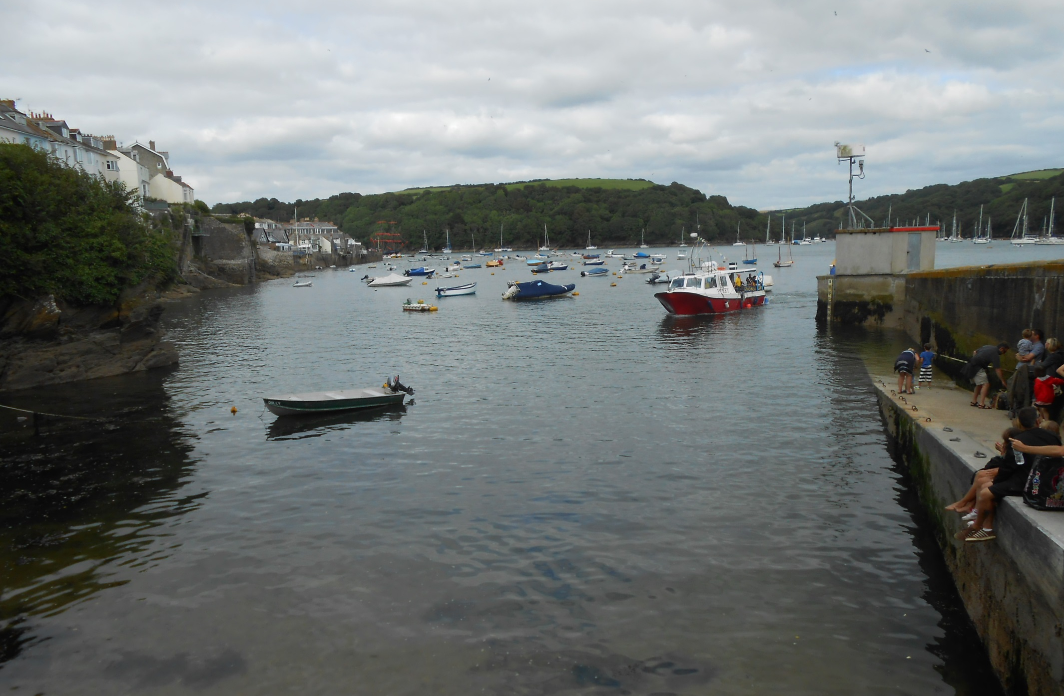
As, at Whitehouse Quay, the Bessie James approaches, the summer only Fowey to Mevagissey ferry.

Slide 4
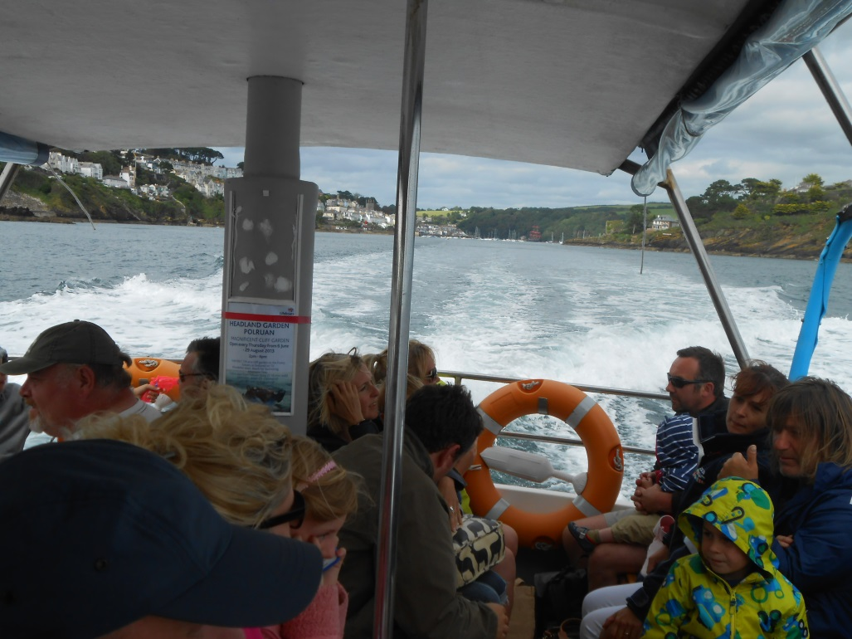
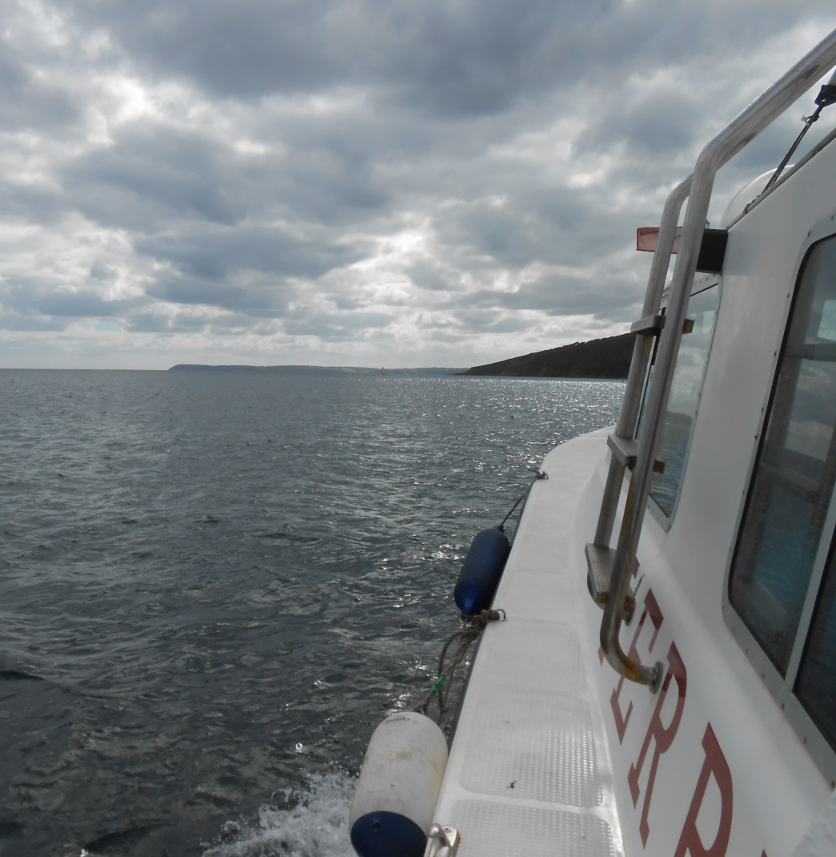
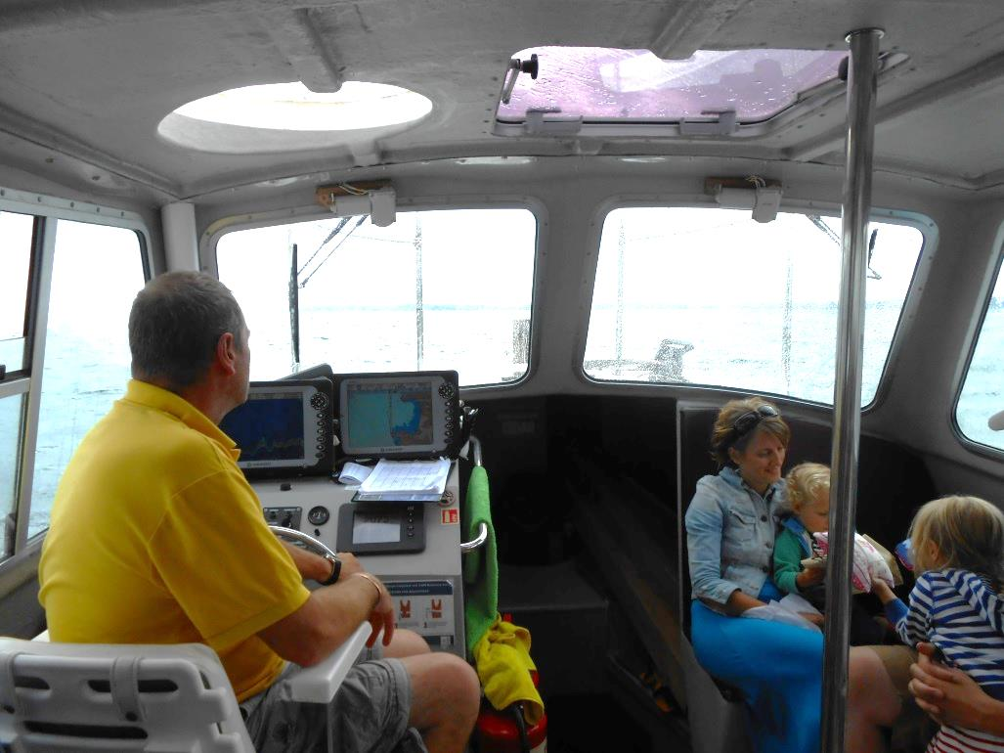
The ferry was busy with pre-booked passengers and I was relieved to make it aboard as we head out of Fowey towards Gribben Head.

Slide 5
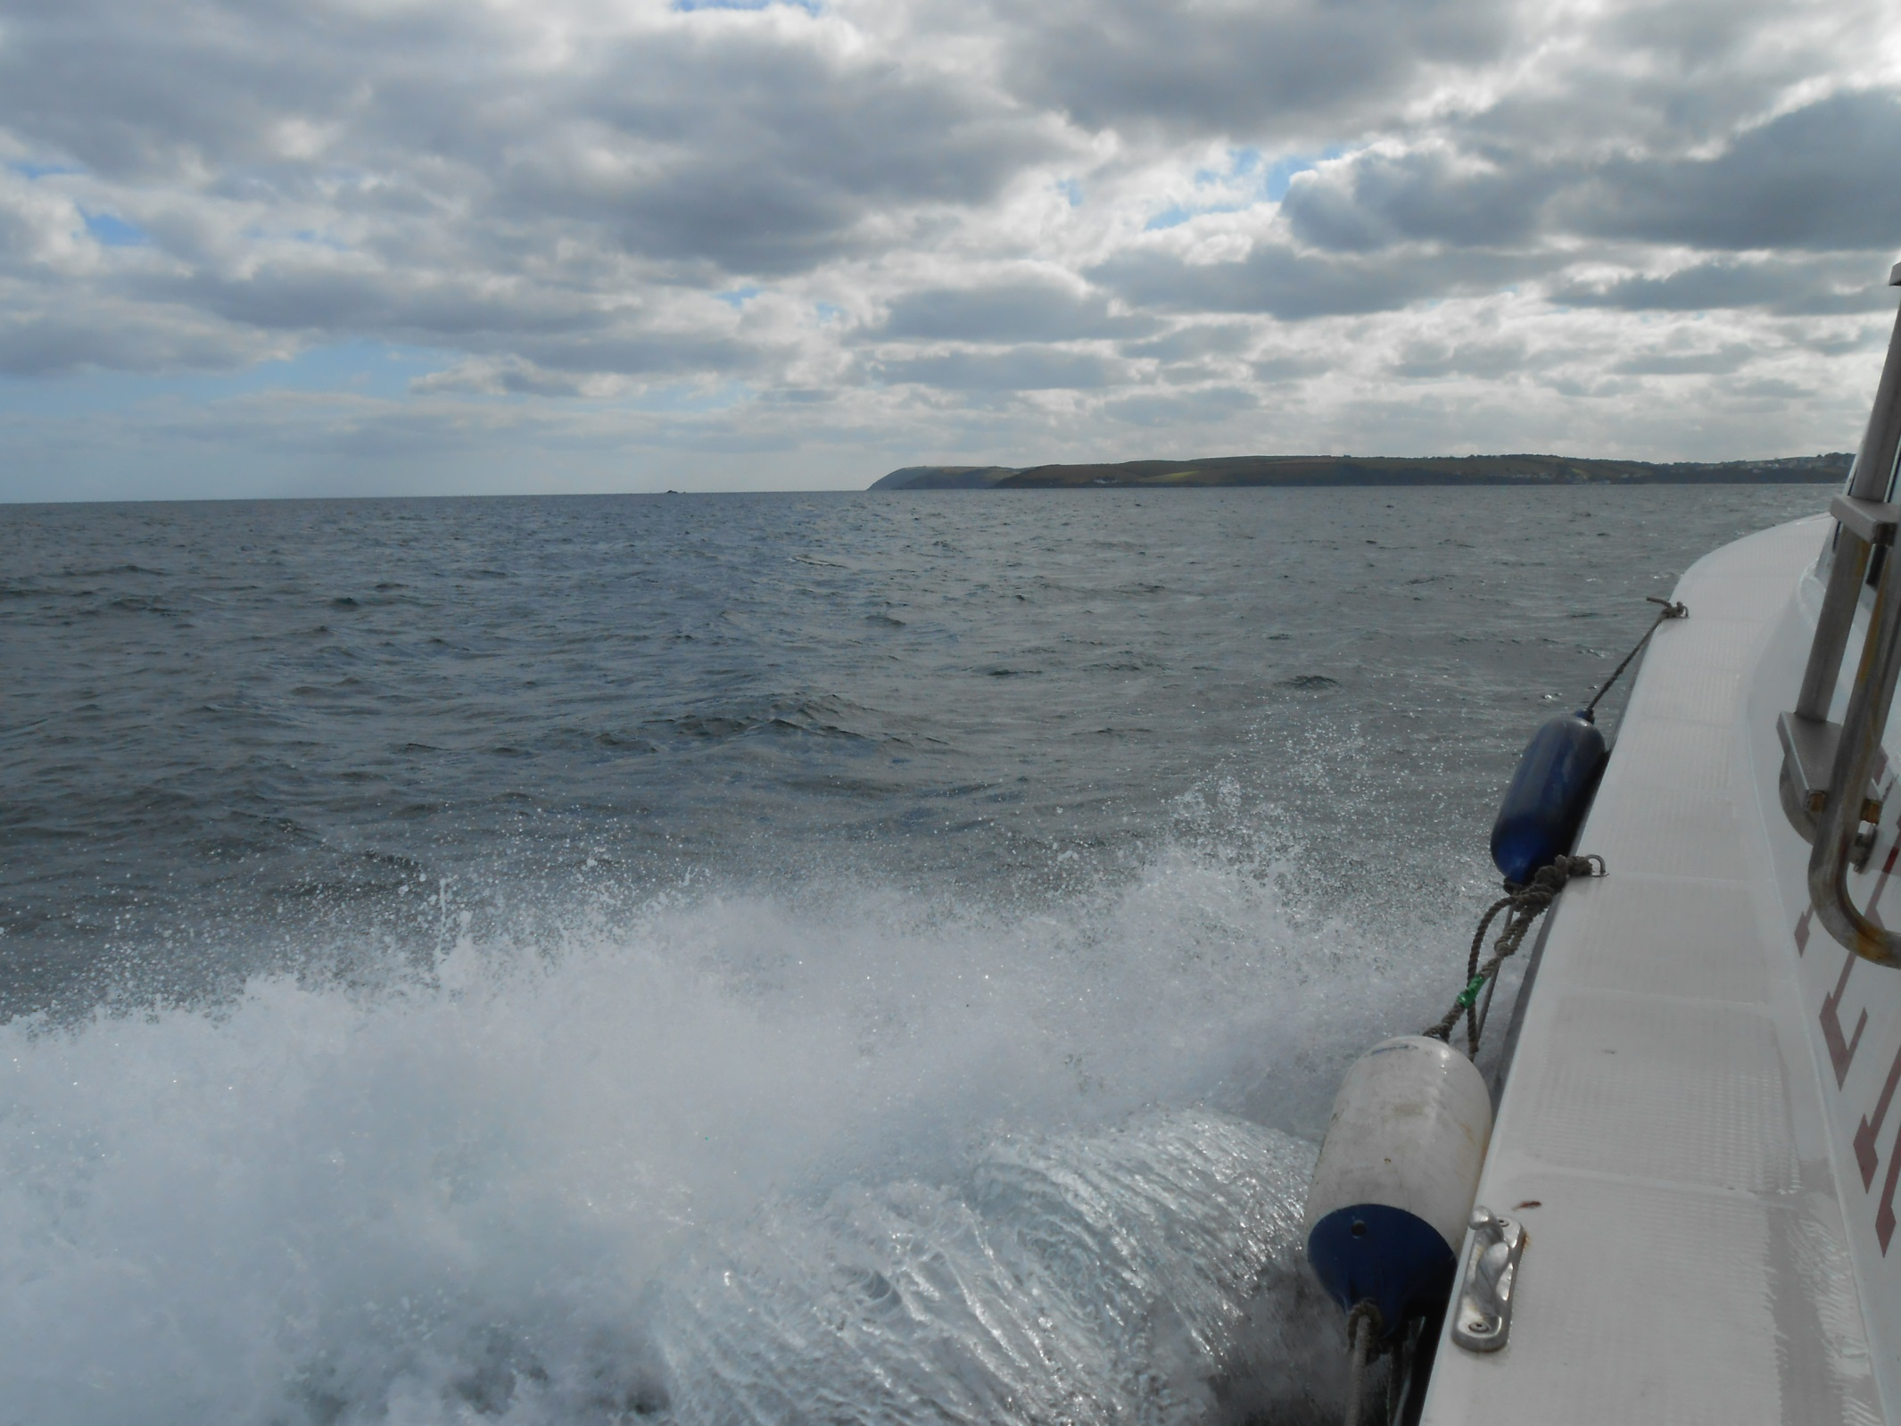
Then it’s full speed across St. Austell Bay on this 35 minute ride.

Slide 6
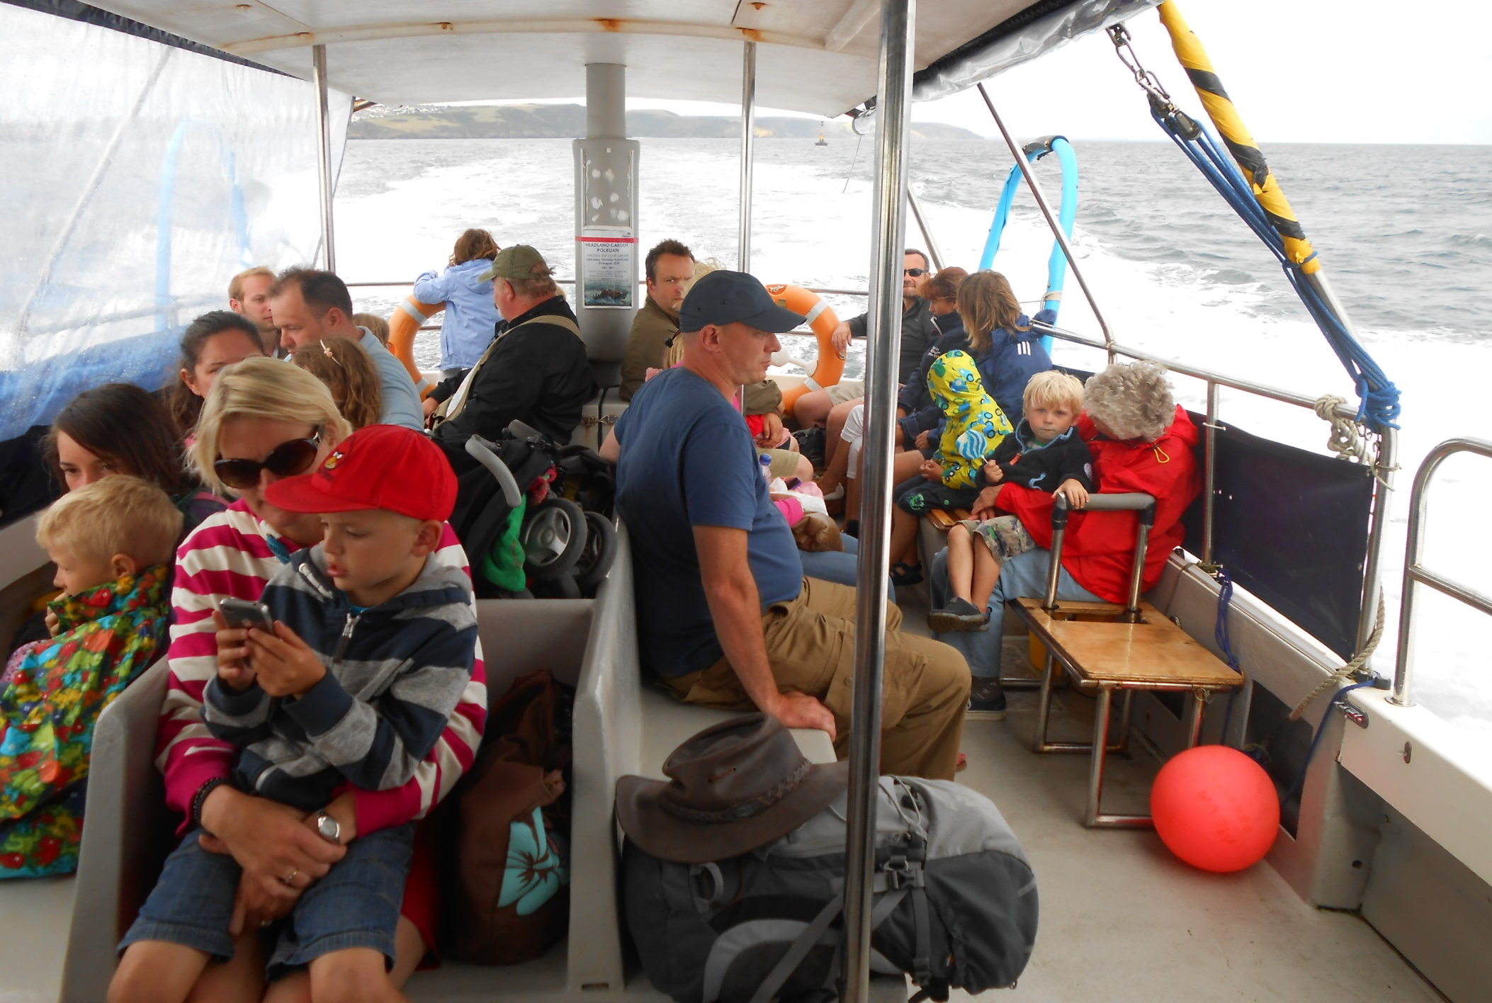
With sheets down on the windward side to keep the spray out.

Slide 7
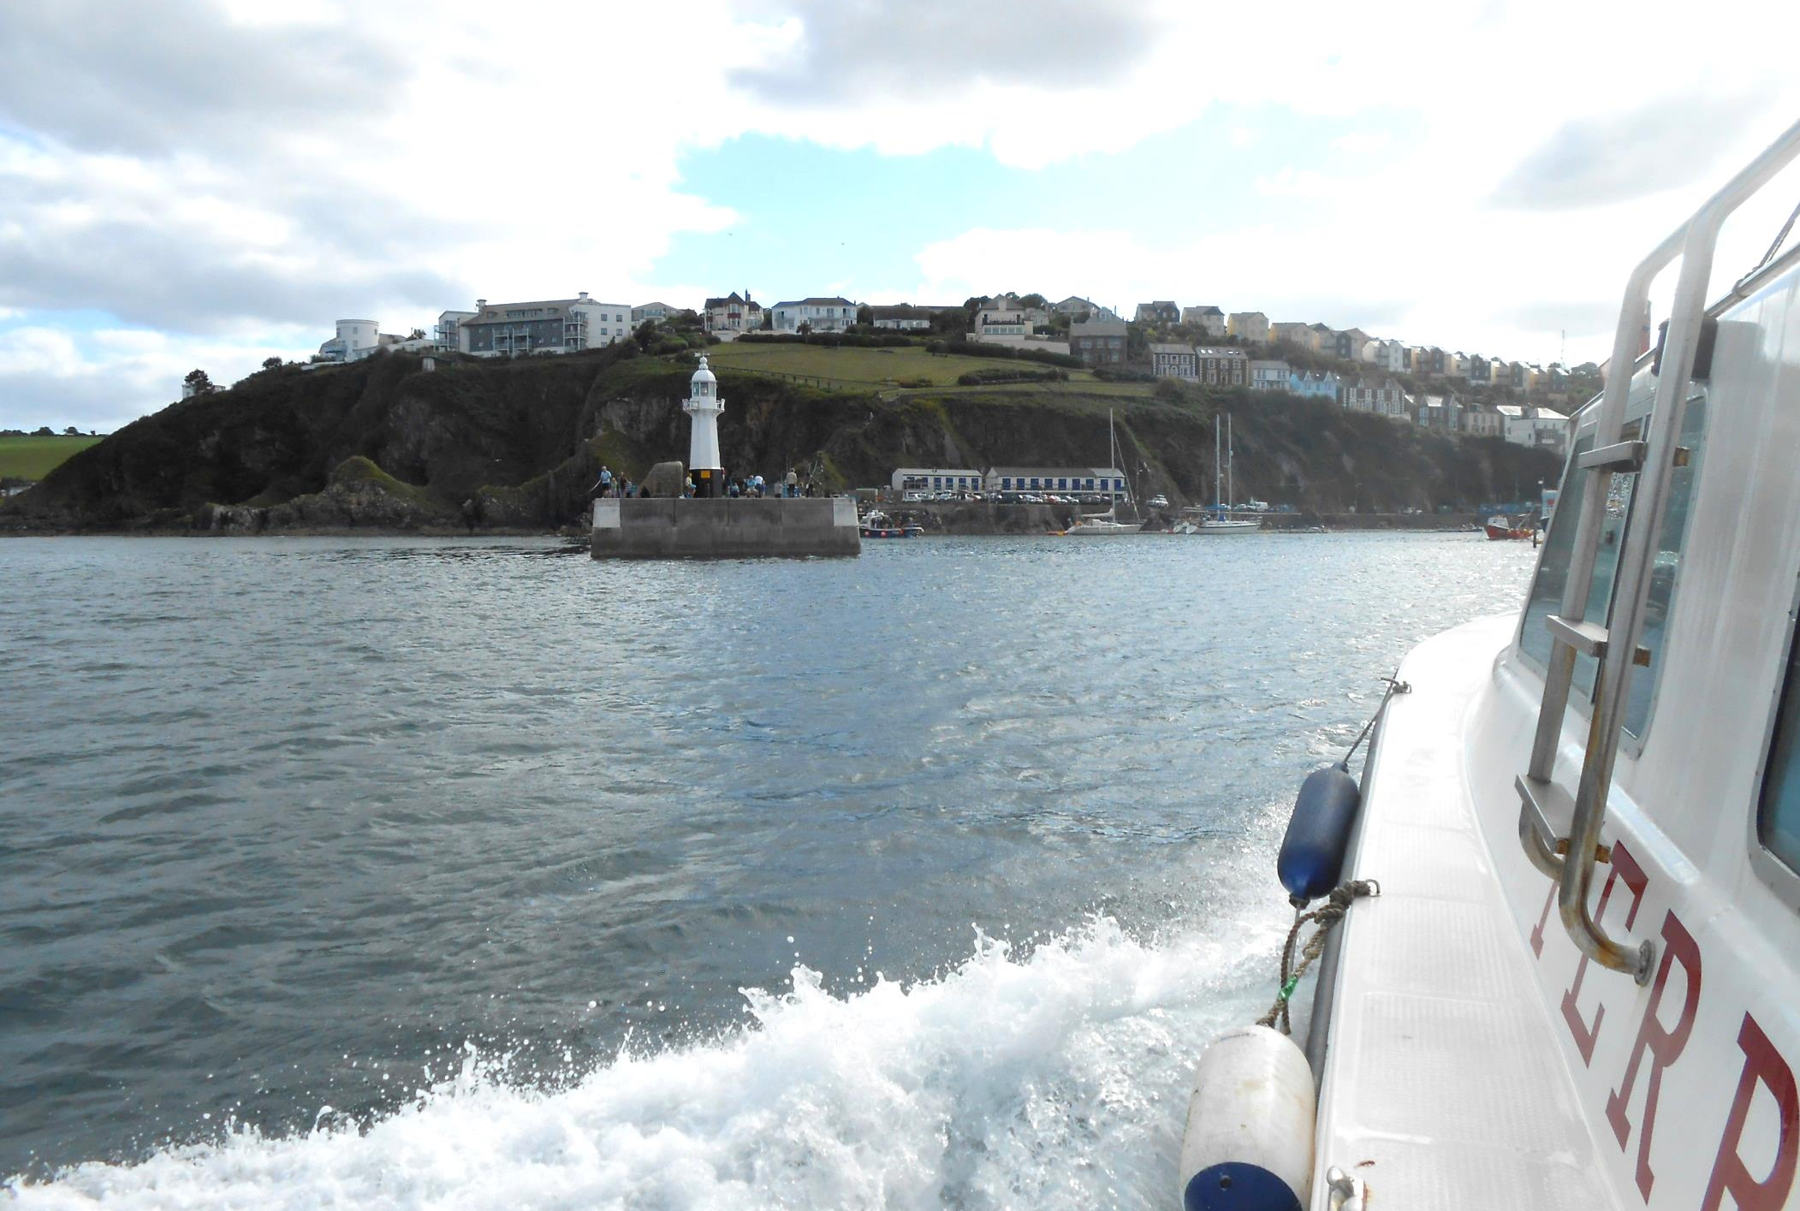
To reach Mevagissey, where we unload at the steps of Lighthouse Quay, the outer harbour wall.

Slide 8
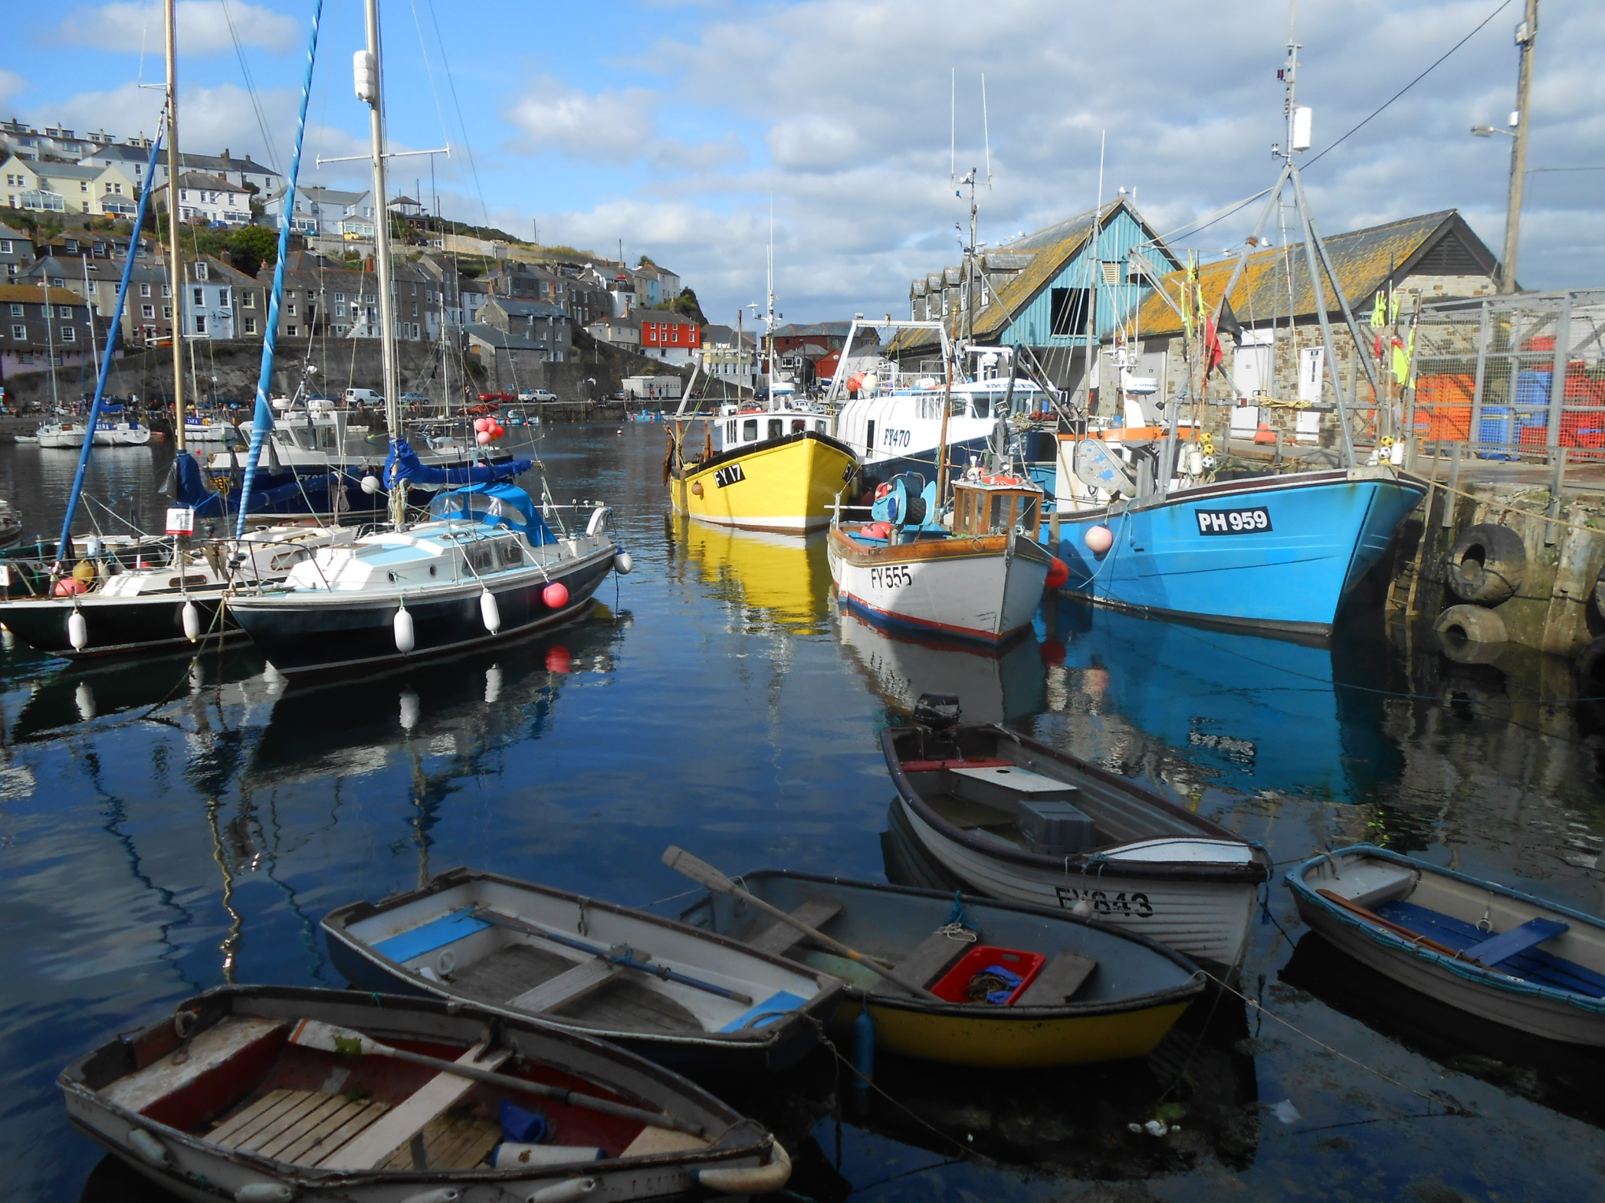
This is the Inner Harbour of this once very busy fishing port.

Slide 9
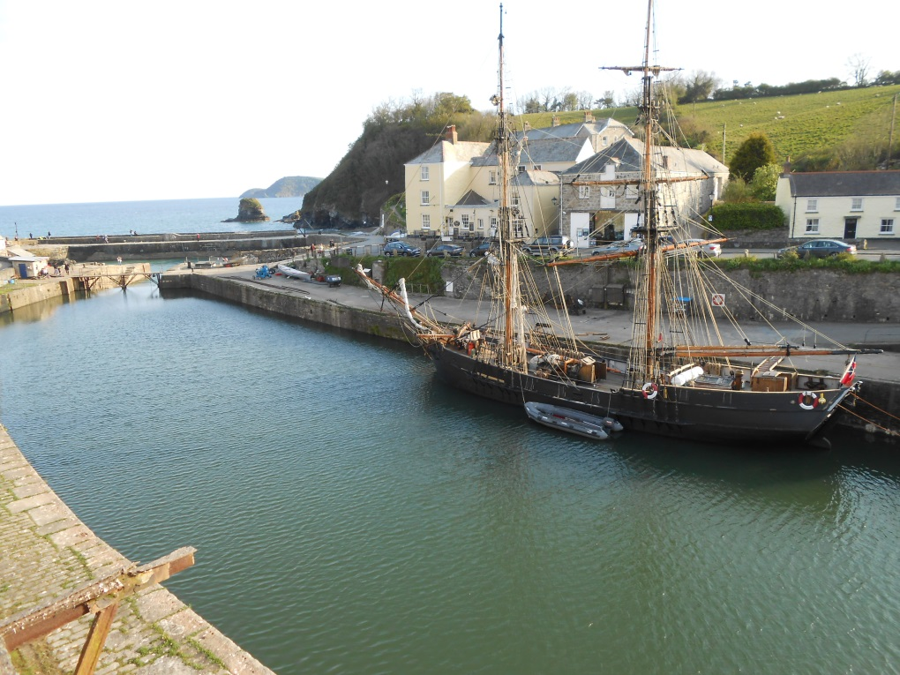
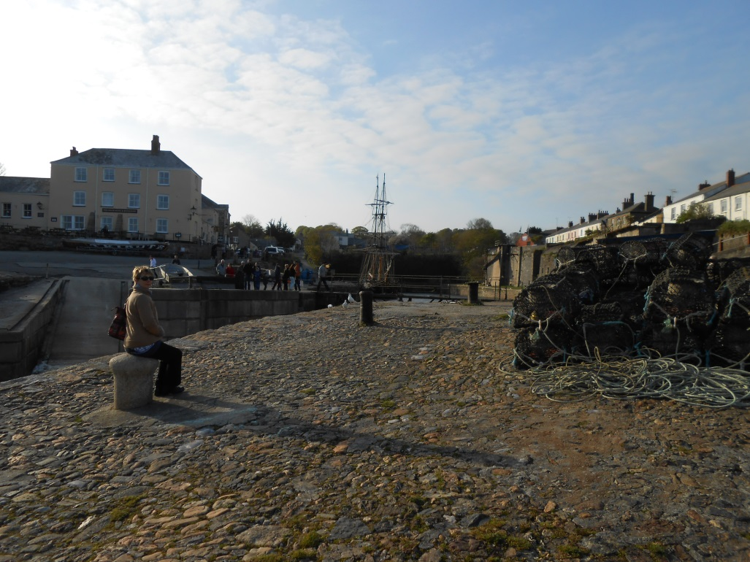
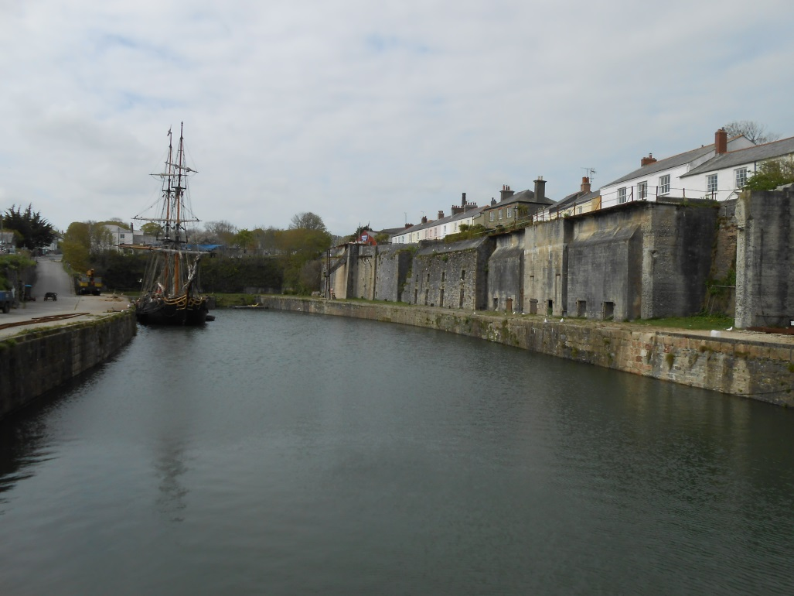
The next leg of our journey actually began with an overnight stay at historic Charlestown, a Georgian port slightly higher up
St Austell Bay where Phoenix is berthed.

Slide 10
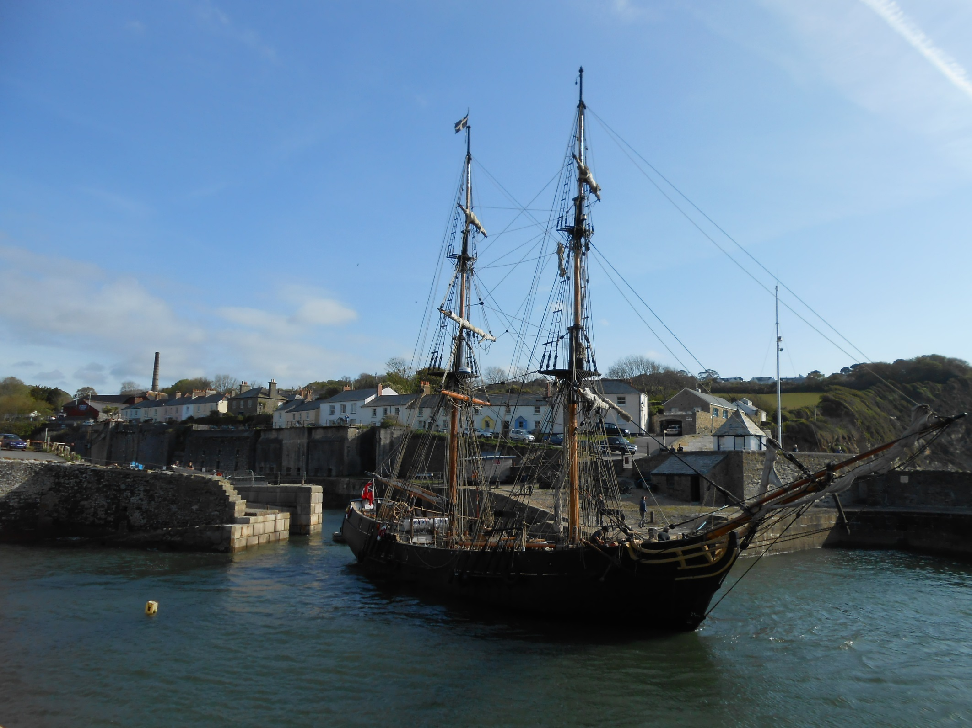
And wonderful to see Phoenix lock out on the morning tide.

Slide 11
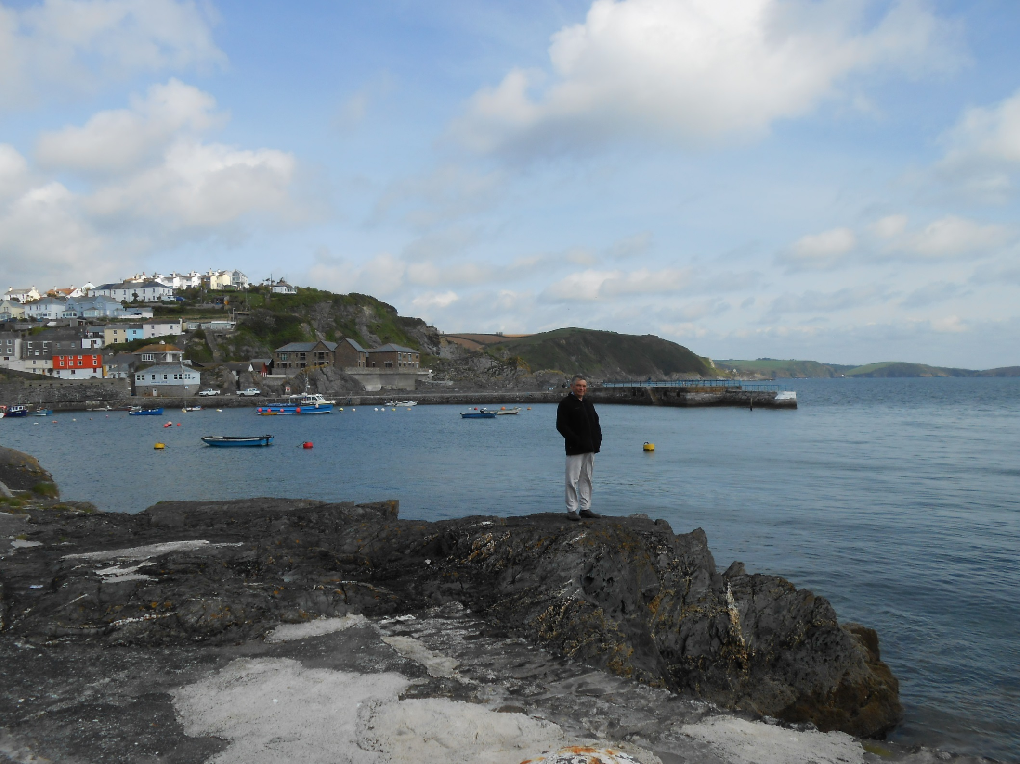
We then head back to Mevagissey to await the Bessie Vee.

Slide 12
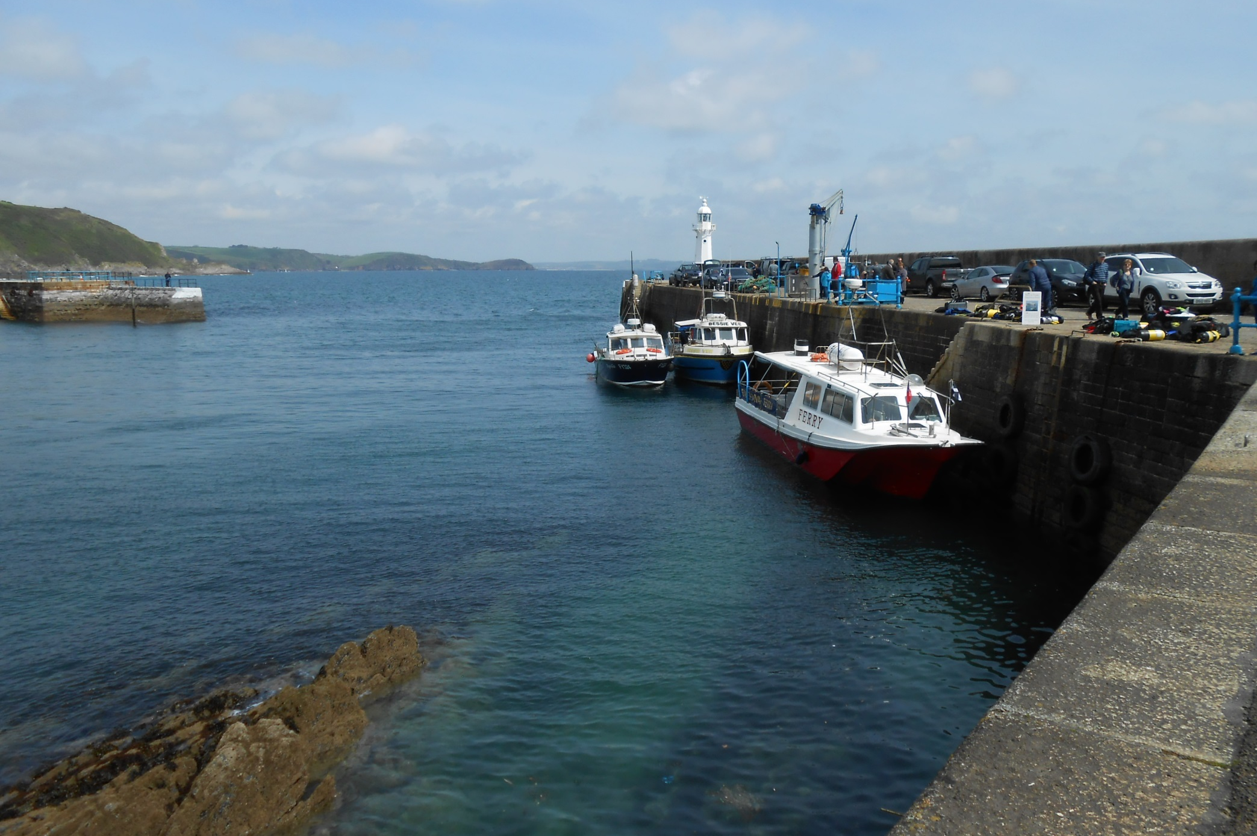
And here she is against the harbour wall with the
Fowey Ferry and a fishing charter also in attendance.

Slide 13
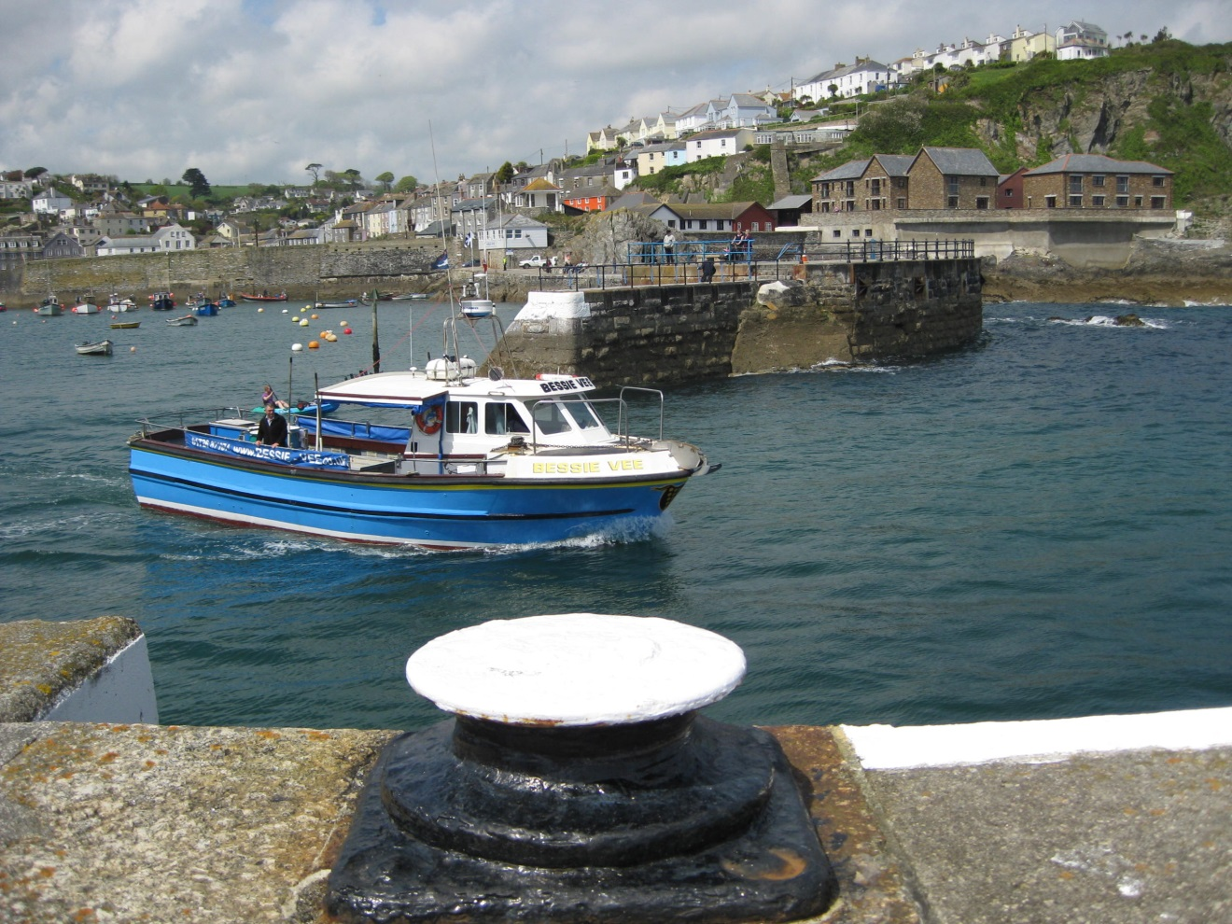
As we depart Mevagissey on another perfect day.

Slide 14
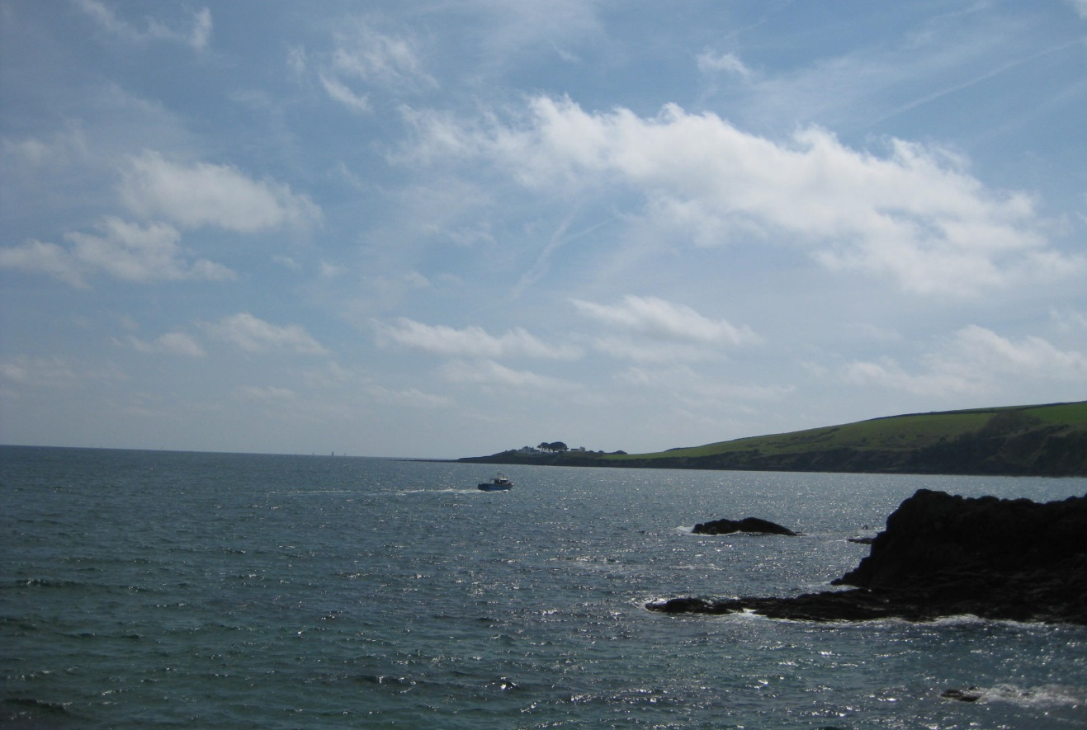
The Bessie Vee mostly operates deep water fishing trips but today will hug the coast as we head for Chapel Point.

Slide 15
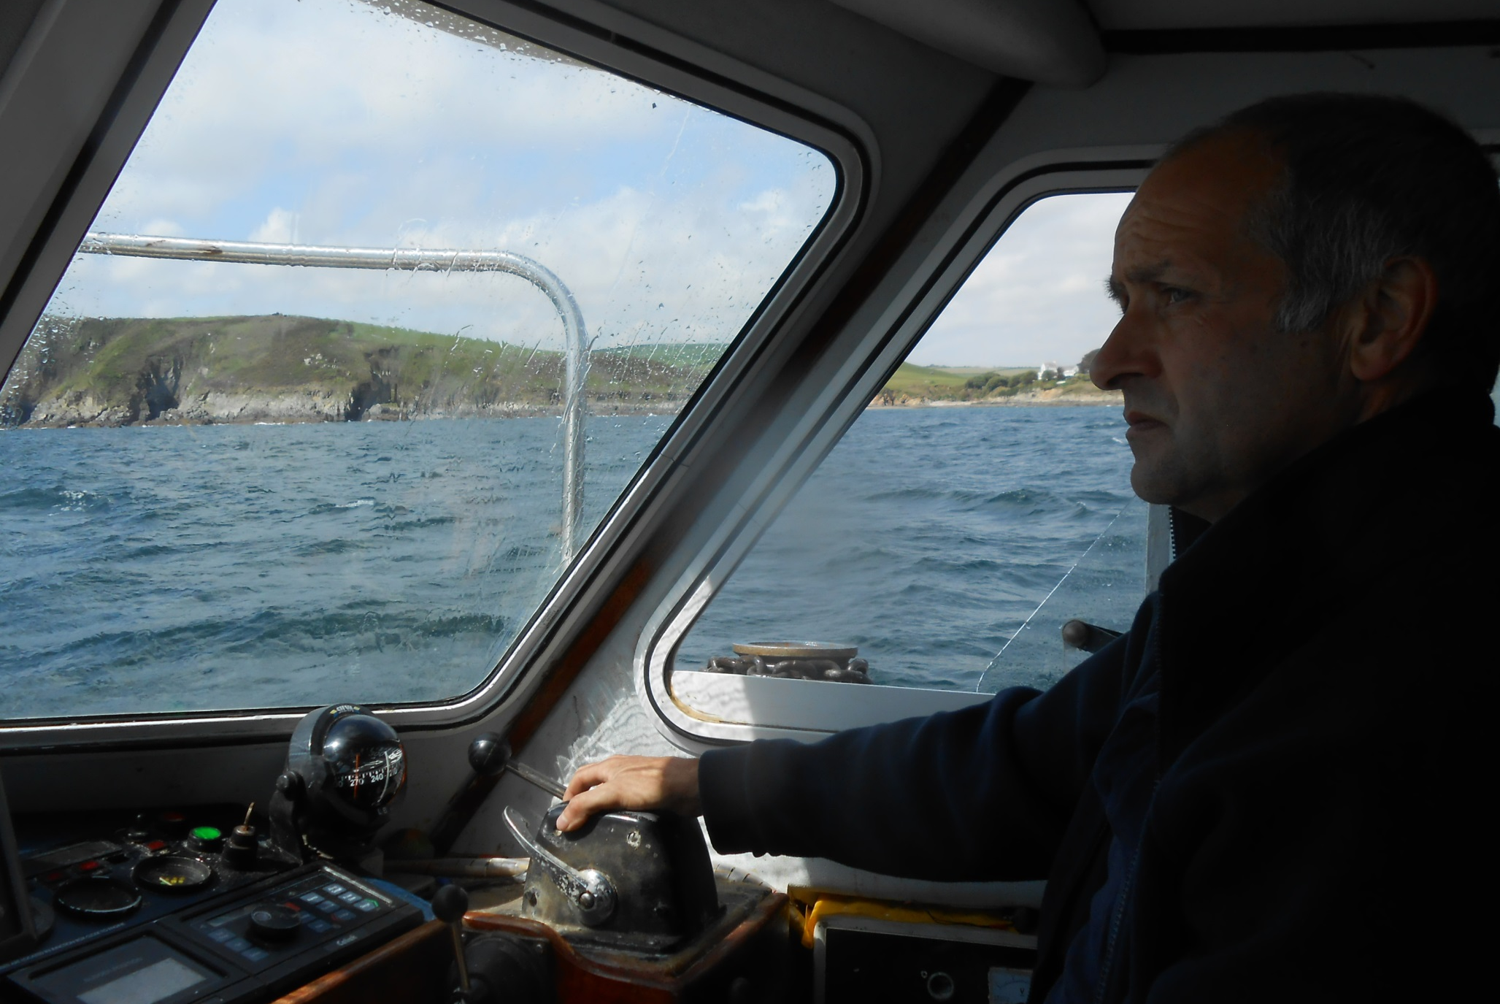
This is skipper Dave Hunkin, from a long established Mevagissey family and has been at sea all his life.

Slide 16
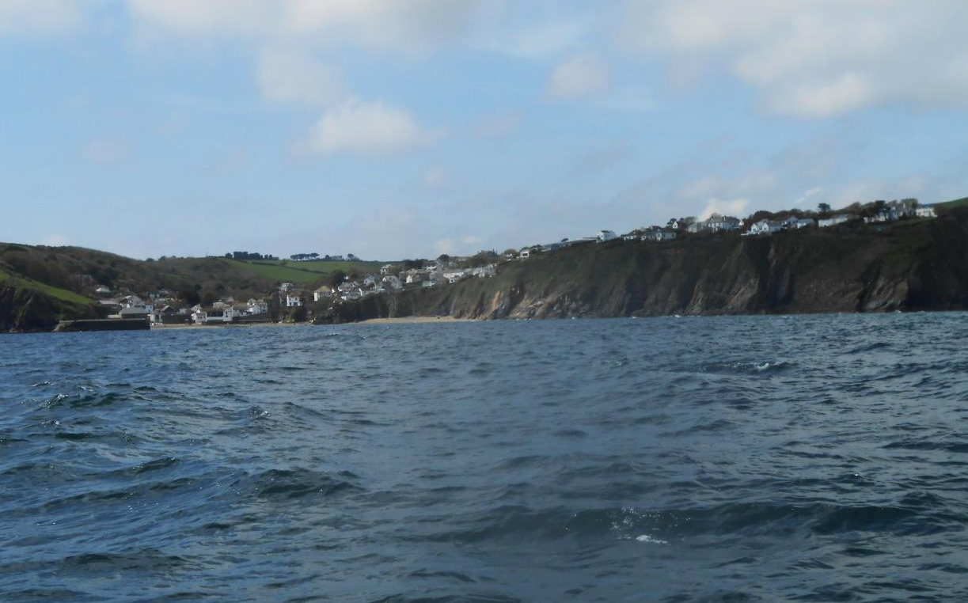
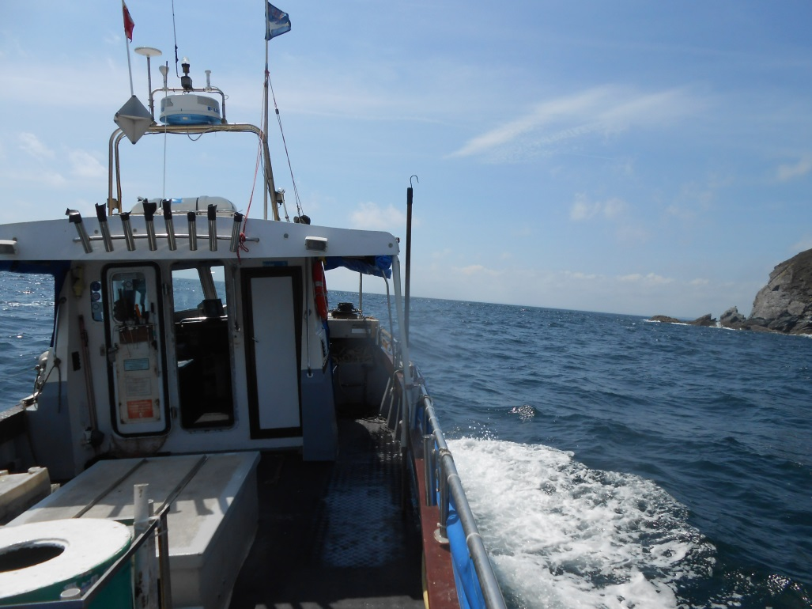
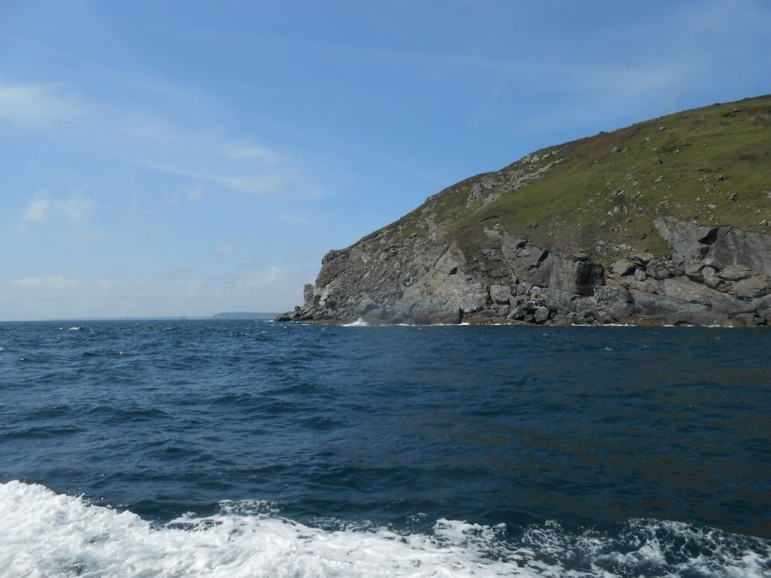
Gorran Haven passes, then Dodman Point, another landmark granite headland.

Slide 17
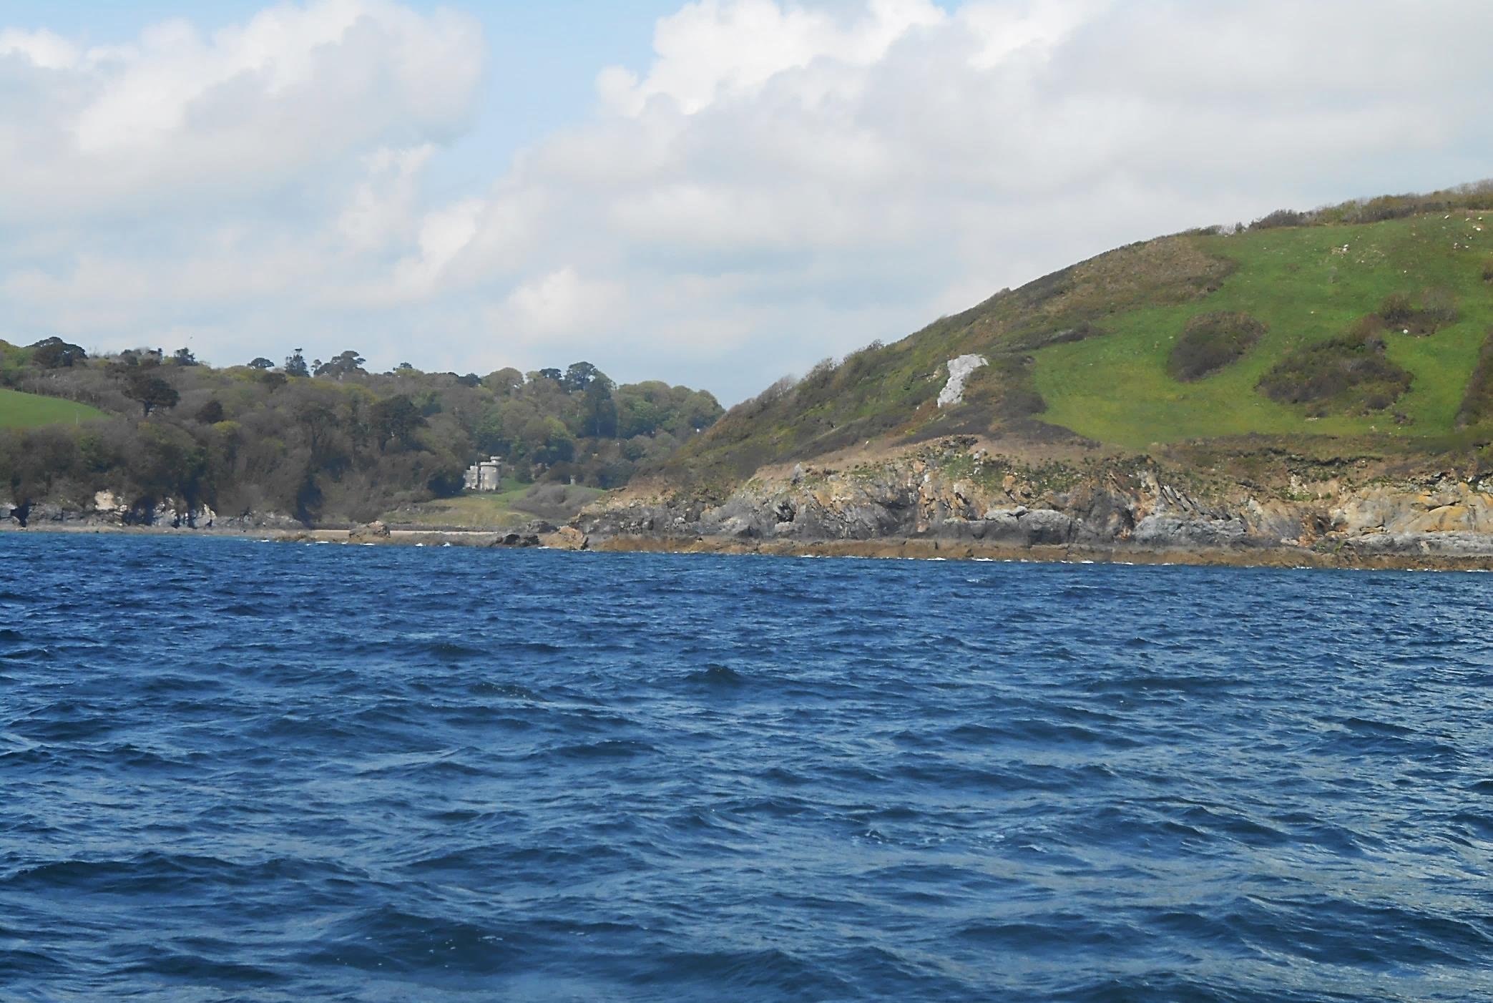
We are now in Veryan Bay and this is Porthlune Cove with Caerhays Castle behind.

Slide 18
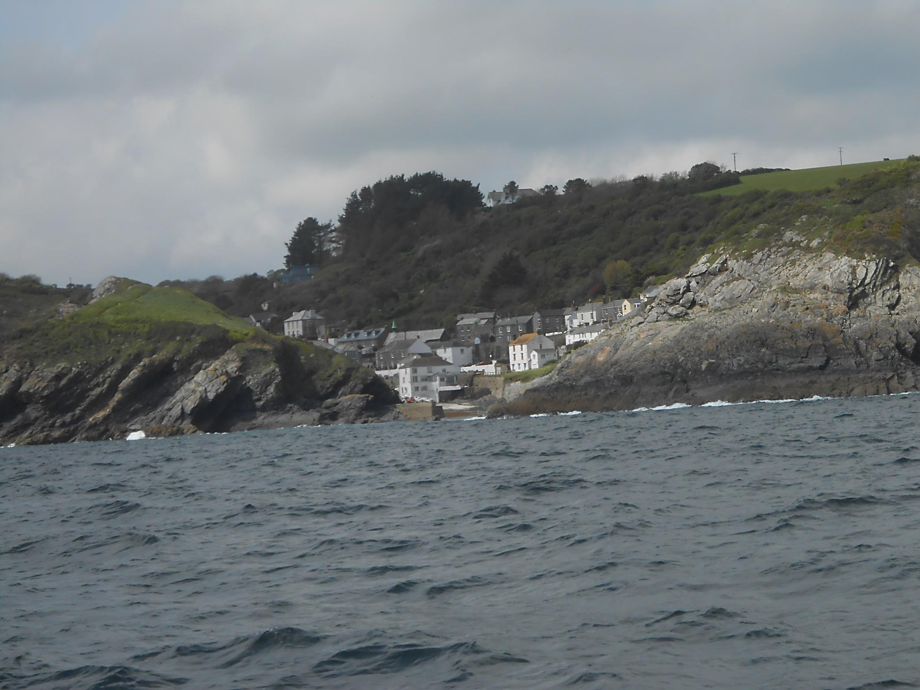
Slightly further on comes well protected Portloe.

Slide 19
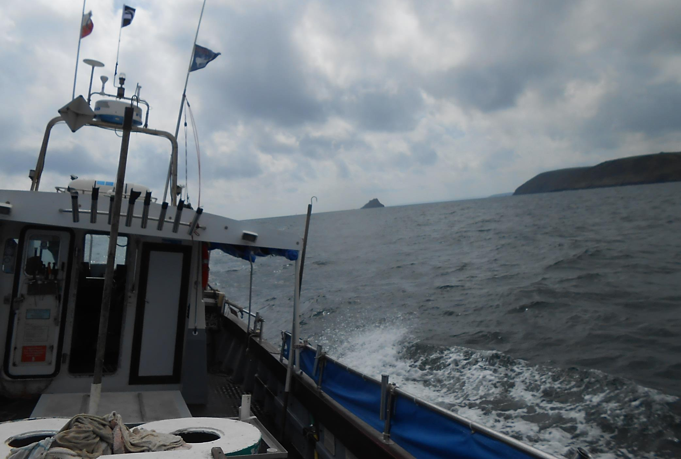
As we roll towards our next landmark, Gull Rock, off Nare Head.

Slide 20
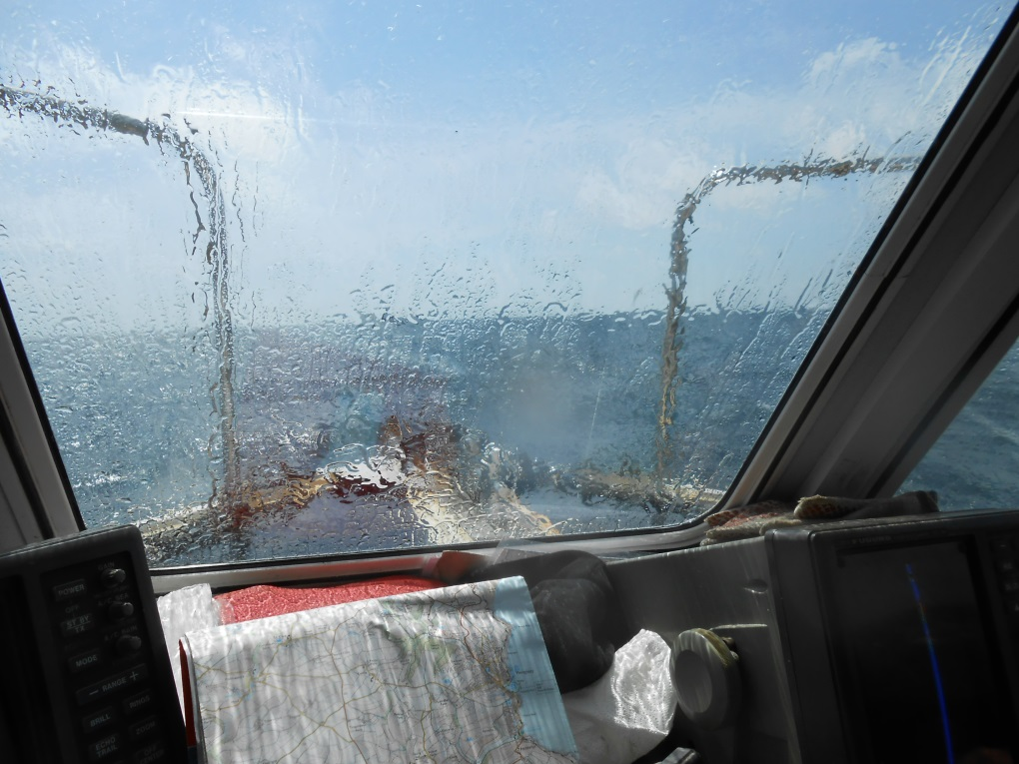
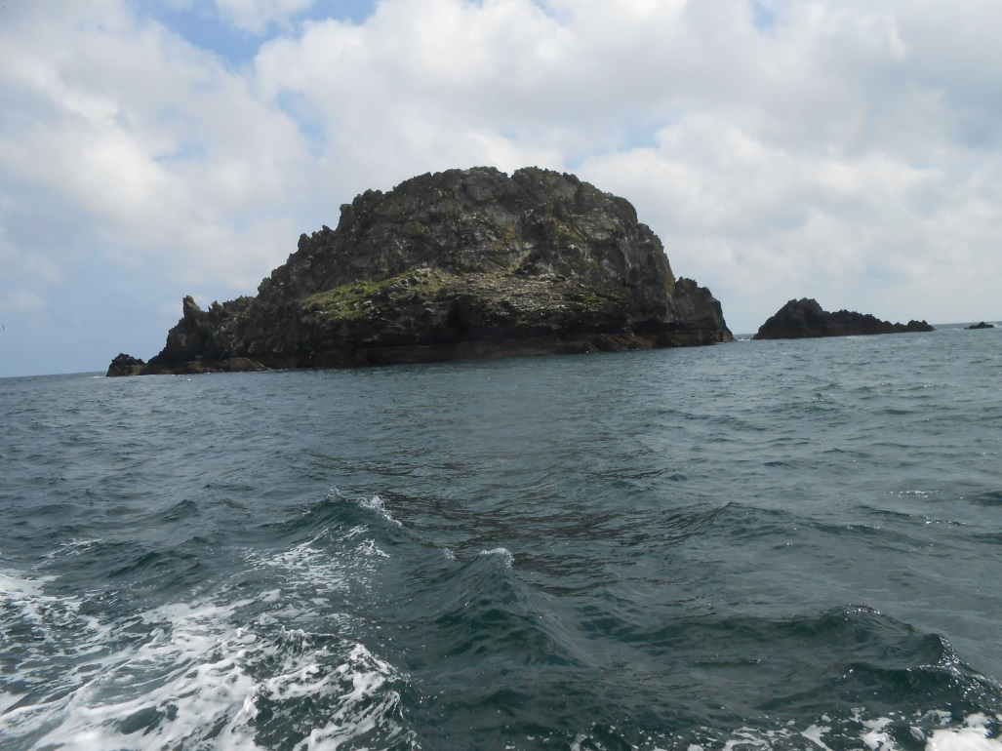
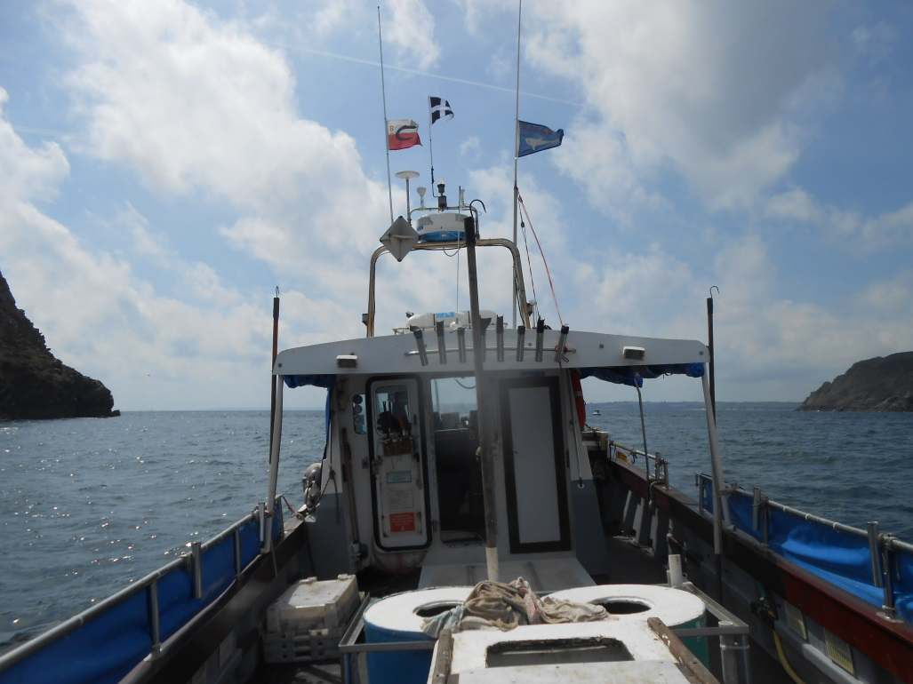
With plenty of spray from turbulence as we pass between the two.

Slide 21
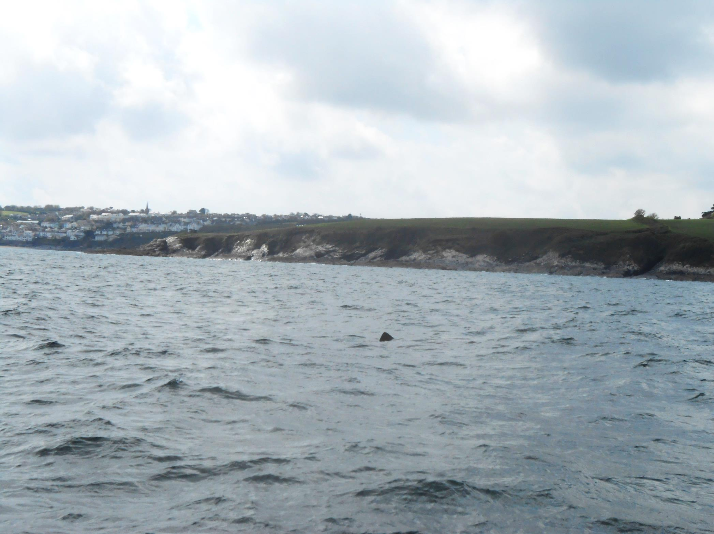
Gerrans Bay now where, off Portscatho, we find a basking shark.

Slide 22
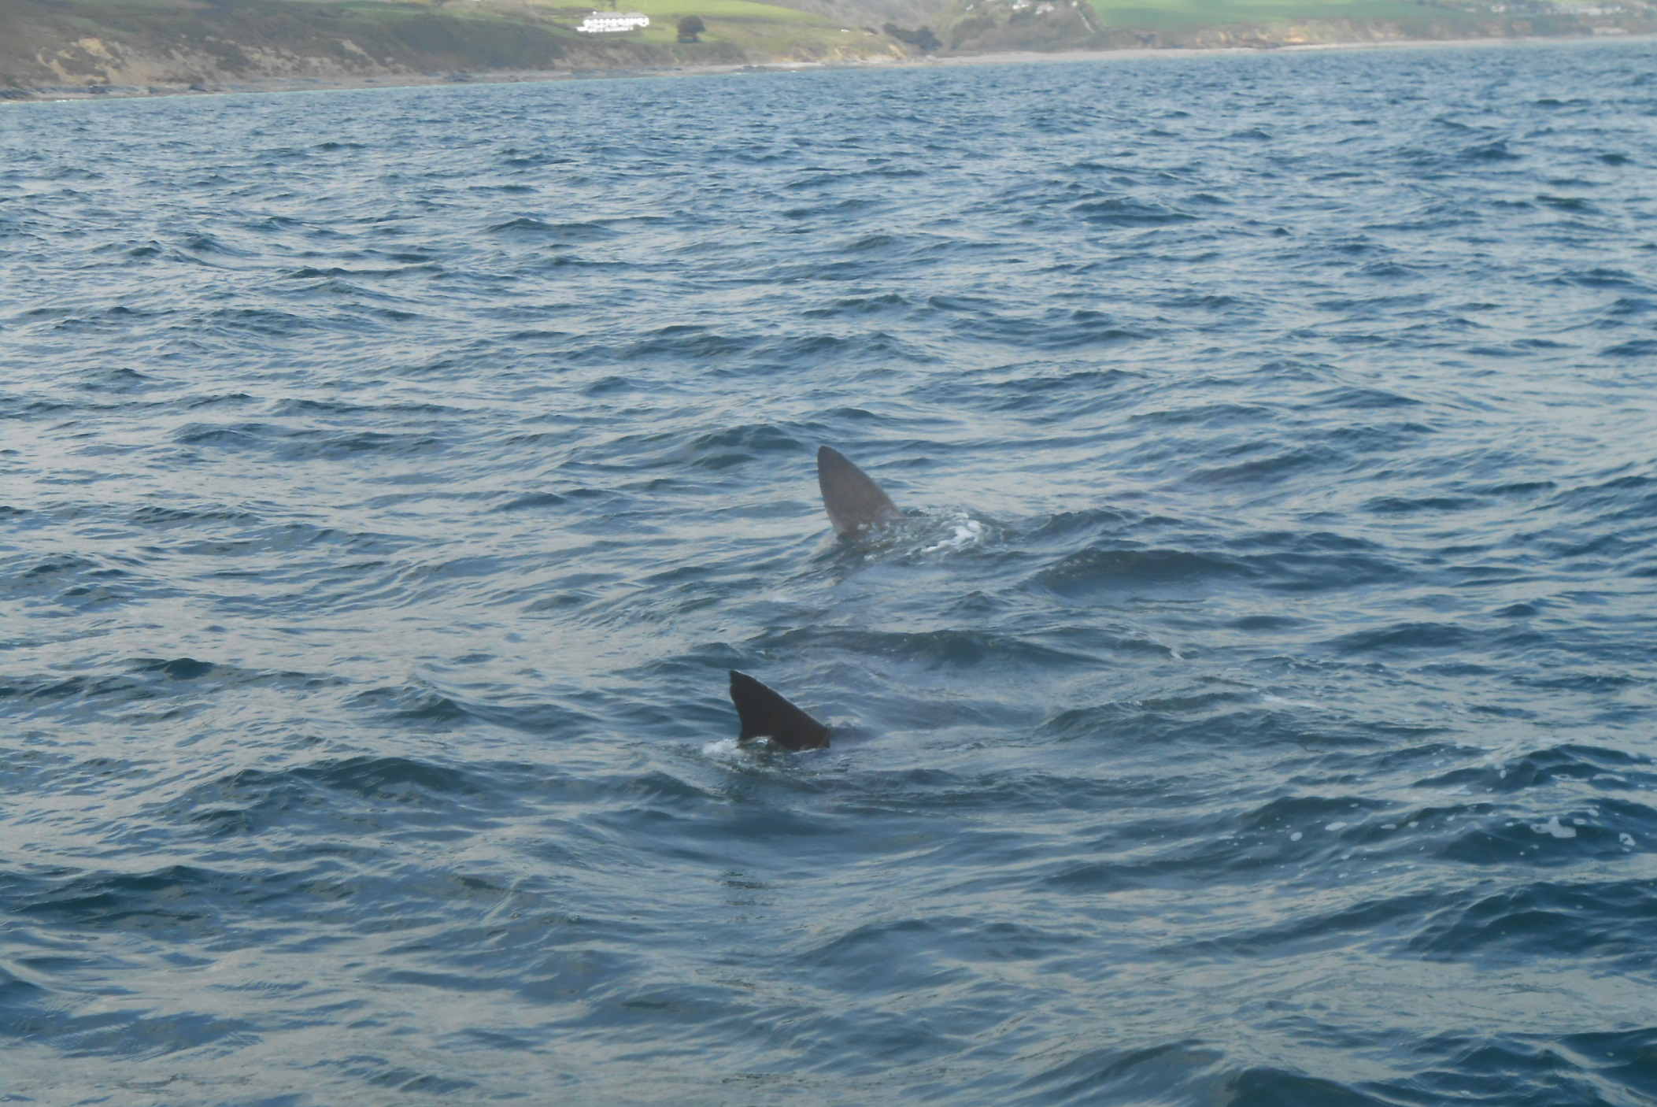
Sadly the sea was not calm enough to see its full outline but Skipper Dave called it “pretty big”.

Slide 23
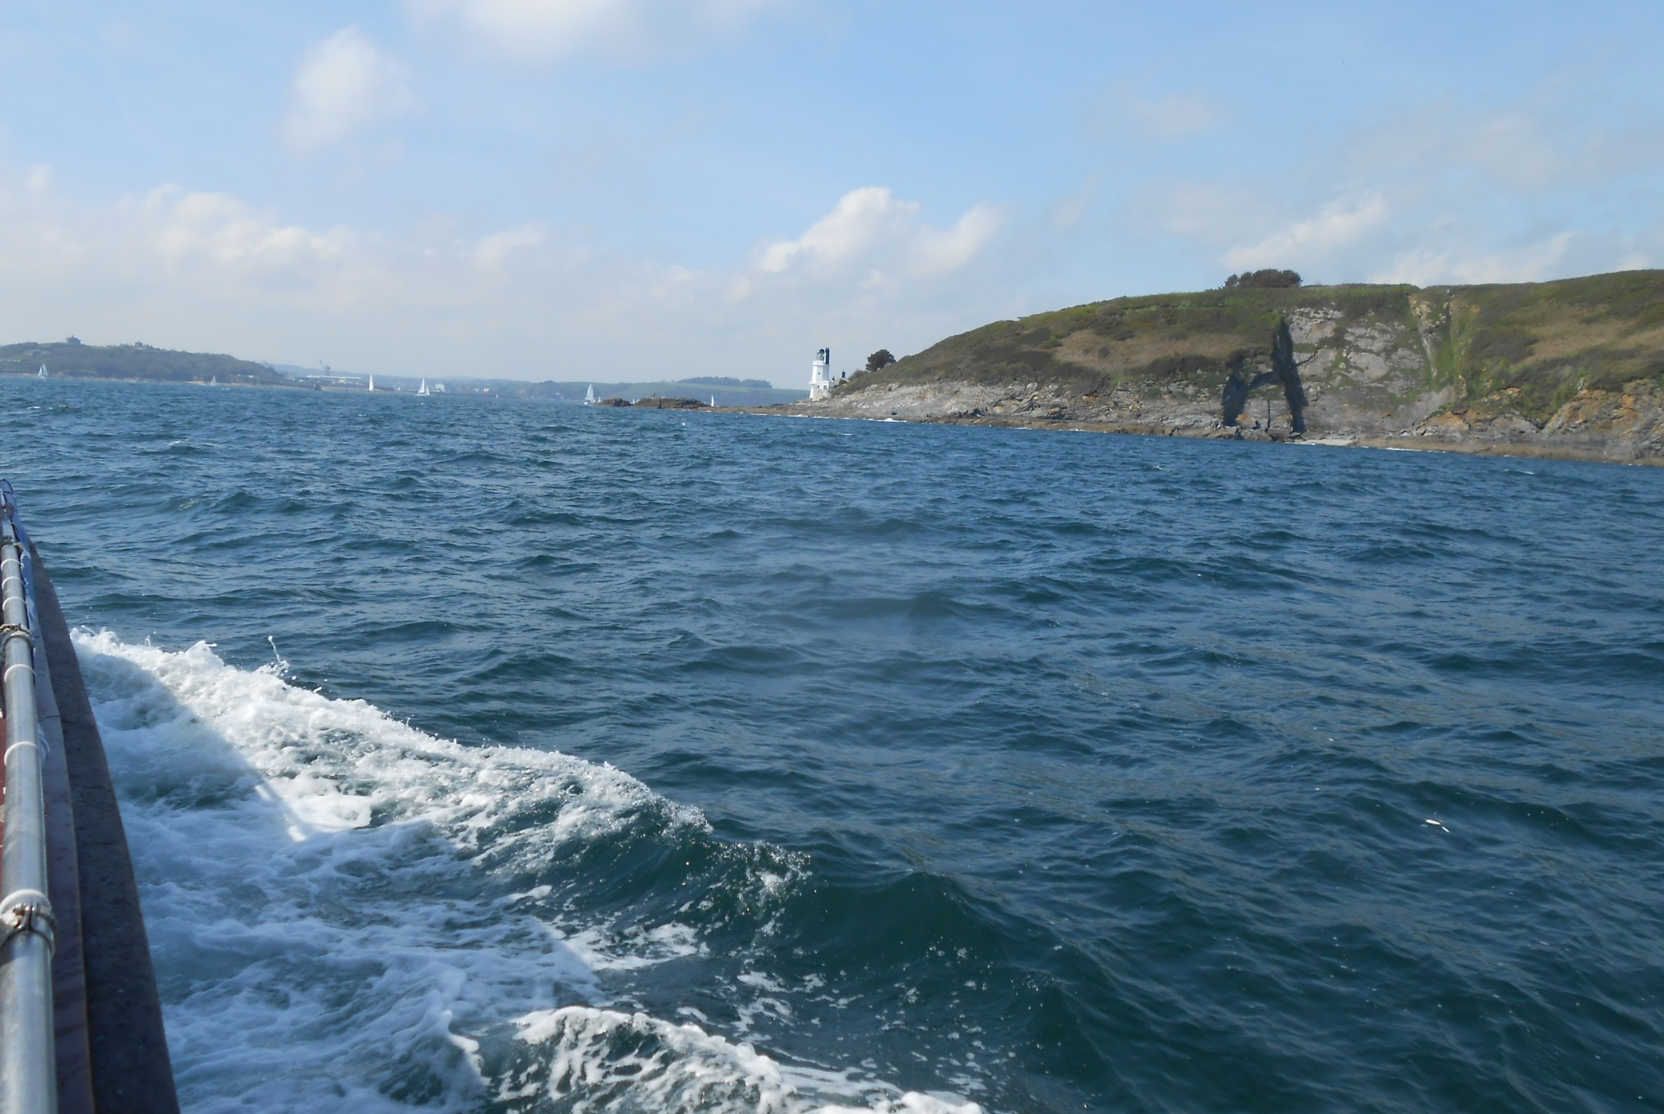
Then came St Anthony Head and the deep channel of the Carrick Narrows and Falmouth Harbour.

Slide 24
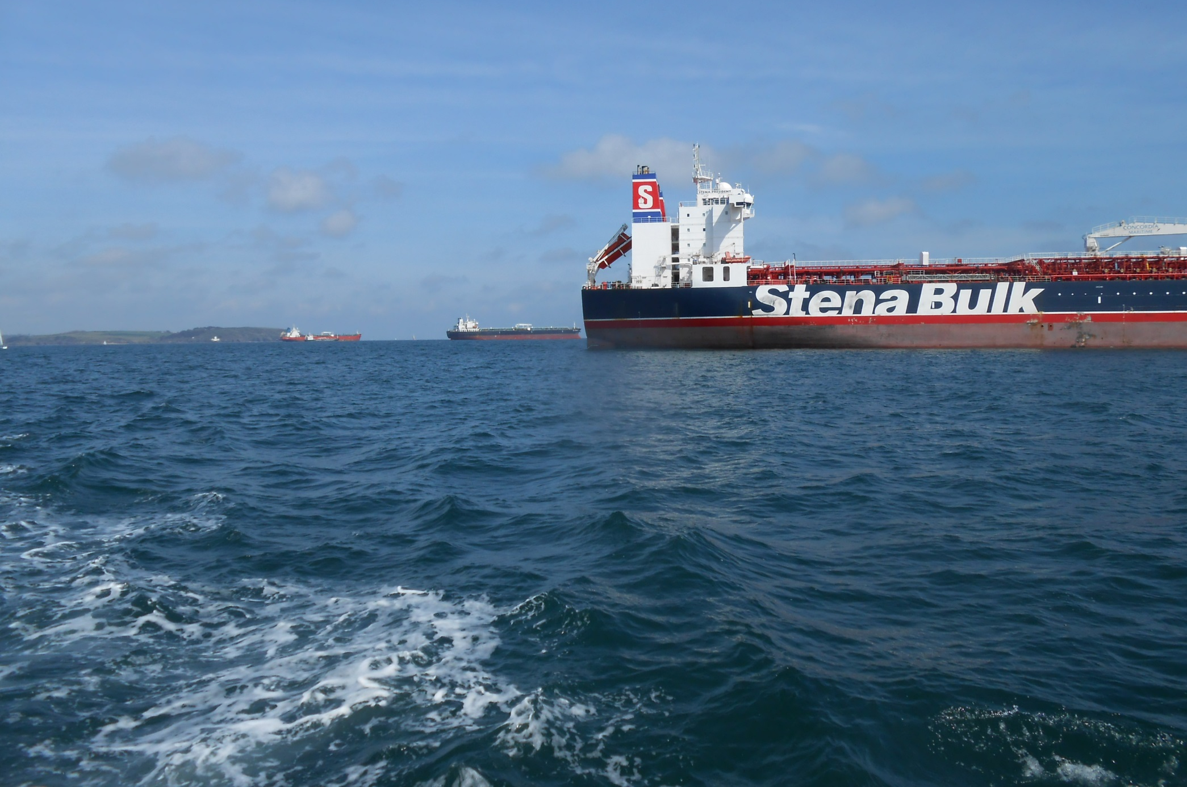
Falmouth is an important shipping centre and several ships were at anchor in the bay for bunkering purposes.

Slide 25
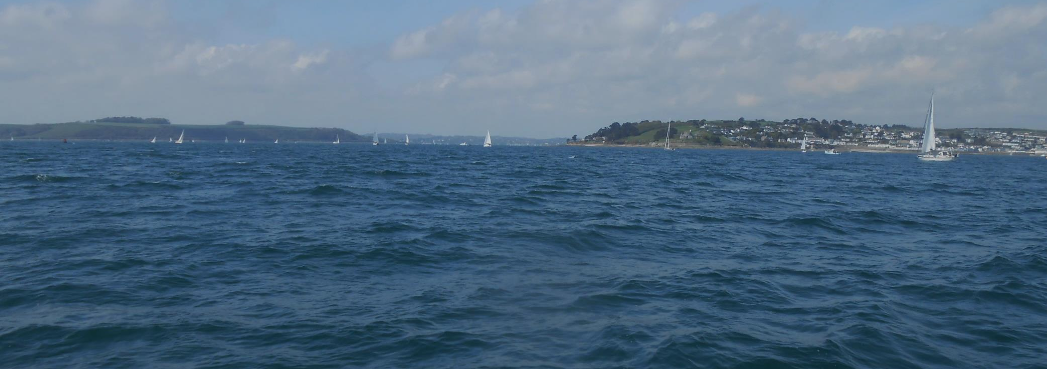
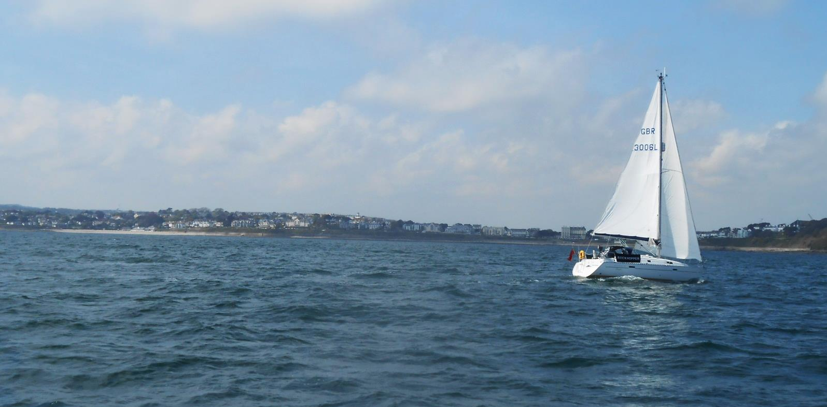
Whilst inland, both St. Mawes and Falmouth are busy with sail.

Slide 26
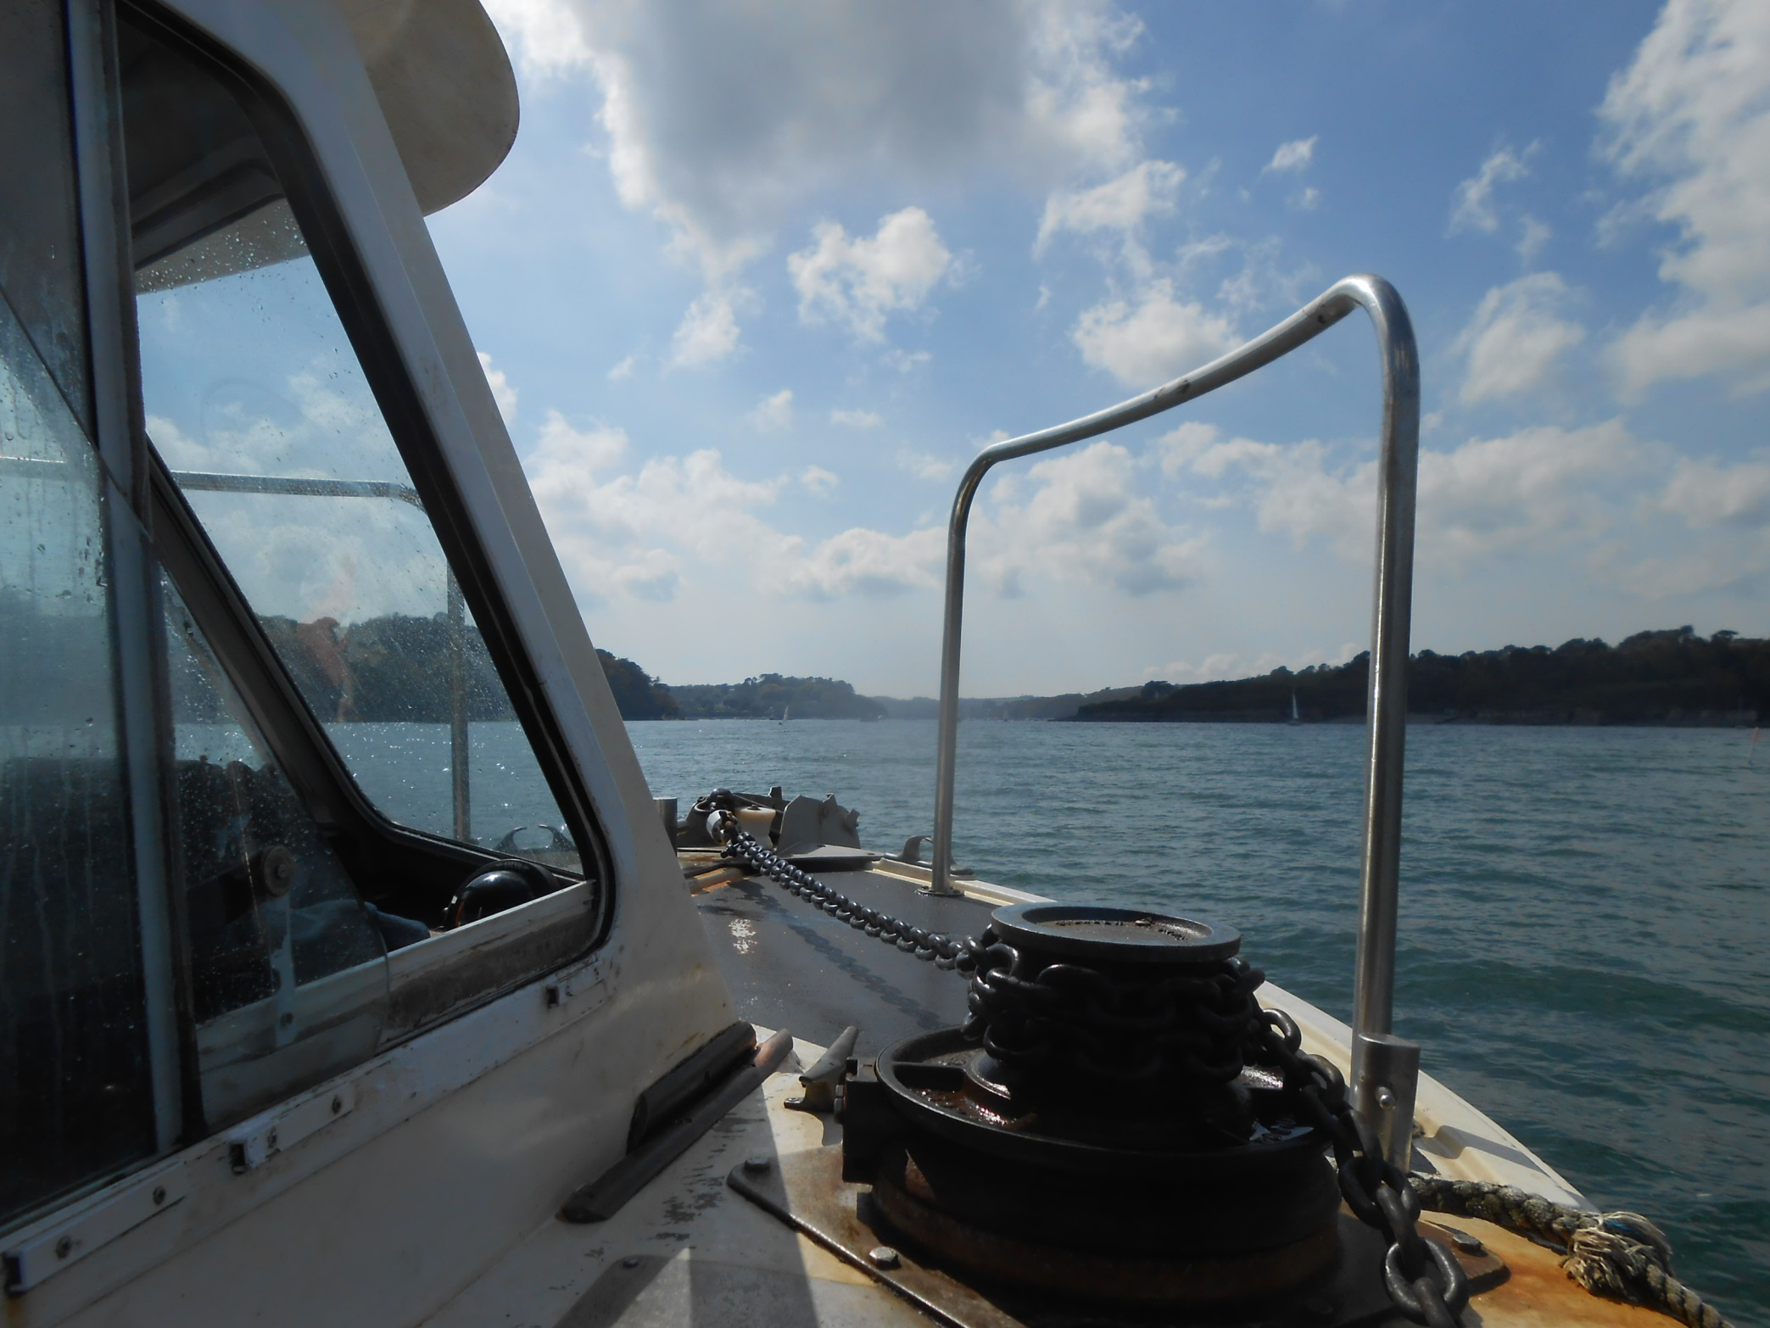
As Bessie Vee curves towards the attractive Helford Estuary.

Slide 27
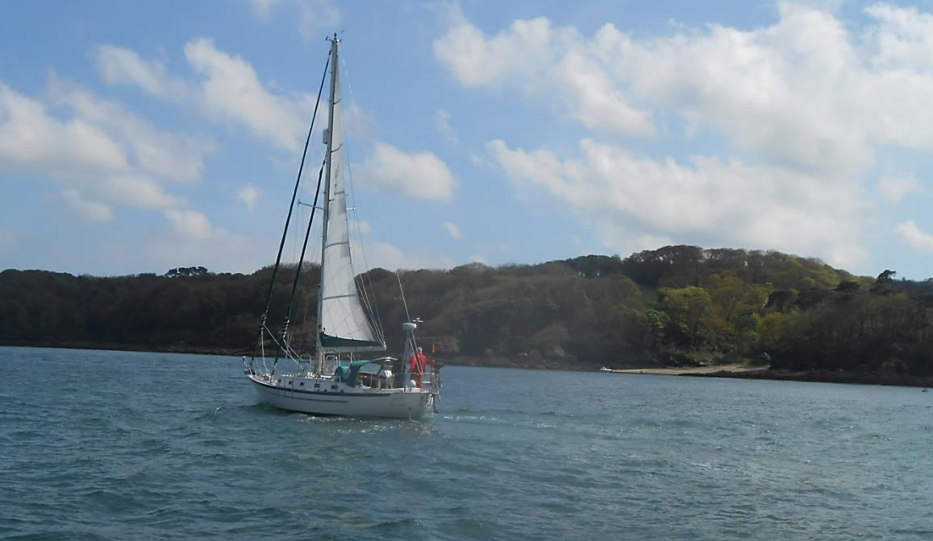
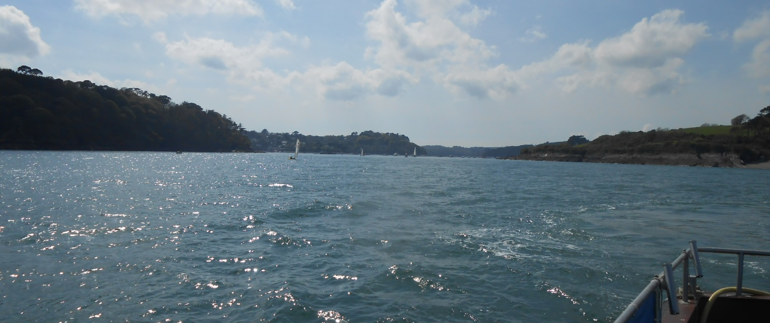
And it is in the lovely surroundings of the Helford River that we close this trip.

Slide 28
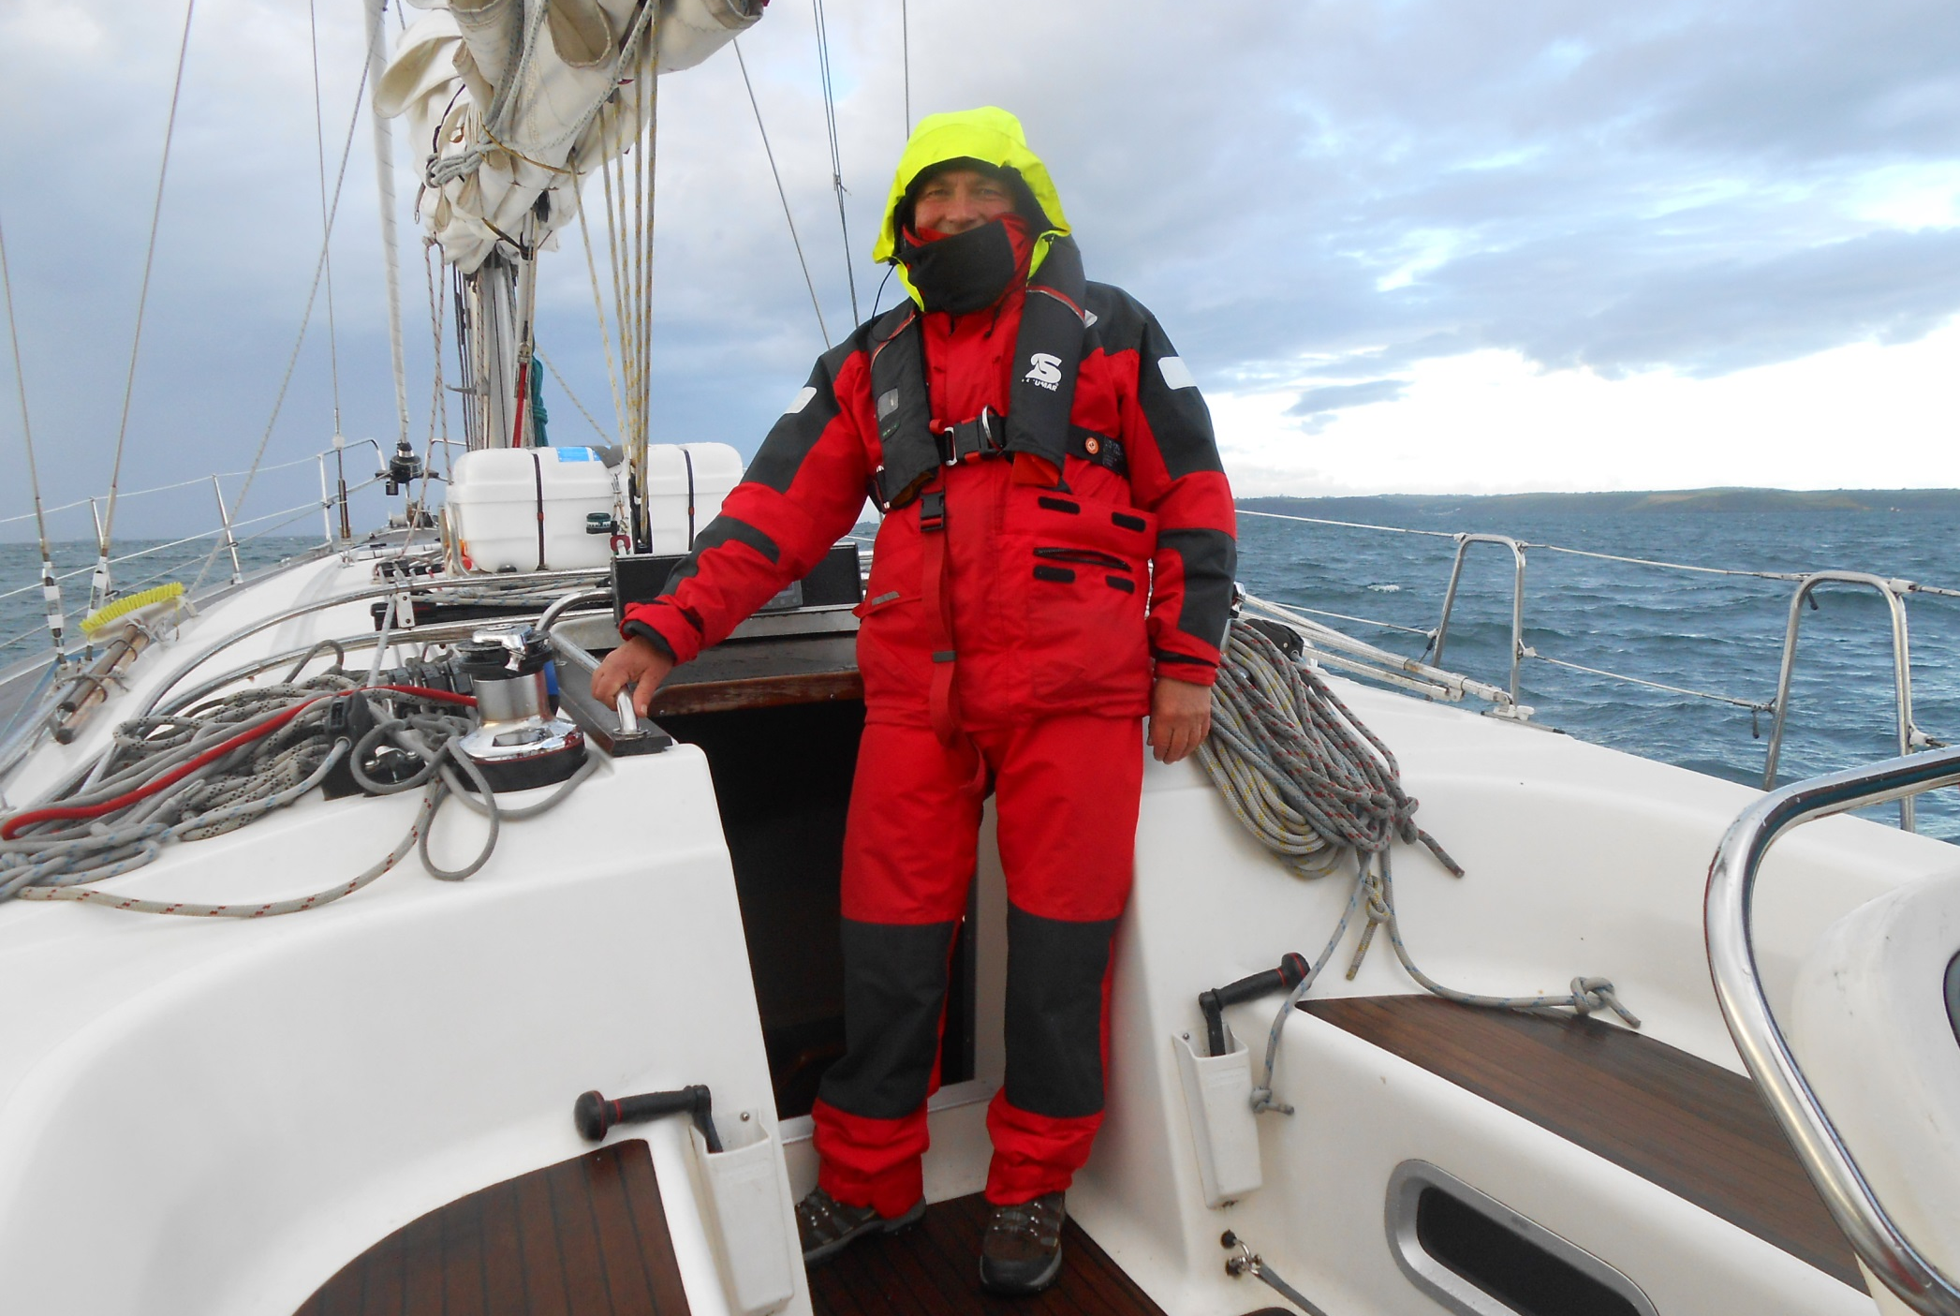
To follow it, on 27th June 2014, with something more challenging, rounding the Lizard aboard yacht Tonic.

Slide 29
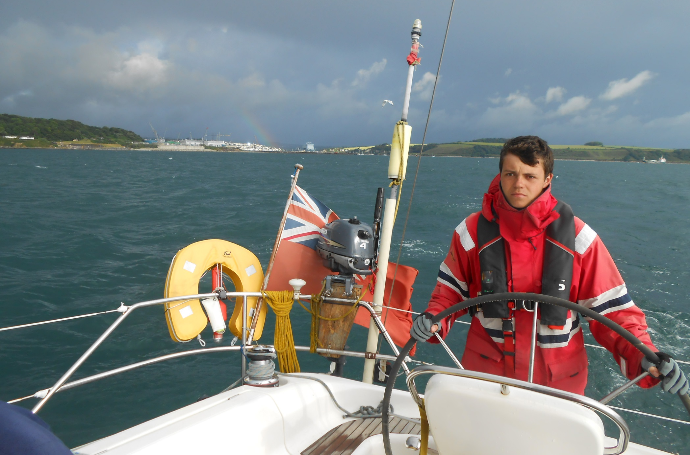
As we leaving Falmouth under a threatening sky with Yachtmaster trainee Robert at the helm.

Slide 30
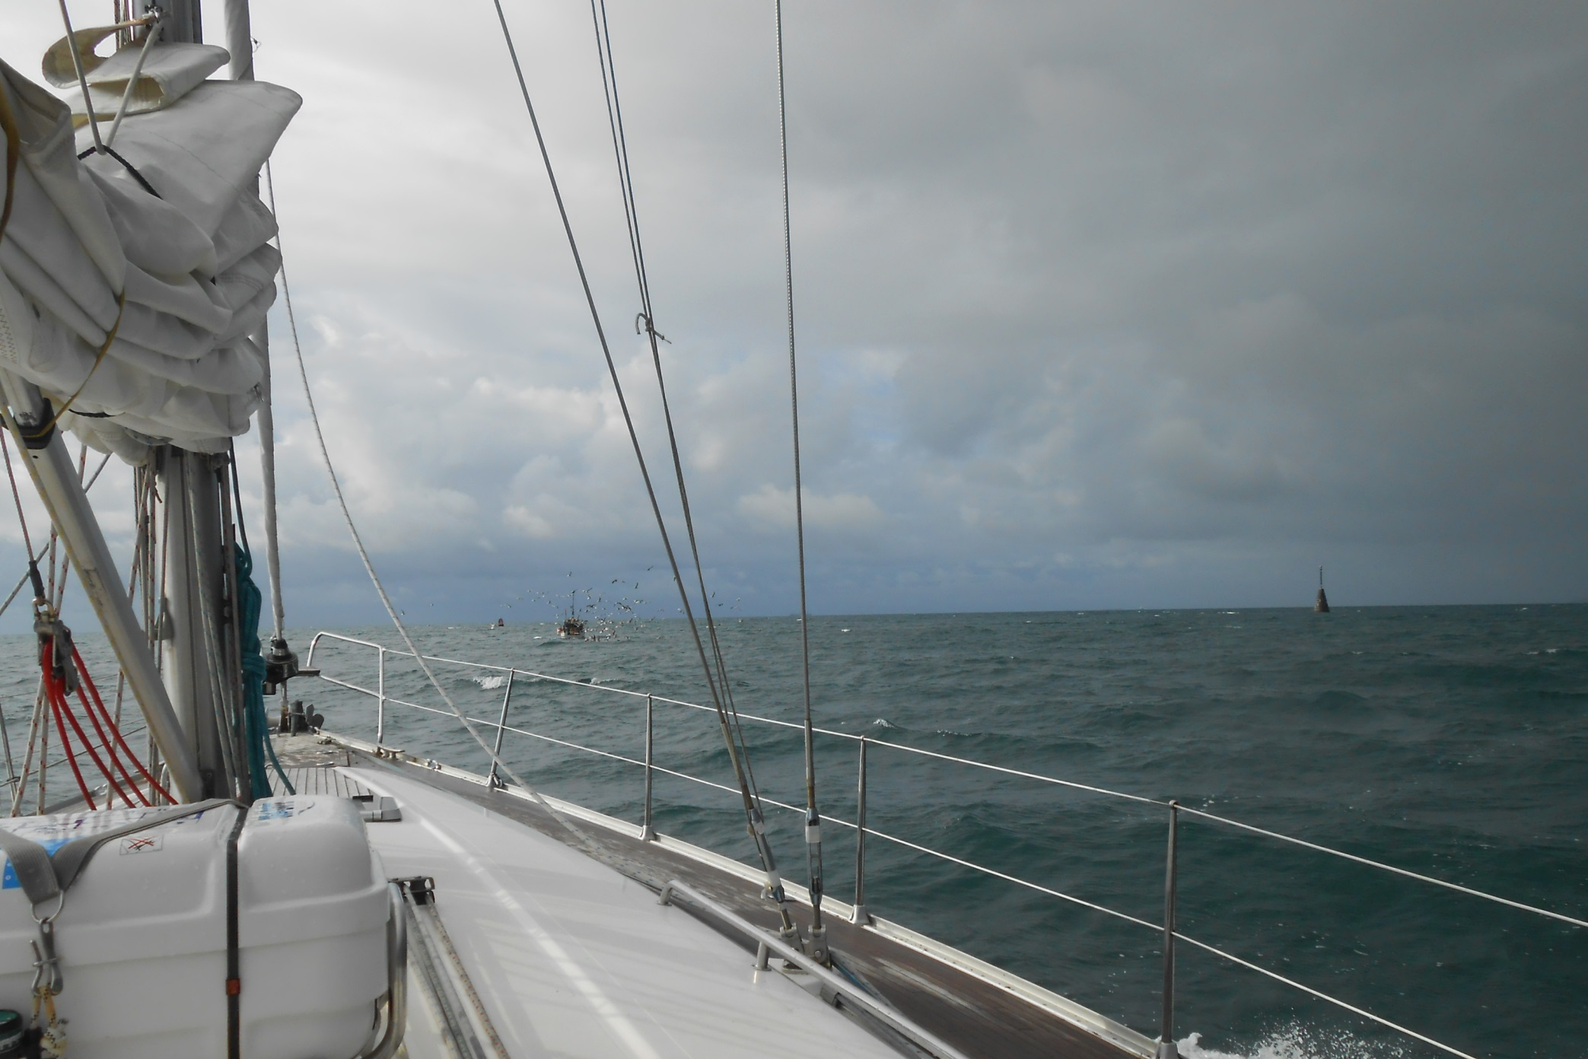
Robert is taking care to avoid Black Rock, marked by the stone pillar to the right, a real hazard leaving Falmouth Harbour.

Slide 31
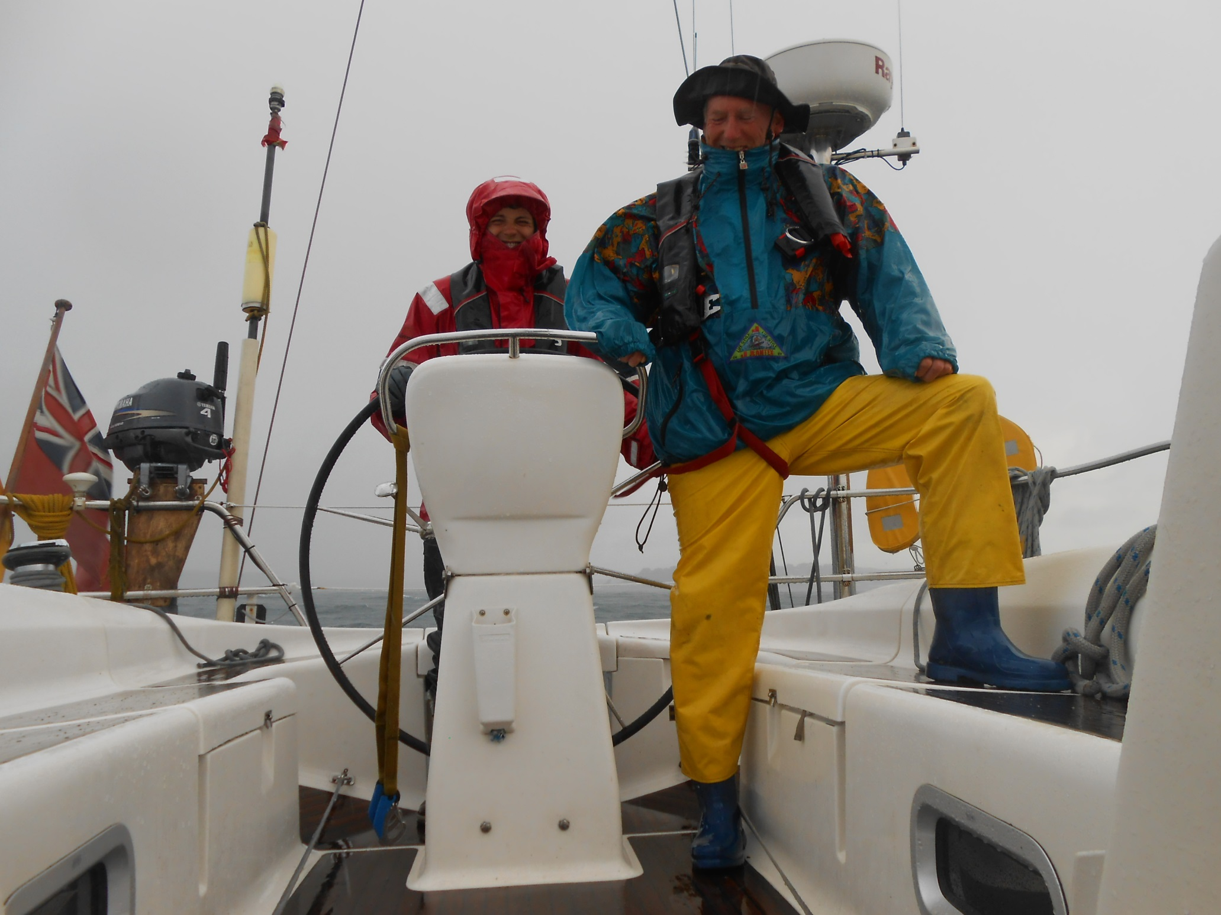
The heavens then open. Tonic rounds the British Isles three times a year on training runs, an amazing schedule.

Slide 32
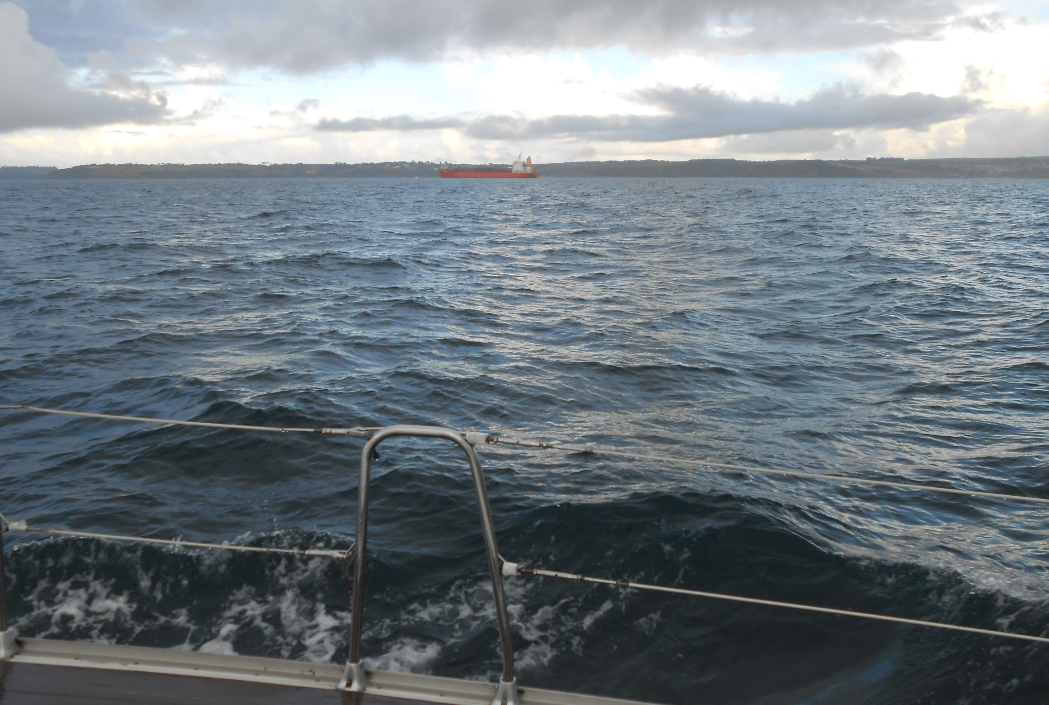
And it is was very good of Elite Sailing to include me in the crew for this section as we pass Porthoustock, near Manacle Point.

Slide 33
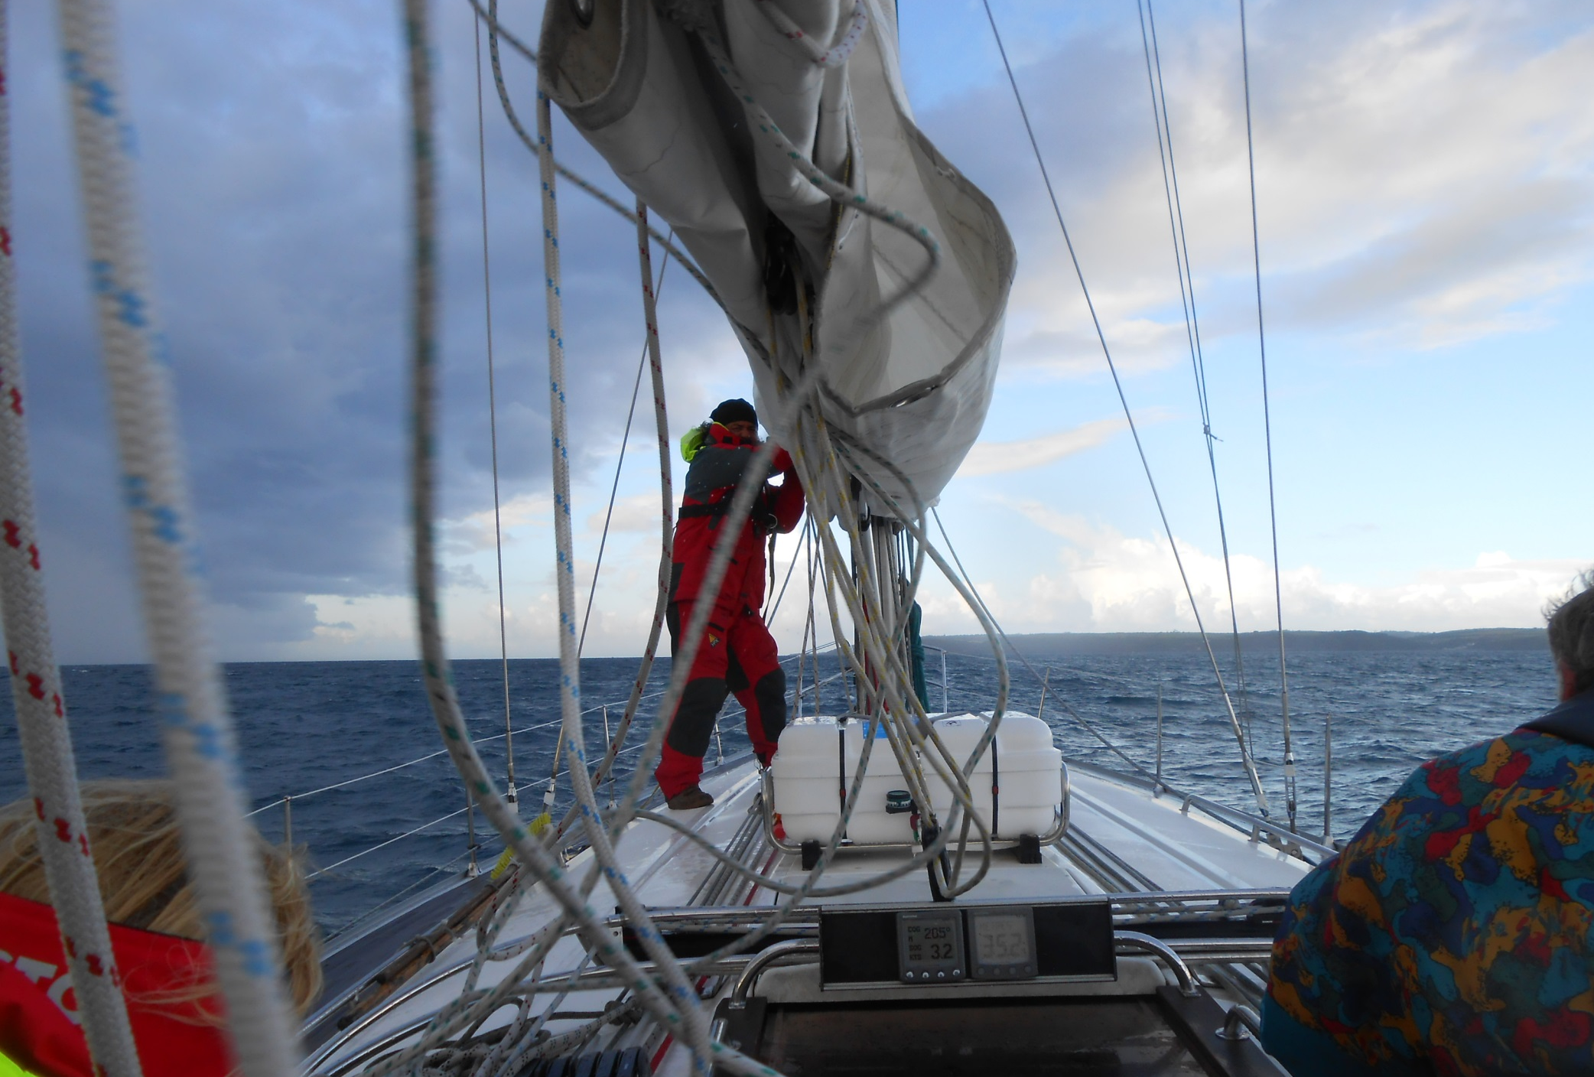
As, in a rolling sea, Nic Mavroudis, our exceptional
Greek skipper, raises sail.

Slide 34
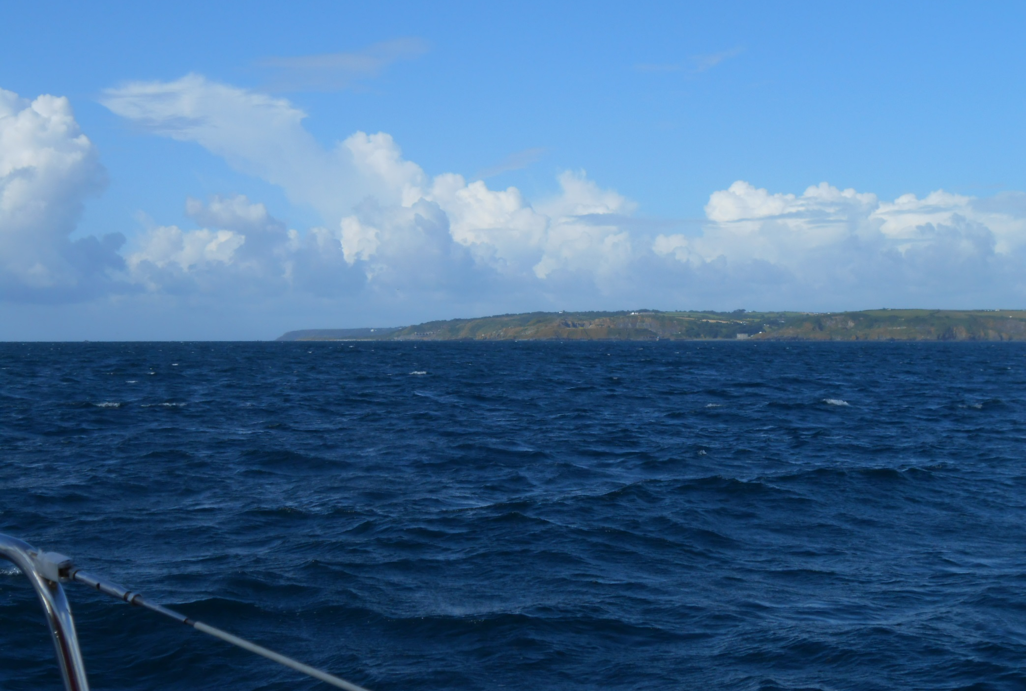
The weather is changeable and the wind speed increases as we tack towards Coverack and Black Head.

Slide 35
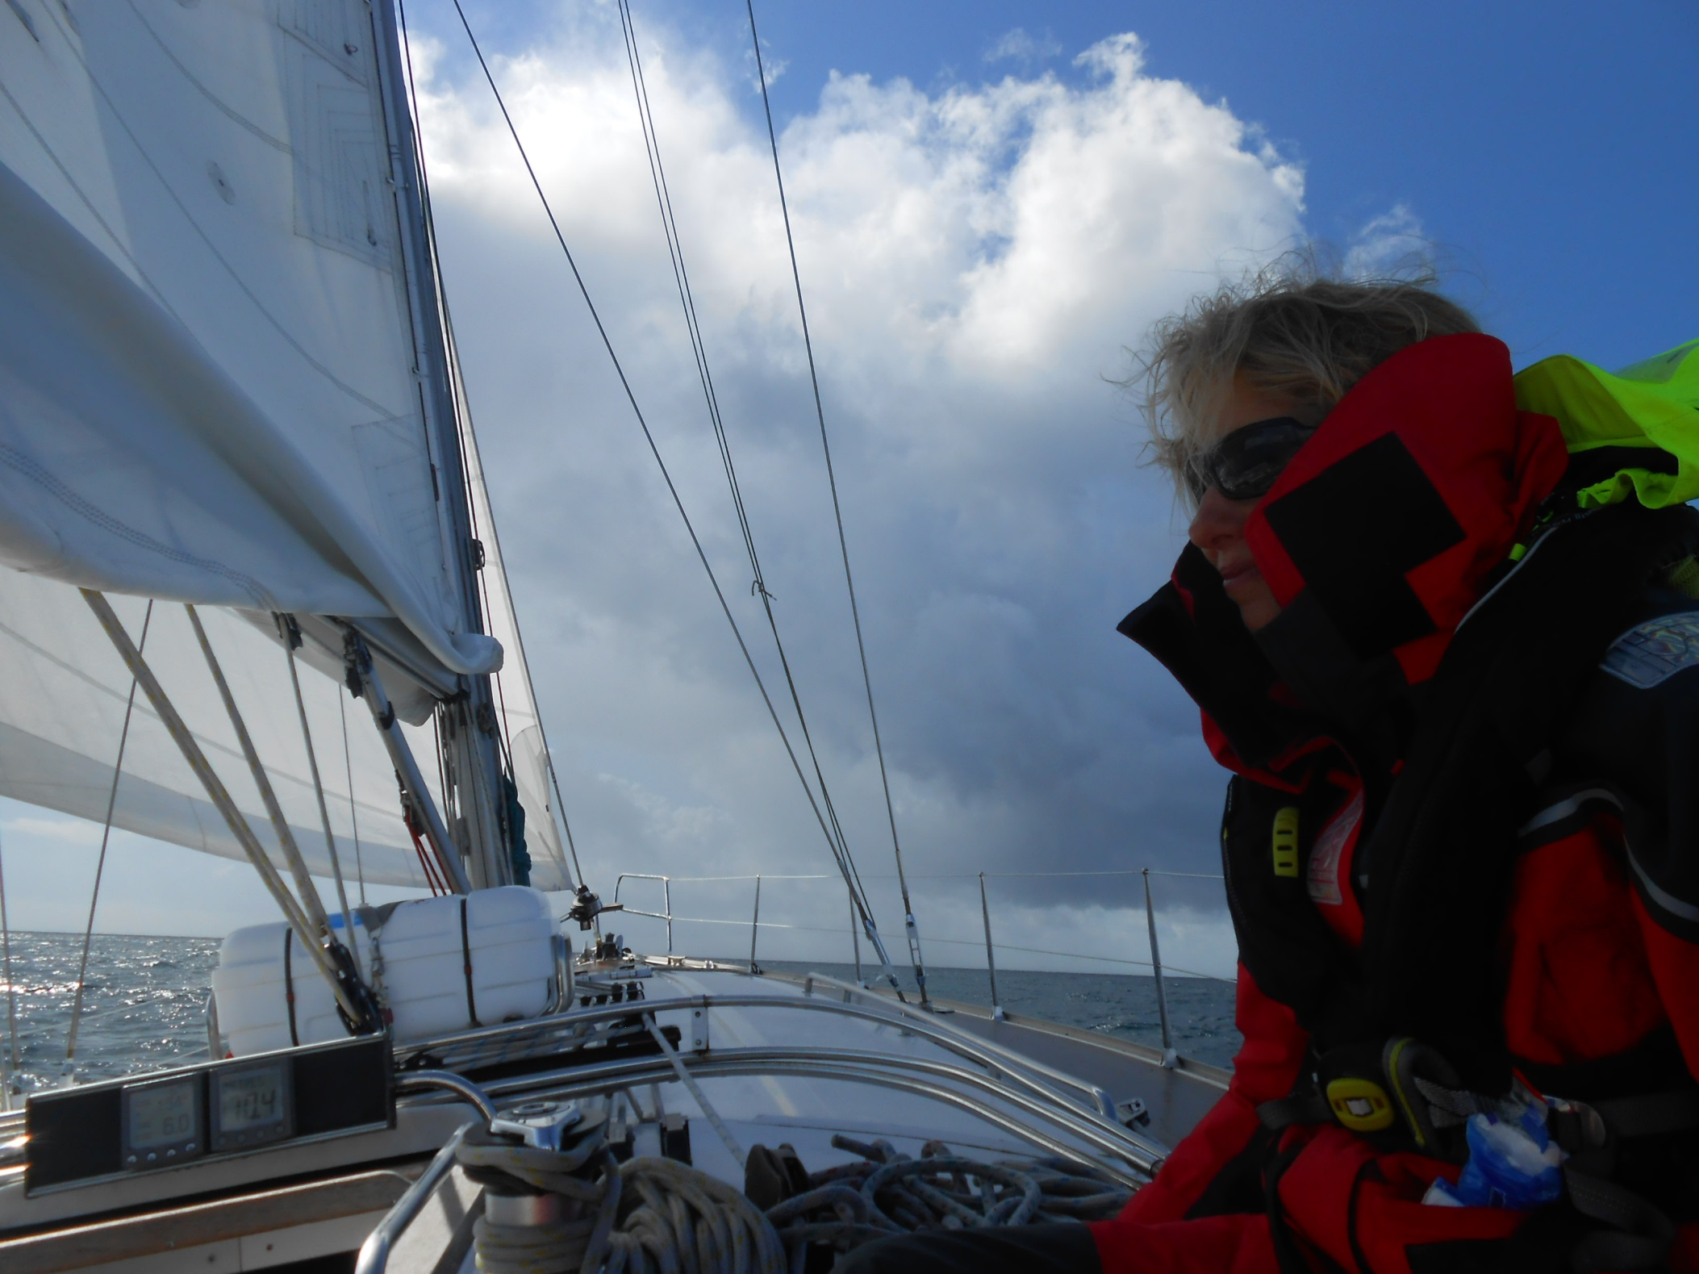
Squalls approaches.

Slide 36
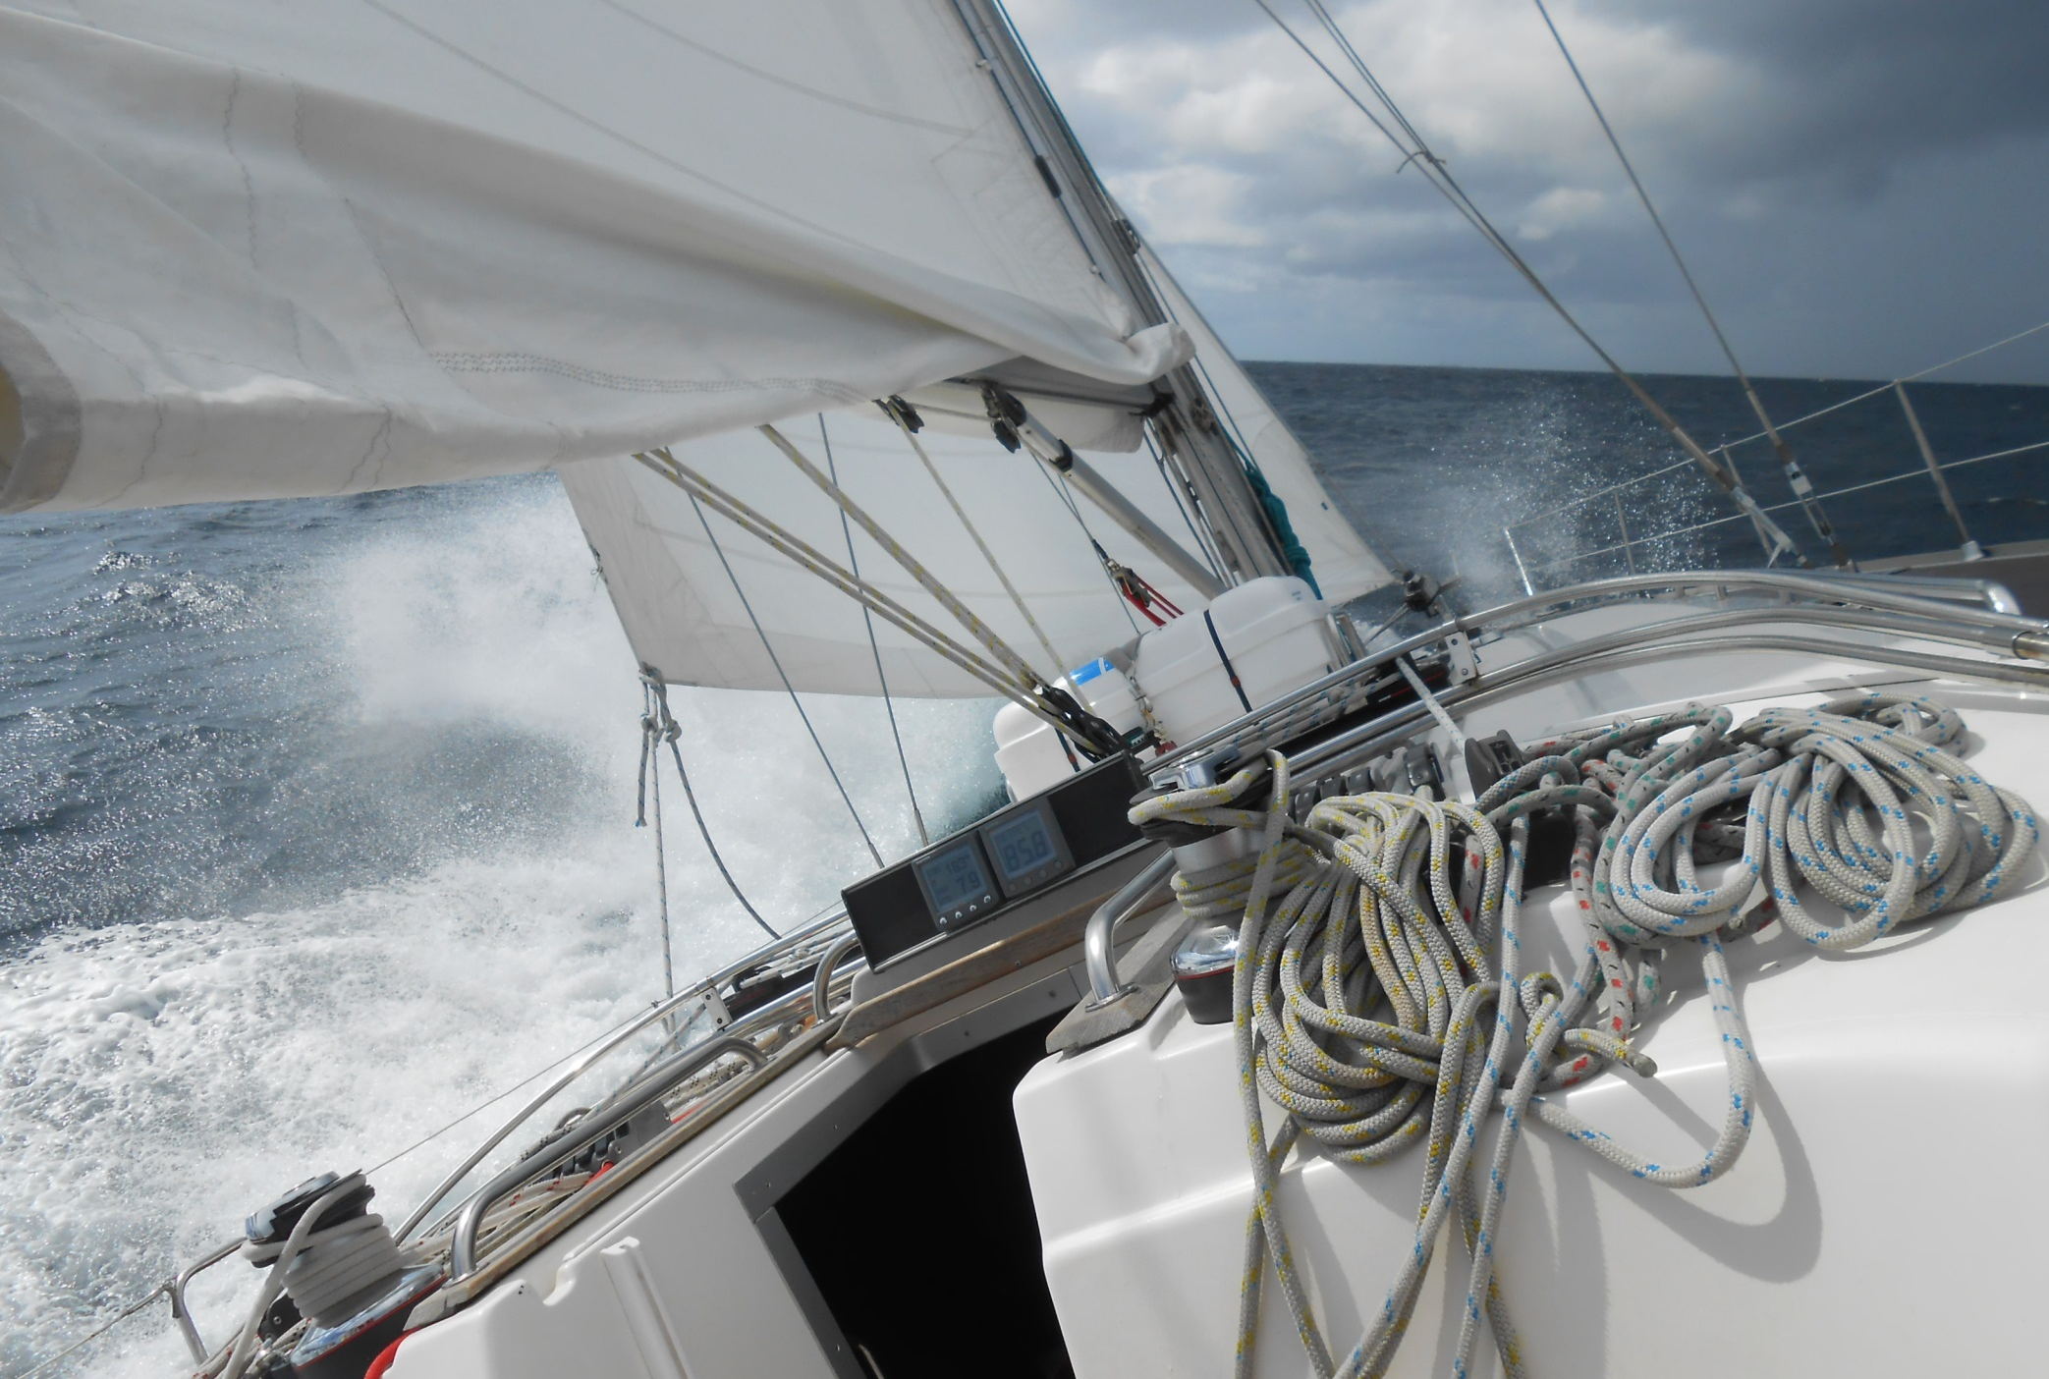
And at the peak of the storm Tonic’s gunnel’s touch the water, that’s quite a lean!

Slide 37
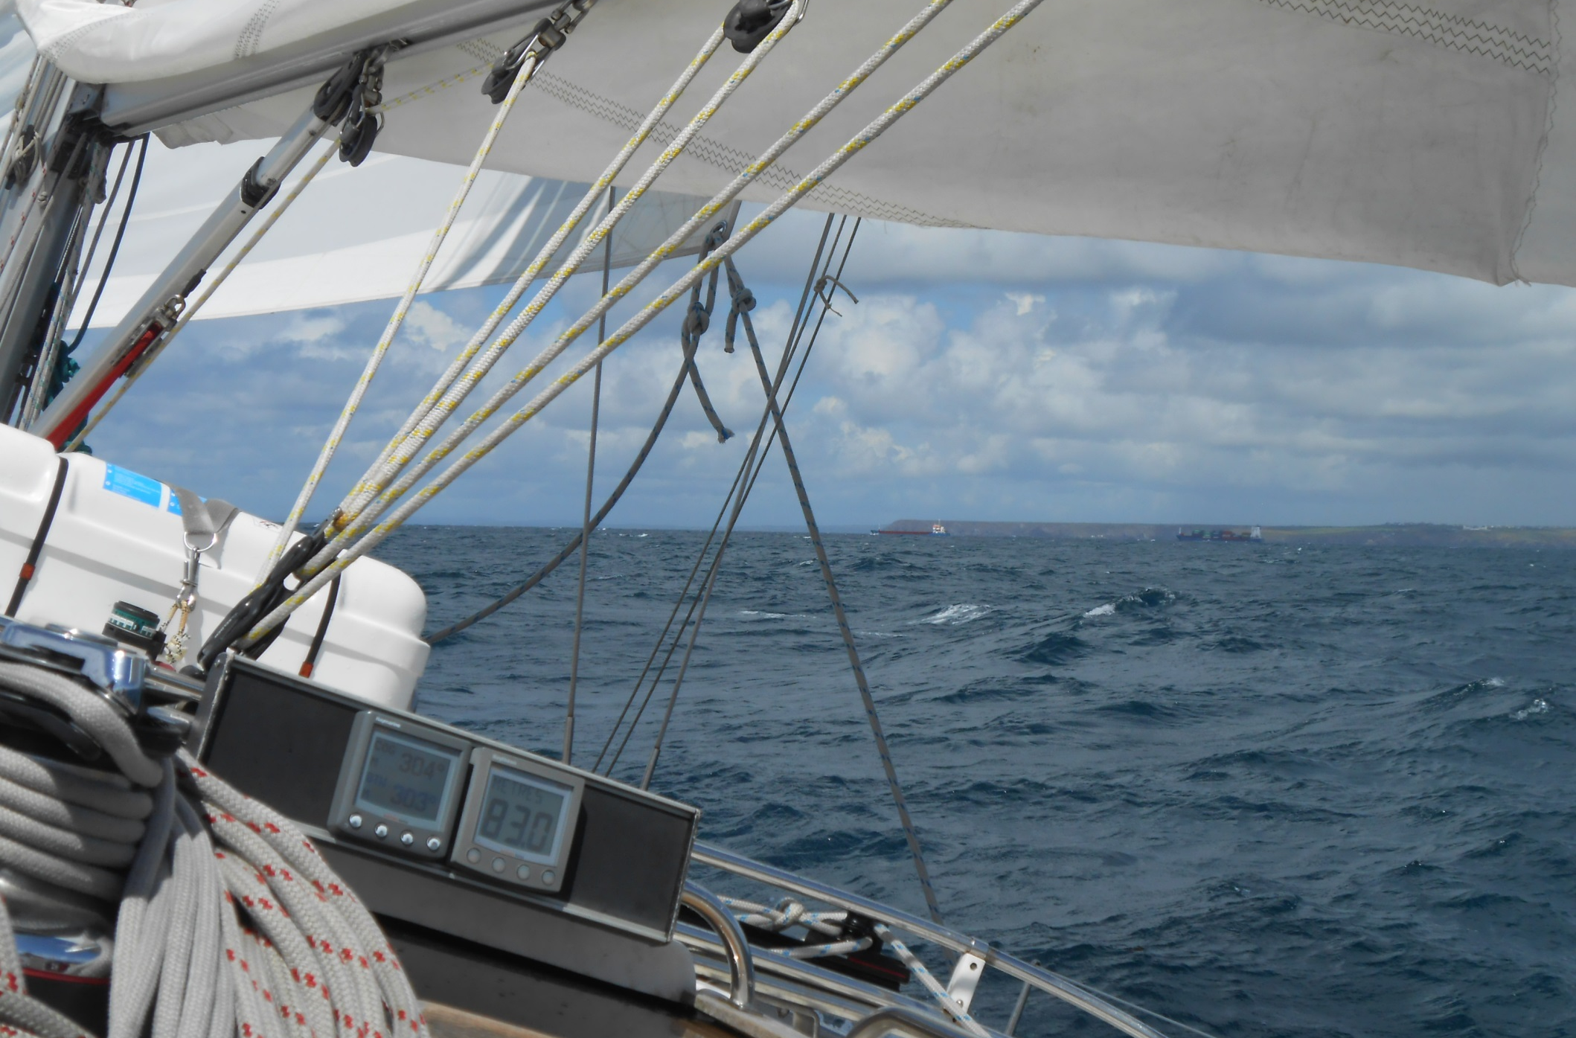
But things clear as we tack back towards the Lizard, as Lizard Point and tricky tidal races race by.

Slide 38
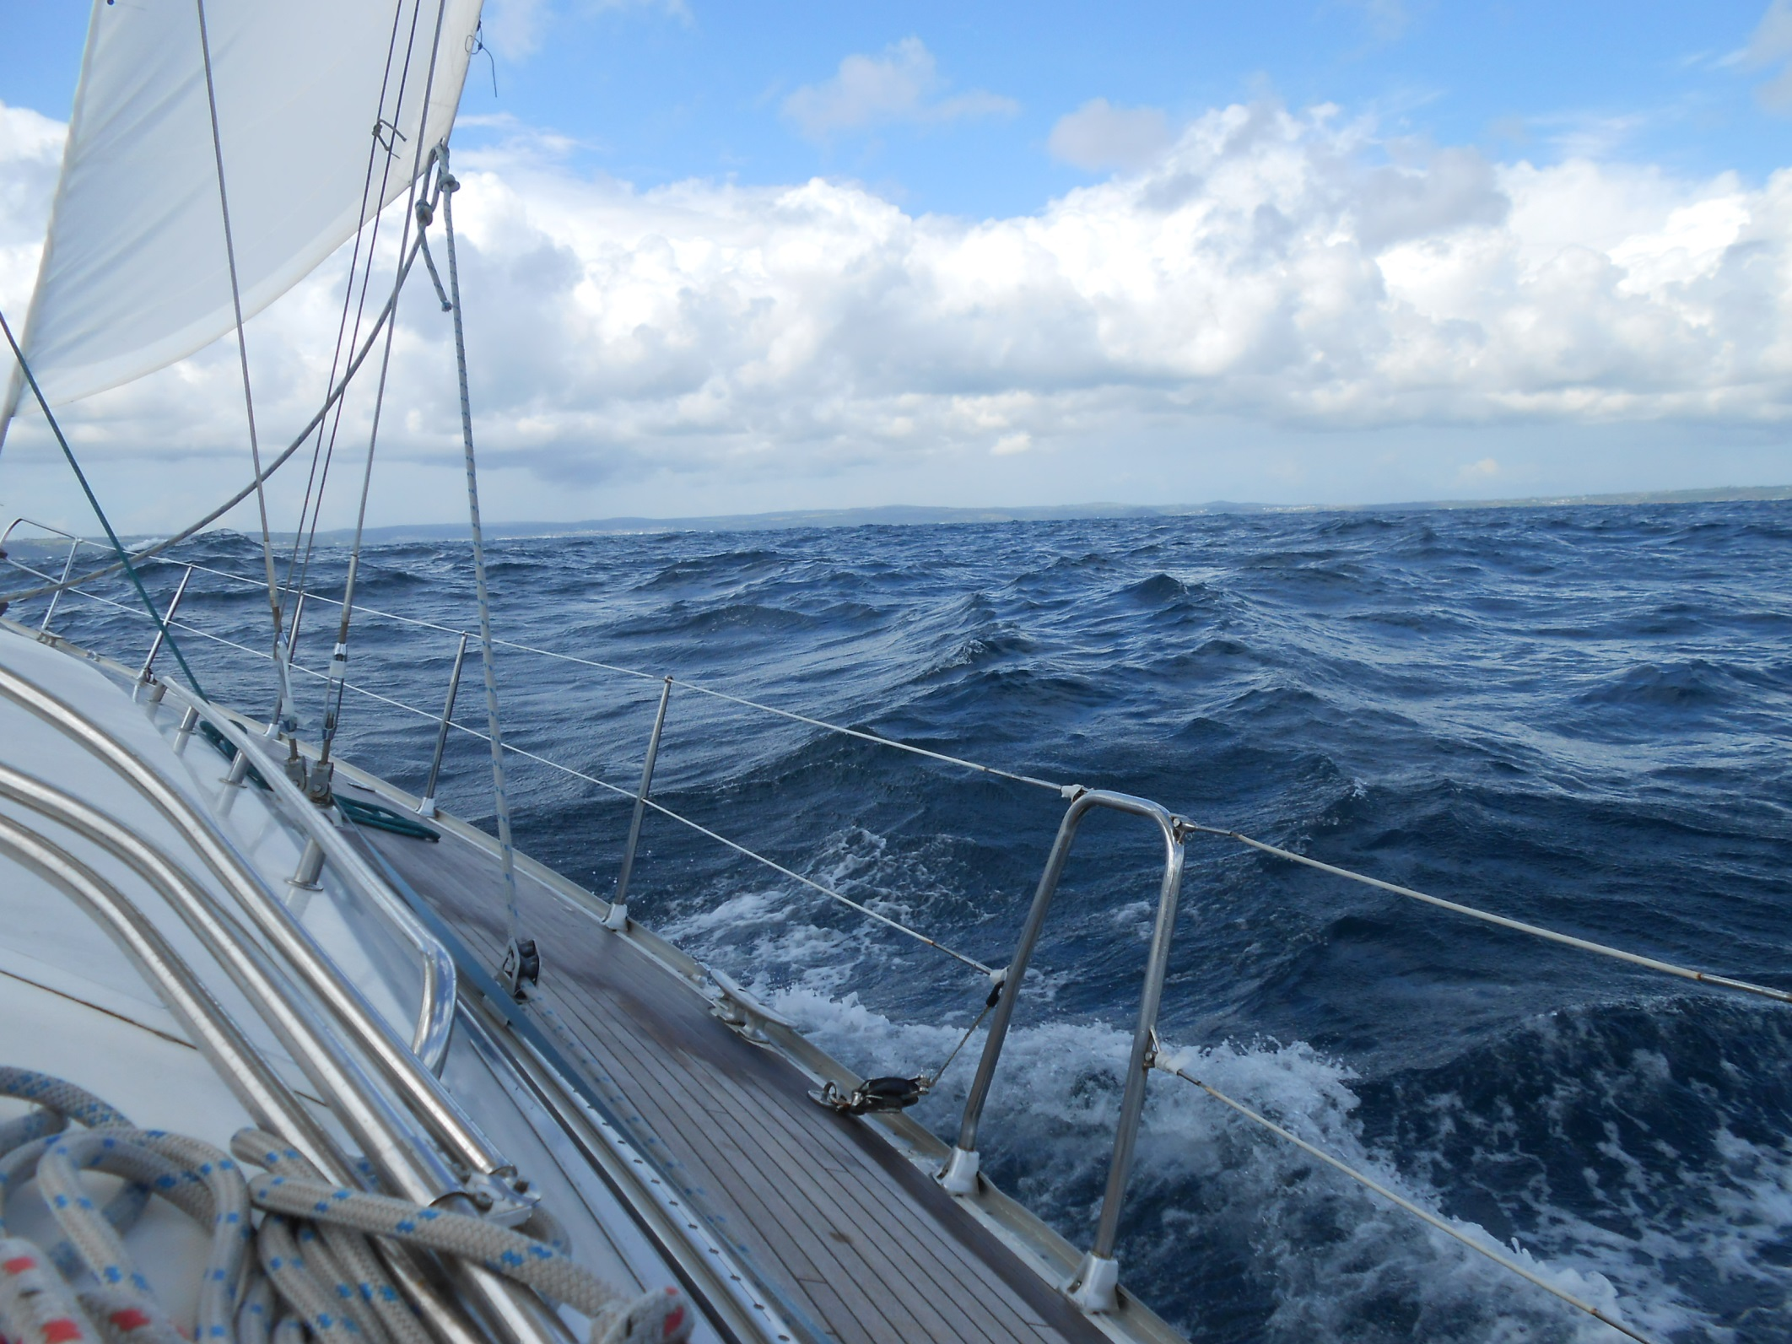
We zoom past Porthleven.

Slide 39
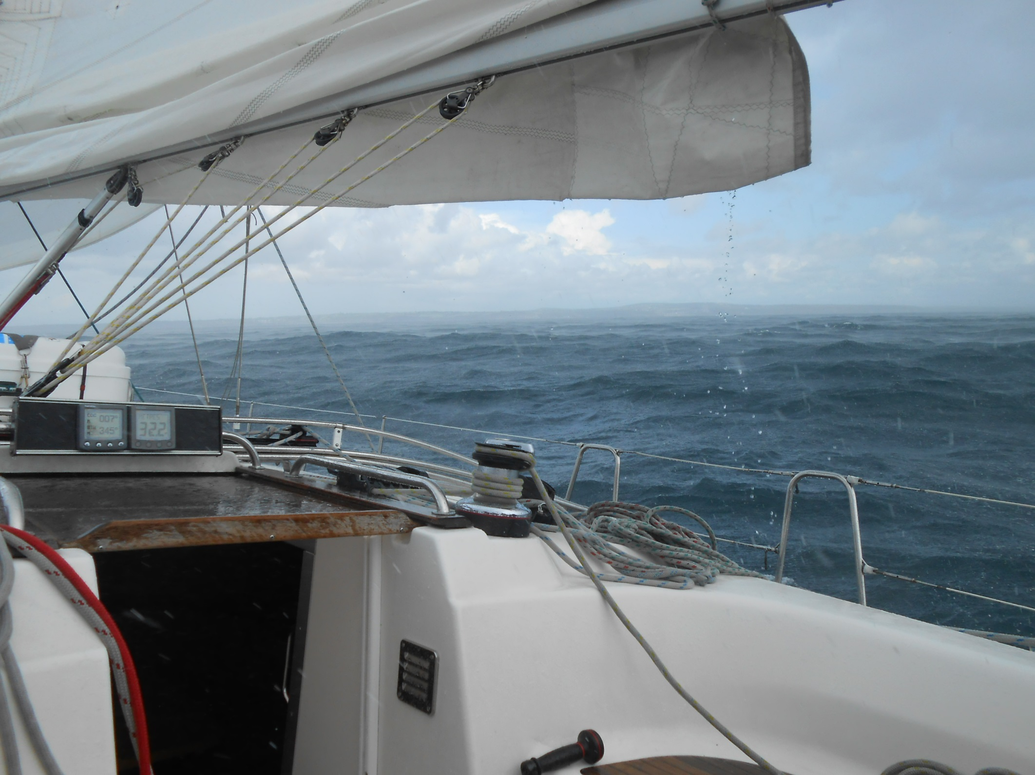
And receive a further downpour in Mount’s Bay.

Slide 40
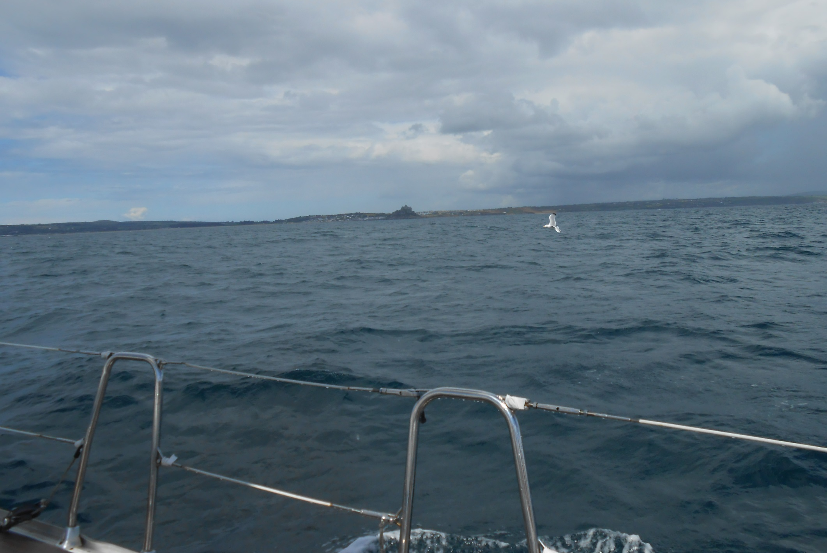
Then in clearing conditions reach spectacular
St. Michael’s Mount, Marazion.

Slide 41

As everything miraculously clears for our approach to Penzance.

Slide 42

Penzance Harbour is controlled by a rotary gate, open only near high tide, as the Gry Maritha, the Scilly Isles cargo ship, emerges.

Slide 43

Heading for the open gate we pass two trawlers, moored on the harbour wall awaiting access to Penzance dry dock.

Slide 44

Nic manoeuvres us to our mooring as we bid farewell, once more, to the amazing yacht Tonic.

Slide 45


Then watch the Scillonian arrive.
Tomorrow we are aboard to complete our journey to
Lands End.

Slide 46

The Scillonian, the Scilly Isles passenger ferry, is Devon built and runs summer months only.

Slide 47

As luggage, containerised for the various islands, is craned aboard.

Slide 48



At 9.15 we are off.
We have 407 passengers aboard and progress out of Penzance, with our top speed of 15 knots, is brisk.

Slide 49

As we head towards Mousehole village and Kemvel Point.

Slide 50

From out at sea it is obvious why Mousehole is so called!

Slide 51

Lamorna Cove, dotted with houses with Tater Du lighthouse beyond, Cornwall’s newest lighthouse, only opened in 1965.

Slide 52

Sandy Porthcurno next, with the Minnack Theatre on the headland to the left.

Slide 53

Nearly there now with Porthcurno still to the right and
Gwennap Head, our penultimate headland, directly ahead.

Slide 54

And around Gwennap Head is Lands End, the southern end of this fantastic project. Made it!

Slide 55
The End
Lands End has been 555 water miles from
Tower Bridge and 1731 water miles from John O’Groats.
What a trip!

