Slide 1
Exploring Britain
Boating South Part 3
Chapter 13
Devon
2nd October 2011 to 9th August 2013

Slide 2
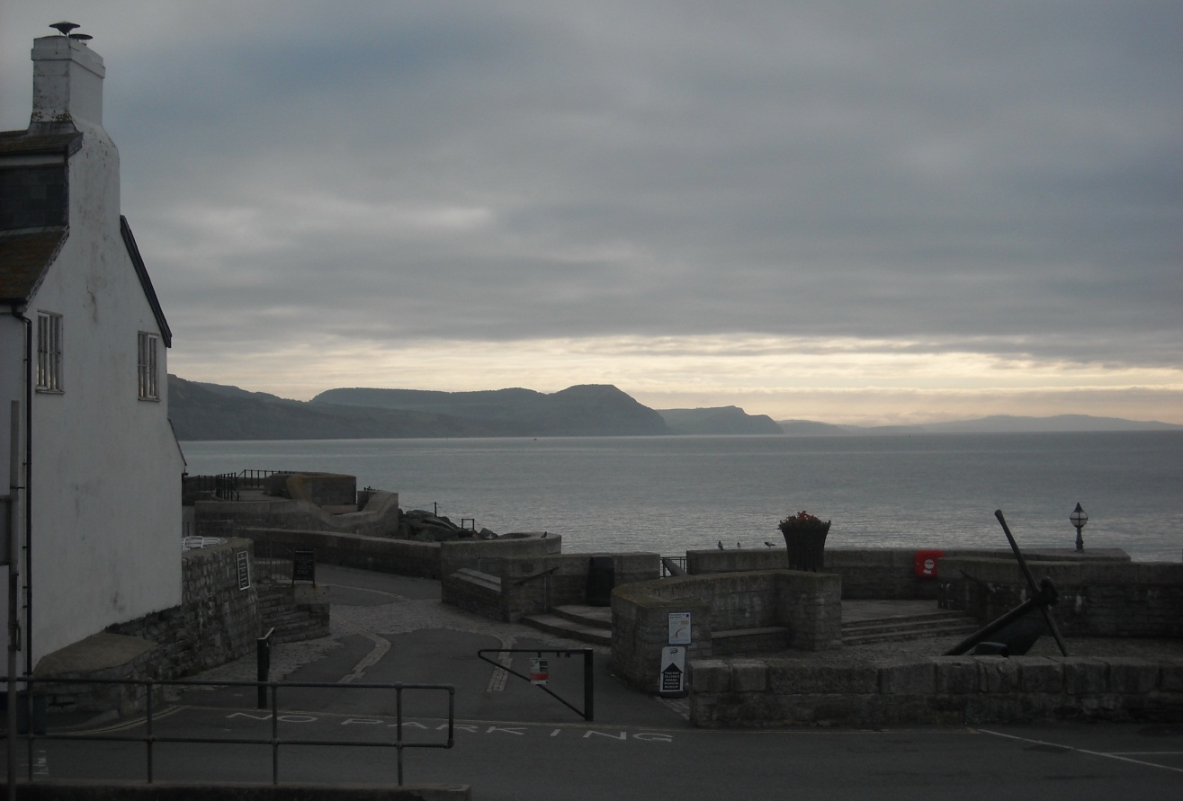
Early morning in Lyme Regis as we look back to Golden Cap, and our Dorset route so far.

Slide 3
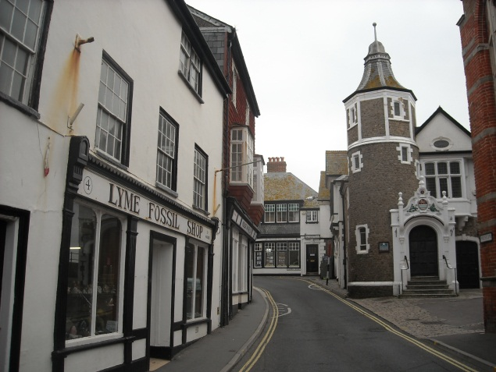
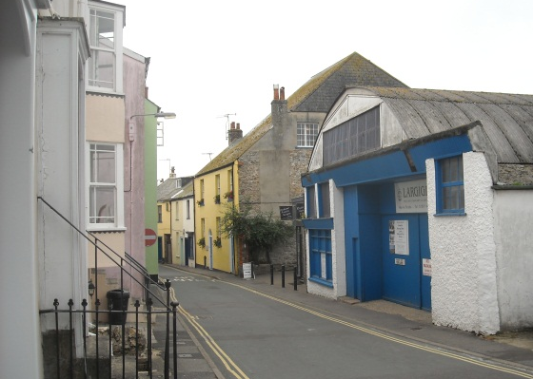
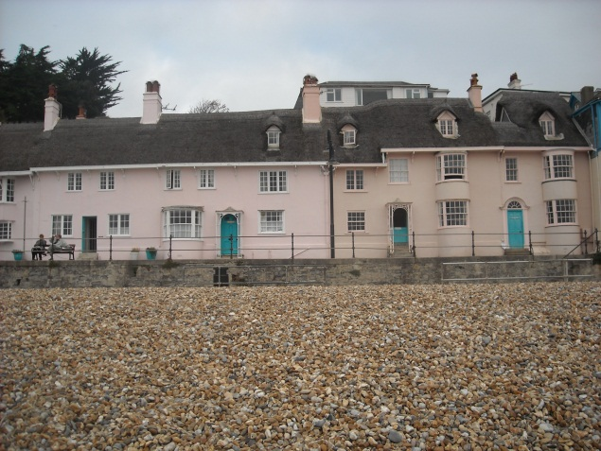
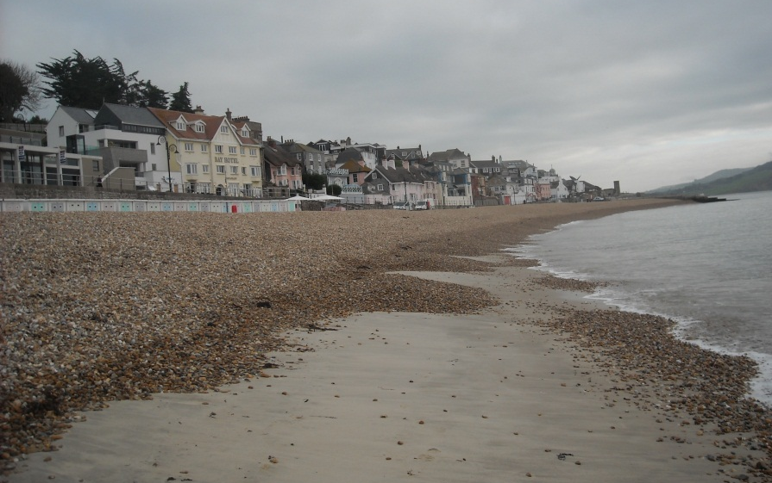
Attractive Lyme Regis, a town that once had worldwide trade.

Slide 4
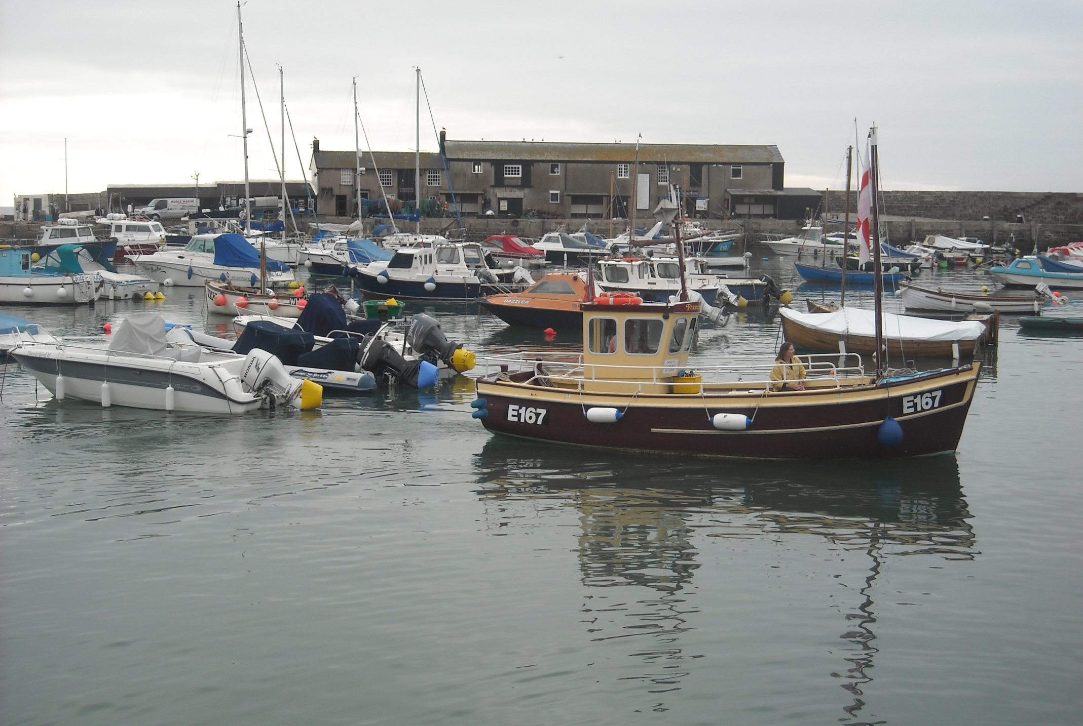
As E167, Frances Jane approaches, a 1952,
Falmouth built, mahogany, Cornish Crabber.

Slide 5
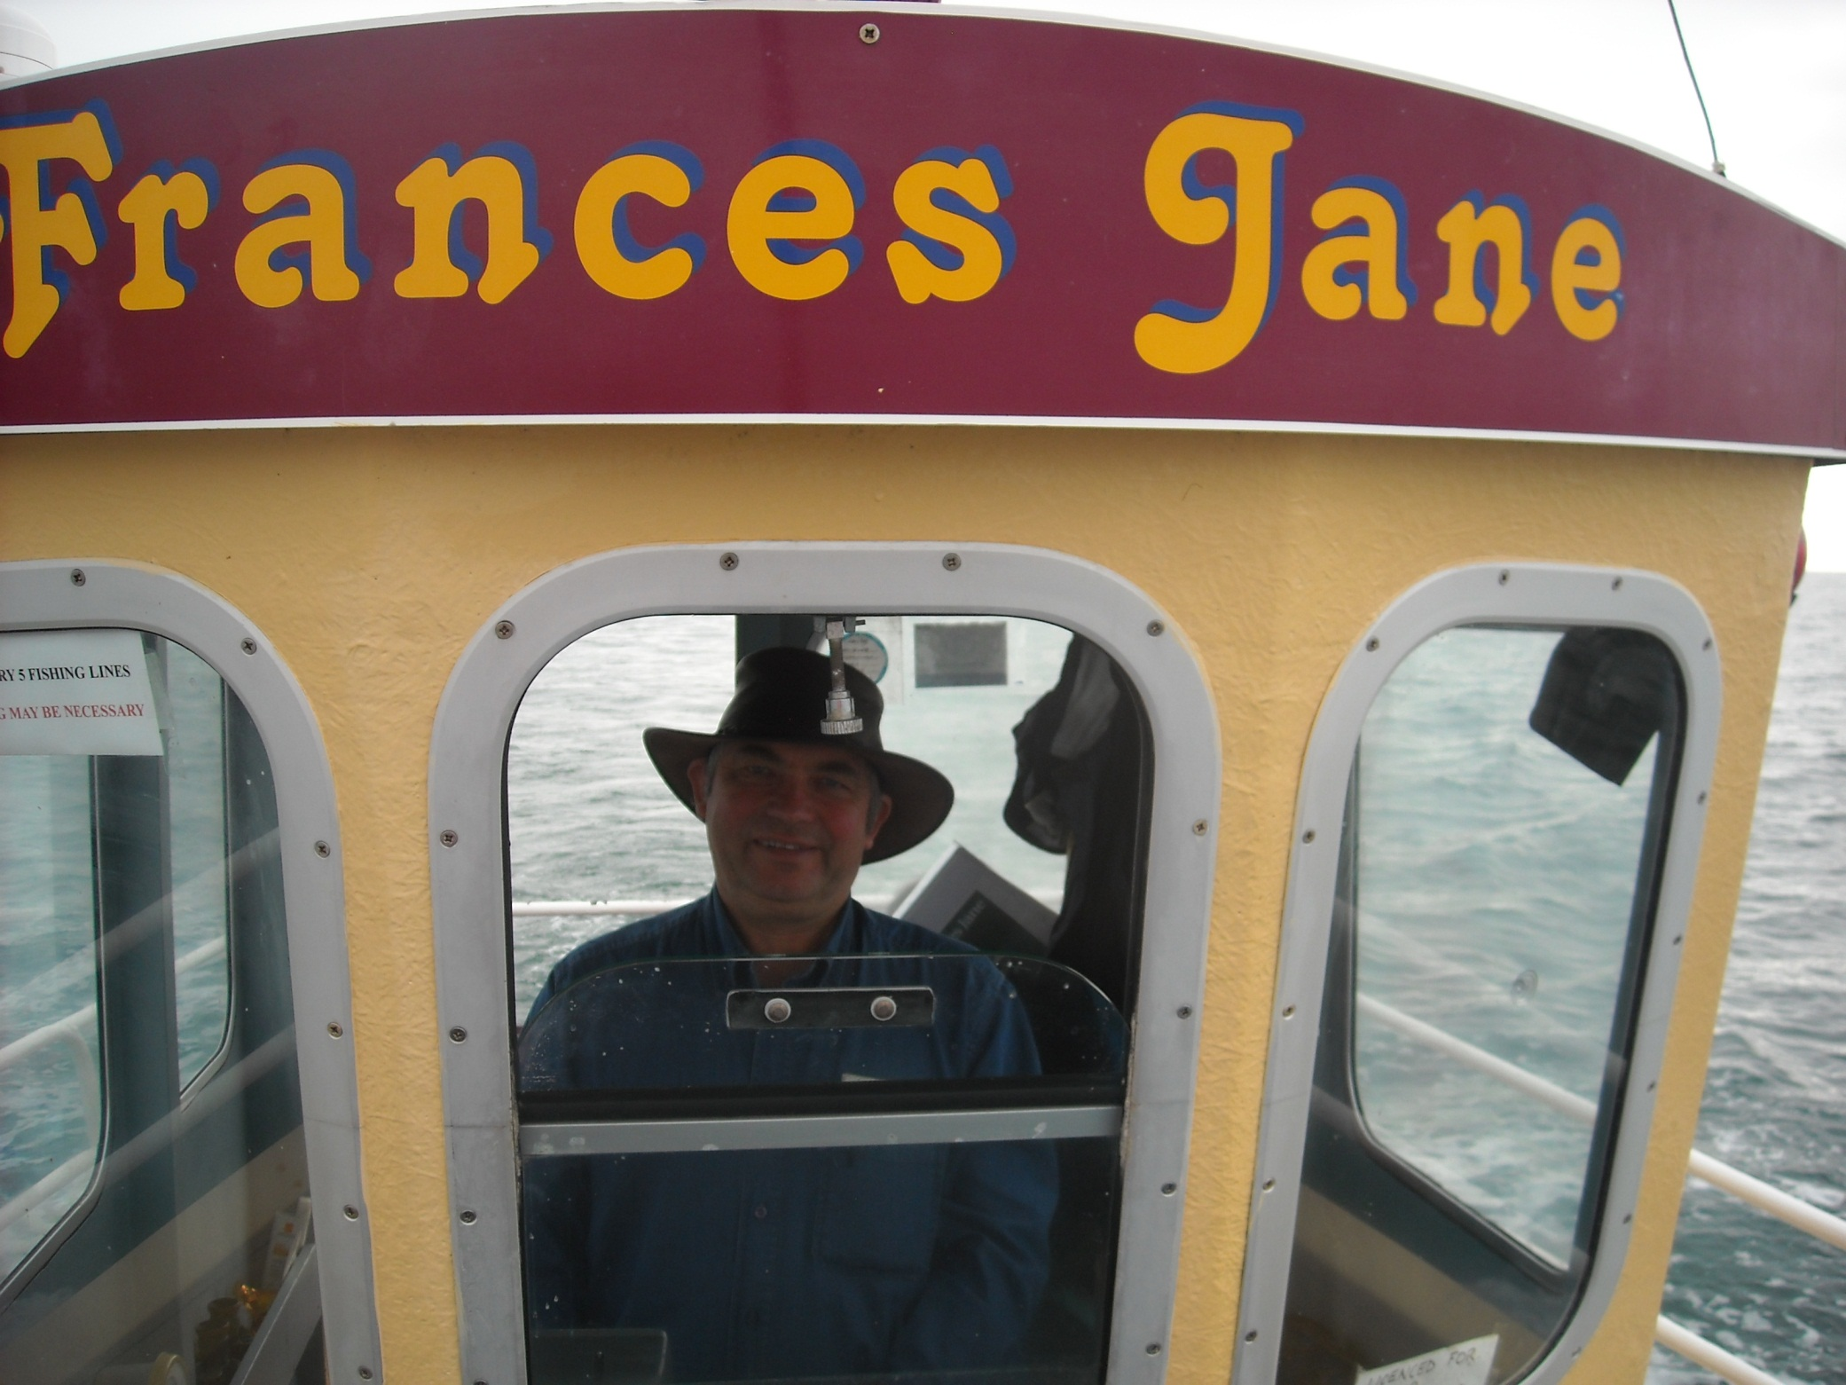
As off we go again aboard the Frances Jane.

Slide 6
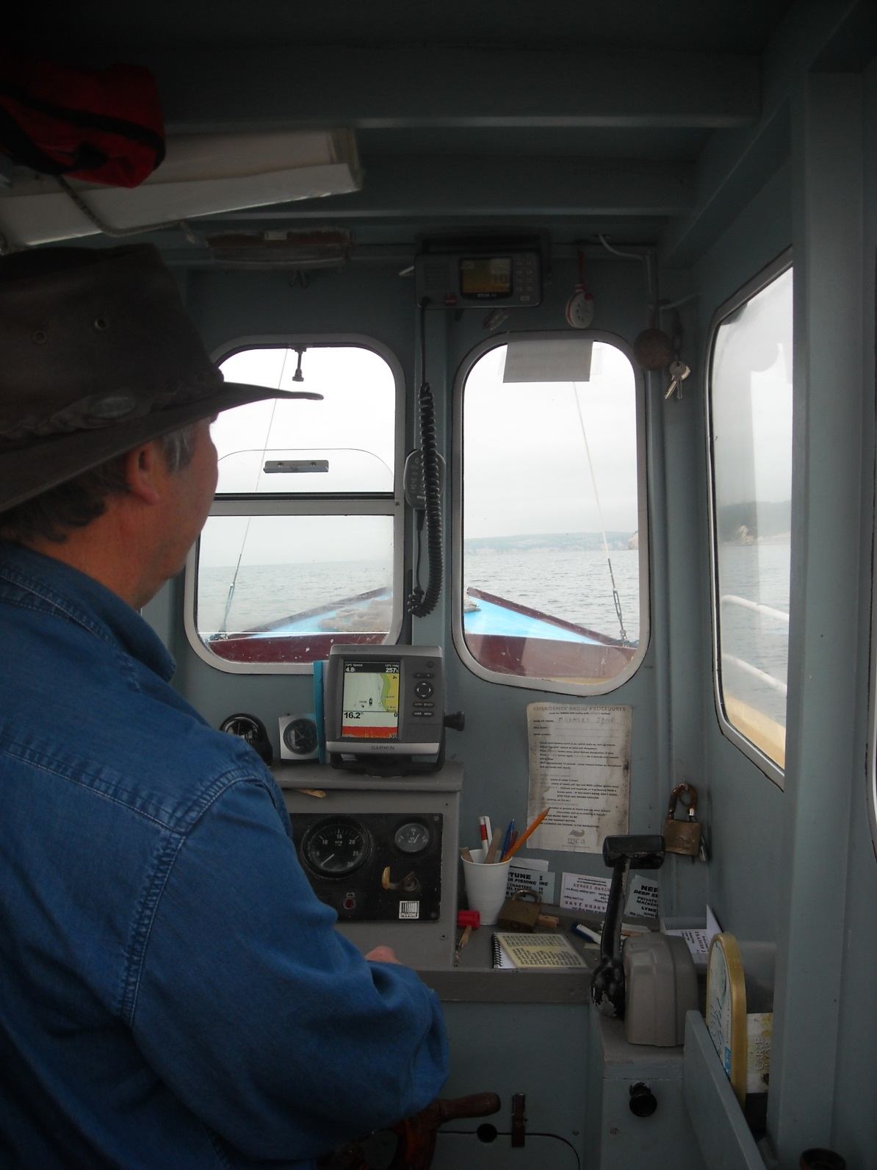
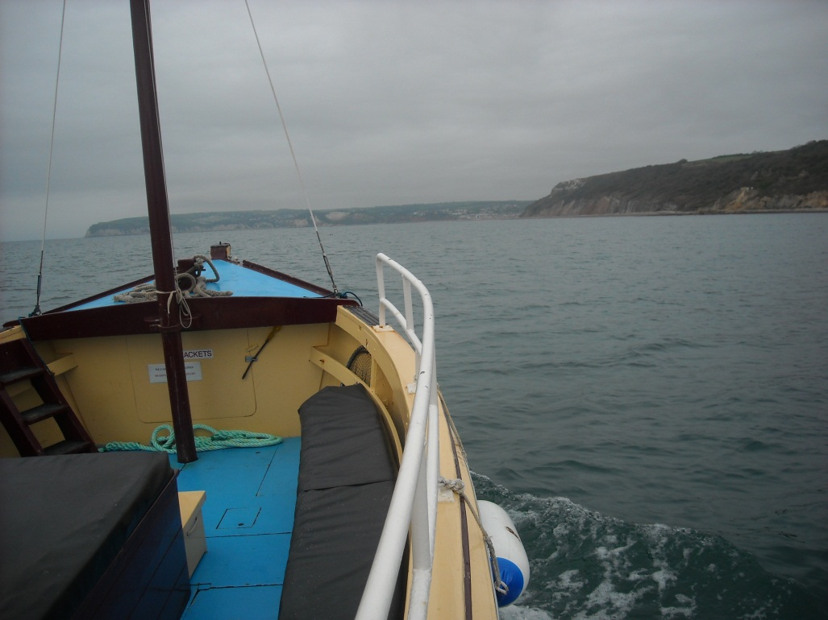
Originally tiller steered, this trip is a very different to the boat’s normal fare of one hour mackerel trips.

Slide 7
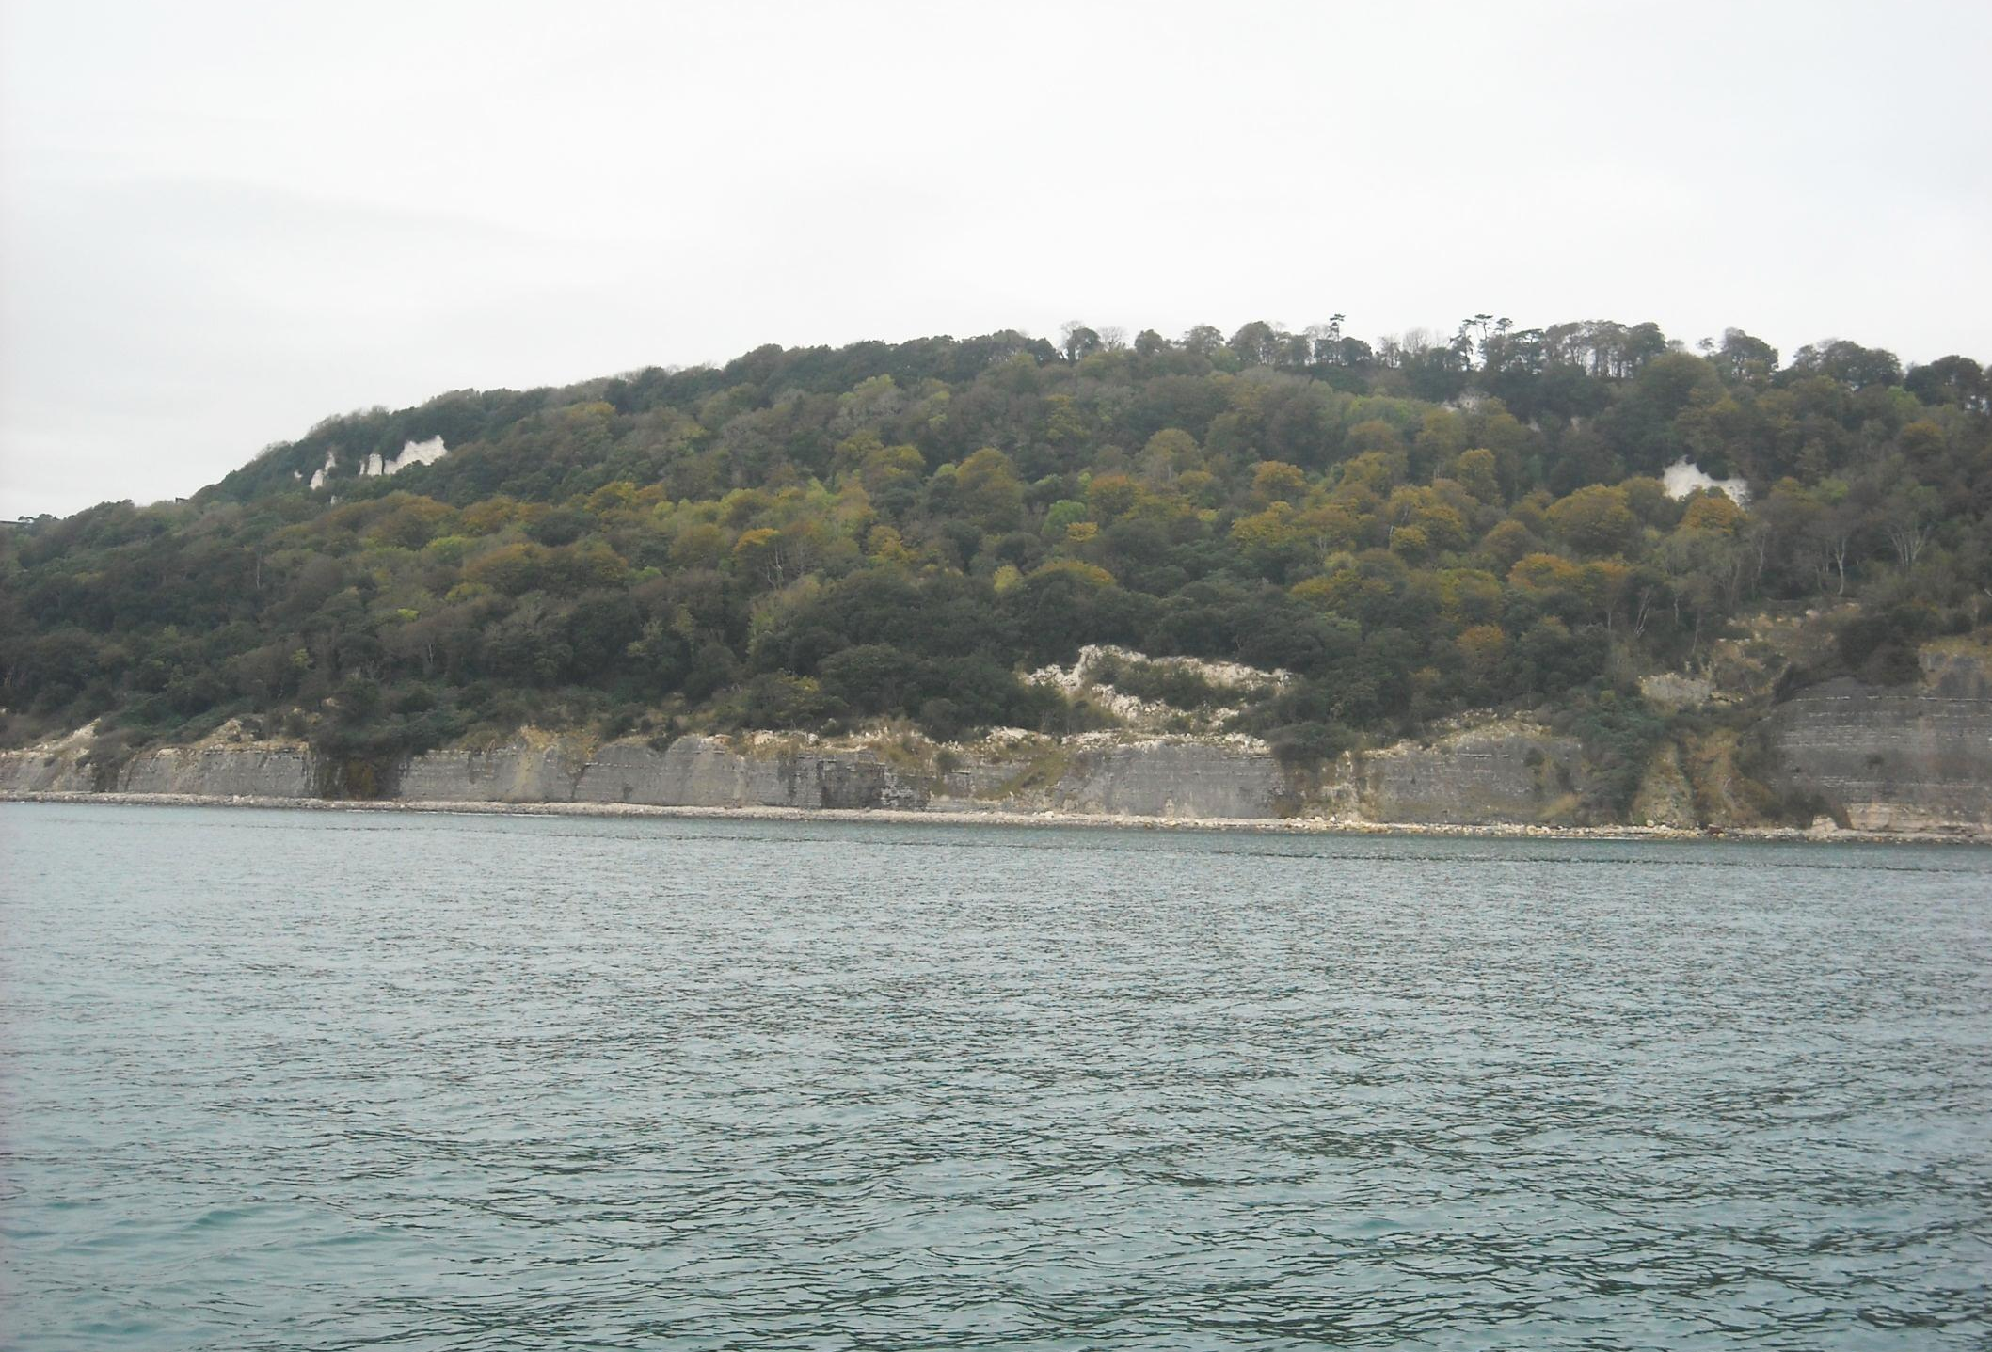
We begin by passing Blue Lias cliffs, again well known for fossils.

Slide 8
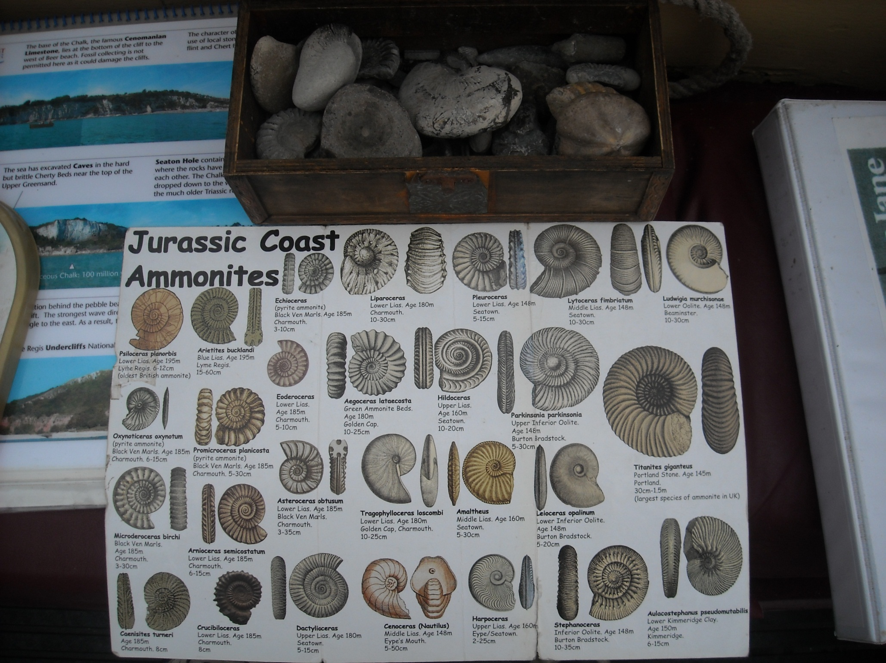
Skipper Doug has a box full, collected from local beaches.

Slide 9
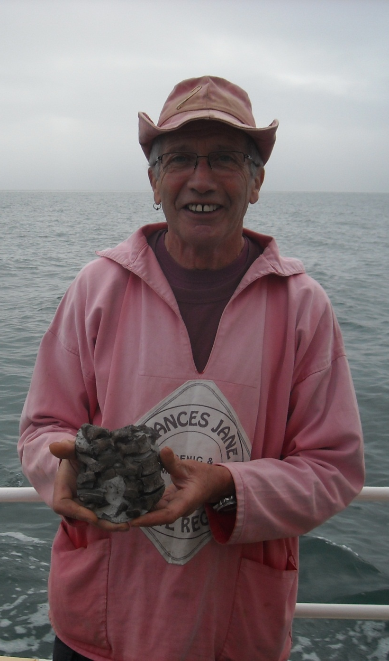
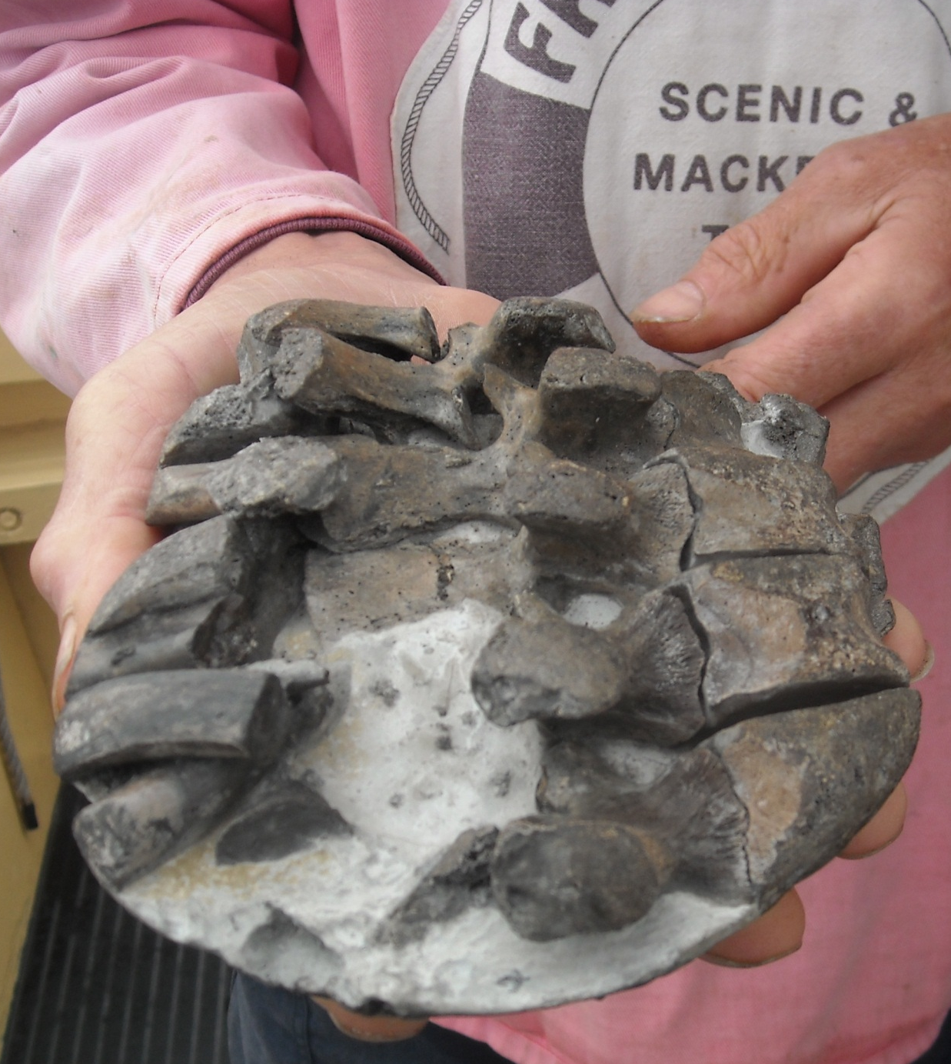
Including a Plesiosaurus vertebrae, a specimen found as a beach pebble with just the ends of the vertebrae showing.

Slide 10
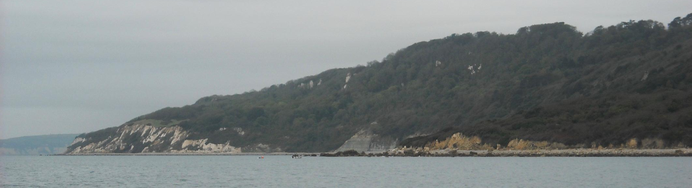
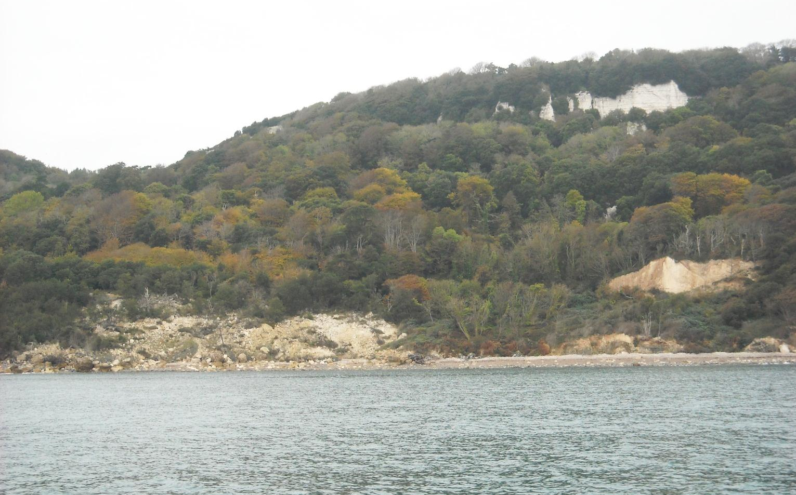
Five miles of inaccessible undercliff follow, as we pass Pinhay Bay and Humble Point.

Slide 11
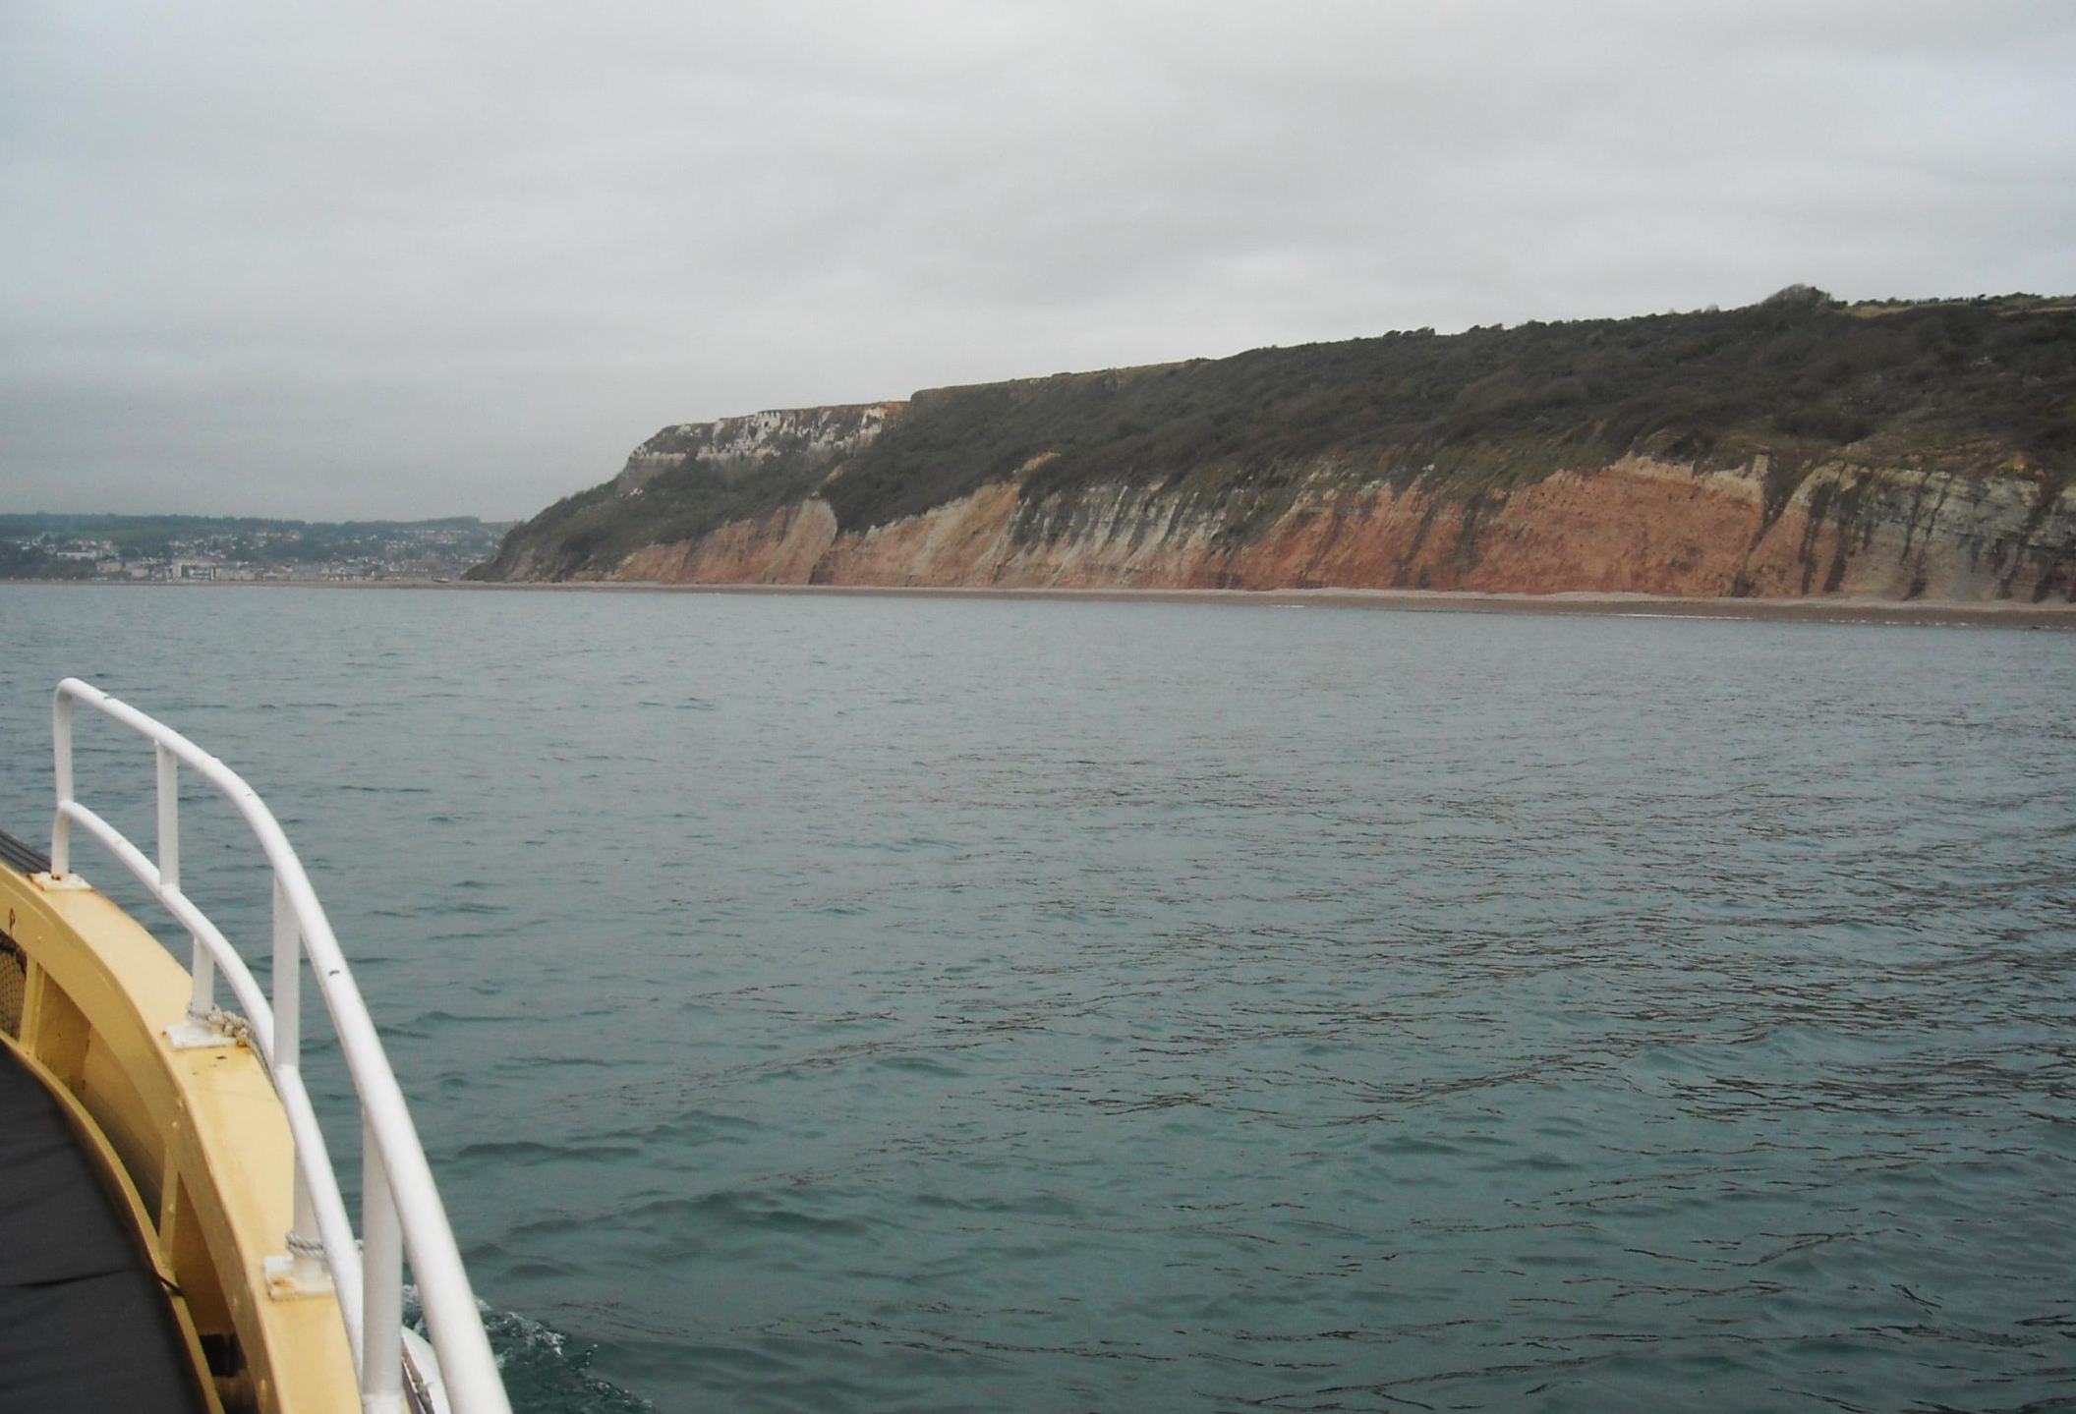
Seaton is ahead now, proceeded by red mudstone cliffs and the tricky River Axe access to tiny Axmouth Harbour.

Slide 12
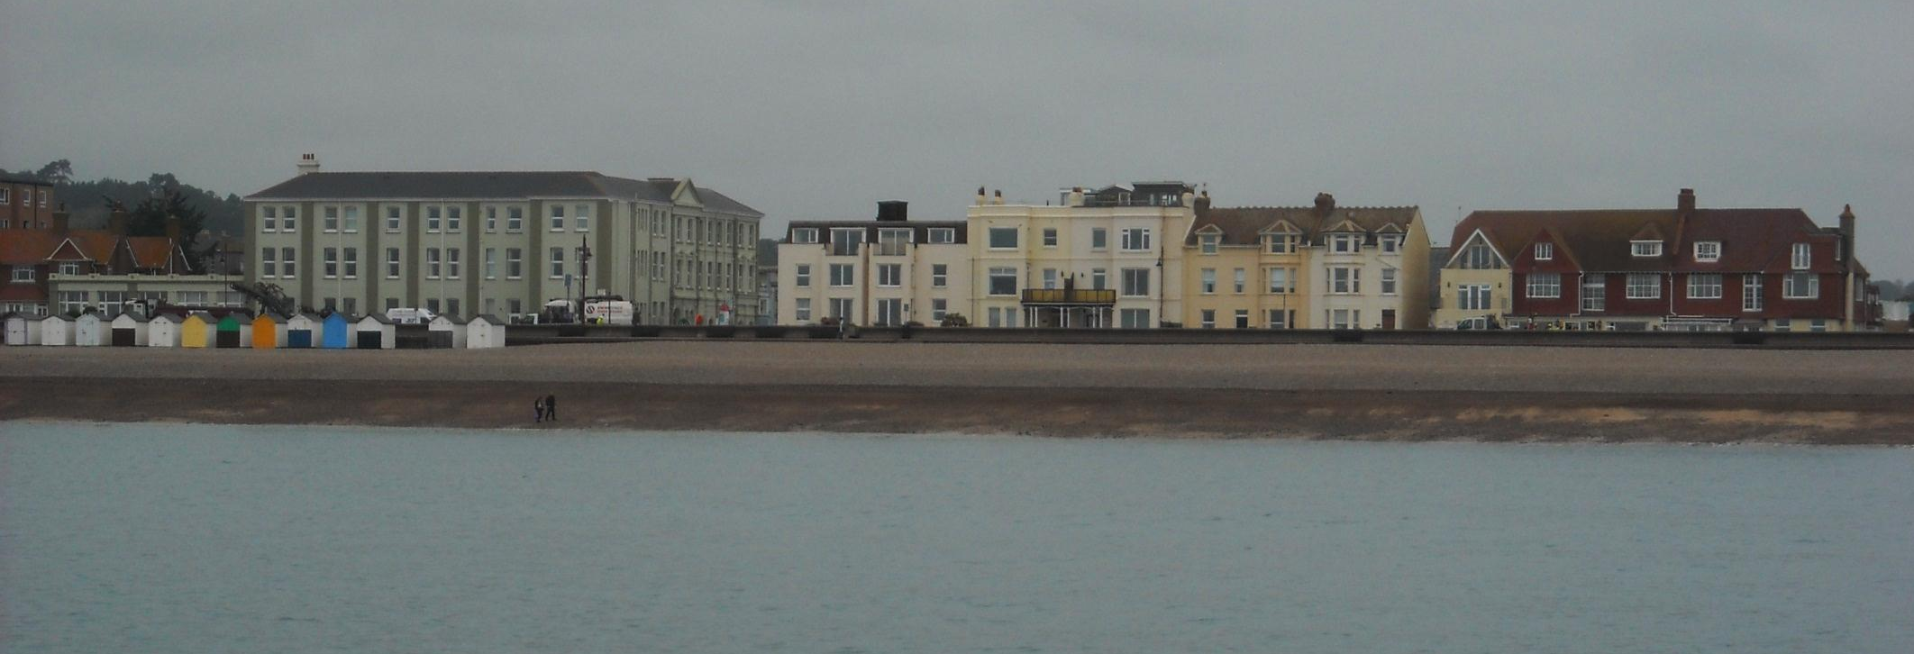
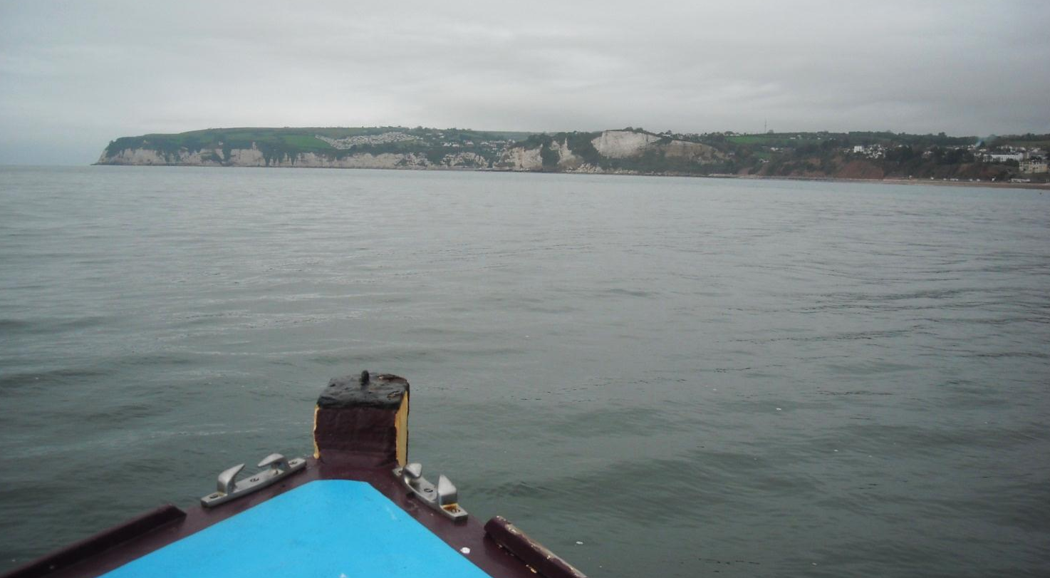
Seaton seafront appears plain as we continue onwards to Beer.

Slide 13
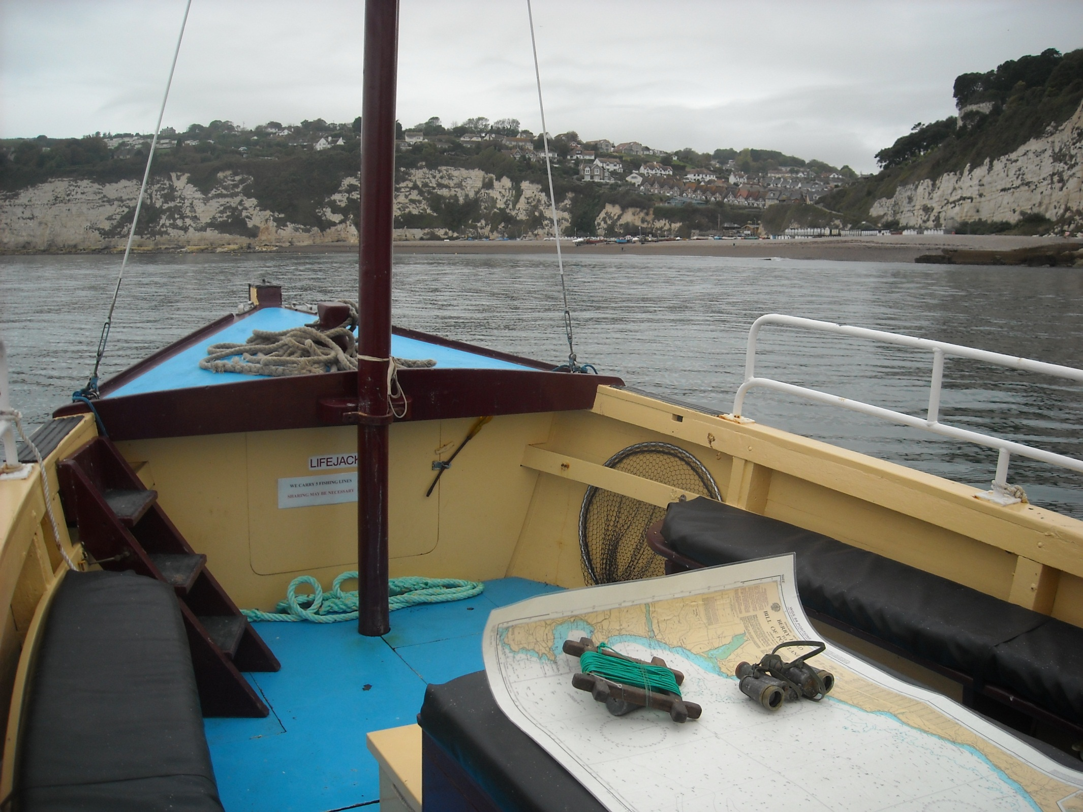
Beer is interesting. There is no harbour, just a beach to land on.

Slide 14
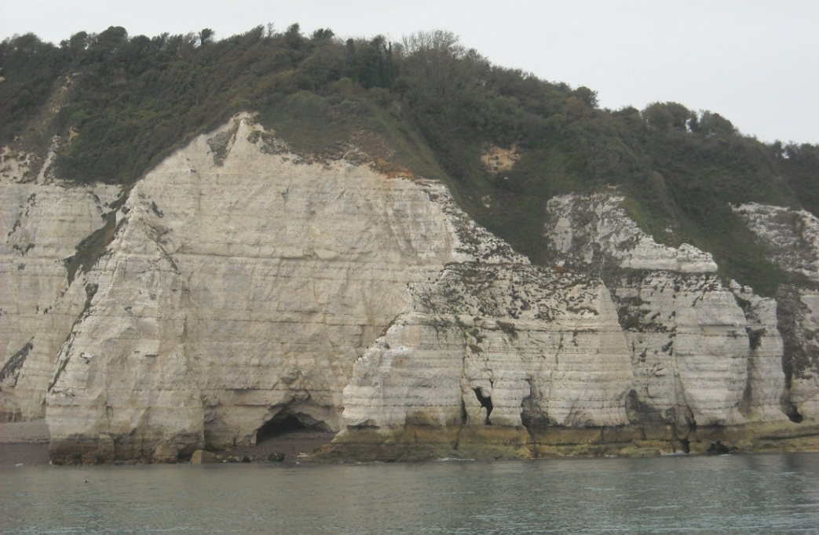
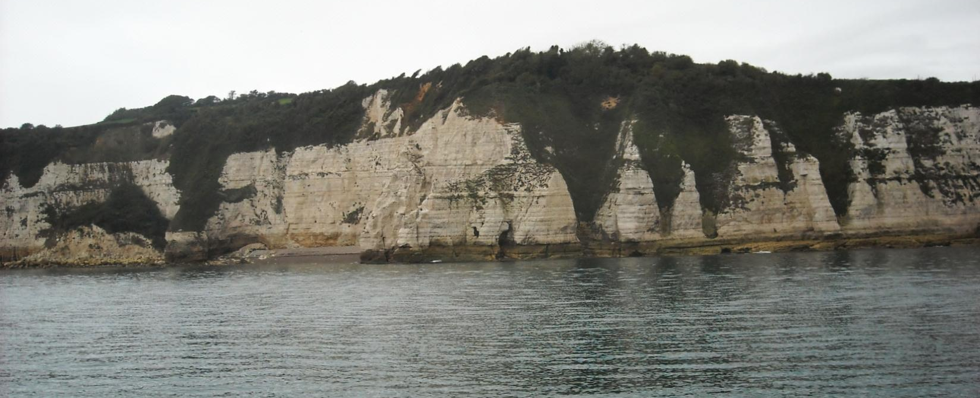
As we continue to the chalk cliffs.

Slide 15
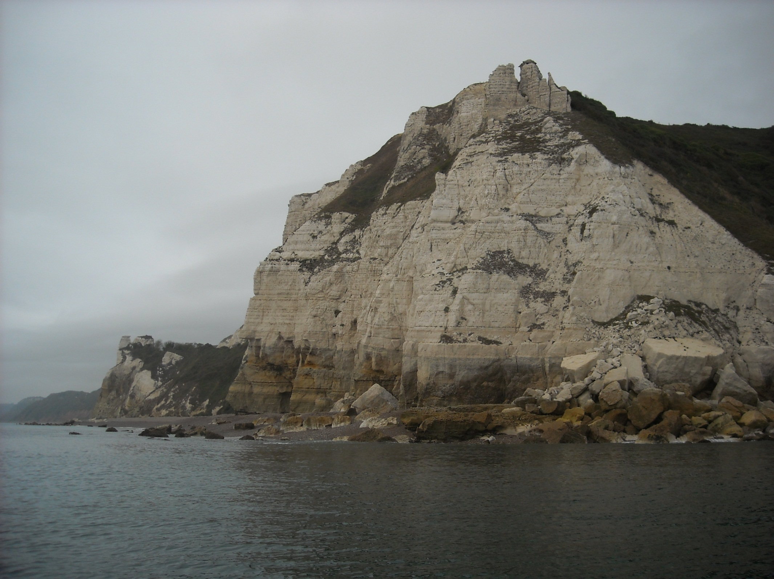
Rounding Beer Head, another moment to savour.

Slide 16
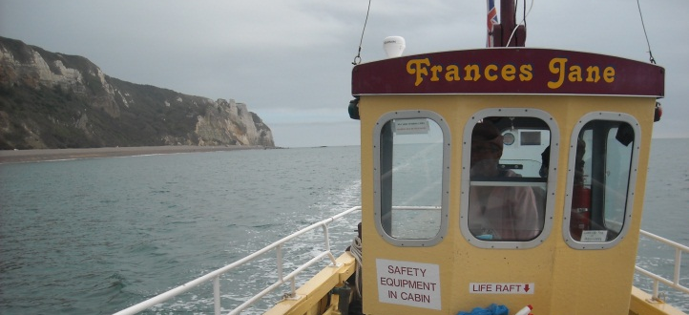
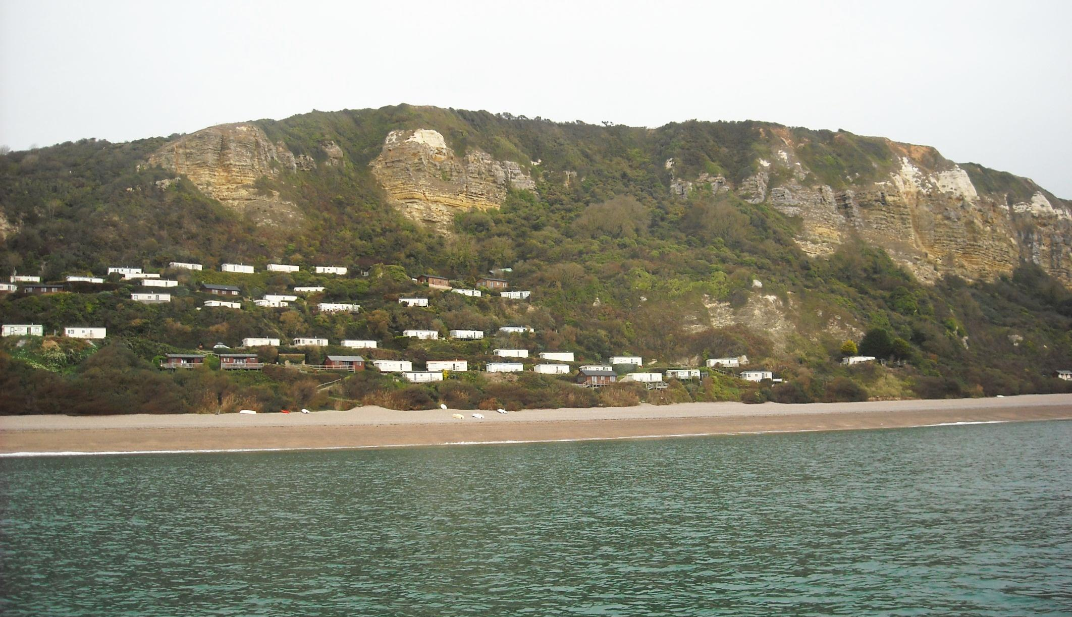
To reach Branscombe where chalk gives way to greensand and mudstone and the cliffs become dotted with desirable caravans and chalets.

Slide 17
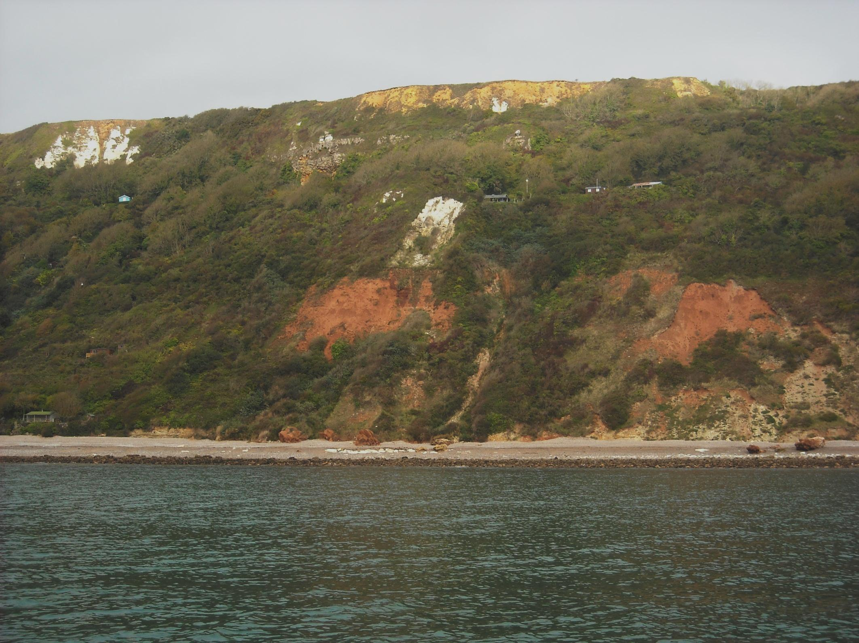
Mercia Mudstone, Upper Greensand, Lower Chalk and Wild Cliffs.

Slide 18
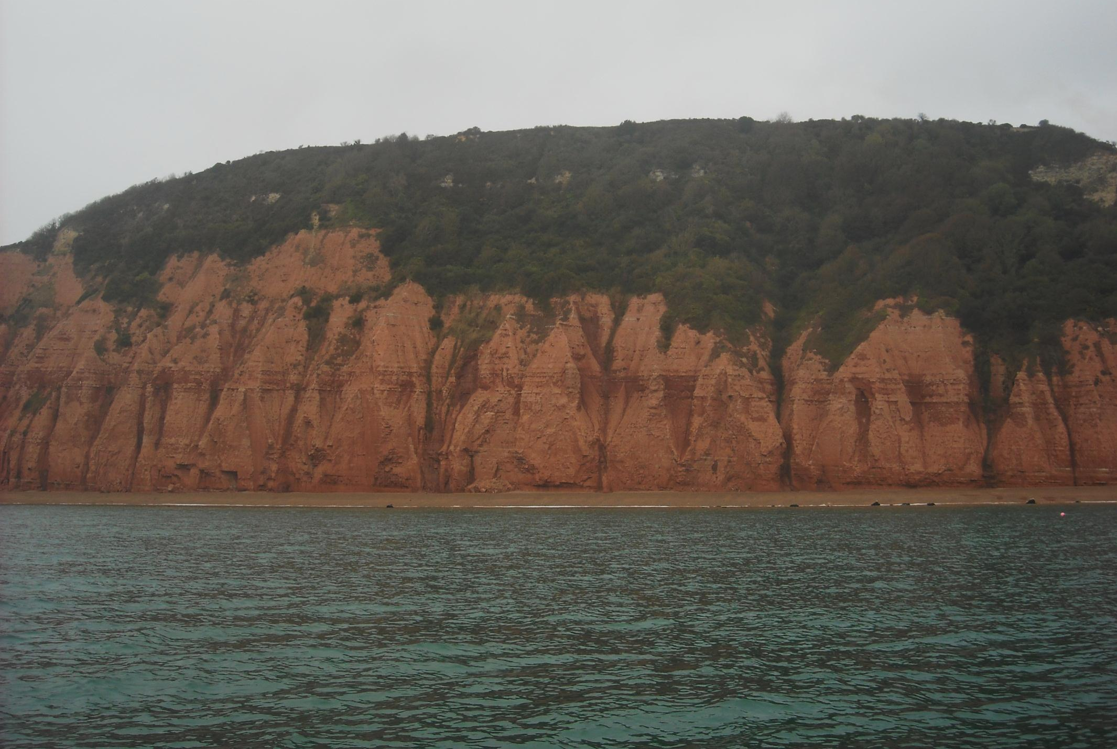
The softer mudstones thicken approaching Sidmouth as the cliffs become nearly vertical with the constant erosion.

Slide 19
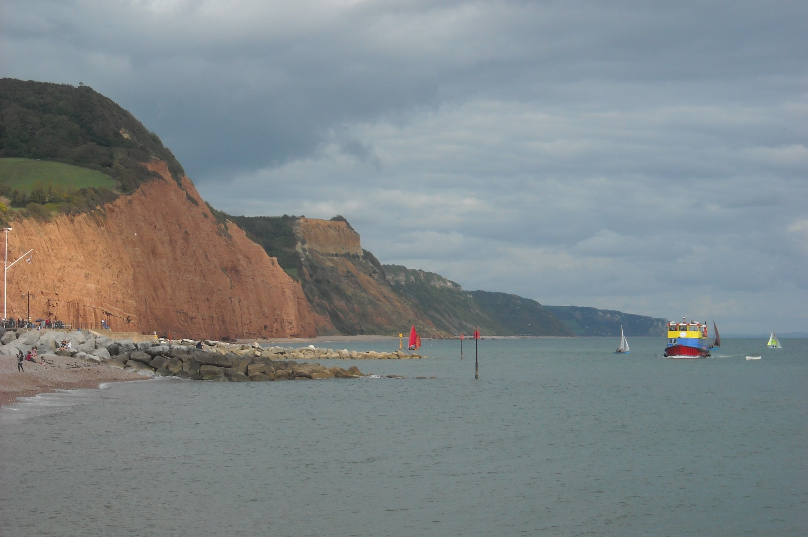
And the cliffs from the shore as, on a different day, the Pride of Exmouth approaches, a vessel purpose built for the Jurassic Coast.

Slide 20
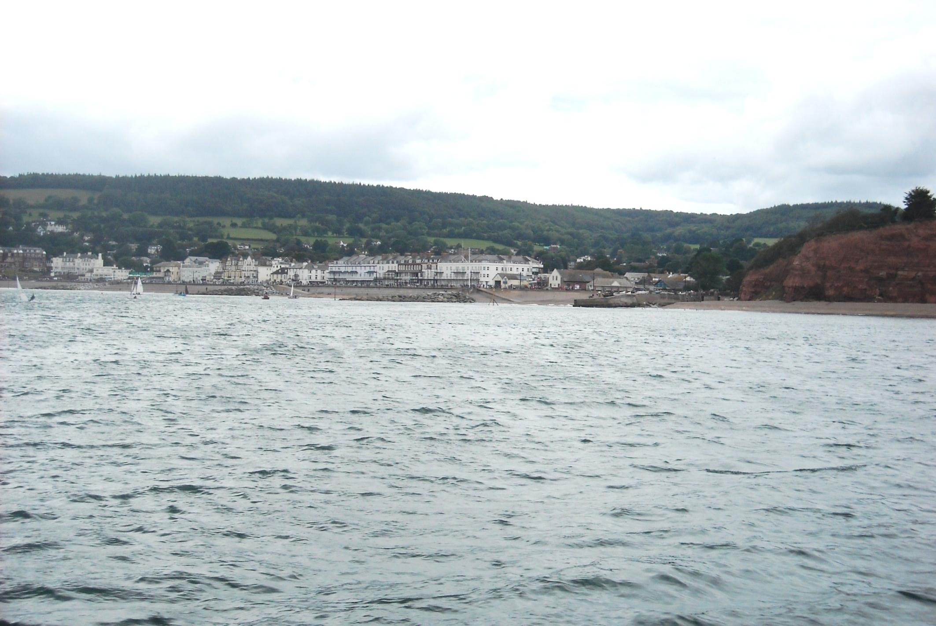
And this is Sidmouth, by the Sid mouth, from aboard the Pride of Exmouth. No port can be built here. The sea is just too difficult.

Slide 21
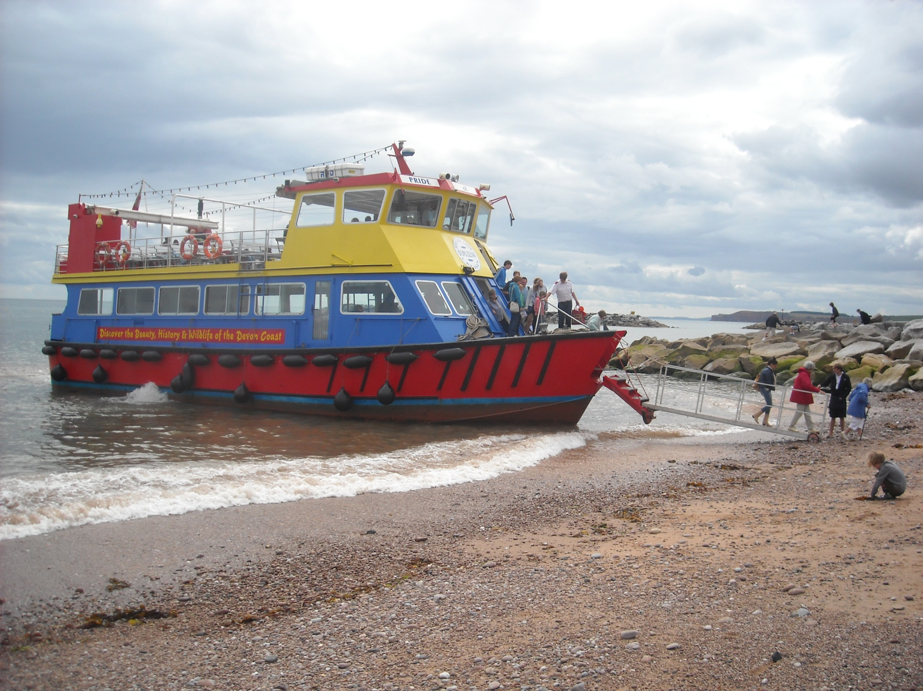
So, hereabouts, the Pride of Exmouth powers up the beach to land.

Slide 22
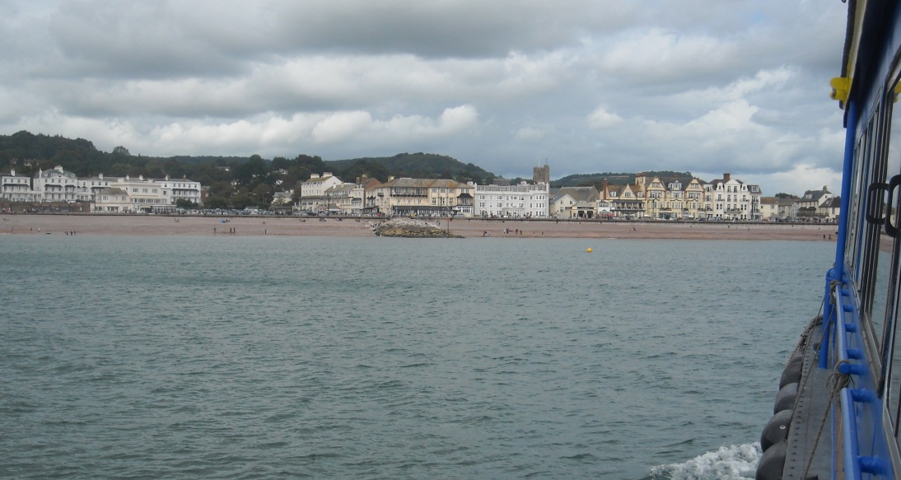
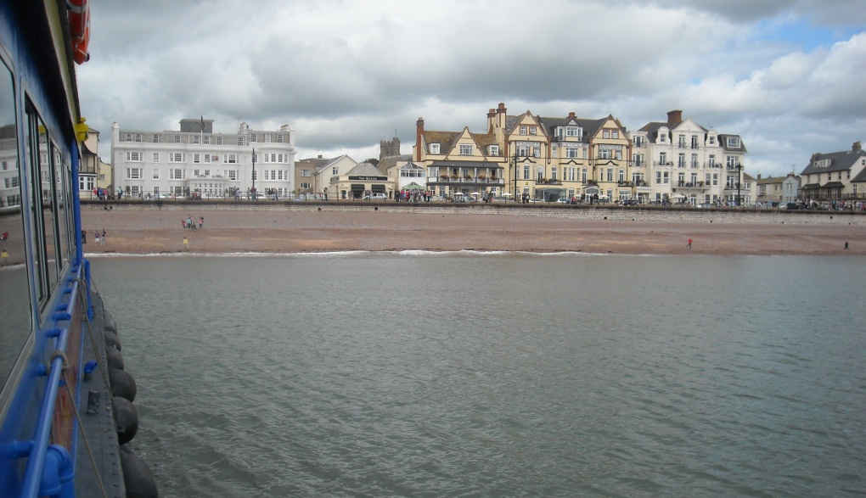
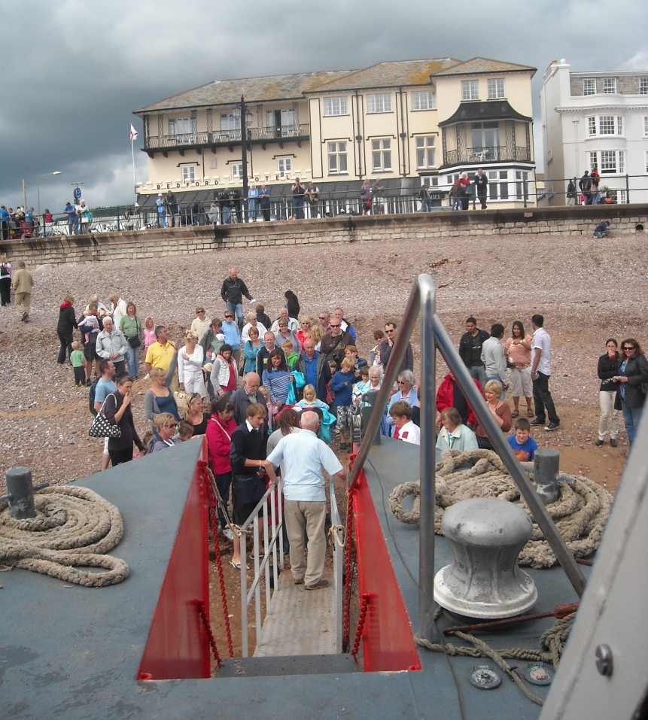
And landing on the beach by ramming it is a pretty spectacular thing to do!

Slide 23
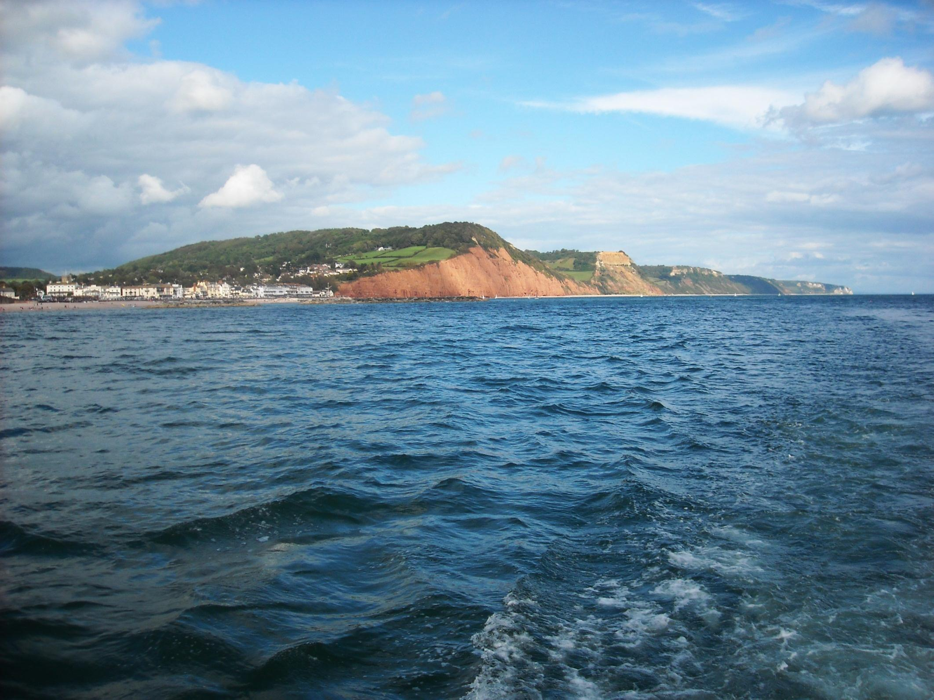
As we leave Sidmouth to continue our journey west.

Slide 24
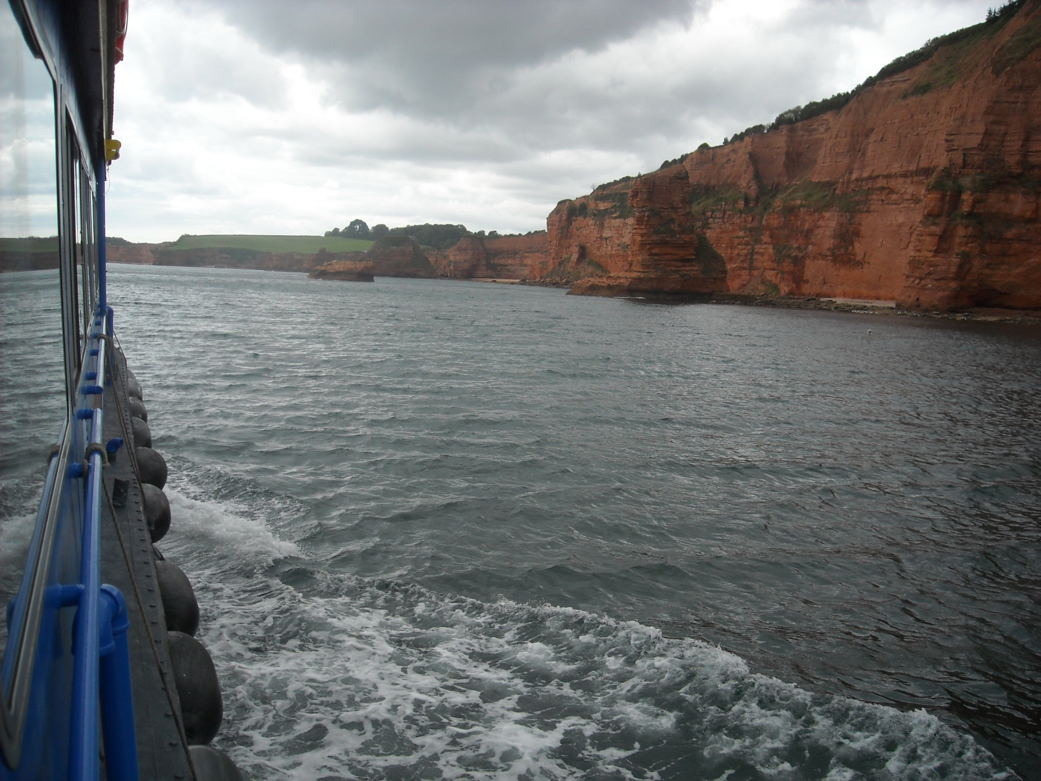
To reach the stacks of Ladram Bay.

Slide 25
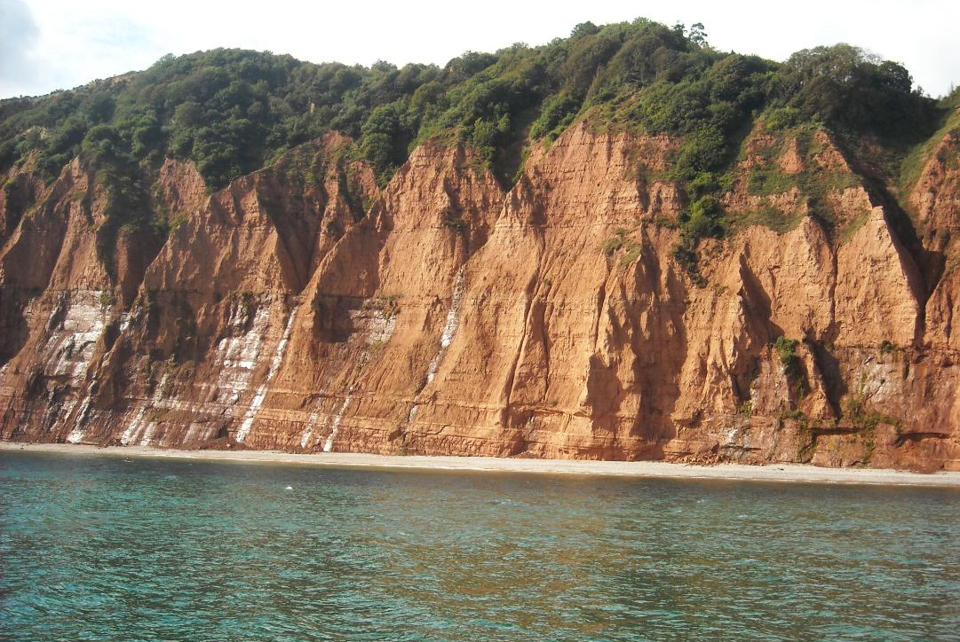
Here Otter Sandstone outcrops beneath the mudstones and this helps stabilise things a little.

Slide 26
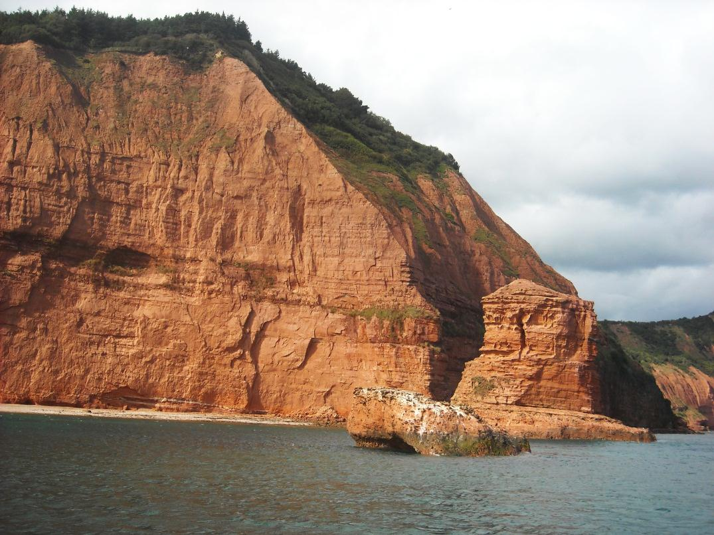
But erosion still continues. Not so long ago this stack was an arch.

Slide 27
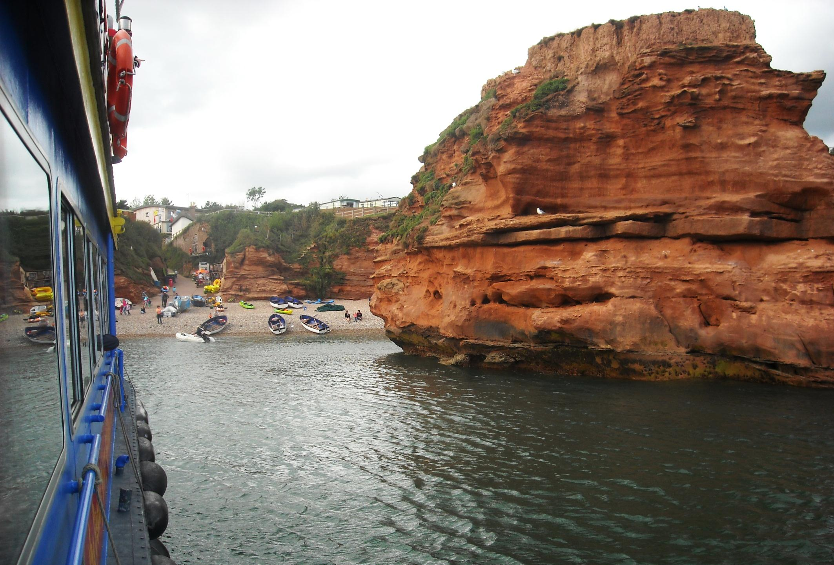
We get very close to this sea stack in Ladram Bay village.

Slide 28
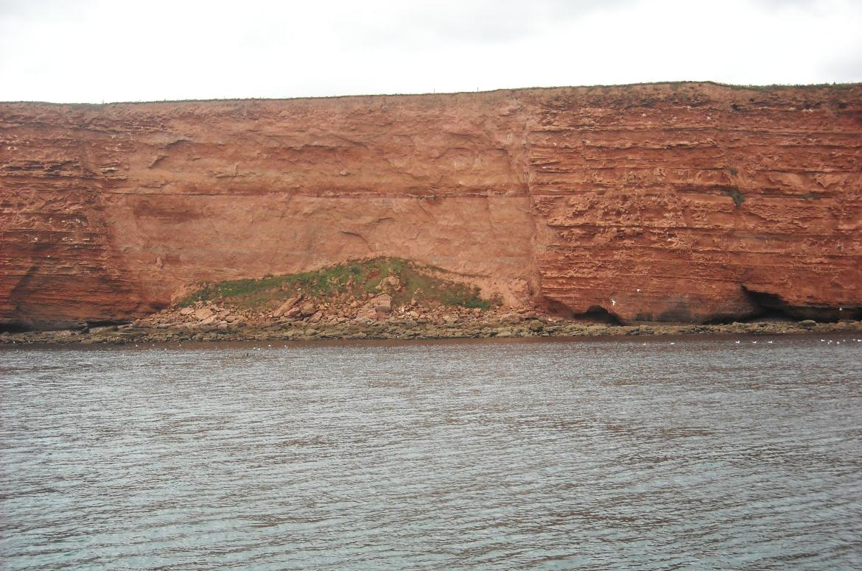
As onwards we go past this landslip at Brandy Head, Budleigh Salterton.

Slide 29
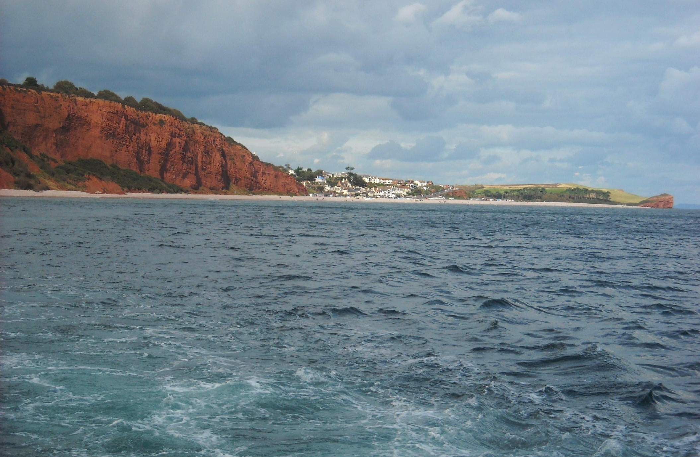
Budleigh Salterton, by the Otter mouth, is protected by a spit of round pebbles eroded from this adjacent cliff.

Slide 30
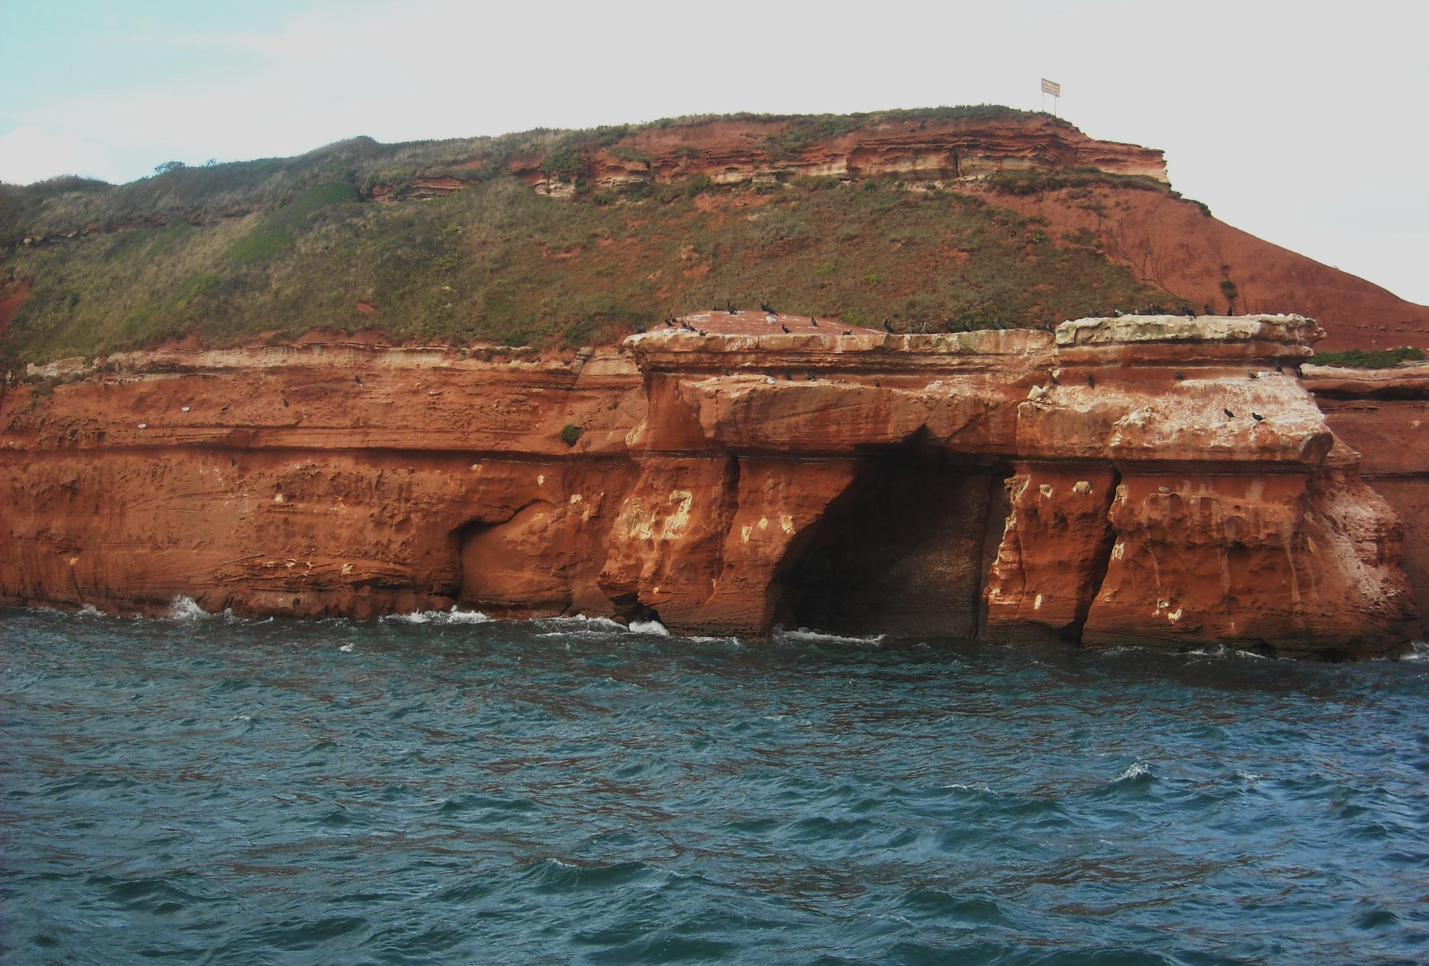
And Straight Point. It looks deceptively isolated but is actually the firing range for the Lympstone Royal Marines!

Slide 31
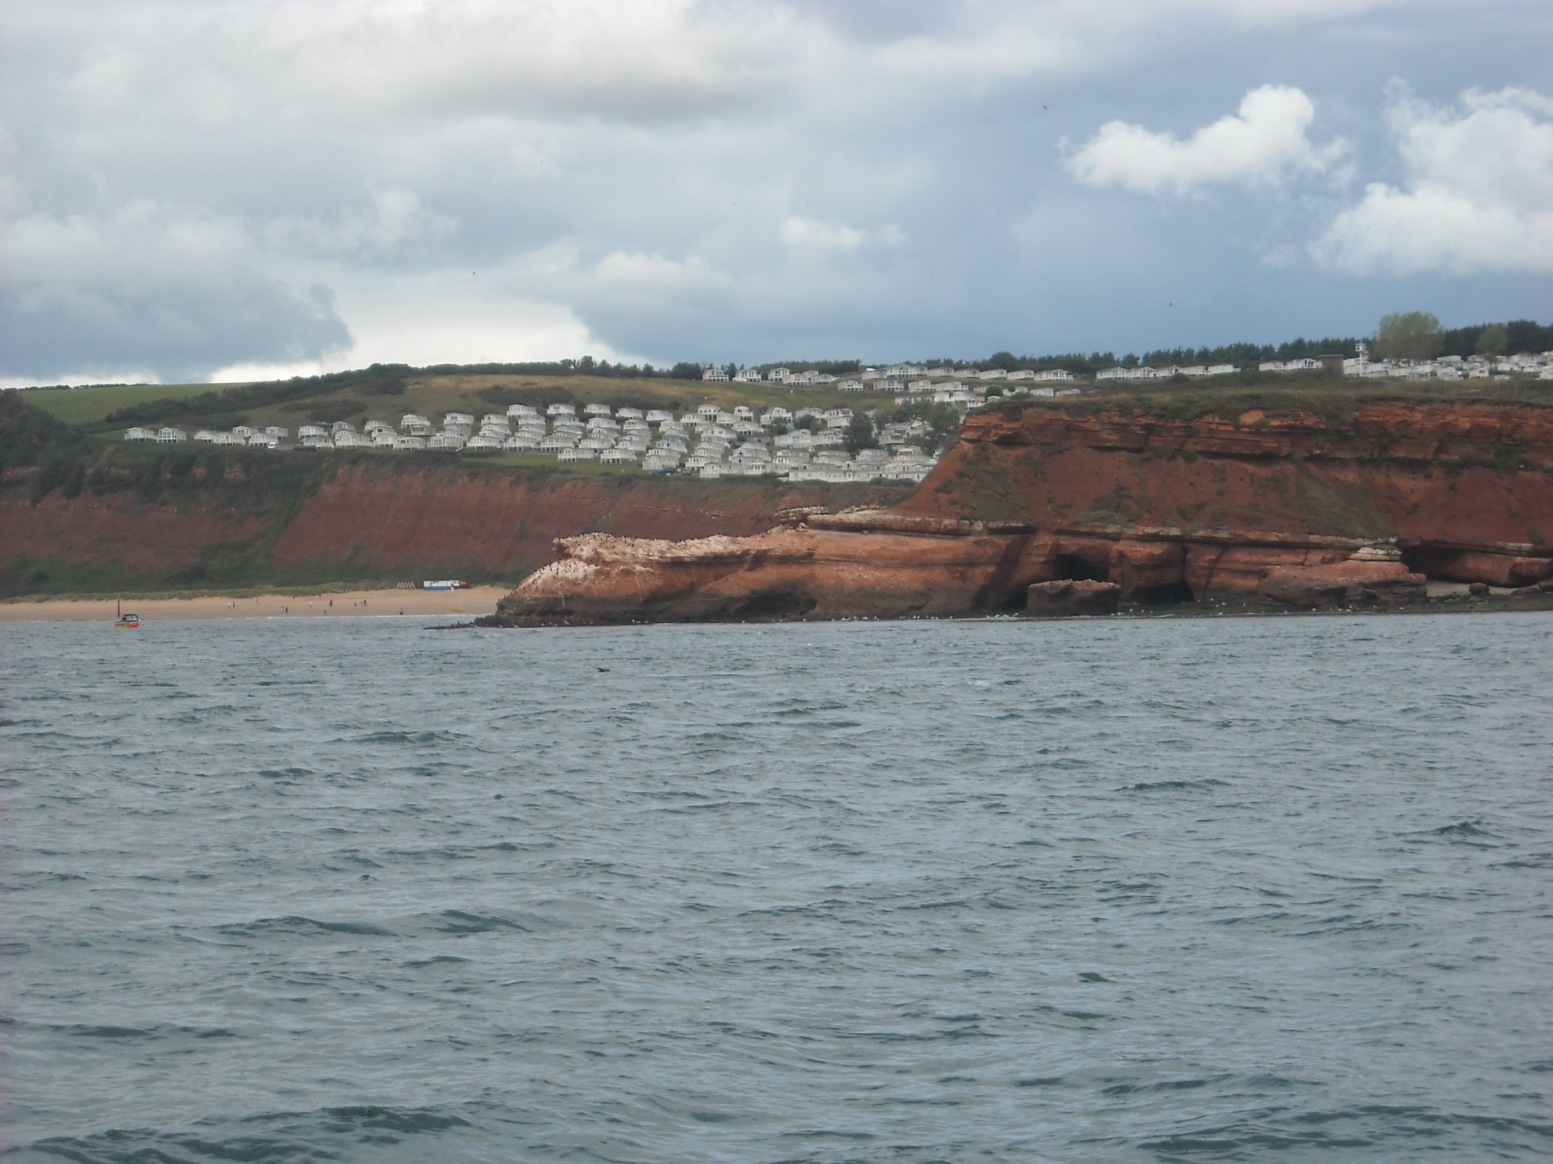
And behind the firing range is Sandy Bay, a massive caravan site.

Slide 32
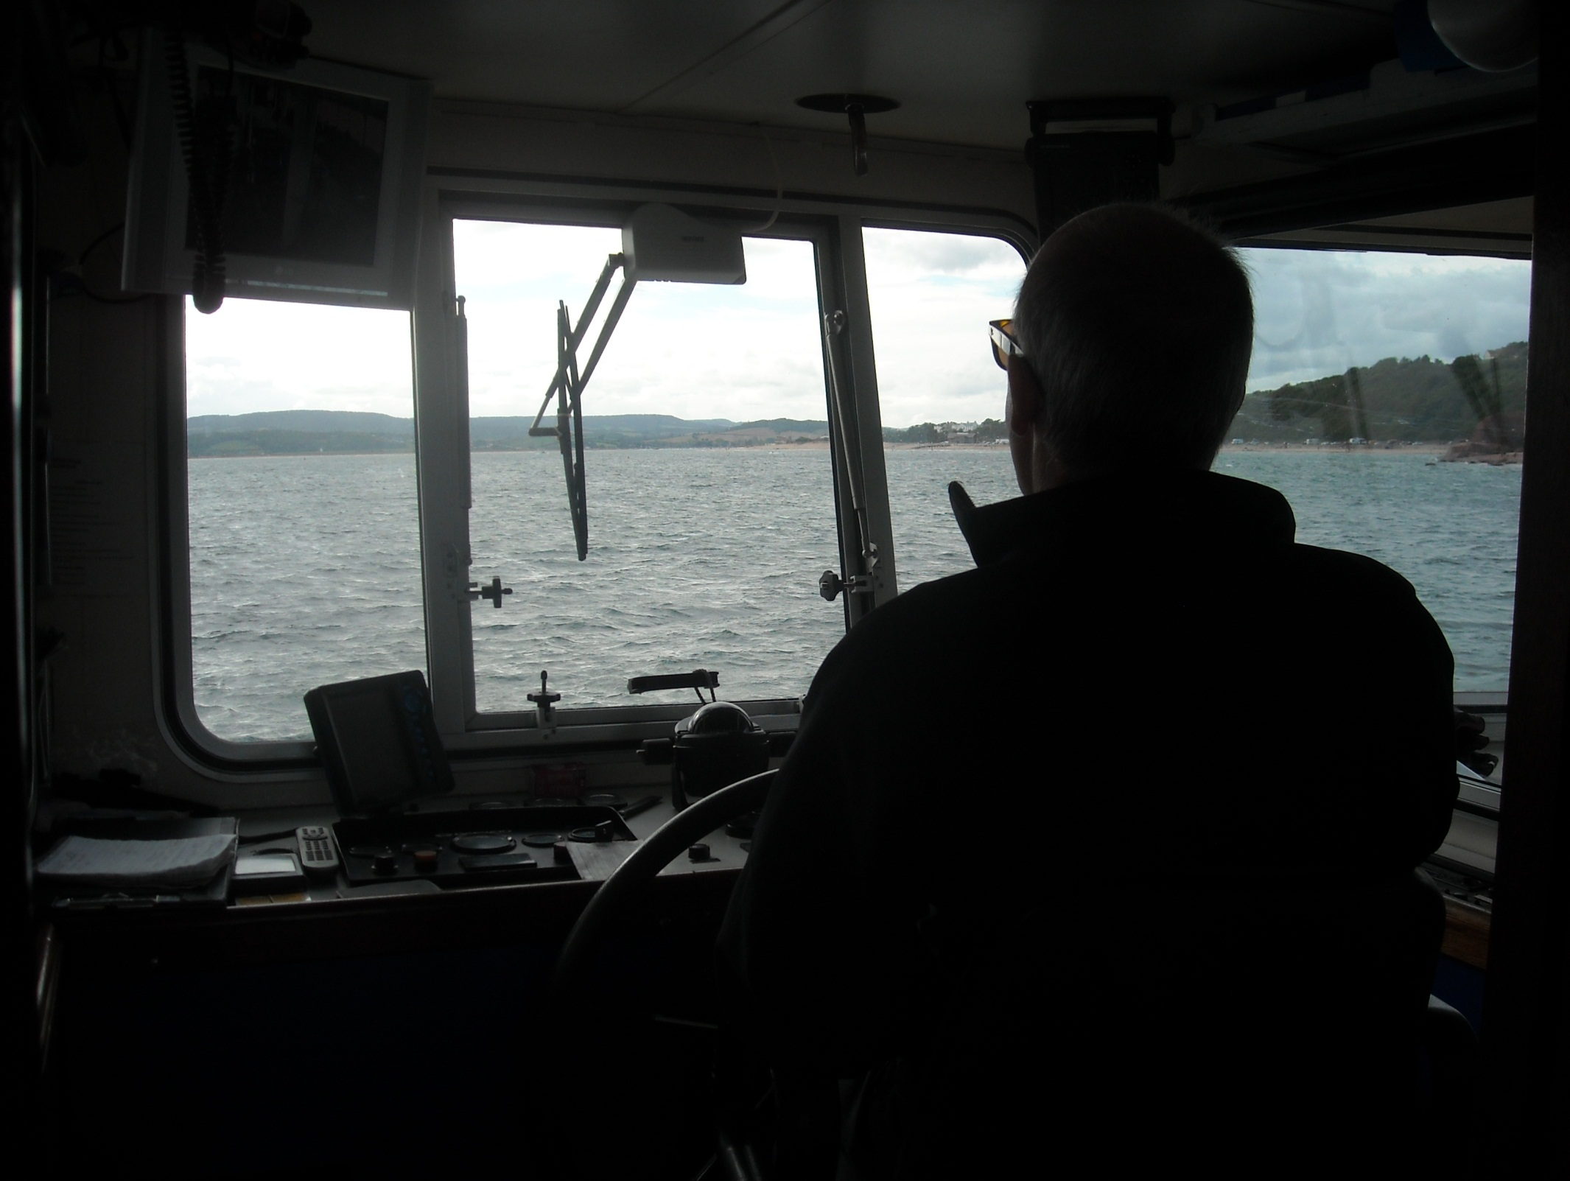
As Ian, our skipper, steers us towards the River Exe.

Slide 33
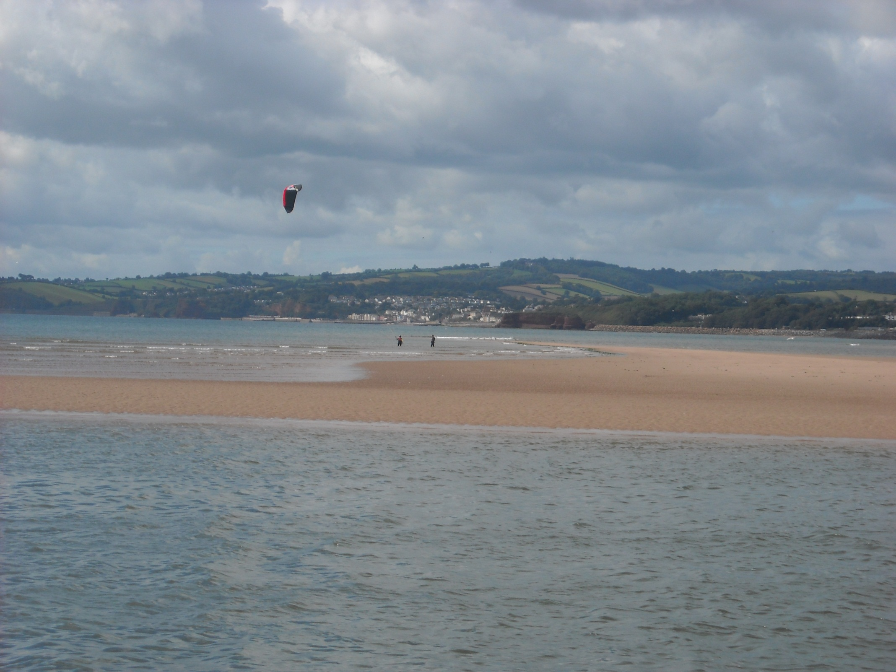
The Exe is protected by this sand spit across to Dawlish Warren.

Slide 34
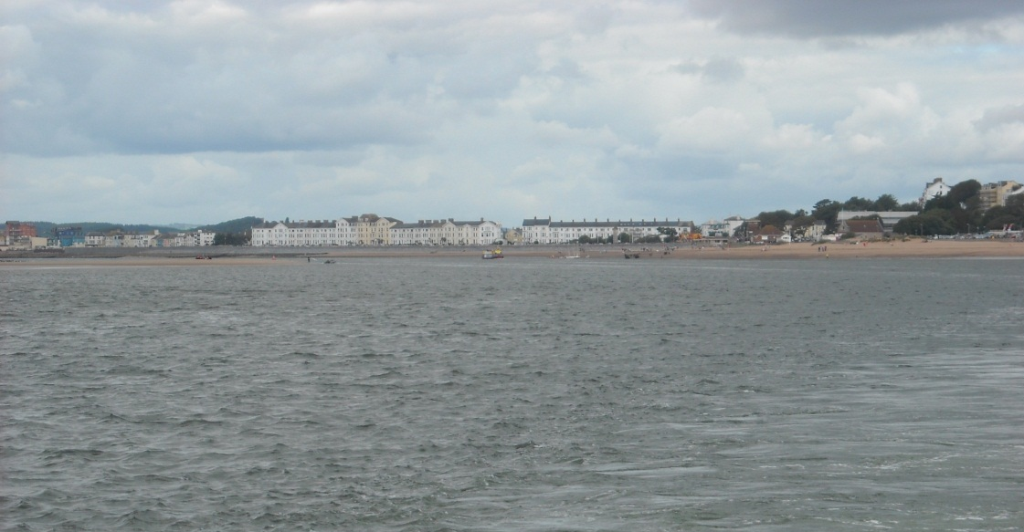
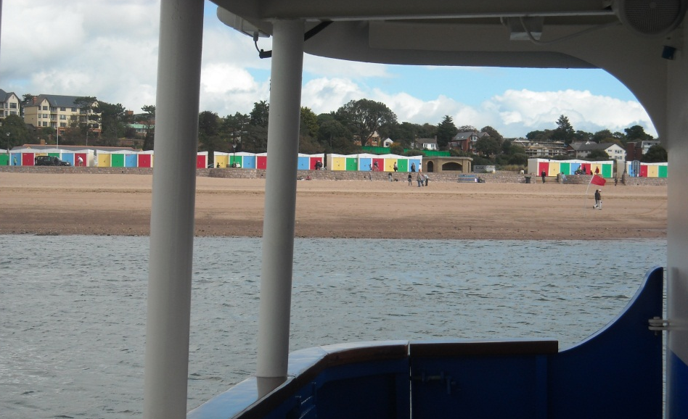
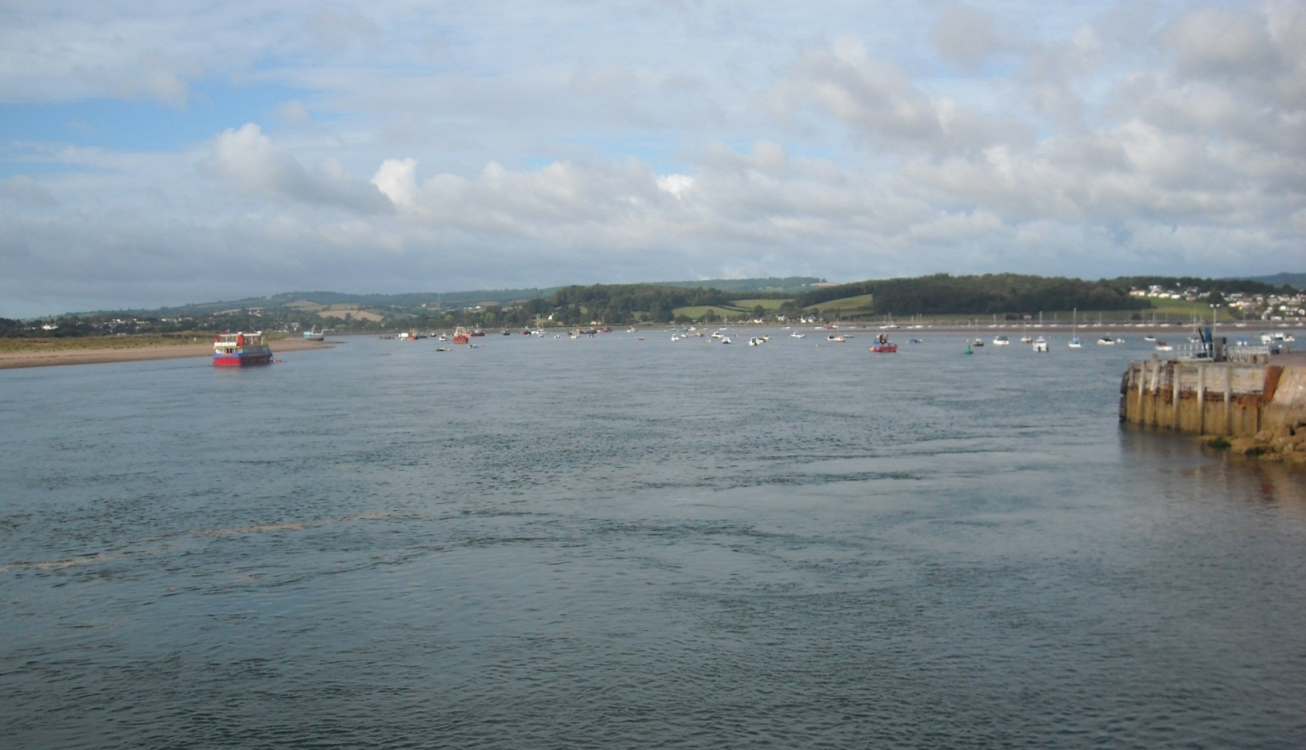
As we head up the Exe to Exmouth.

Slide 35
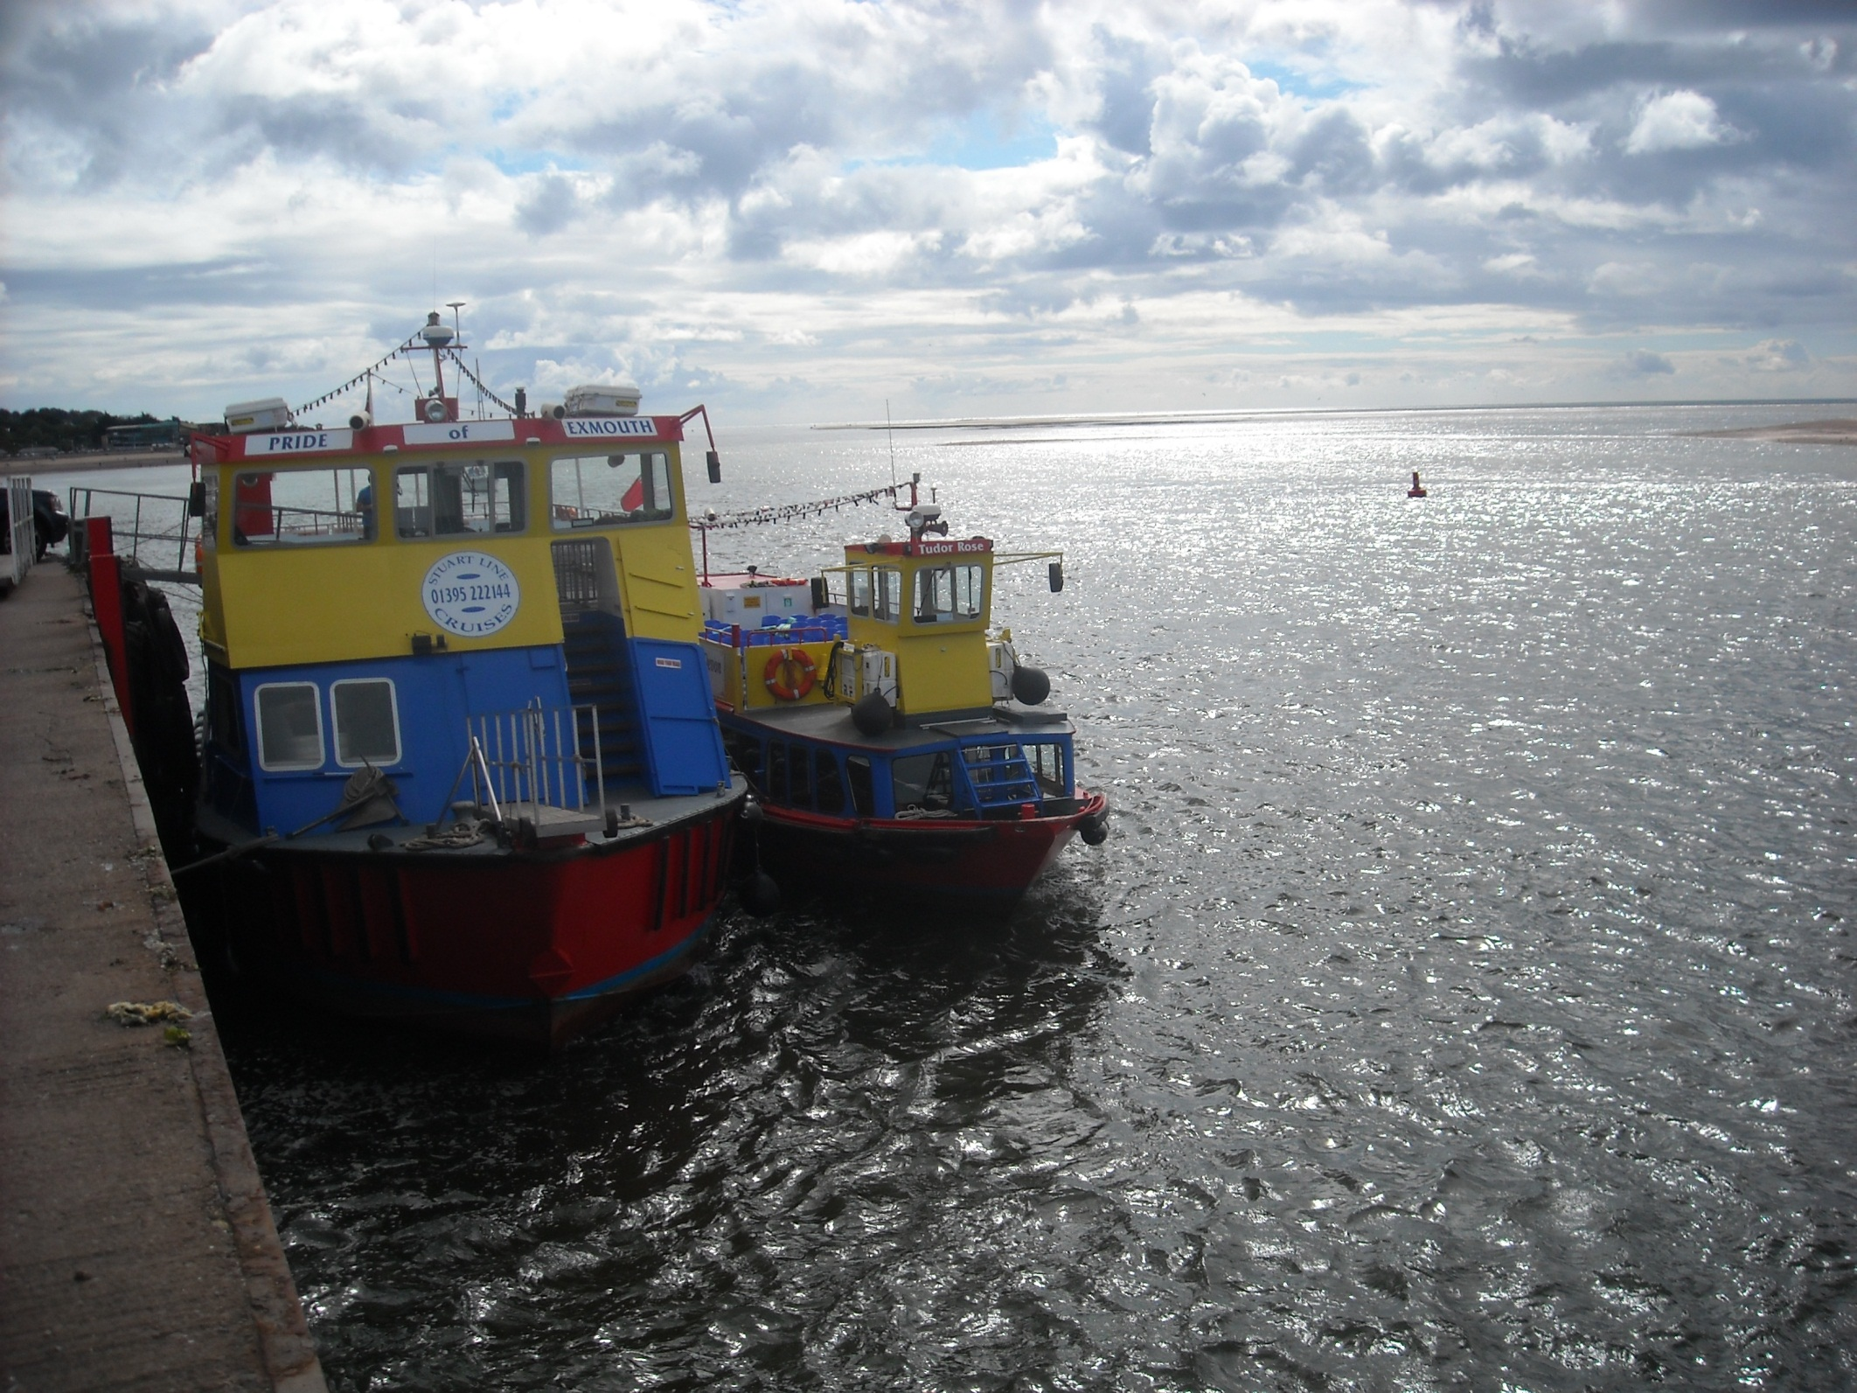
To moor at the Stuart Line mooring at Exmouth Quay.

Slide 36
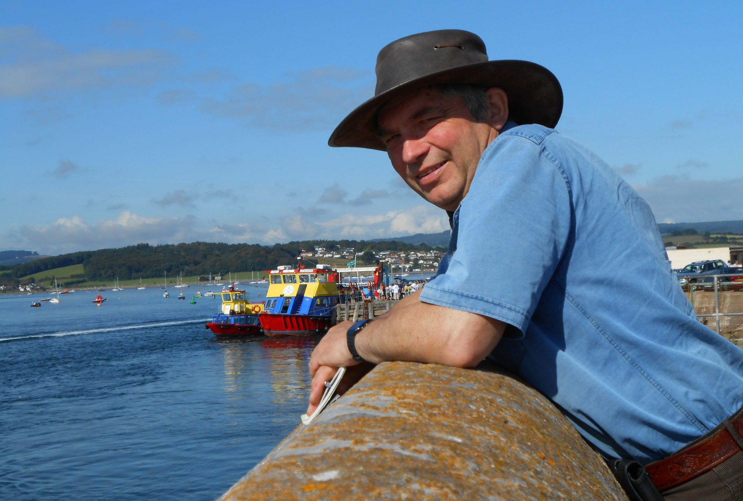
We continue our journey on 9th August 2012.

Slide 37
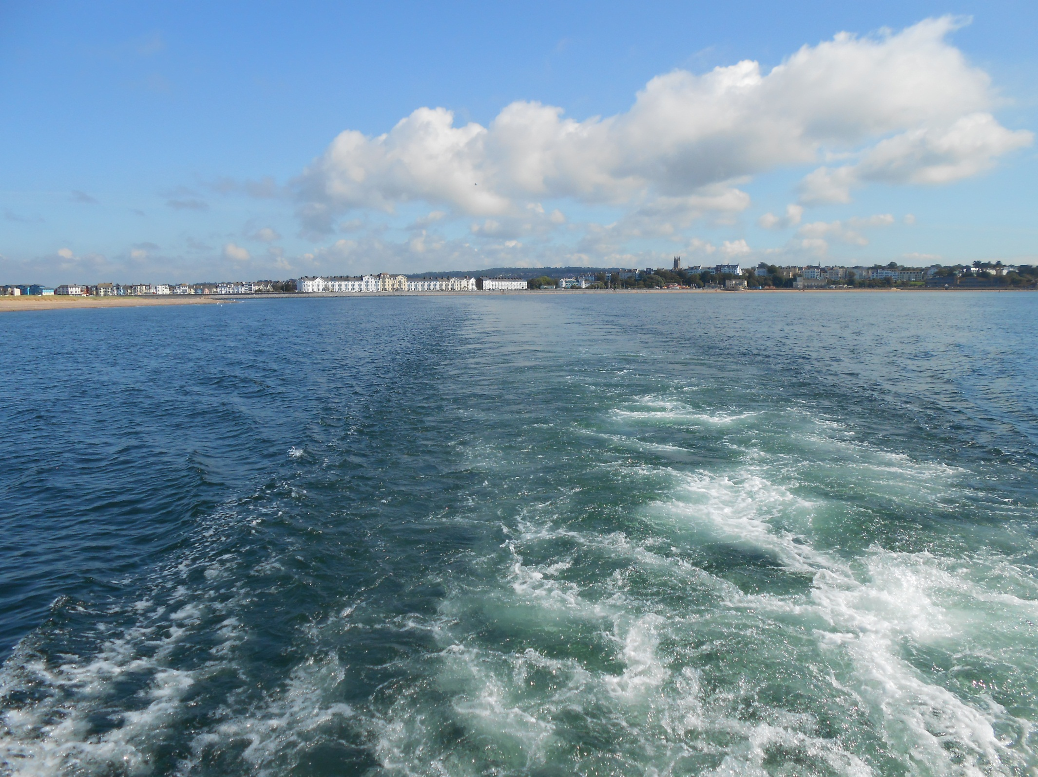
A high tide allowing us close in to the Exe mouth sand spit.

Slide 38
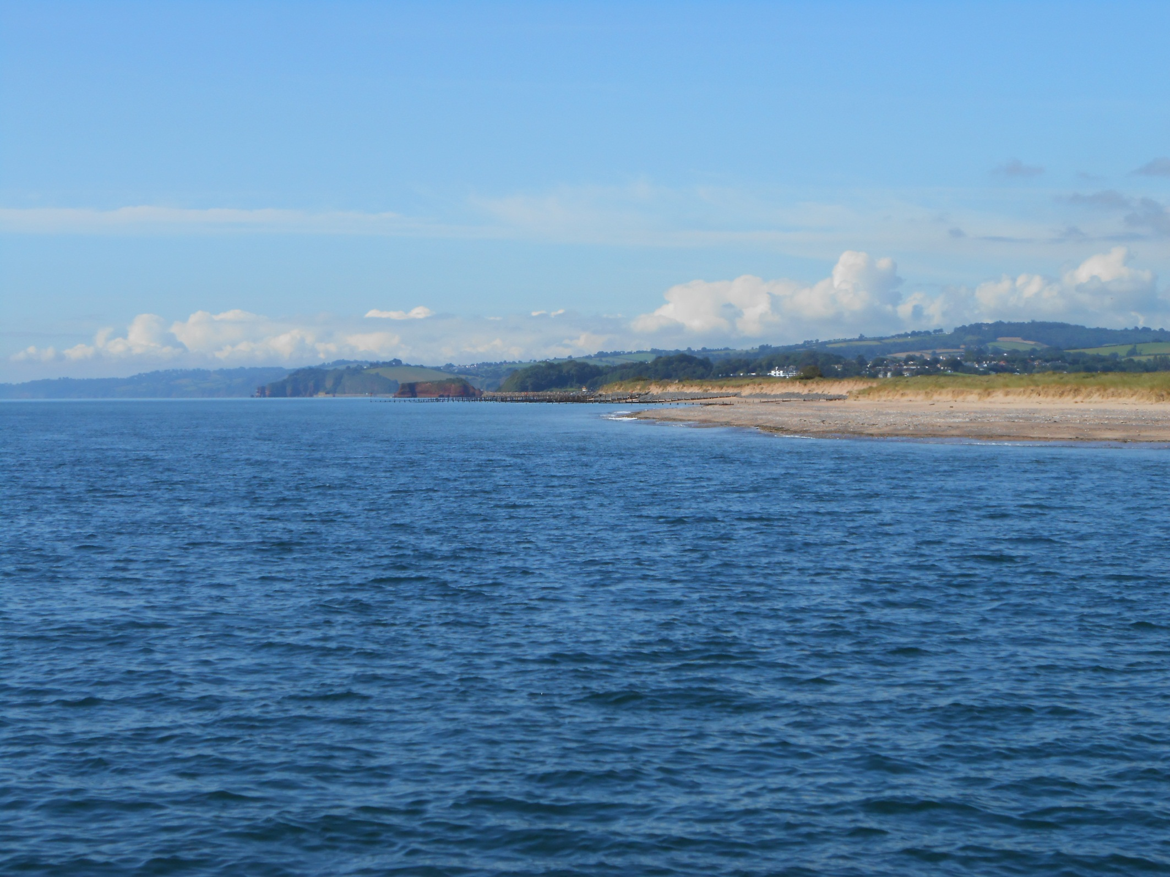
As we cruise beside the dunes of Dawlish Warren.

Slide 39

At Langstone red rock returns with Permian rocks of desert origin.

Slide 40

Brunel’s coastal railway is now also beside us.

Slide 41

With Dawlish Station right on the beach.

Slide 42

The Great Western Railway then dives into a tunnel to pass the Parson and Clerk headland.

Slide 43

This is the Parson with the Dawlish trip boat My Queen alongside.

Slide 44

Sadly the Clerk lost his head on a stormy night in January 2003.

Slide 45

This trip runs Thursdays, summer months only but the first four trips this year have been cancelled by rough weather.

Slide 46

Seaside Teignmouth next, looking attractive from out at sea.

Slide 47

Tiny Teignmouth port, up the River Teign, is behind the headland. Access to this beach is through a Victorian foot tunnel.

Slide 48

More inaccessible coves and unstable cliffs follow in Babbacombe Bay.

Slide 49

This is Maidencombe, again foot access only.

Slide 50

But Oddicombe can also be reached by funicular railway.
The rock fall on the right took place in February 2010.

Slide 51



Landmark rocks mark the entrance to
Tor Bay.
Flat Rock and Ore Stone, then greener
Thatcher Rock.
It was peaceful on the stern deck.

Slide 52

But on top deck it was very different. The Pride of Exmouth is full up today with 208 passengers on board.

Slide 53

Most got off here, at Torquay, climbing the concrete steps on the inner side of the right hand harbour wall.

Slide 54


Remaining passengers continue across Tor Bay.
This is Paignton.

Slide 55

We reach Brixham, where several modern trawlers are moored by the fish quay.

Slide 56

At Brixham Pride of Exmouth unloads by the steps of the harbour wall, as our excellent Stuart Line trips come to a close.

Slide 57

Brixham is an interesting mix of fishing industry and holiday resort.

Slide 58

And it is great to see a family crabbing opposite a trawler refit.

Slide 59



Also creditable is the restored heritage fleet which includes wooden trawlers Pilgrim of 1895 and Vigilance of 1926.
Over 300 sailing trawlers once sailed from here.

Slide 60

We move on from Brixham just three days later.

Slide 61

In another wooden boat, the 2nd World War motor rescue launch Fairmile, built Southampton in 1941.

Slide 62


Fairmile is owned by local company Greenway Ferry.
Built for speed,
Fairmile is the pride of the fleet.

Slide 63


The hull structure is double diagonal mahogany, designed to flex in rough seas. She once did 22 knots but we doing about 10 knots passing Berry Head with Vigilance at sail in the bay.

Slide 64

After Berry Head the coastline stretches to Scabbacombe and the River Dart. Cod Rocks ahead obviously need care.

Slide 65

As do other obstacles on the approach to Dartmouth.
The Devon coastline necessitates constant vigilance!

Slide 66

The River Dart is a sheltered and very attractive natural harbour.

Slide 67

And Dartmouth Naval College remains an important part of this this historic naval town.

Slide 68



With Dartmouth College in the background Fairmile pulls in to the jetty as we disembark and explore the town.

Slide 69



Attractive Dartmouth is an interesting town.
Fascinating Dartmouth is proud of a famous son,
ironmonger Thomas Newcomen. By 1800 1,000 of his atmospheric engines were powering the Industrial Revolution.

Slide 70


And this is one of his engines, a former colliery pumping engine that finished up on the canals at Hawkesbury Junction.
Dated about 1720, it is the oldest steam engine in the world.

Slide 71

Meanwhile Fairmile returns after a trip up the River Dart.

Slide 72



But few passengers remain aboard as we head to sea again to continue our coastal journey.

Slide 73

At Stoke Flemming we encounter a storm.

Slide 74

But passengers can shelter in the period saloon on the rear deck.

Slide 75

Fairmile, one of some 650 built, was RML 497 in naval days.
She came to Torbay in 1946 and named Western Lady III.

Slide 76



Crew access to the two Gardner engines necessitates a tight vertical squeeze!

Slide 77


The weather improves for Slapton Sands with Start Point in the distance.

Slide 78

And Torcross now, in Start Bay, where we close this Fairmile trip.
Our next leg will be something of a contrast.

Slide 79

And it is this, a rigid inflatable, or rib, and it is 12th July 2013.

Slide 80


One is nearer the sea in a rib as we view Torness again before returning along the coast towards Start Point.

Slide 81

With the wind in our hair we bounce along the waves.
This is Hallsands, population in 1891, 159. Population now, 0!

Slide 82

Hallsands was washed away after dredging of the Skerries Bank for building materials removed its natural sea defences.

Slide 83

Start Point is marked by a fine lighthouse as we pass the lighthouse keeper’s rock hewn steps.

Slide 84

Start Point was choppy so we hung back to let a fishing boat take its preferred line.

Slide 85

As Skipper Ali scans the cliffs ahead for seals.

Slide 86

Here are two. A grey seal to the left and a common seal right.

Slide 87

Prawle Point now with its coastwatch station, in a picture taken one handed at powerboat speed of around 30 knots.

Slide 88

Gammon Head and attractive Black Cove as Salcombe nears.

Slide 89

Salcombe enjoys a perfect setting but does have a tricky sand bar across the harbour entrance.

Slide 90


There’s also a bit of
“what country are we in now” on entering Salcombe, perhaps as near as the UK gets to the Mediterranean feel.

Slide 91

As we end this Sea-N-Shore experience. “I’d like one” I said to Ali, “£60,000 and she’s yours” was the quick reply!

Slide 92

We return to Salcombe the following day.

Slide 93

In the company of experienced fishermen Ian and David Wright.

Slide 94



Plus Ros and Phil, cousin Kate and her husband Ian.
And skipper Chris is at the helm of charter boat Atlantis.

Slide 95


Leaving sheltered Salcombe we pass well named Sharp Tor then curve around Bolt Head.

Slide 96

After Bolt Head the Ham Stone is ahead.

Slide 97

All is well aboard Atlantis as we savour the views.

Slide 98

Between Bolt Head and Bolt Tail cormorants take to the air.

Slide 99

And in Bigbury Bay the Atlantic becomes surreally calm.

Slide 100

Burgh Island passes, causeway connected with an exclusive hotel.

Slide 101

The coastline becomes softer approaching Plymouth.
This is the Great Mew Stone guarding Plymouth Sound.

Slide 102

And here, in Plymouth Sound with Cawsand ahead, we curve out to sea for some fishing.

Slide 103

Ros and Phil concentrate as Kate gets the first mackerel.

Slide 104

Then Ian has a bite.

Slide 105

…………And lands a Pollock.

Slide 106

Then the other Ian gets an even bigger one!

Slide 107

It was a great day aboard the Atlantis and a great fishing team!

Slide 108

And this is the Great Mew Stone and Plymouth Sound from a different angle and a different boat just four weeks later.

Slide 109


We are aboard Minalto, just four months old and Jacquie and Mart have kindly invited me to join them on a trip from Plymouth to Fowey.

Slide 110



The Cawsand ferry passes as we head out of Plymouth towards Penlee Point and Rame Head.

Slide 111

With a slight swell as we speed, initially anyway, towards the legendary Eddystone lighthouse, some 9 miles off shore.

Slide 112

A tack then returns us almost back to Rame Head.
One can travel a long way for a short distance out sailing!

Slide 113

And to and fro we go until, by mid afternoon, we reach Looe.

Slide 114



It then clouded over for our next tacks which bring us close to Polperro.

Slide 115

We then line up for Fowey.

Slide 116

It was a perfect arrival. Fowey, with Polruan on the far shore, is yet another incredible harbour.

Slide 117

With the picturesque everywhere, as a steam launch chuffs on by.

Slide 118

This is the Earl of Pembroke, a member of the Square Sail
Film & TV fleet, based at nearby Charleston Harbour.

Slide 119

And here we bid our grateful farewell to Jacquie, Matt and Minalto.

Slide 120
End of Chapter 13

