Slide 1
Exploring Britain
Boating South Part 2
Chapter 12
Hampshire and Dorset to Lyme Regis
30th May to 2nd October 2011

Slide 2
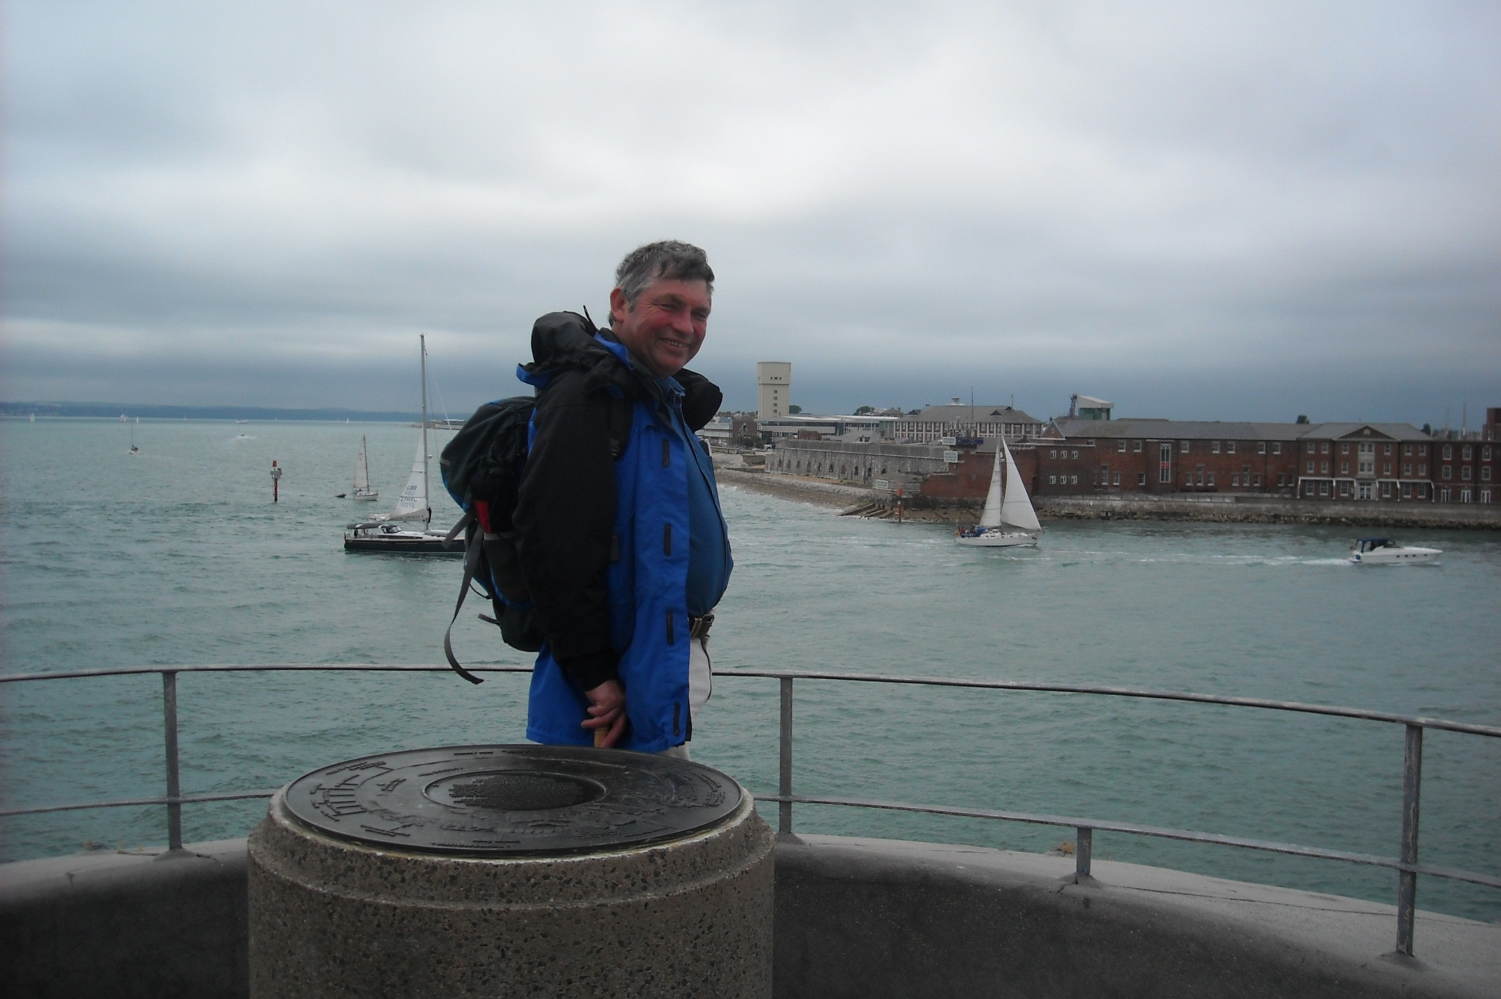
We are back in Portsmouth with a picture taken by a crew member of a visiting American aircraft carrier.

Slide 3
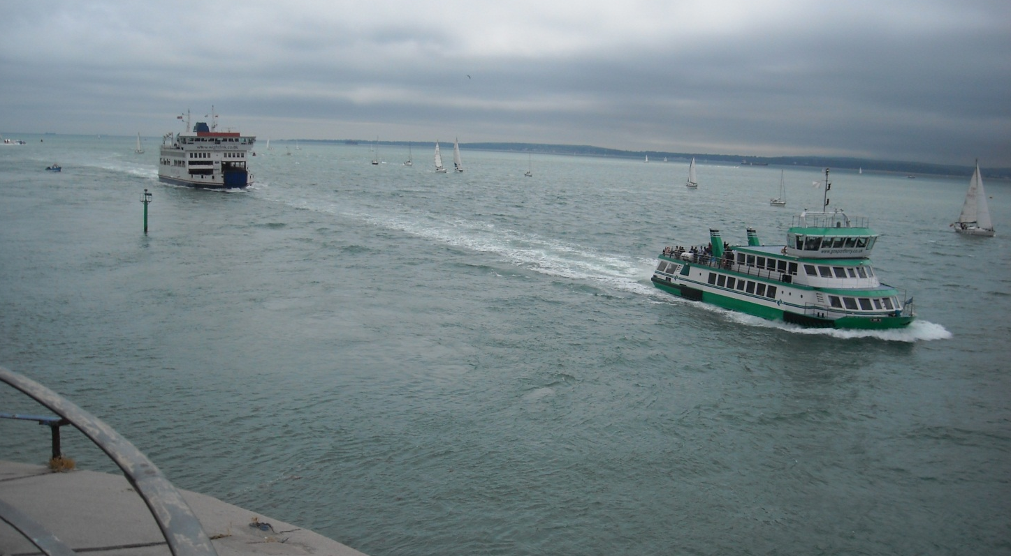
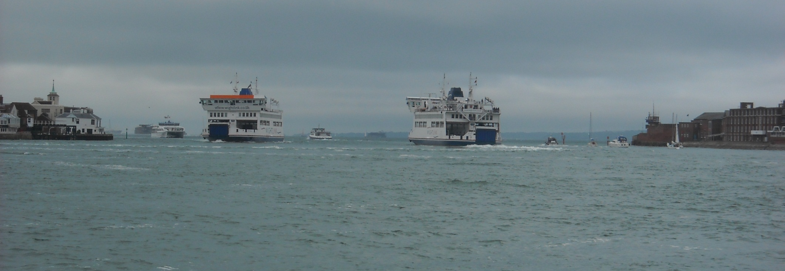
Portsmouth Harbour was extra busy today with craft helping service this warship.

Slide 4
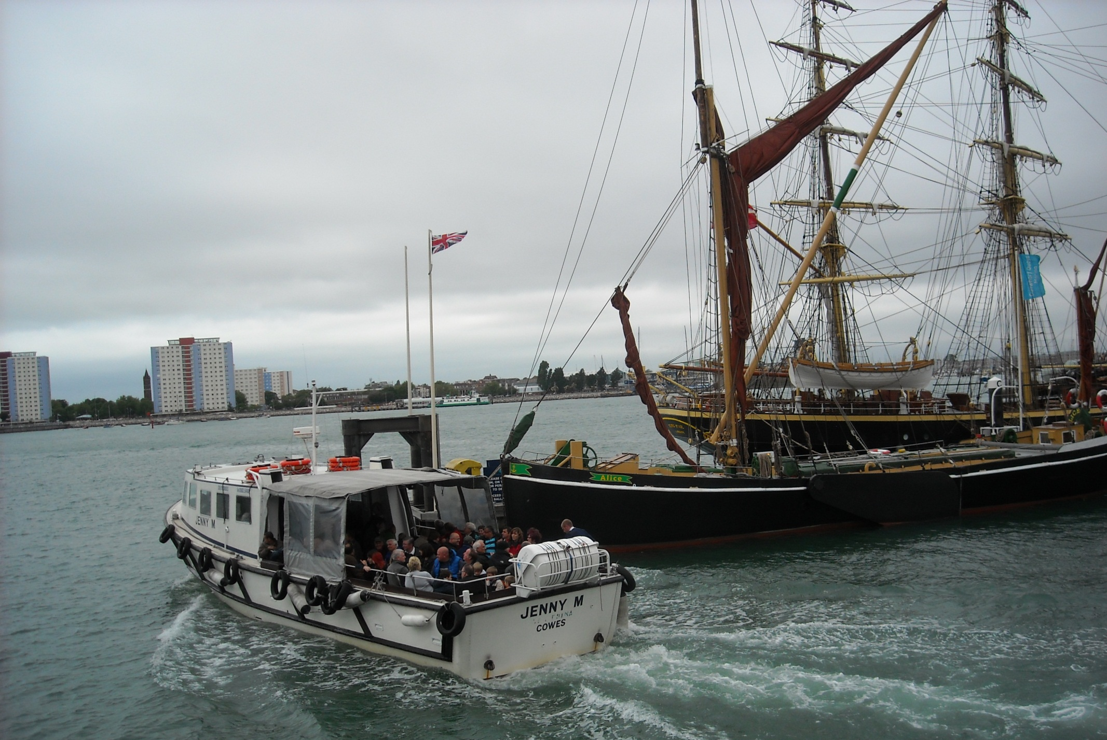
As Jenny M passes sailing barge Alice and Danish tall ship Georg Stage on a trip to view the carrier.

Slide 5
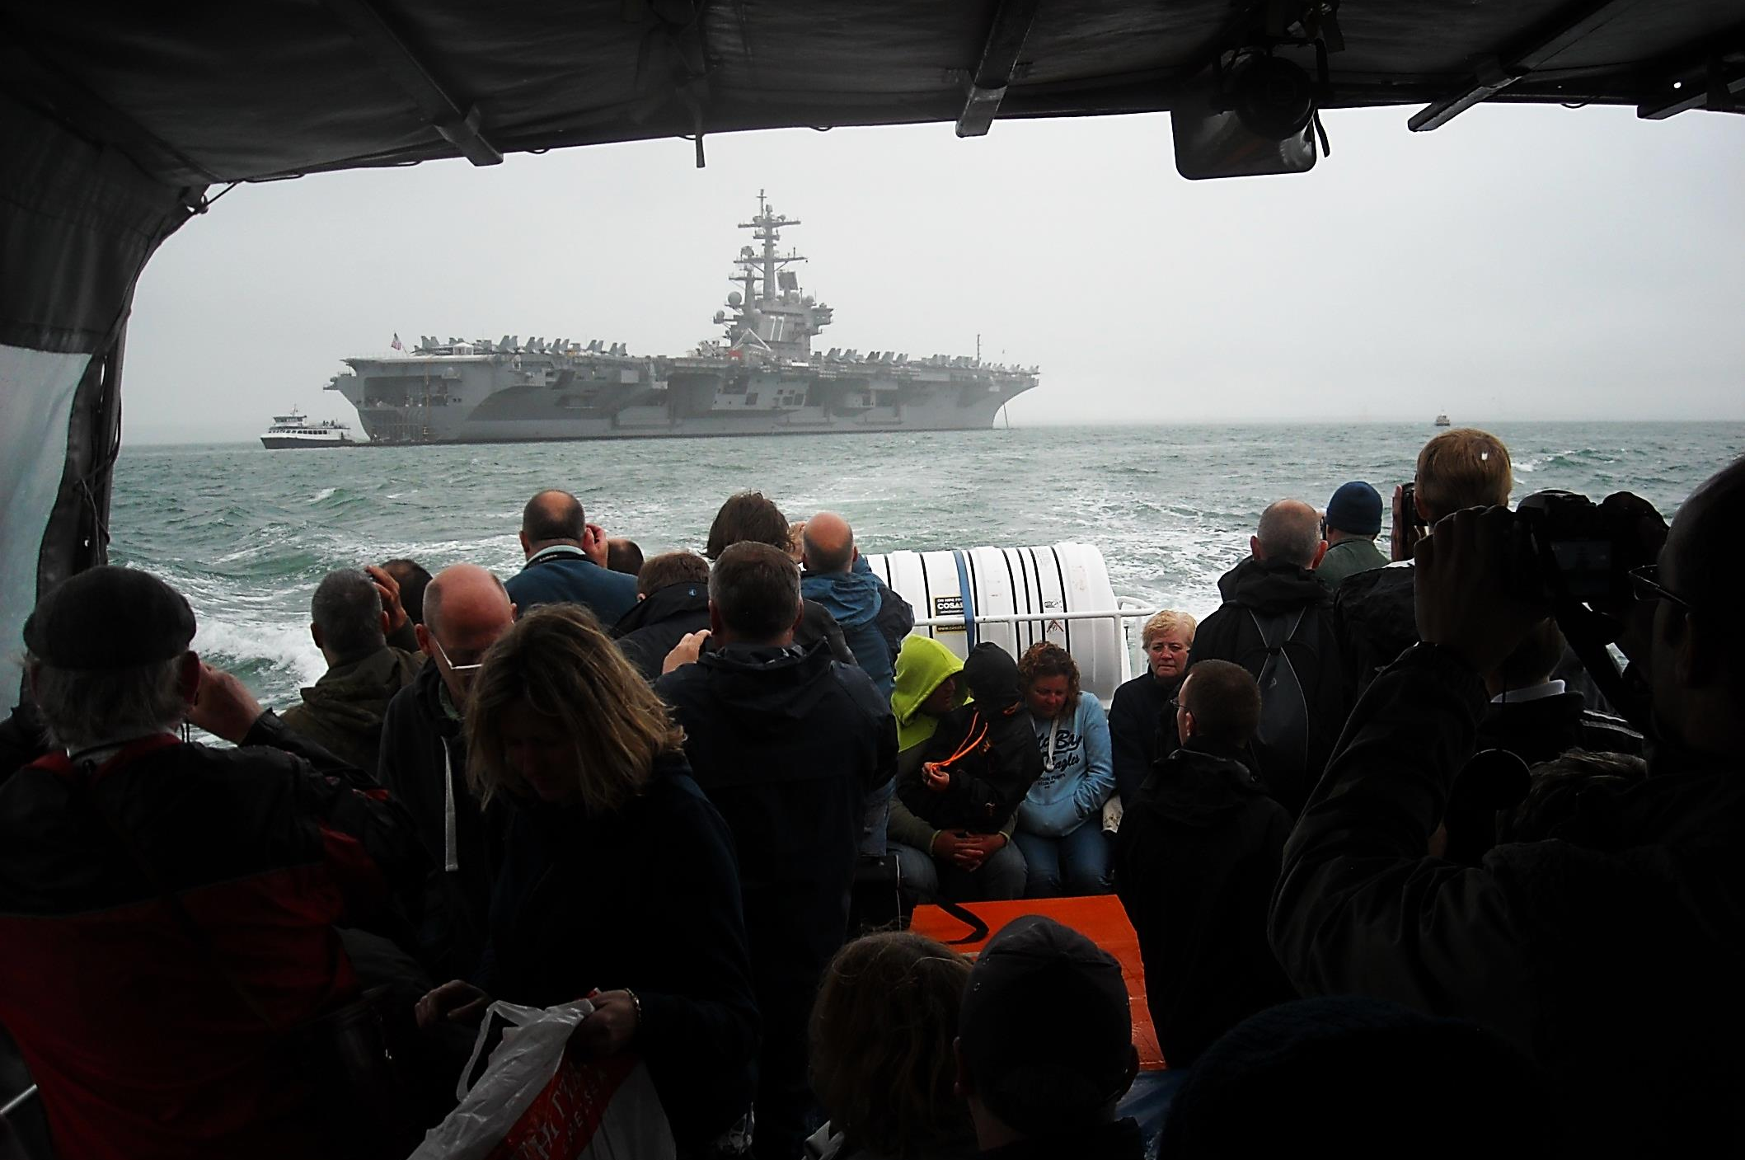
It is George Bush on its maiden voyage, one of the largest ships in the world with 5,500 crew. Maps, I was told, are everywhere.

Slide 6
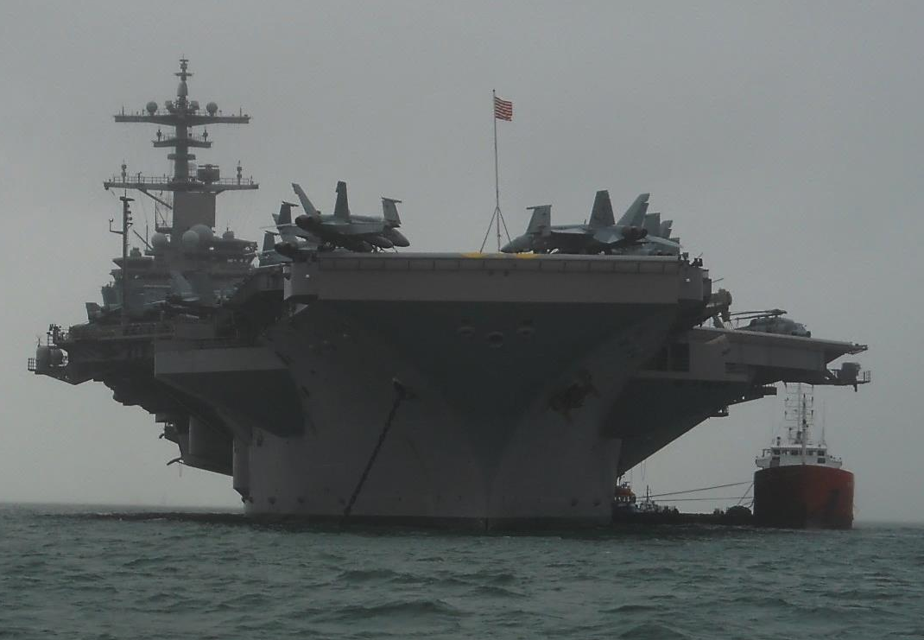
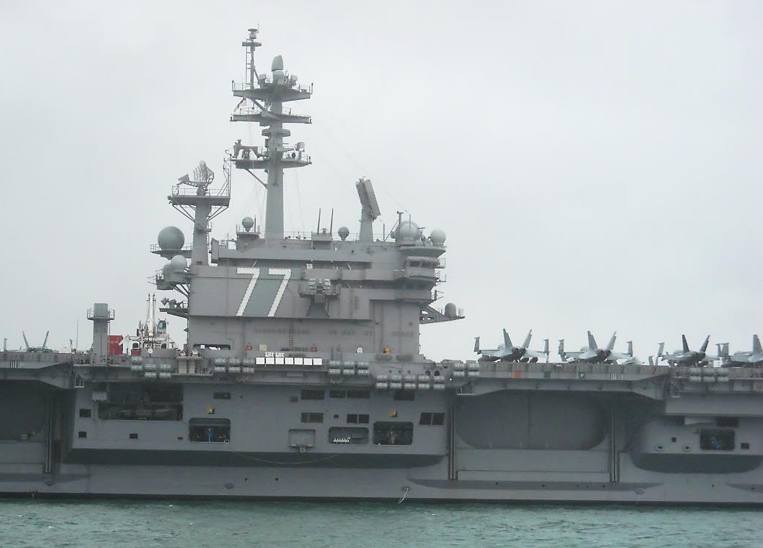
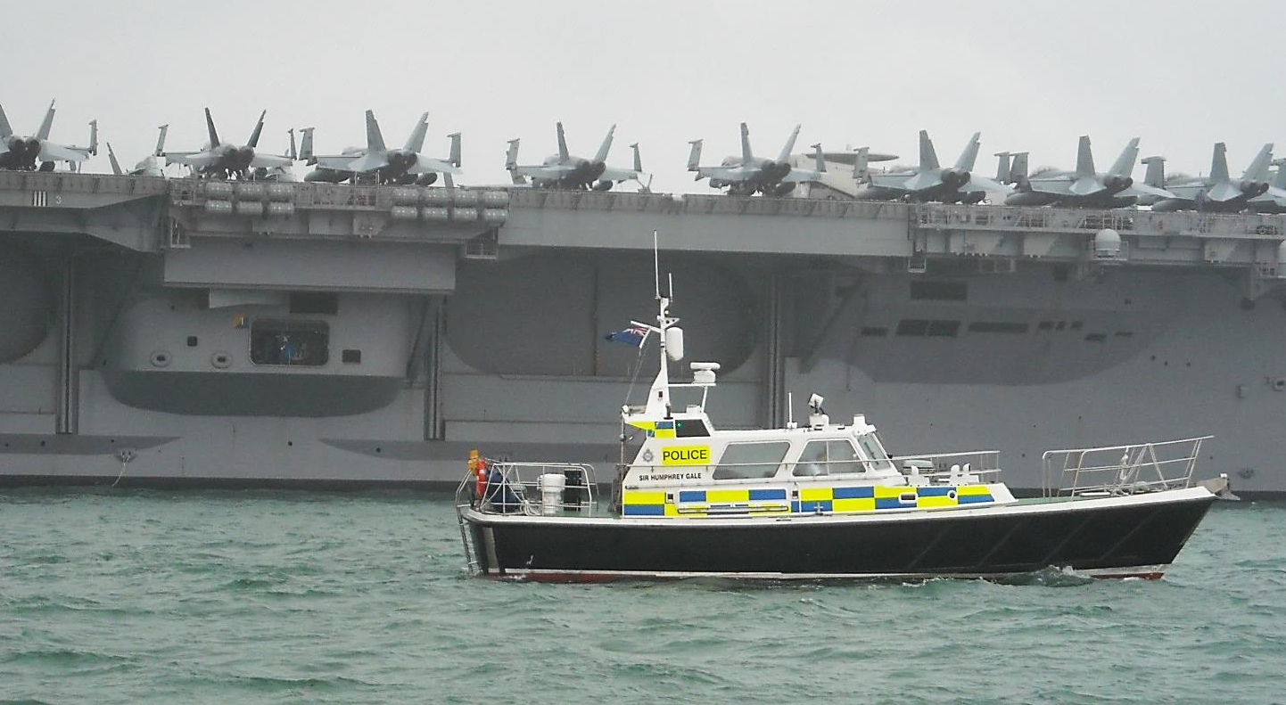
”I can get to where I eat and to where
I sleep and to the flight deck and for everywhere else
I need a map” was a comment of my photographer earlier today.

Slide 7
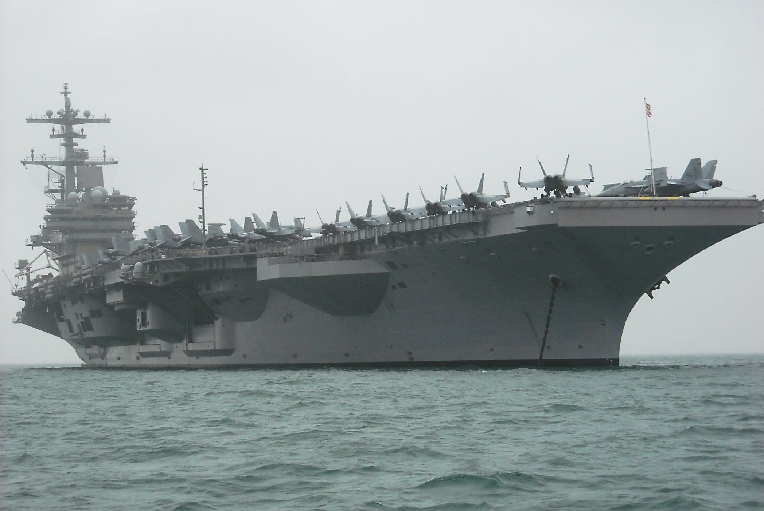
Powered by 2 nuclear reactors there are over 90 aircraft on board and the ship can apparently stay out at sea for 20 years!

Slide 8
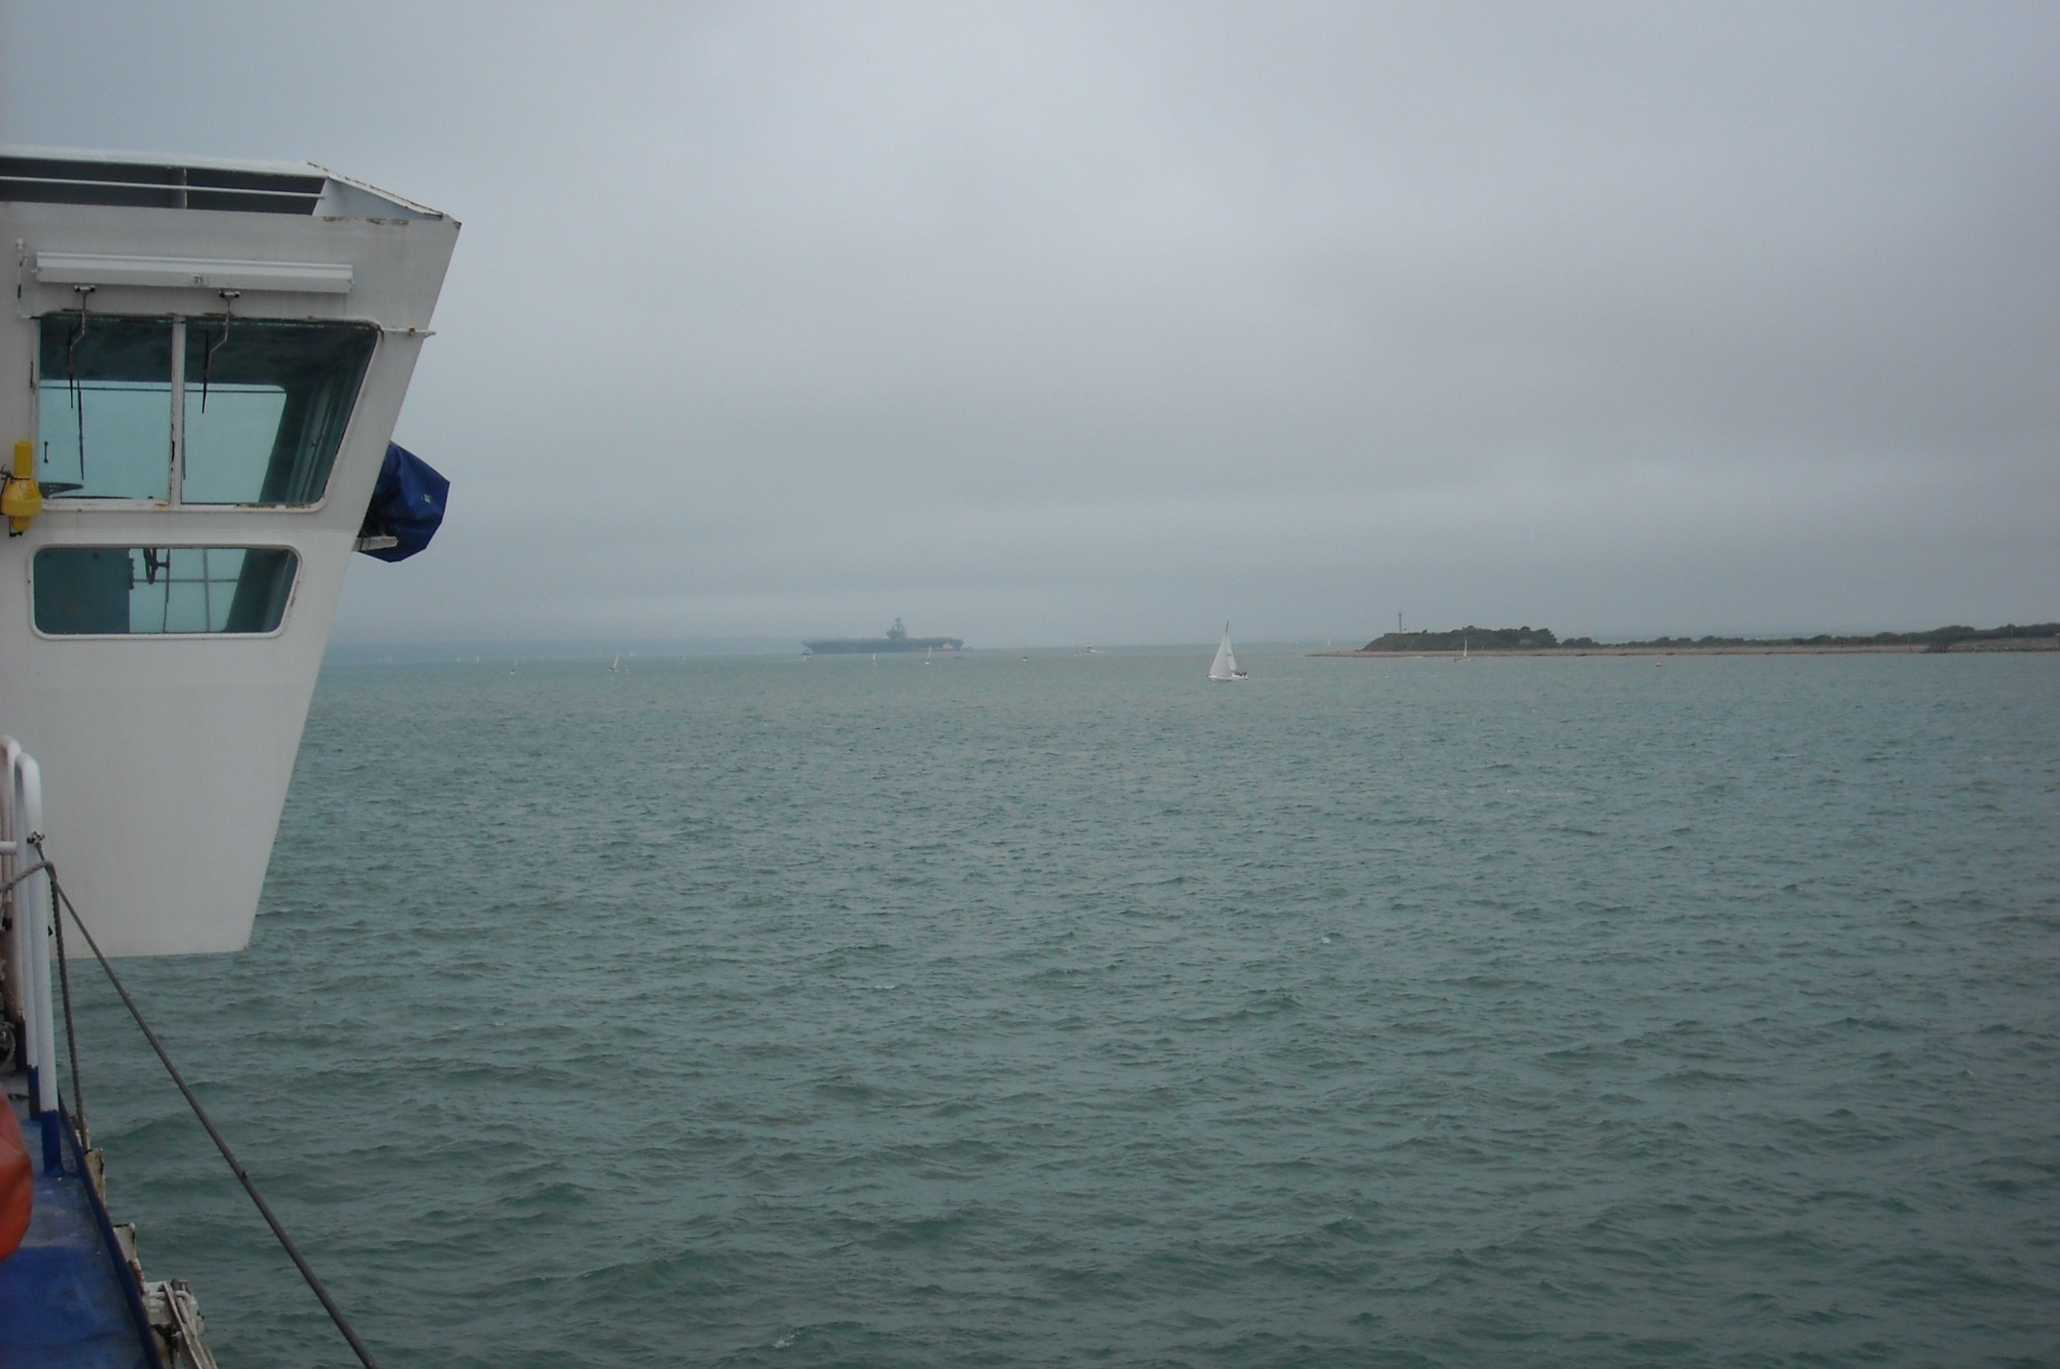
The carrier is anchored off Fort Gilkicker and can be seen from the Isle of Wight ferry to Fishbourne on which we now travel.

Slide 9
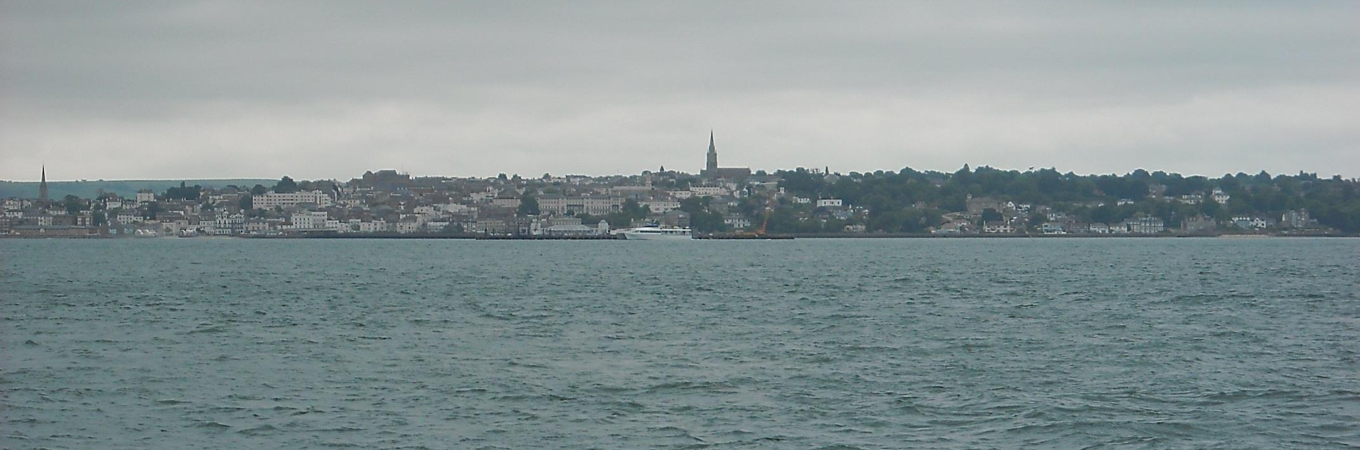
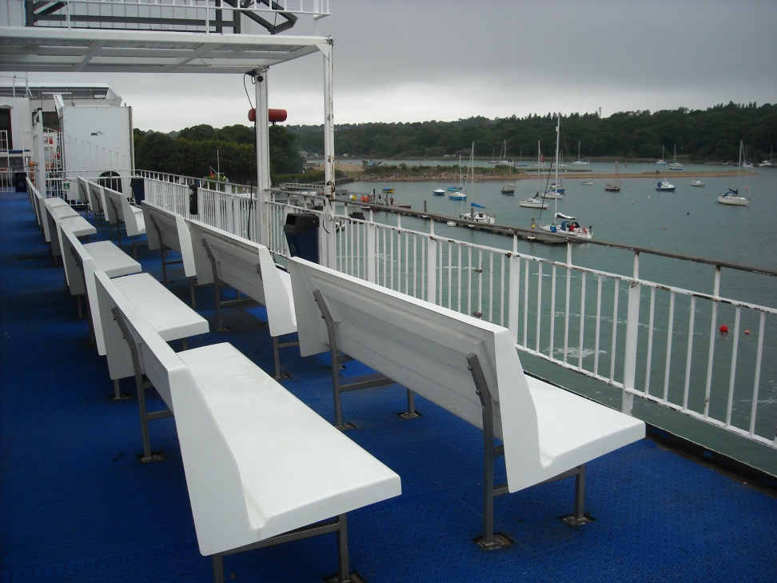
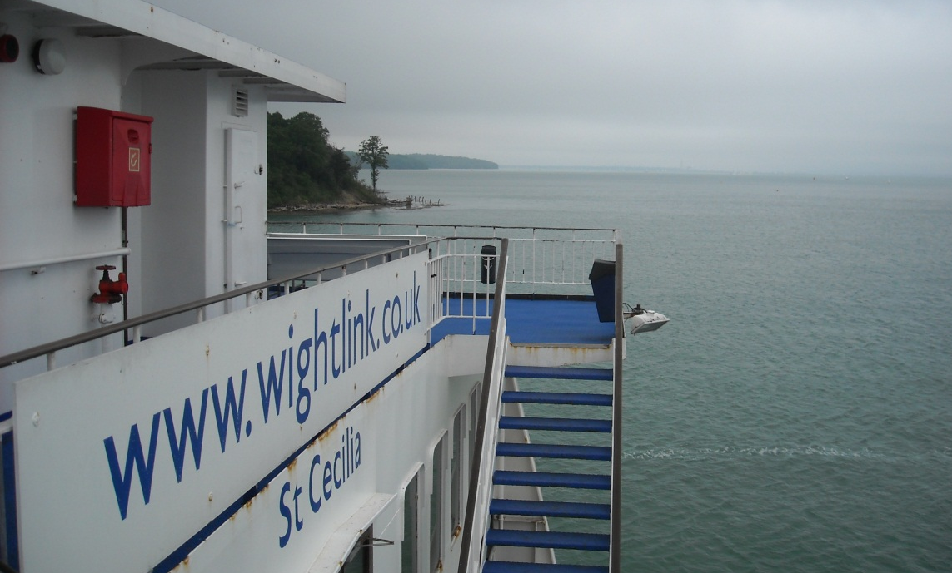
Passing Ryde before berthing in attractive Wootton Creek.

Slide 10
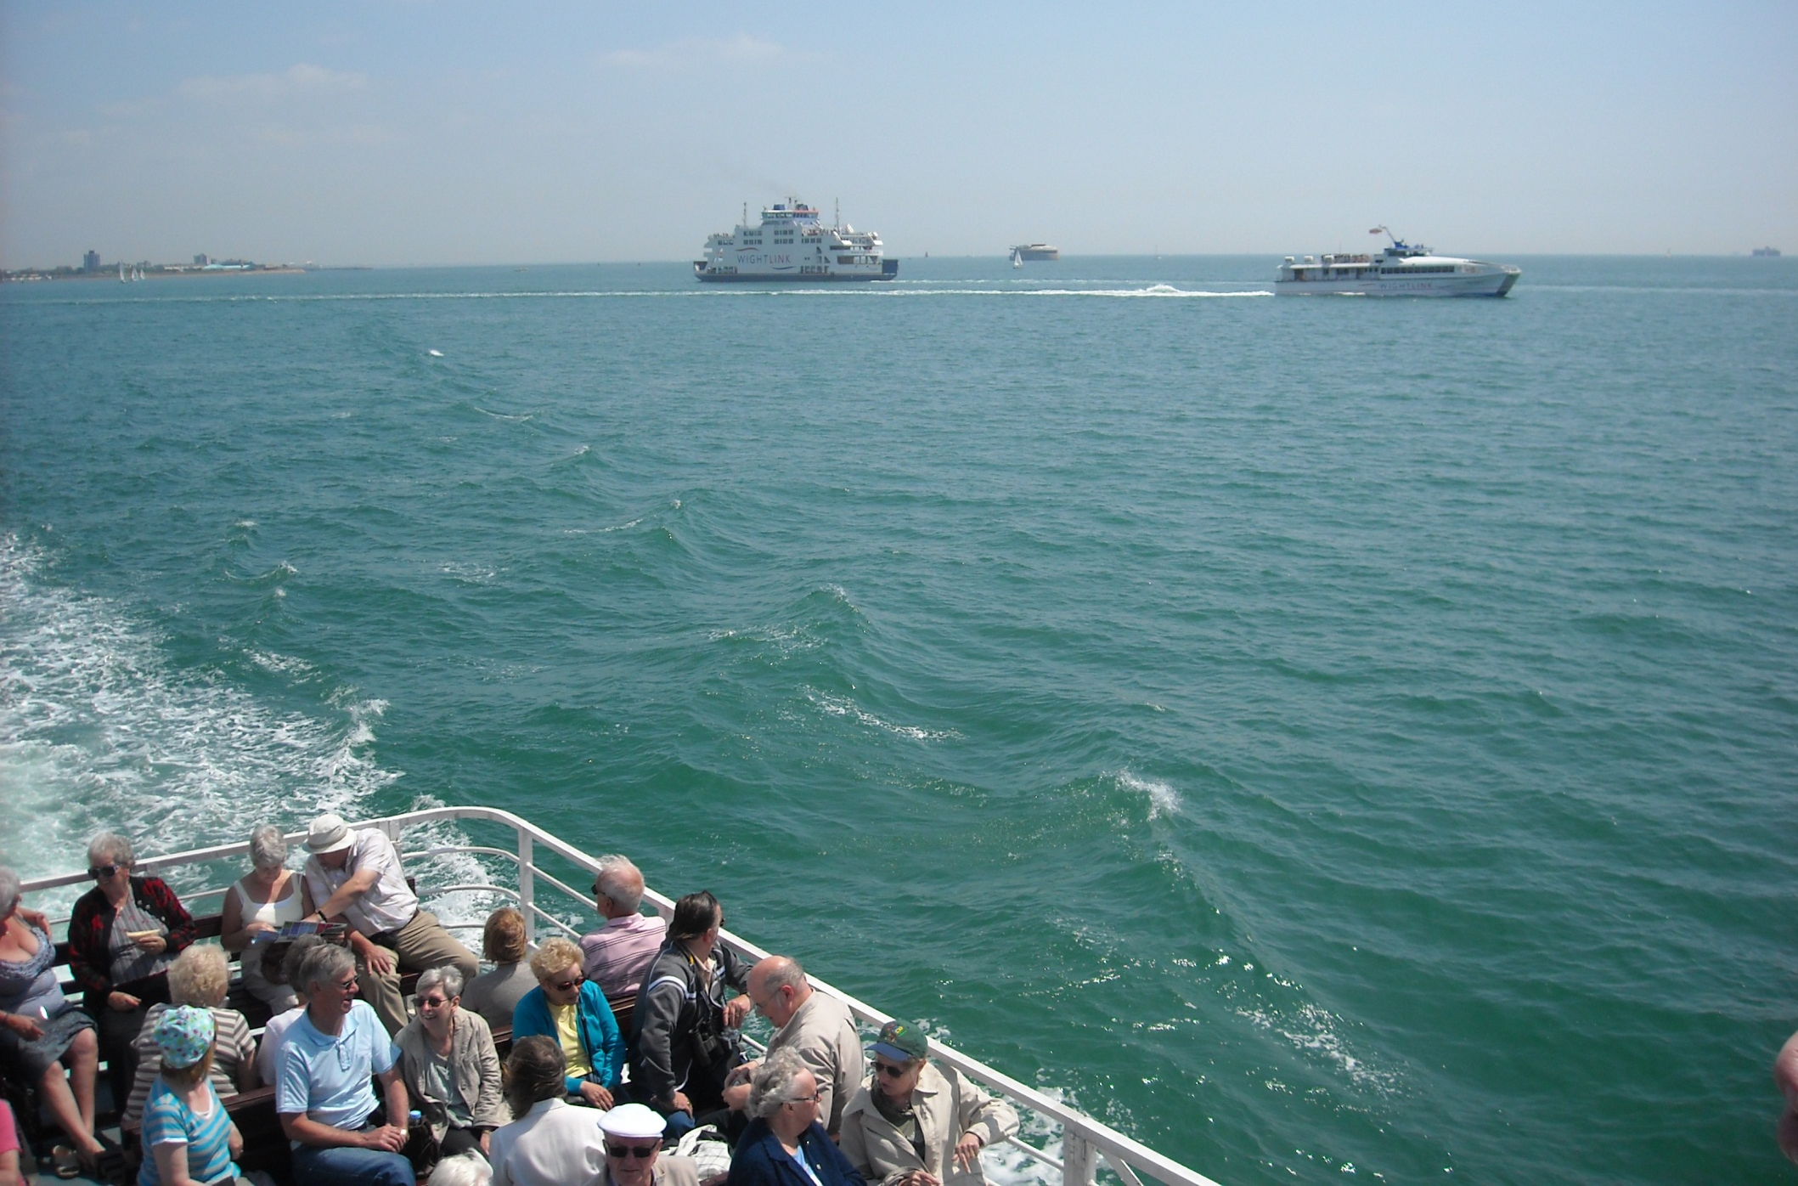
The next section of Isle of Wight coastline is travelled on an excursion to Cowes.

Slide 11
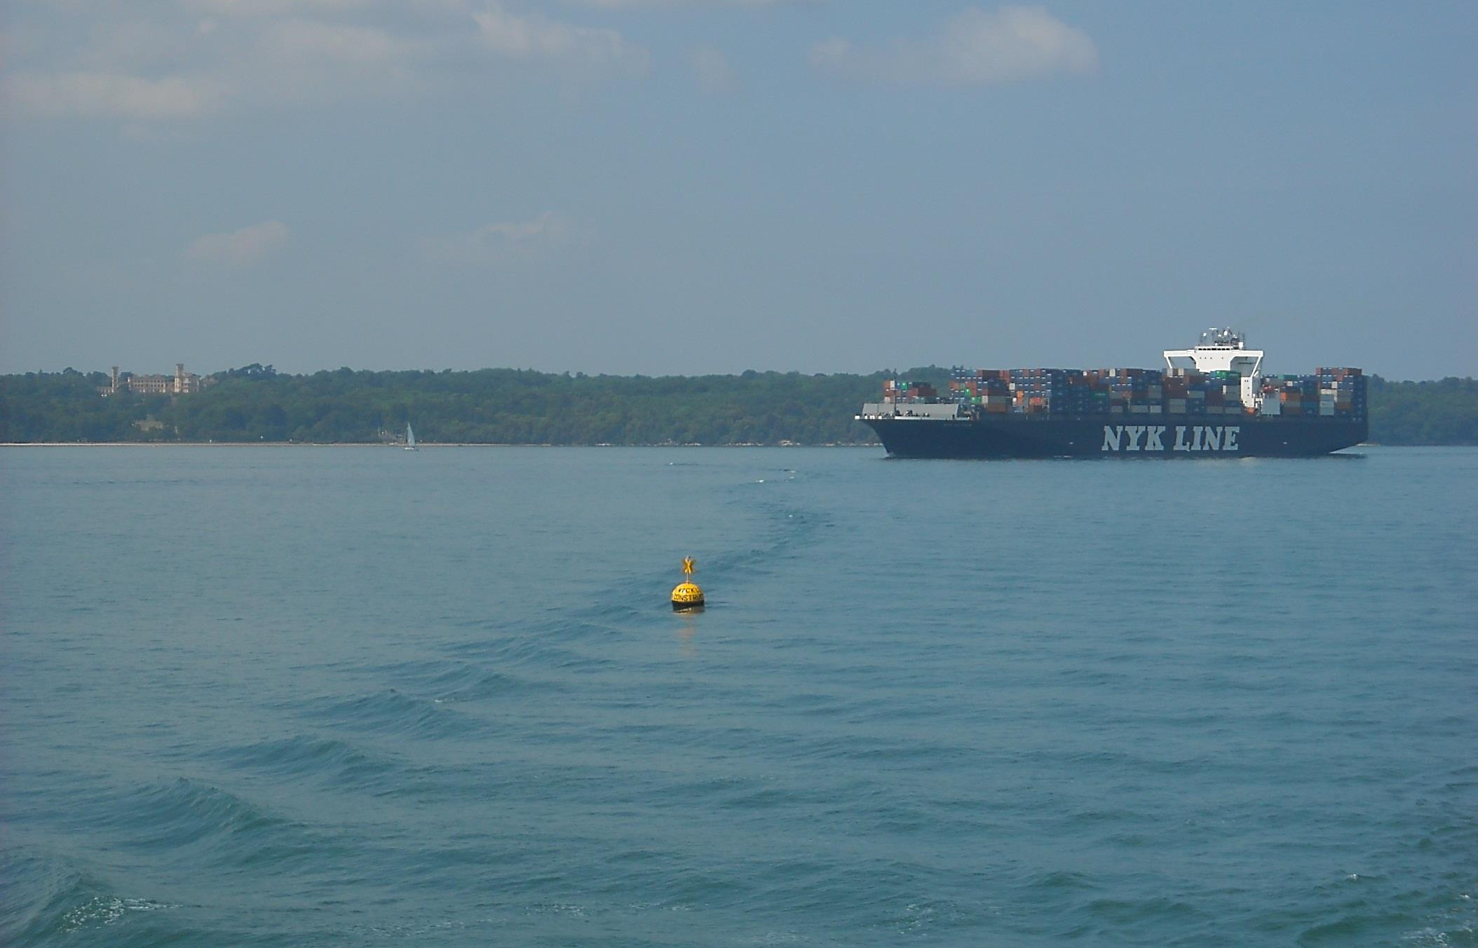
Passing, on our way, Queen Victoria’s favourite residence,
Osborne House. She died here in 1901.

Slide 12
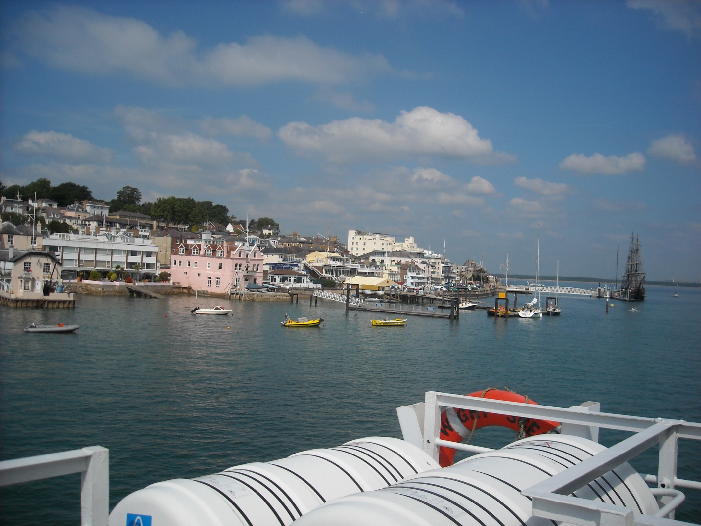
Then comes attractive Cowes on the Medina River.

Slide 13
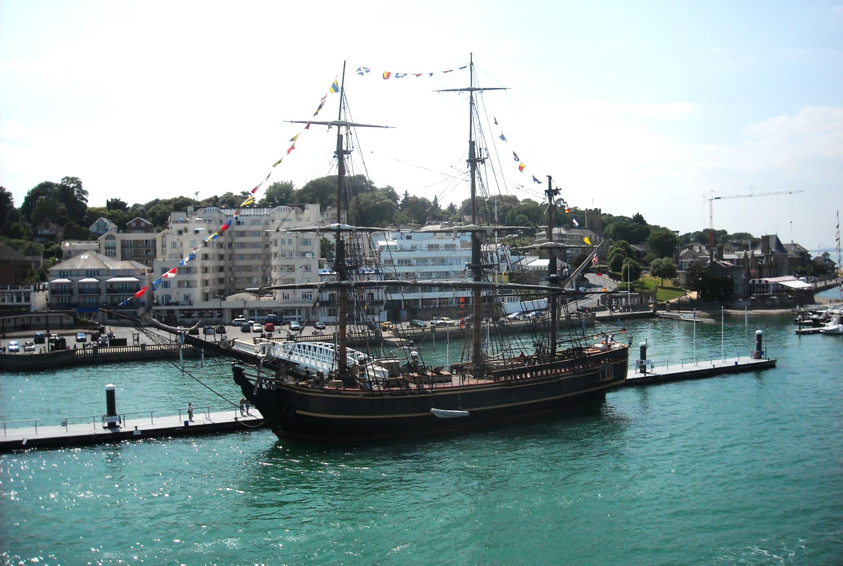
Also visiting today is replica tall ship HMS Bounty, on a world tour. (Sadly she will sink next year in rough seas off eastern USA).

Slide 14
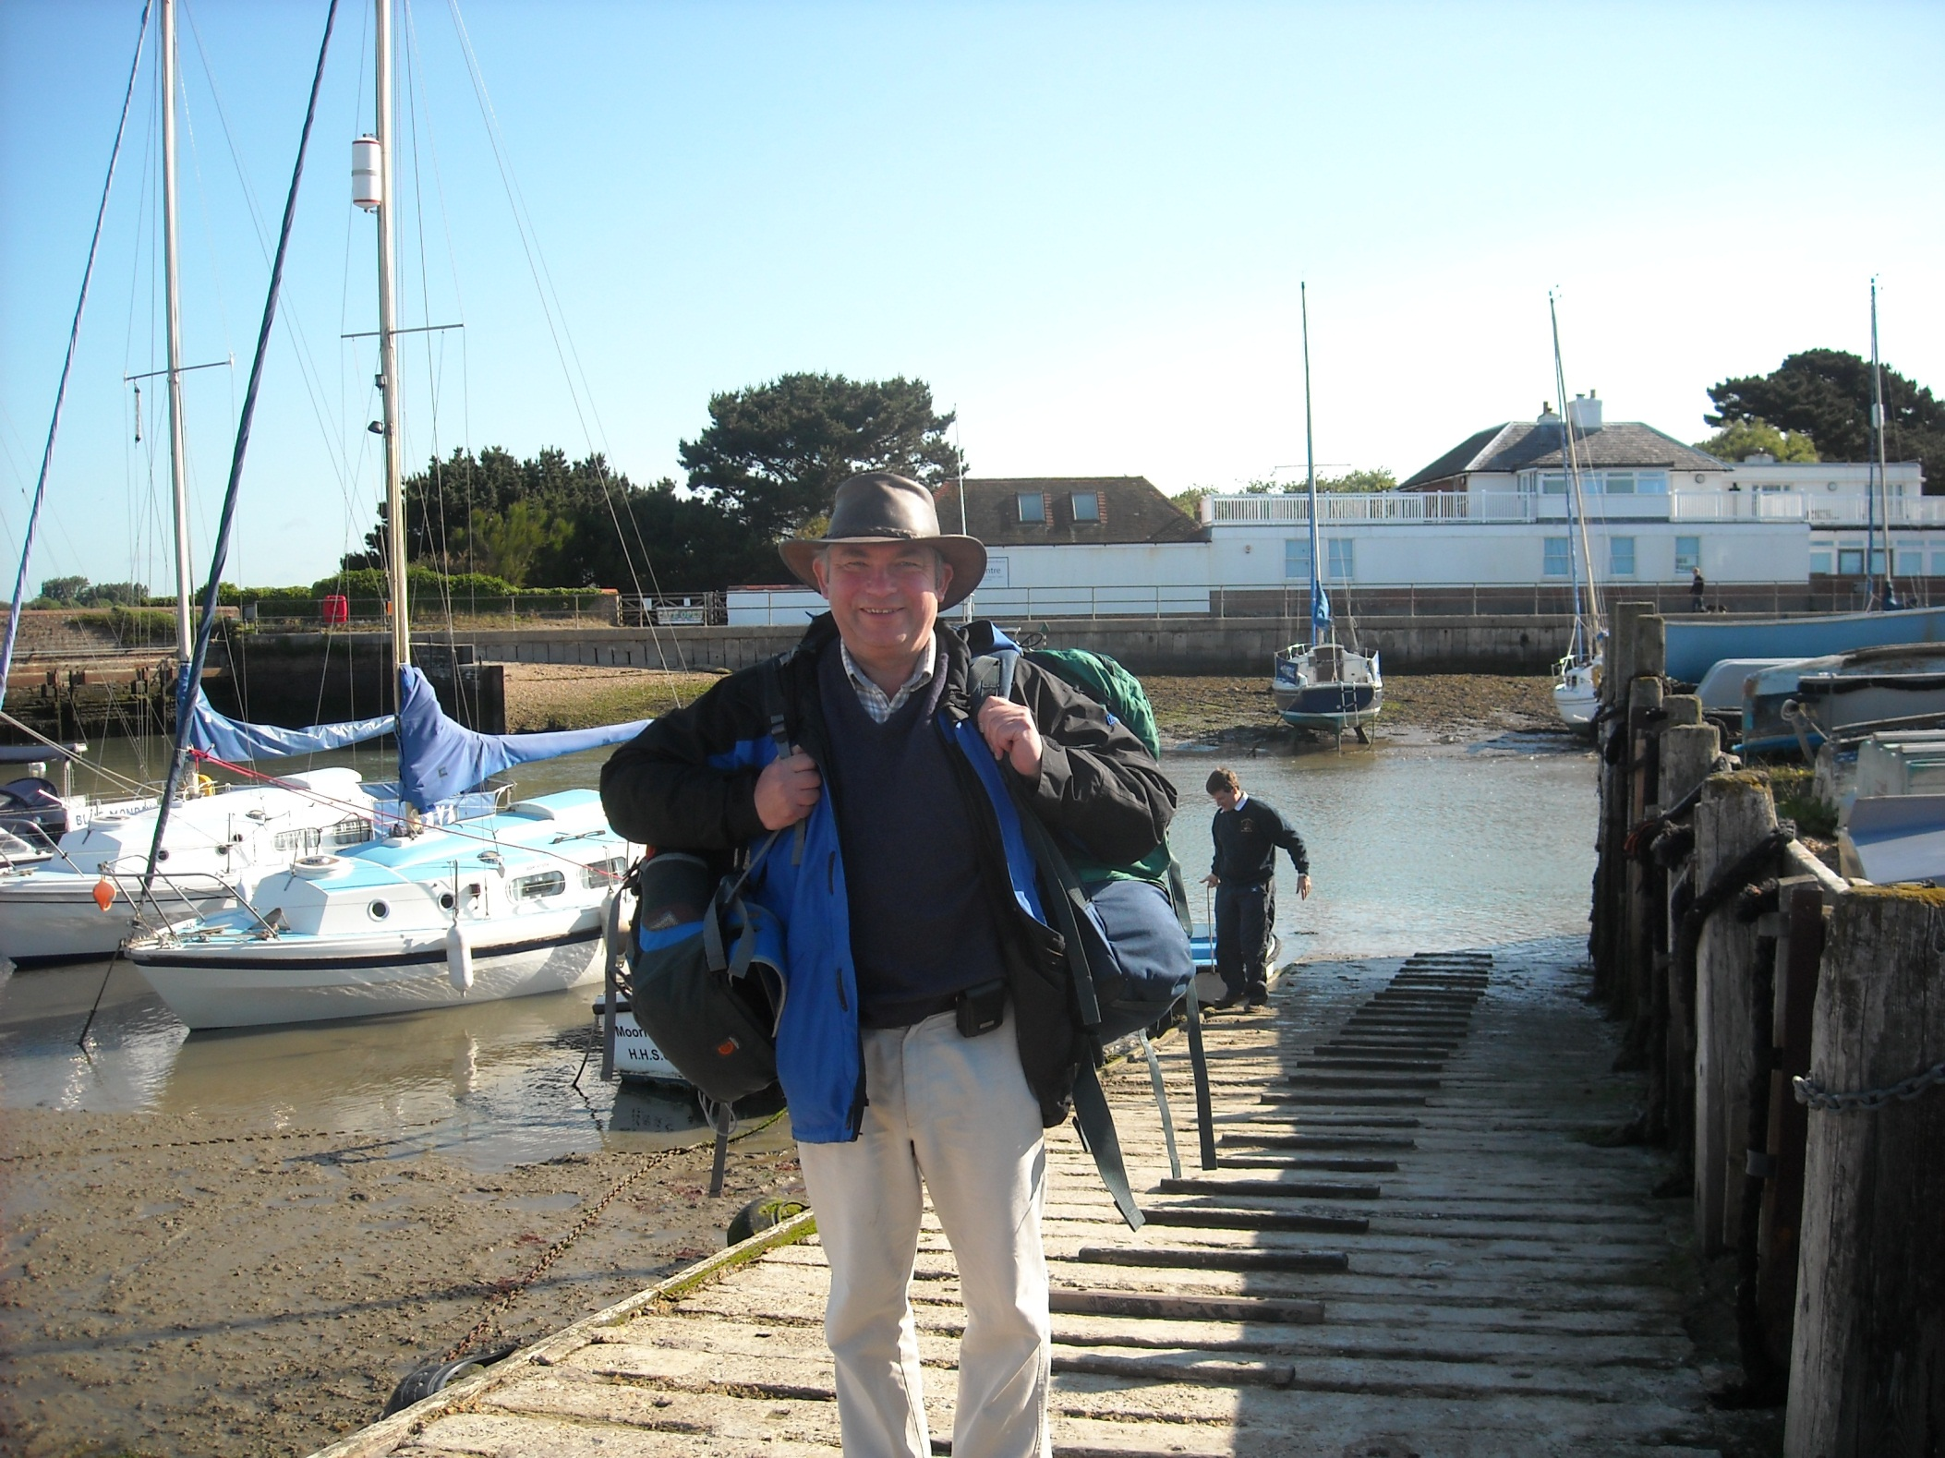
But the best Solent trip was from here, Hill Head Harbour, where Alastair is loading the tender.

Slide 15
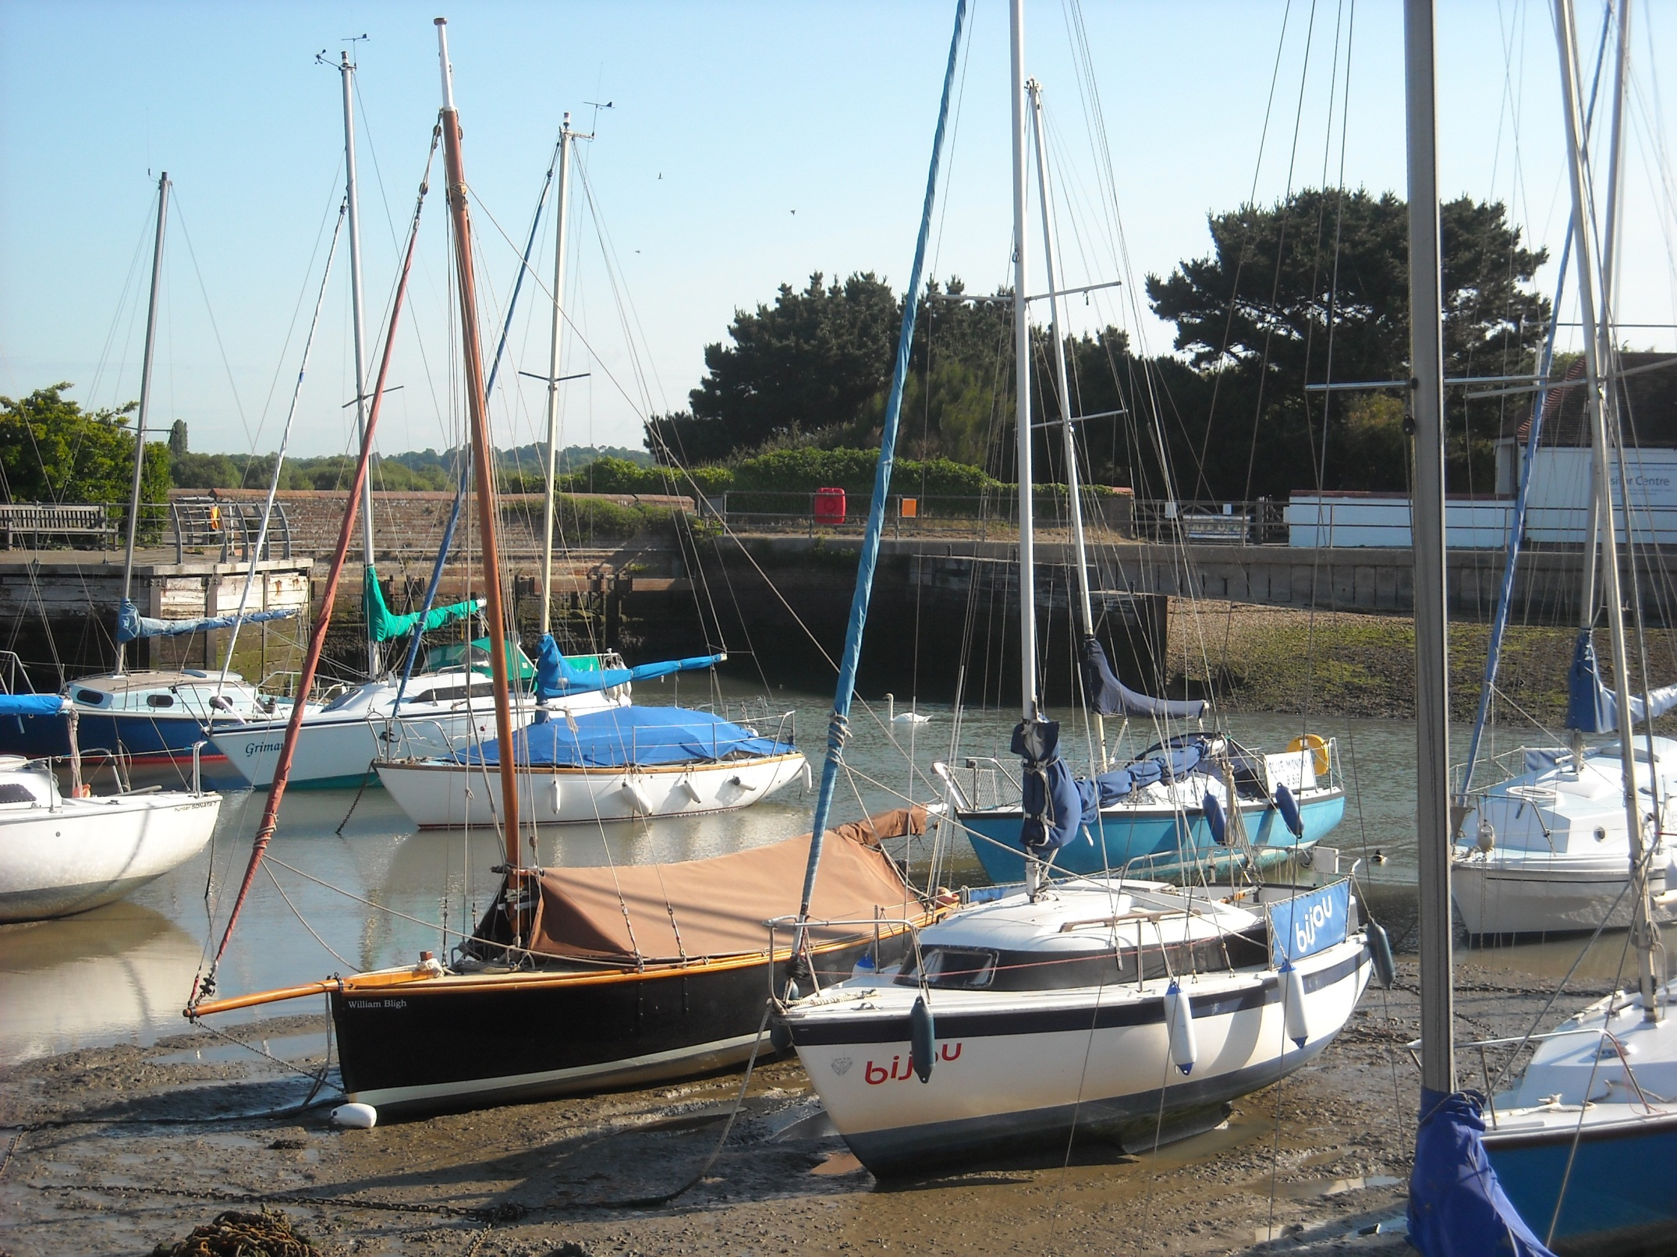
Which takes us to his gaff rigged sloop, the black Memory.

Slide 16
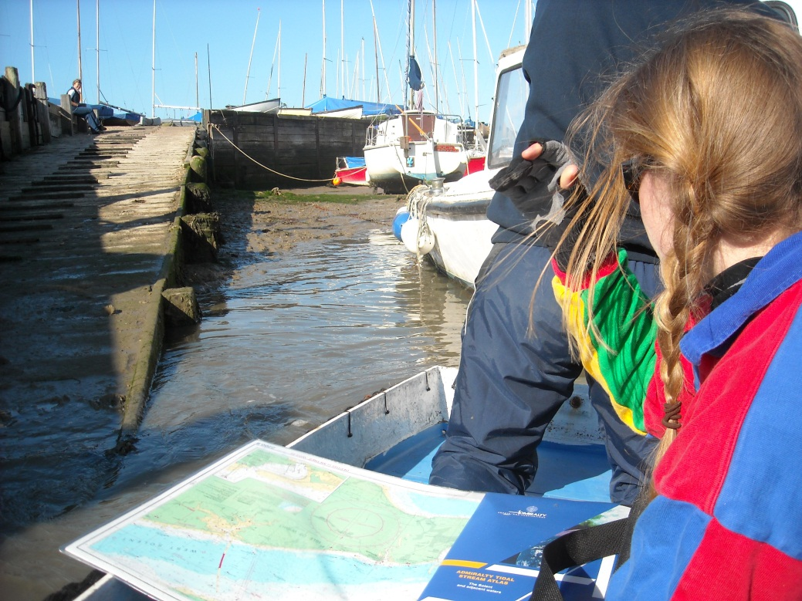
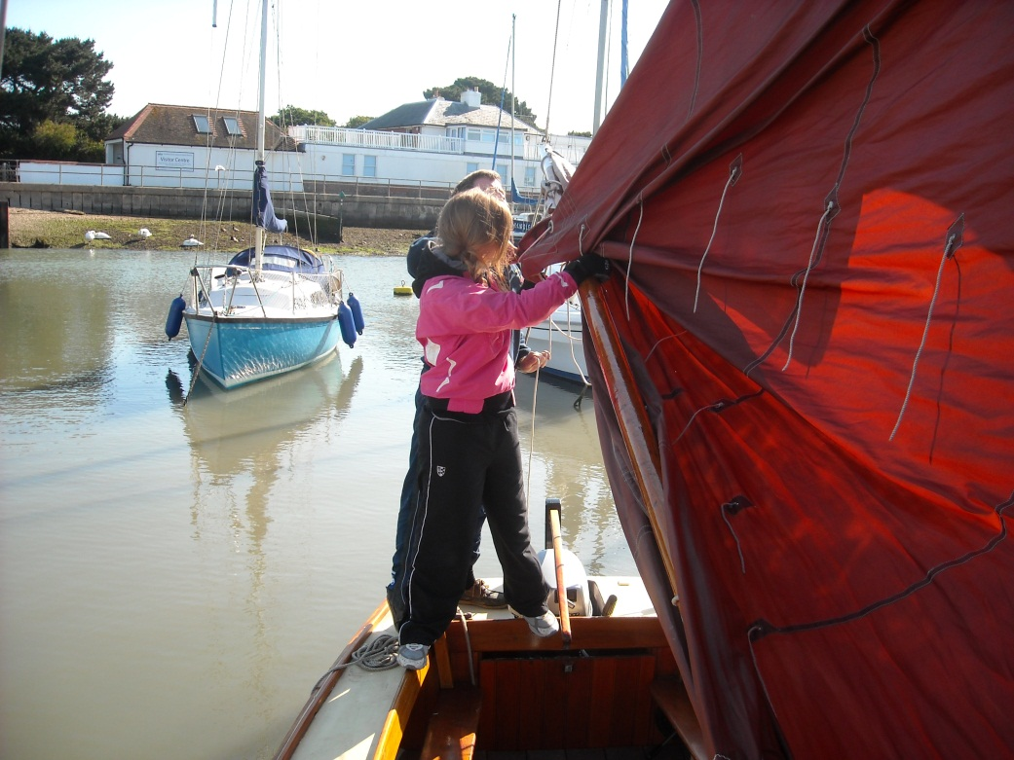
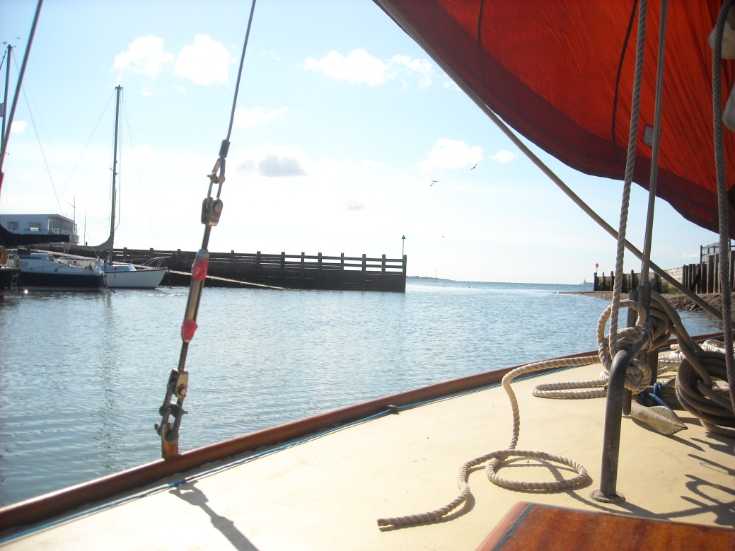
And off we go, assisted by the outboard leaving the harbour.

Slide 17
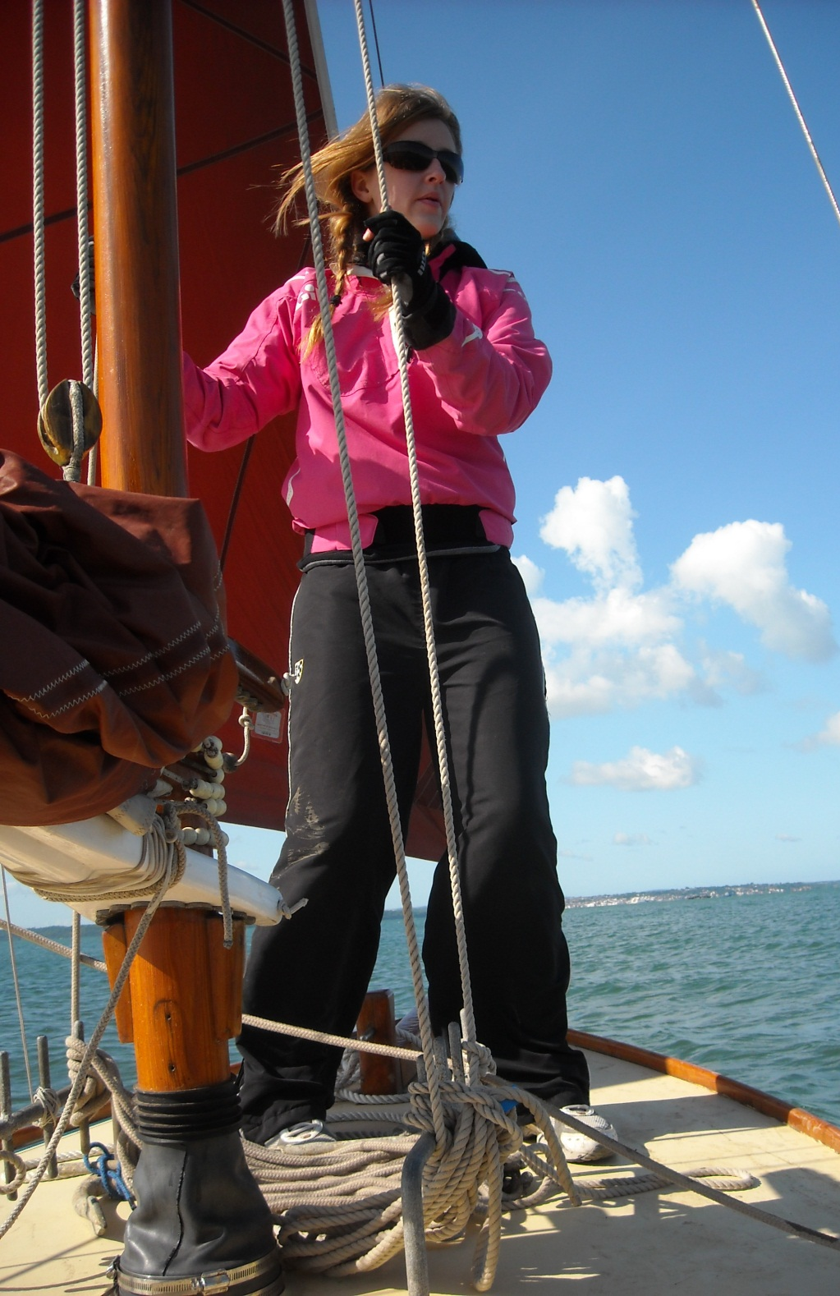
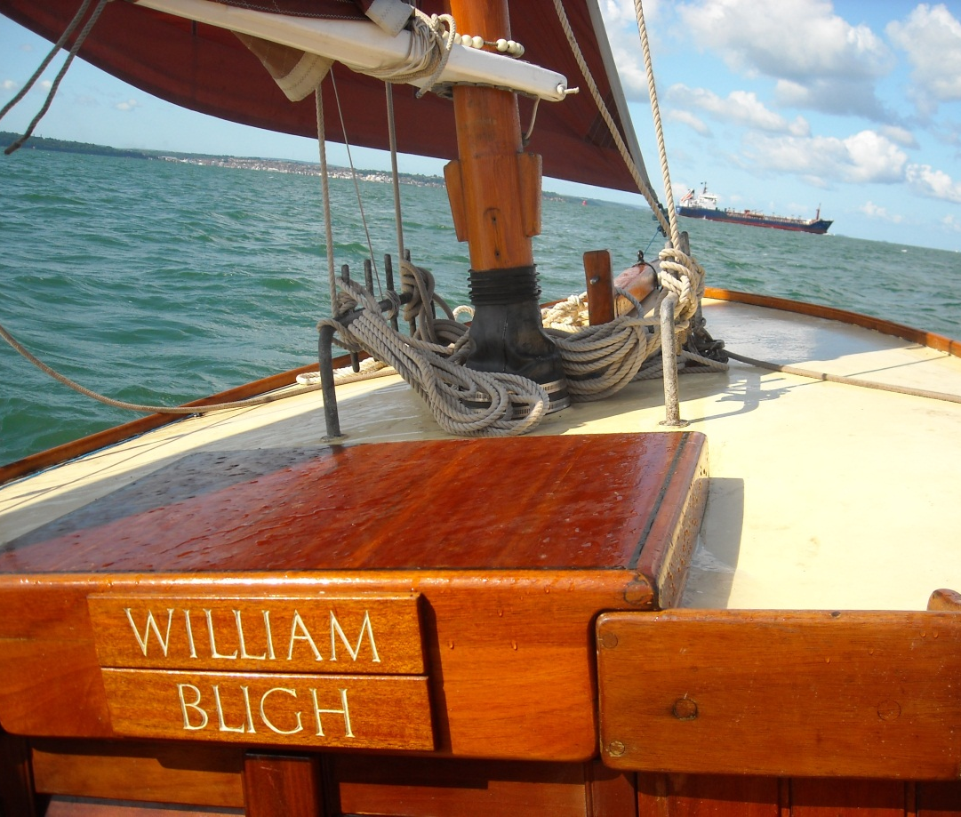
Hannah then hoists the sail and the William Bligh, (named after the captain of HMS Bounty), speeds towards the shipping lanes.

Slide 18
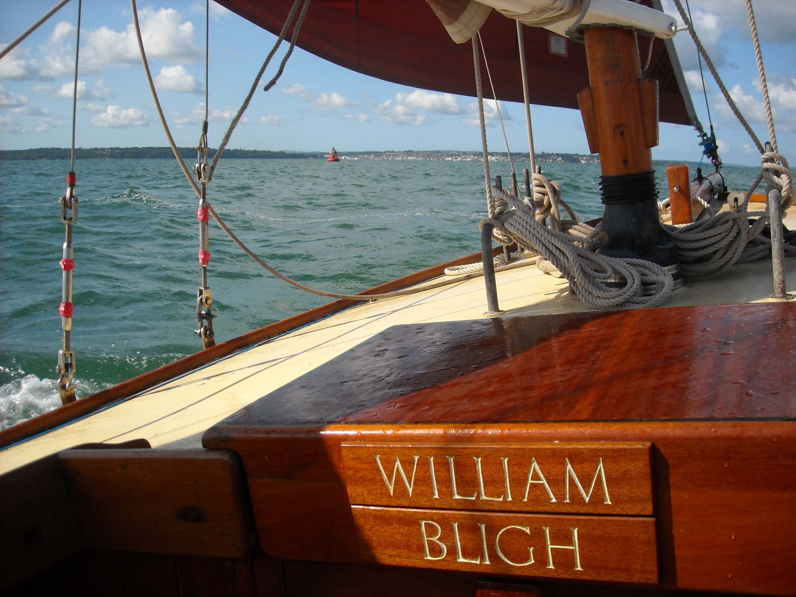
With Cowes to our left on this lovely morning.

Slide 19
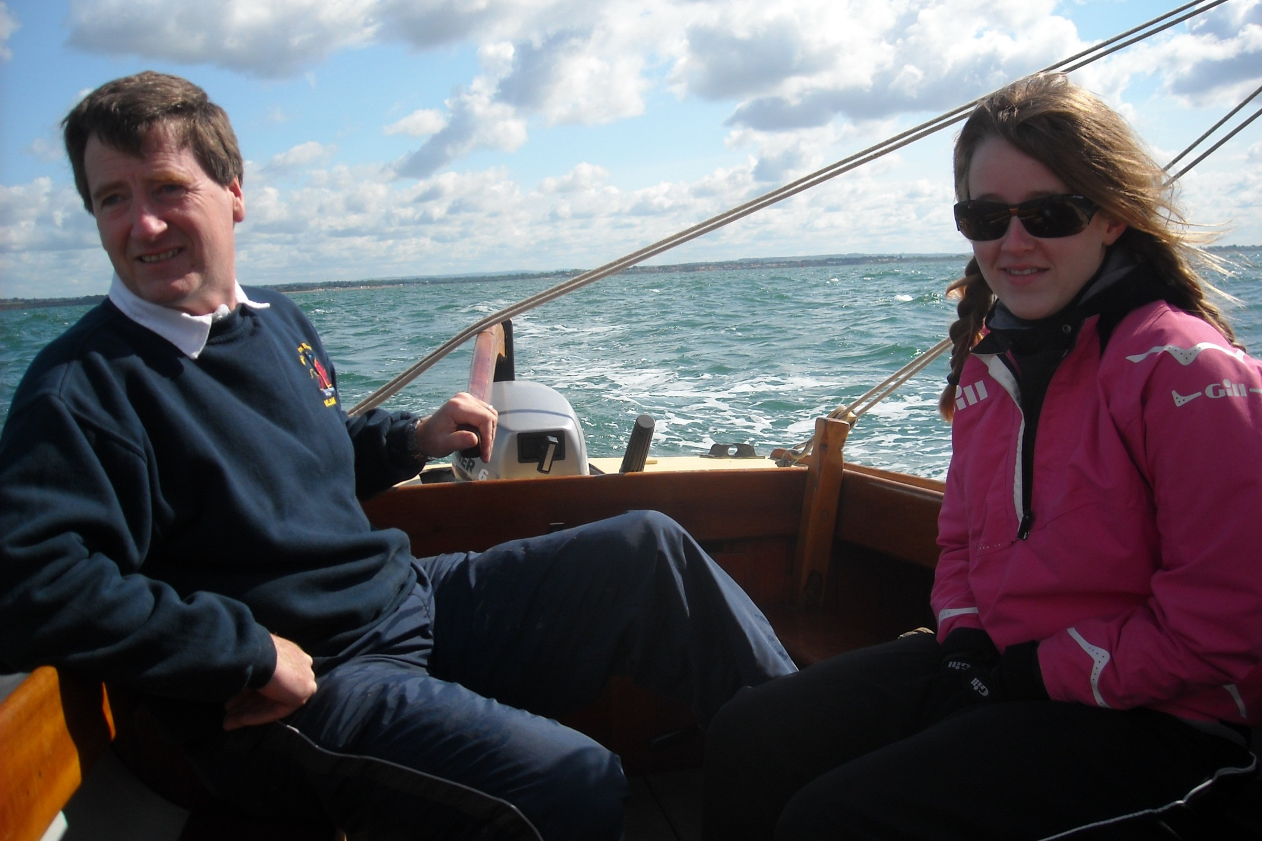
Hill Head and Lee-on-the-Solent recede into the distance as wind and tide speed us on our way.

Slide 20
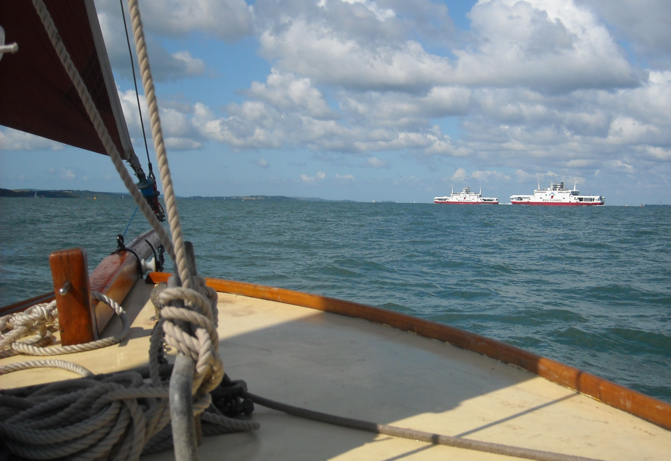
Fast moving Red Funnel ferries cross our bows.

Slide 21
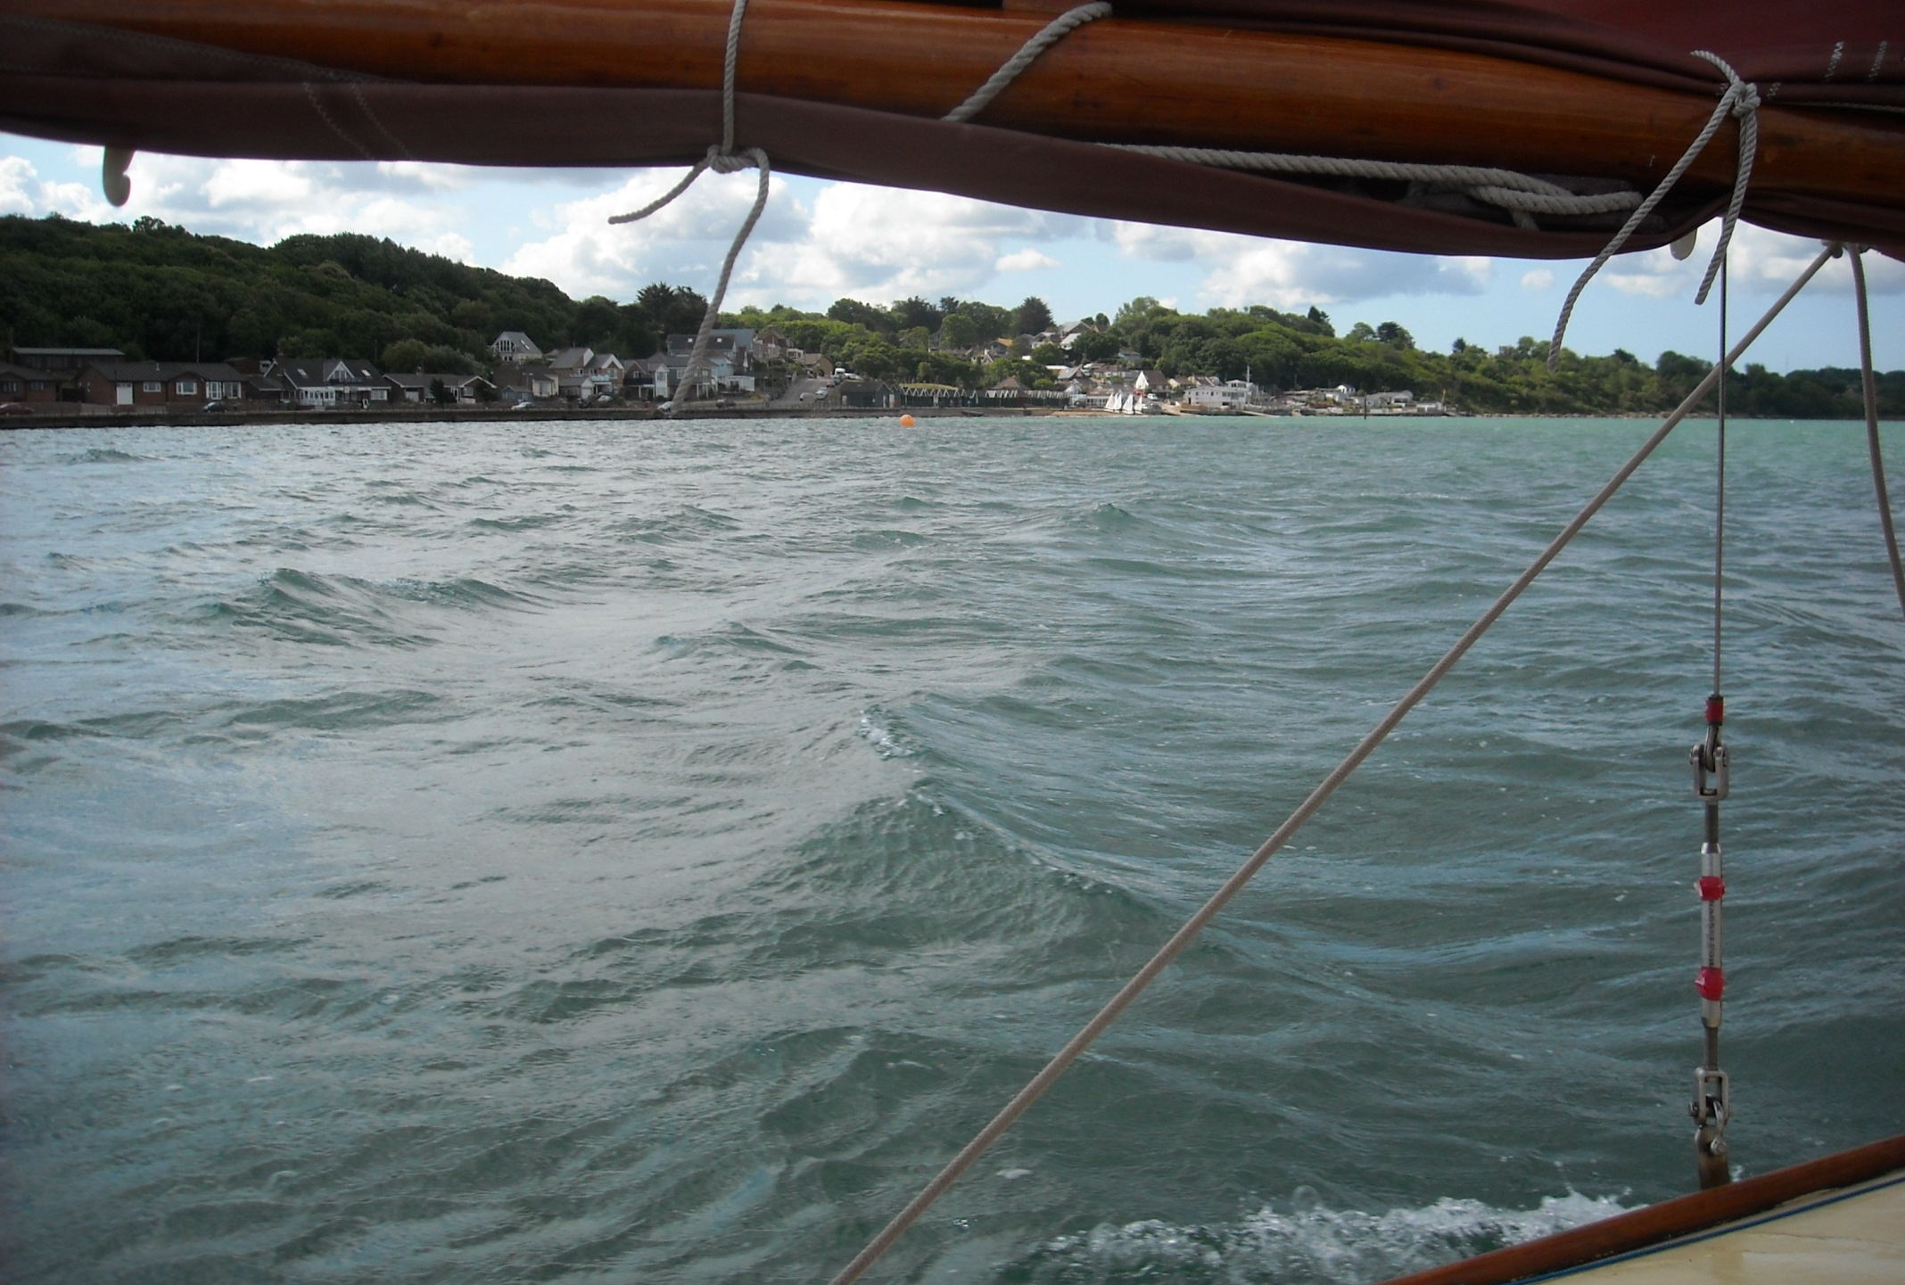
As we reach Gurnard as start following the remoter northern shore of the Isle of Wight.

Slide 22
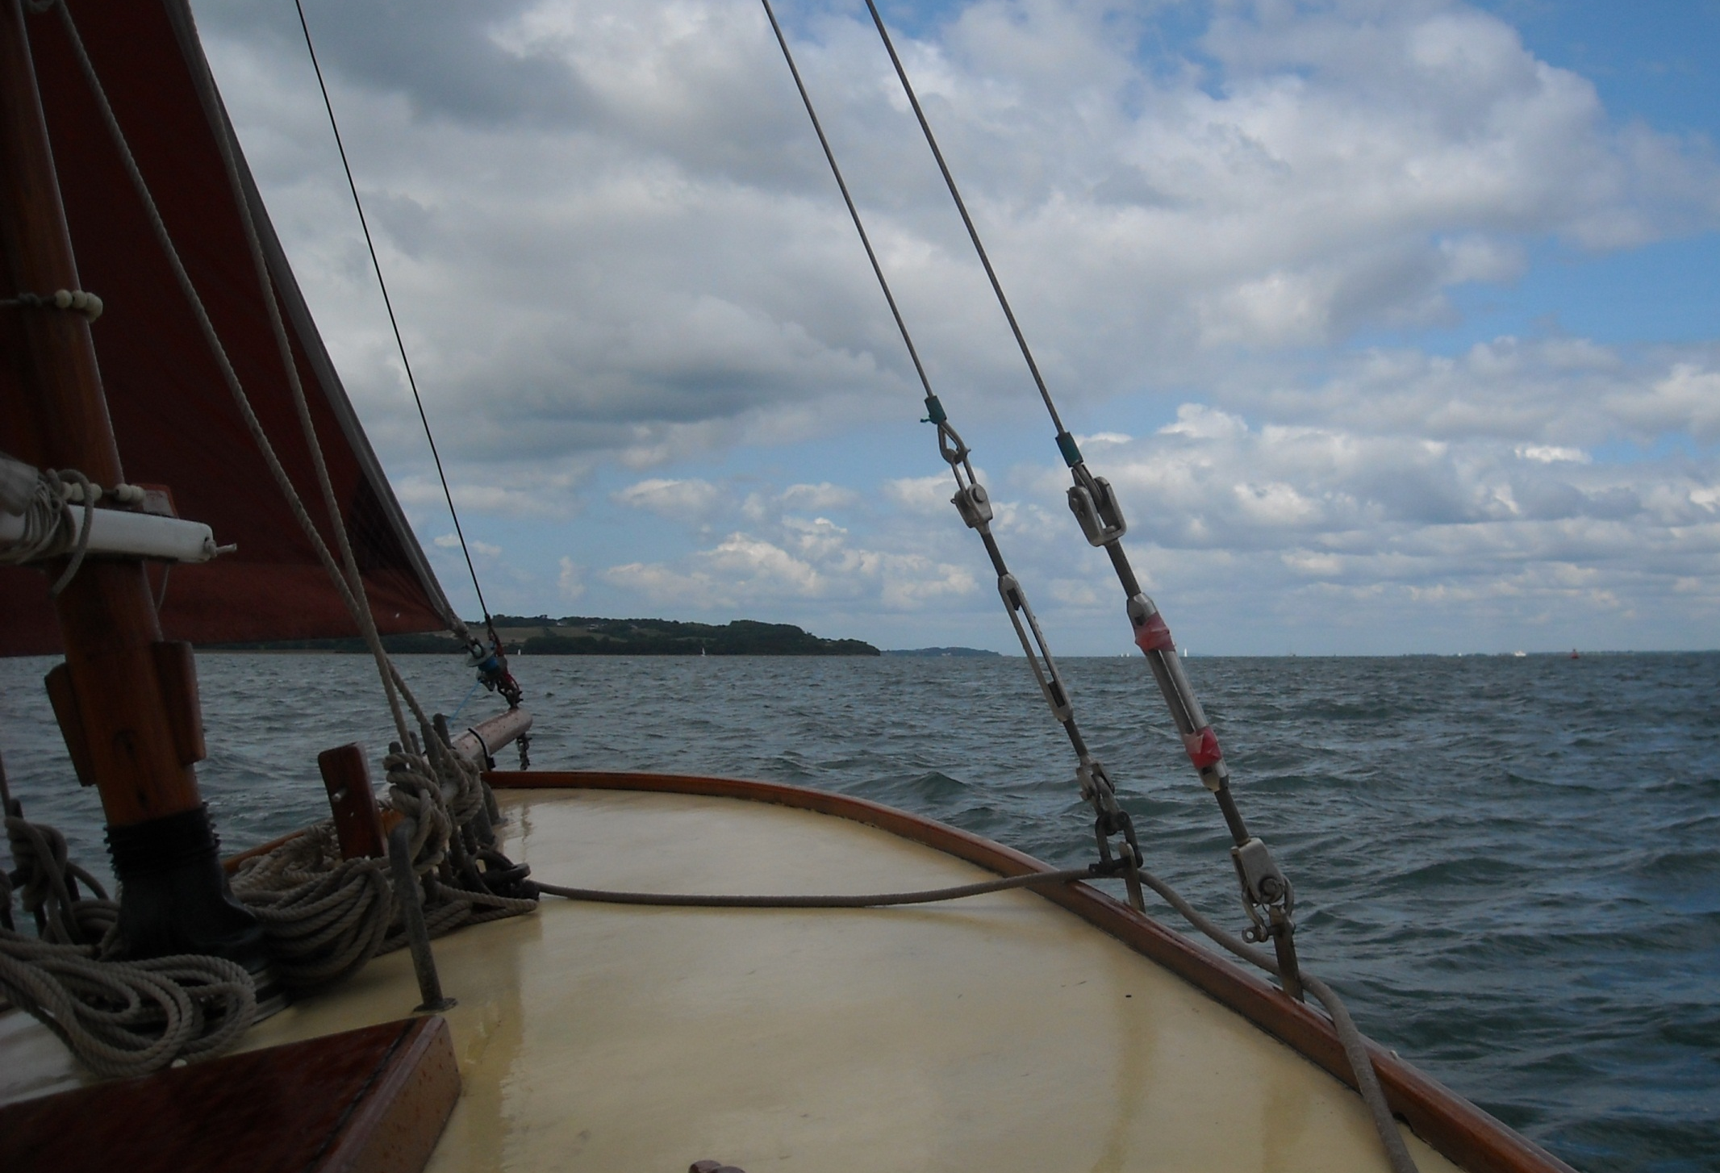
We are heading for the field with the hedge down the middle of it, our marker for the Newtown River.

Slide 23
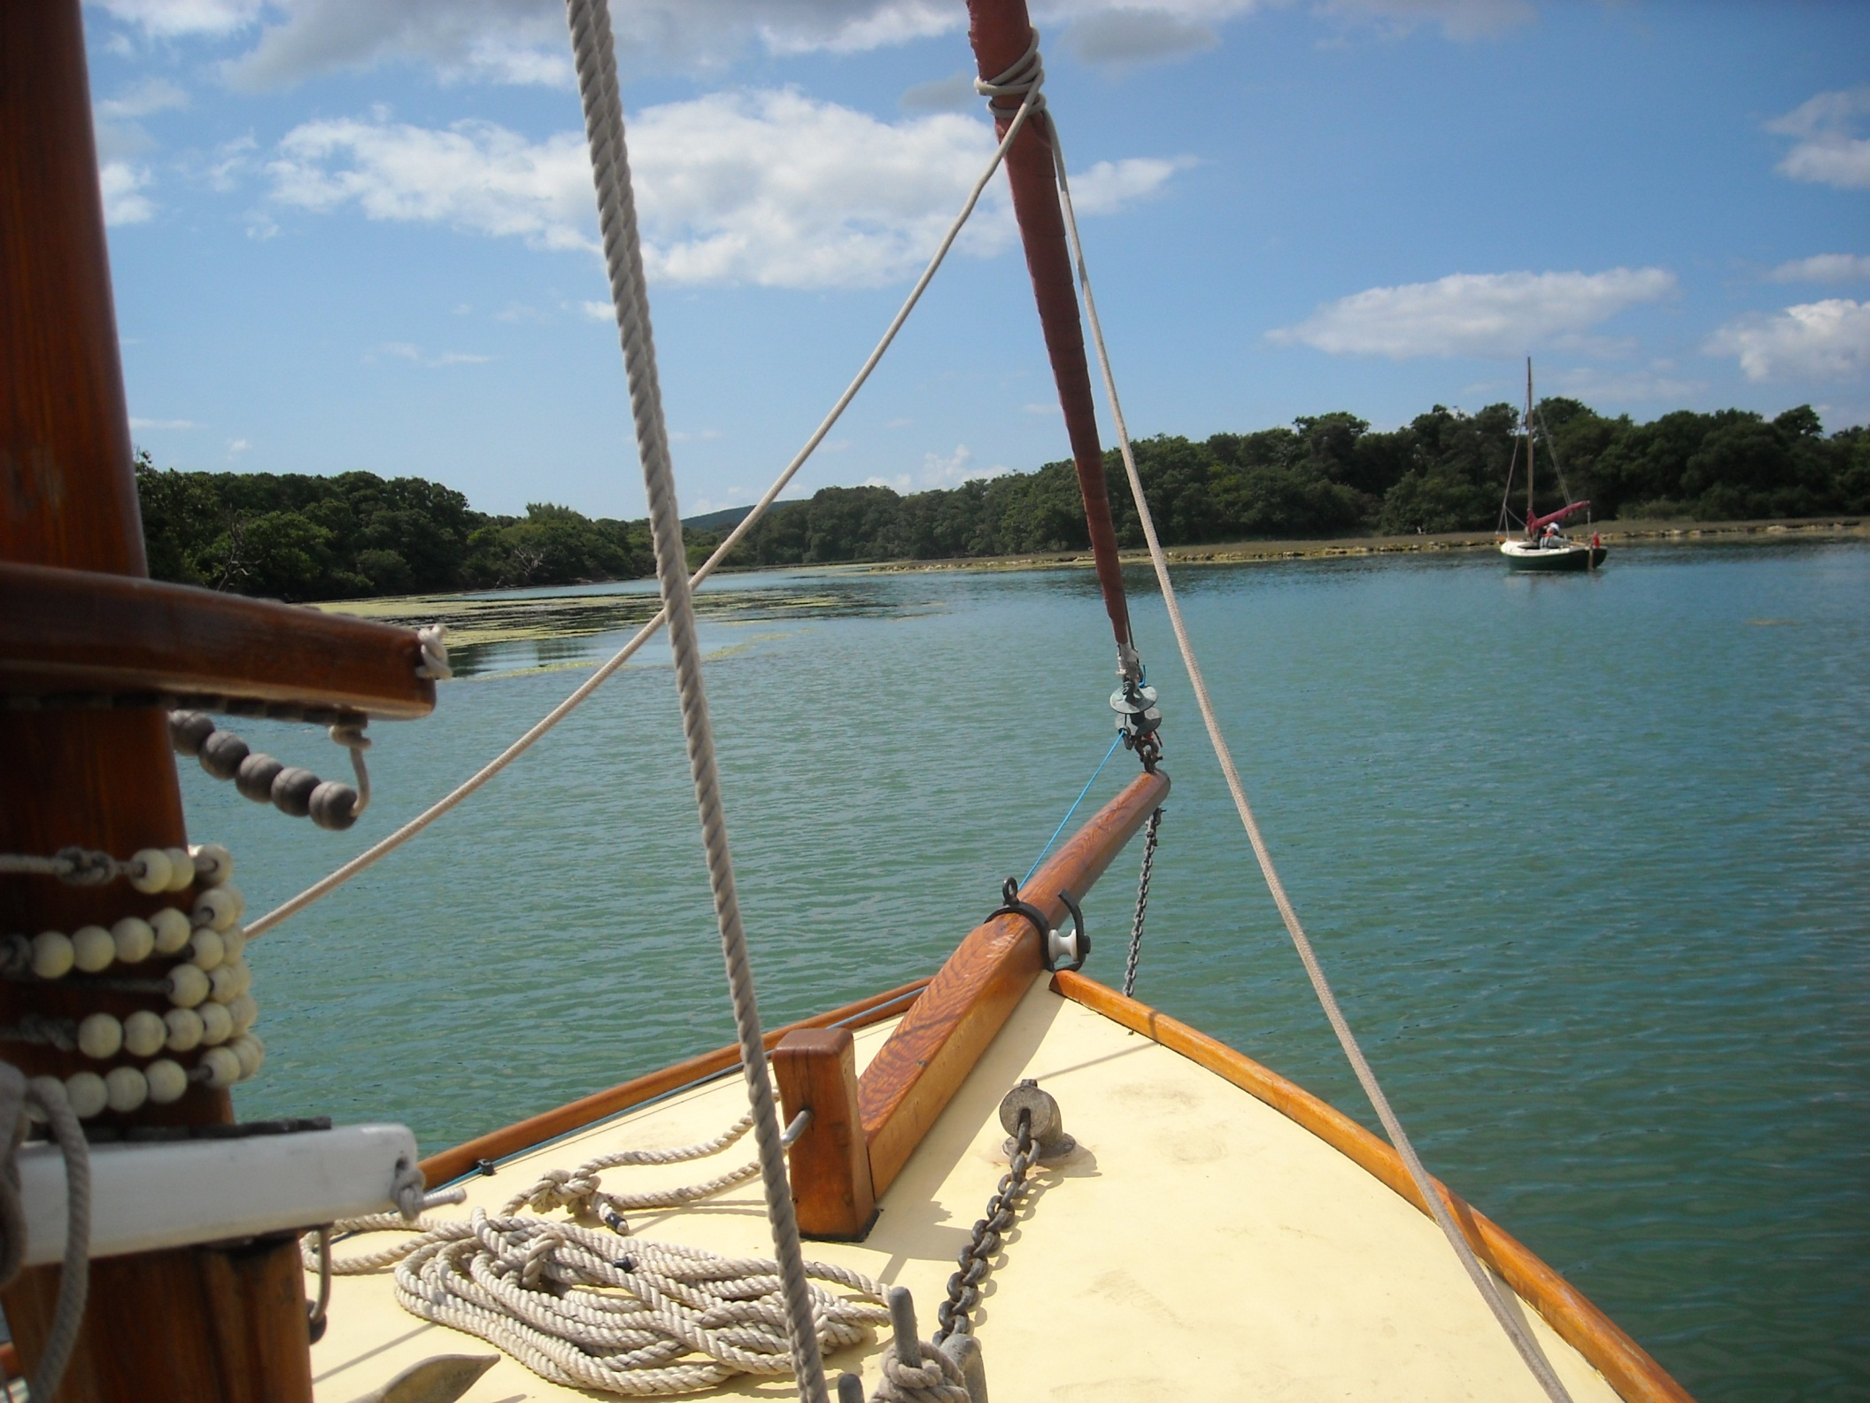
The Newtown River is in National Trust care and a magical spot as we head up Western Haven.

Slide 24
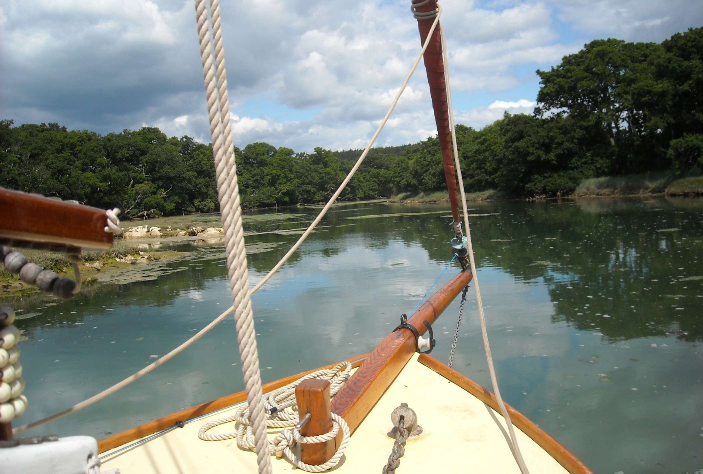
This woodland creek is accessible only at high tide and Alastair knows it well as he once ran water based activity camps here.

Slide 25
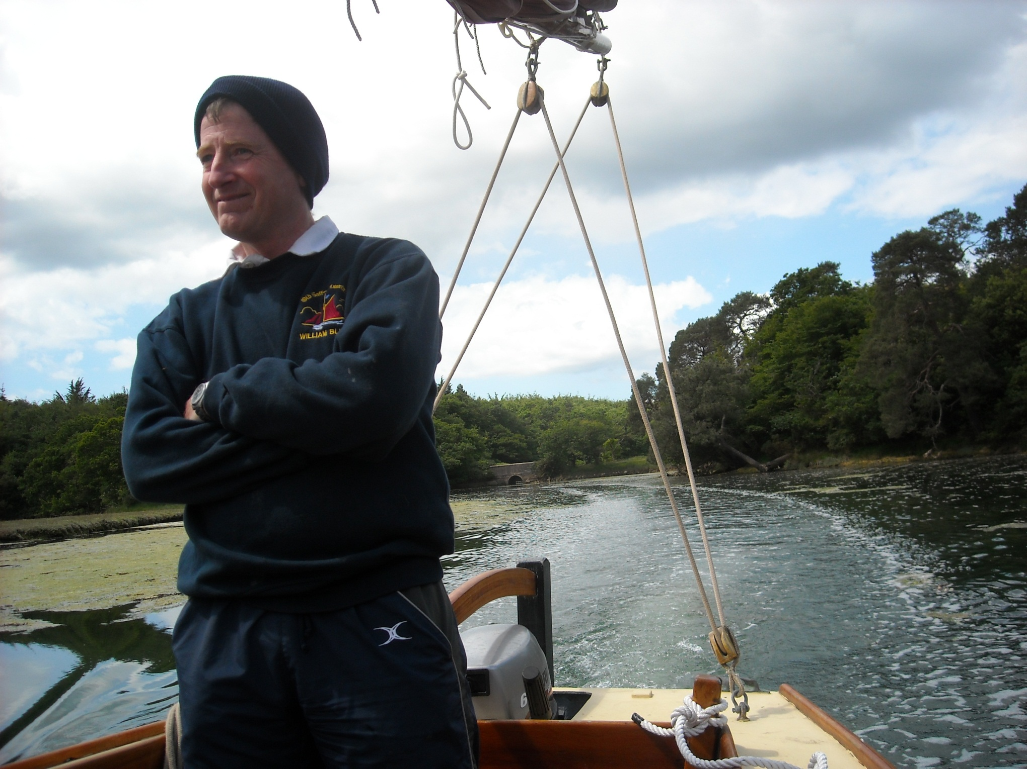
And he found it fascinating to return after all those years.

Slide 26
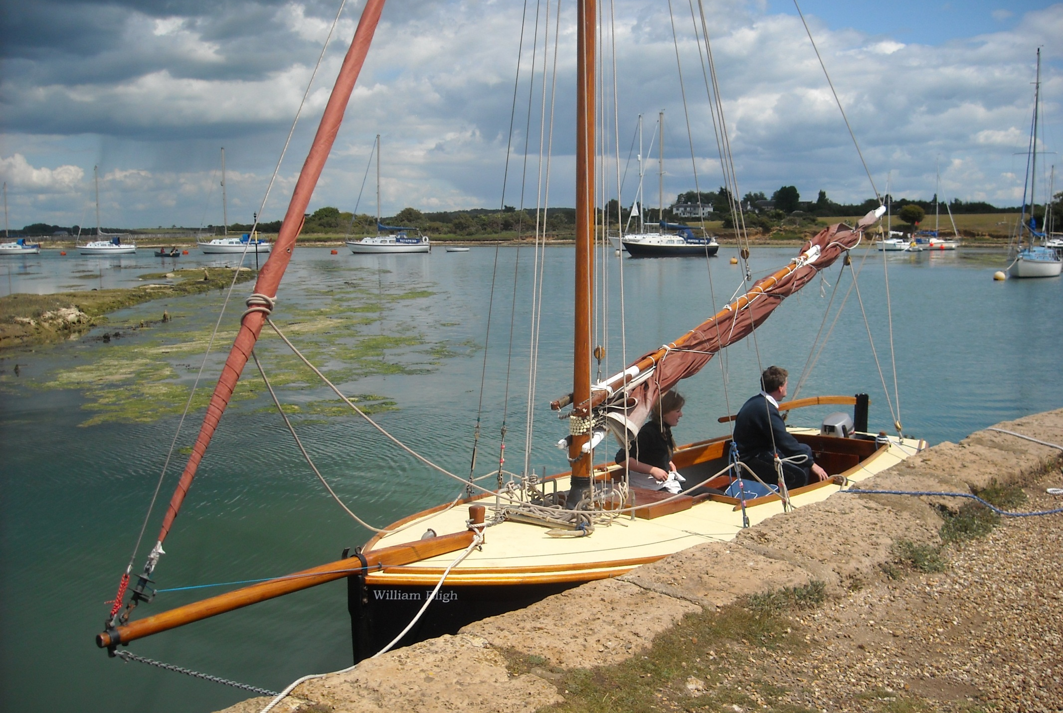
Another estuary arm led us to Shalfleet where an old stone jetty gave us this lunchtime mooring and a track to the local pub.

Slide 27
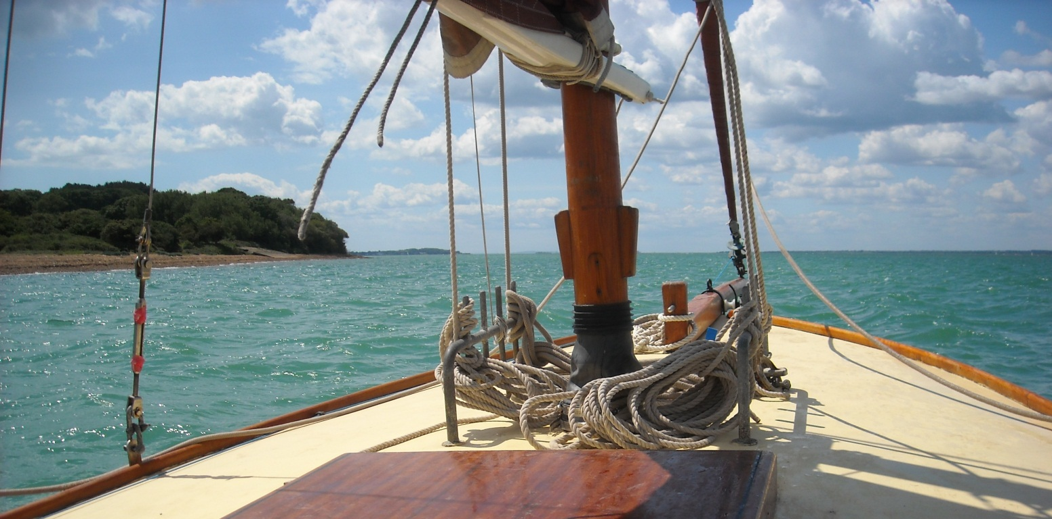
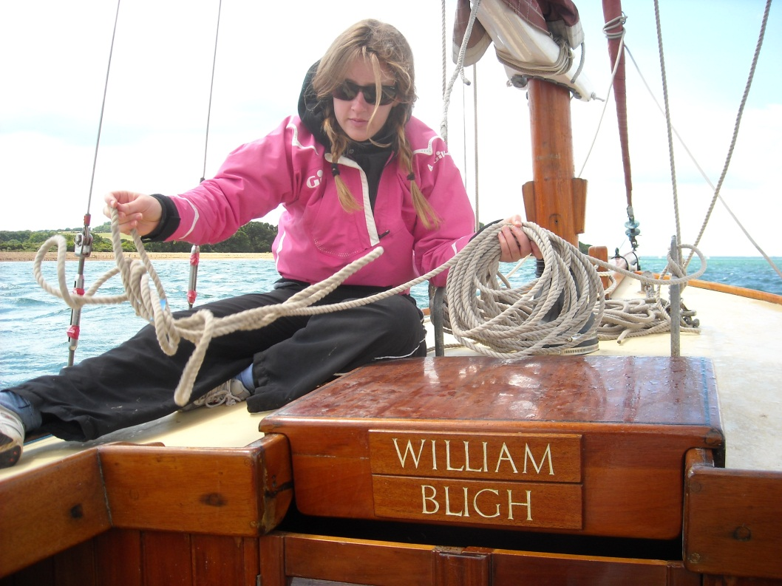
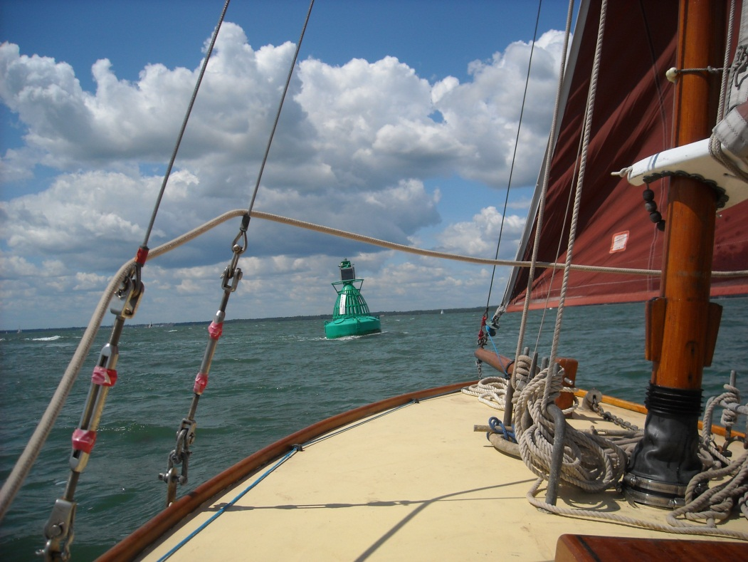
We then returned to the Solent by Hamstead Ledge buoy.

Slide 28
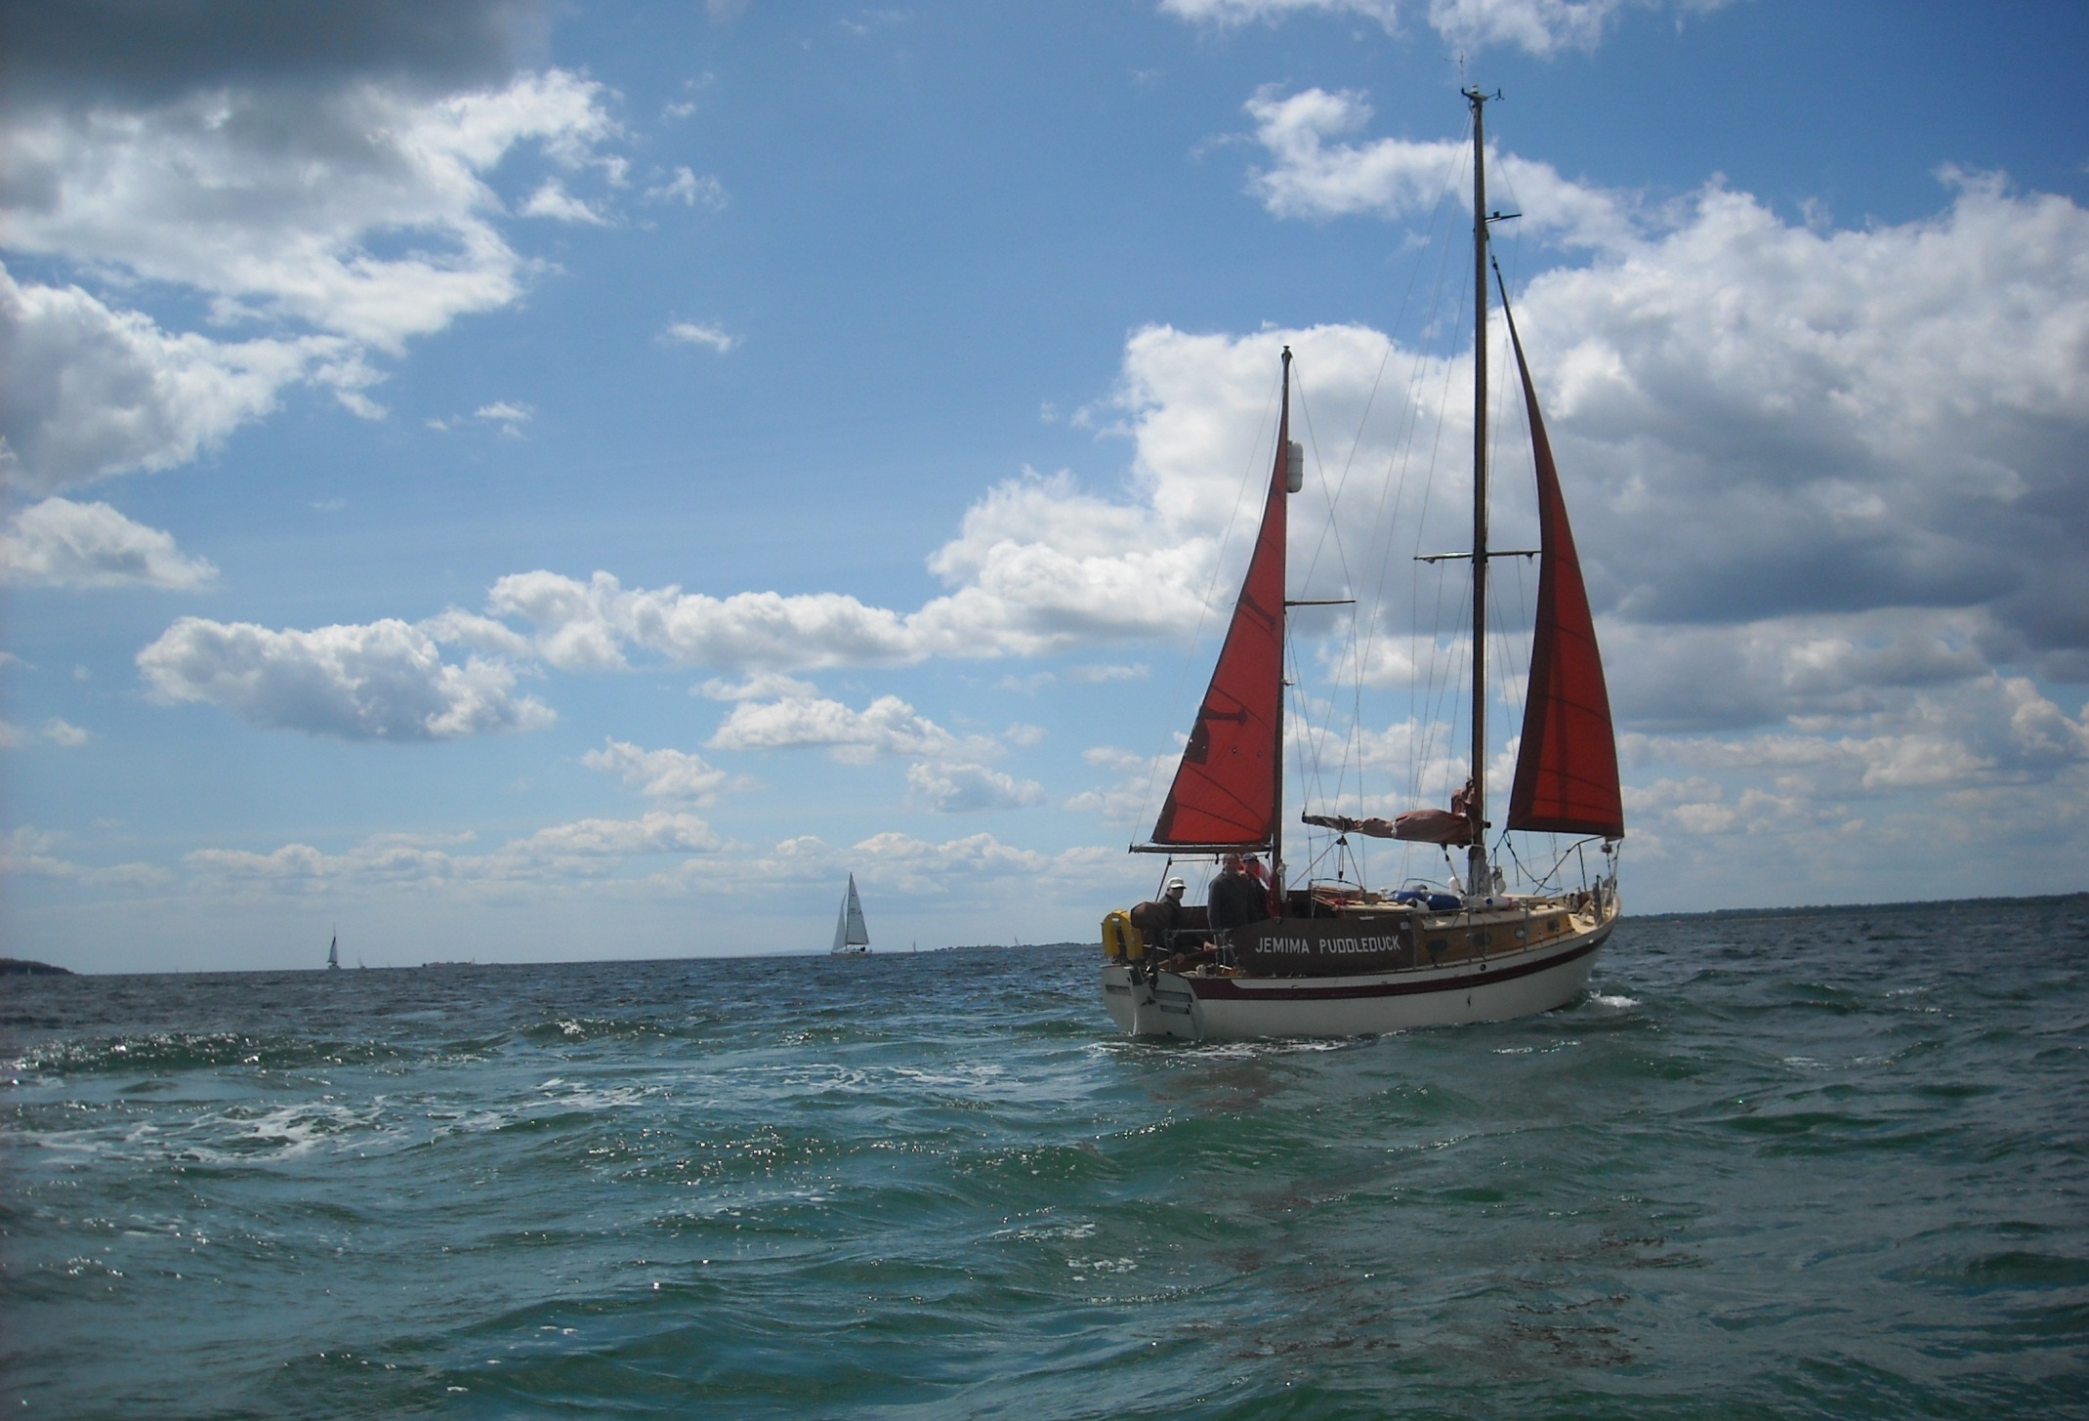
Jemma Puddleduck, one of the other yachts on the water today.

Slide 29
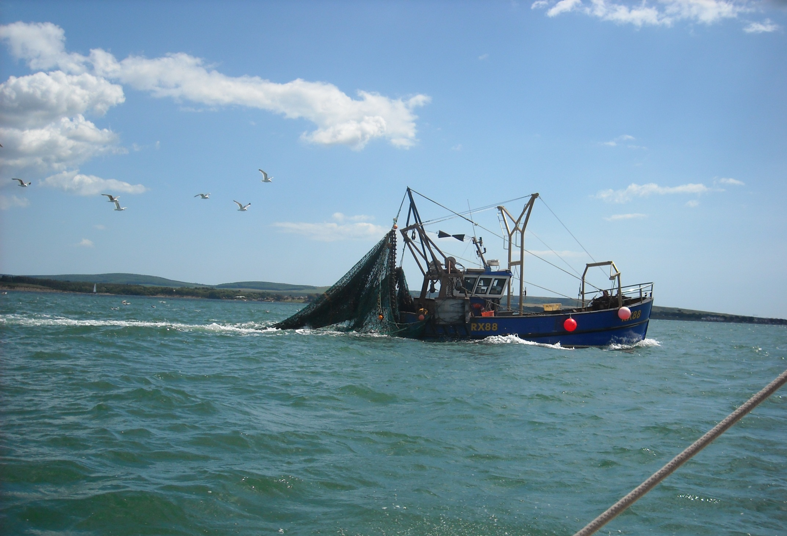
And a busy, Rye registered trawler.

Slide 30
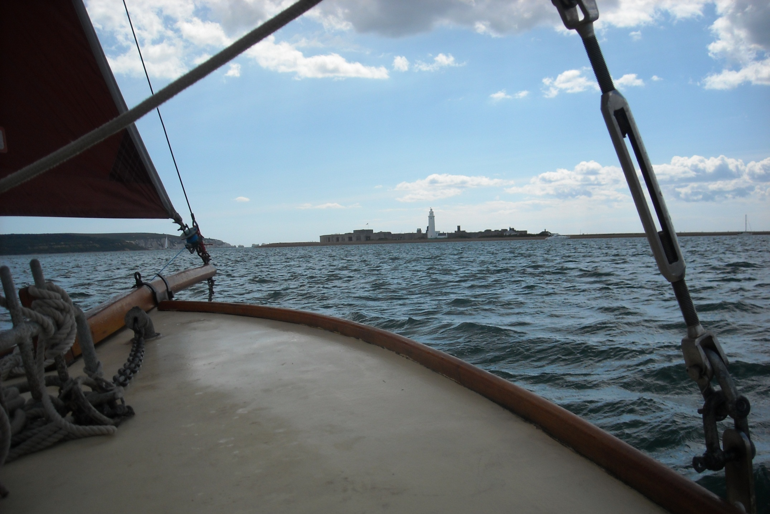
We are now at Hurst Castle and take a look at the spit before crossing back over to Yarmouth, Isle of Wight.

Slide 31
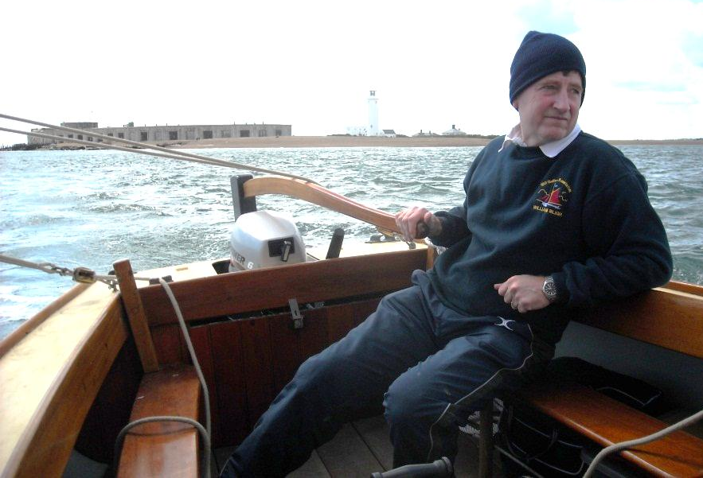
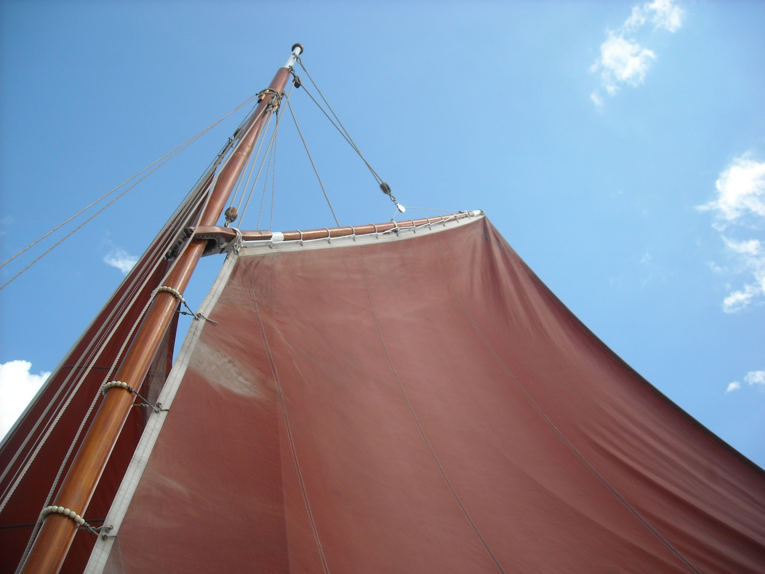
And at Yarmouth I am put ashore, as the Bligh prepares to head home.

Slide 32
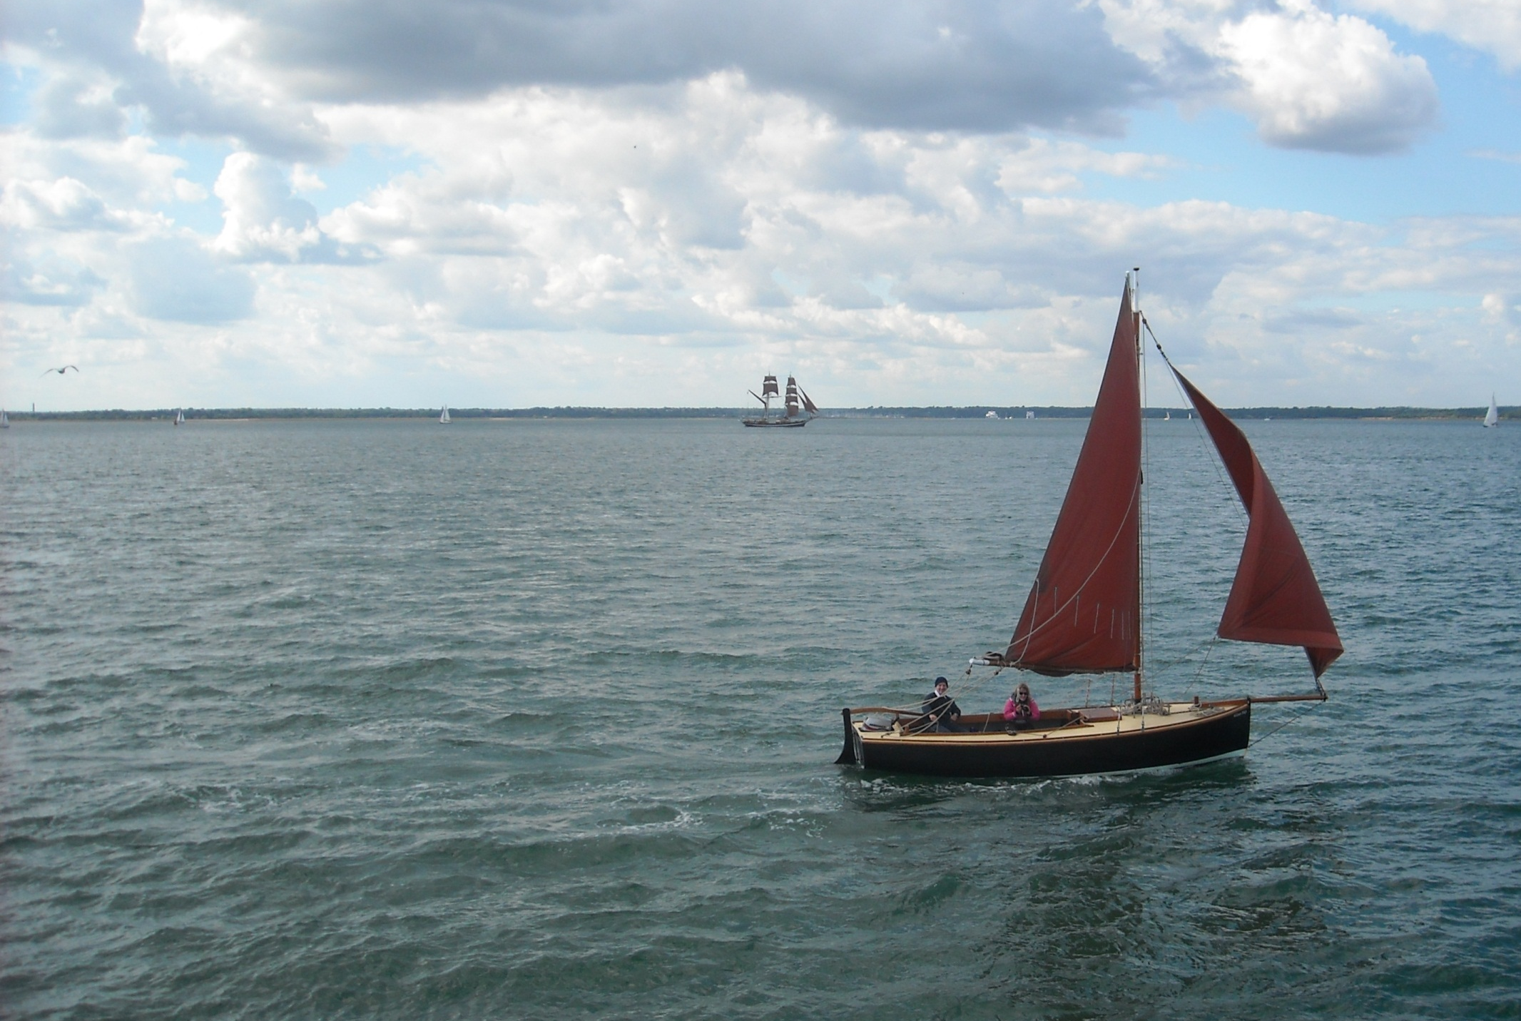
I bid farewell from the pier as, with perfect timing,
William Bligh and Georg Stage set off into the sunset together.

Slide 33
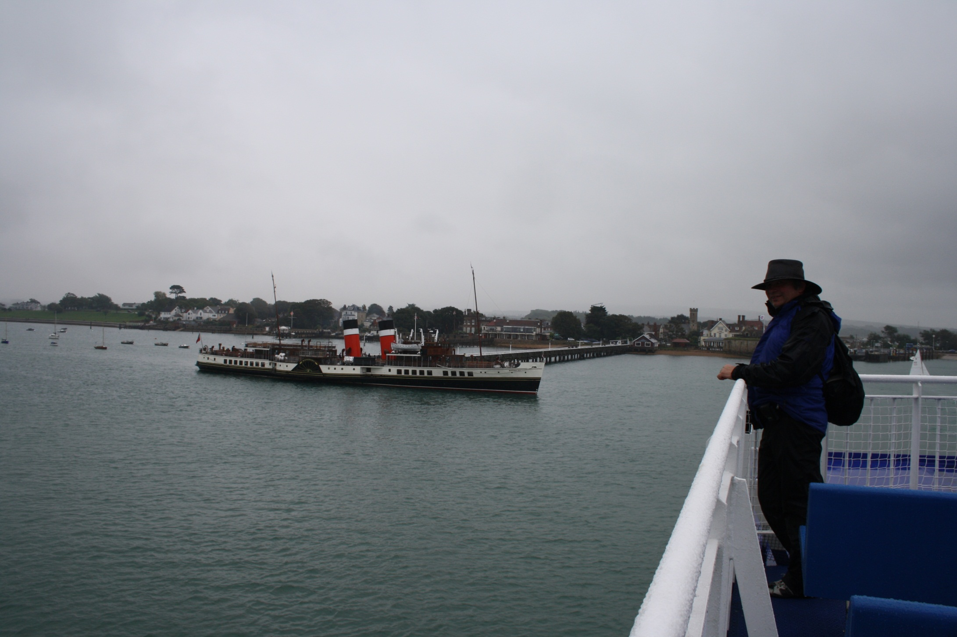
It proved unexpectedly difficult to progress from Yarmouth as I arrive on a Lymington ferry intending to board the Waverley.

Slide 34
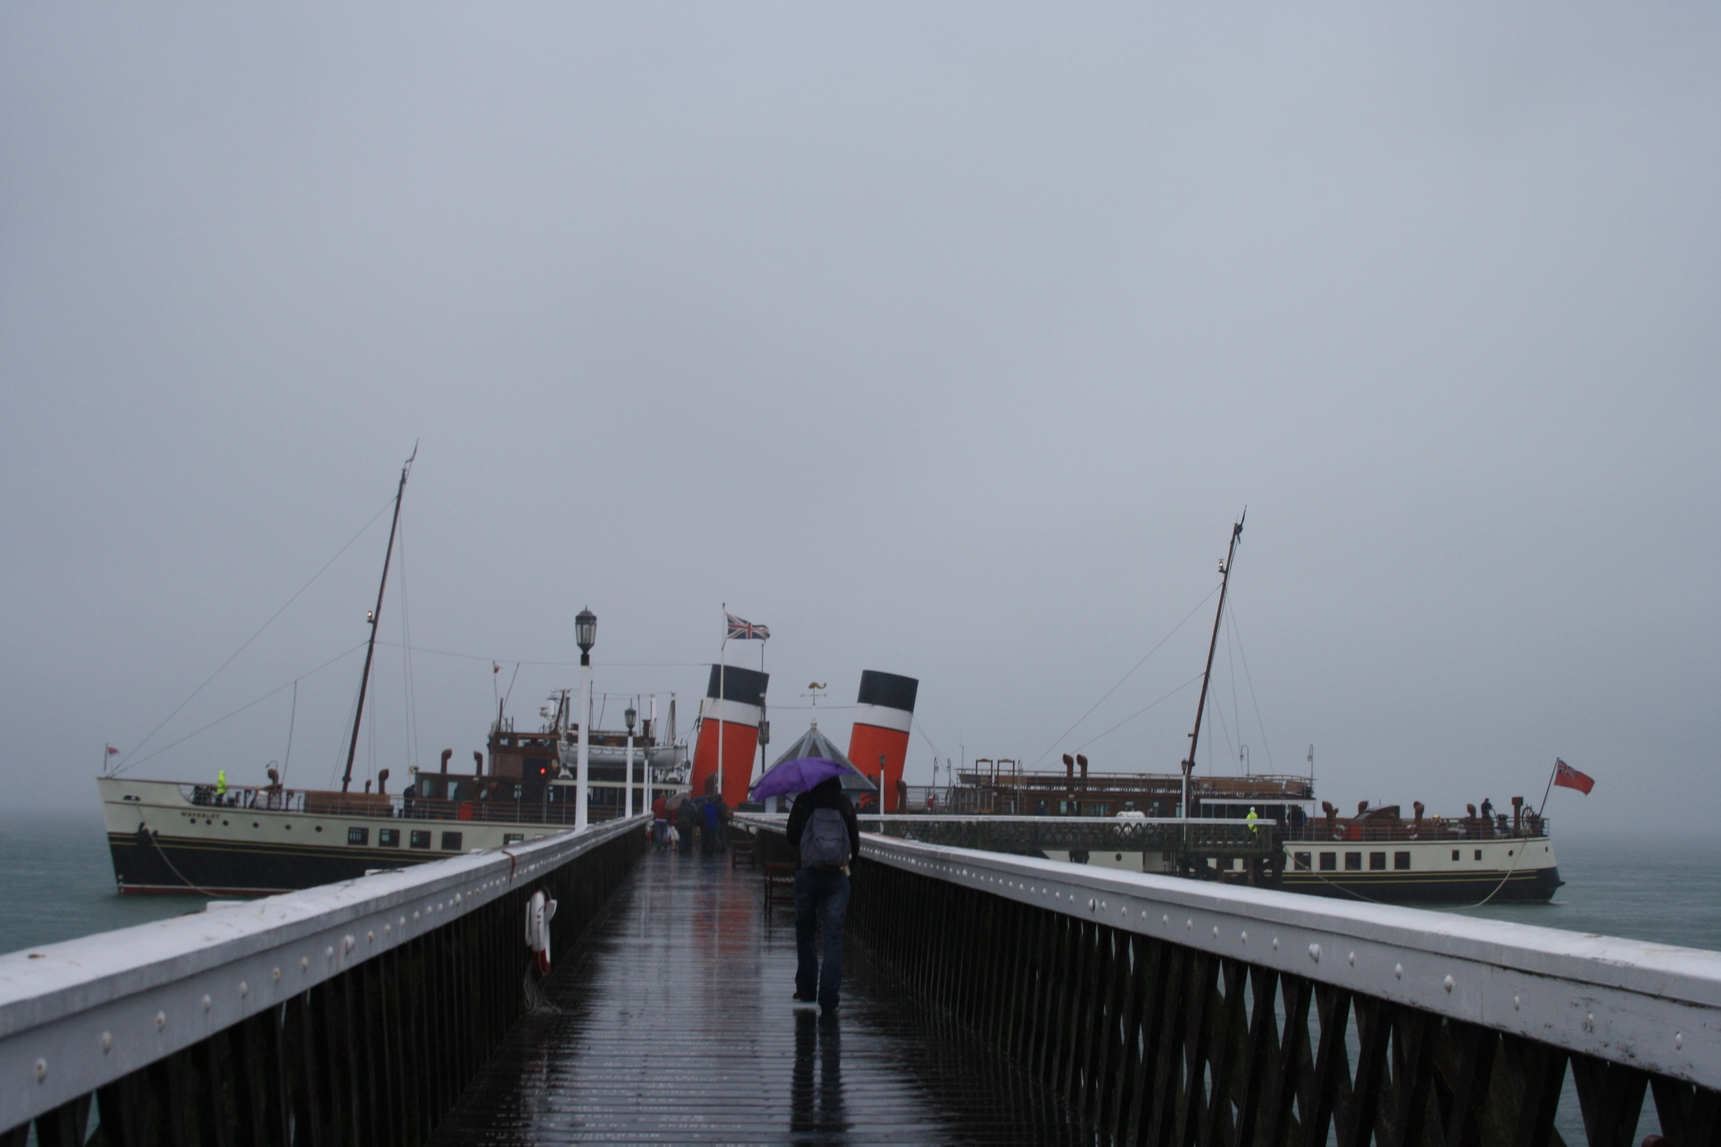
As my 4th September 2011 trip became cancelled by bad weather.

Slide 35
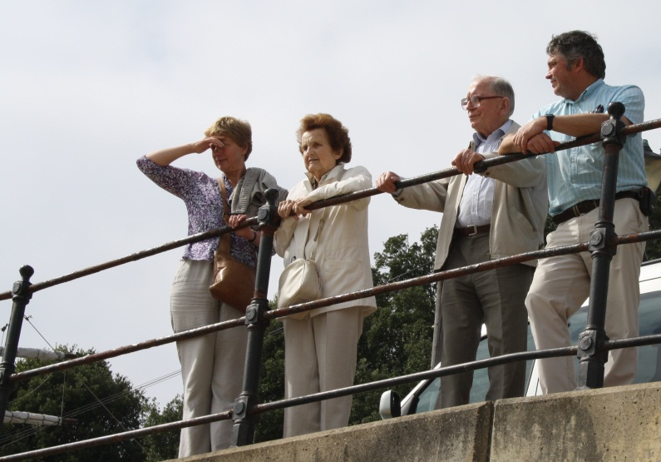
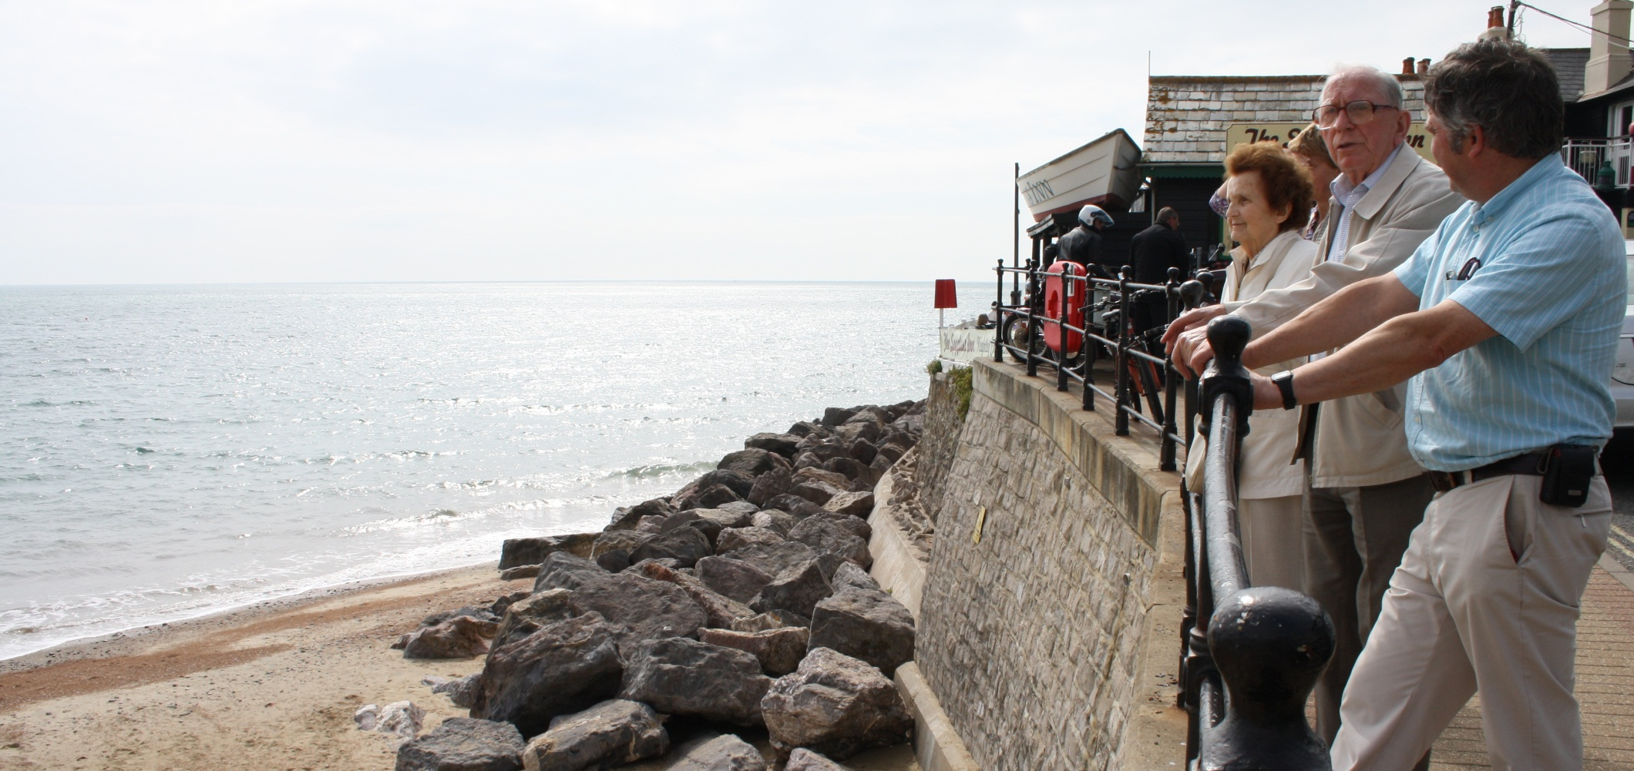
But this did give me extra time with my parents, residents of Bonchurch, Isle of Wight, for over 30 years.

Slide 36
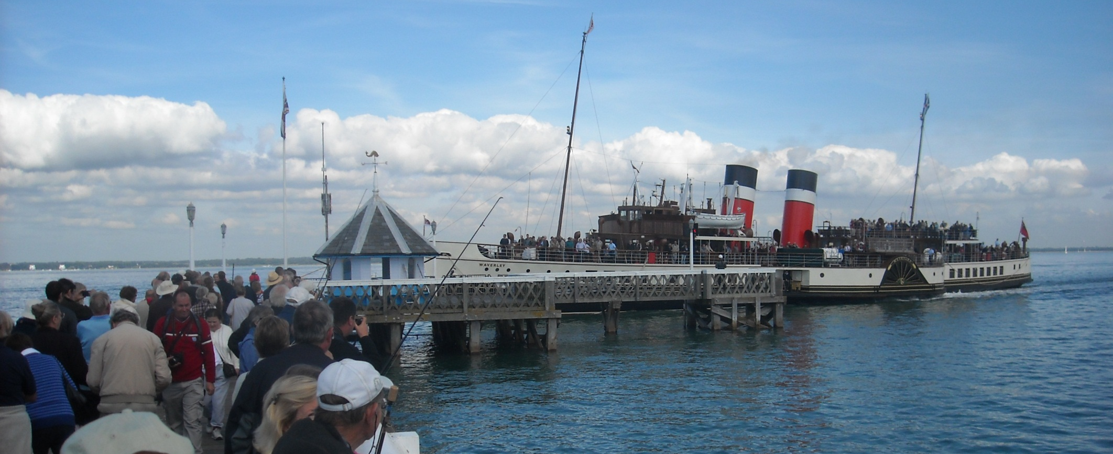
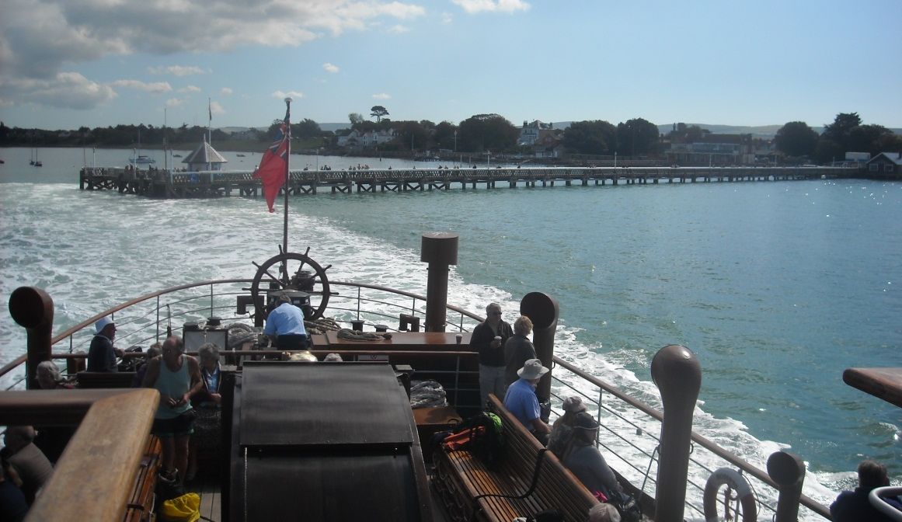
And it was second time lucky with the Waverley as we finally steam away from Yarmouth Pier on 15th September 2011.

Slide 37
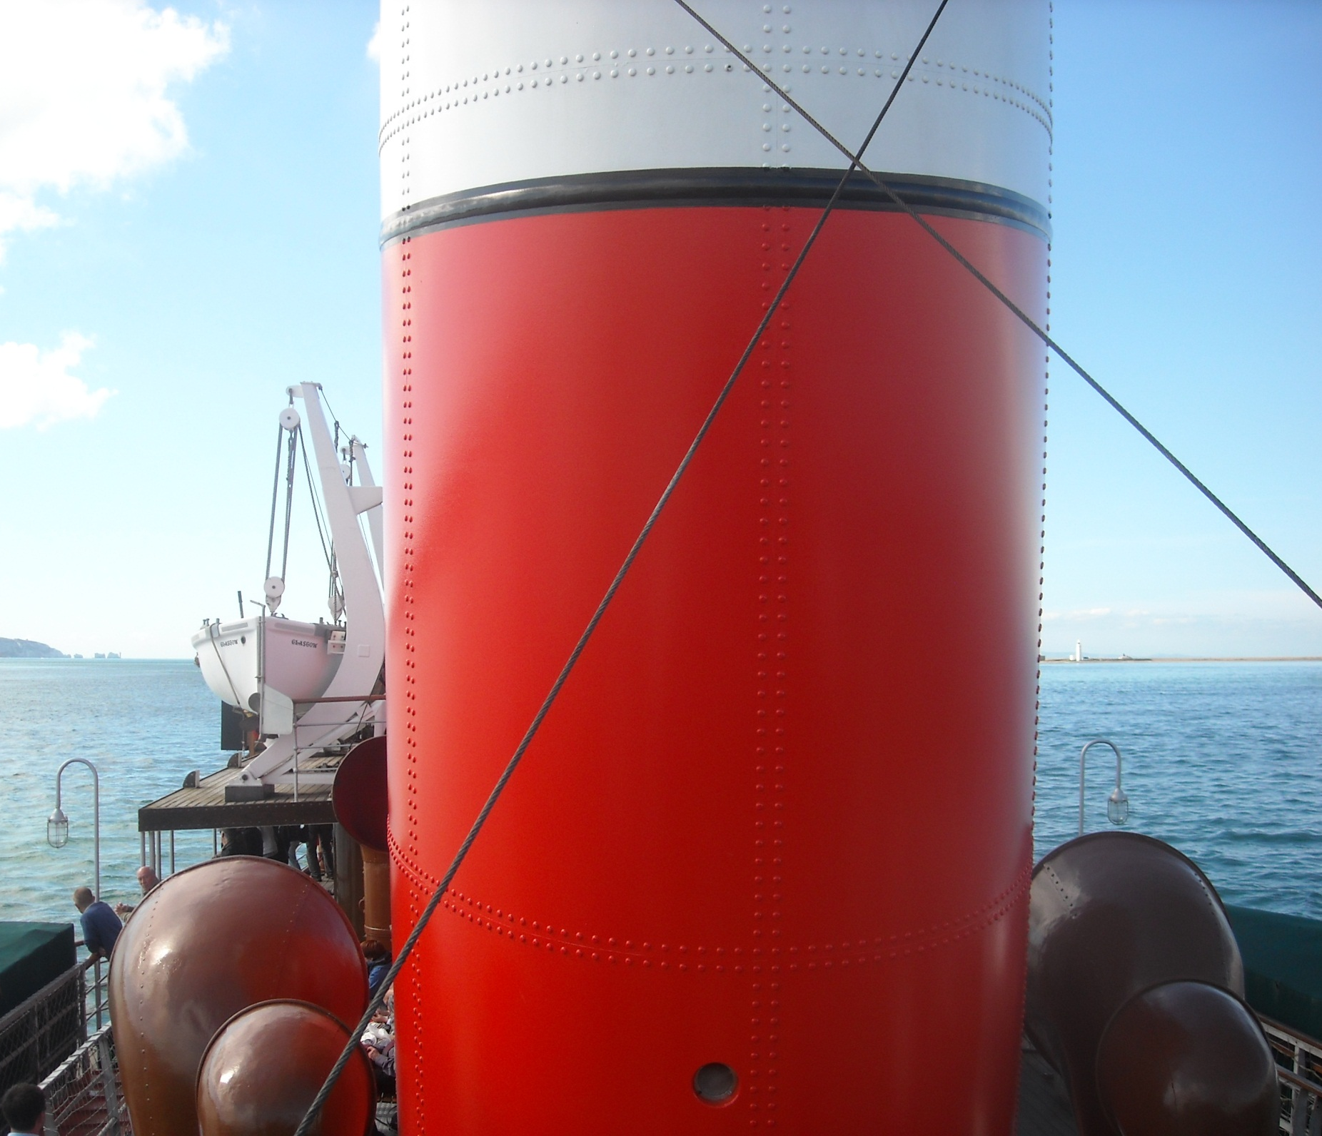
To head down the Solent.

Slide 38
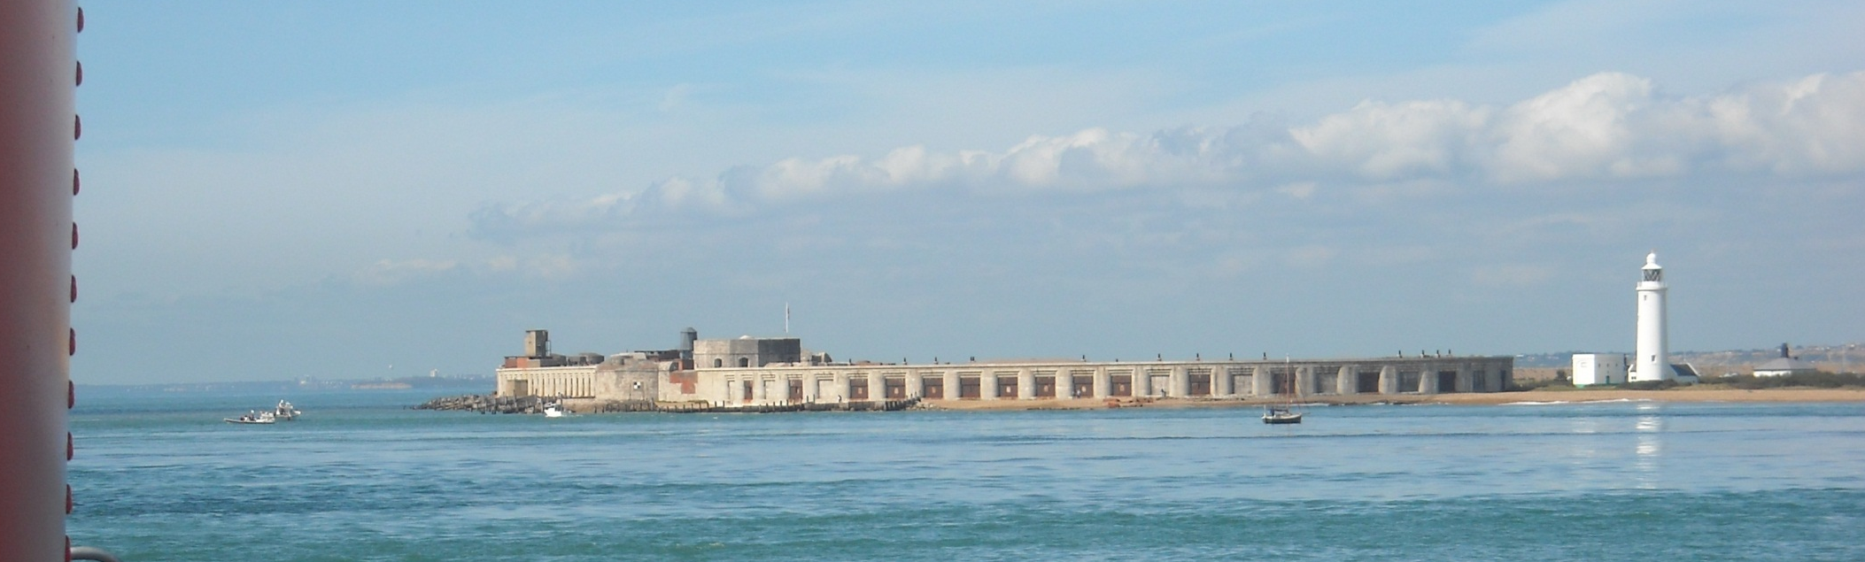


Past Hurst Castle and the Needles.

Slide 39

And shingle Hurst Beach to
Milford on Sea and Christchurch Bay.

Slide 40

Milford on Sea is beach hut land extraordinaire.

Slide 41

We then curve round Hengistbury Head

Slide 42

And pass the small pier in the Bournemouth suburb of Boscombe.

Slide 43

Before preparing to call at tricky Bournemouth Pier itself.

Slide 44


Conditions need to be just right for the Waverley to call here.

Slide 45

And there were plenty of potential passengers waiting today.

Slide 46


The shallow draughted paddle steamer Waverley at Bournemouth Pier in the 21st century is an incredible sight!

Slide 47



We cast off and move on.

Slide 48


To leave Bournemouth and cross Poole Bay.

Slide 49

We reach Old Harry, the famous chalk stack at Handfast Point, a formation once connected to the Needles.

Slide 50

The chalk cliffs of Ballard Down leading us into Swanage.

Slide 51

Where even more people are waiting to board.
Waverley, in weather like this, is a big draw.

Slide 52

From Swanage we round Durlston Head to follow the spectacular cliffs of the Isle of Purbeck, an island only in name.

Slide 53

This is the Anvil Point light with Tilly Whim Caves below, once one of the many stone quarries around here.

Slide 54


We pass two more quarries near
Worth Matravers.
Dancing Ledge, mainly Purbeck Limestone.
And Whinspit quarry, mostly Portland Stone.

Slide 55

Disturbed water next round St Adhelm’s Head, definitely not a place to be in rough weather!

Slide 56

Then the Kimmeridge Cliffs on which a Nodding Donkey is patiently pumping away at oil reserves below.

Slide 57

But trouble is ahead as, out of Worbarrow Bay comes a Range Safety Boat to steer us away from Lulworth tank range.

Slide 58

So Worbarrow Bay will be as far as we go on this particular trip, almost, but not quite, to Lulworth Cove.

Slide 59

As, with the Isle of Portland silhouetted behind, the Waverley turns for home.

Slide 60

And here comes Ros in Worbarrow Bay on 1st October 2011.

Slide 61

It is a Sunday and there is no range firing on a Sunday.
This is also one of the finest days of the year.

Slide 62

As Ros heads for Lulworth Cove. We are aboard Sirius, a fast, twin engine cruiser, based in Weymouth.

Slide 63



Our Skipper is Euan McNair, who is also an instructor.

Slide 64

We then reach Stair Hole, a Lulworth Cove in the making as the sea is just breaking through the outer band of harder rock.

Slide 65

This is spectacular coastline and fantastic to view it like this.

Slide 66

We call in at Man o’ War Cove, again protected by an outer band of Portland Stone.

Slide 67

Then, just round the corner, famous Durdle Door.

Slide 68

As we drift behind the spectacular arch.

Slide 69

Wonderful chalk cliffs then follow to Bat’s Head and Bat’s Hole.

Slide 70

Bat’s Hole beach is only accessible by boat.

Slide 71

We then increase speed and head for Weymouth.

Slide 72


Passing Osmington Mills as the Dorset coastline becomes gentler.

Slide 73


And Weymouth ahead as we curve into the river mouth that forms
Weymouth Harbour.

Slide 74




We enjoy bustling Weymouth as we head under
Town Bridge and into the marina.

Slide 75

As we now depart for Lyme Regis.

Slide 76

As we head through old Weymouth to the open sea.

Slide 77

Where our first task is to circumnavigate the Isle of Portland.

Slide 78


Which begins by passing the defences and breakwaters of the old naval base. The breakwaters are built of Portland Stone, some convict quarried from the cliffs.

Slide 79

Portland’s cliffs are riddled with old quarries. Some, quite remarkably, still having their wooden cranes by the waters edge.

Slide 80

Christopher Wren was MP for Weymouth and used Portland Stone to help rebuild London after the fire, including St. Pauls Cathedral.

Slide 81

And on this cliff hand hewn blocks still await their ship!

Slide 82



Rounding Portland Bill is a quality moment with landmark Pulpit Rock, at the very tip, a product of the quarrying age.

Slide 83

A real change follows as Fortuneswell and Chiswell villages mark the start of the 18 pebbly miles of Chesil Beach.

Slide 84

Millions of pebbles, 50ft high with, as far as Abbotsbury, a brackish lagoon behind known as The Fleet.

Slide 85

Chesil Beach pebbles become smaller as the beach advances west.

Slide 86

And, when The Fleet disappears, public access becomes easier.
This is West Bexington.

Slide 87

As Euan speeds along Chesil Beach in his lovely boat.

Slide 88



Cliffs ahead!
The spectacular cliffs of Bridport Sand, an important oil reservoir, leading to West Bay, Bridport.

Slide 89

Spectacular cliffs indeed!

Slide 90



Then come the higher cliffs of Seatown with Doghouse Hill, lower left, then Golden Cap, below, at 625ft the highest point on the southern coastline.

Slide 91

Charmouth cliffs follow, full of fossils and famed for dinosaurs.

Slide 92

Then fossiliferous Black Venn, famed for mudslides.

Slide 93

And arrival at attractive Lyme Regis.

Slide 94

Where we close this Chapter in the harbour at Lyme Regis Cobb.

