Slide 1
Exploring Britain
Boating North
Chapter 10
Oban to John O’Groats
7th September 2013
to 1st August 2015

Slide 2
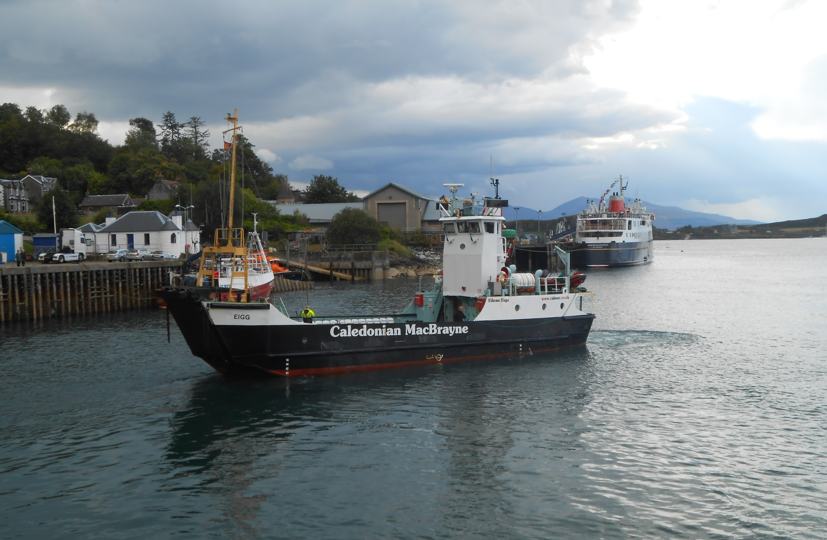
We are in Oban, the heart of MacBrayne’s ferry network, waiting to board Eigg for Lismore Isle.

Slide 3
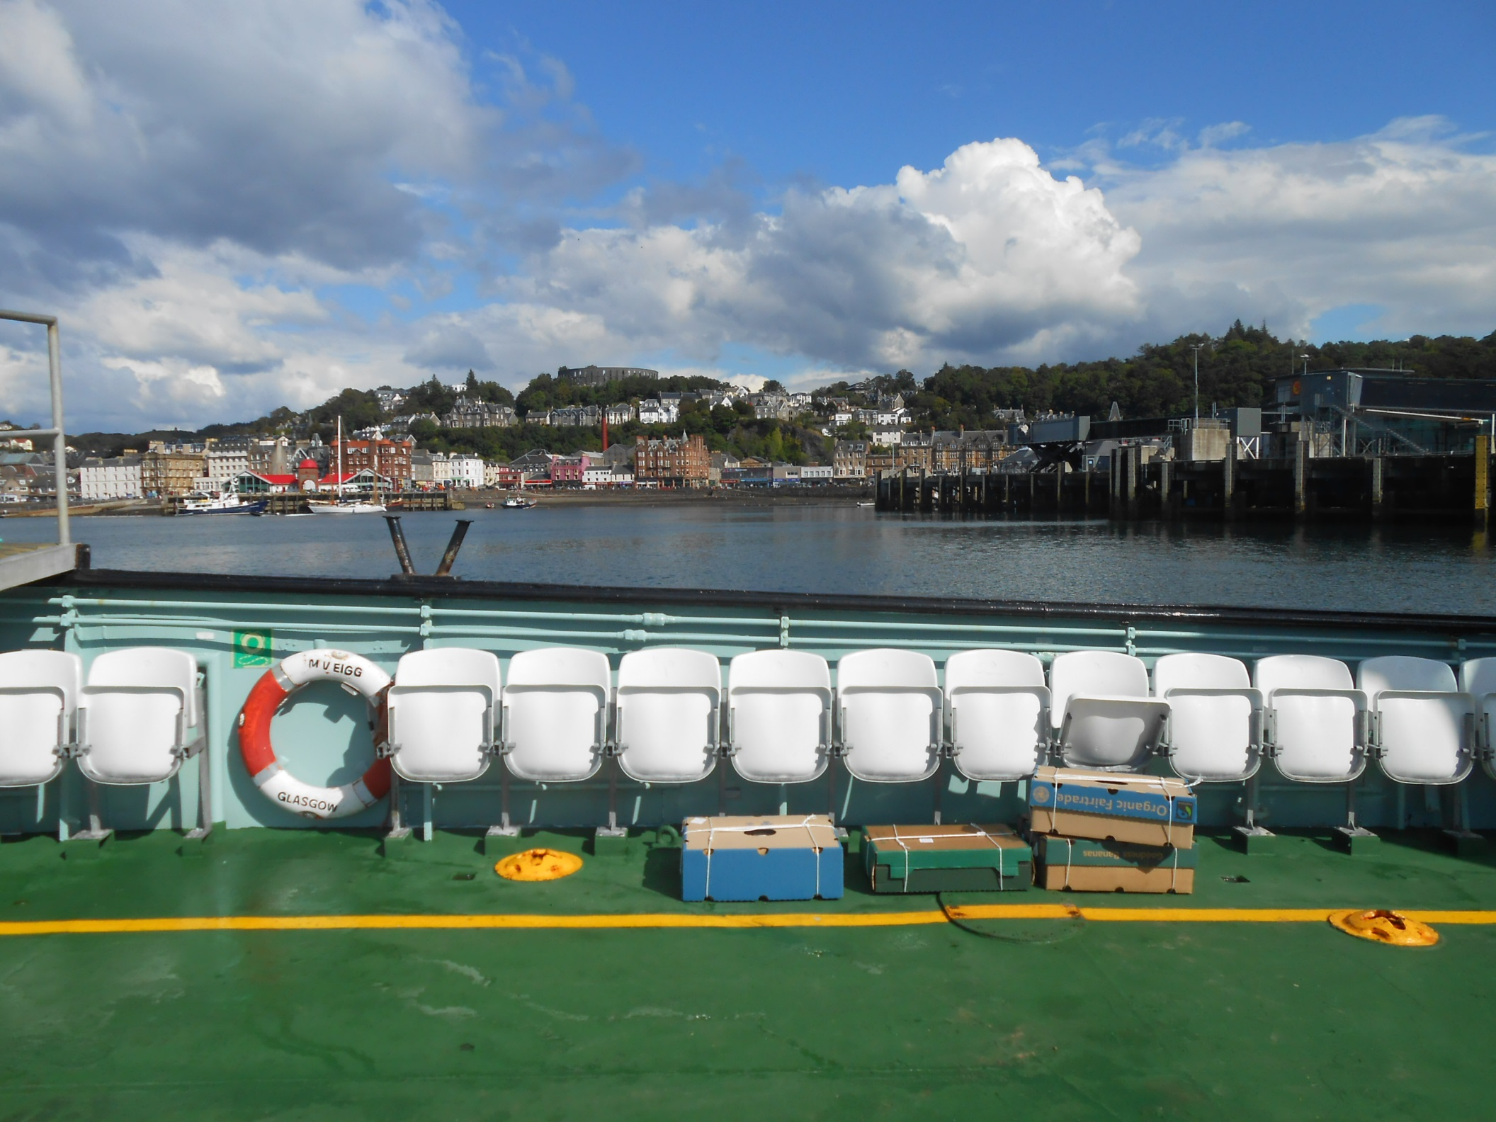
As we say farewell to Oban in an empty boat on a lovely day.

Slide 4
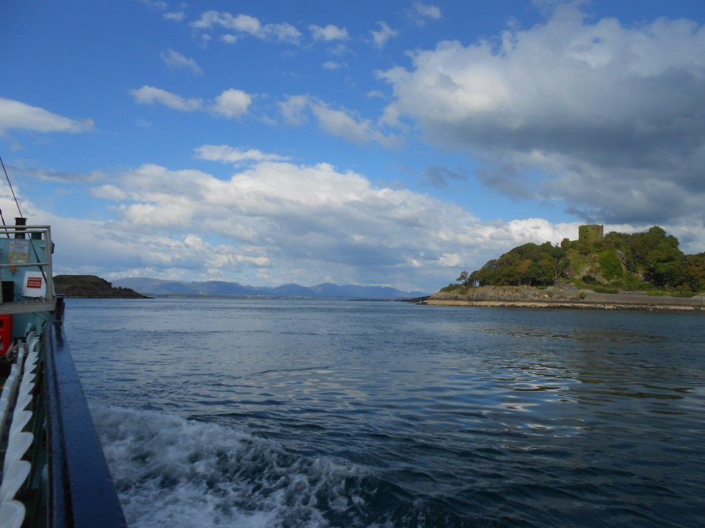
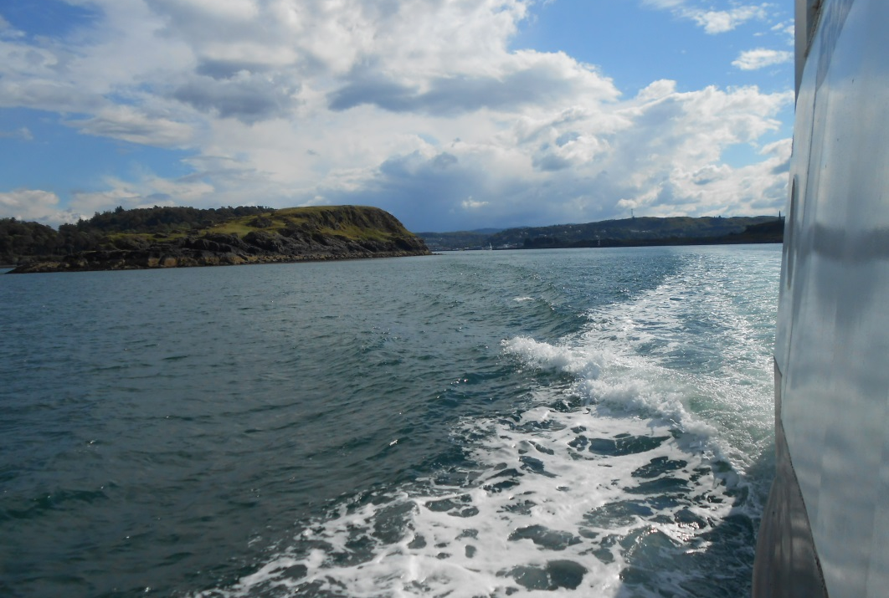
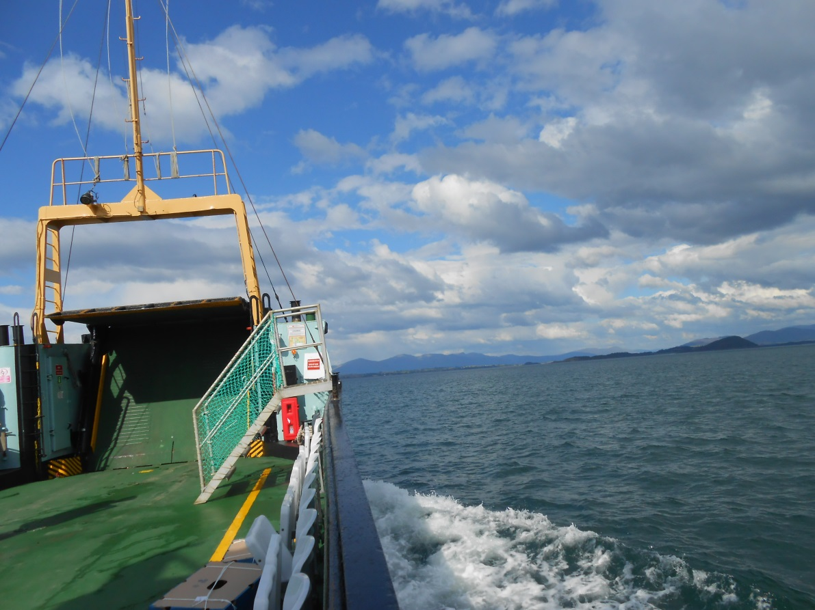
We head past Dunollie Castle and Maiden Island and into the Lynn of Lorne.

Slide 5
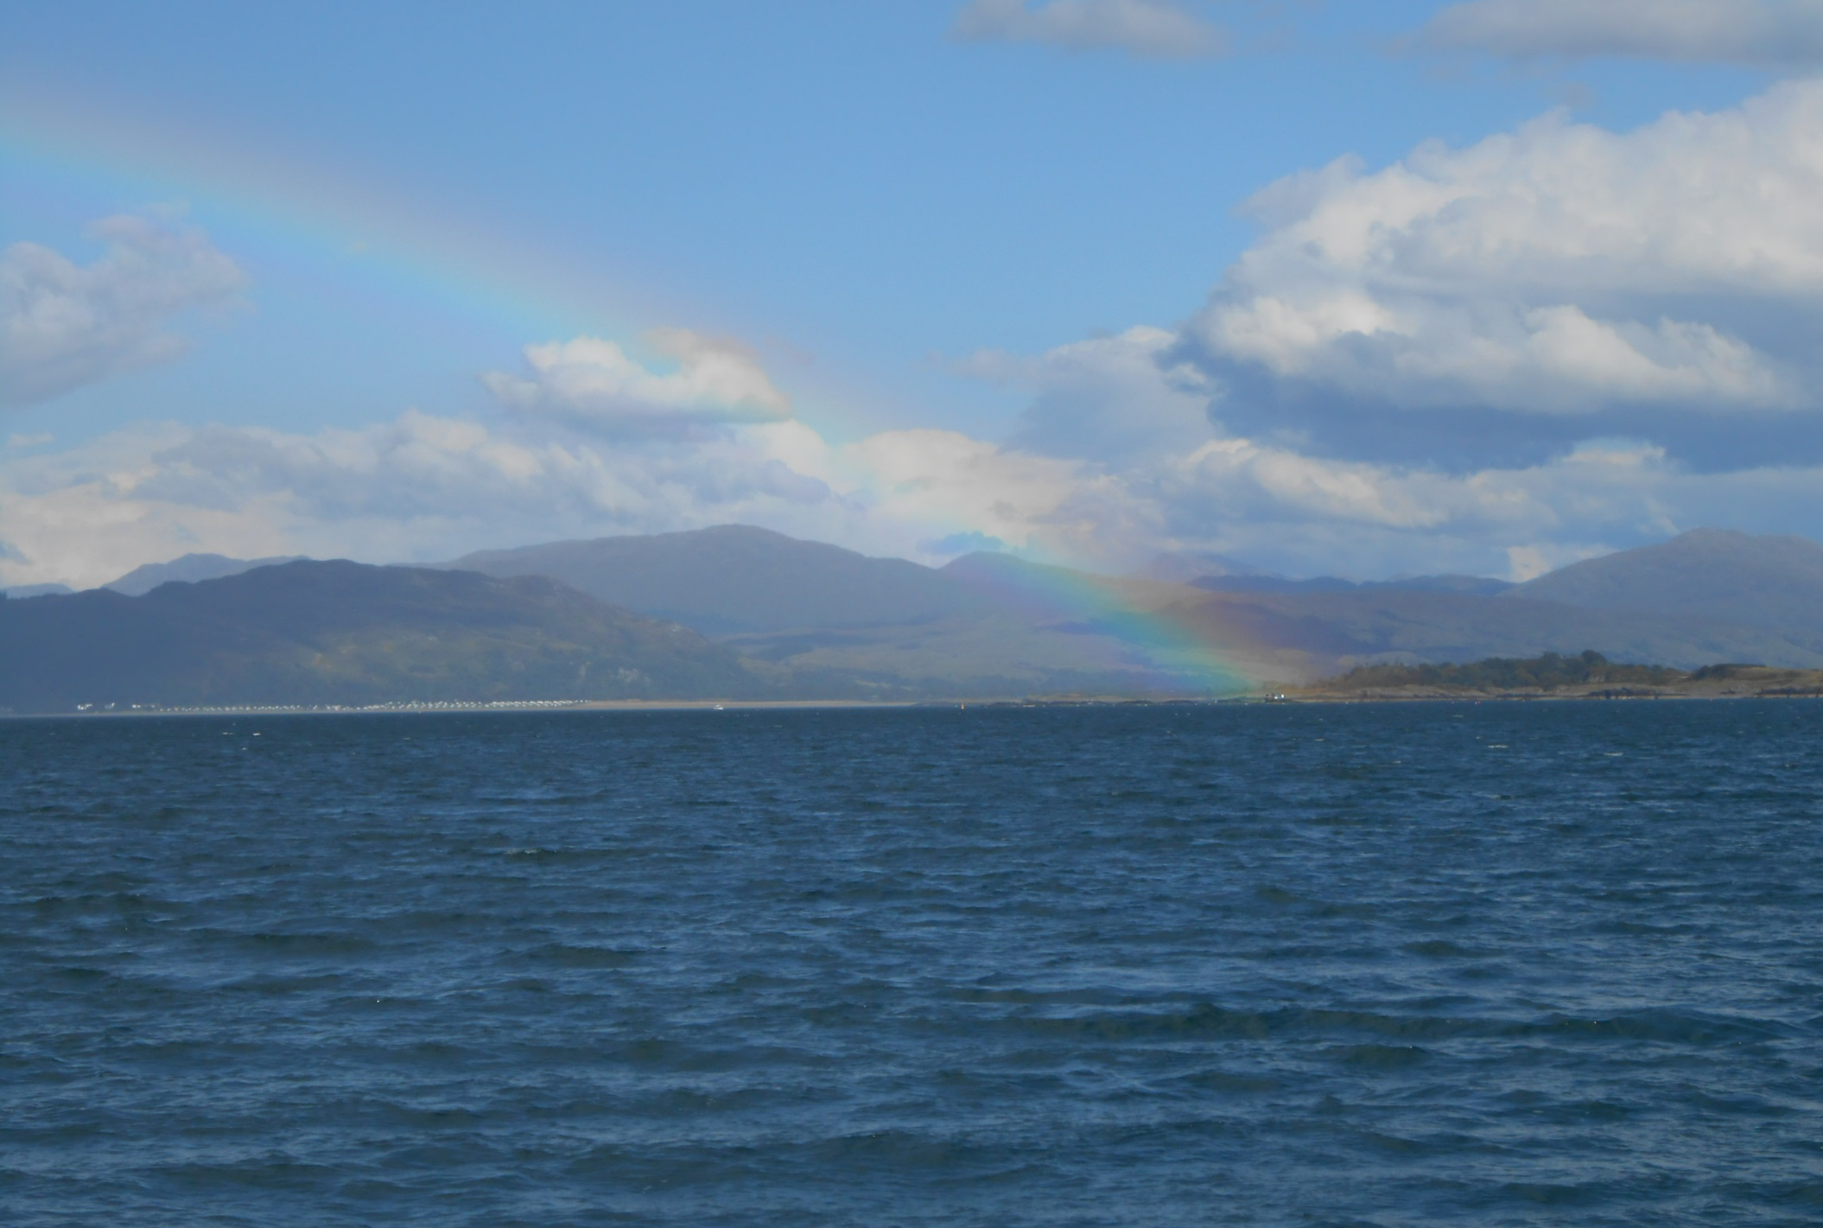
Where we find a rainbow over Connel Bridge and the Falls of Lora, the tidal race under Connel Bridge on falling tides.

Slide 6
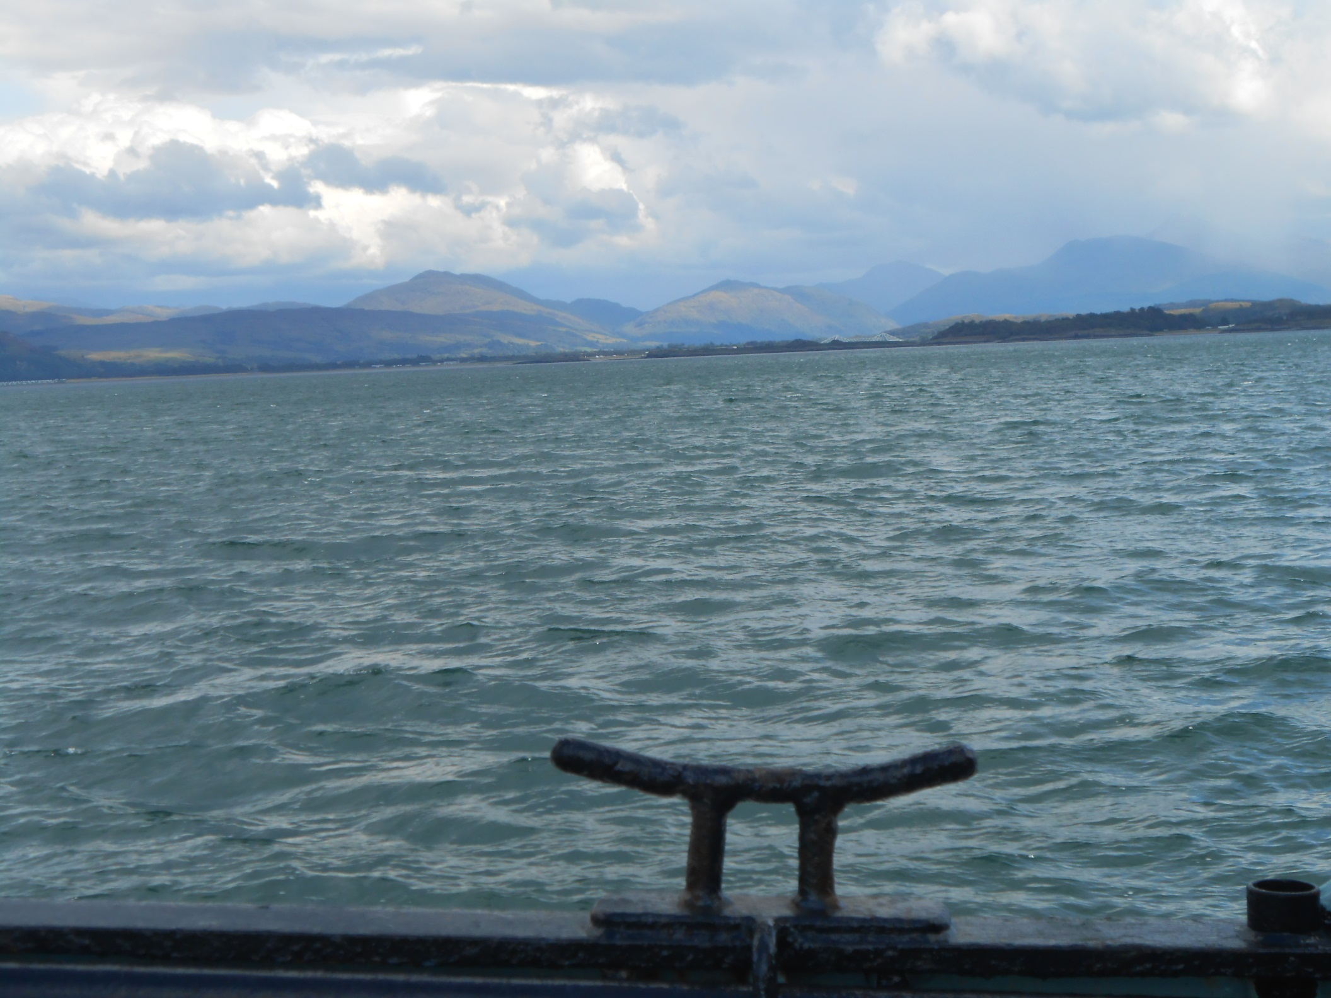
Whilst on the other side of the boat are the mountains of Mull.

Slide 7
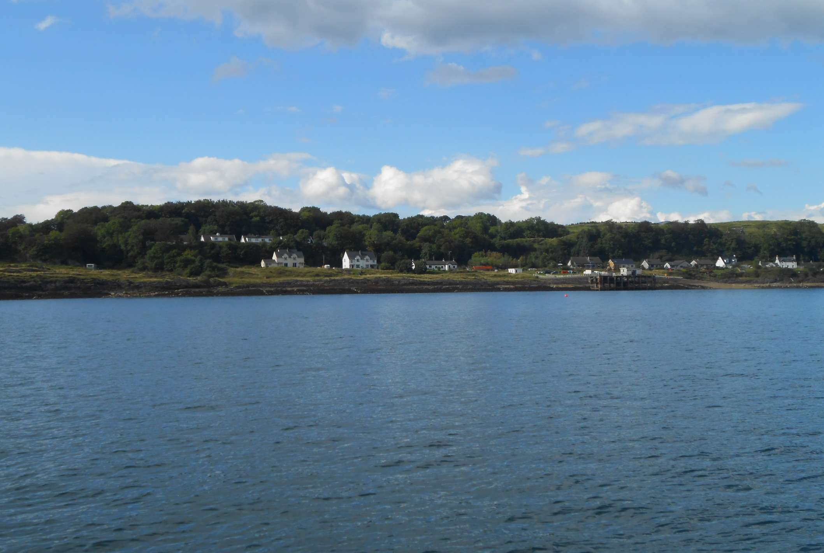
We reach Achnacroish, Lismore’s main ferry terminal.
Lismore has a population of 146. 150 years ago it was about 900.

Slide 8
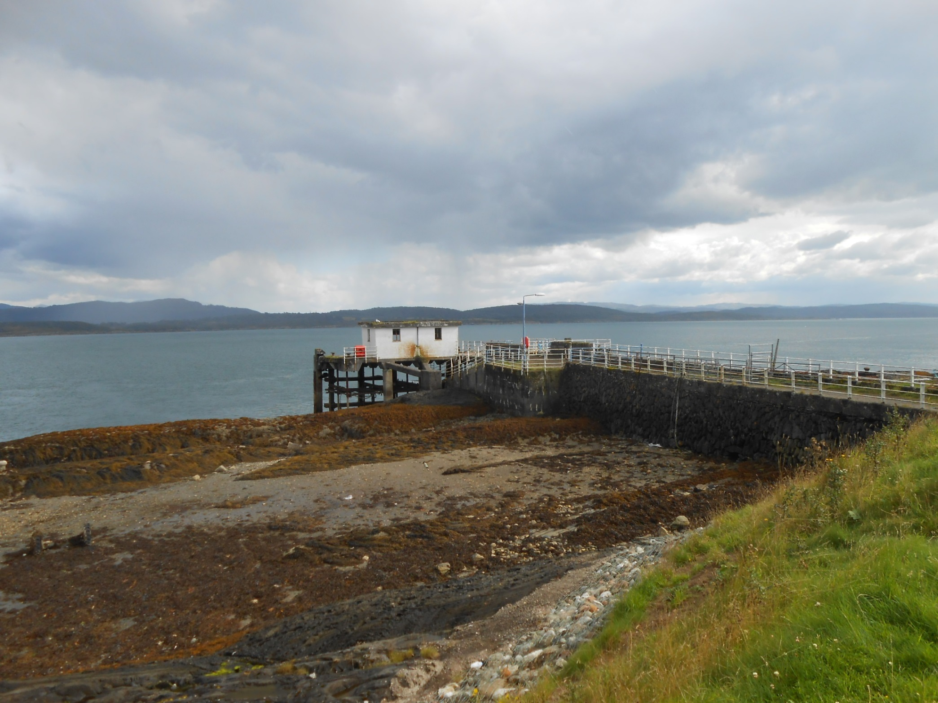
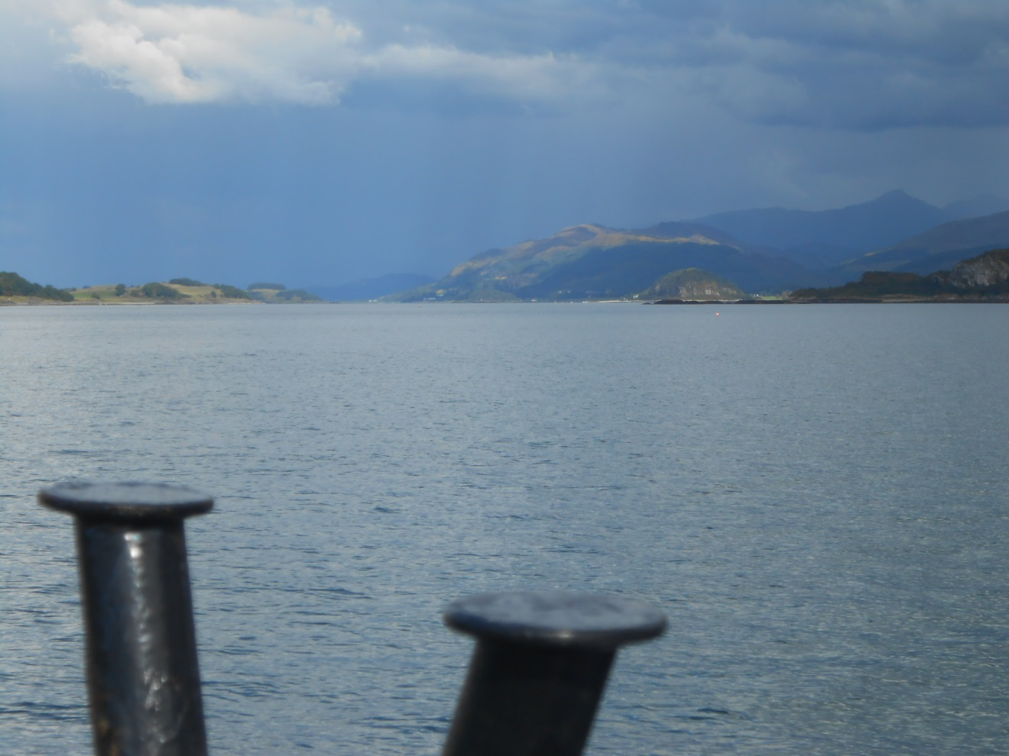
This is the old steamer jetty at Achnacroish.

Slide 9
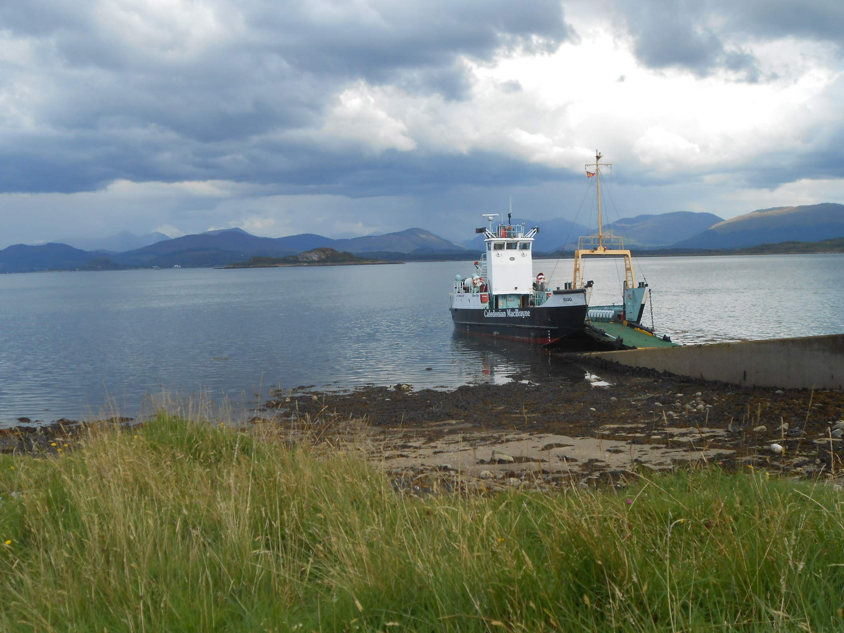
Modern day ferries use a ramp.

Slide 10
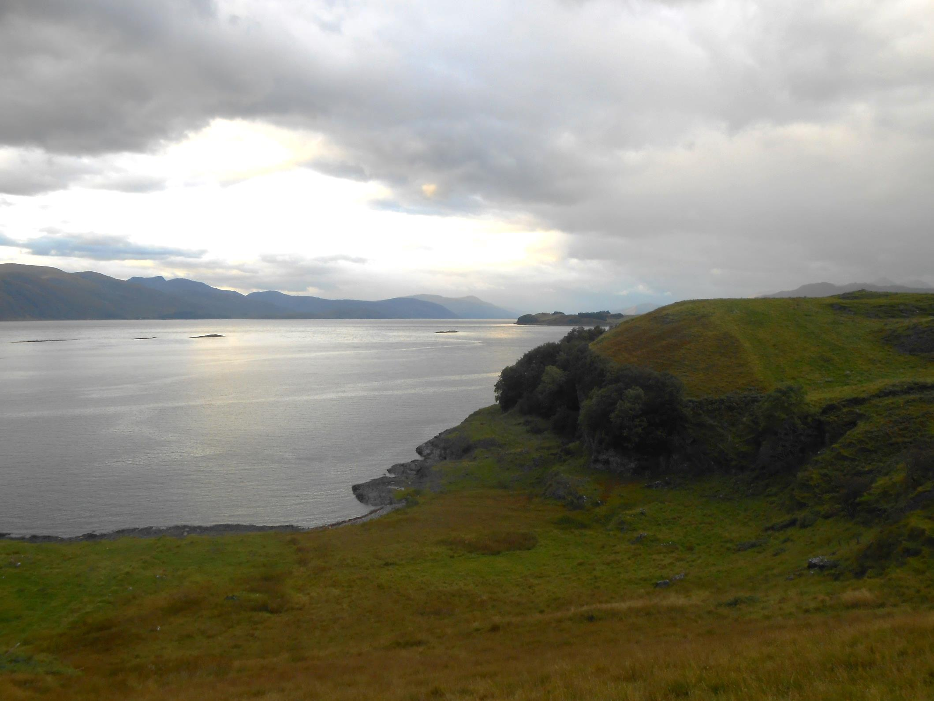
Lismore is a very narrow island.

Slide 11
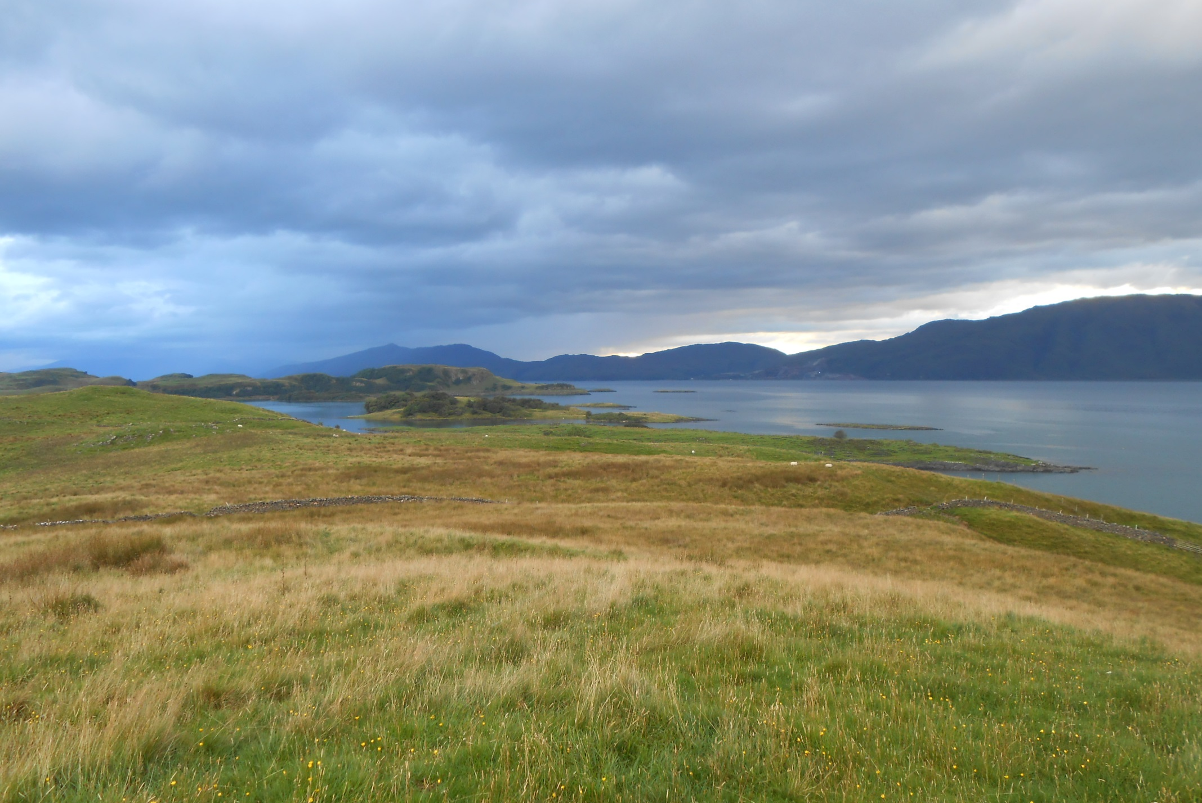
And looks remote in this eastwards view across Loch Linnhe to Glensandre.

Slide 12
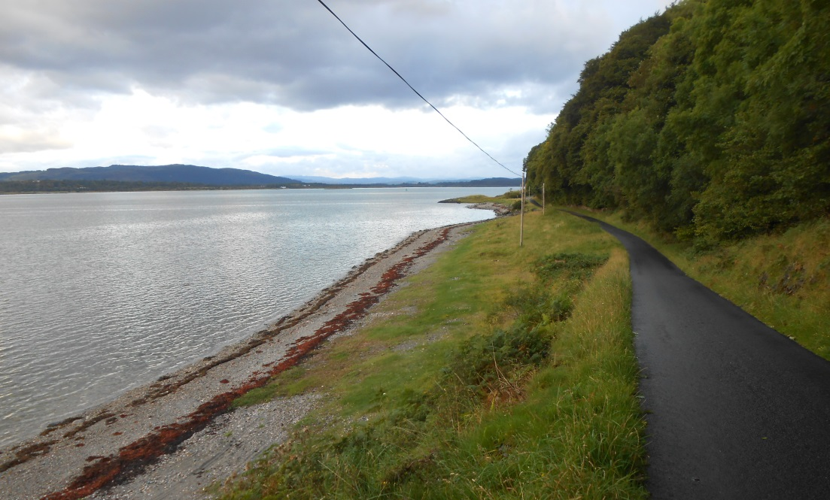
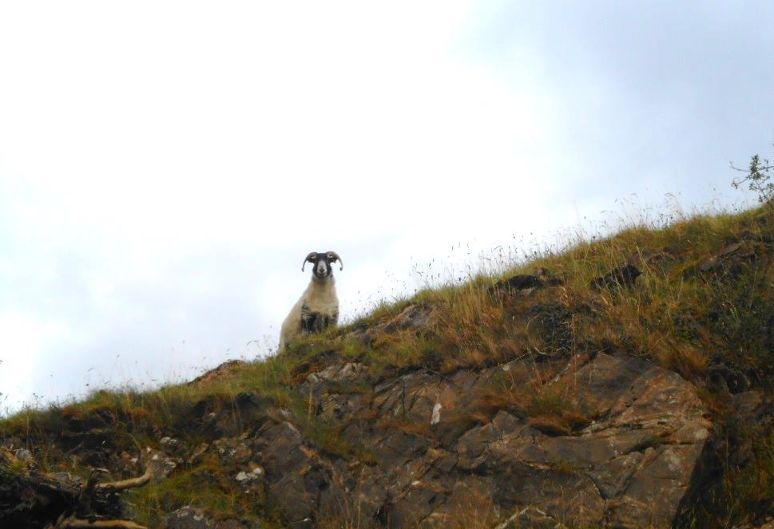
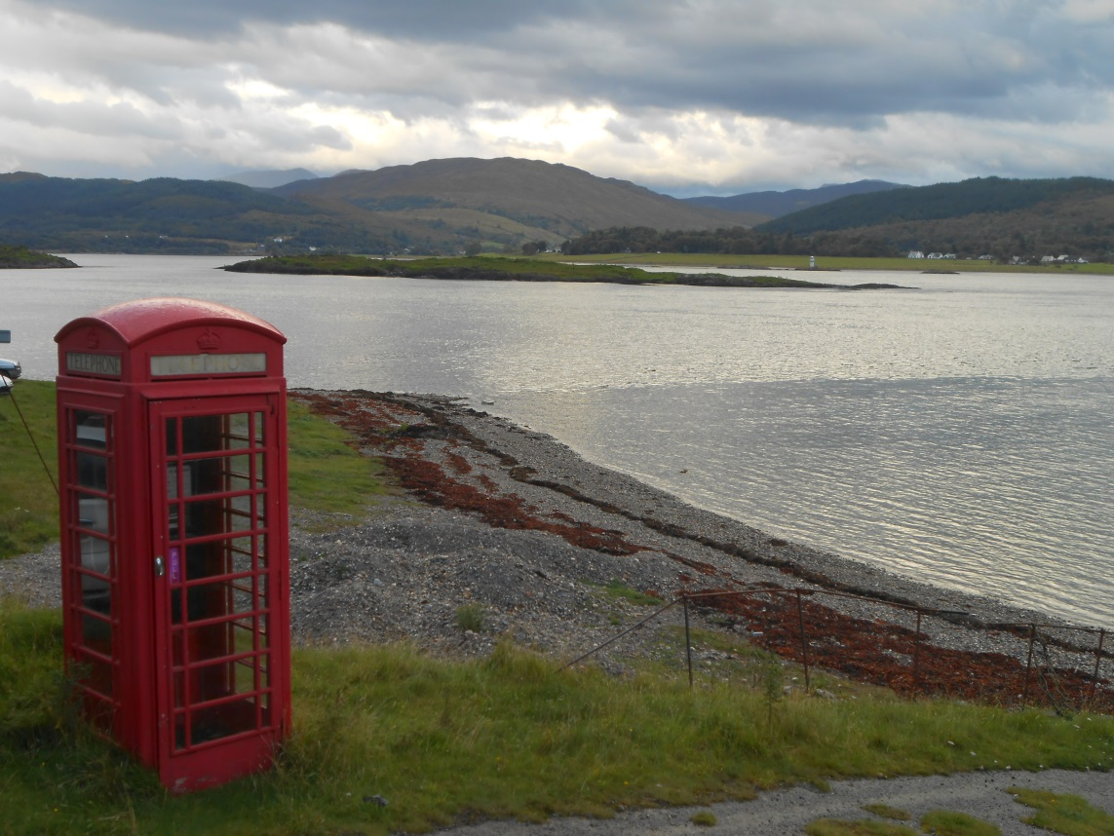
Just a little way up from Achnacroish is another ferry link, the link to Port Appin as we await the evening boat.

Slide 13
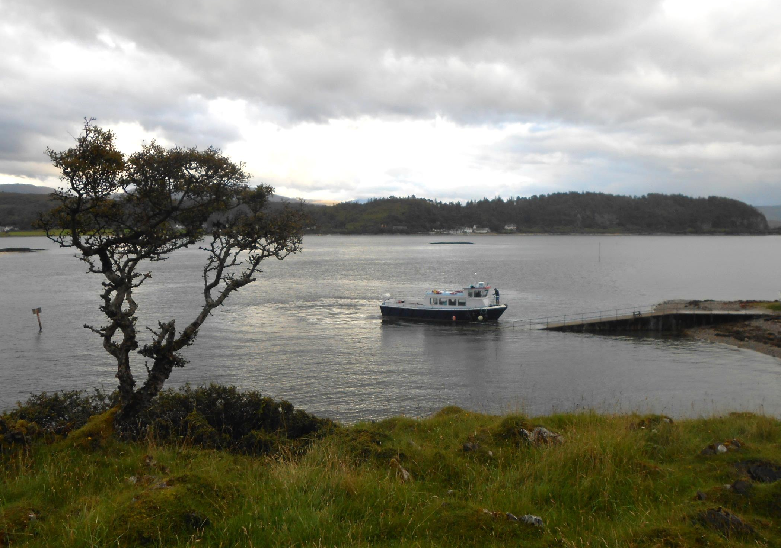
The ferry arrives. In winter this crossing must be very quiet.

Slide 14
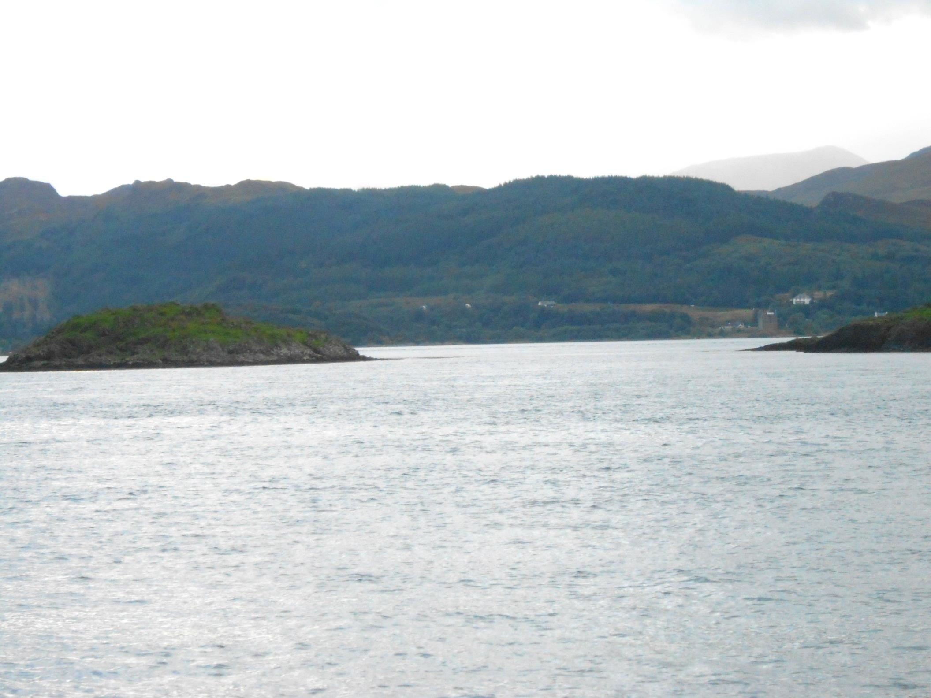
There are views to Castle Stalker as we cross to Port Appin.

Slide 15
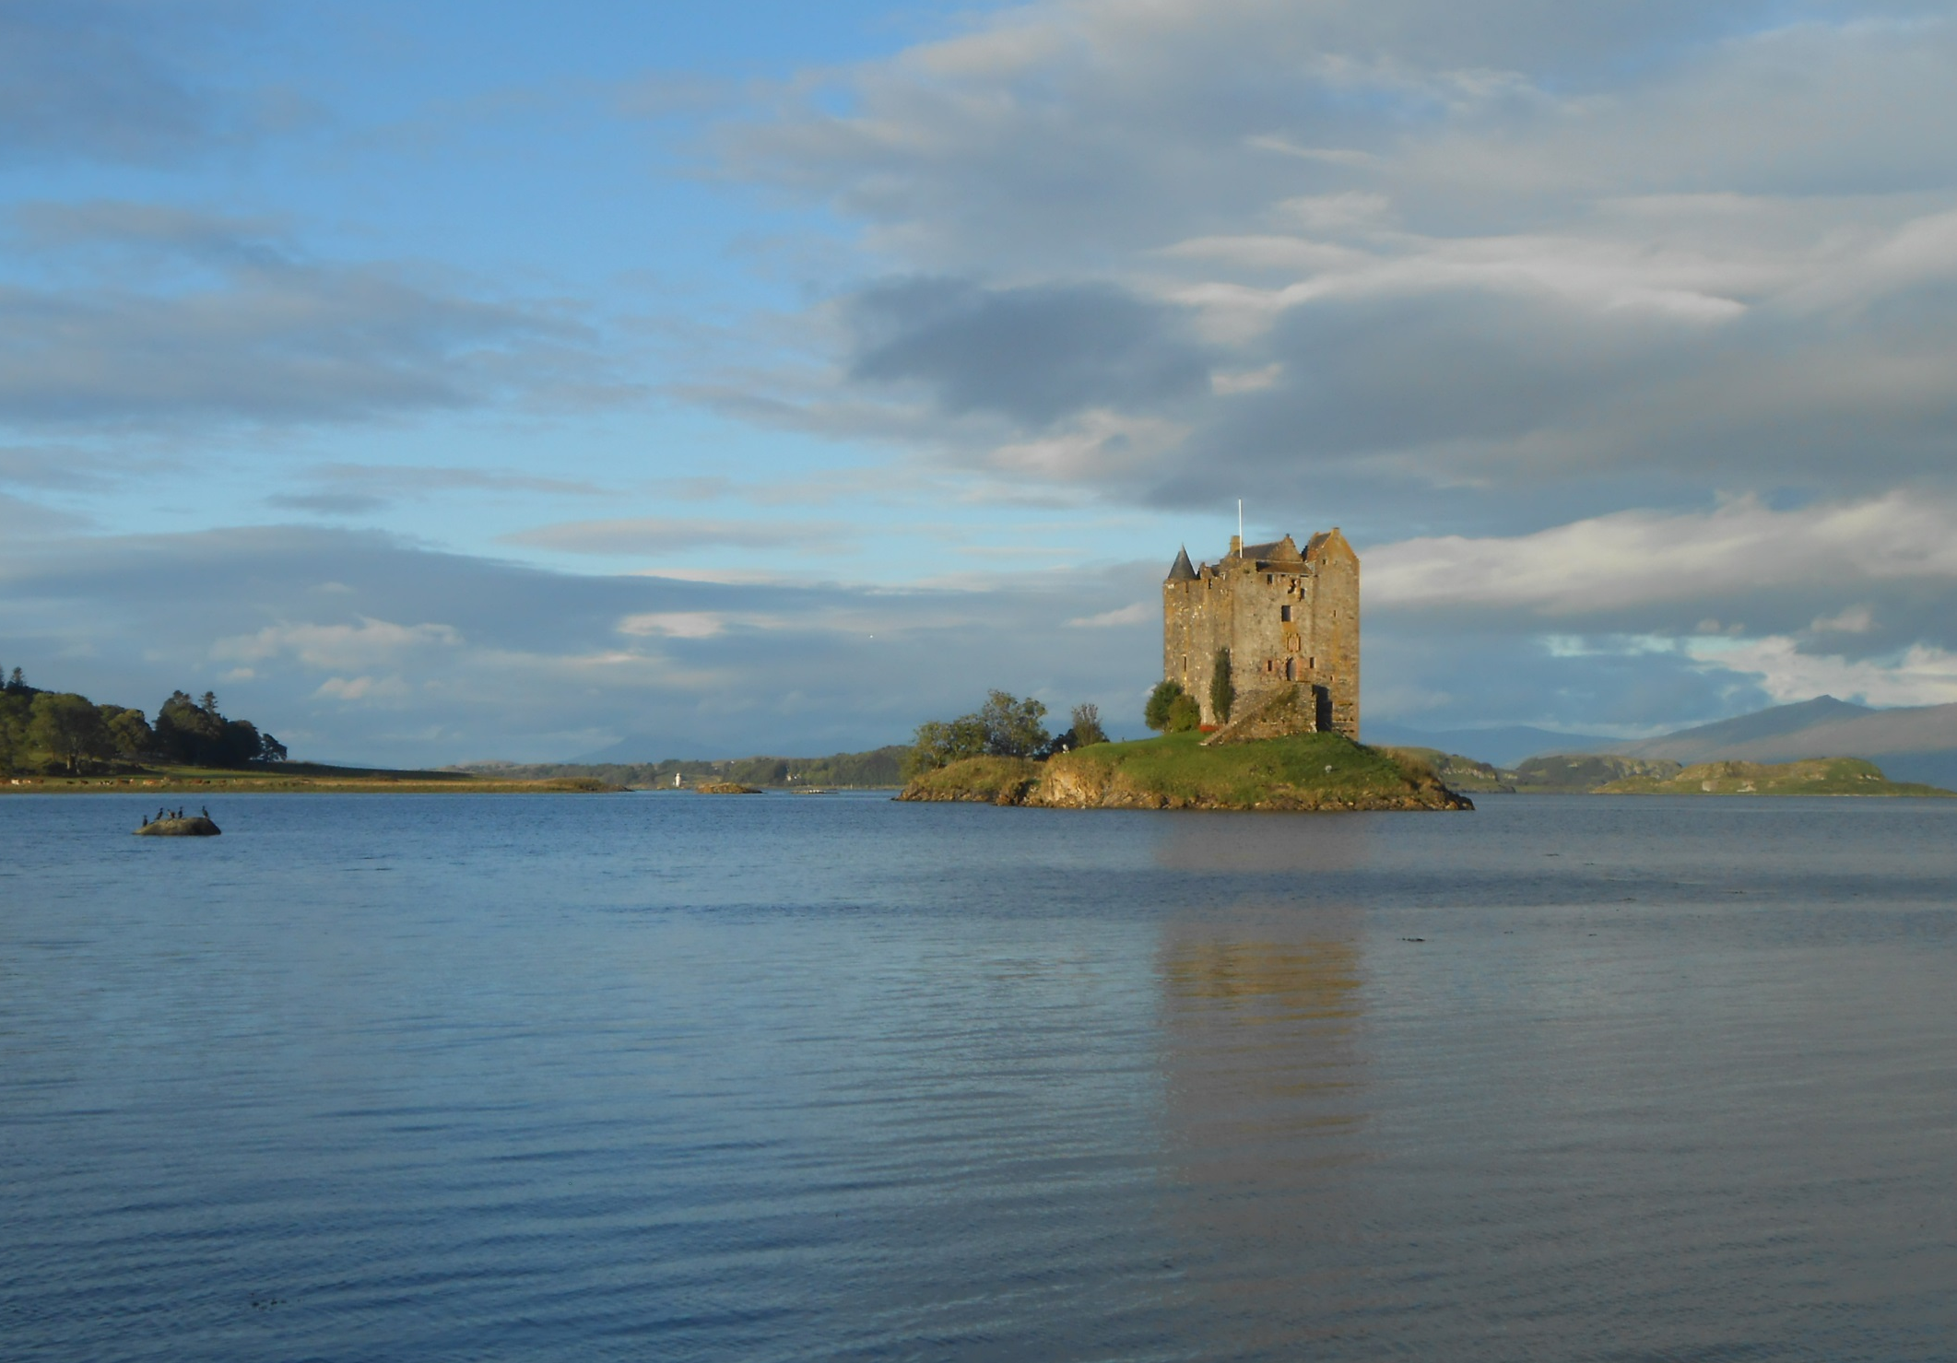
But much better views of Castle Stalker the following morning.

Slide 16
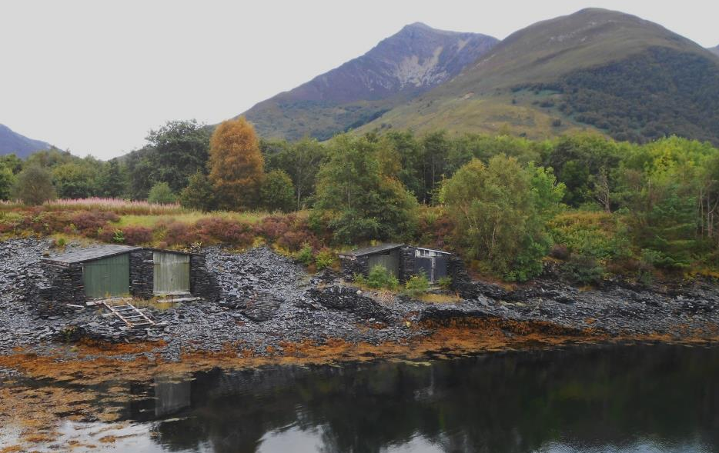
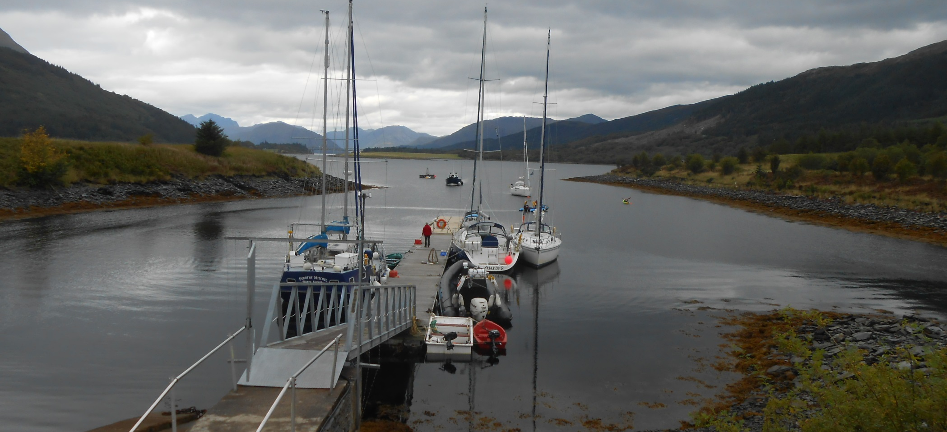
The idea now was to take a trip from Ballachulish to close the gap from Lismore but the black rib at the jetty here has gear box trouble and all trips are cancelled today.

Slide 17
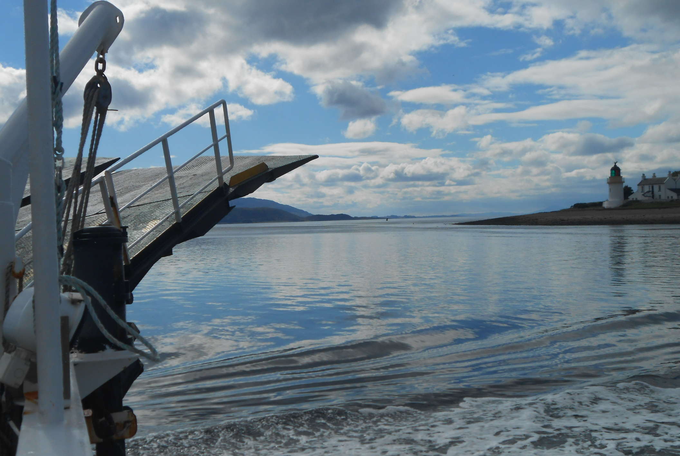
But the Corran Ferry comes to the rescue as on it we have line of sight down Loch Linnhe to Lismore Isle!

Slide 18
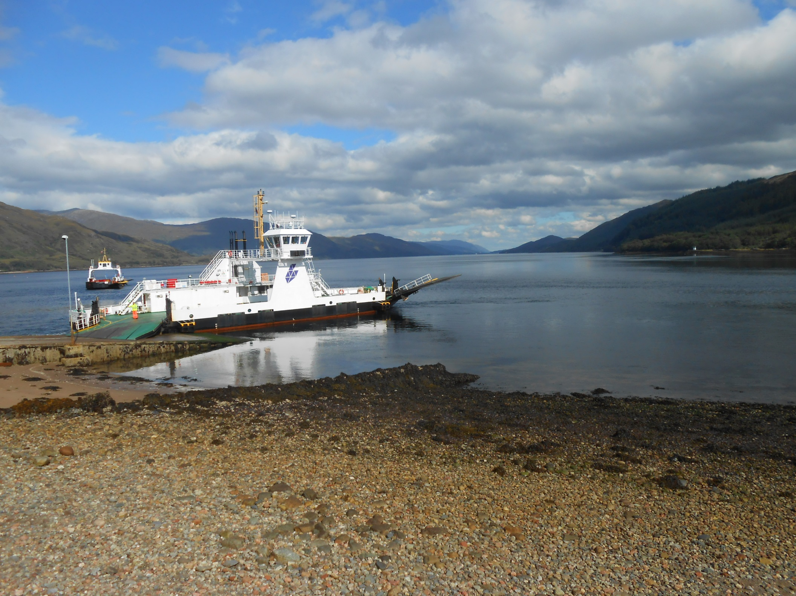
The Corran Ferry is well used and a popular short cut to the Ardnamurchan Peninsular.

Slide 19
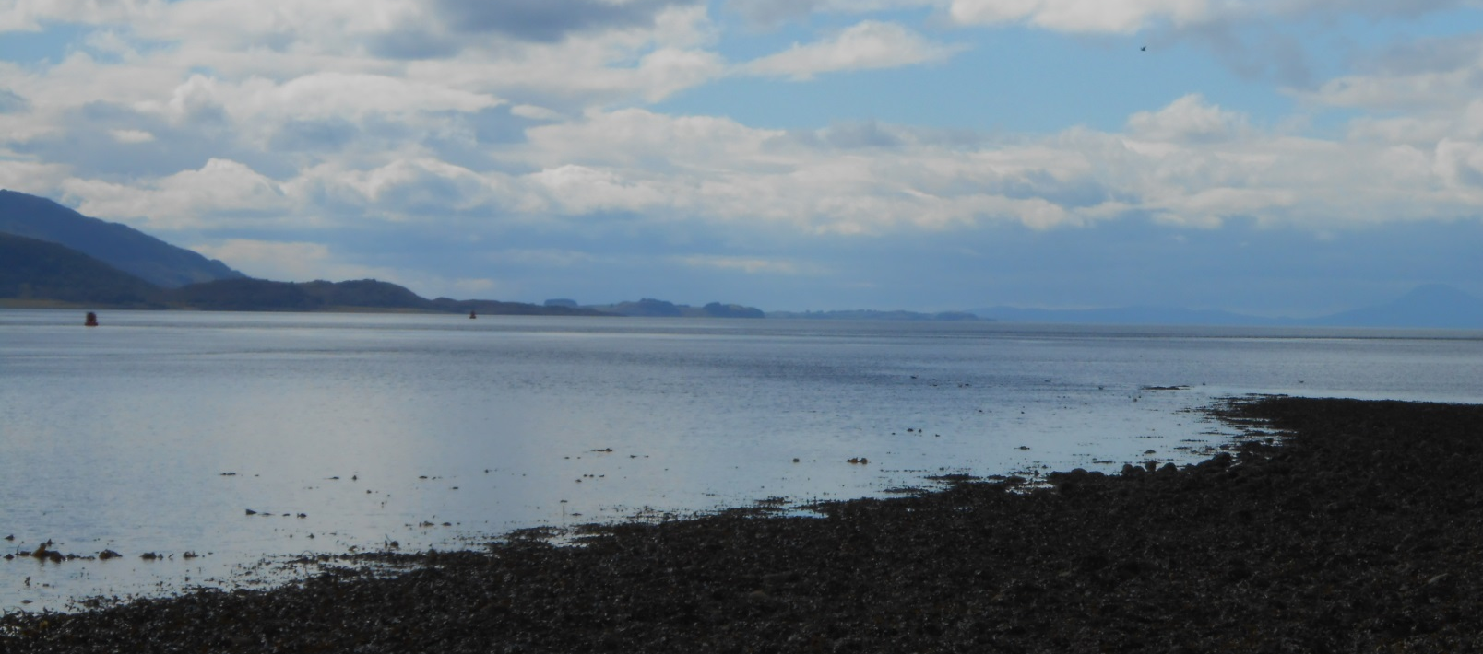
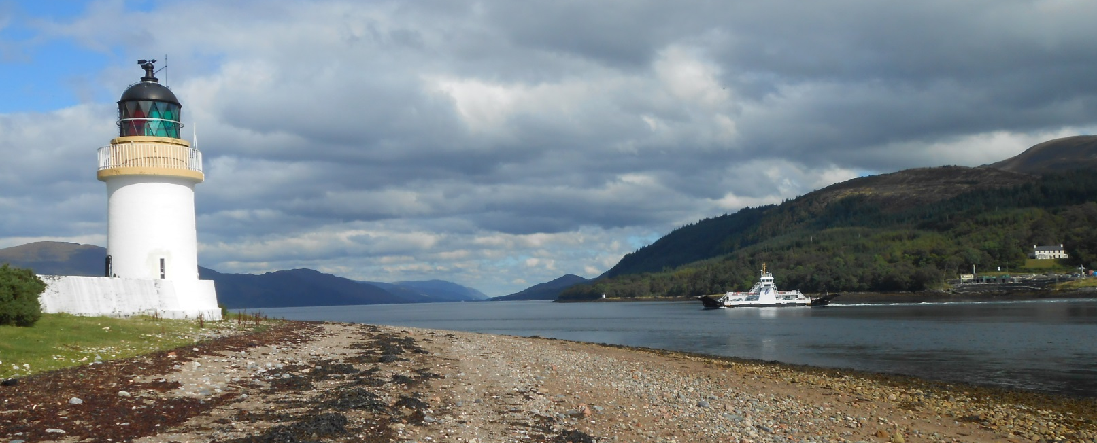
Tidal Loch Linnhe can also be tricky hereabouts, hence the light.

Slide 20
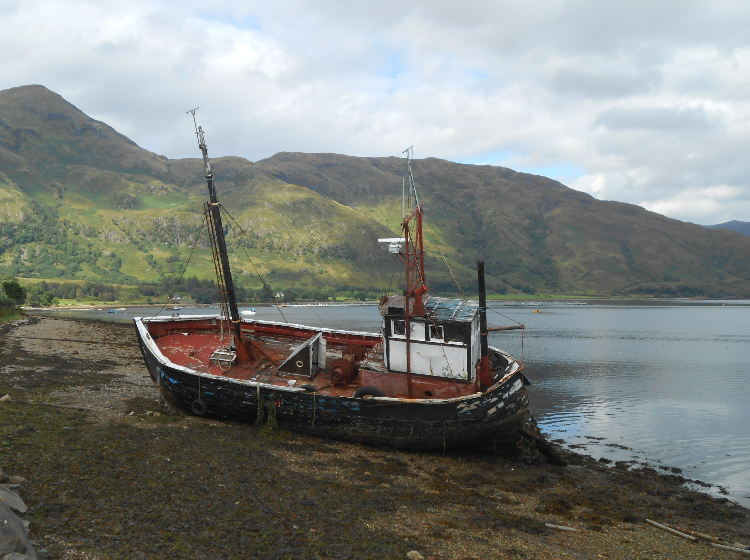
And sad to see this old fishing boat decaying by the ferry ramp.

Slide 21
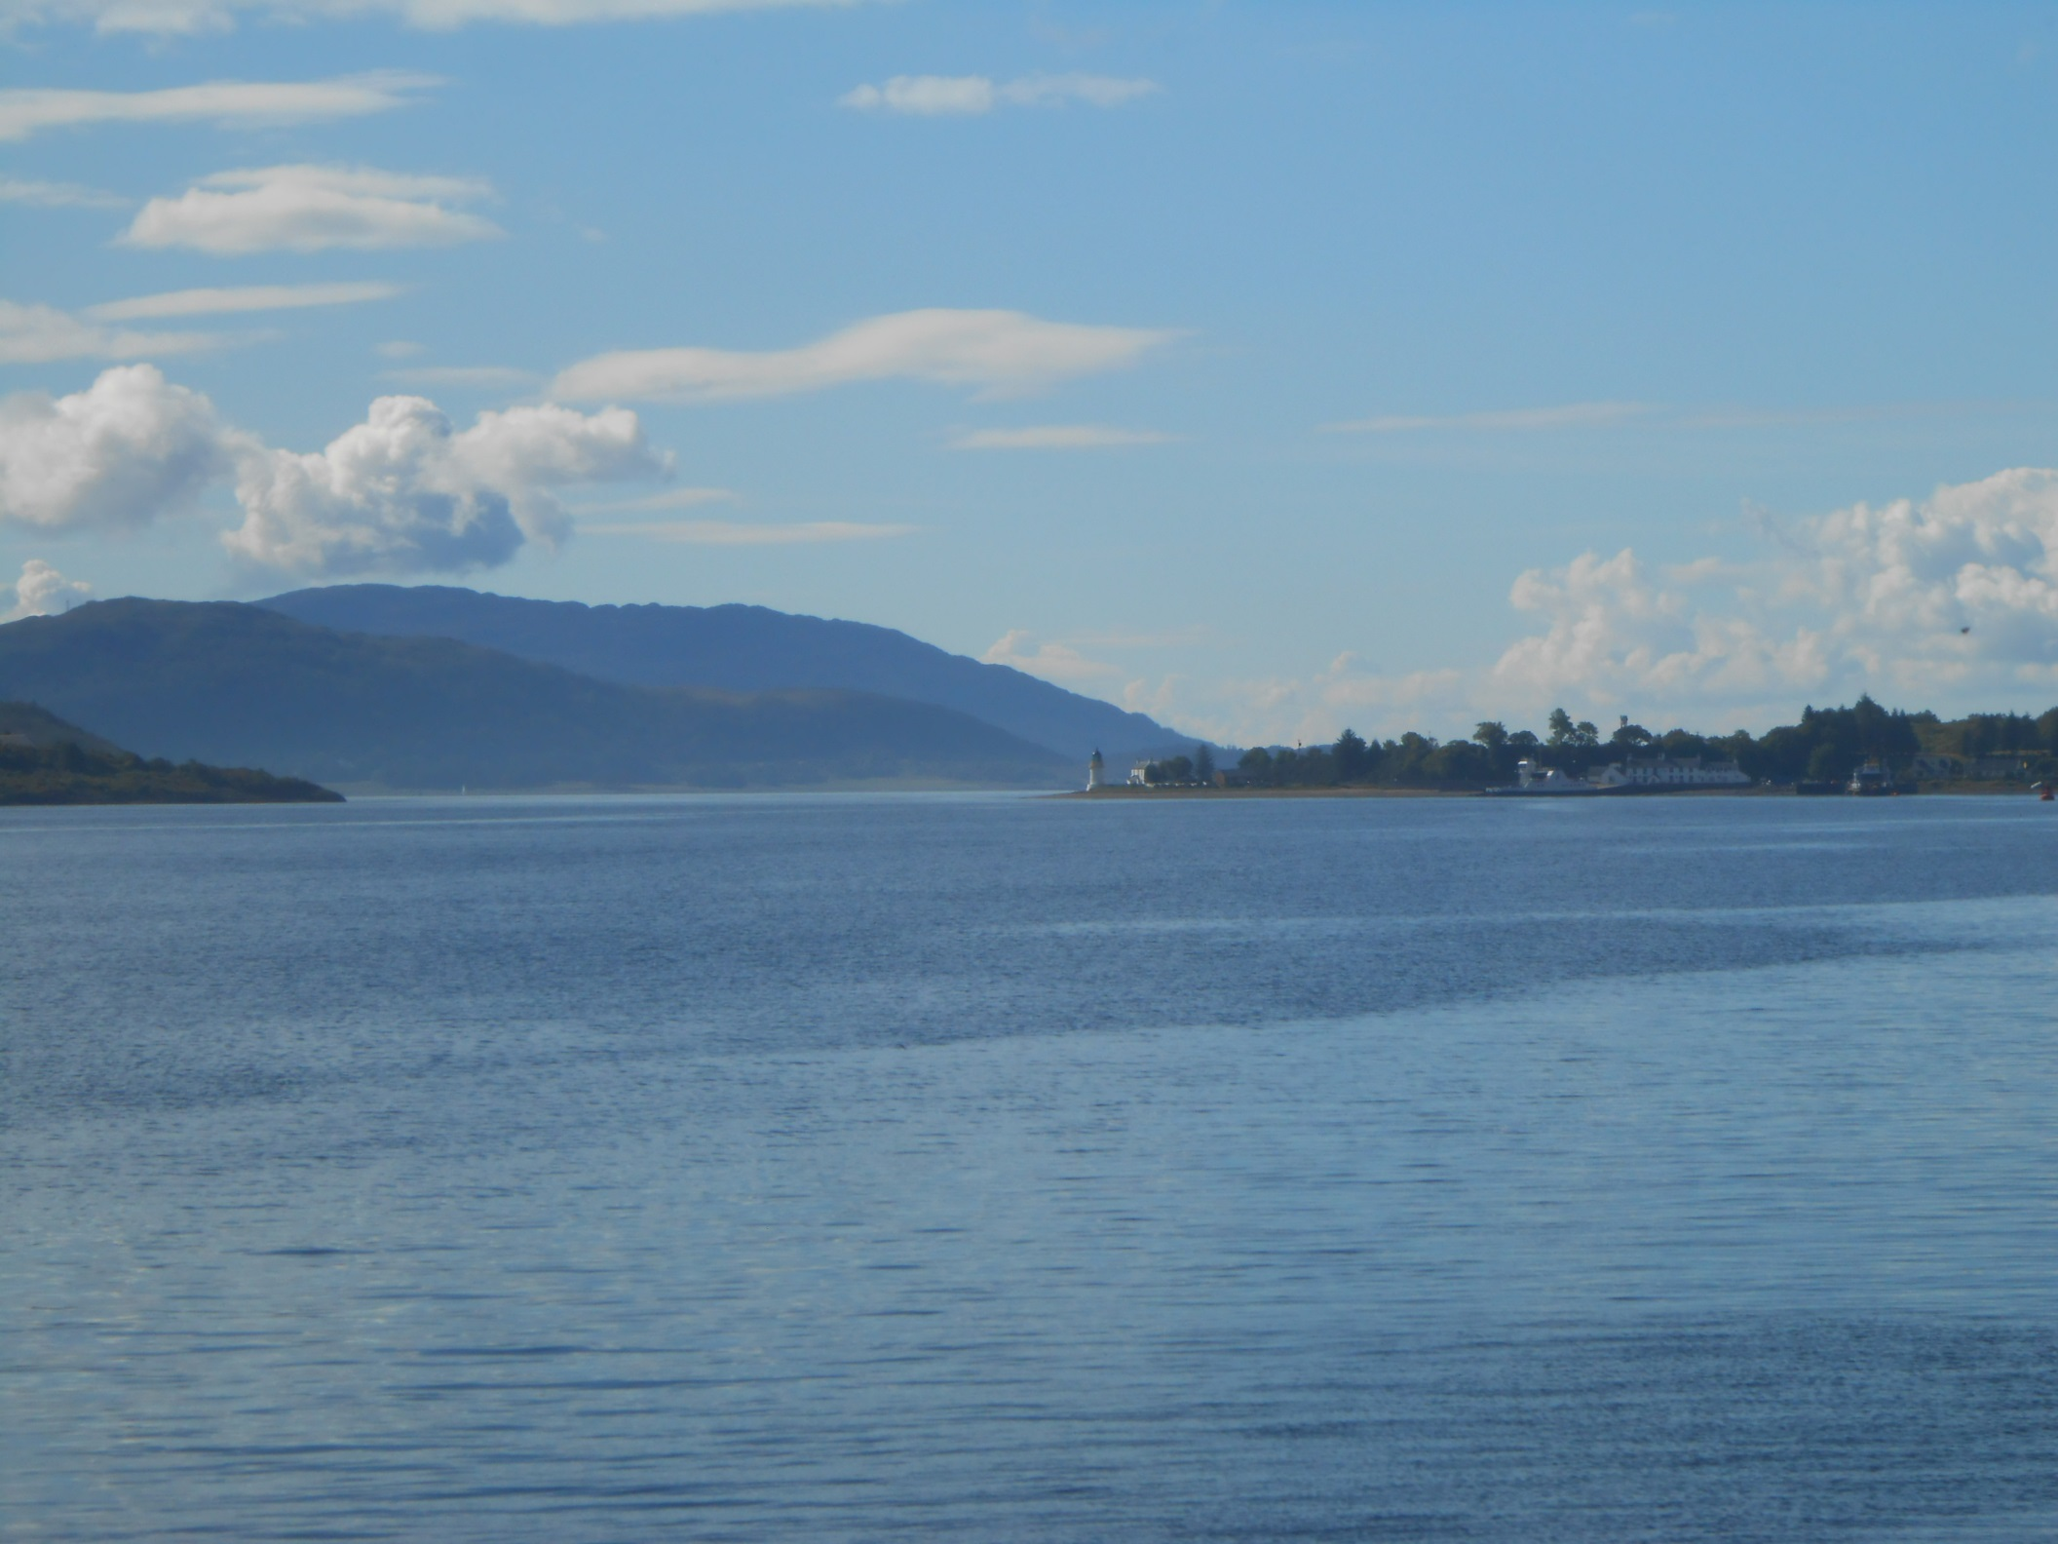
And Corran and the lighthouse the following morning as we now cruise Loch Linnhe in real style.

Slide 22
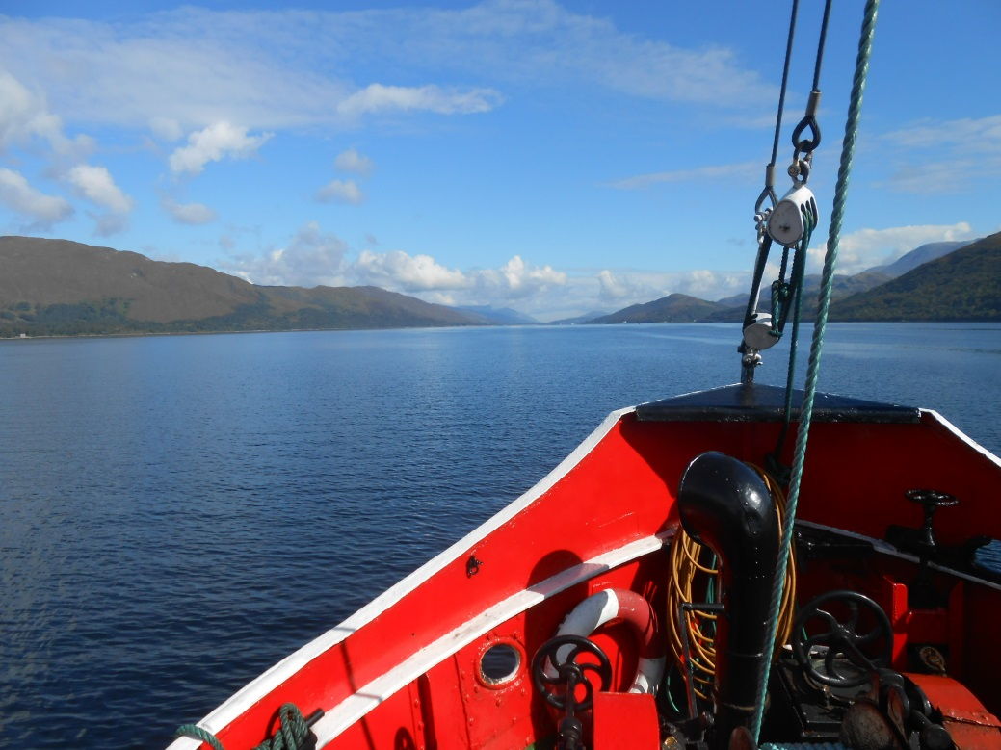
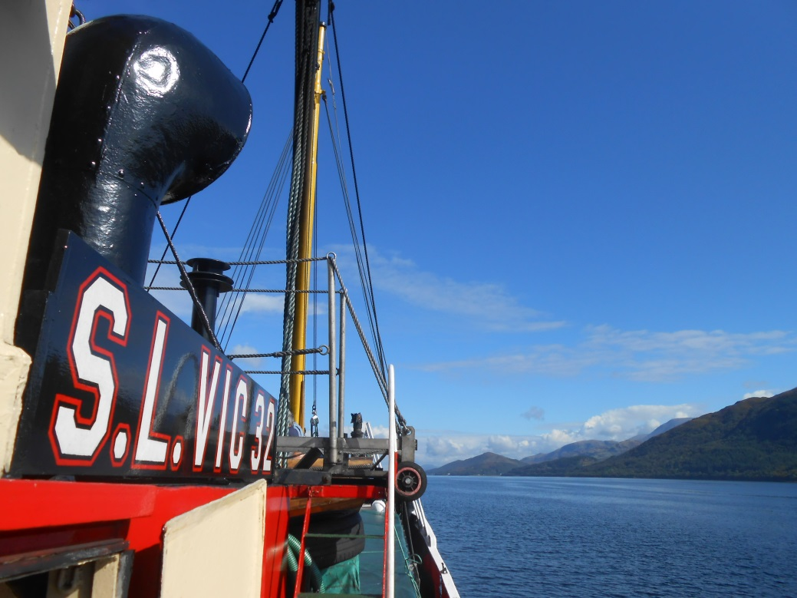
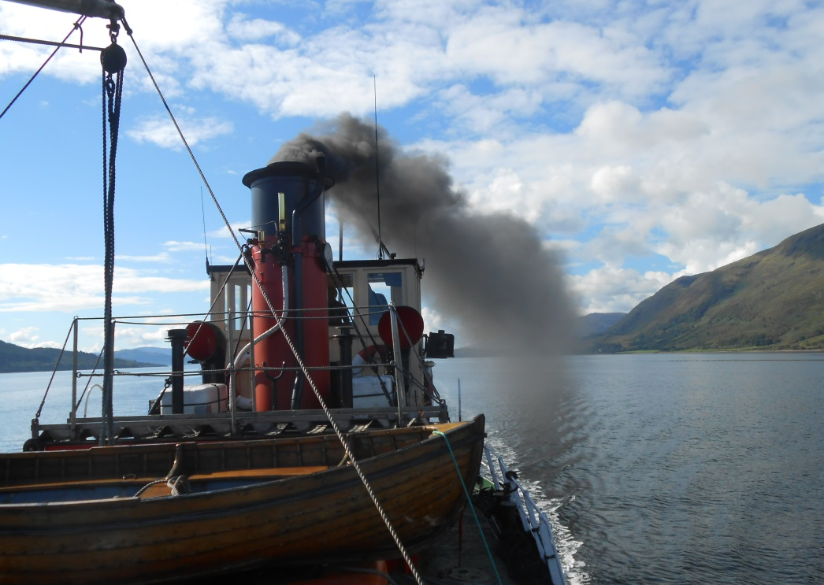
We are aboard VIC 32, one of the last of the famed Clyde Puffers, at the start of a five day trip to Inverness and the Black Isle.

Slide 23
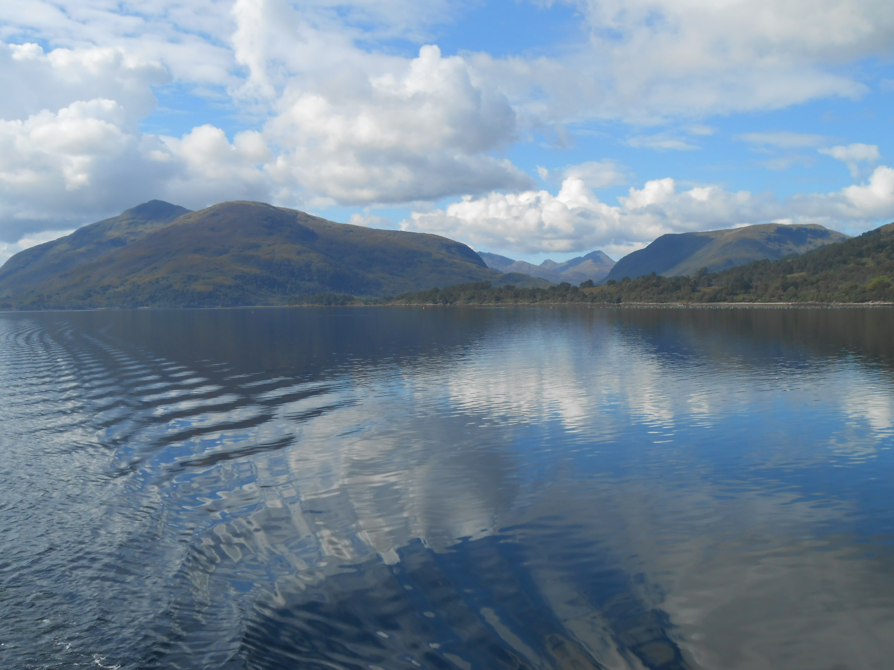
And Loch Linnhe today is stunning.

Slide 24
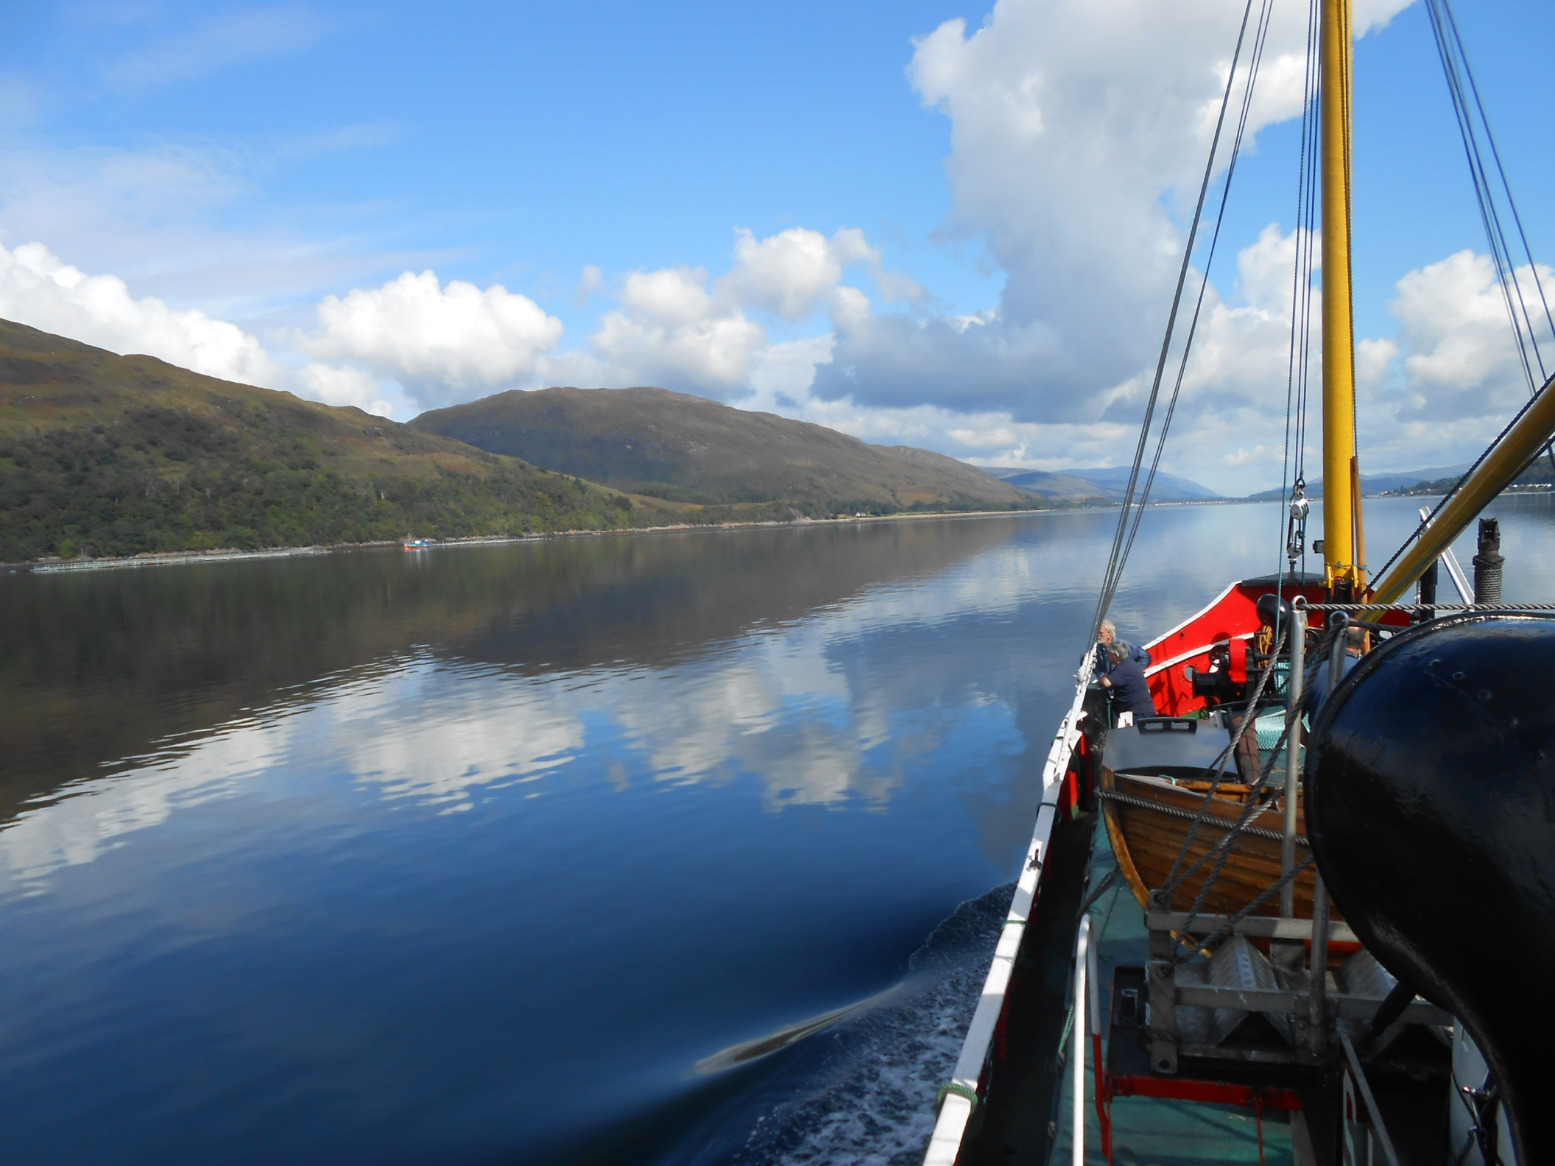
The perfect boat on the perfect day in perfect waters.

Slide 25
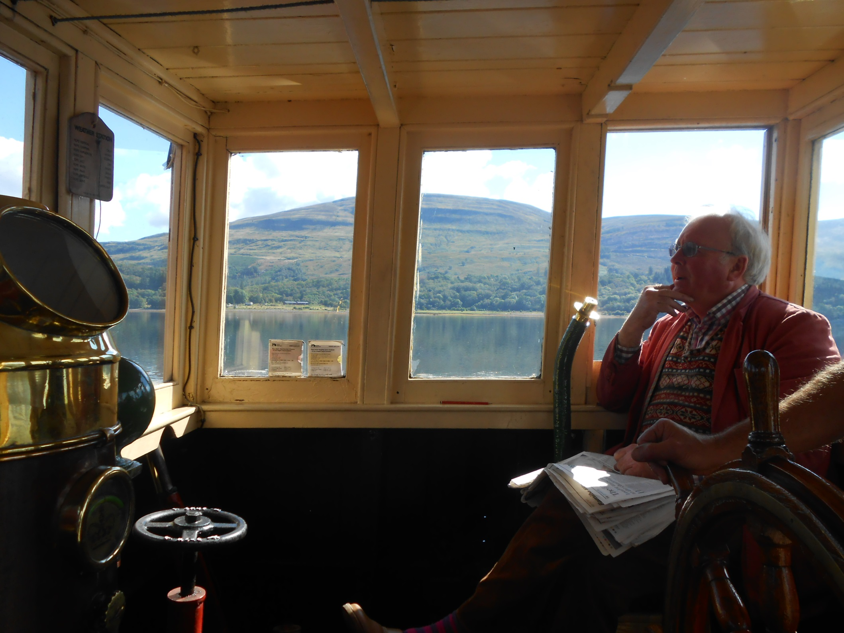
This is Nick Walker. Nick rescued VIC 32 from dereliction in 1975.

Slide 26
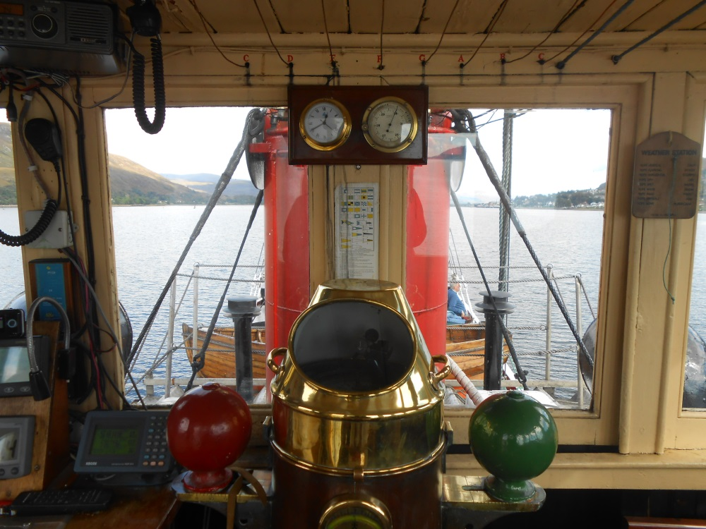
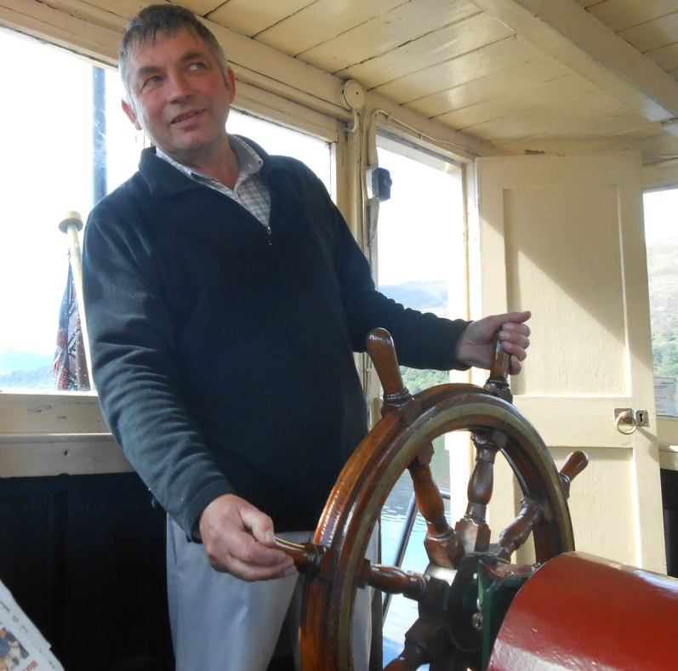
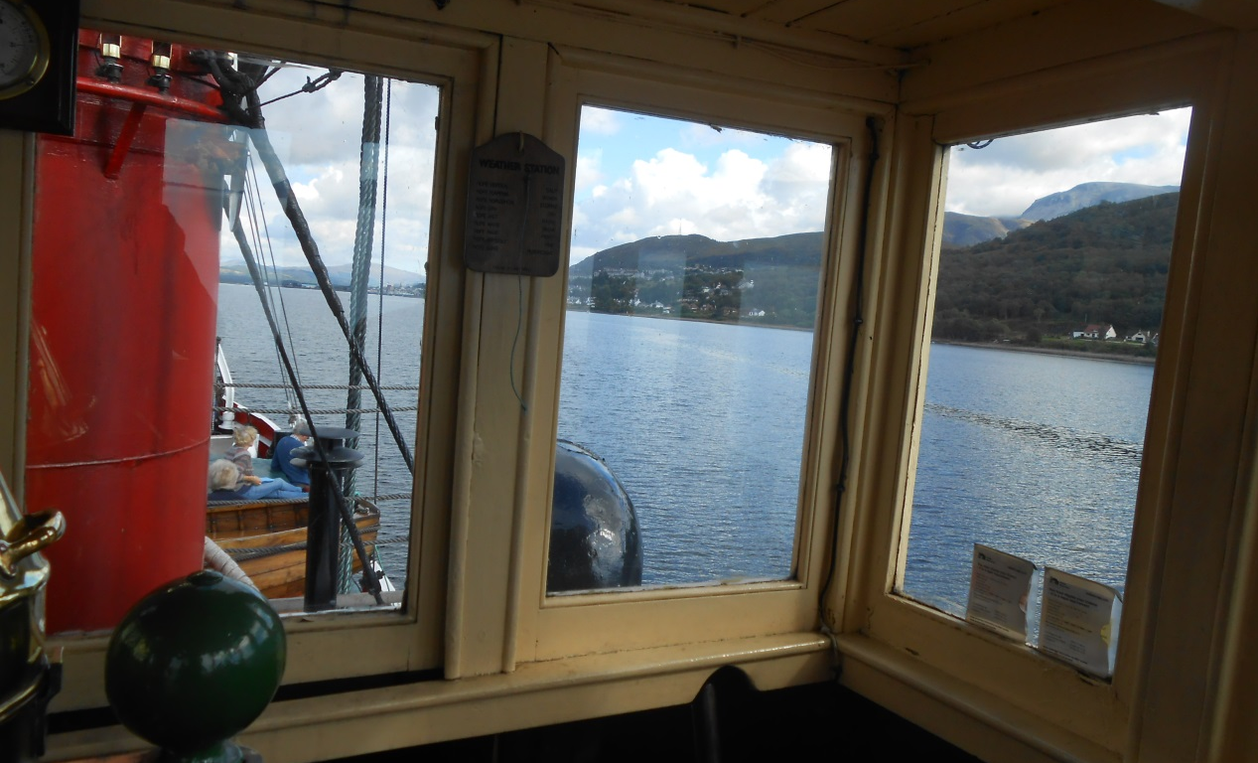
And Nick is still in charge today.
The funnel obstructs the view from the wheel as the helmsmen guides VIC 32 towards
Fort William.

Slide 27
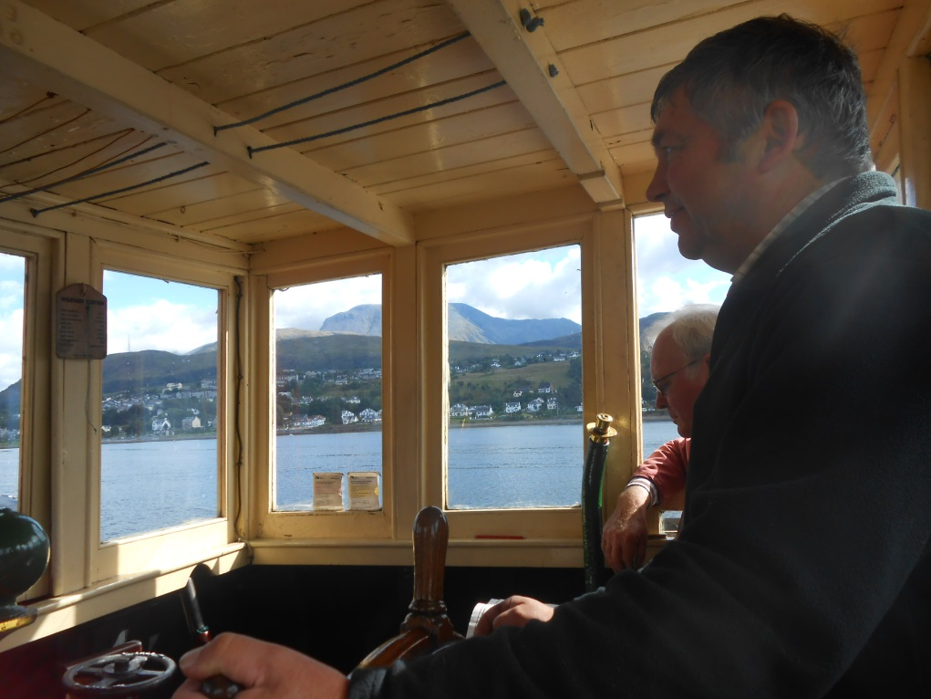
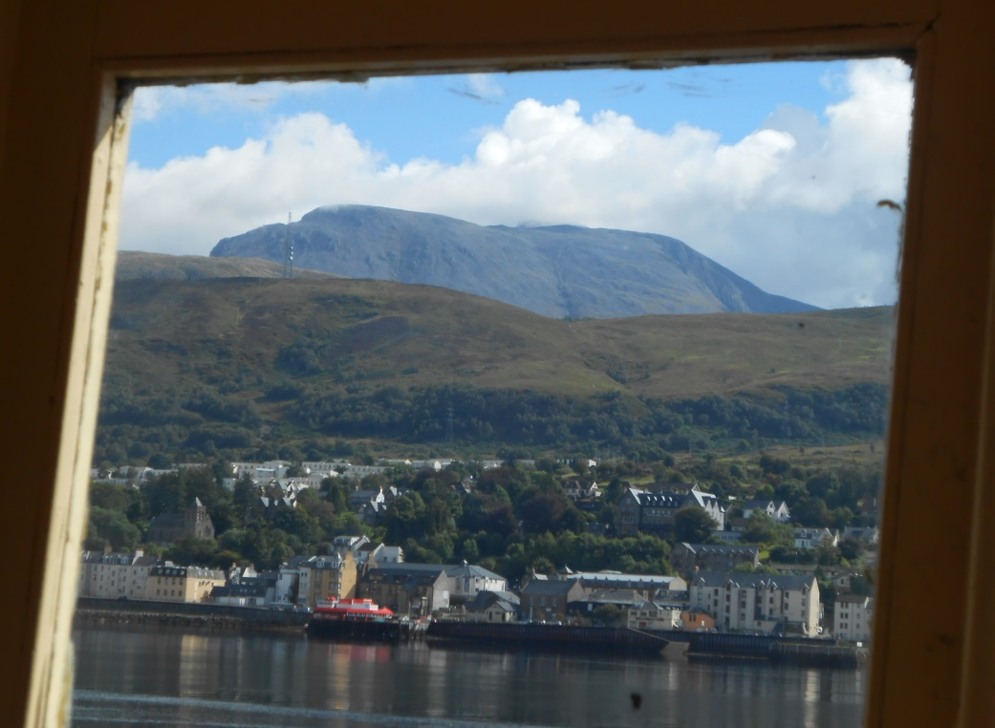
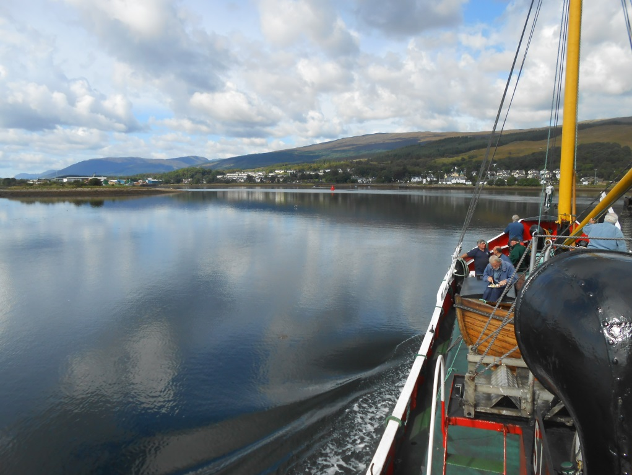
And fantastic that Ben Nevis is cloud free as we curve towards Corpach and the entrance lock of the Caledonian Canal.

Slide 28
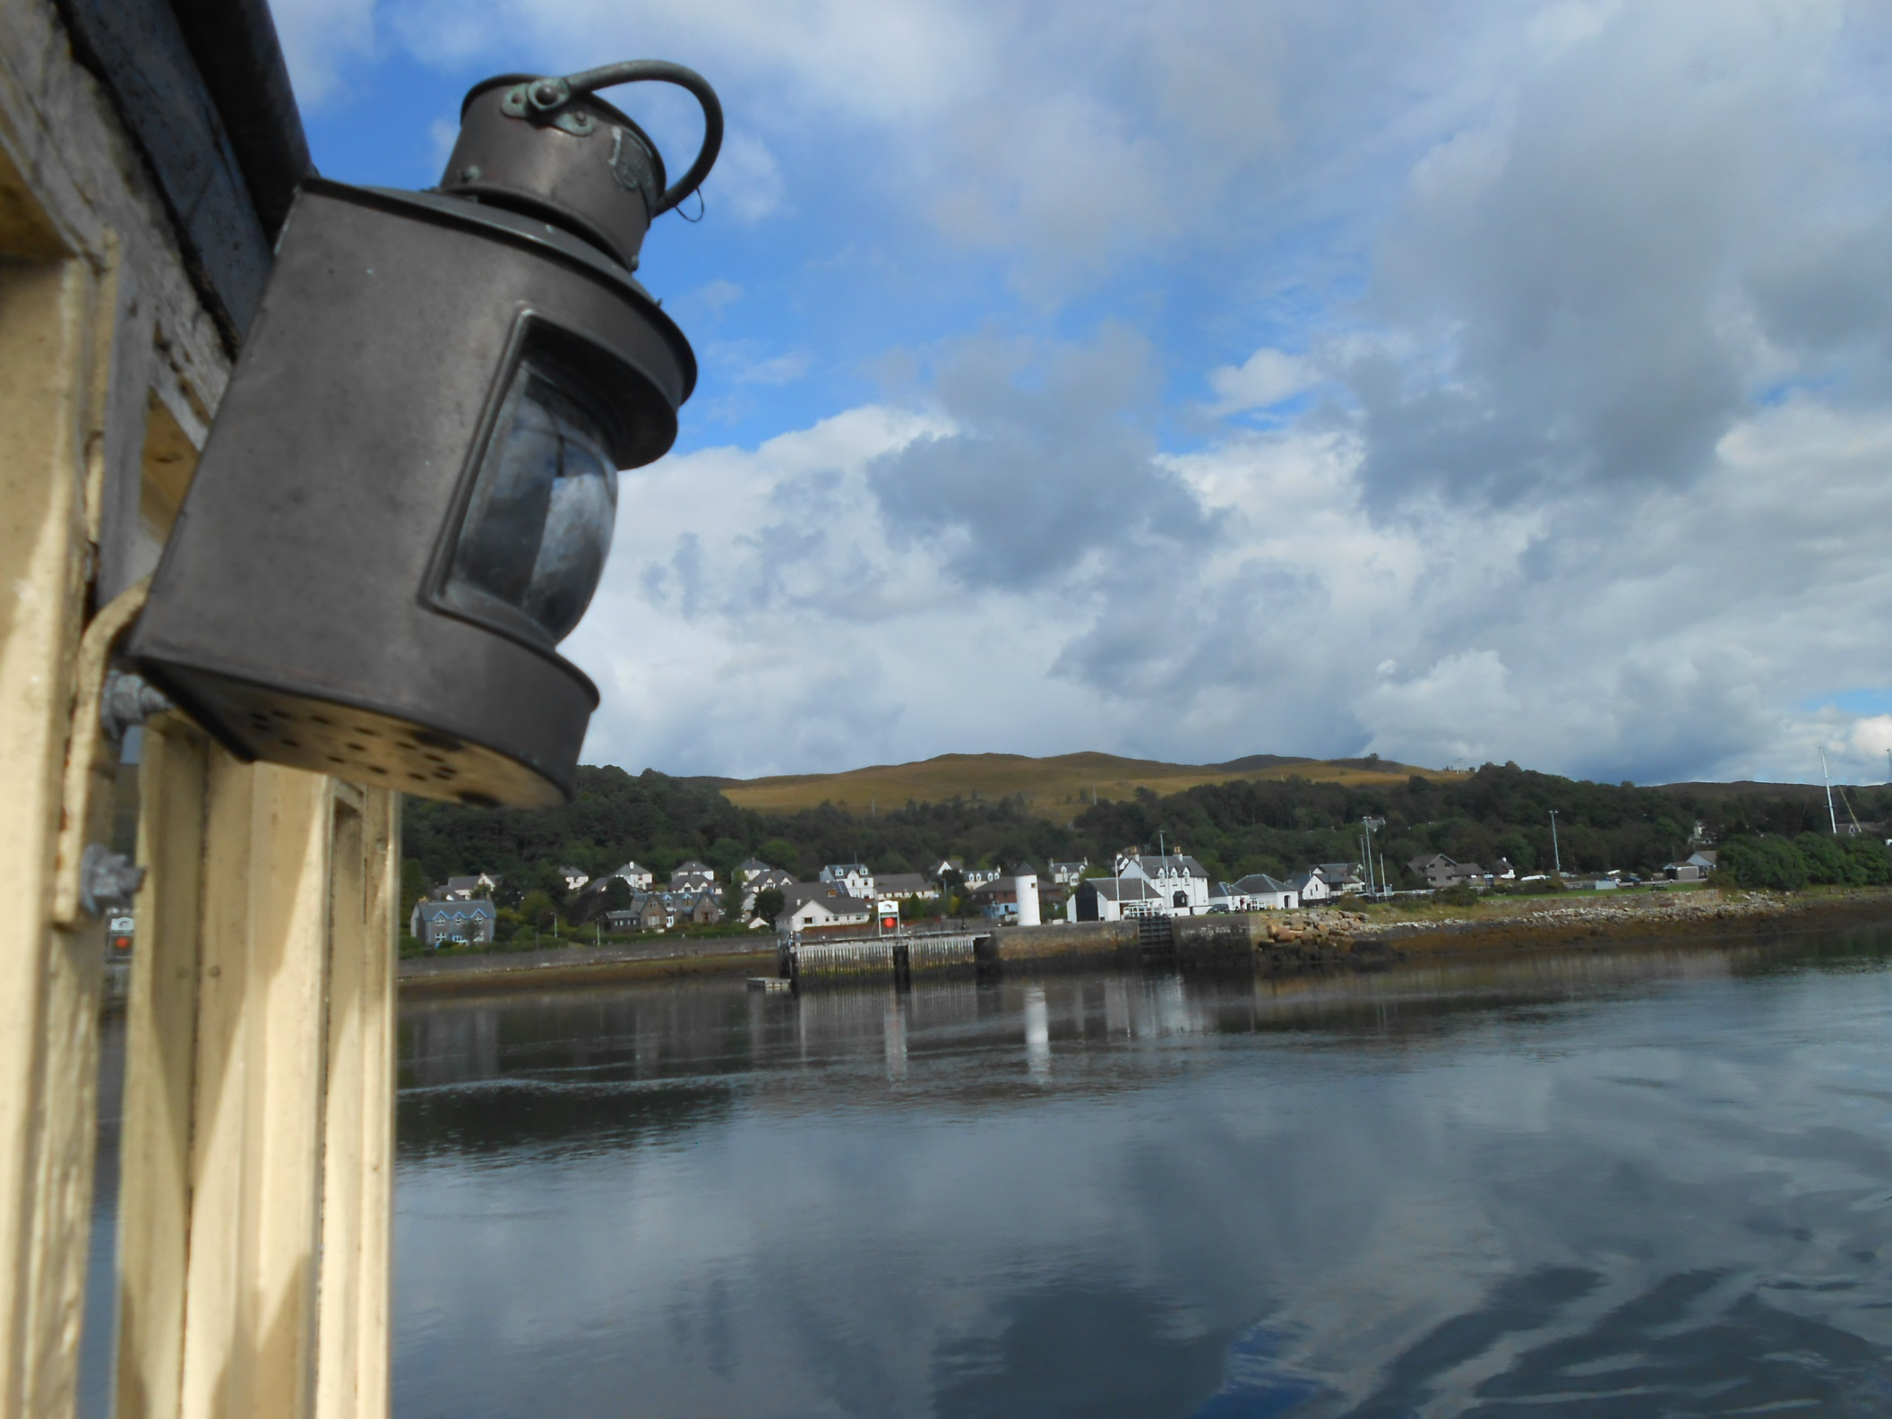
This is not an easy approach.

Slide 29
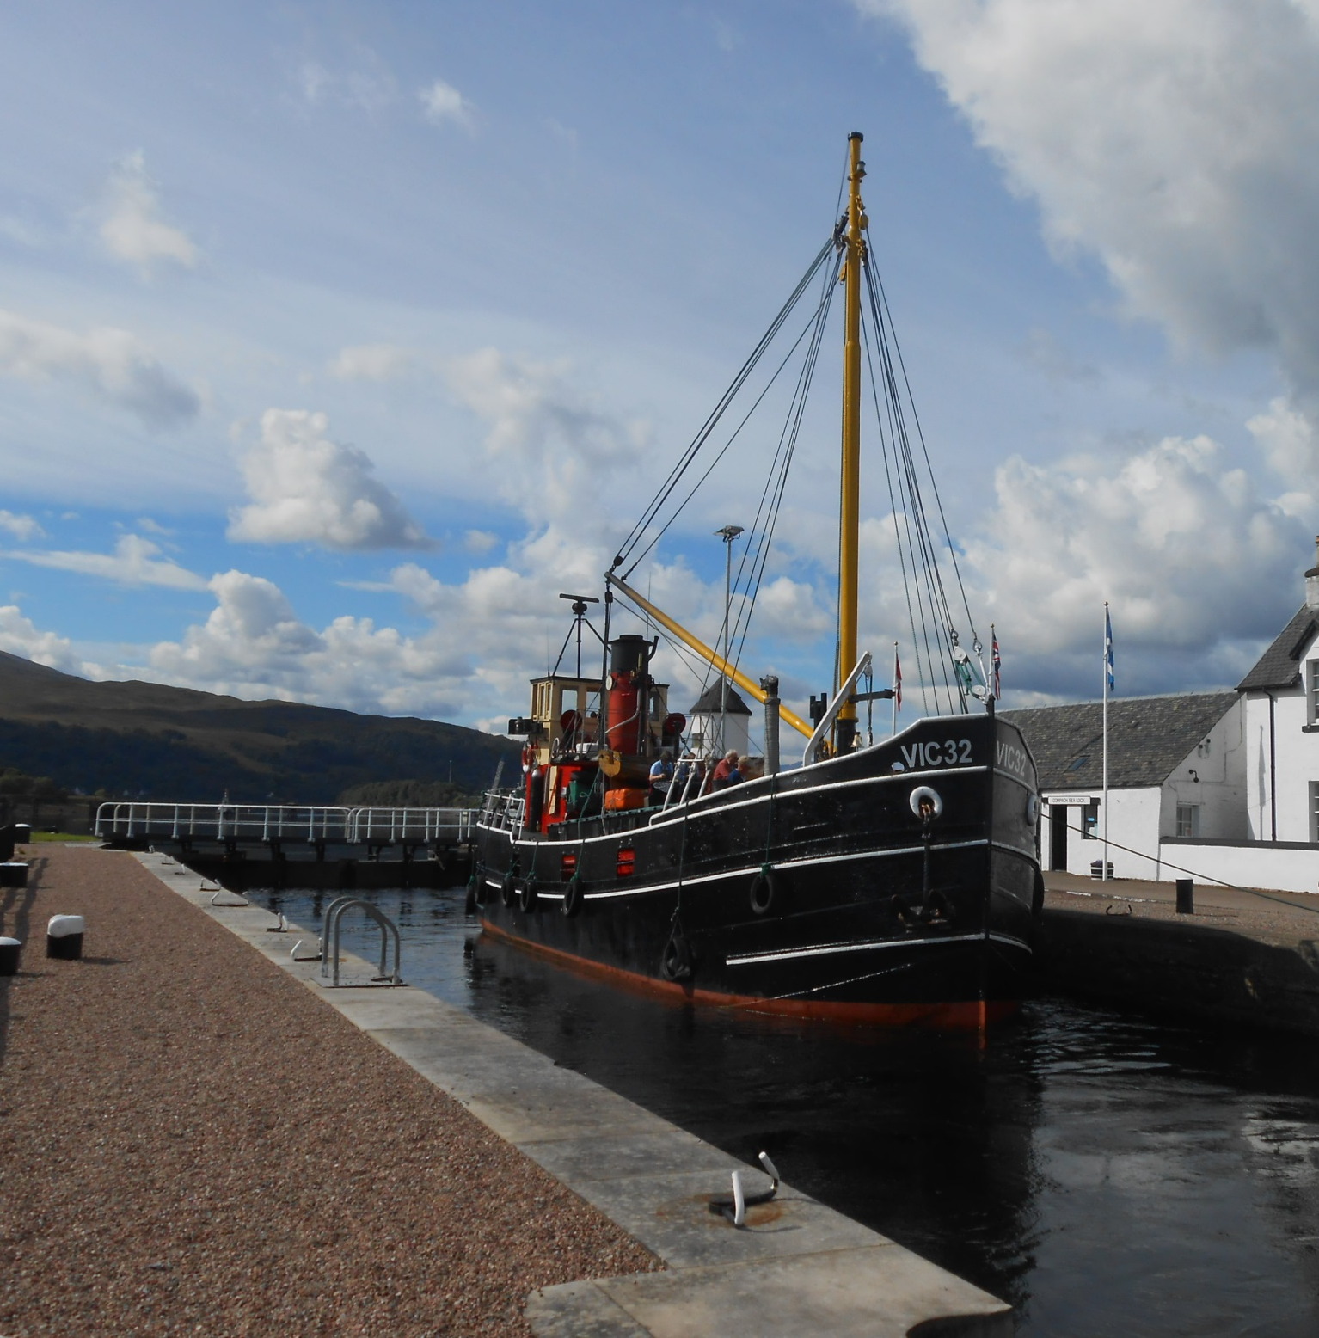
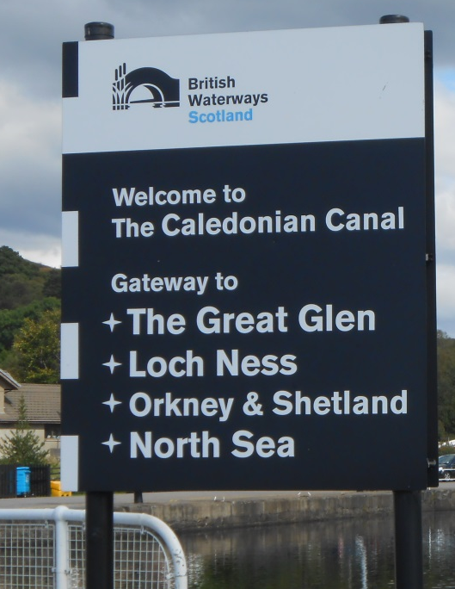
But we come through without issue into the 351st lock of this journey north.

Slide 30
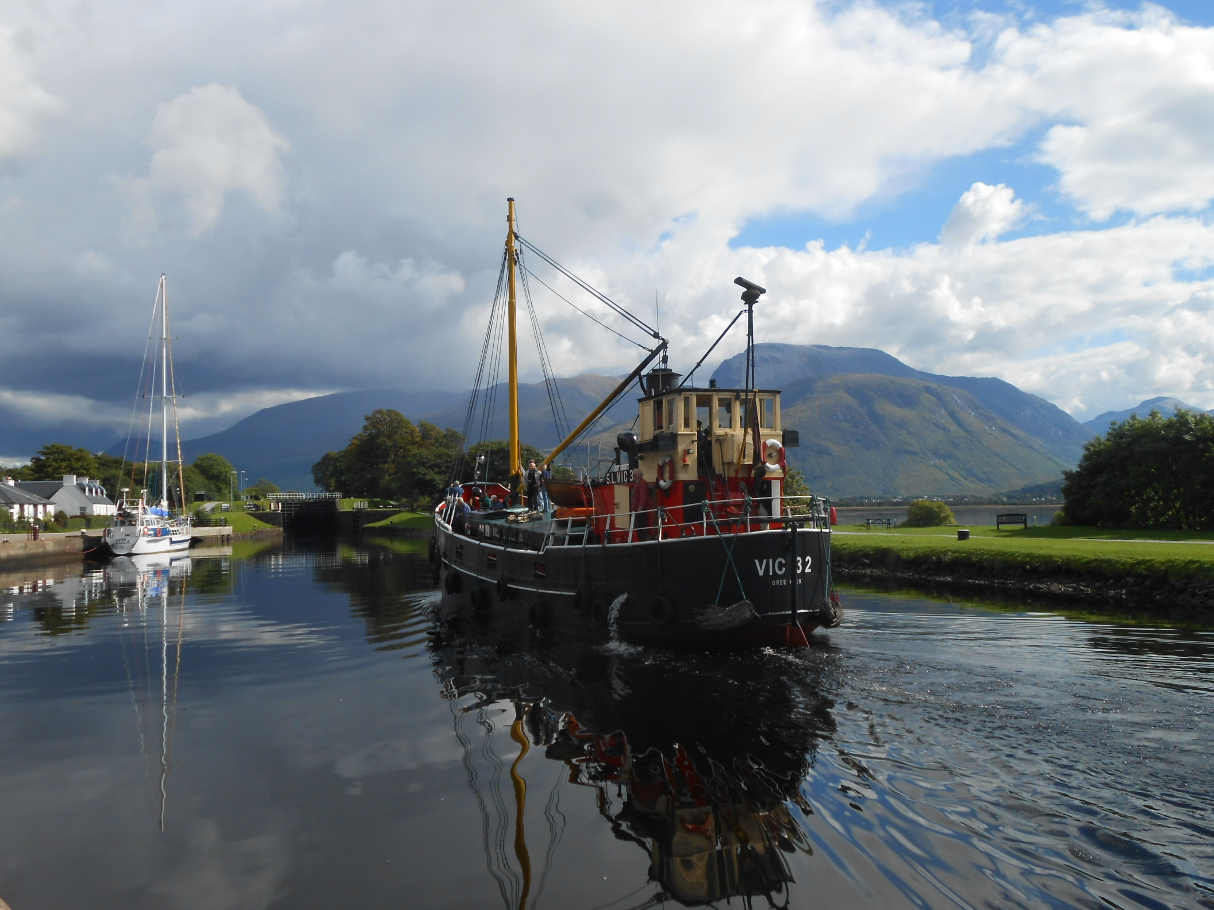
VIC 32 looks at home steaming through Corpach Basin to lock 2.

Slide 31
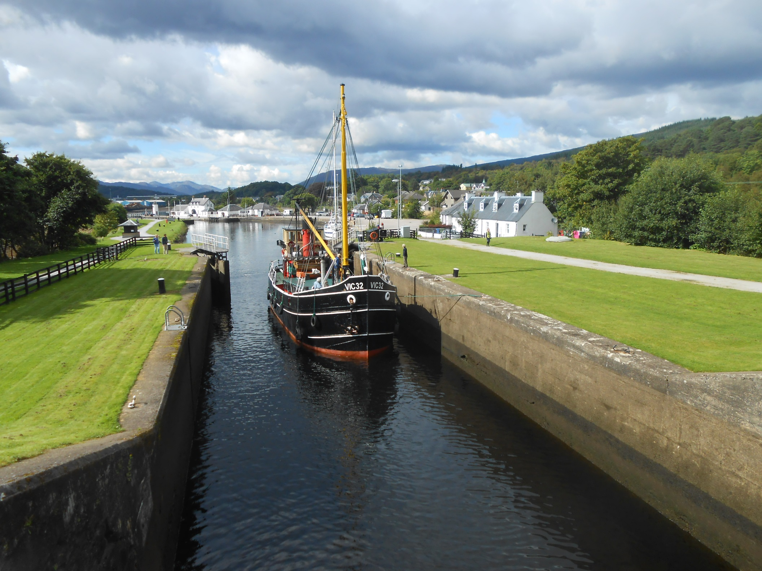
The perfect boat on the perfect day in the perfect lock.

Slide 32
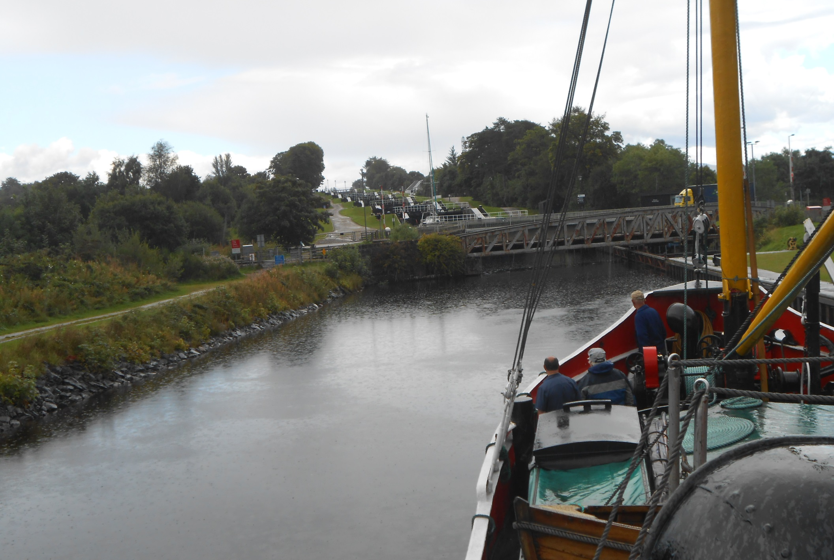
It then rained and we were held for a while by electrical problems with the road bridge leading to Neptune's Staircase.

Slide 33
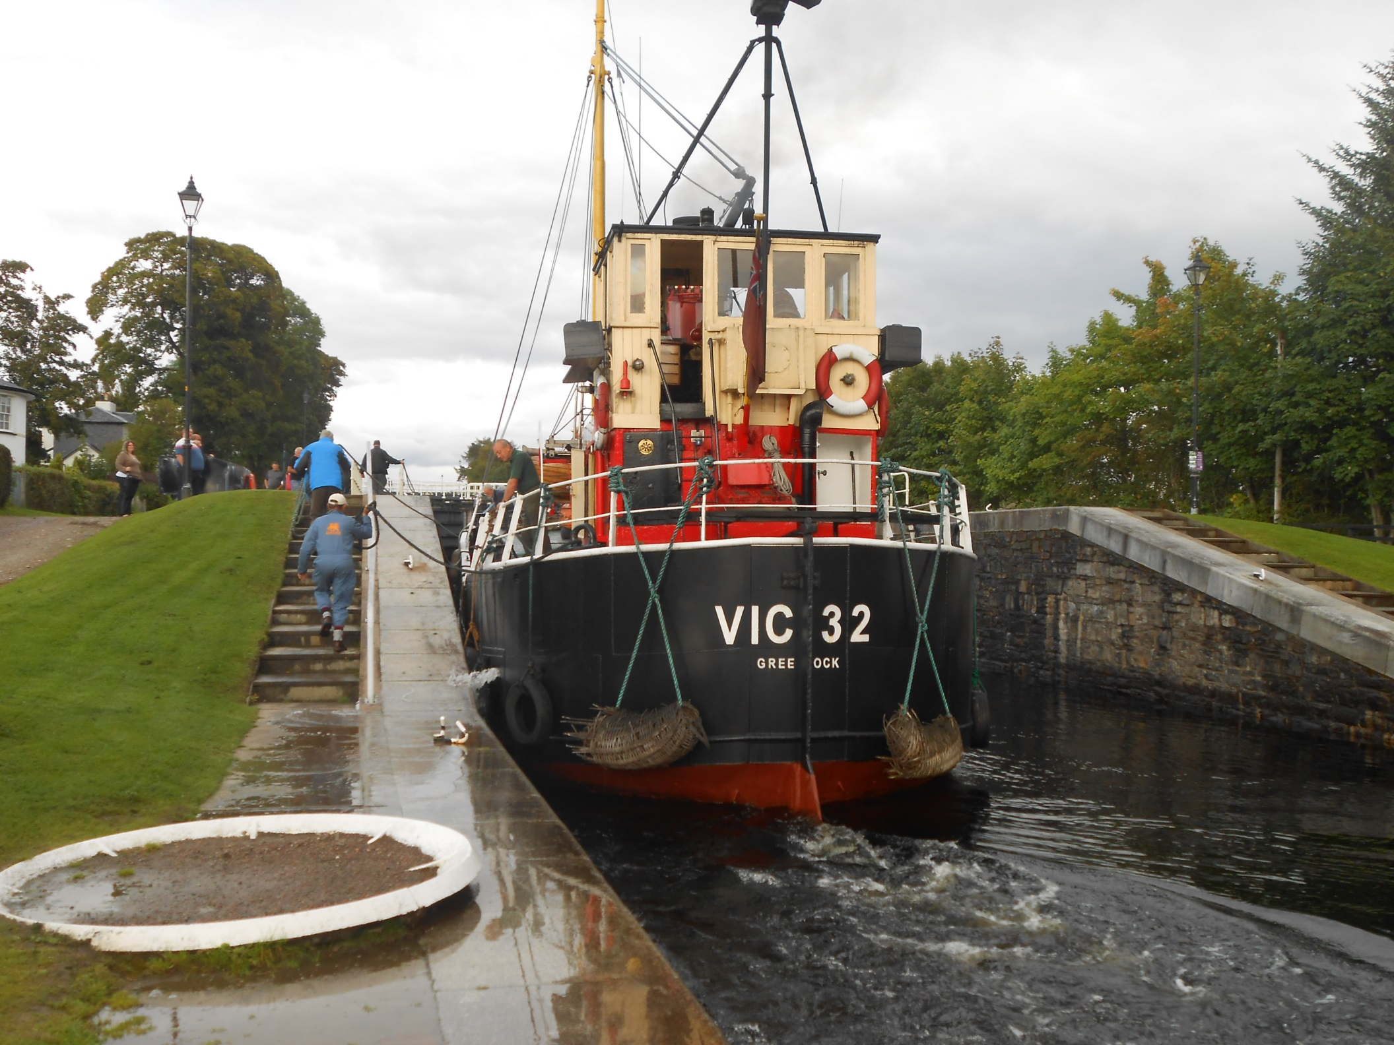
But the problems were solved and up the famous flight we went.

Slide 34
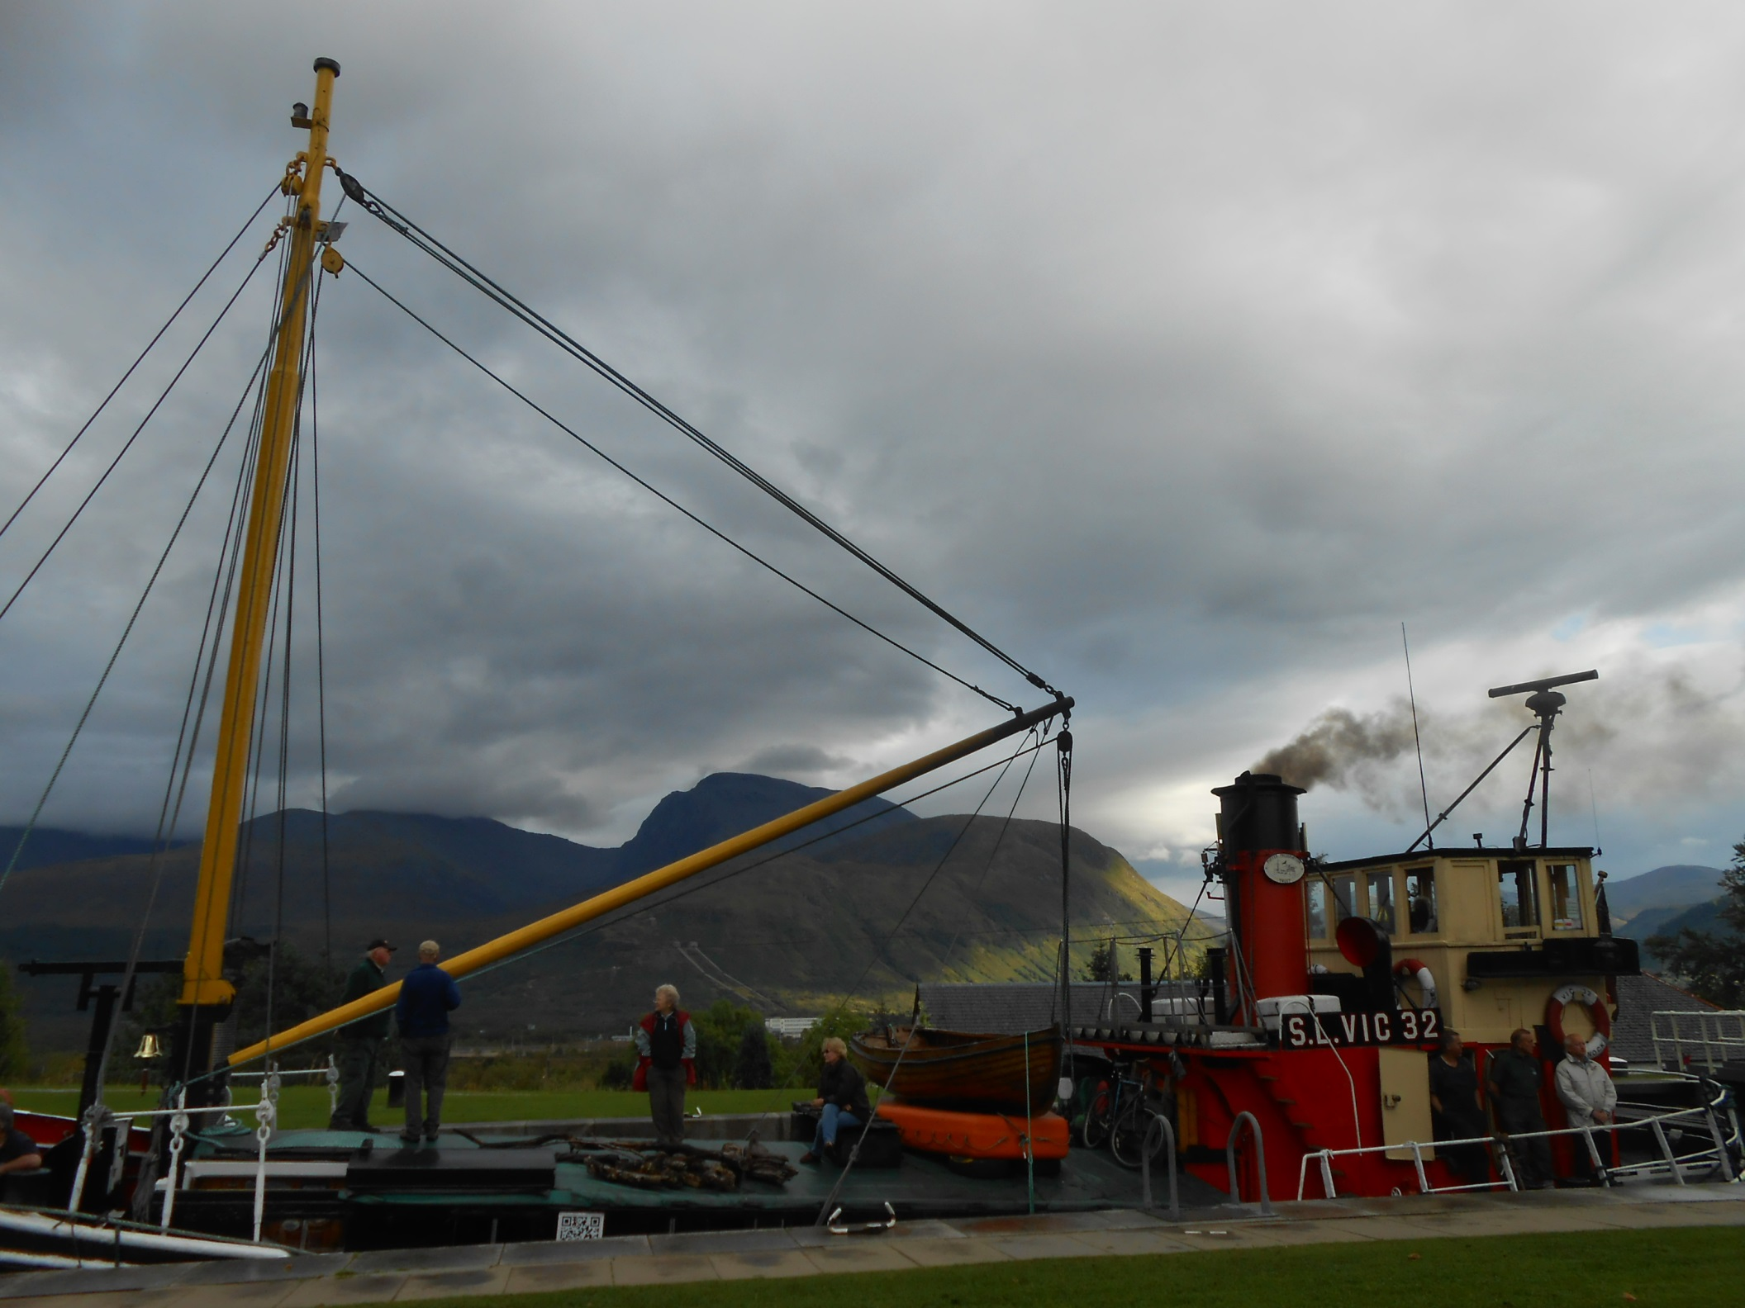
With Ben Nevis beside us too.

Slide 35
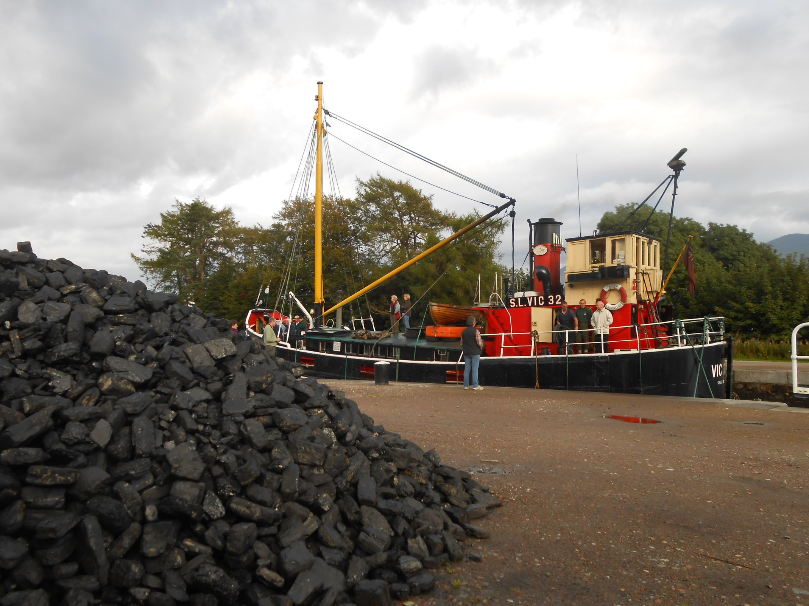
By the top lock was 10 tons of best steam coal. A job for later!

Slide 36
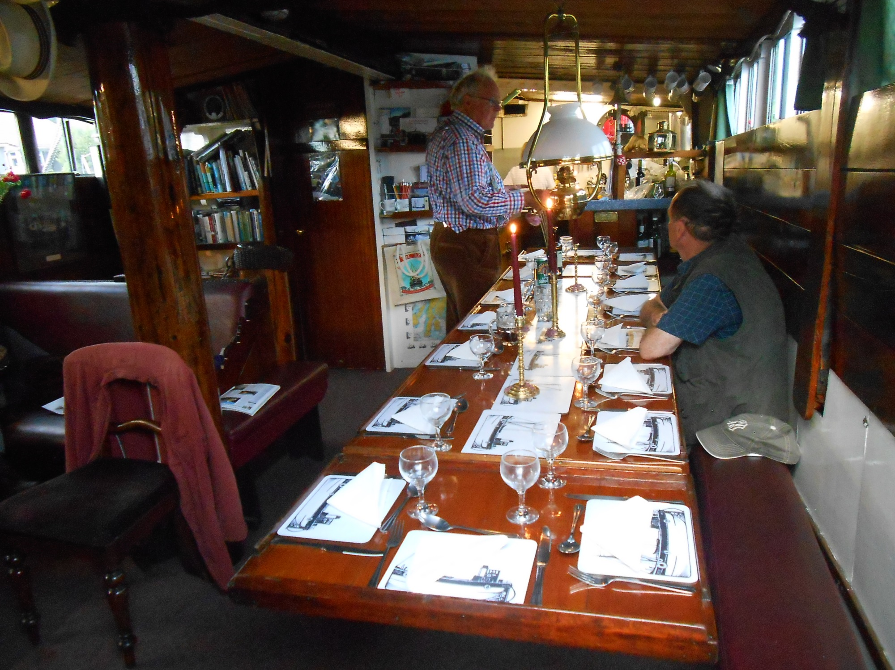
The long dining table is prepared for evening meal.

Slide 37
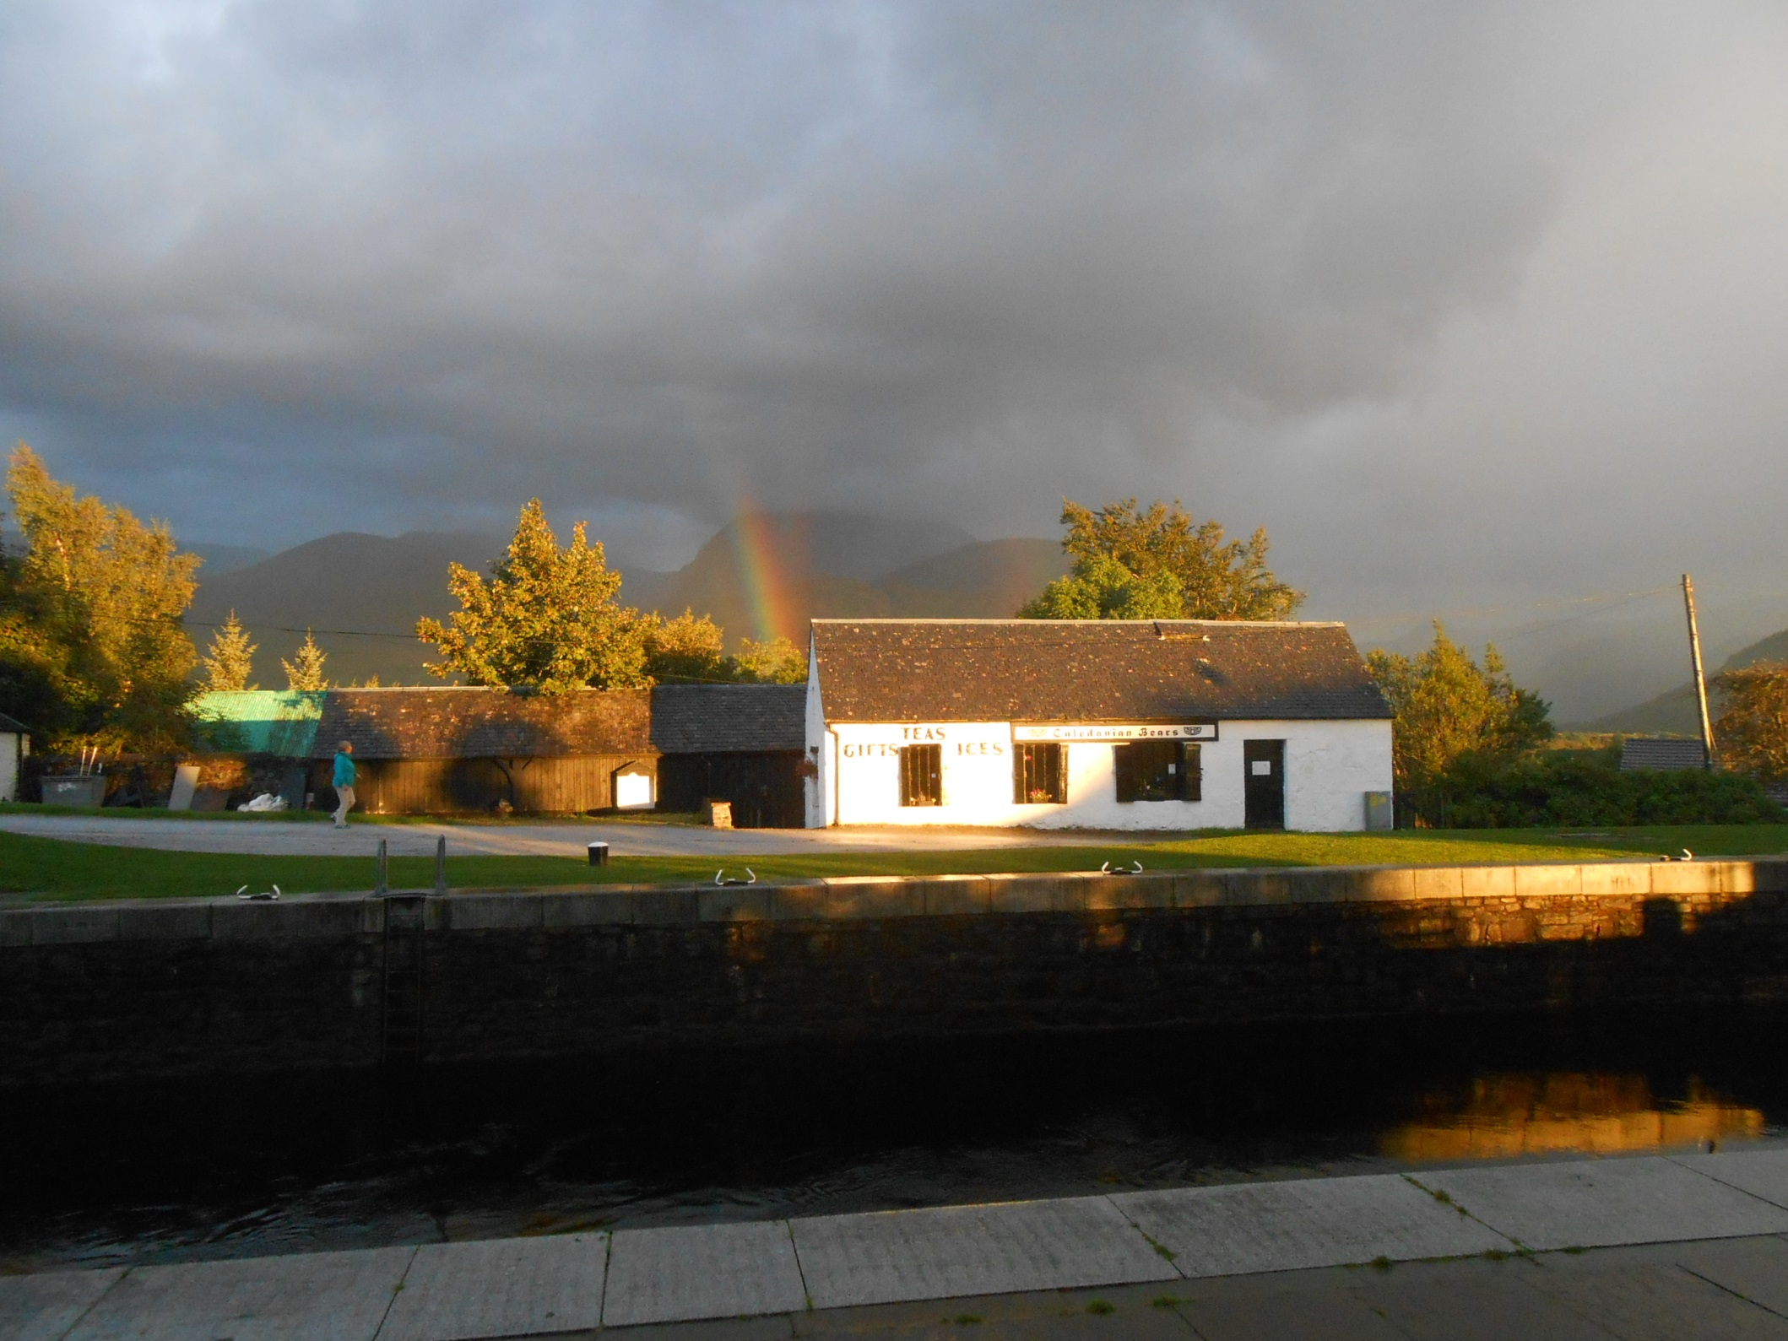
As the sun sets over Ben Nevis and the Caledonian Canal.

Slide 38



The first job the following morning was to load coal.
There are two bunkers, one either side and a listing
VIC 32 must therefore be turned half way through!

Slide 39

The lean is pronounced and the derrick is used as a counterweight.

Slide 40

Coaling over and equilibrium regained we continue on our way.

Slide 41

As Lyle, the engineer, takes the air after stoking.

Slide 42


We reach attractive Moy Bridge, the last original split bridge.
Then Gairlochy, remembered, with darkness falling and in pouring rain on one of our walking trips.

Slide 43

We then lock up to Loch Lochy, the first loch on the line of the Great Glen Fault.

Slide 44

The army fly by as Lyle appears once more from below.

Slide 45

And this is Lyle’s boiler room from above.
Lyle stokes his boiler every six minutes.

Slide 46

And this is his engine.
It is the original, built in 1943 by Crabtrees of Great Yarmouth.

Slide 47

As Loch Lochy, all 10 attractive miles of it, passes by.

Slide 48

Loch Lochy ends at Laggan Lock.

Slide 49



And moored above Laggan Loch is The Eagle, a floating pub that was once a Dutch sugar beet barge.

Slide 50

We then cruise the absolutely still summit level.

Slide 51

Effortlessly gliding through the two mile pound.

Slide 52


To reach, through another swing bridge, lovely Loch Oich.

Slide 53

Looking a trifle sombre on this overcast evening.

Slide 54

We pass isolated Leitirfearn, remembered from our walk.

Slide 55


Oich Bridge comes next, named after its 1854 wooden decked suspension bridge over the River Oich.

Slide 56

Then comes Cullochy Lock, another lovely approach.

Slide 57

And more steam than usual as we head for our overnight mooring as Lyle prepares the derrick winch.

Slide 58



As Skipper Nick organises a shore party to go foraging for mushrooms.

Slide 59


And freshly picked chanterelle mushrooms add that little bit extra to another quality evening meal.

Slide 60

It was a damp the following morning as we steam away.

Slide 61



To we reach isolated Kyltra Lock, where we load firewood that has been especially kept for us by the lock keeper.

Slide 62

John the Mate, a volunteer from Aberdeen, saws the wood as
Ros Crana, a Dutch barge converted for canal cruising, passes by.

Slide 63

Then comes Fort Augustus with its flight of five locks down to Loch Ness. All is peaceful in the top lock.

Slide 64



But lower down the flight it is very busy indeed.
VIC 32 is quite an attraction!

Slide 65

We then pause at Inveroich Pier to collect supplies before heading out into legendary Loch Ness.

Slide 66


Where we join Lyle in the engine room.
Loch Ness is very murky and very, very deep, nearly 750 feet deep.
Anything could hide in here!

Slide 67

And there is certainly something in the water here as we pass landmark Horseshoe Craig as Nessie evades the camera yet again!

Slide 68

But there were no further Nessie sightings as we head for our overnight mooring in Foyers.

Slide 69

Where we are joined by another converted
Dutch barge, this time Fingal of Caledonia.

Slide 70

As the sun sets over peaceful Loch Ness.

Slide 71

An early start next day as we pass popular Urquart Castle, well ahead of the tourist crowds.

Slide 72

As, with breakfast on the move, we steam up Loch Ness.

Slide 73

Neglected Bona lighthouse marks the channel at Lochend.

Slide 74


As we enter tiny Loch Dochfour with Dochfour House on its northern shore.

Slide 75


Loch Dochfour ends with a long Telford weir that effectively ponds back
Loch Ness!
We then enter Dochfour lock.

Slide 76


Most Loch Ness water now flows down the River Ness to Inverness as the Caledonian Canal continues to parallel the river for a further three miles.

Slide 77

The canal then curves away for the four locks to Muirtown Basin, which look out over Inverness to the Kessock Bridge.

Slide 78

Muirtown was once very busy but nowadays all is quiet.
The last half mile of canal onwards from here is fascinating.

Slide 79

As, departing next morning, we head for the lock beside
Clachnaharry maintenance yard.

Slide 80

Below the yard is the Thurso and Wick line railway bridge which the signalman has swung open for us.

Slide 81


An impressive causeway then takes us out to the sea lock.

Slide 82

Strong tidal flows in the Beauly Firth rip past here and great care is required most of the time.

Slide 83


But today was a relatively easy departure as we turn towards the Kessock Bridge and the open sea.
The VIC 32 calliope is a character touch. The Skipper’s best tune being the Skye Boat Song!

Slide 84

And under the Kessock Bridge we go to reach the Moray Firth.

Slide 85

Where we meet a boat, the Inverness registered Scott Venture.

Slide 86

Then, by Fortrose, we get dolphins for company. Fantastic!

Slide 87

We are following the coastline of the Black Isle and this is Chanonry Point, the narrowest part of the Moray Firth.

Slide 88

Then comes impregnable Fort George, completed in 1769 and considered one of the mightiest fortifications in Europe.

Slide 89

The Black Isle now stretches ahead and this is as far as we go on this particular trip.

Slide 90

As we bid farewell to VIC 32 and its stunning crew.

Slide 91

And say hello to Magellan, a 1,250 berth cruise liner.

Slide 92

And this is the Black Isle from Magellan on 21st June 2015 as the Invergordon pilot boat heads out to meet us.

Slide 93

We then pass Cromarty, sited on the narrows separating the
Moray Firth from the sheltered Cromarty Firth.

Slide 94

Once an important naval base the Cromarty Firth now services the oil industry as we pass eight laid-up rigs as we head for our berth.

Slide 95

A further rig is under repair at the dockside as
Magellan cautiously approaches her mooring.

Slide 96


Port tenders assist ropes ashore to the isolated sections of what is still known as Admiralty Pier.

Slide 97

Cruise Ships are a relatively new market for Invergordon and, with so many Highland attractions nearby, it is proving popular.

Slide 98

Although today I go running rather than coach touring!

Slide 99



Departure from Invergordon is accompanied, in the rain, by a hardy pipe band.

Slide 100


As we pass Sutor cliff and return to the ever widening Moray Firth.

Slide 101

We then curve round to a northerly course.

Slide 102

And are some way out passing the flat headland to
Tarbat Ness, the entrance to Dornoch Firth.

Slide 103

The weather pleasingly clears passing Brora and Helmsdale.

Slide 104

And by Berriedale we are close to the working rigs of the Beatrice oil field.

Slide 105

But sadly, off Wick, with just 20 miles to go to John O’Groats, the clouds close in again.

Slide 106

Magellan’s Bermuda flag flutters in the breeze.

Slide 107

And darkness begins to fall on the longest day of the year.

Slide 108

Lights on the bridge point the way ahead to the difficult waters of the Pentland Firth. Just five miles to go now.

Slide 109

But the Isle of Stroma and its lighthouse are as near as we will get to John O’Groats this trip.

Slide 110

And to reach our target another visit will be required
Cheers everybody!

Slide 111

And just a month later we are back in the Pentland Firth.

Slide 112

Aboard the Orkney ferry Pentland Venture, purpose built in Hull in 1986 and cleverly lengthened since with a new centre section.

Slide 113

And the view aboard Pentland Venture with Stroma behind.

Slide 114

Stroma once had a viable population but life was harsh, the island’s population dropping from 375 in 1901 to zero in 1997.

Slide 115

And we get very close to Stoma light on this particular trip.

Slide 116


We are making a crossing to Burwick on the Orkney Isles as a cargo ship passes in the shipping lane.

Slide 117

Heading for John O’Groats now Duncansby Head is the impressive headland to the left.

Slide 118

And the skipper takes us close in to the vertical cliffs as we approach the coast.

Slide 119

We then follow the northern shore to John O’Groats as this incredible waterway journey draws to a close.

Slide 120

A crewman throws the line for the last time.

Slide 121

And the Pentland Venture is made fast.

Slide 122

We have arrived in John O’Groats and our journey north is done.
What an adventure it has been.

Slide 123
End of Chapter 10

