Slide 1
Exploring Britain
Boating North
Part 9
The Forth to the Clyde
and on to Oban
24th September 2012
to 3rd May 2013

Slide 2
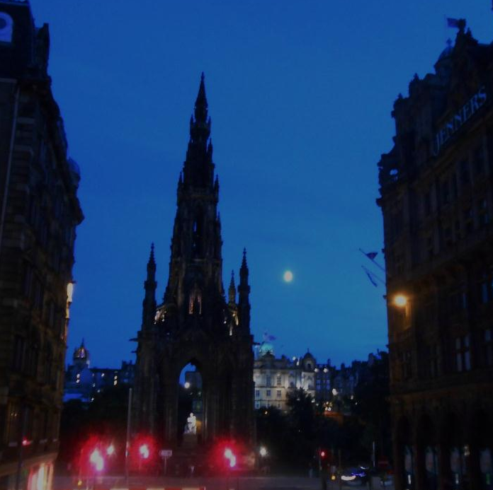
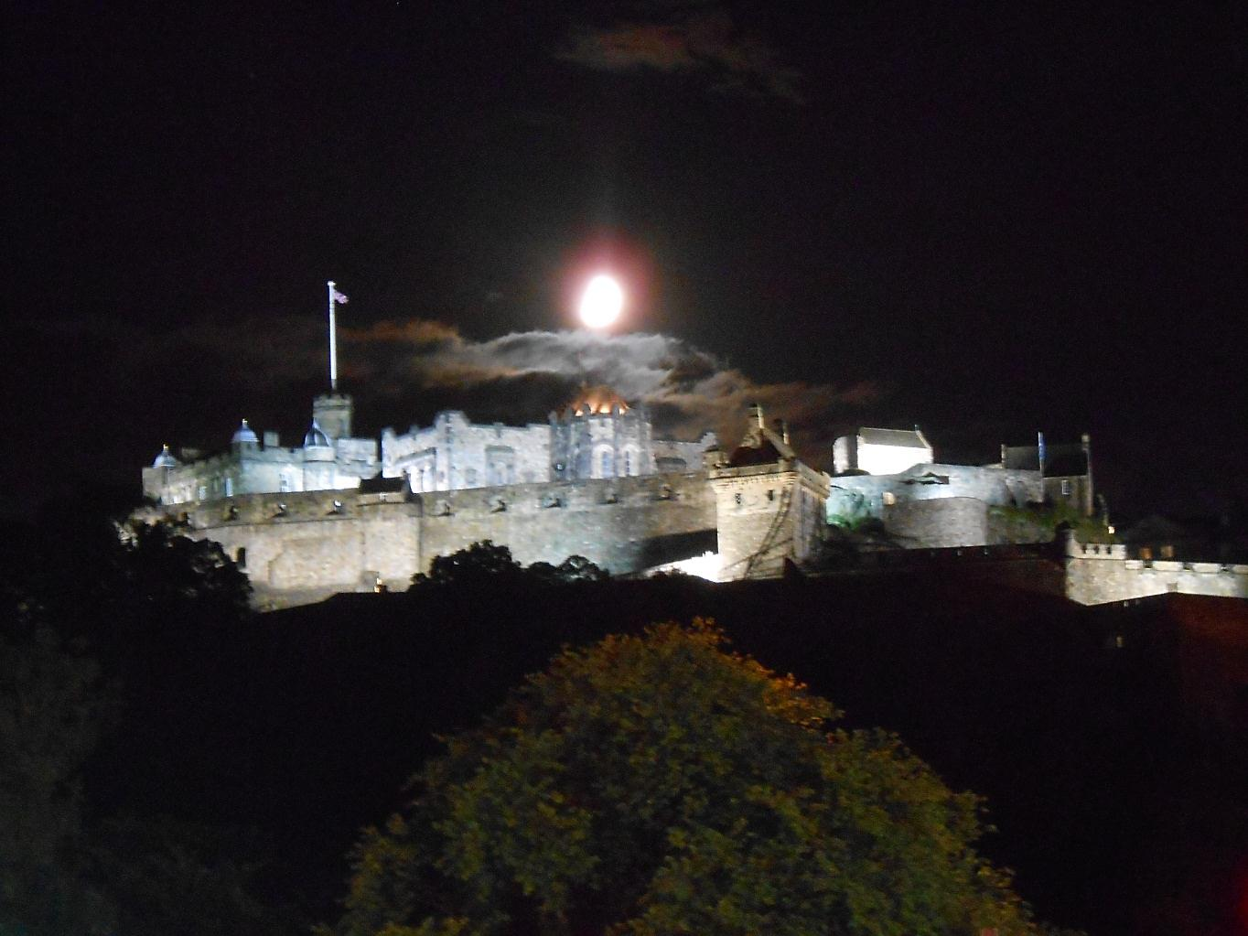
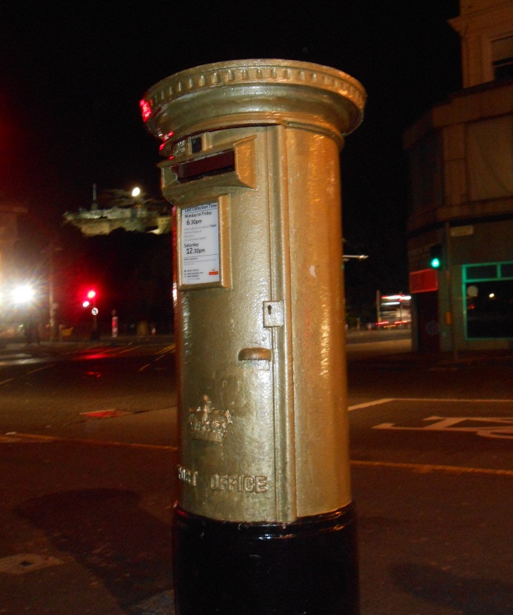
We have reached Edinburgh where we find a gold letter box for an Olympic rowing gold in this Olympic year.
Surprisingly close to Edinburgh city centre we also find the Union Canal.

Slide 3
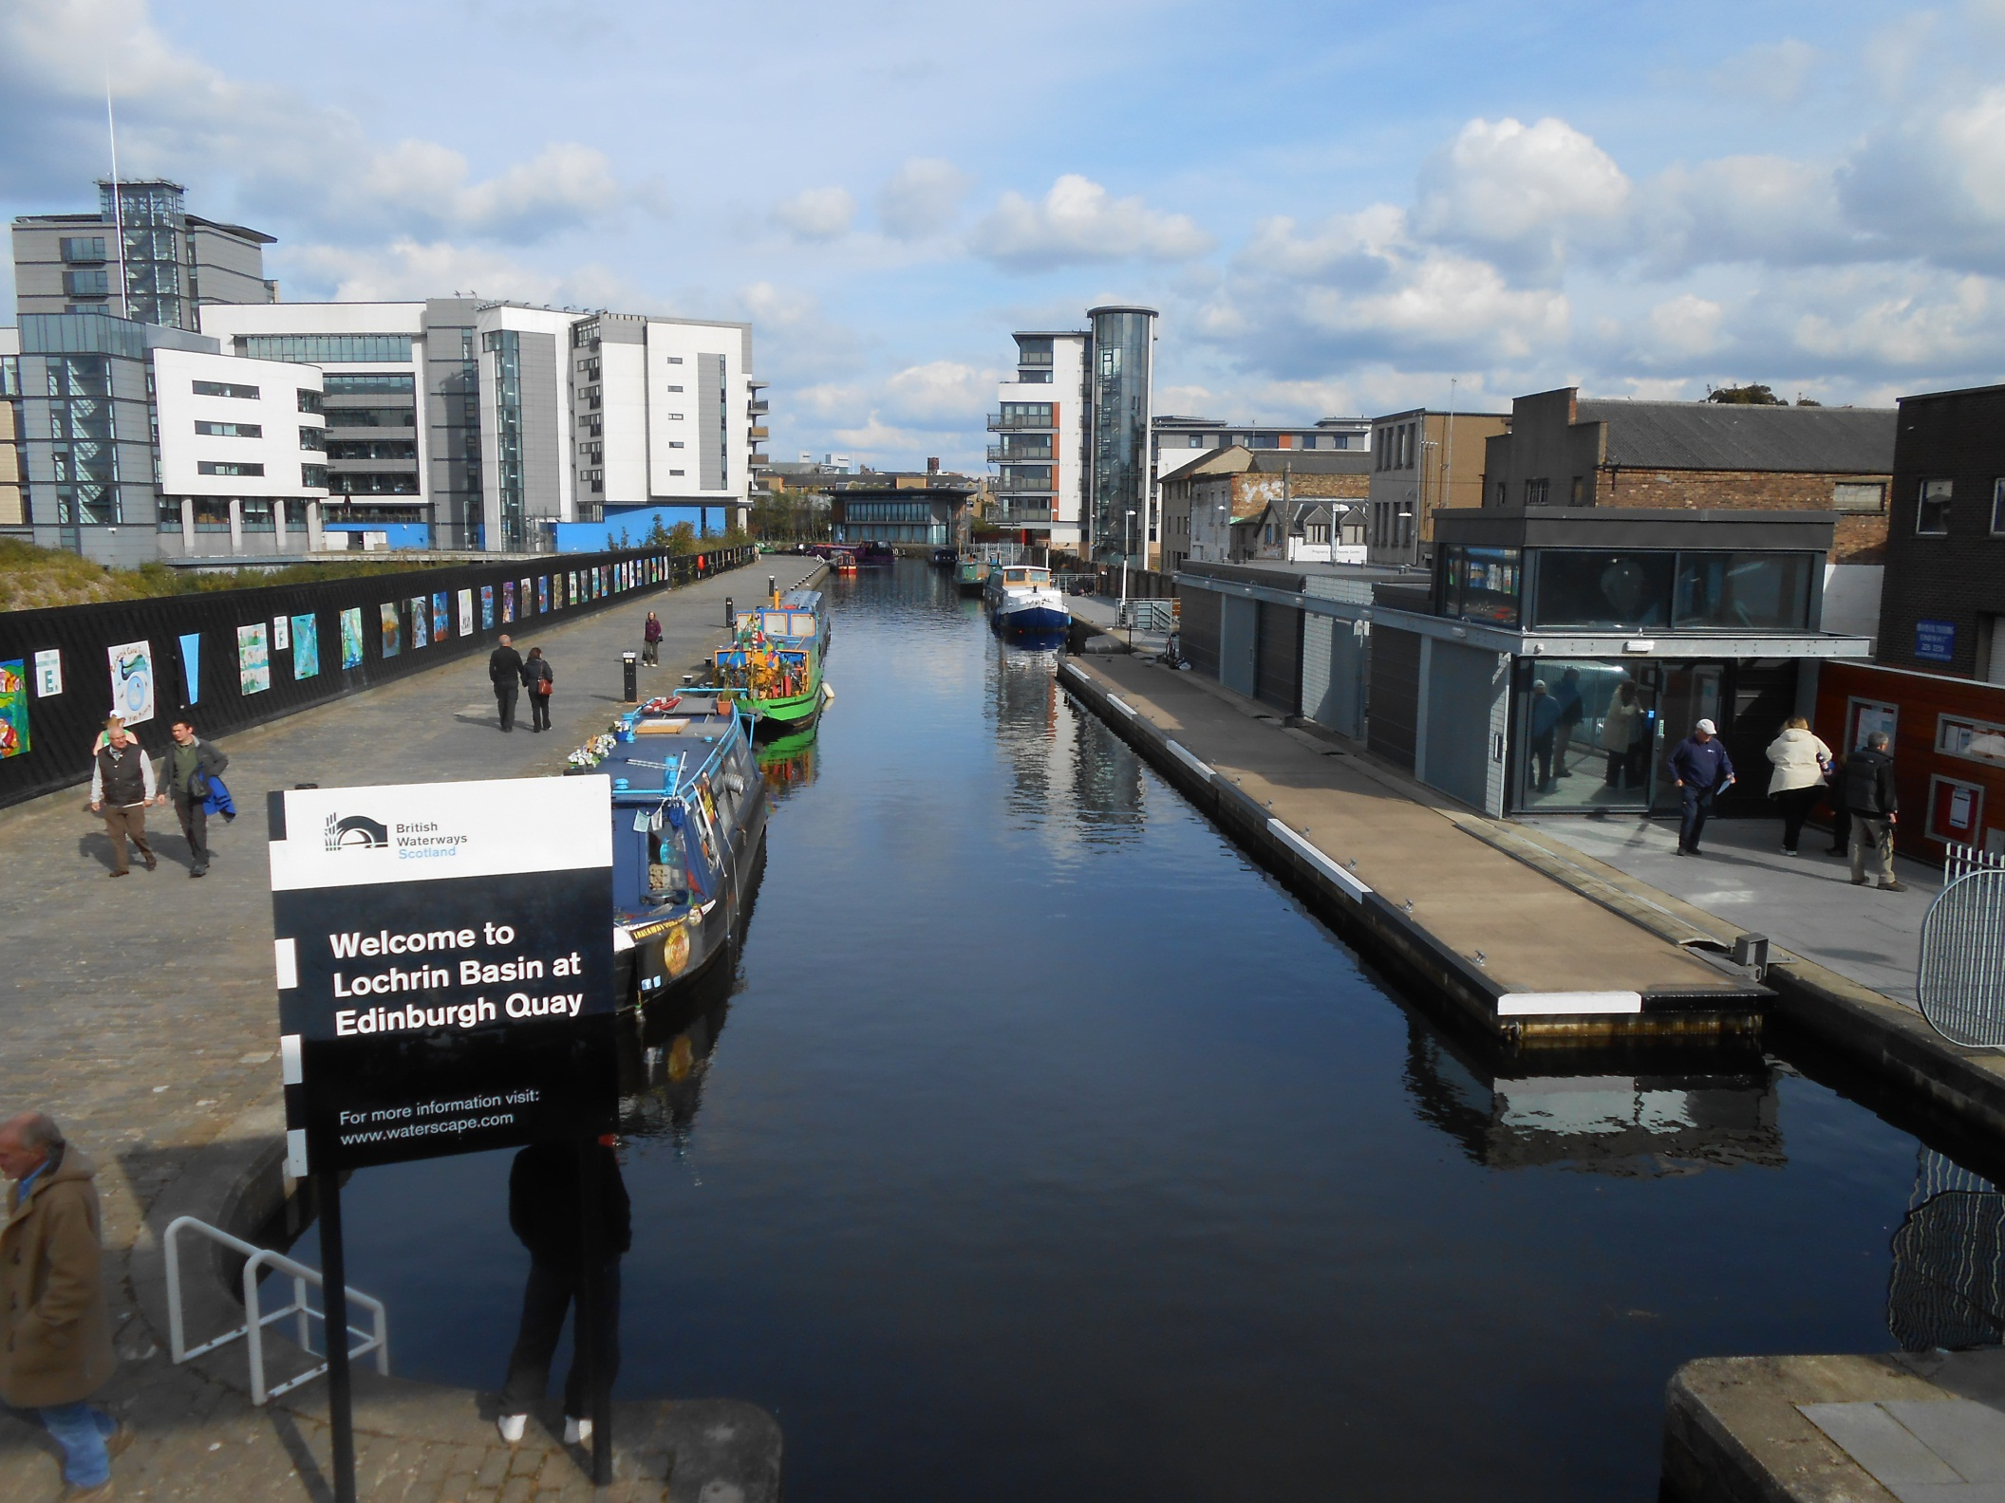
But it was once even closer as modern redevelopment has built on the original terminal basins.

Slide 4
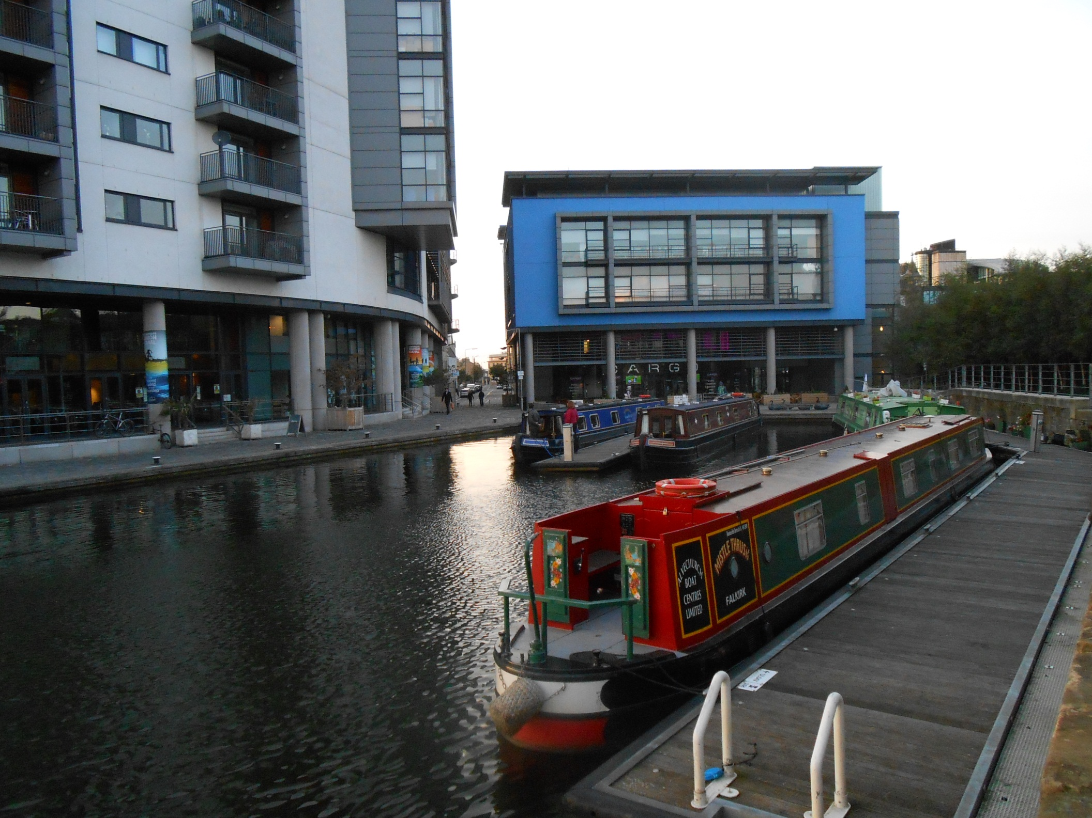
So this is now Edinburgh’s canal terminus.

Slide 5
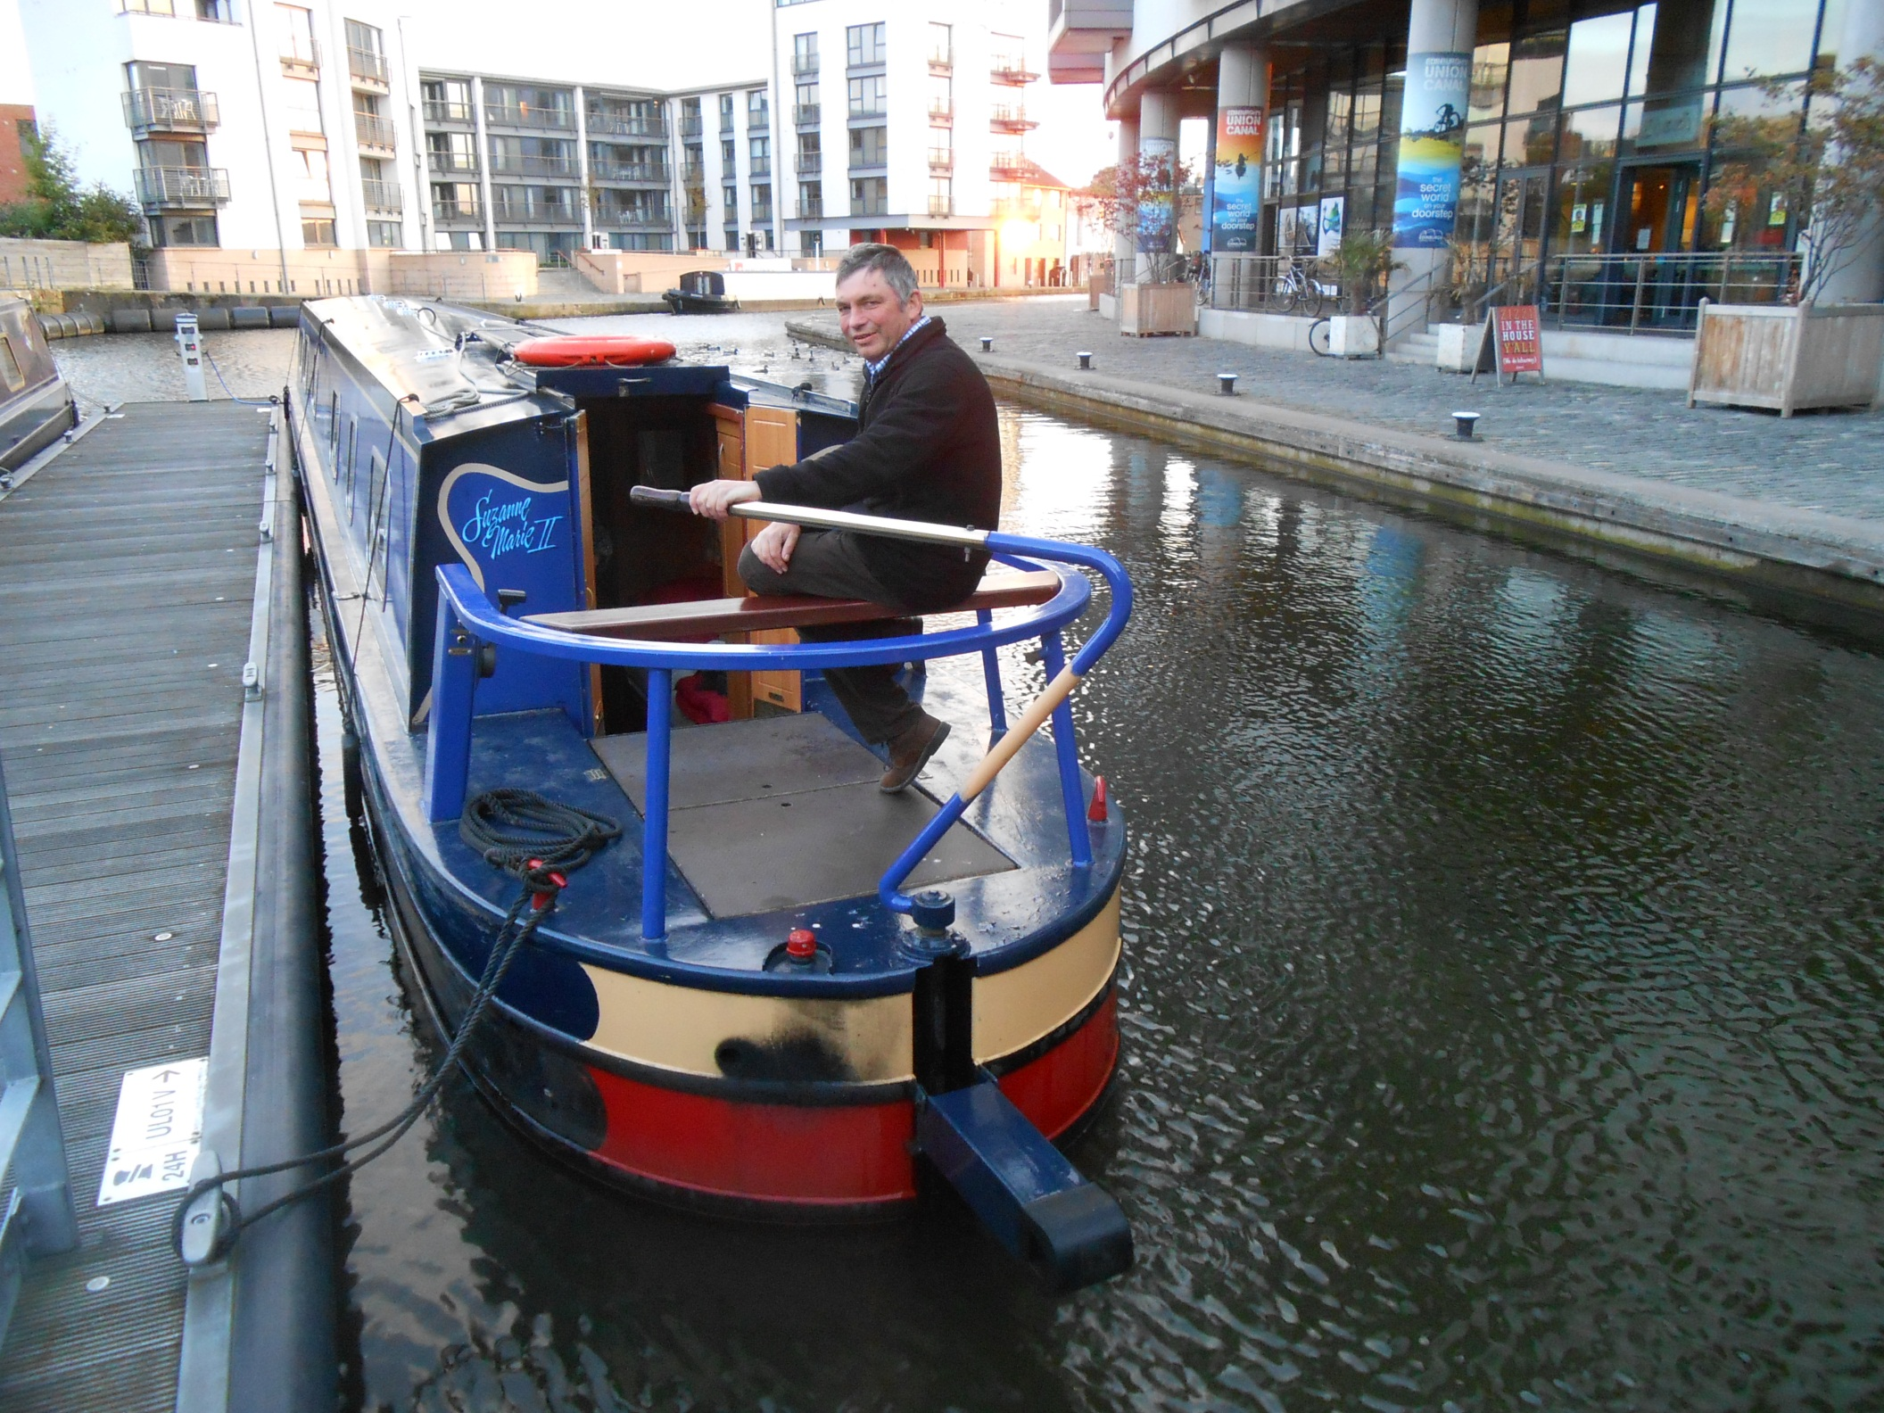
As we set off aboard the 62ft narrowboat Suzanne Marie, to travel the Scottish lowland canals to the River Clyde.

Slide 6
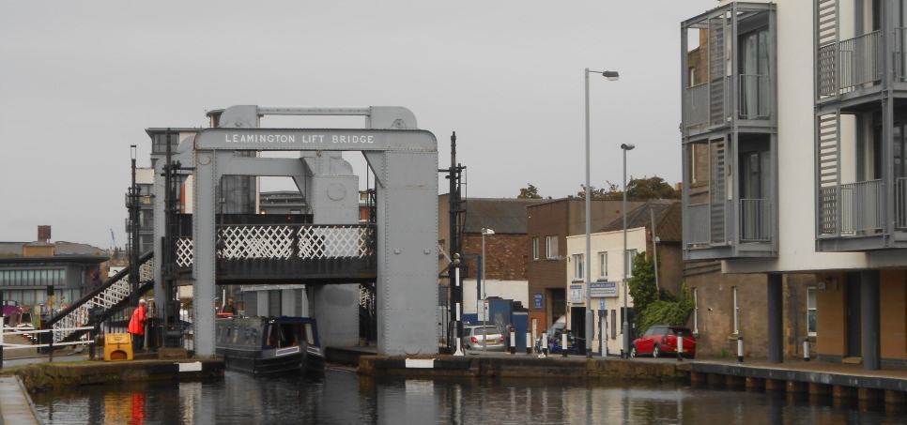
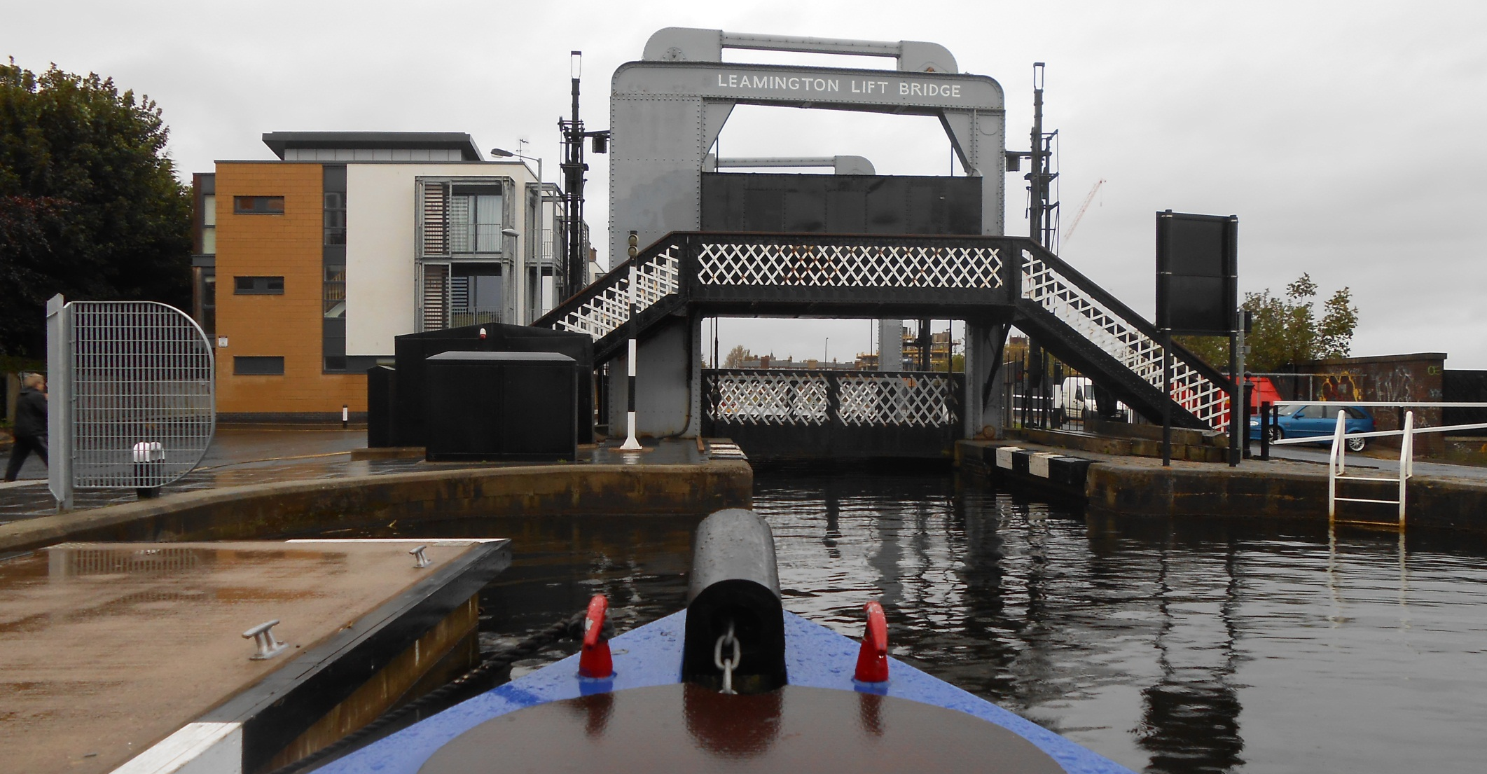
A British Waterways Scotland employee lifts Leamington Lift Bridge to start our journey along this impressive contour canal.

Slide 7
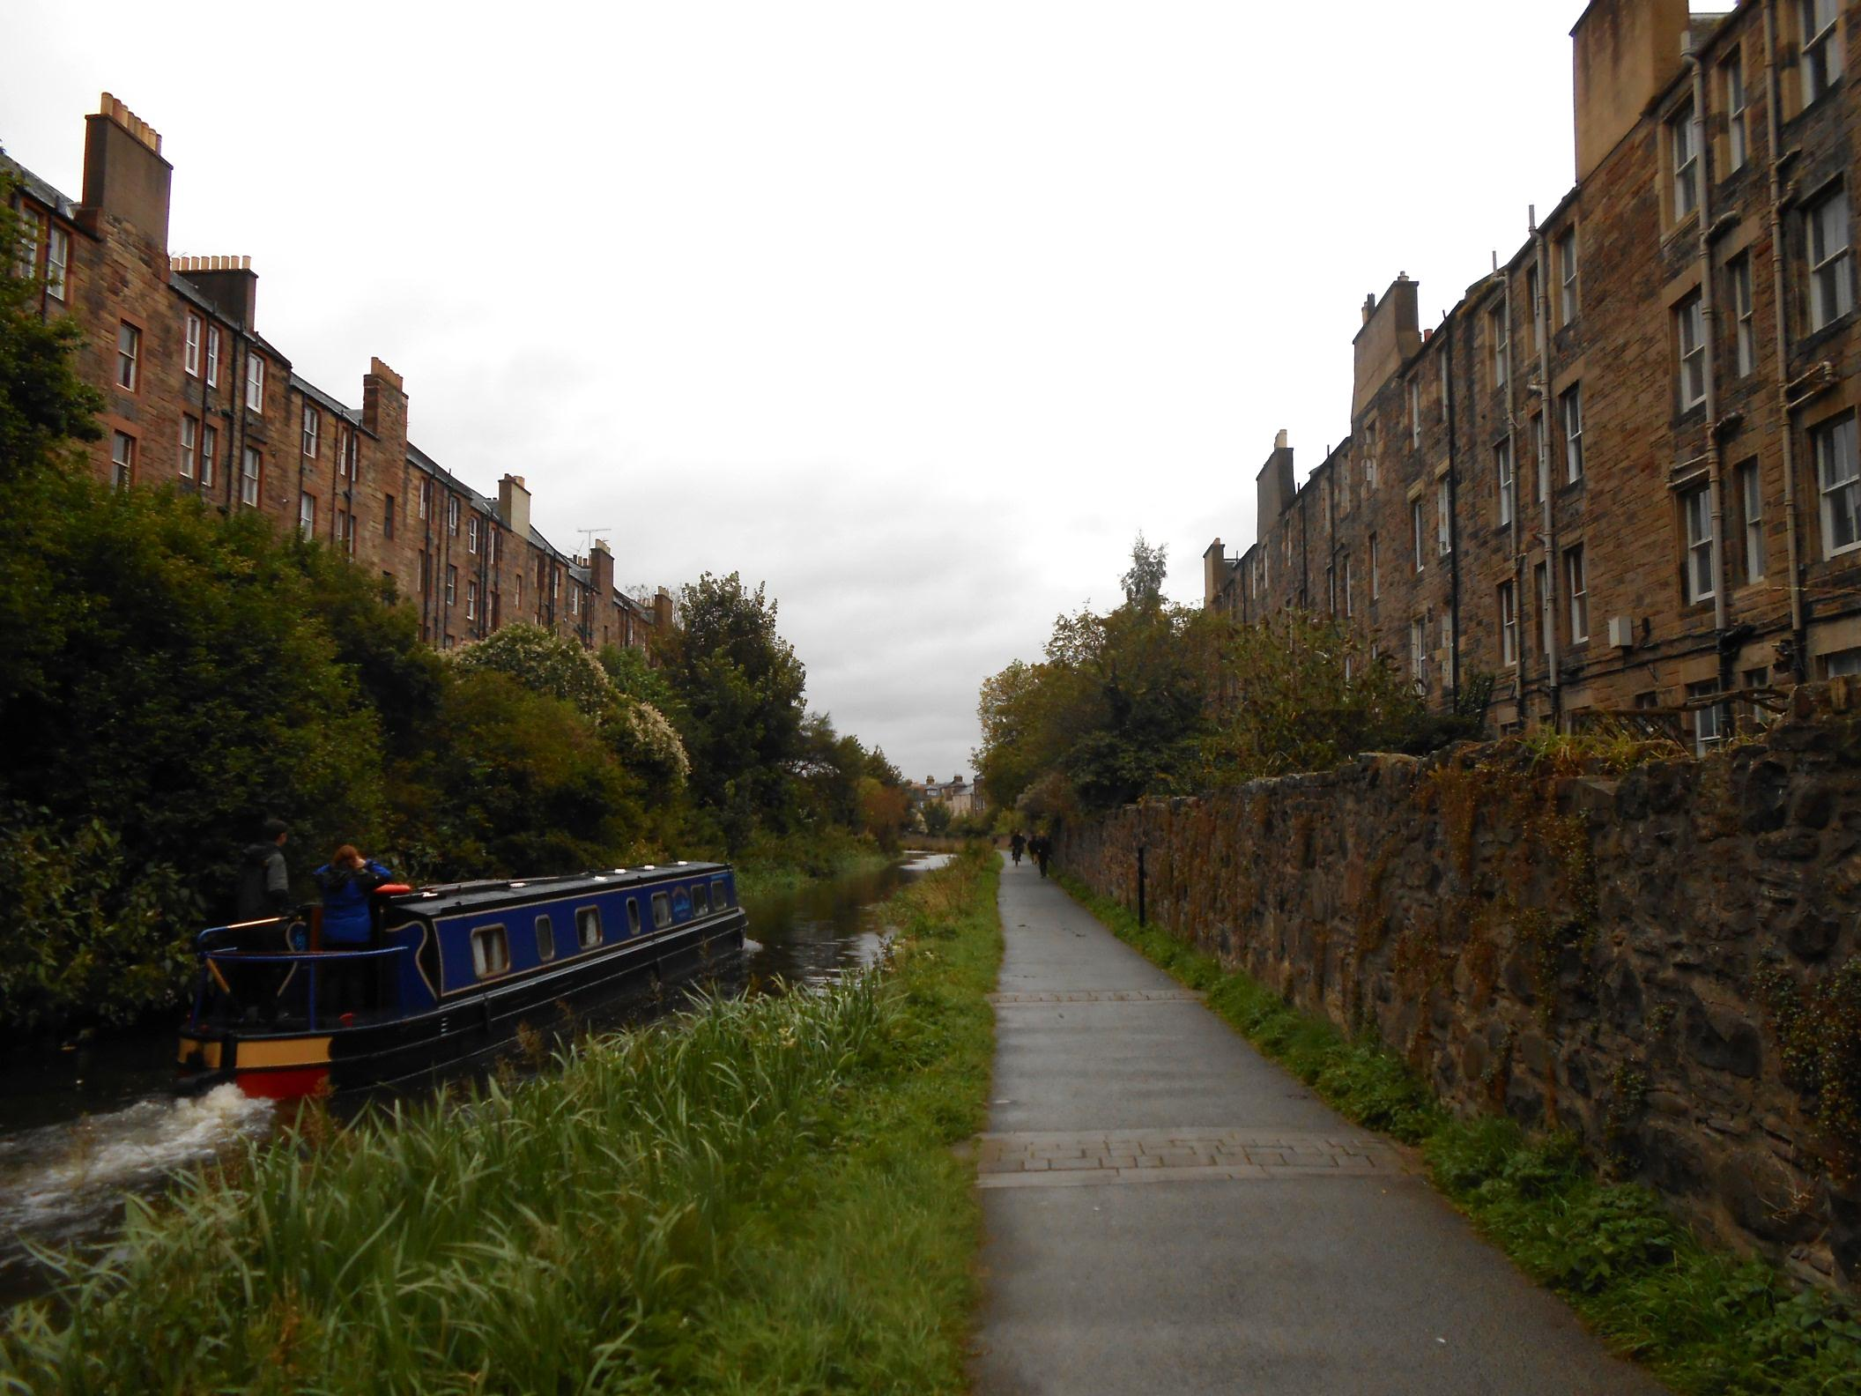
As solid tenements line our departure from Edinburgh.

Slide 8
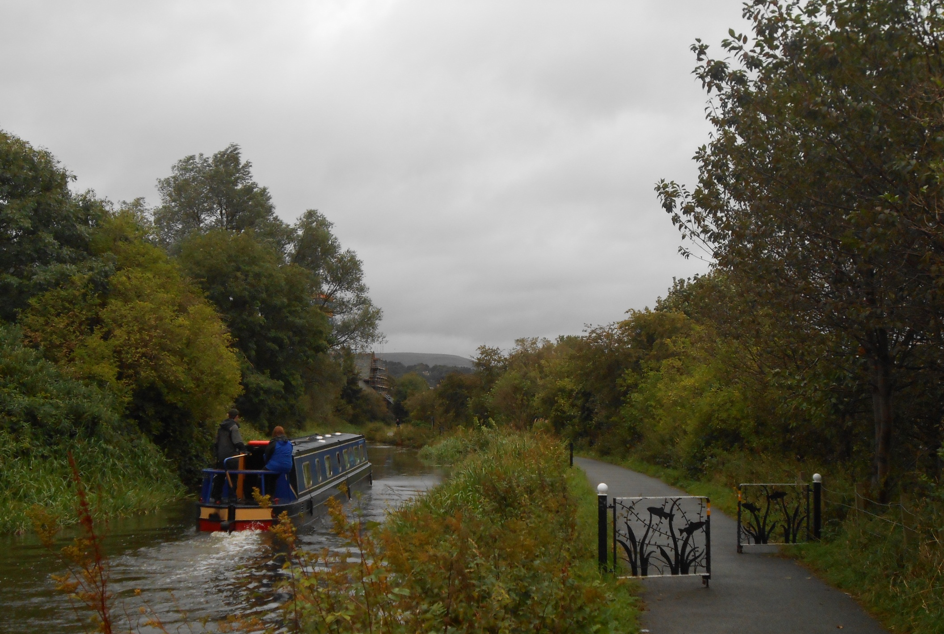
We soon reach the greenery of Harrison Park, typical of the rural feel of most of the Union Canal.

Slide 9
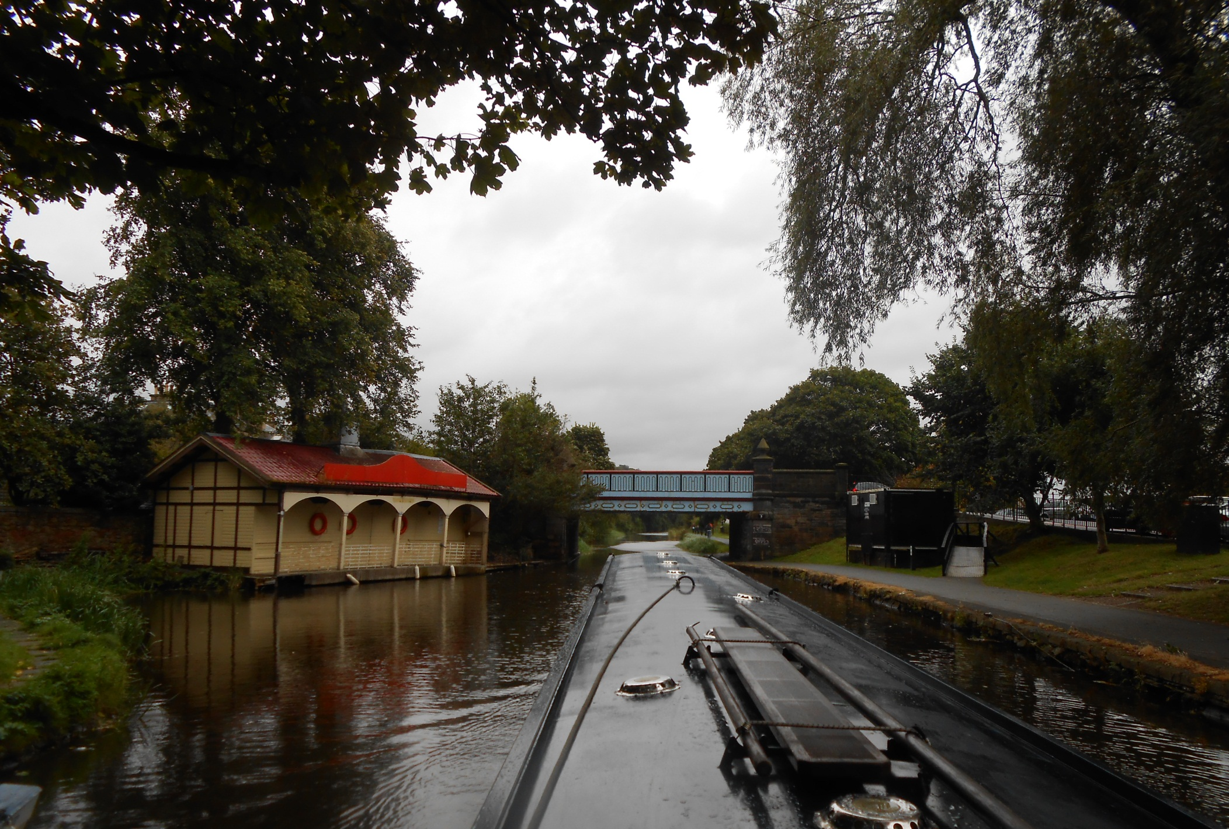
Bridge 3, with its period boathouse for rowing boat hire.

Slide 10
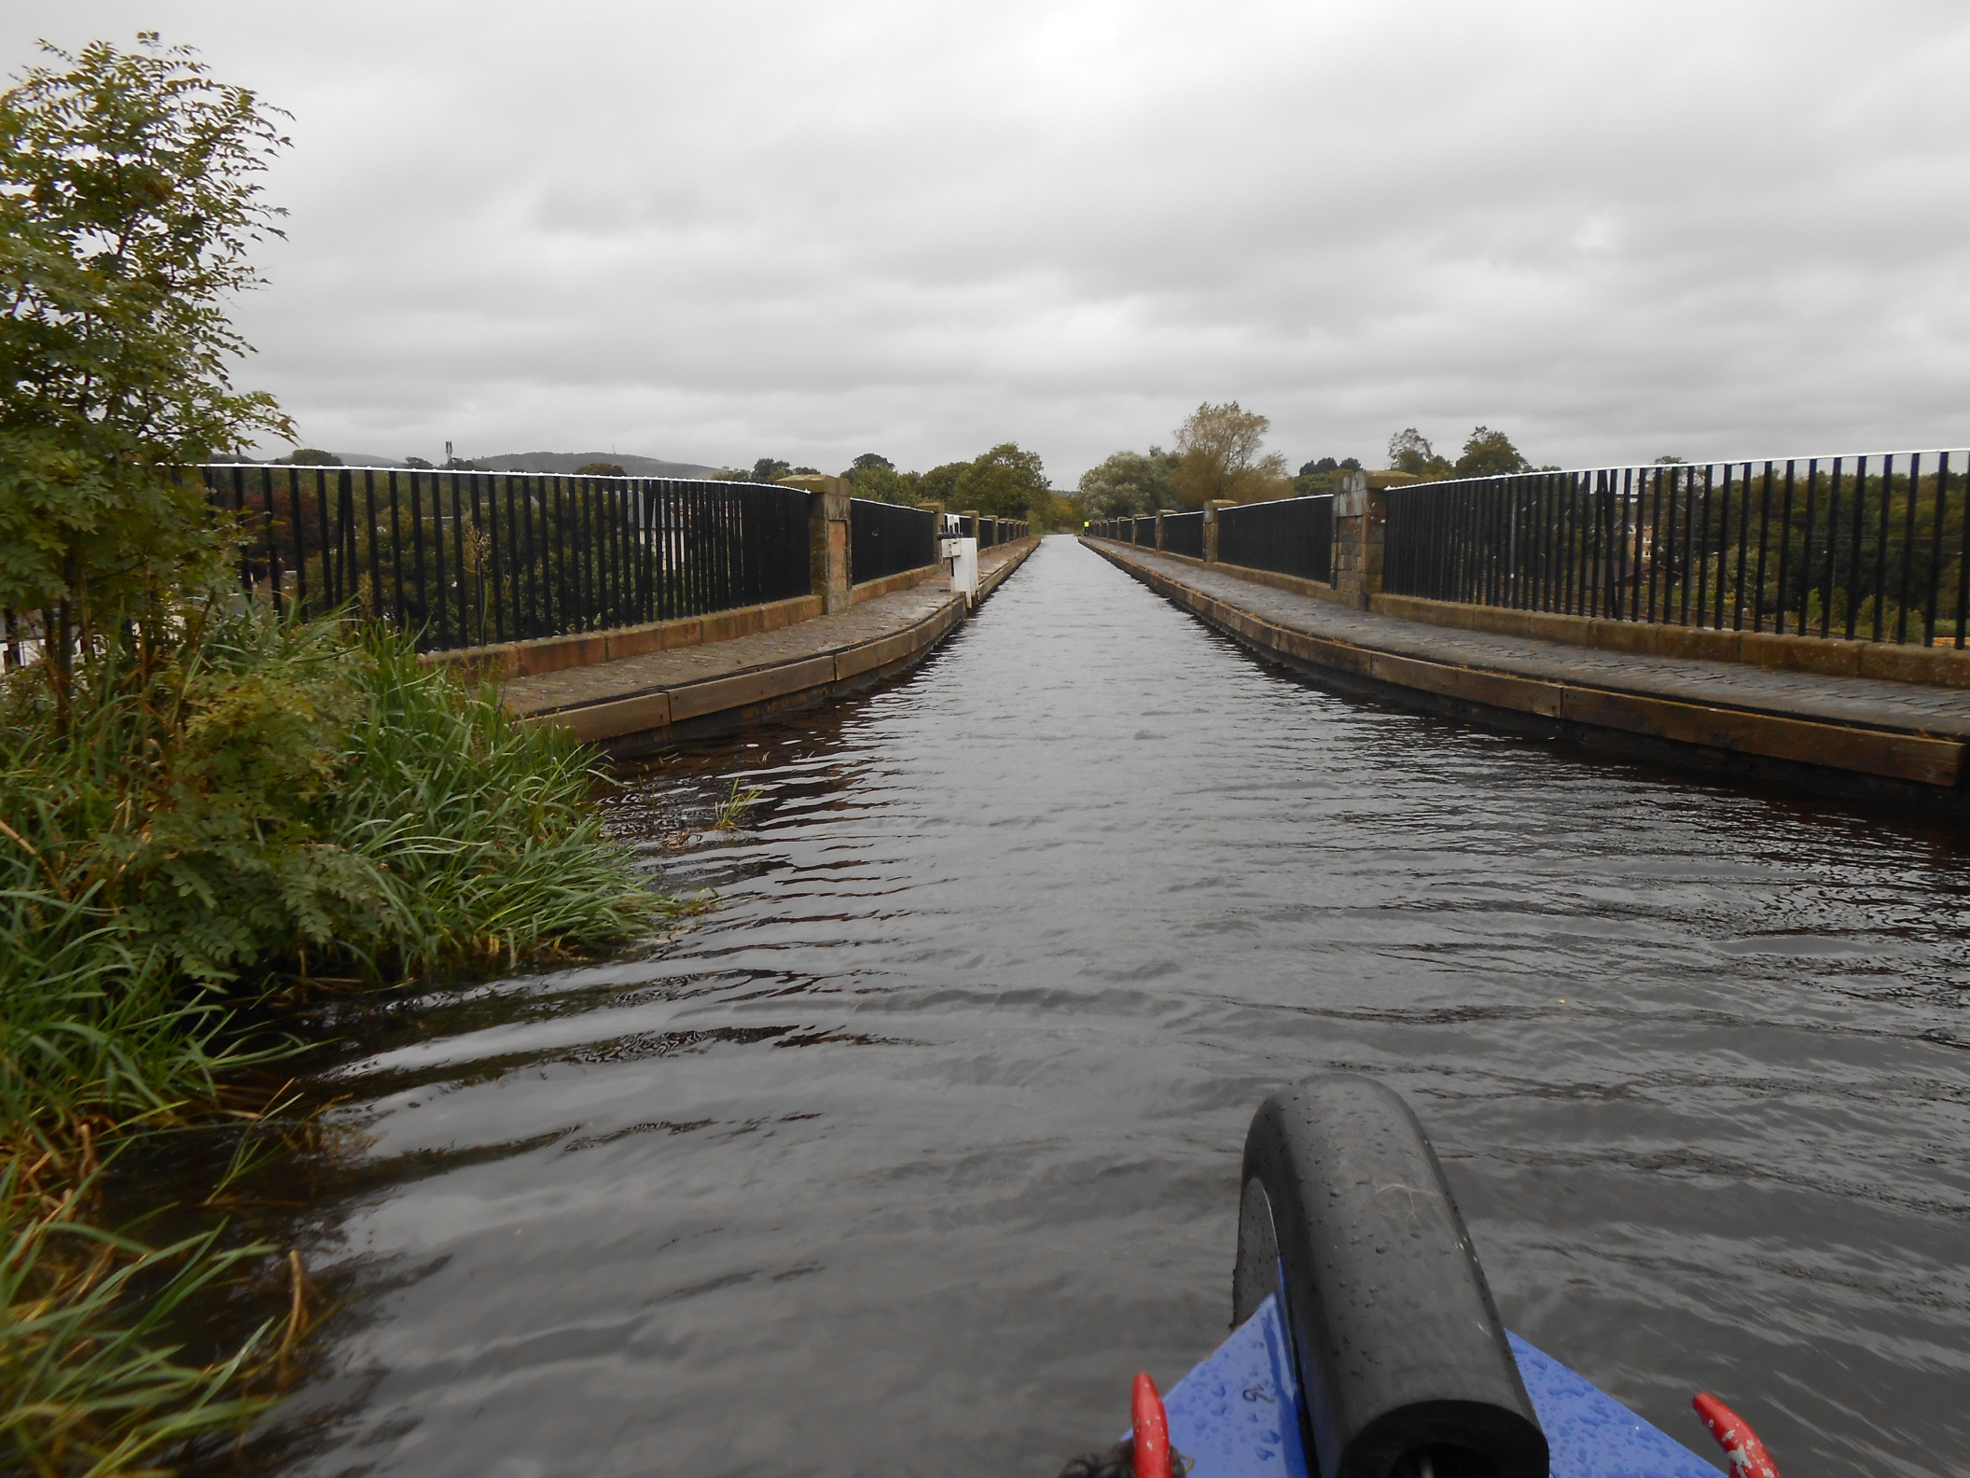
Then Slateford Aqueduct, the first of three substantial aqueducts.

Slide 11
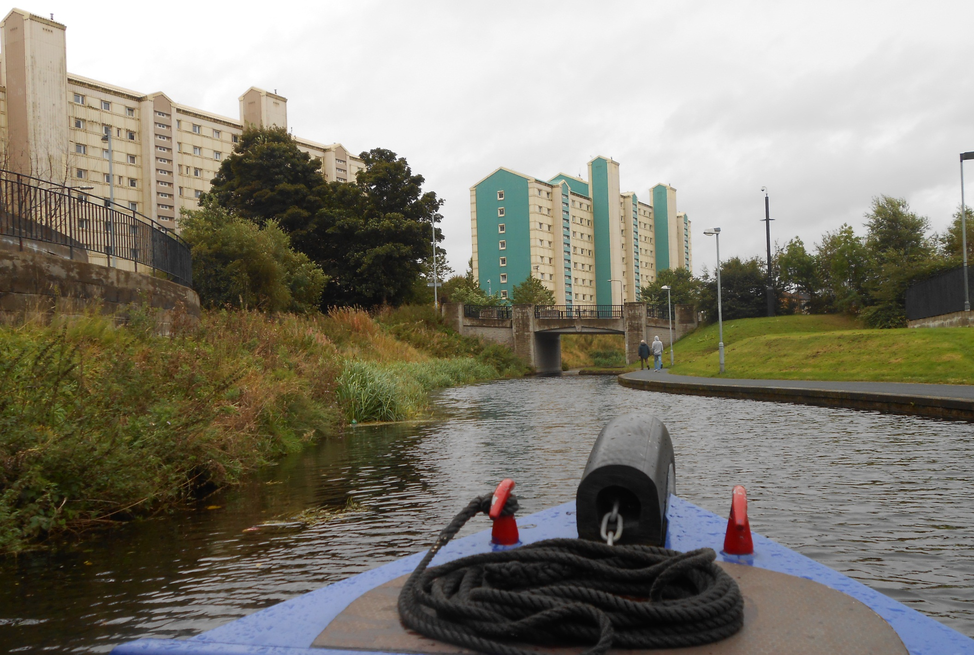
Urban Wester Hailes next where, in a millennium restoration project, a mile of infilled canal was completely rebuilt.

Slide 12
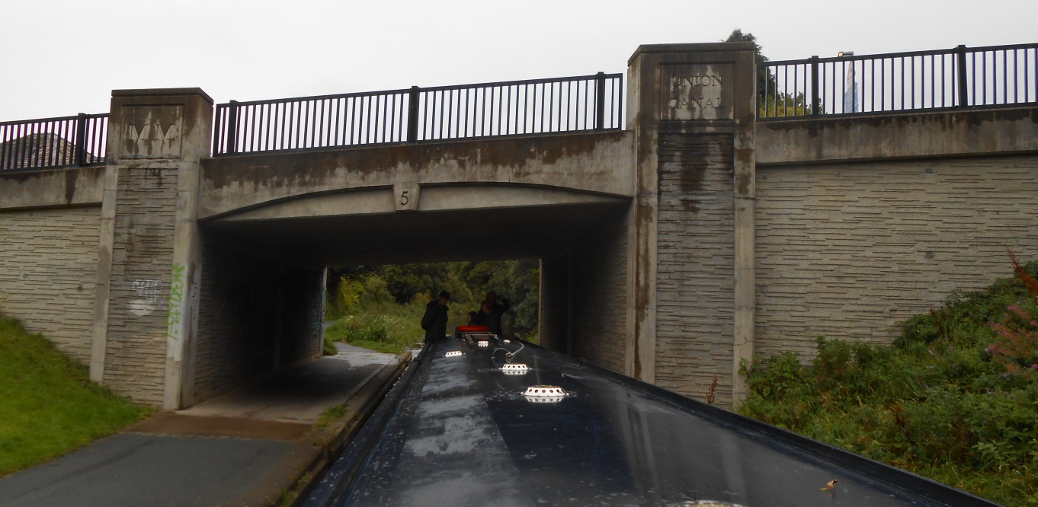
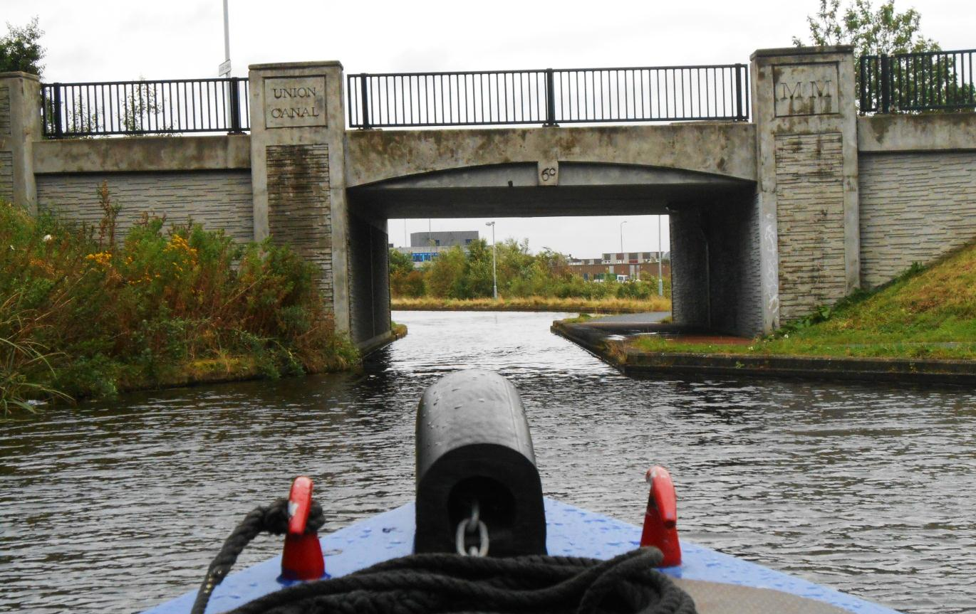
This is a typical Millennium Link bridge and seven of these were needed in Wester Hailes alone.
The restoration MM’s,
(the Roman 2000), pop up everywhere.
A nice feature.

Slide 13
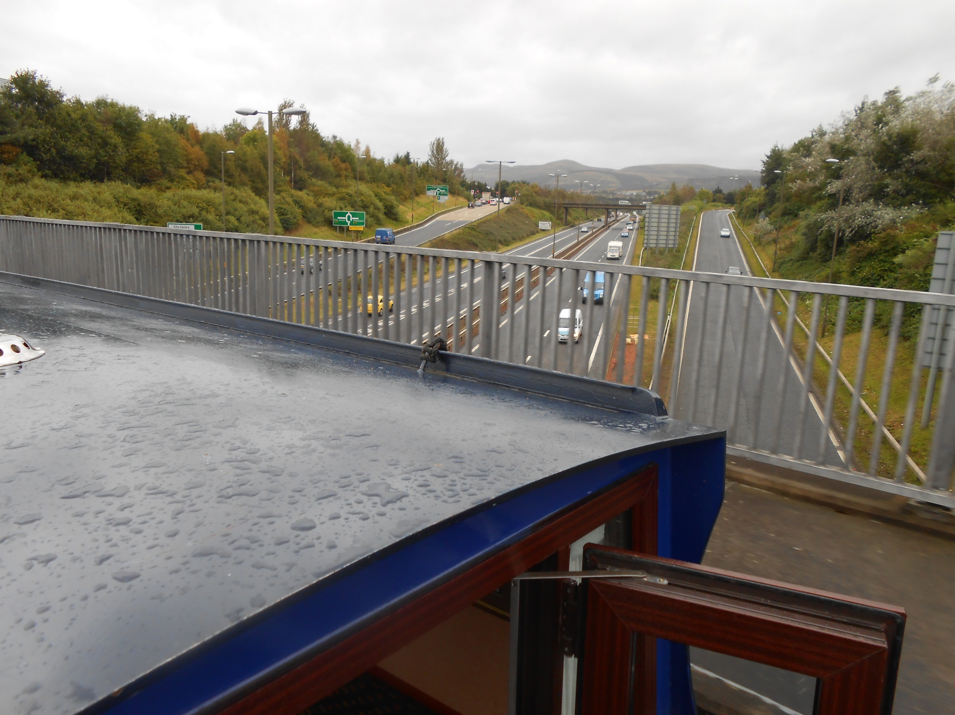
A modern aqueduct crosses Edinburgh ring road.

Slide 14
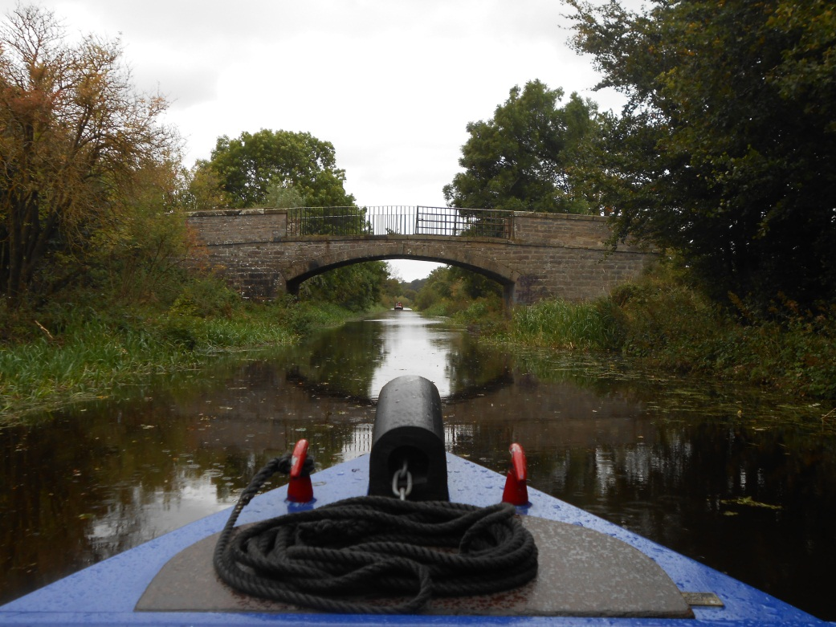
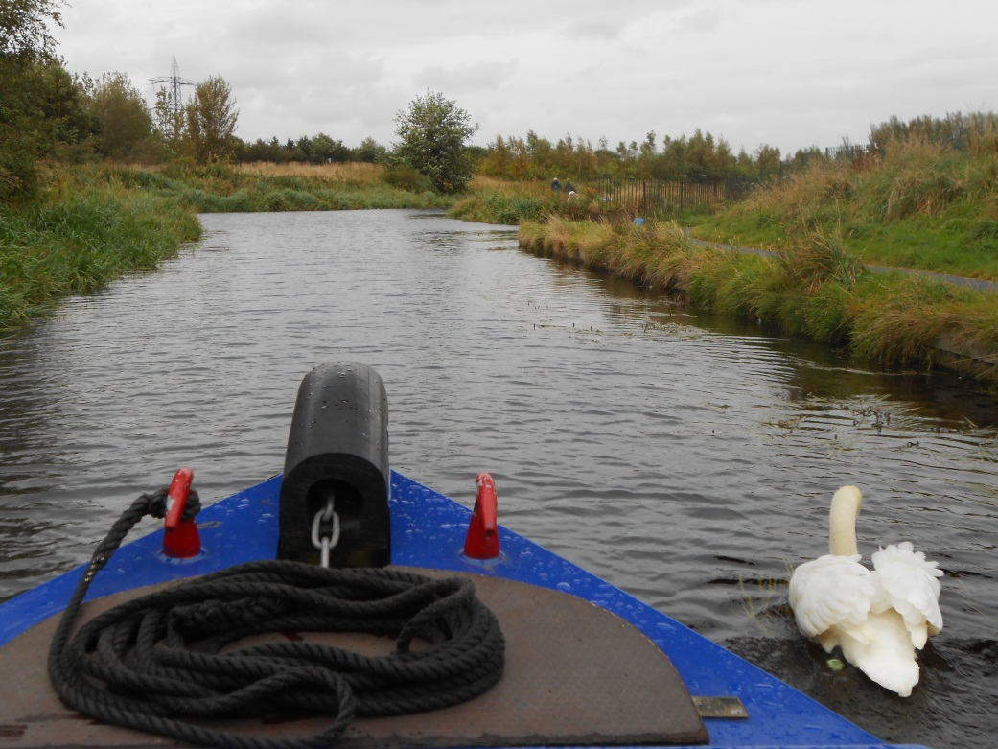
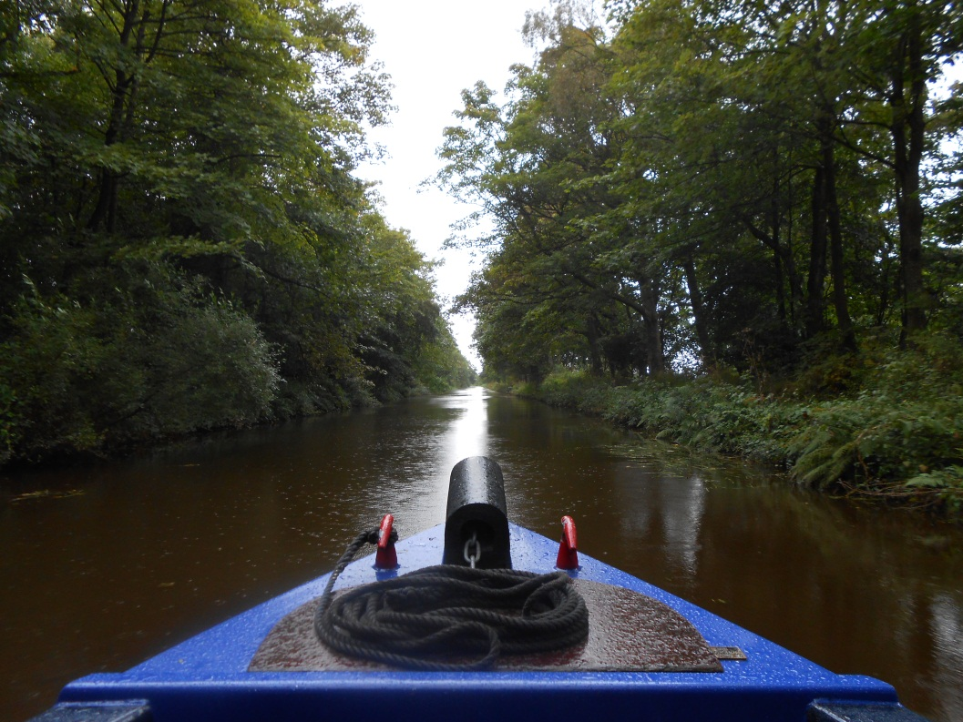
As we reach pleasing
Lothian countryside.

Slide 15
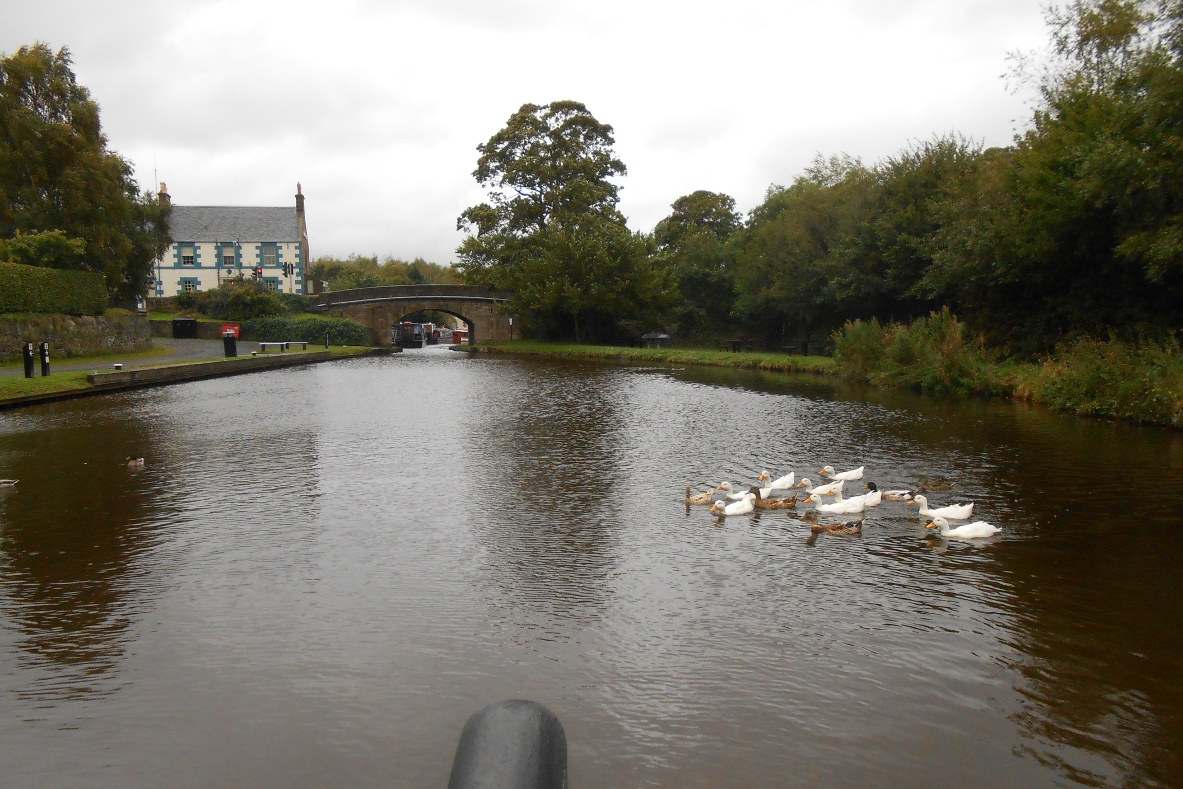
To Ratho and the canal focused Bridge Inn.

Slide 16
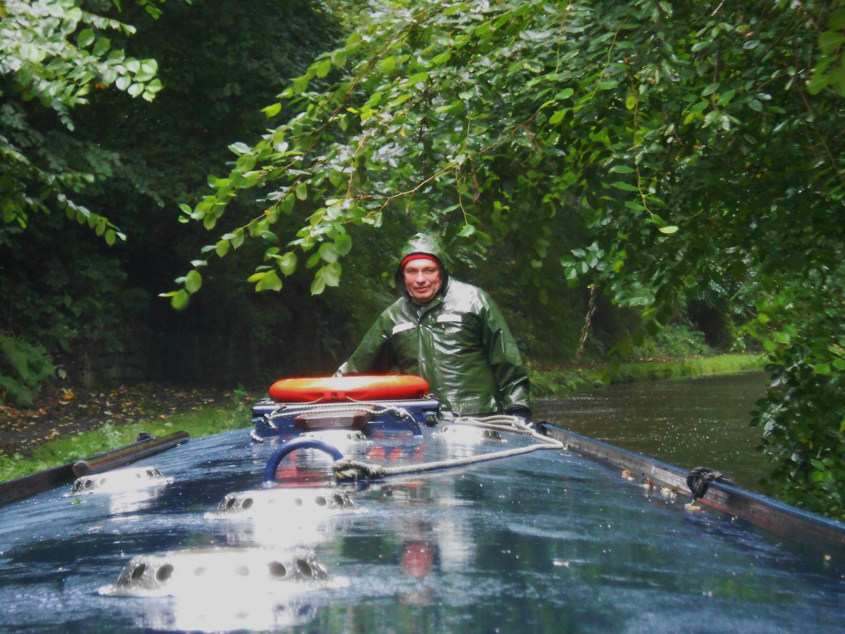
It then rained but we pressed on.

Slide 17
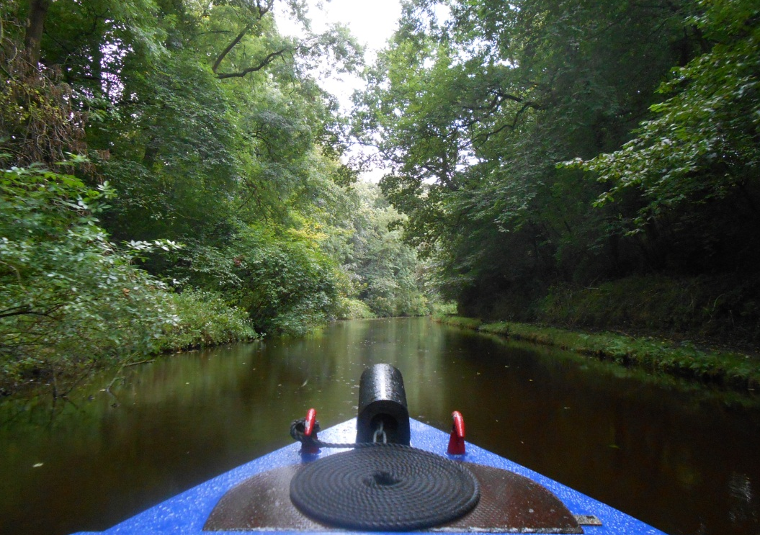
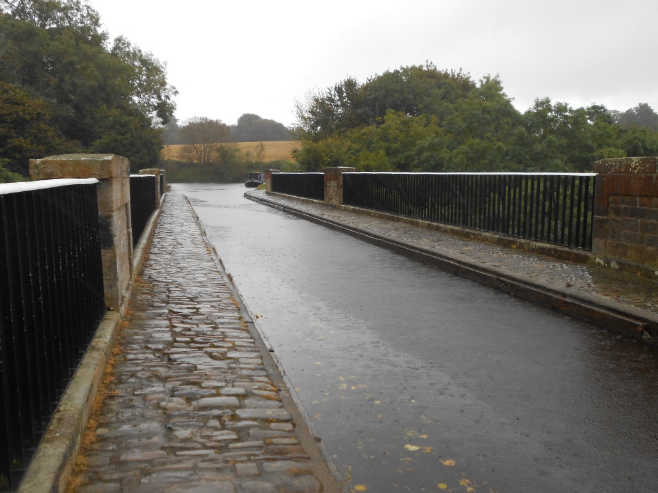
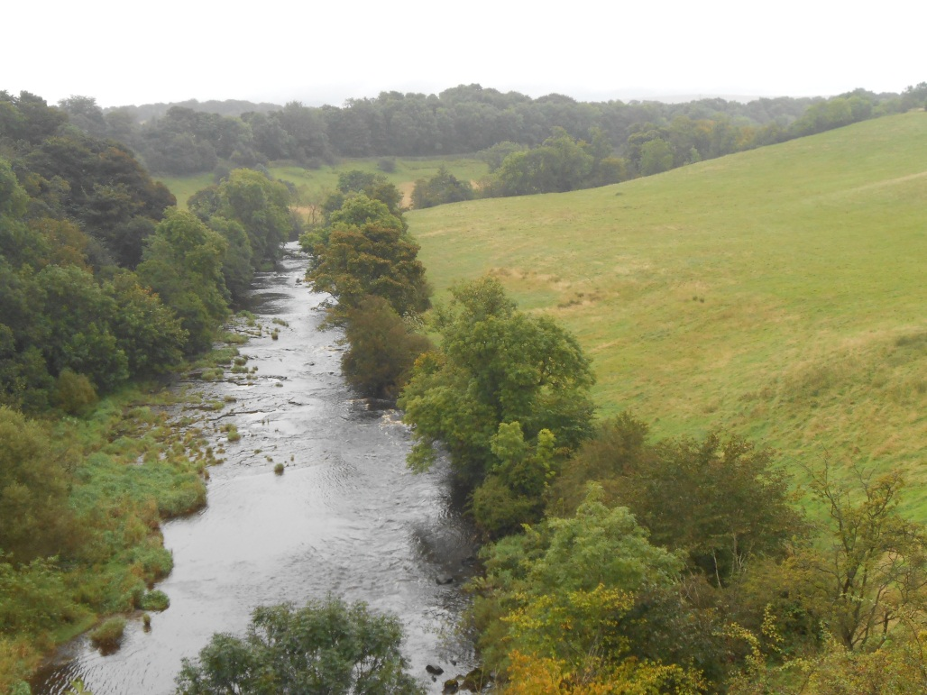
Winding our way round the 240ft contour to the second classic aqueduct, the
River Almond Aqueduct.

Slide 18
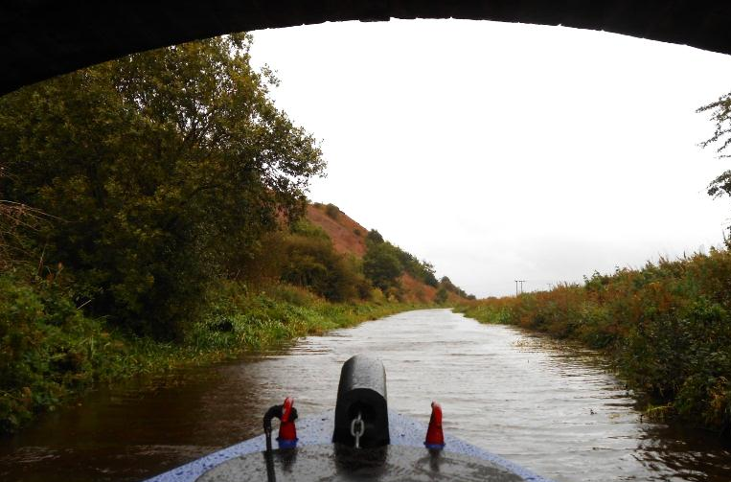
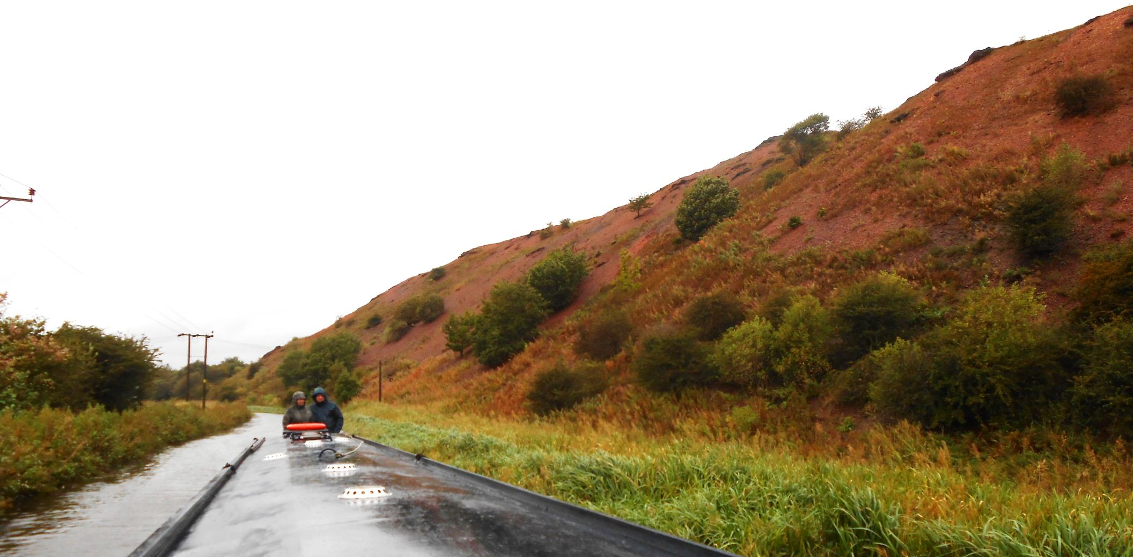
Then come the shale bings of Lothian. James “Paraffin” Young founded an industry here that from the 1860’s extracted oil from local oil shale. These distinctive spoil heaps are its legacy.

Slide 19
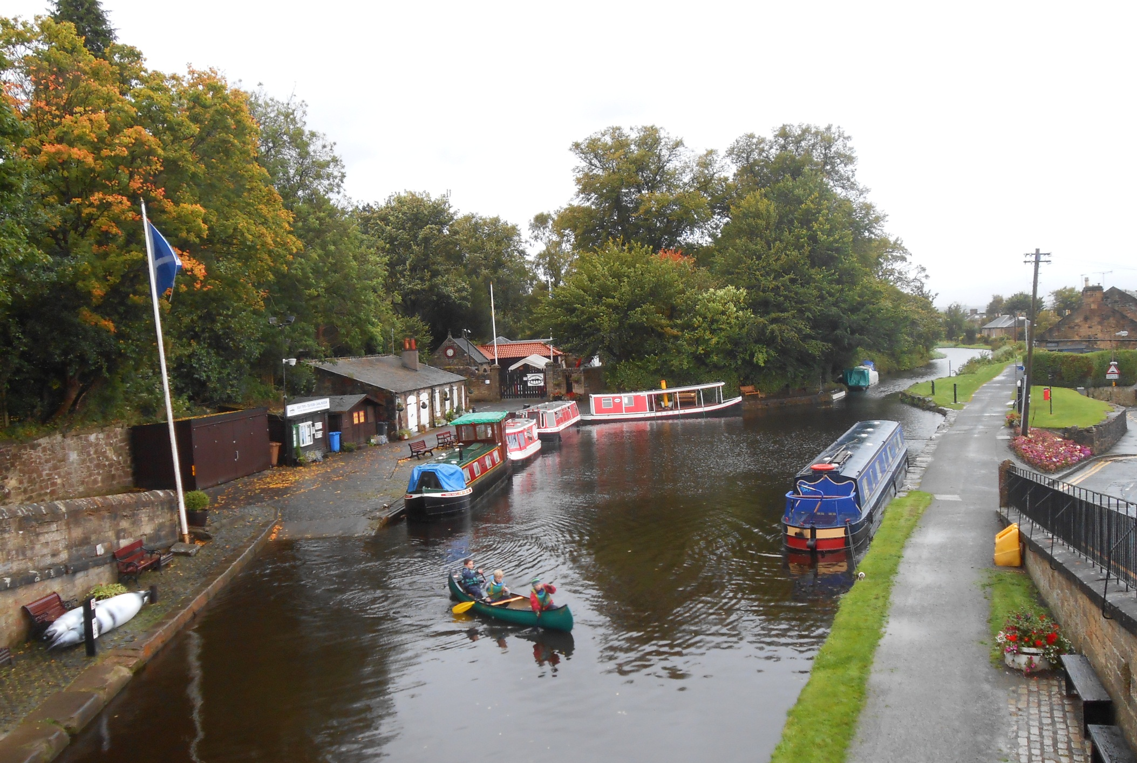
Linlithgow now and our overnight mooring, with the replica, (but sadly diesel powered), steam packet boat Victoria by the wharf.

Slide 20
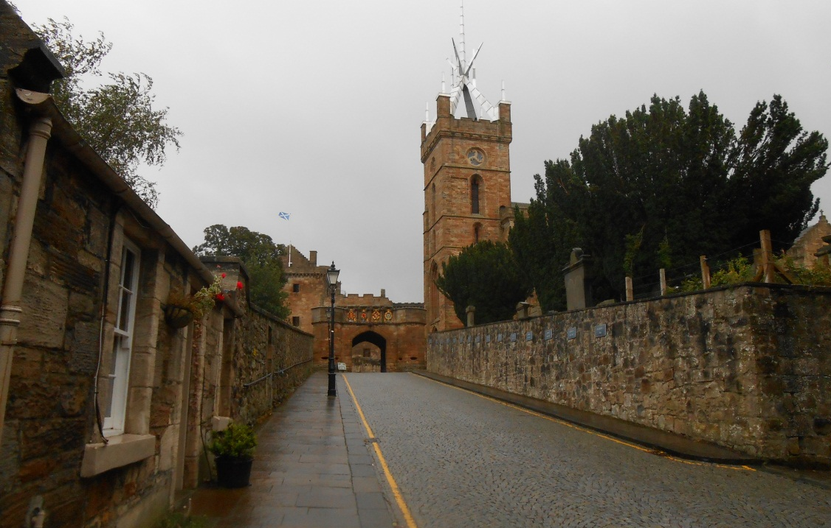
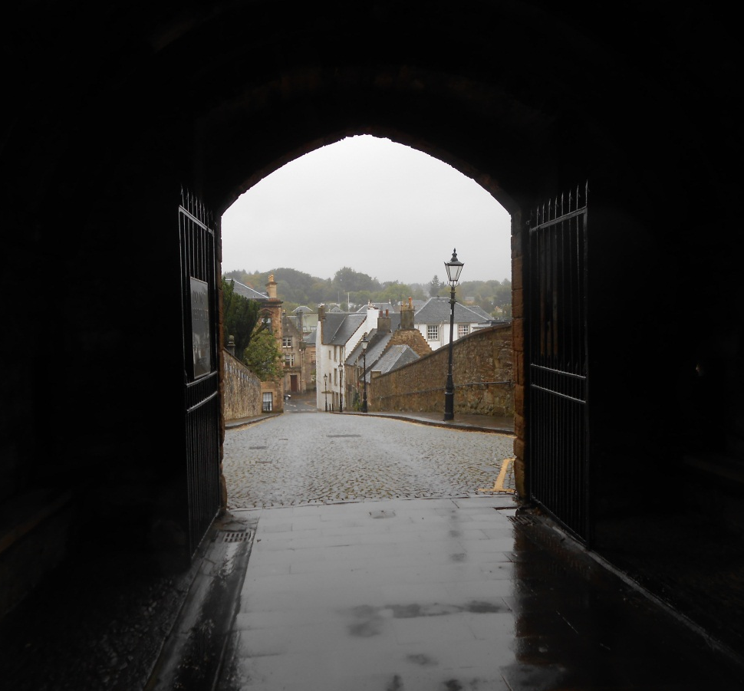
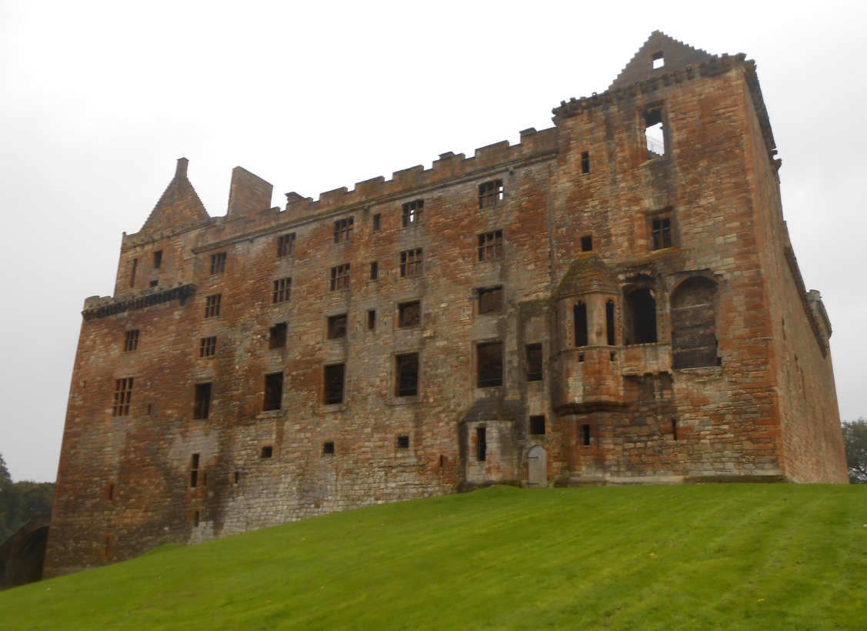
Heavy rain continues to fall as we view impressive Linlithgow Palace.

Slide 21
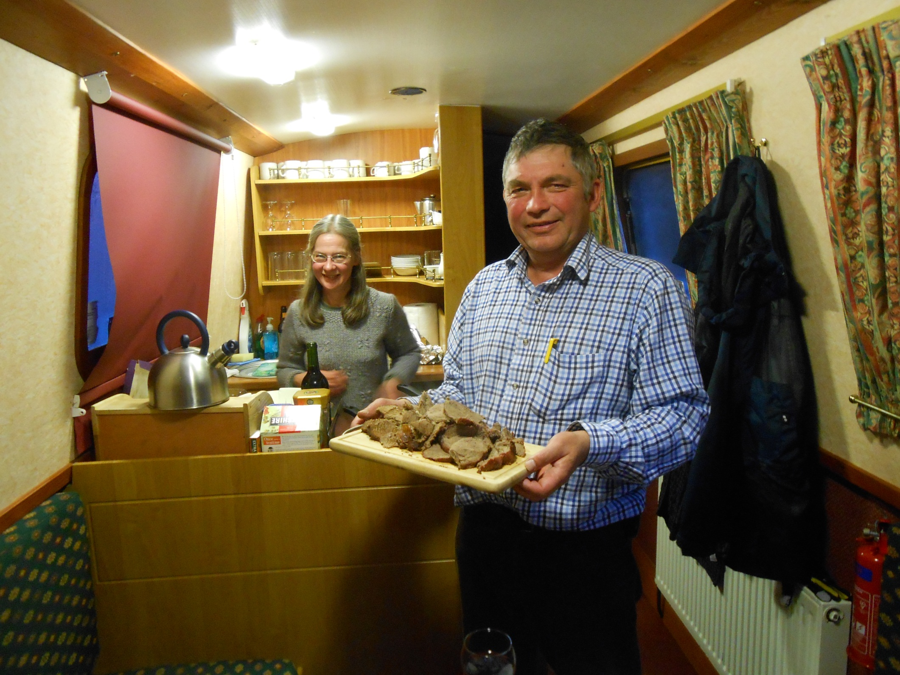
Before returning for a boaters dinner on this stormy night.

Slide 22
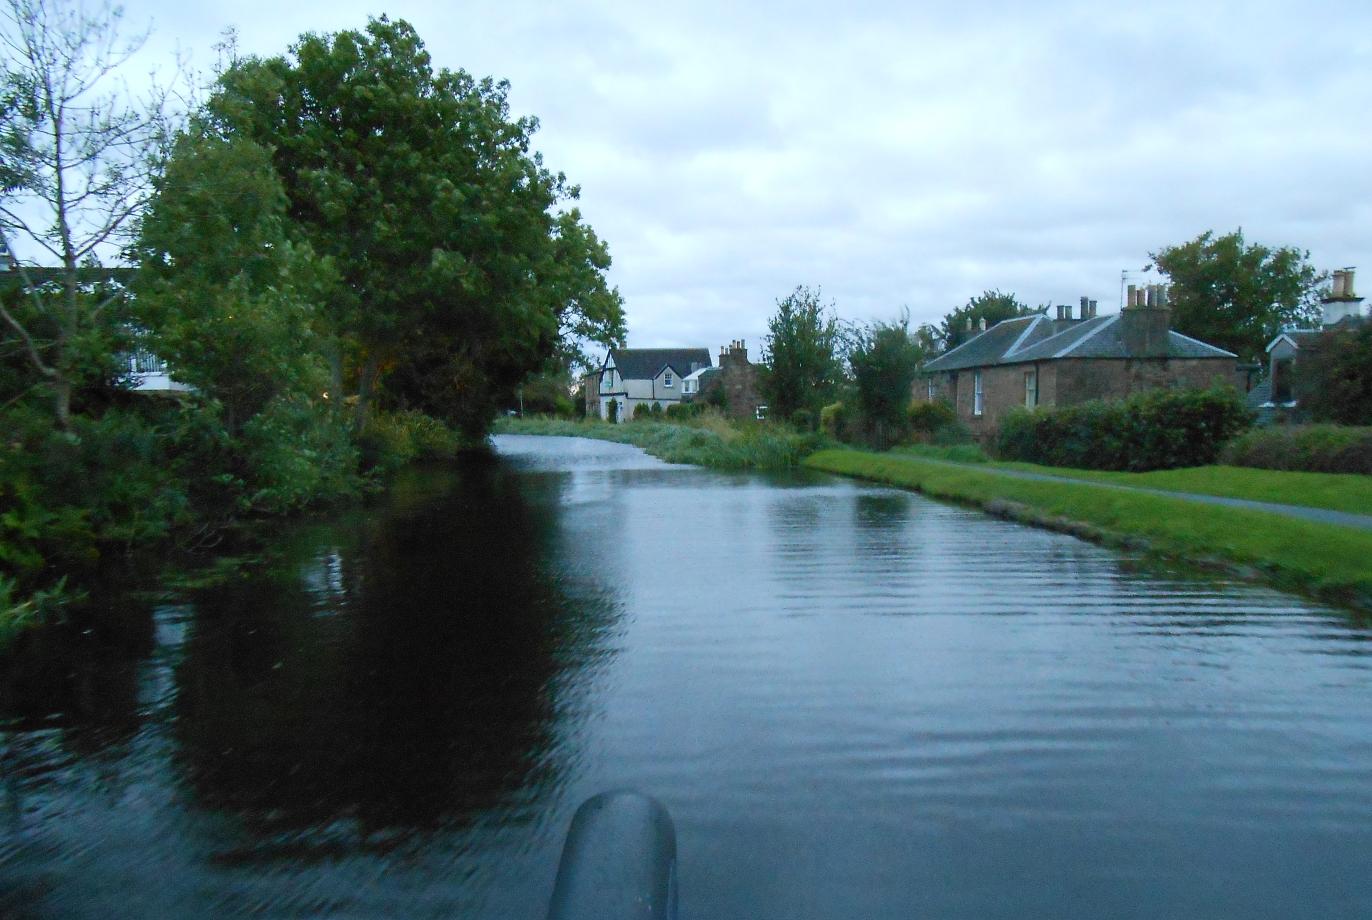
As usual, we depart early next morning.

Slide 23
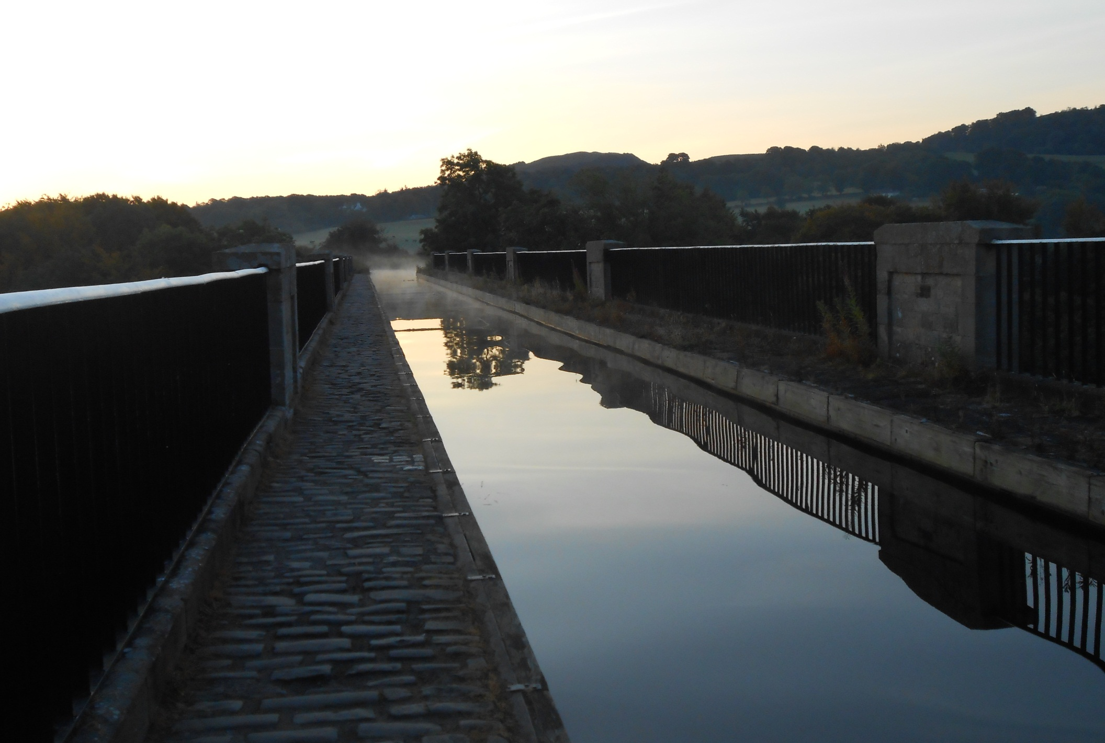
And soon reach our third spectacular aqueduct, Avon Aqueduct.

Slide 24
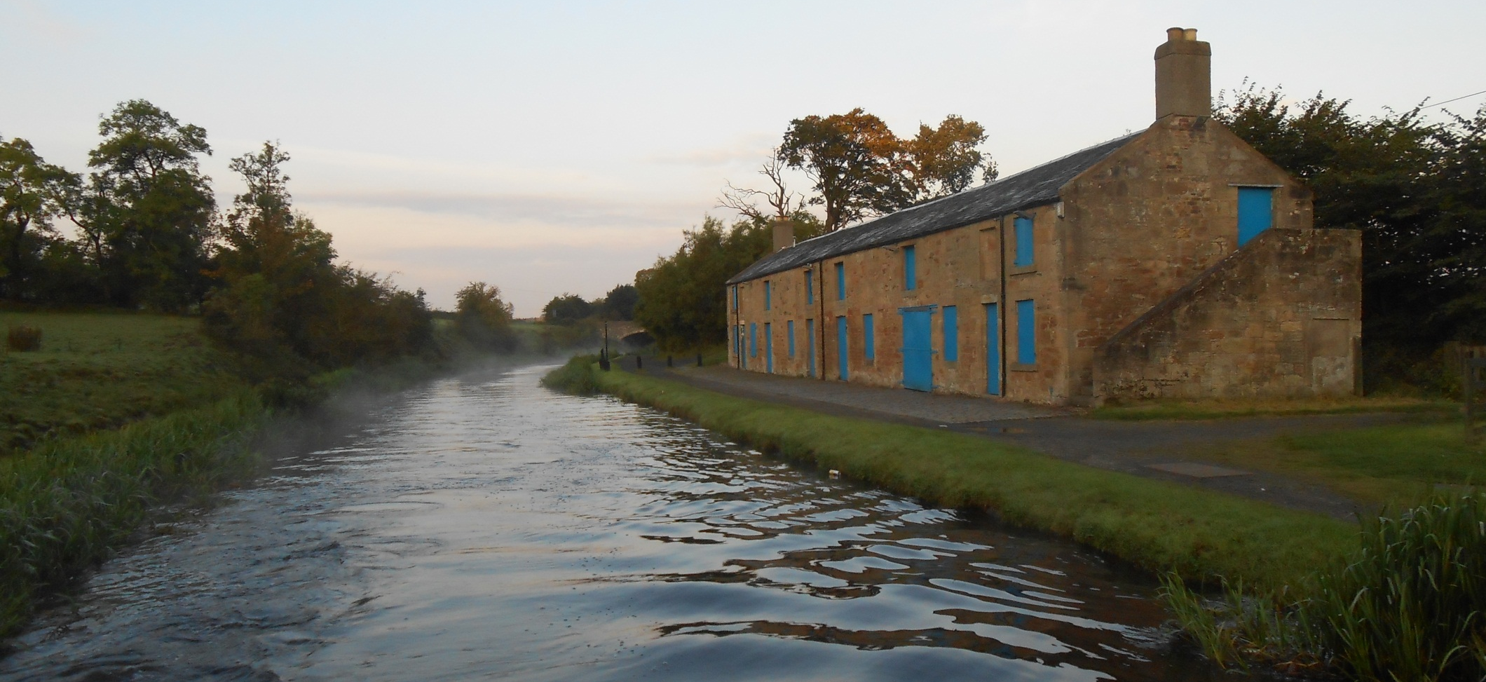
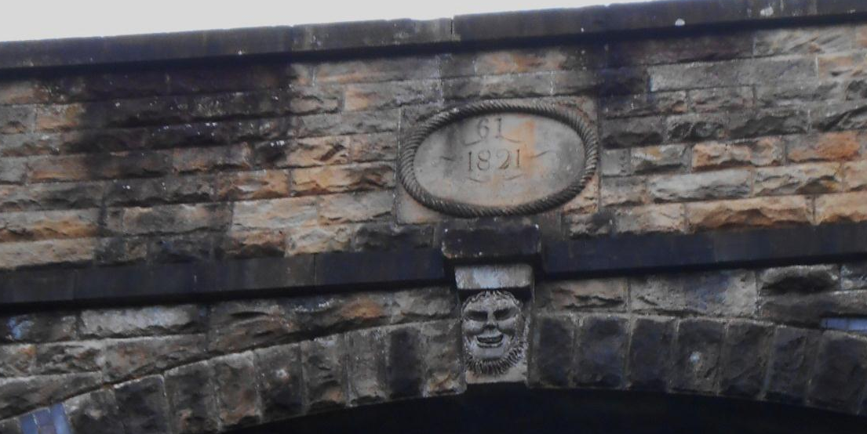
Also nearby, this old stable block. Then comes the wry grimmace of the Laughin’ and Greetin’ bridge approaching Falkirk.

Slide 25
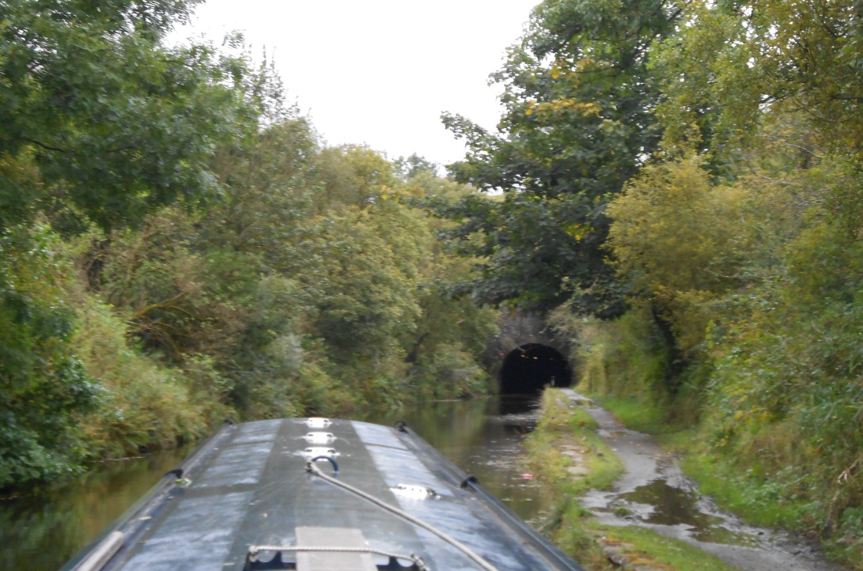
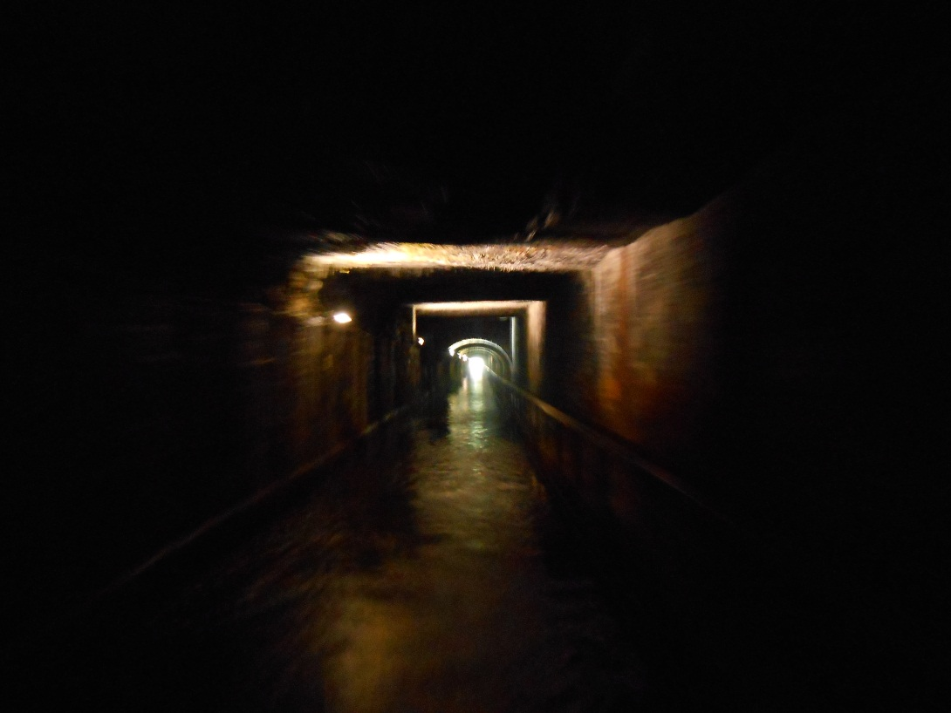
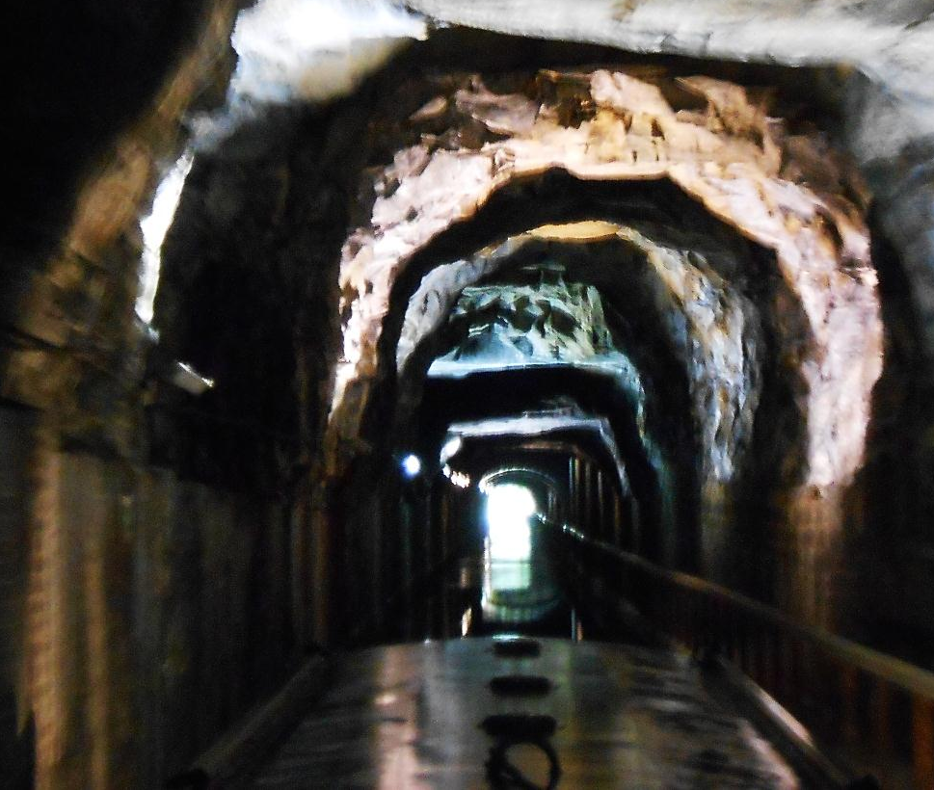
Cavernous Falkirk tunnel comes next, lit throughout and a quality waterways experience.

Slide 26
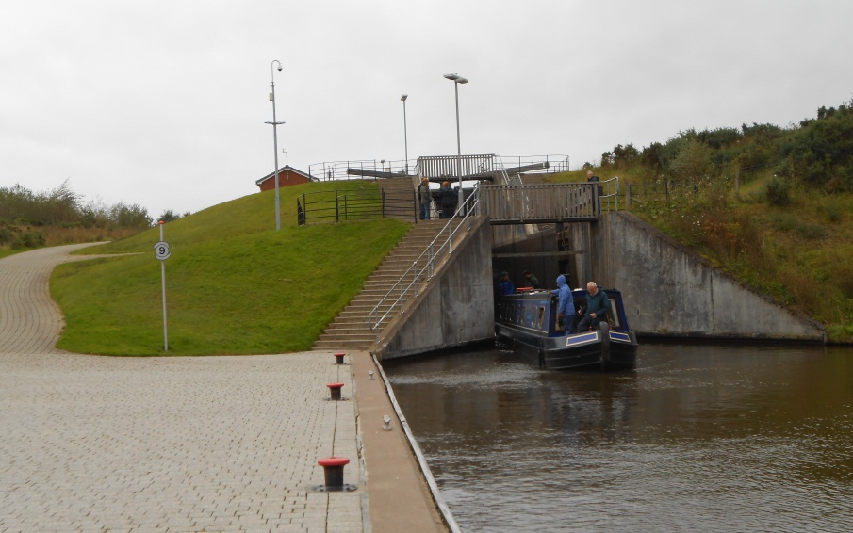
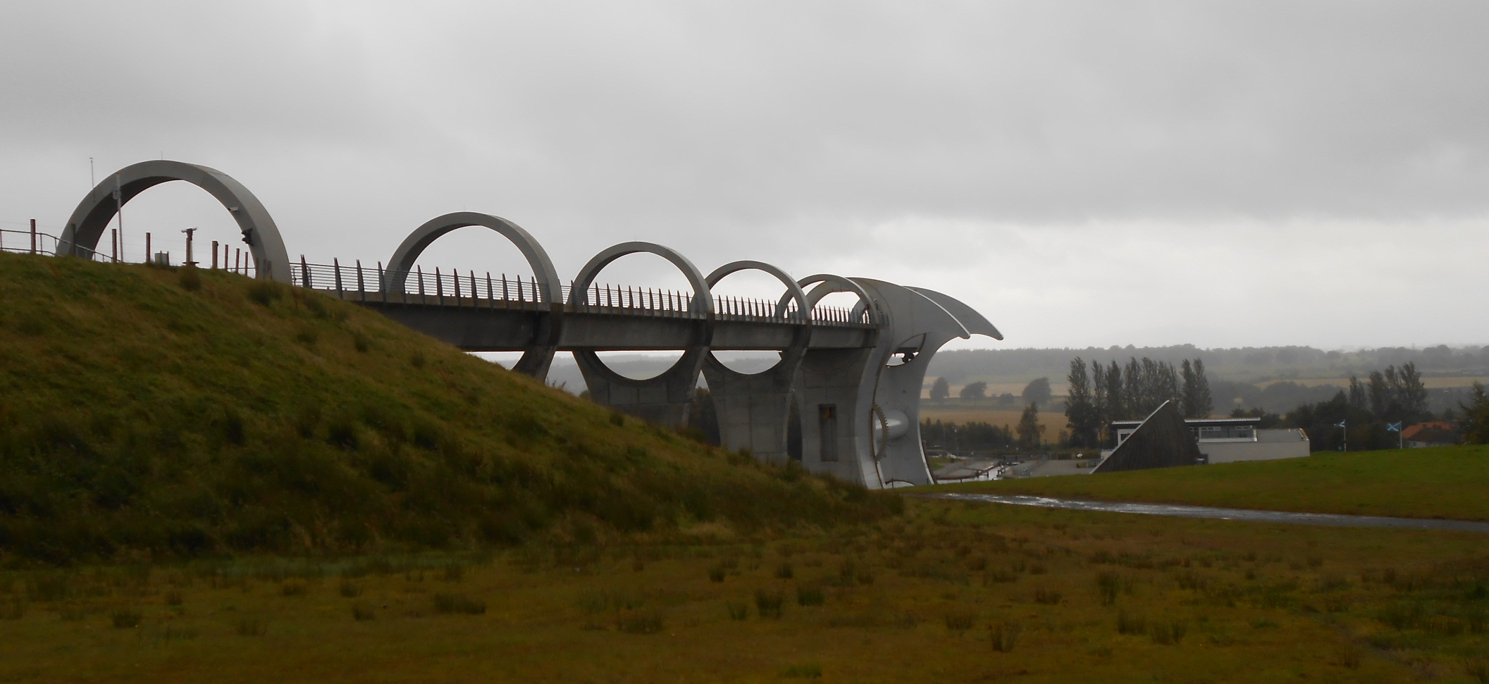
As, of course, is the nearby
Falkirk Wheel.
But it is extra tricky today as the wind is considered too strong for safe passage.

Slide 27
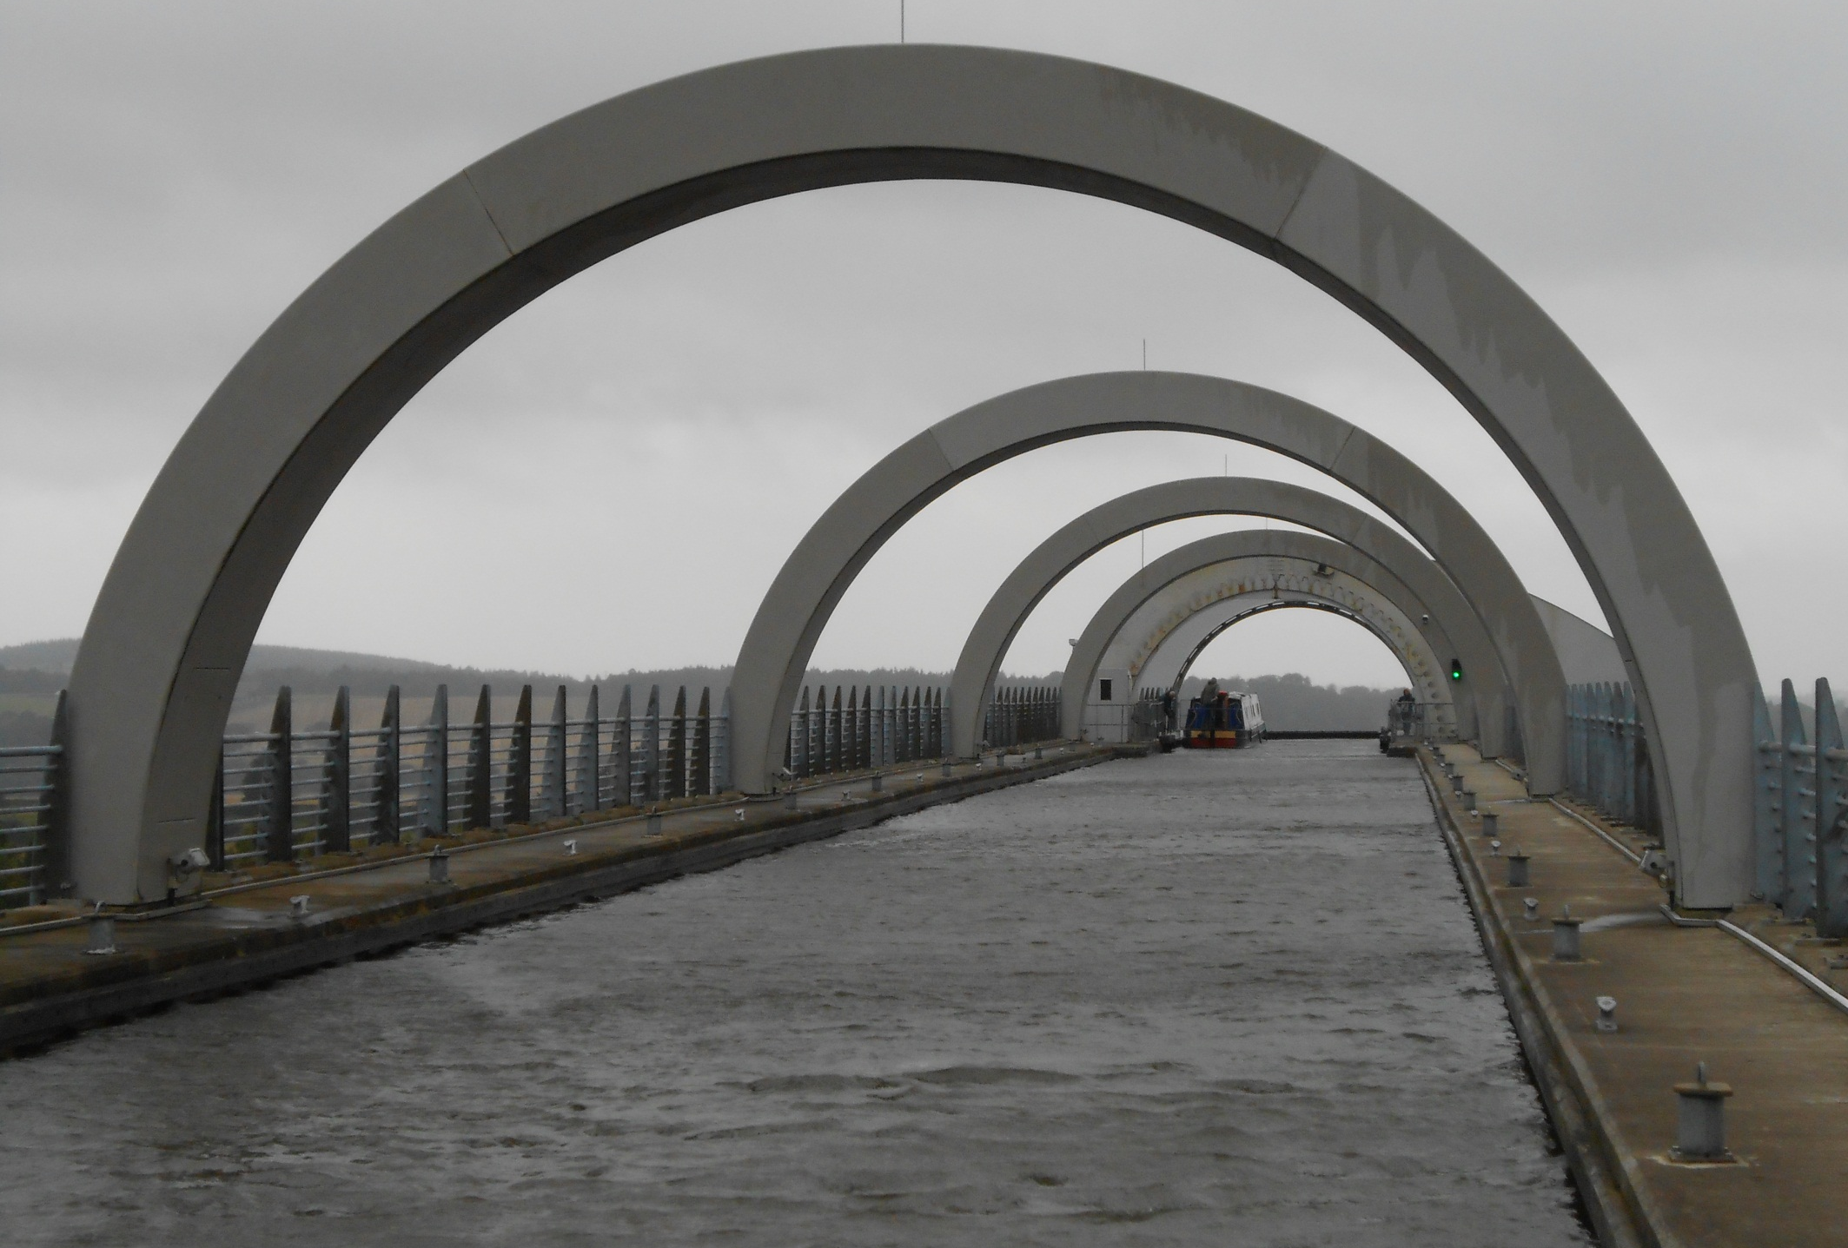
BW therefore hold us for two hours before allowing us to proceed, “as a test run for the trip boat”.

Slide 28
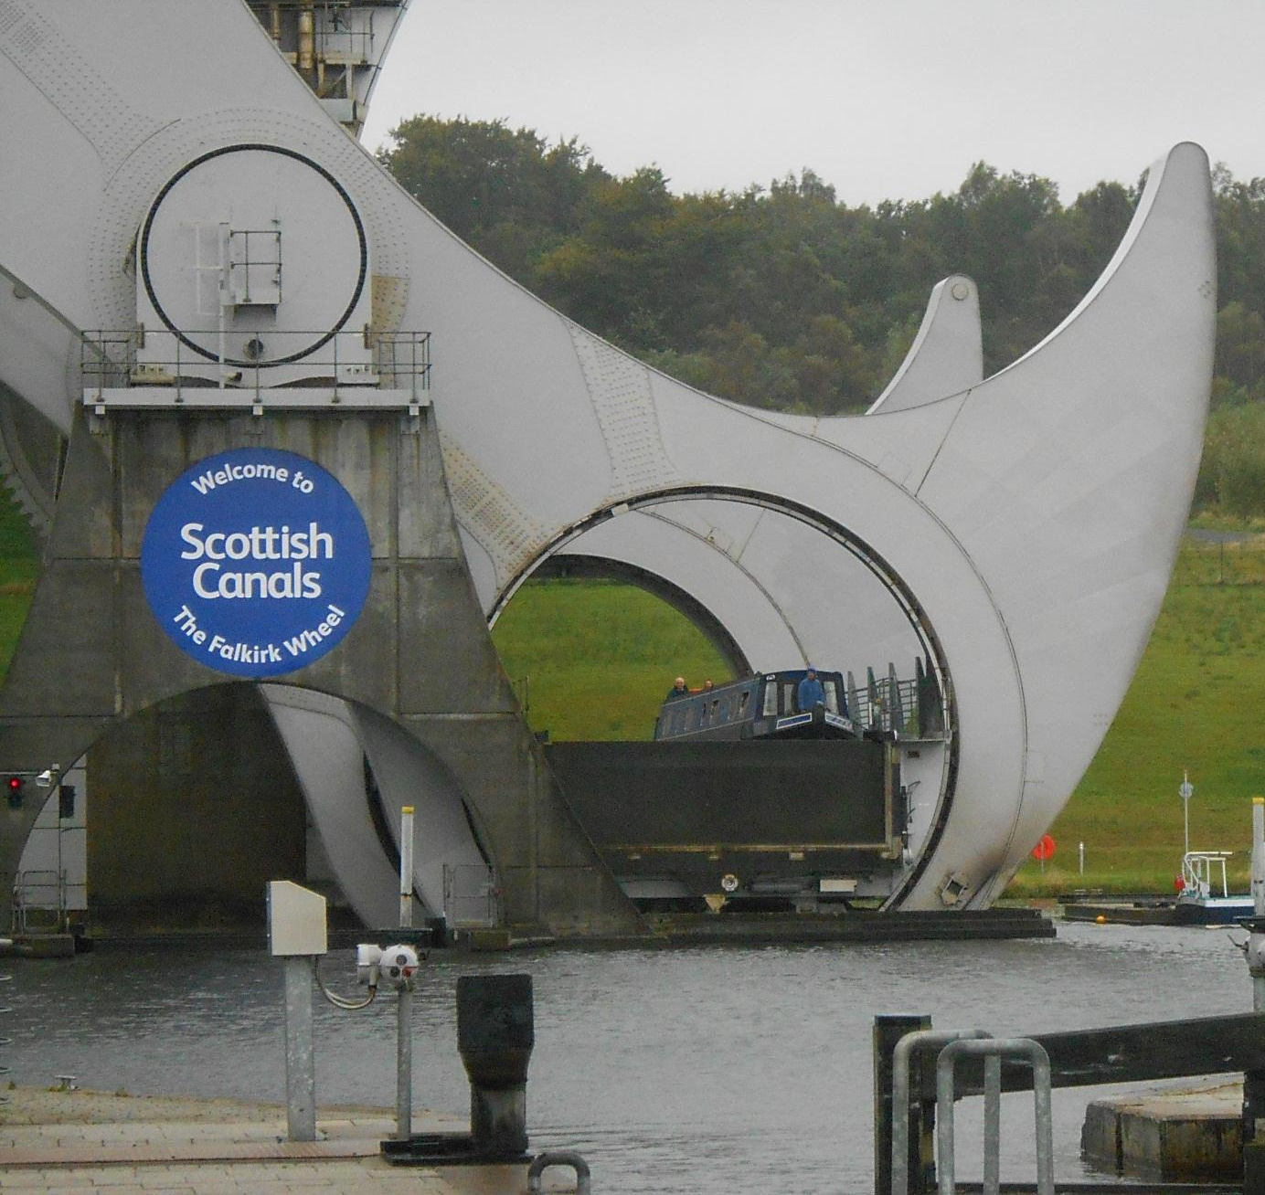
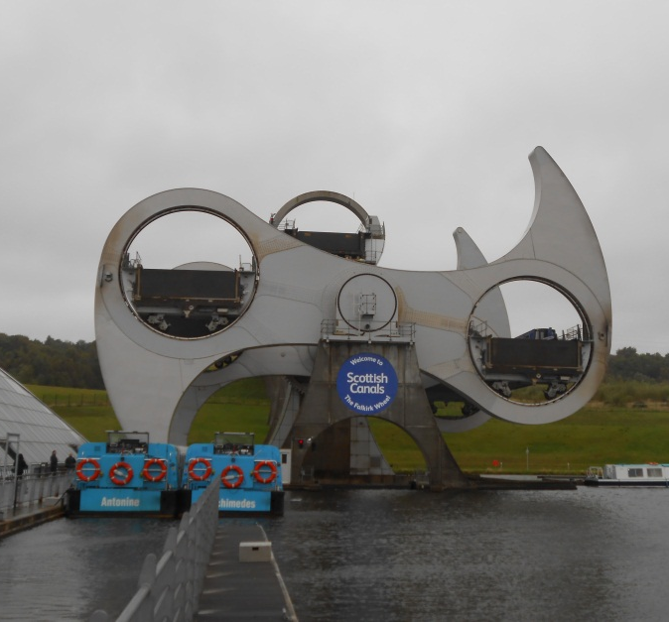
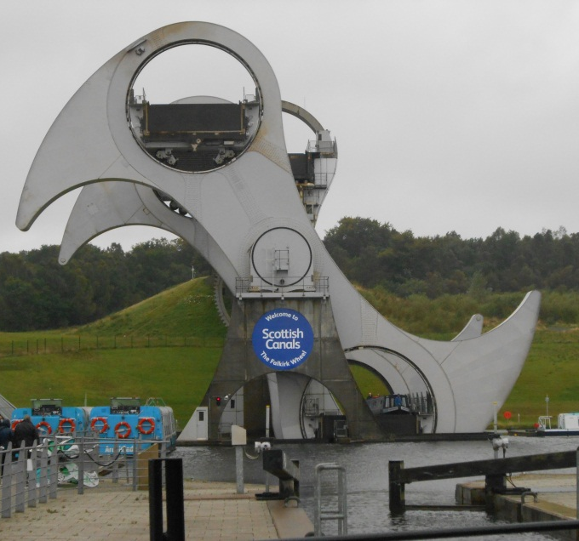
However round went the wheel for an exhilarating and very blowy ride to lower us down what was used to be a flight of 8 locks.

Slide 29
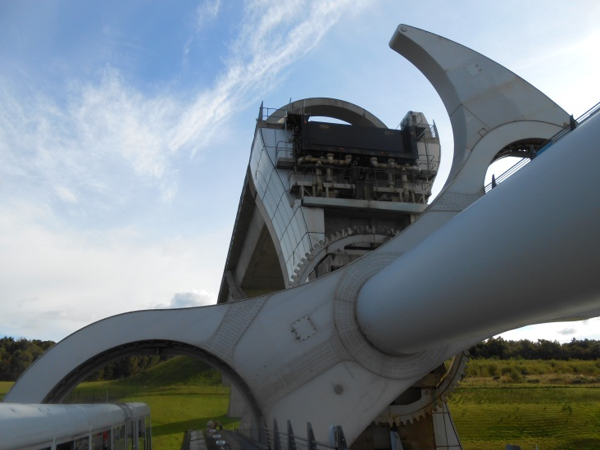
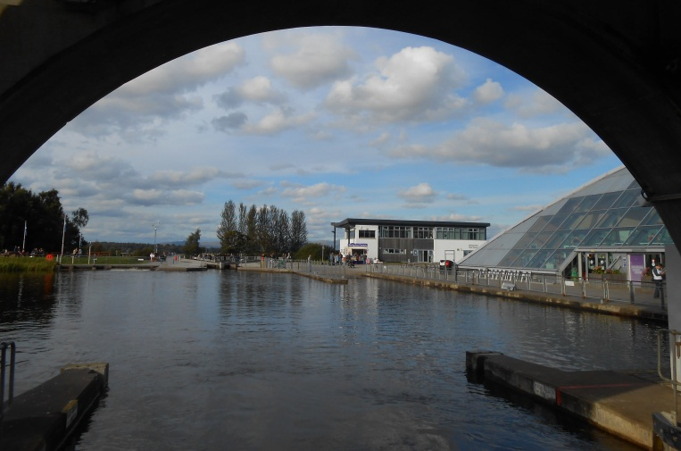
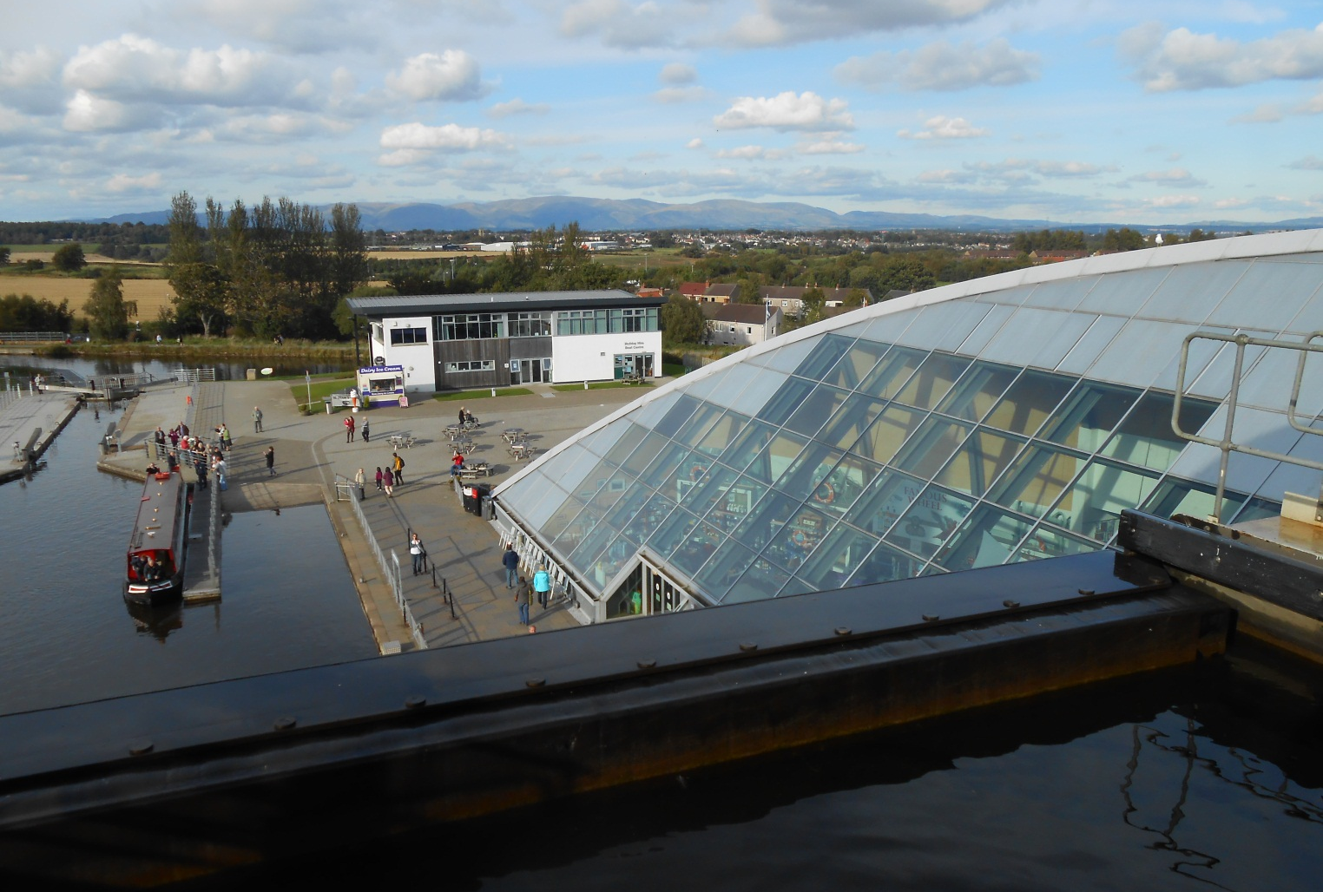
And views from aboard.
The Falkirk Wheel is a great design and a real asset to the canal network.

Slide 30
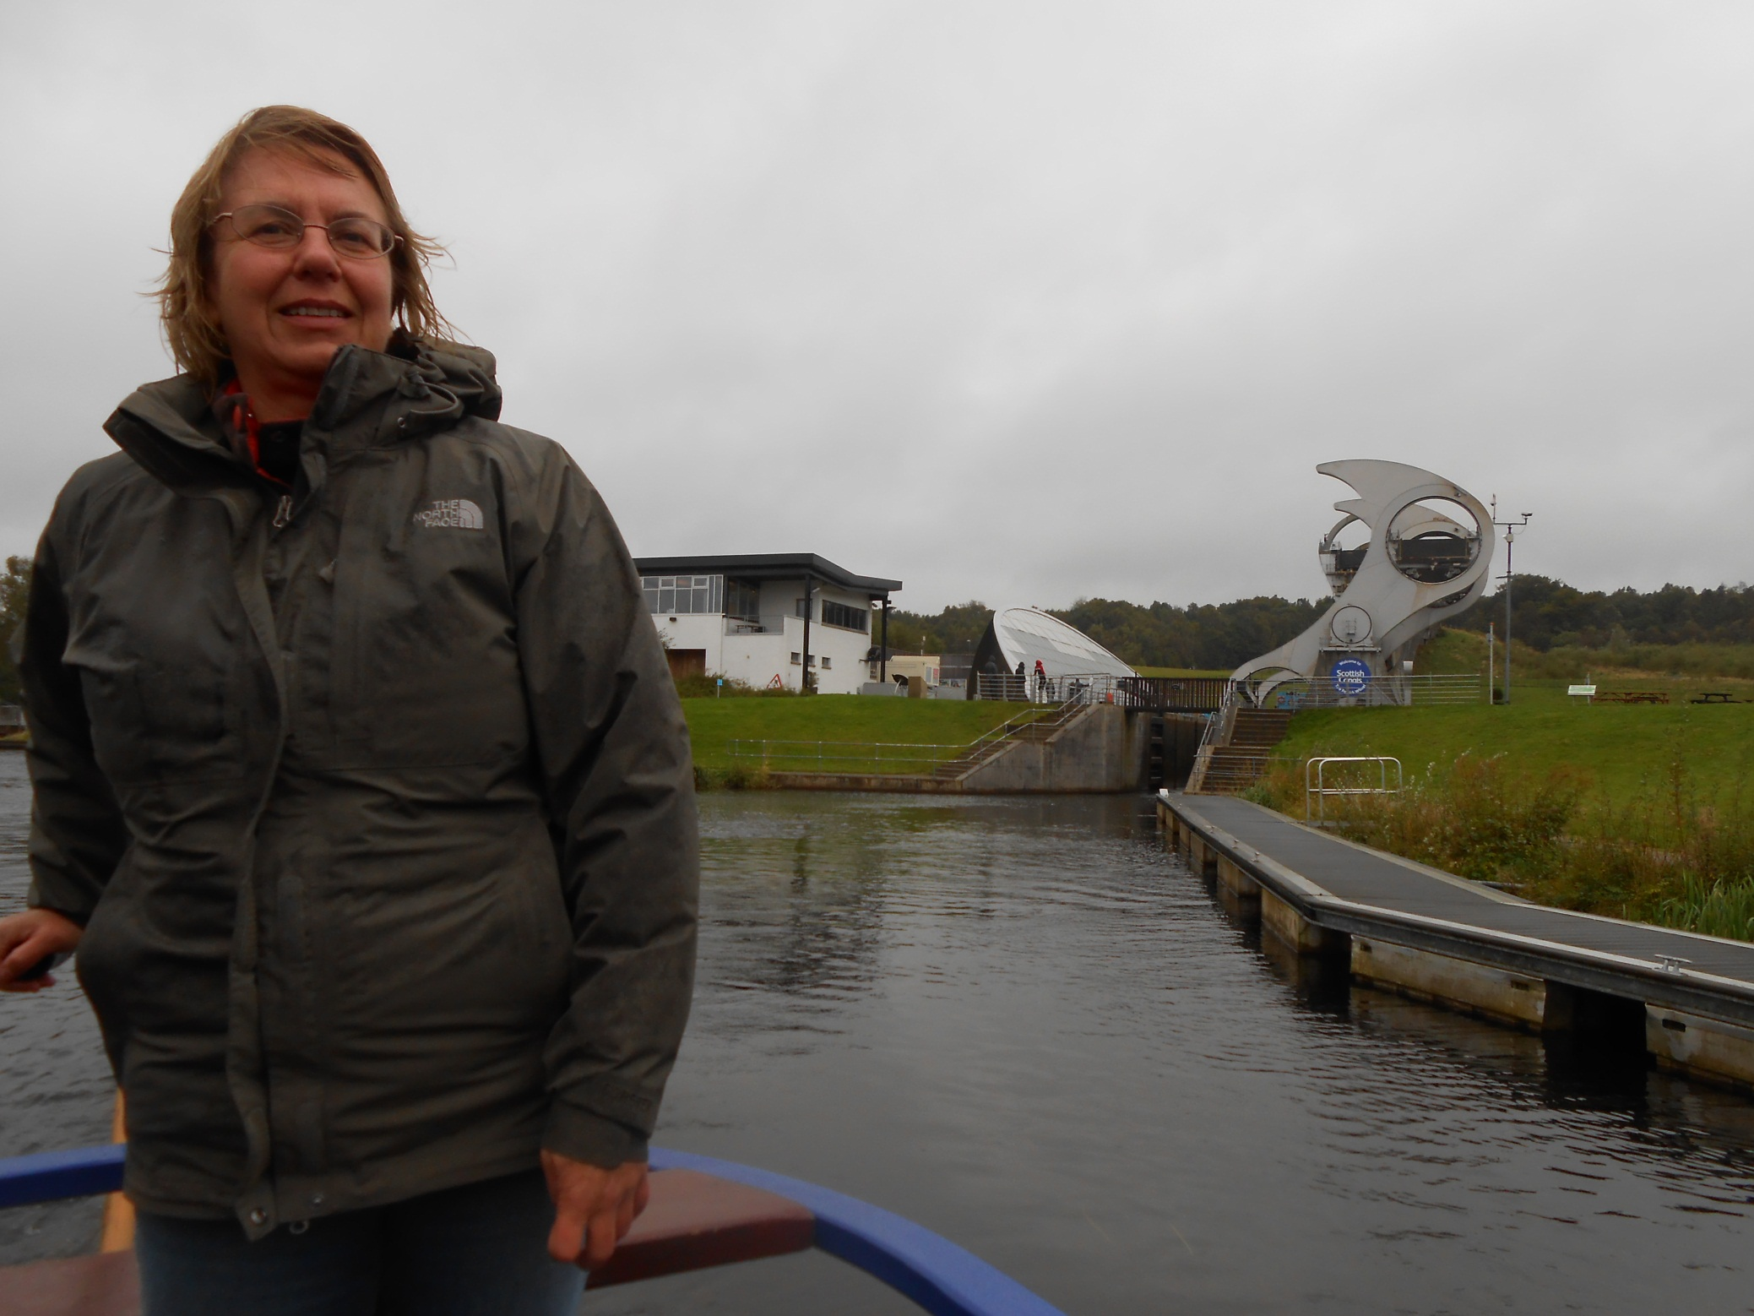
We have now reached the wider, older, Forth and Clyde Canal.

Slide 31
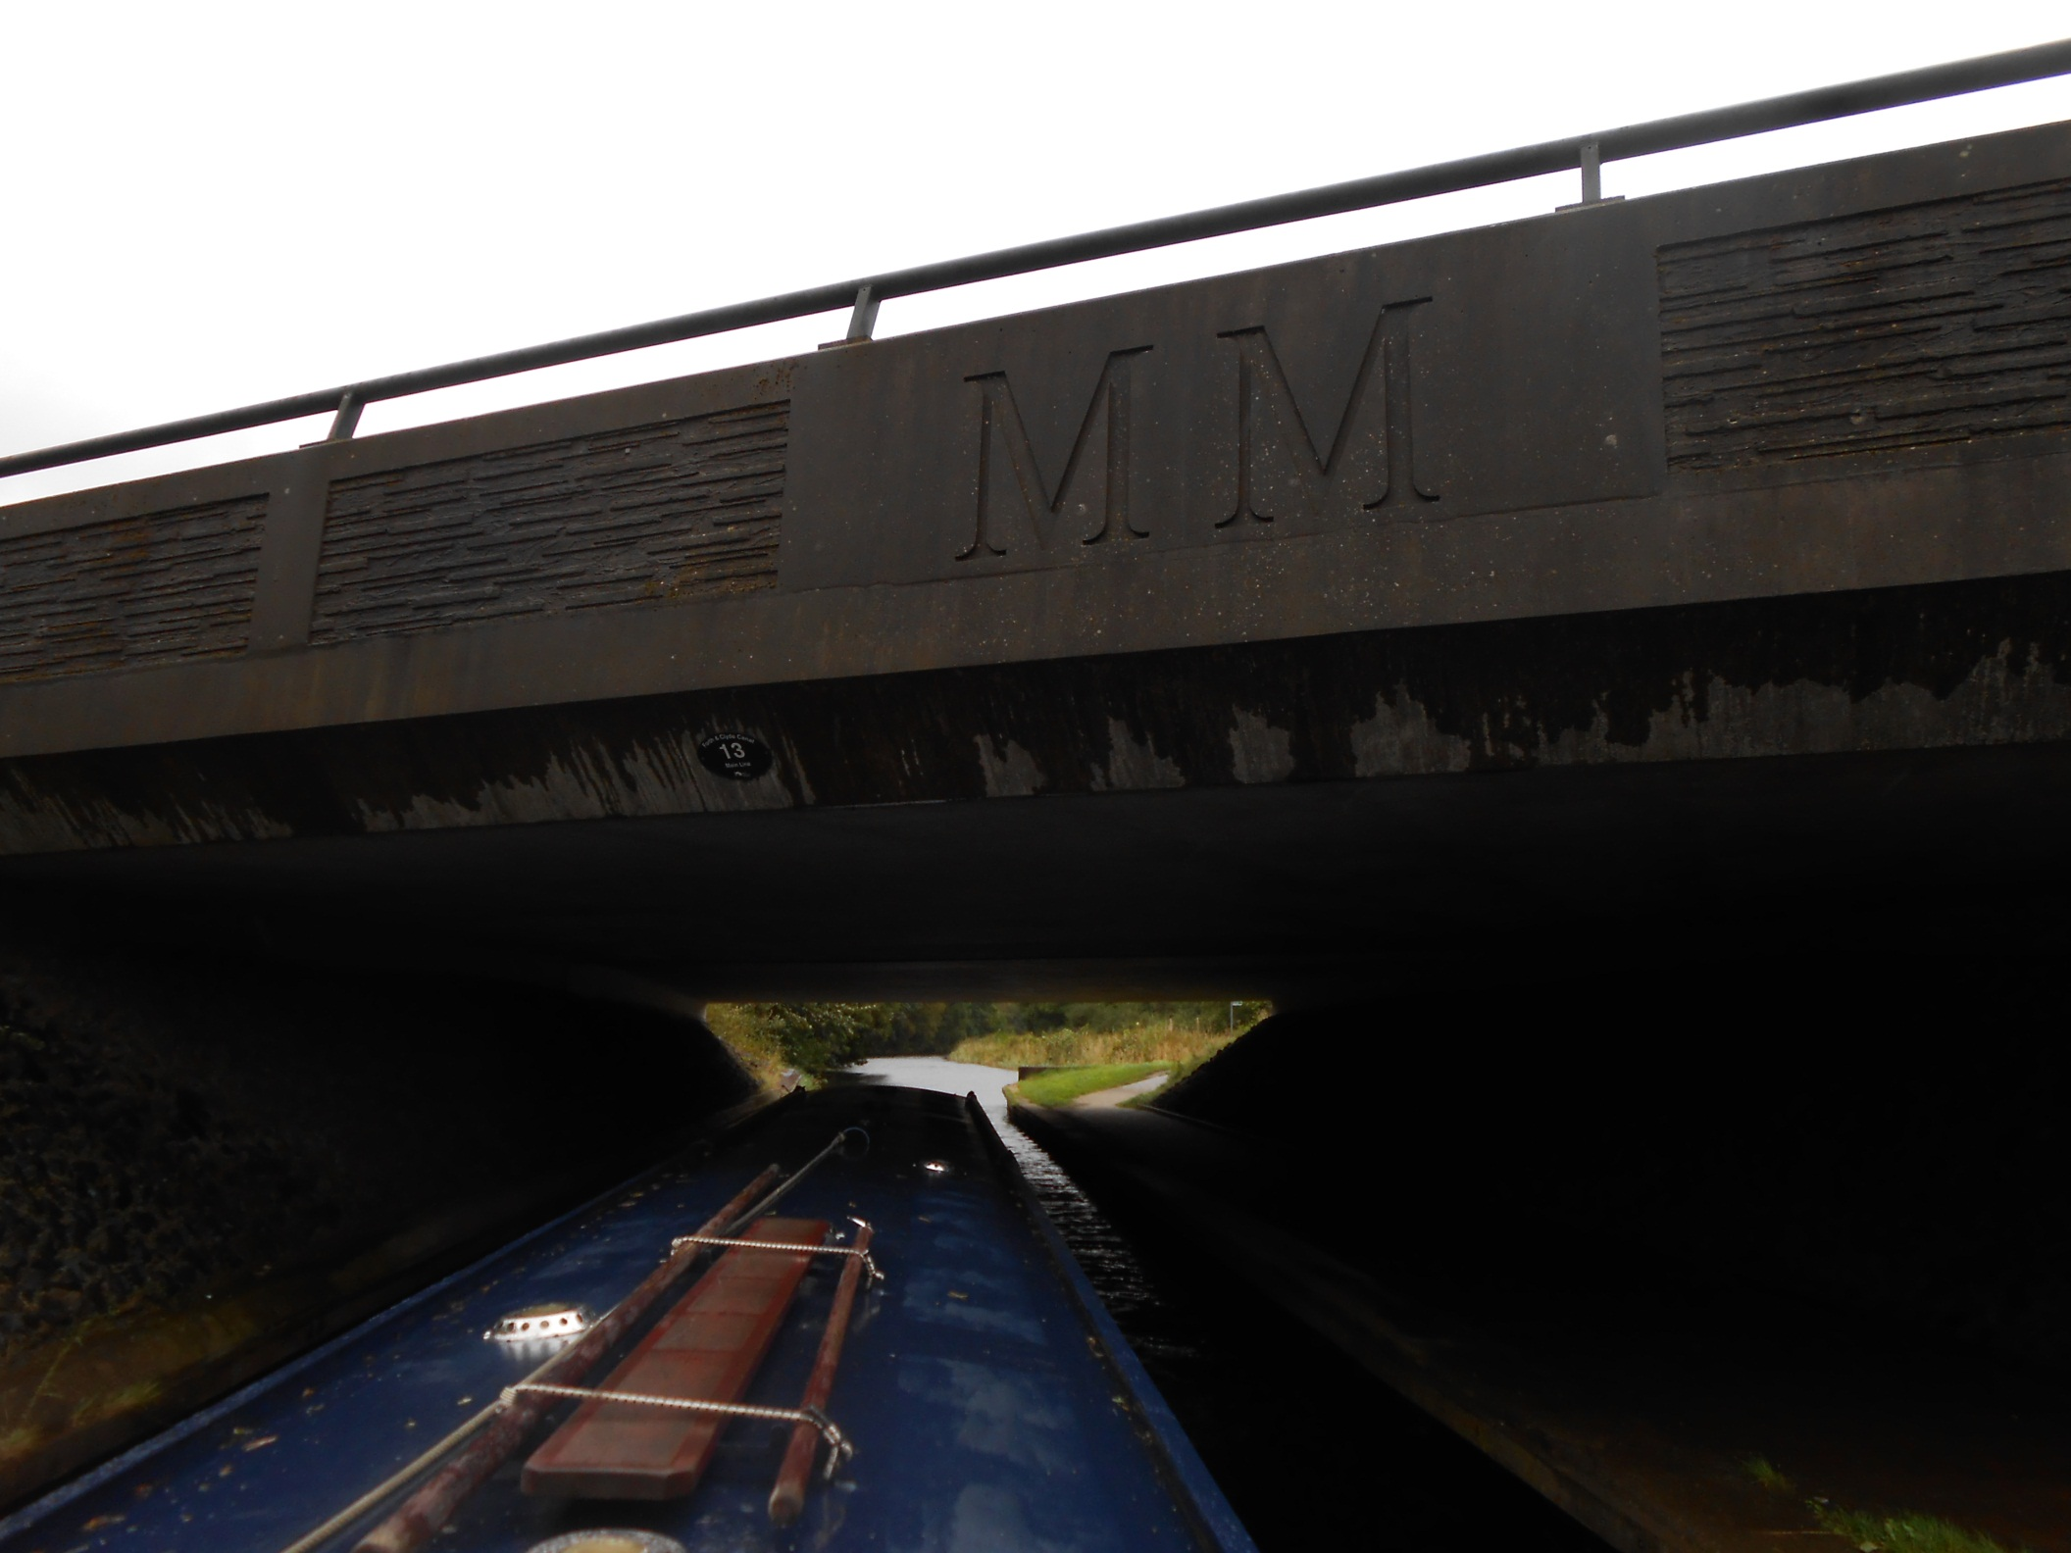
But the MM’s of the millennium restoration continue to abound.
This bridge, carrying the A80 road, cost £2 million.

Slide 32
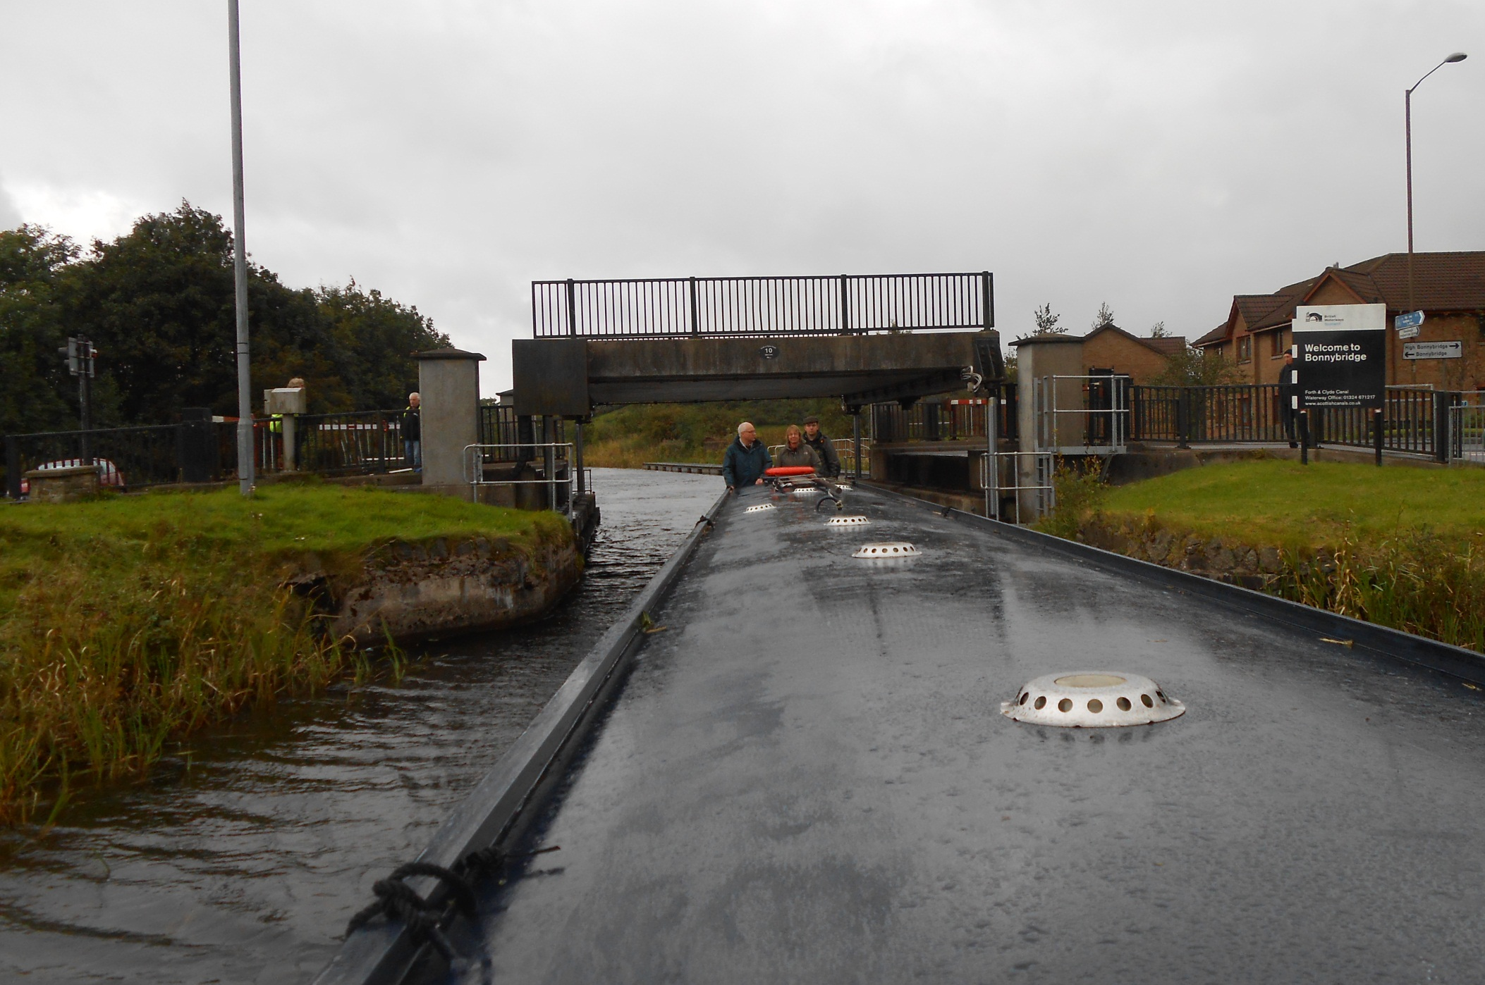
Boats are compelled to book a passage along this canal as all bridges and locks are operated by British Waterways staff.

Slide 33

Not that there are actually that many boats about. We are probably the only boat travelling in this direction today!

Slide 34

This is the remote Dullatur Bog section, tricky to build in the 1770’s.

Slide 35


Twinges of autumn too on the canal bends near Auchinstarry.

Slide 36

And so to Kirkintilloch, where we moor for the night.

Slide 37


Clyde Puffers are the legendary boats of these parts as they could travel both canal and coastal waters.
And here we occupy the traditional Puffer mooring in Kirkintilloch!

Slide 38

Another early start sees us passing this converted stable block in the gloom of dawn.

Slide 39

But things soon brightened up as we enjoy an unexpectedly rural run into Glasgow, these pylons are near Stockingfield Junction.

Slide 40

And from this junction an elevated two mile branch leads to central Glasgow, seen here from the towpath railings.

Slide 41

The current Glasgow terminus is at Spiers Wharf, an immaculate restoration but once again devoid of boats.

Slide 42


Yet £5.6 million has recently been spent on an extension to even more moorings right beside the M8 motorway!

Slide 43

The object is to try and restore back to here, the derelict canal basins at Port Dundas. Note the tree mural on the far left factory.

Slide 44

It’s us celebrating arrival in Glasgow!

Slide 45

But our objective remains the River Clyde so we return to Stockingfield Junction then Maryhill Locks, where life is complex.

Slide 46

Today is Wednesday but Waterways Control have stated that we cannot descend until Friday as other boats are booked.

Slide 47

We therefore arrive at the usual descending time but turn and tell the BW locking gang we intended to moor up and walk the canal.

Slide 48

Whilst turning the local BW men took matters into their own hands had our “no” decision reversed and locked us down with Dungraftin

Slide 49



As the locking team, usually 3 but today 4, lock us down the Maryhill flight on what might actually be the only downhill passage of the week!

Slide 50

The gasometers of Kelvindale pass by heading for Temple Locks.

Slide 51

This 9 mile passage to Bowling Basin has 19 locks and the Suzanne Marie is a tight fit. Care is required at all times.

Slide 52


After Lock 27 both locking and boating crews take a break.

Slide 53

The 5 Clobberhill locks are next, slow to empty with this much water pouring over the top!

Slide 54

Then comes our first distinctive, hand wound, bascule bridge.

Slide 55



These attractive bridges are a feature of the Forth and Clyde Canal.

Slide 56



In the next flight, Boghouse Locks, we pass another moving boat, also accompanied by a locking team. It is likely that this boat, and ourselves tomorrow, are the only uphill journeys of the week.

Slide 57


Clydebank shopping centre next, straddling the canal, where we moor behind this amazing fish and chip shop, purpose built at a Campbeltown shipyard!

Slide 58

After a lunch break for our locking team we pass through the pedestrian bridges connecting the shops.

Slide 59

Then move on to Dalmuir where the boom is raised at Dalmuir Drop Lock, a truly amazing and very expensive bridge project.

Slide 60




Built to avoid interrupting road traffic by boat traffic that never came, water is pumped out to let boats pass under the road!

Slide 61



But this lock takes a very long time to both empty and fill. With weed clogging the intakes the whole operation took nearly an hour!

Slide 62

But there is now not far to go now as we pass the contrasting bridges of Erskine just above Kilpatrick lock.

Slide 63



We then moor above Bowling Basin, as directed by the
Sea Lock Keeper.
It was nice to find him expecting us.

Slide 64

Unfortunately the Suzanne Marie was not allowed to drop down to the basin but the trusty, inflatable, Plain Hunter was to hand!

Slide 65



As the inflated Plain Hunter glides beneath the old Caledonian Railway bridge to join the sea going craft in Bowling Basin.

Slide 66

As we finally arrive at Bowling Sea Lock and the River Clyde.

Slide 67

And the Clyde is home river to the Paddle Steamer Waverley.

Slide 68



On which we enjoy the very first cruise of the 2013 season.

Slide 69

As Waverley glides past Bowling Basin on 3rd May 2013.

Slide 70

And fantastic to be travelling by steam too.

Slide 71

Phil Kendrick is with us today, a friend from Colwall, as we pass Ardmore, just before Greenock.

Slide 72

Waverley's steam engines pound away.

Slide 73

As we pass Dunoon and then Innellan, still mainland settlements on this stormy day.

Slide 74


Bute is the first island we pass, distinctively jagged by Garroch Head on the southern tip.

Slide 75

Arran comes next, looking very remote in places.
I visited with an Aberystwyth University Geology course in 1976.

Slide 76



And Arran views around Lochranza as we steam down the sheltered waters of Kilbrannan Sound.

Slide 77

The water being sheltered by the long peninsular of Kintyre.

Slide 78

We are heading for Campbeltown, additionally protected by
Island Davarr, where rough weather may end this trip.

Slide 79



However a “cheer” went up when Captain O’Brian announced conditions were not as bad as feared and that we were to steam around the
Mull of Kintyre.

Slide 80

And so, with the usual deep blast of the hooter, we reverse out into Campbeltown Loch to continue on our away.

Slide 81



Heading past Island Davarr again towards and the open sea.
Conditions, though, were challenging.

Slide 82

The sea was choppy and we had this rough sea with us for three hours as we headed towards Islay and Jura.

Slide 83



It rained hard and the wind blew.

Slide 84

But Waverley’s paddle wheels kept on turning.

Slide 85

But eventually we did reach Islay, the Sound of Islay being guarded by spectaculary positioned McArthur’s Point lighthouse.

Slide 86

We are now in the Inner Hebrides as we steam through the narrow sound between Islay and Jura.

Slide 87


Jura, to the north, appears less rugged but it still all looks pretty barren in winter browns.

Slide 88

Waverley must dock at least once every 70 miles and, although a detour, tiny Colonsay has the only suitable pier around here.

Slide 89

And this is the Colonsay jetty at Scalasaig. We just paused. Nobody got on and nobody got off. The island’s population is 130.

Slide 90



By coincidence the Friday sailing of MacBraynes Lord of the Isles was also arriving, so we had a rousing exchange of hooters!

Slide 91

And the weather also improved departing Colonsay, as we set off for Oban.

Slide 92

Dusk approaches as Luing and Seil pass and the mainland nears.

Slide 93

As this Waverley epic comes to an end.

Slide 94


Some 15 hours after boarding we walk down the gangplank into Oban after an amazing 207 mile trip.
What a boat!

Slide 95

But sadly things aren’t always so good and the next leg of our trip, the 28 miles to Fort William, was cancelled.

Slide 96

As the Waverley had emergency generator problems.
Repairs could just enable an evening sailing.

Slide 97




So we wined, dined and lazed about in Oban.

Slide 98

But it was not to be. The Waverley is not calling at
Fort William this year. An alternative plan will be required!

Slide 99
End of Chapter 9

