Slide 1
Exploring Britain
Boating North
Chapter 7
Cooper Bridge, Huddersfield,
to the River Humber and Spurn Head
17th September 2011
to 30th March 2012

Slide 2
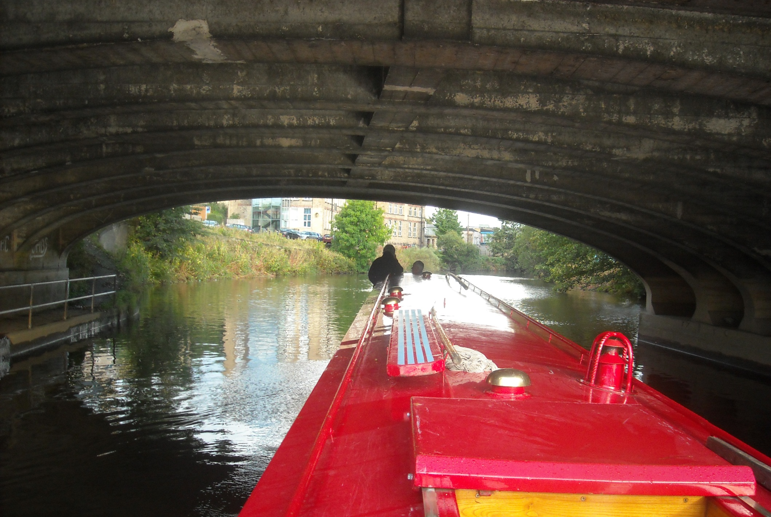
We are back at Cooper Bridge, this time aboard the narrow boat Northumberland on a river section of the Calder and Hebble.

Slide 3
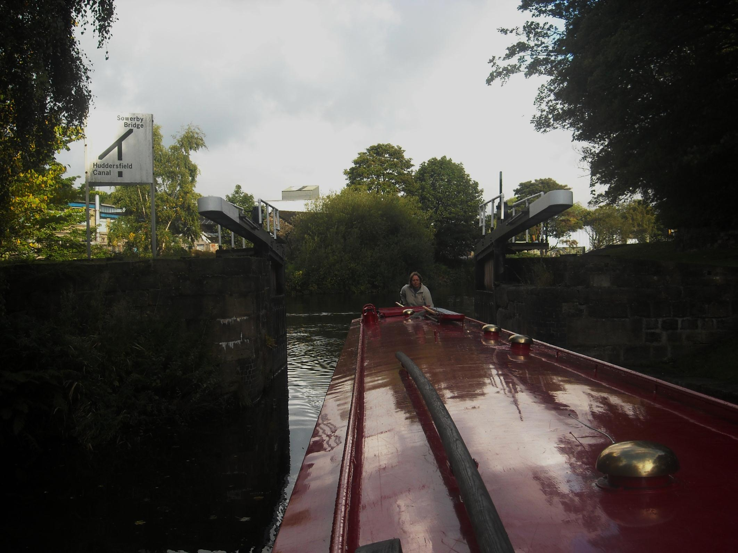
As Bridget turns into the floodgates of a canalised section of river.

Slide 4
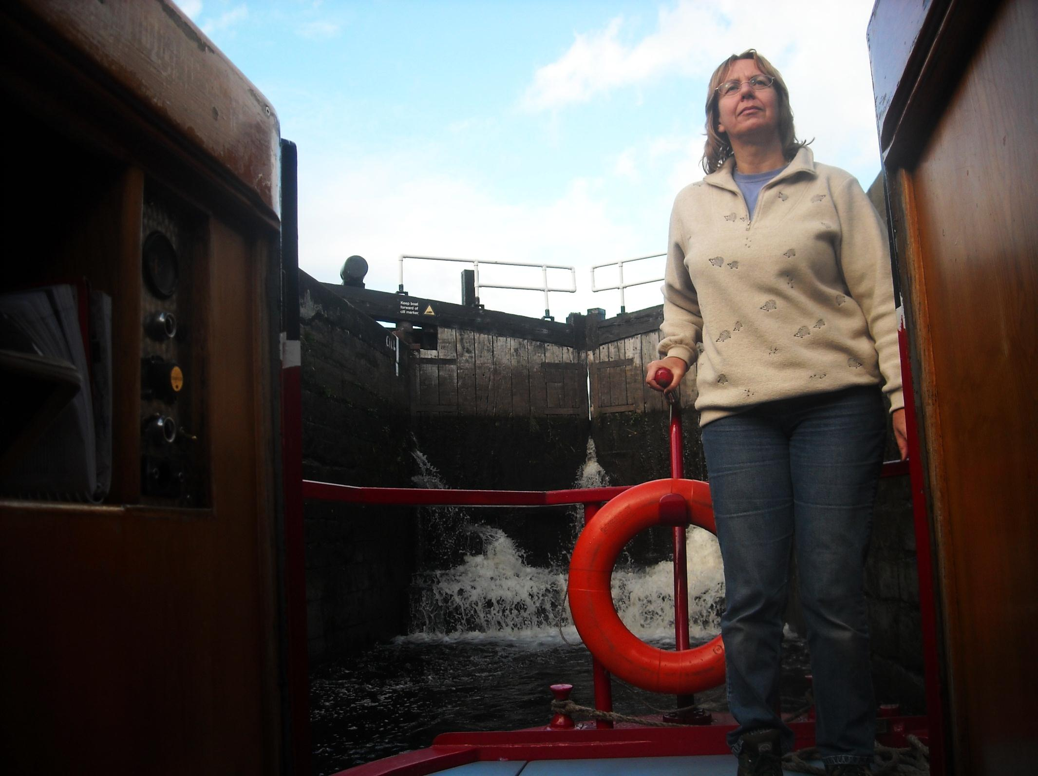
Some of the Calder and Hebble’s broad locks do leak a bit!

Slide 5
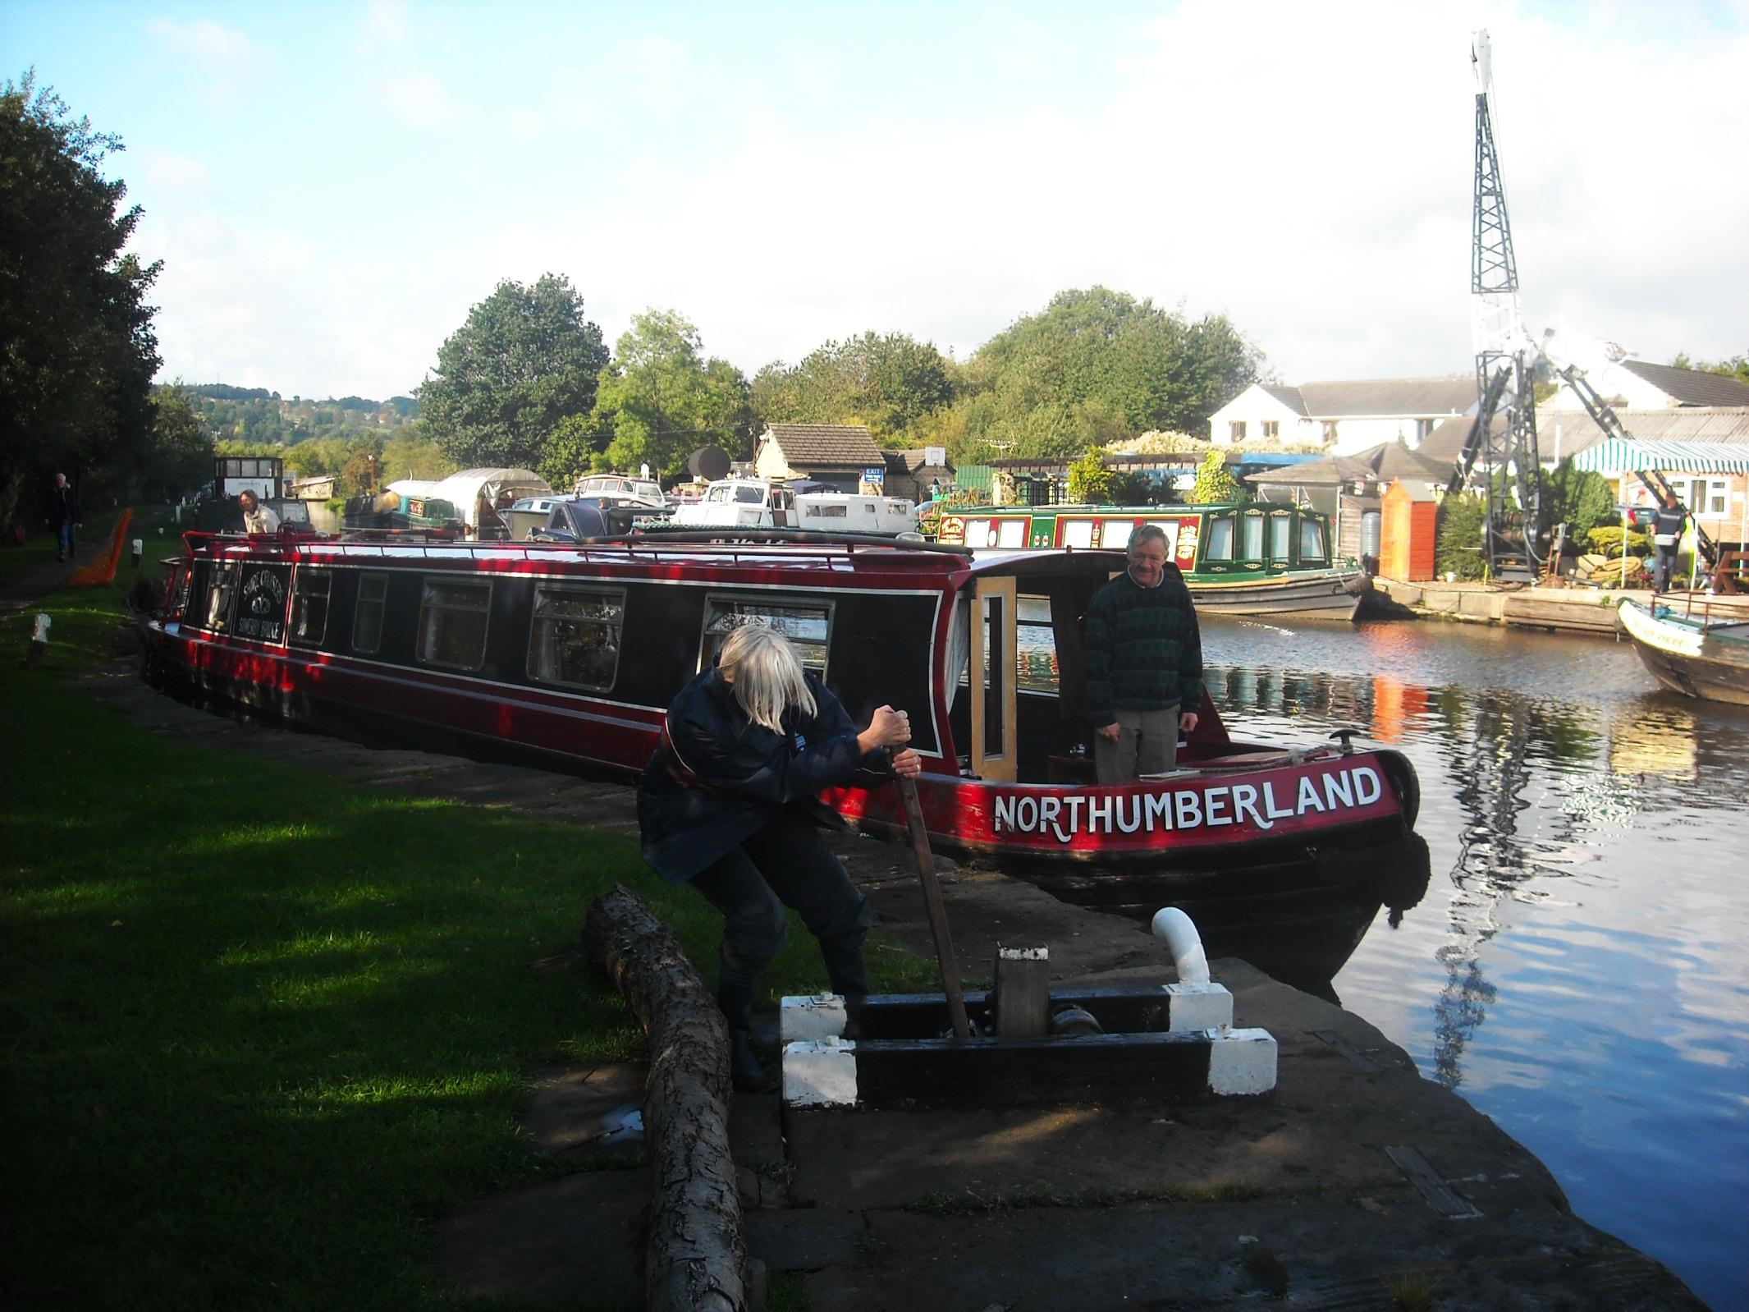
And some paddles, as at Shepley Bridge, are raised by handspike.

Slide 6
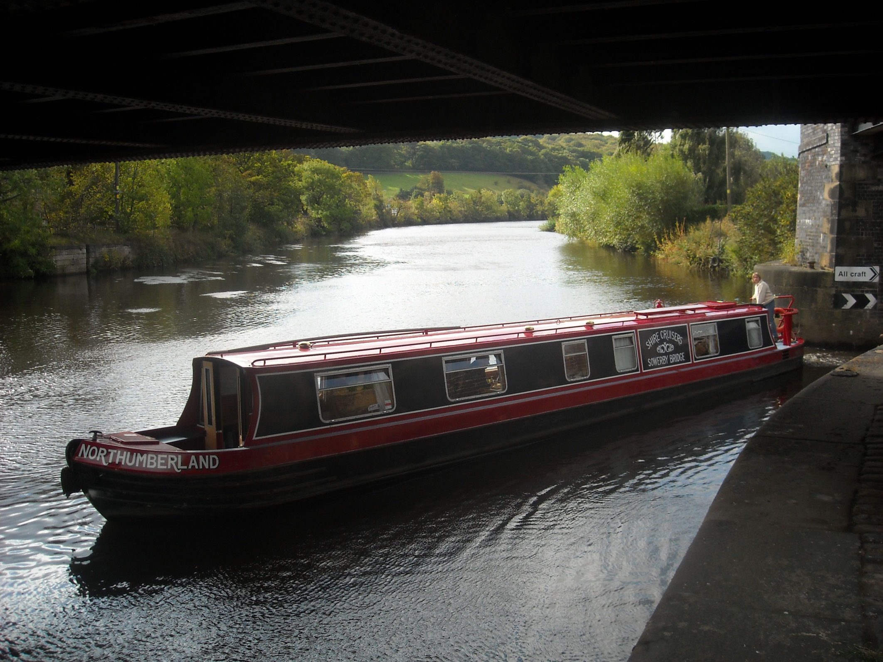
As this impressive waterway cuts in and out of the River Calder.

Slide 7
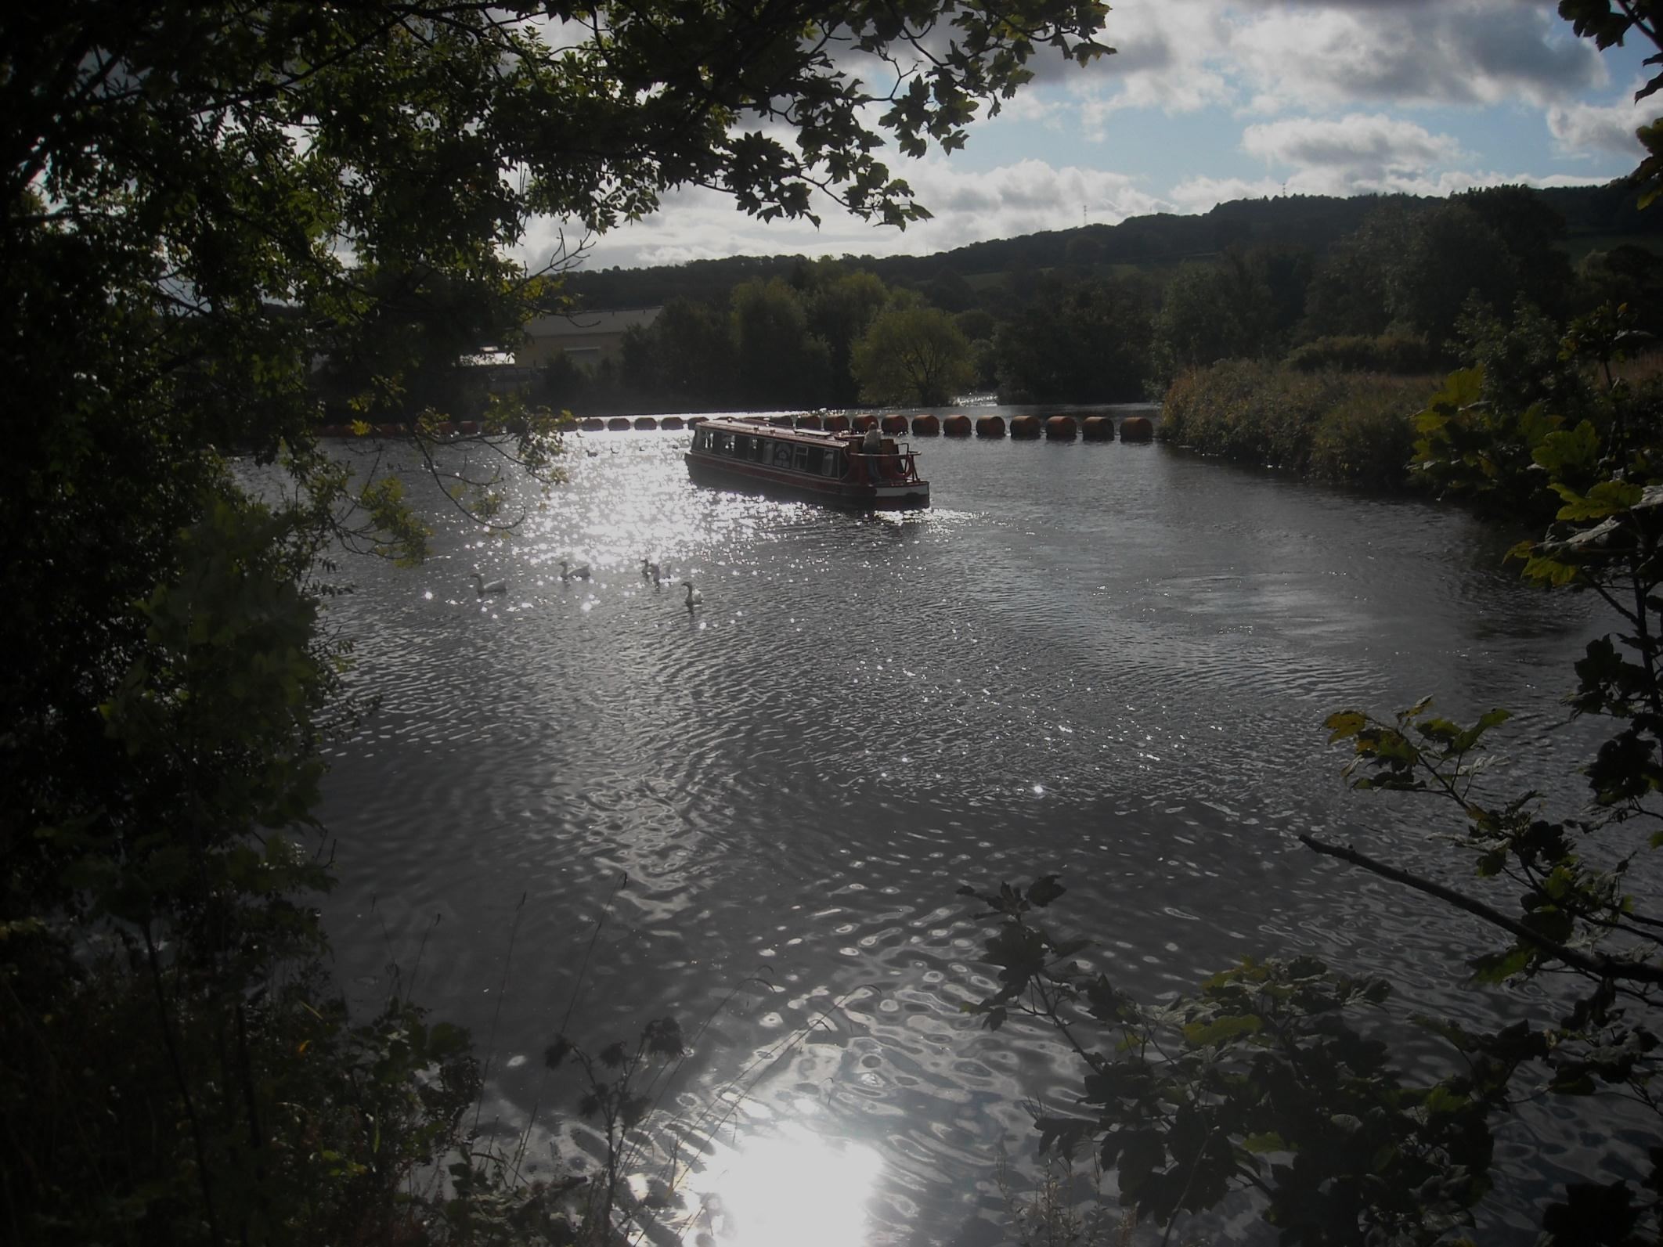
And these canal and river sections give real variety to our journey.

Slide 8
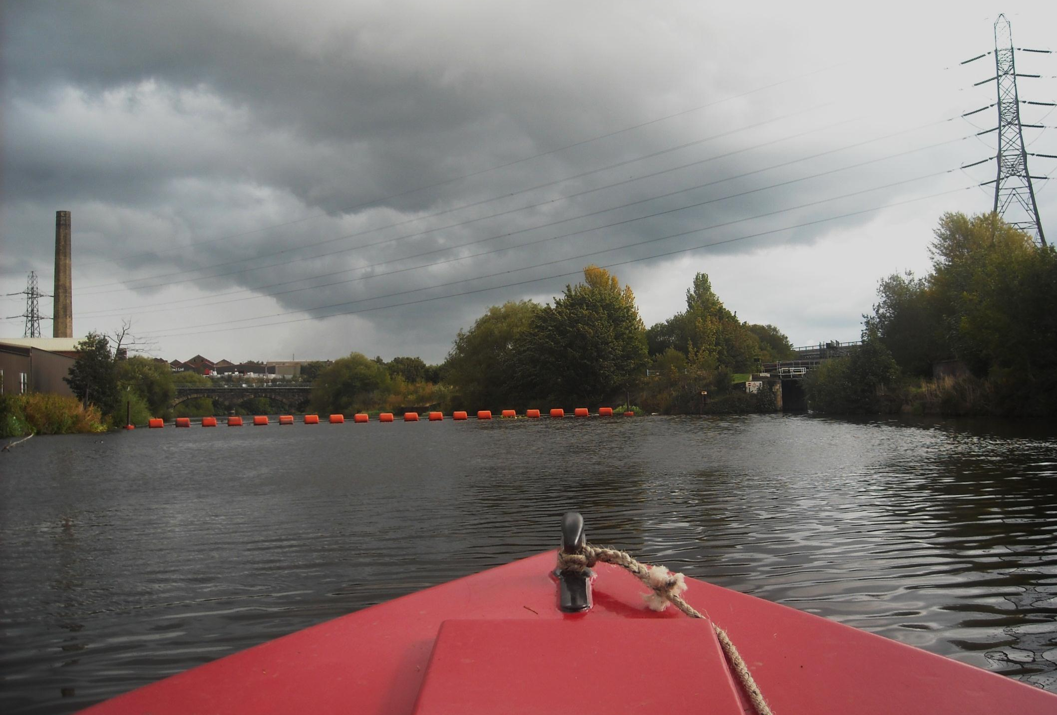
Although modern weir protection does takes away some of the excitement…………As we steer right towards Thornhill flood lock.

Slide 9
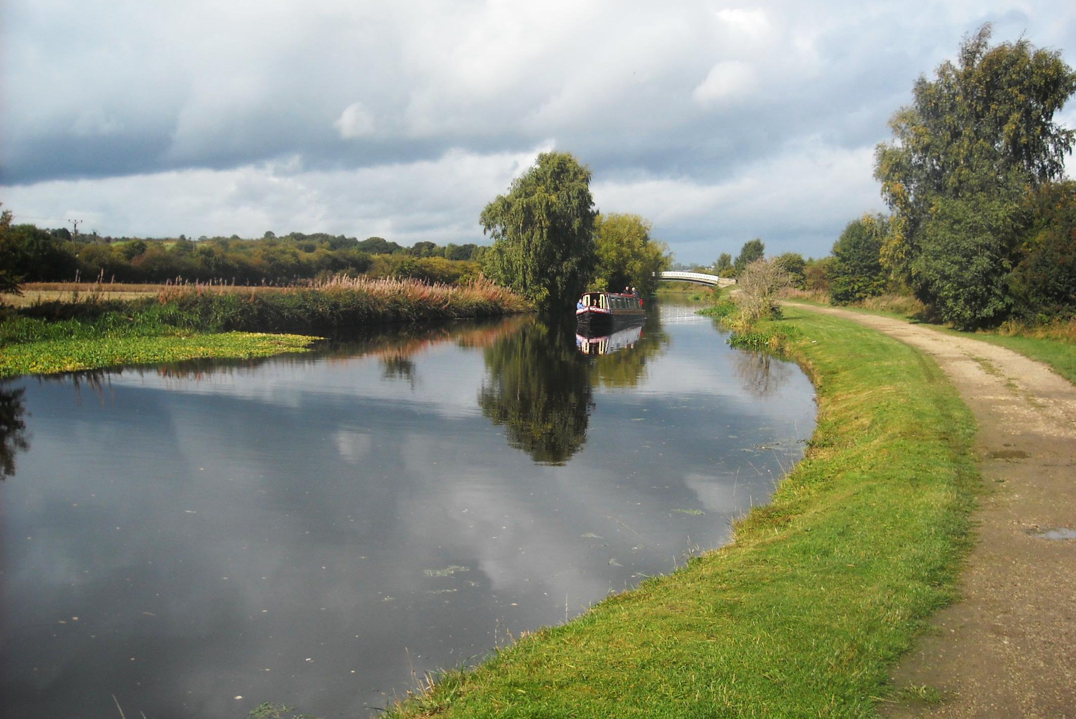
To the next tranquil canal section, near Horbury Bridge.

Slide 10
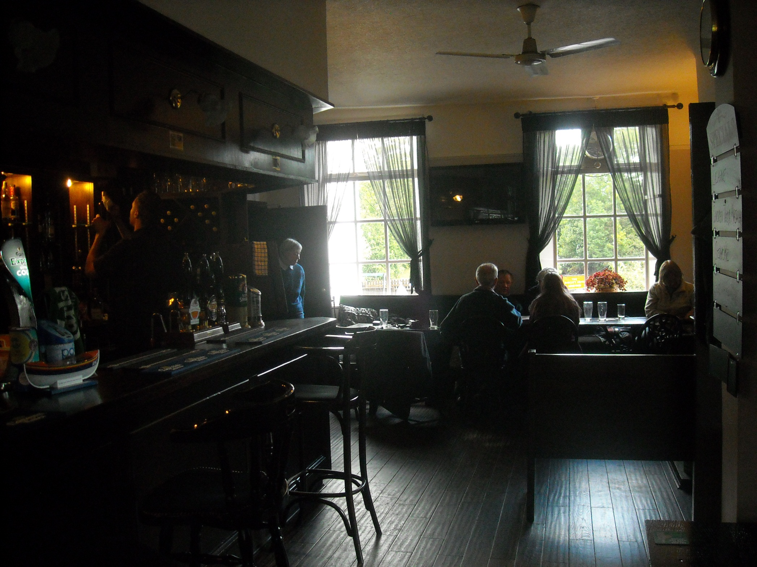
Where we rest and relax awhile in a Horbury Bridge pub.

Slide 11
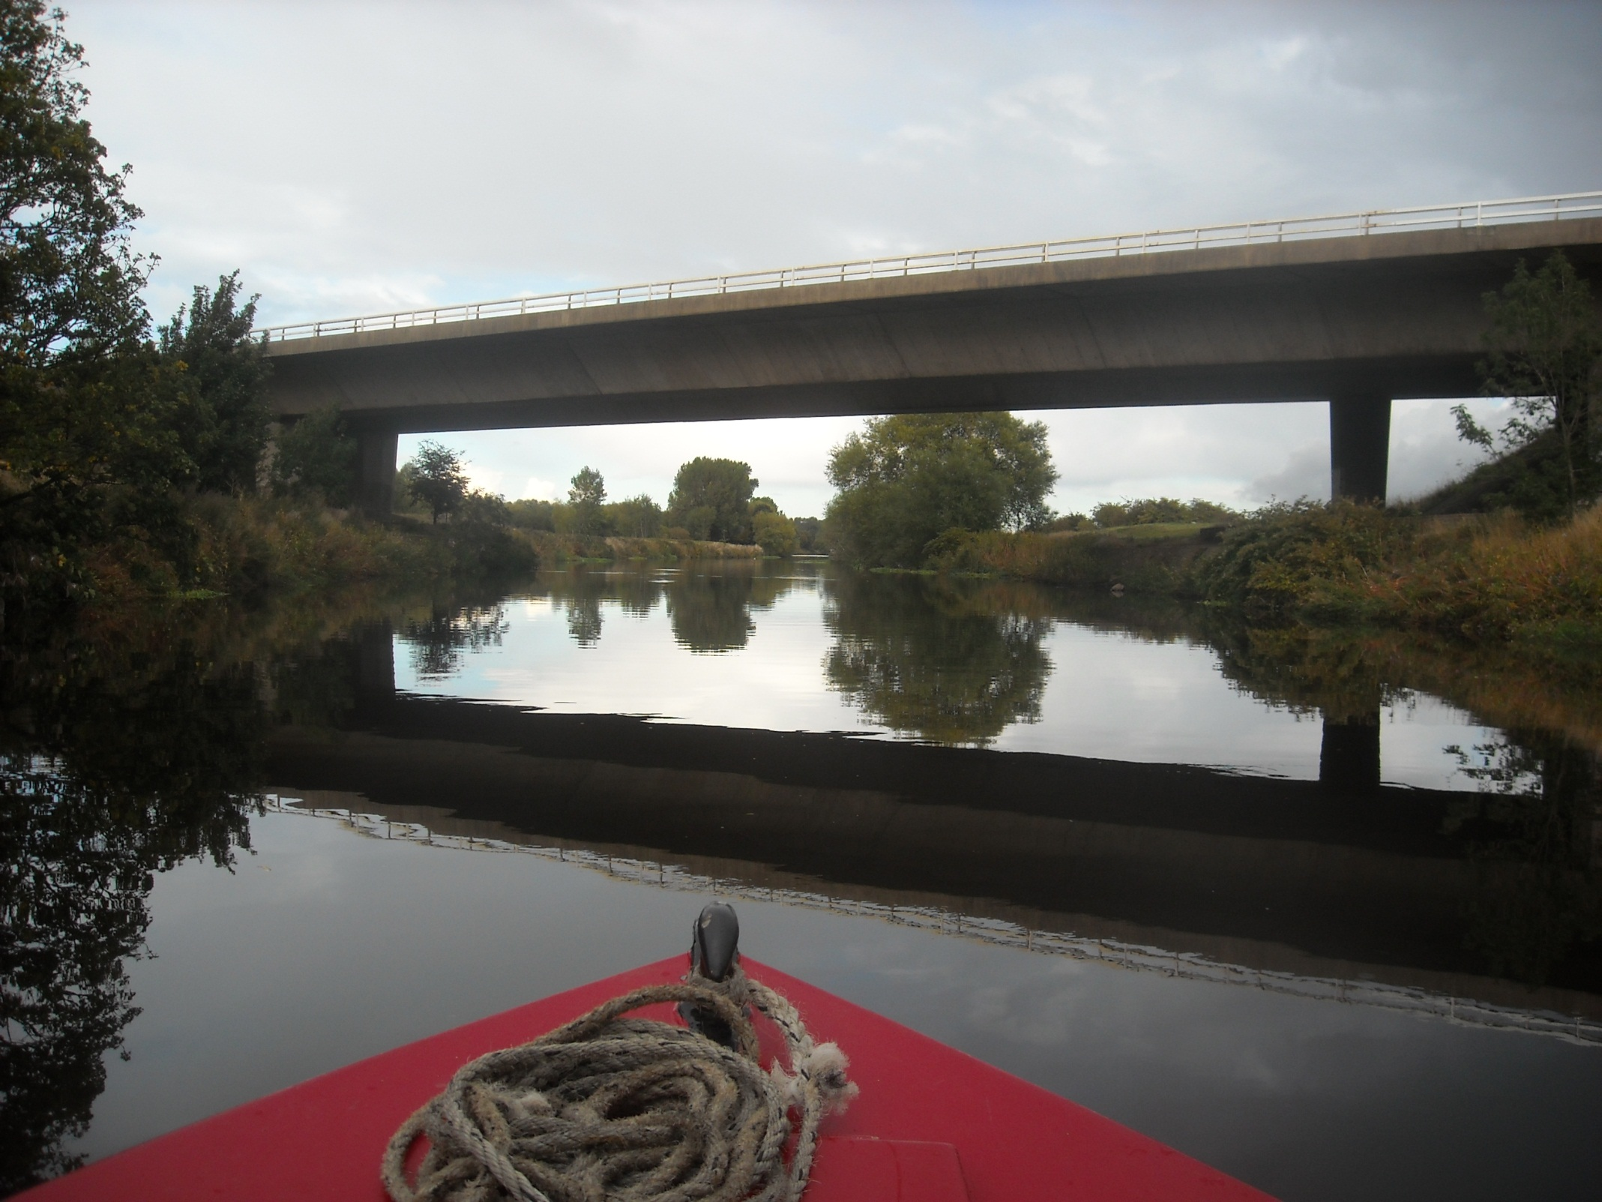
Then onwards towards Wakefield beneath the M1 motorway.

Slide 12
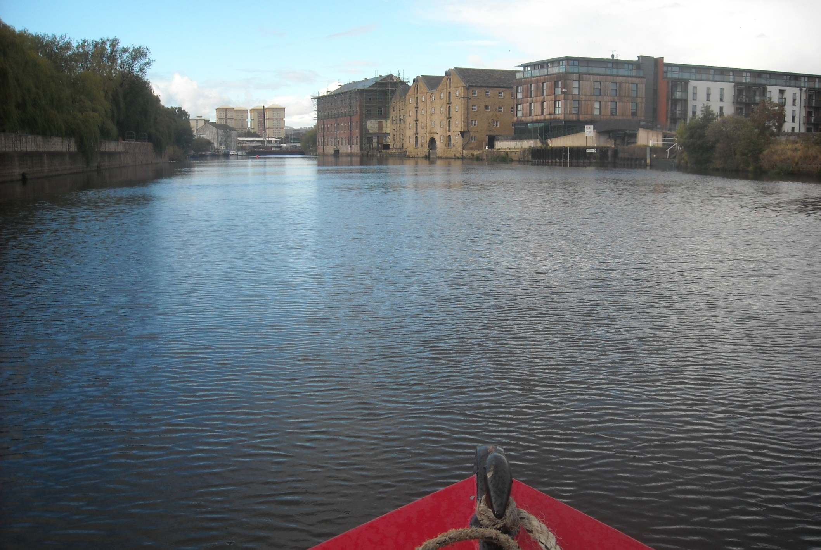
This expanse of Wakefield water was once a hive of industry, ponded back by Wakefield Weir it is known as “The Pond”.

Slide 13
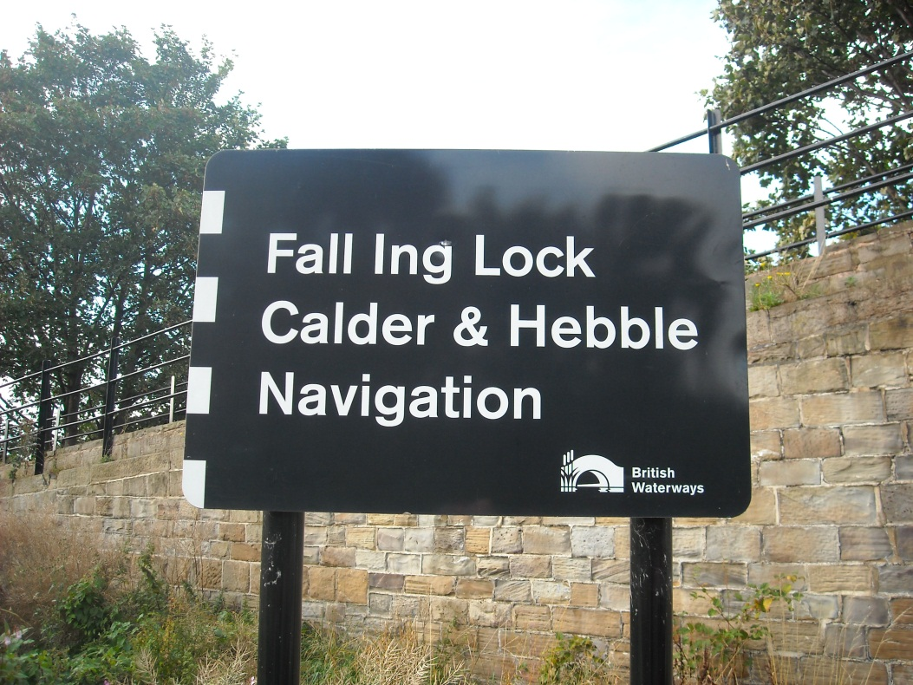
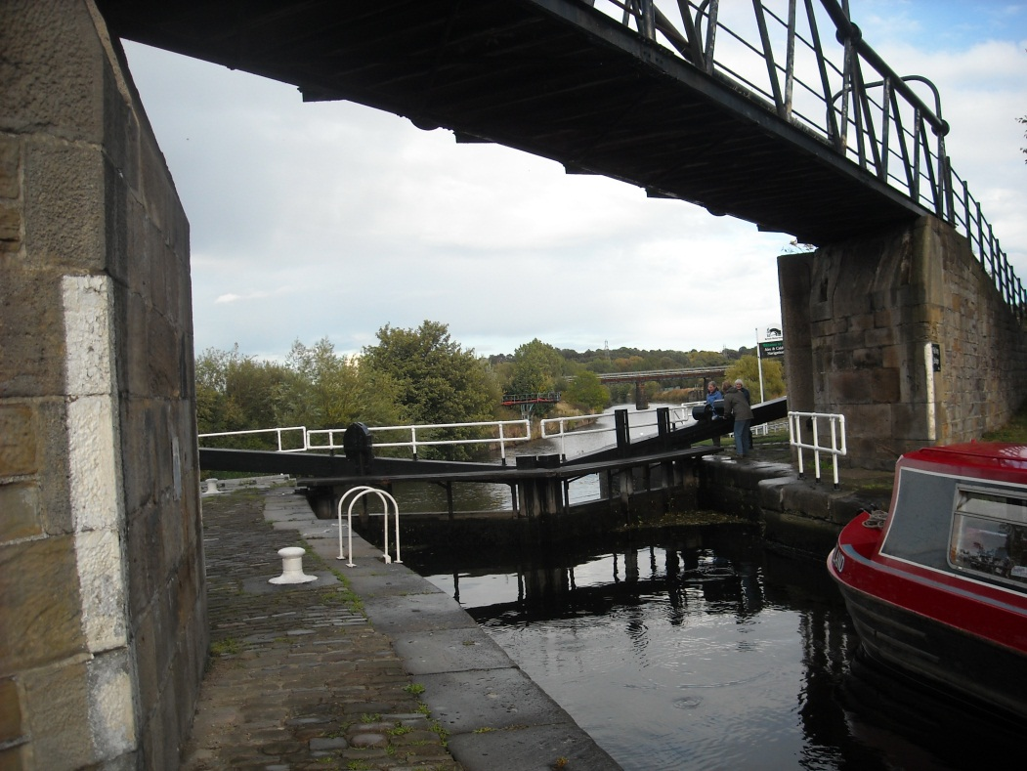
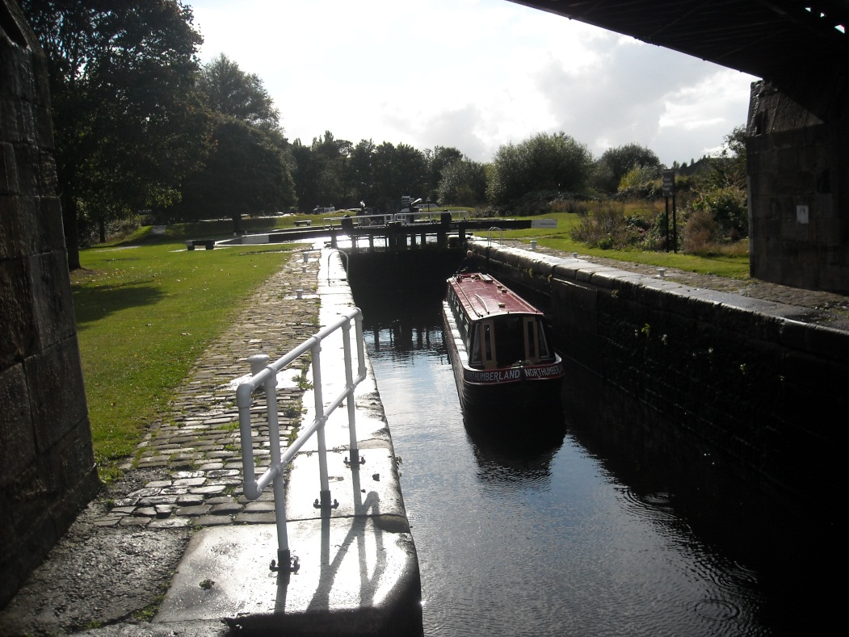
Fall Ing lock is an key spot, the end on junction with the once very profitable
Aire and Calder Navigation.

Slide 14
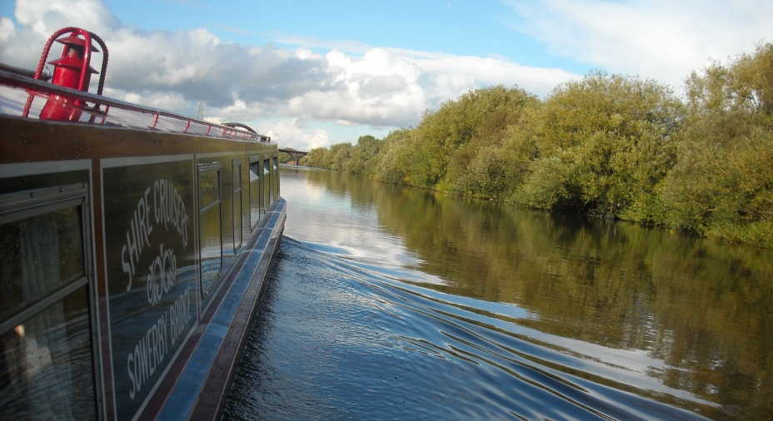
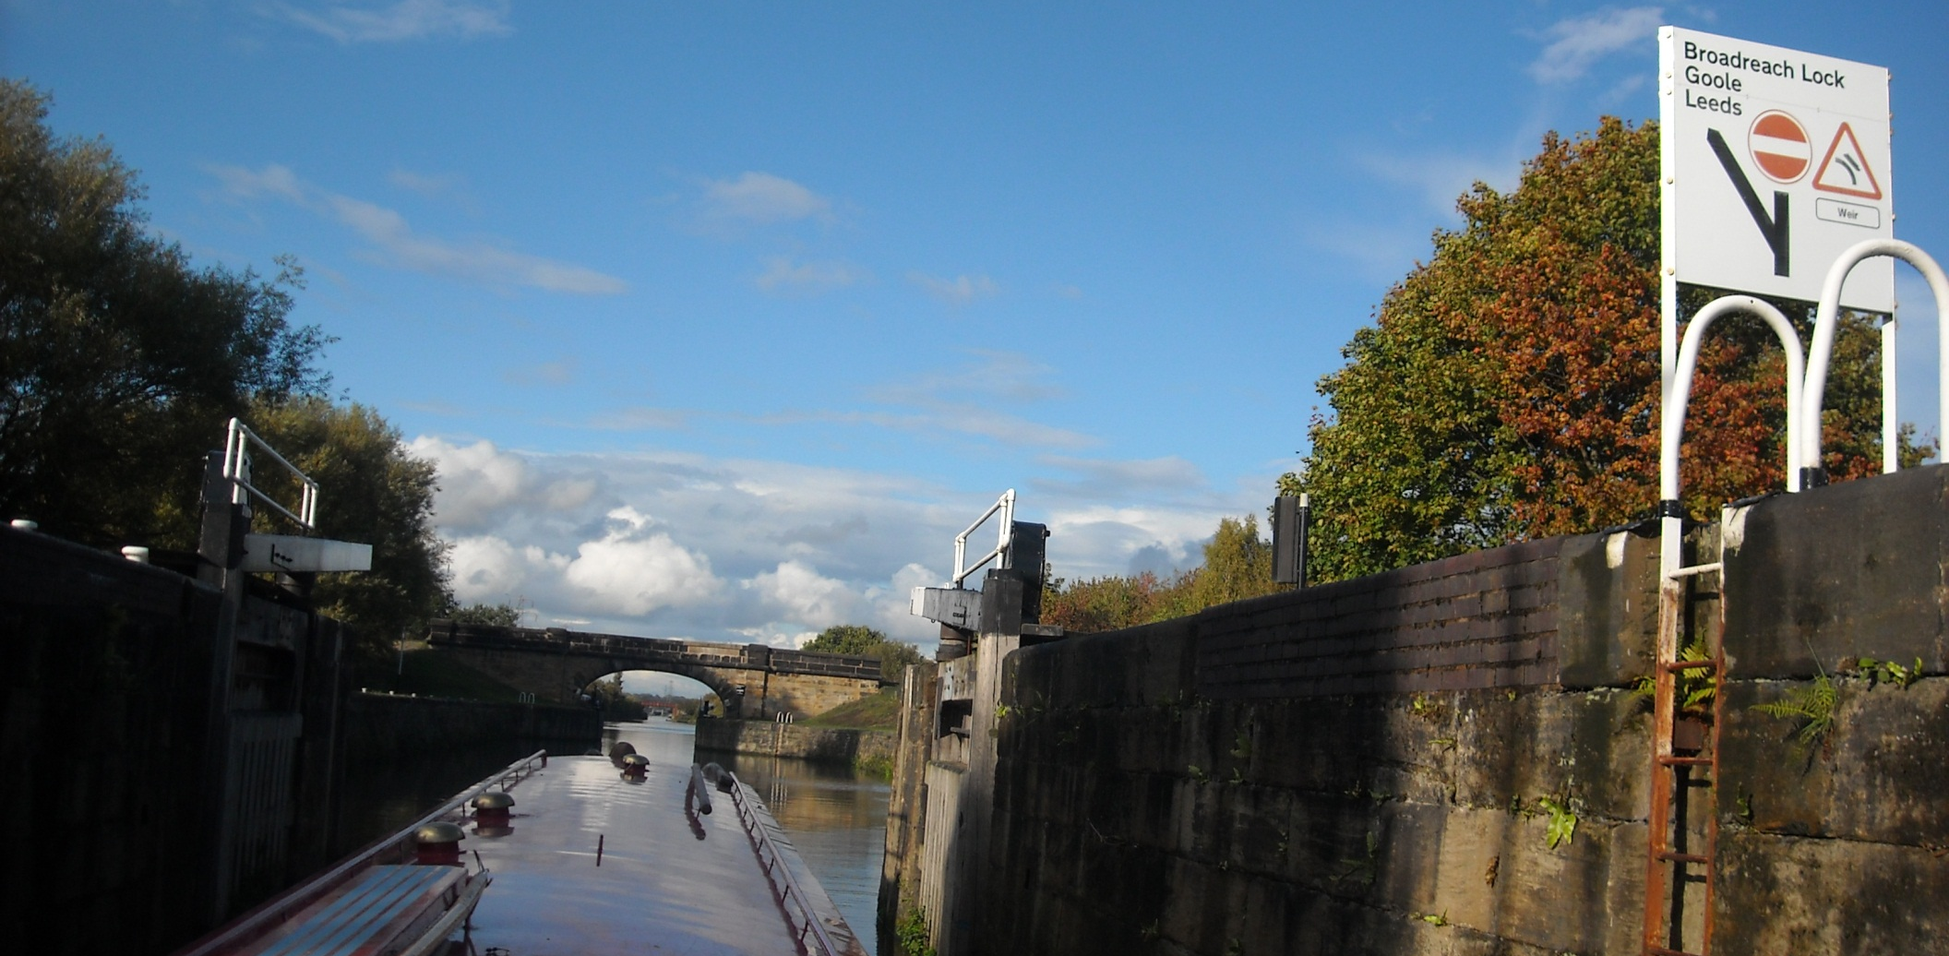
As we carry on down the River Calder to Broadreach flood lock, the start of a remarkable 1831 canal cut through Stanley Ferry.

Slide 15
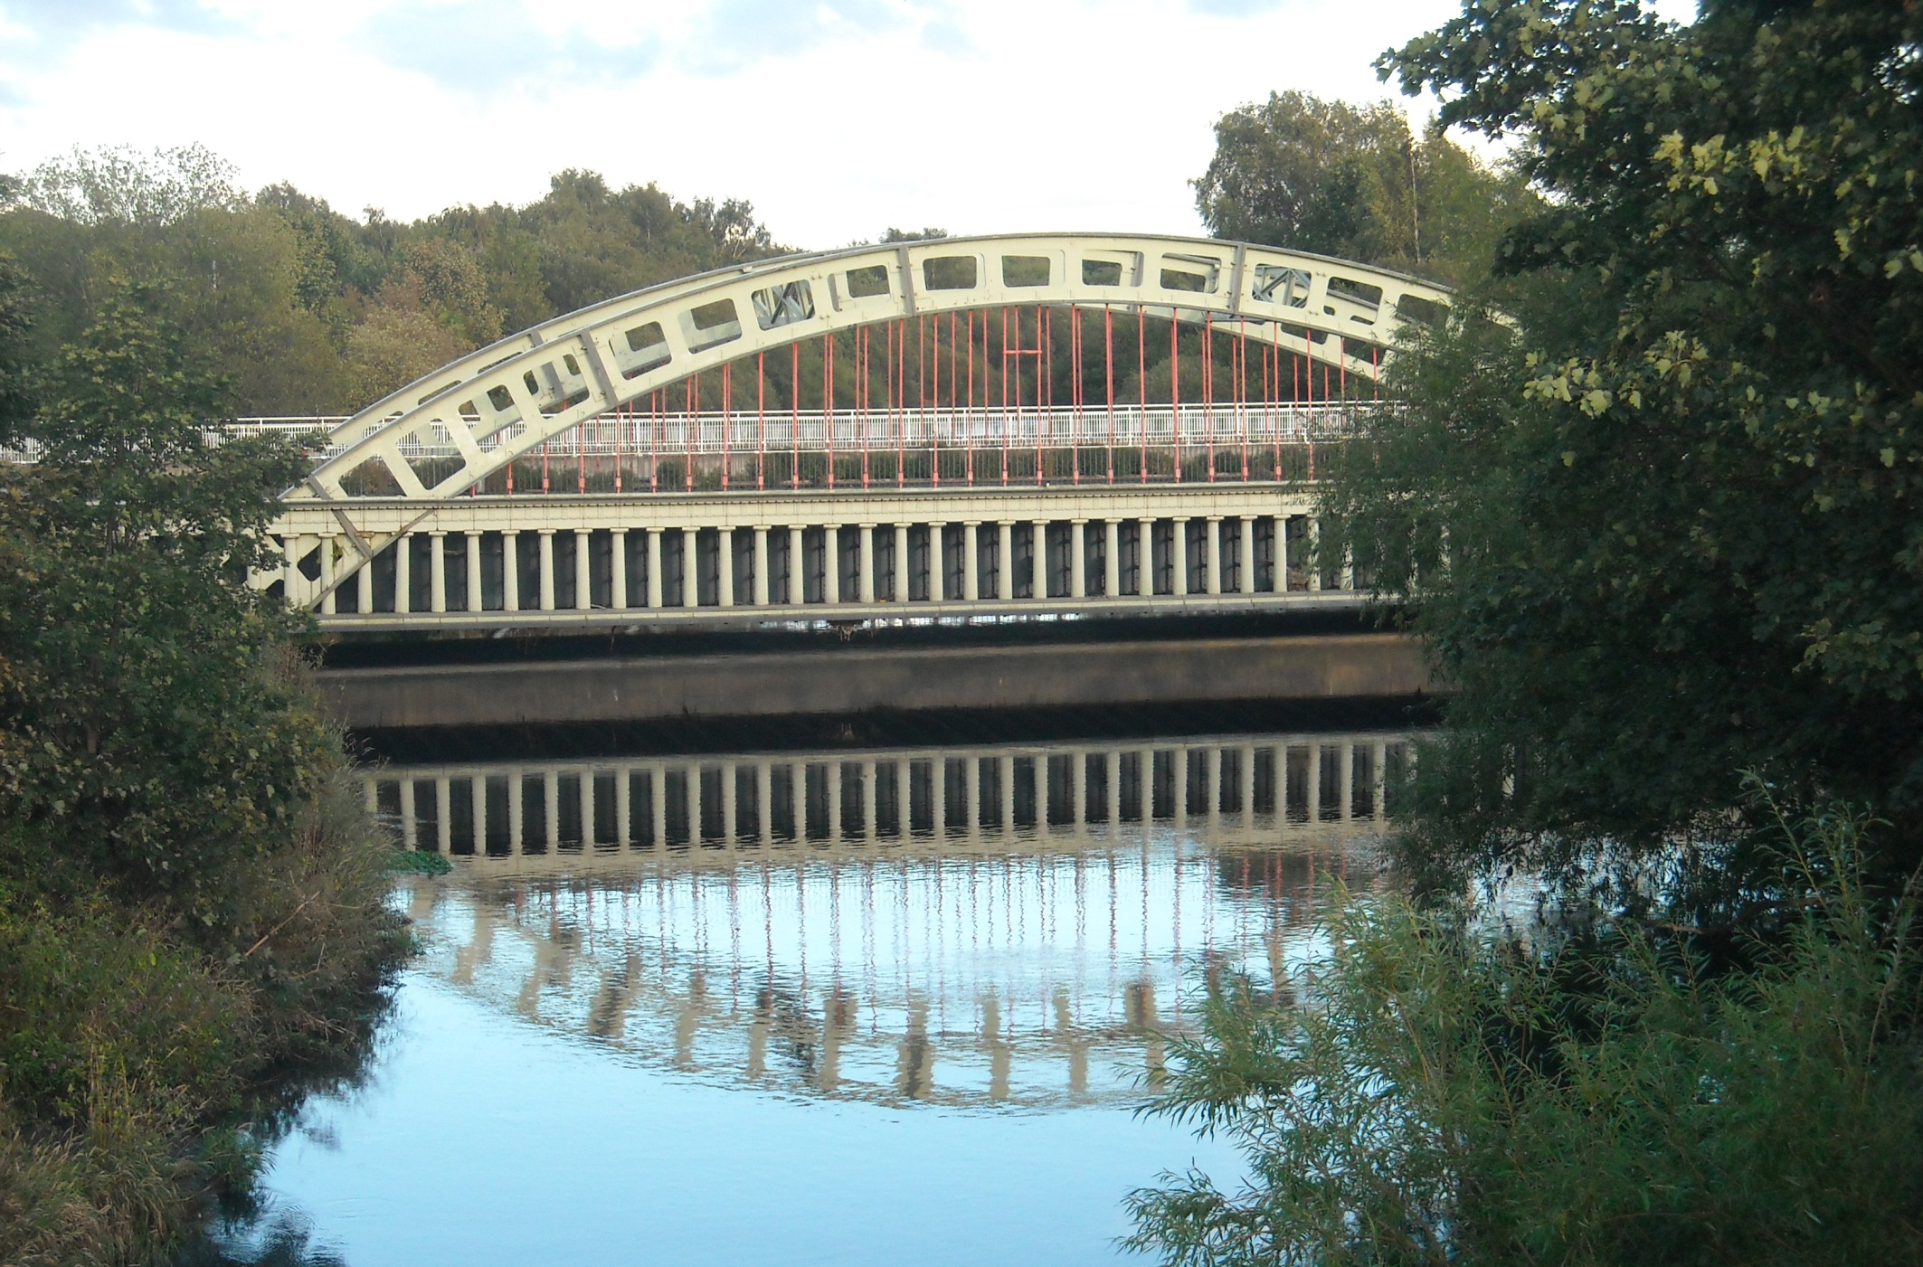
This new canal section cut off several bends and included crossing the River Calder on this much admired iron aqueduct.

Slide 16
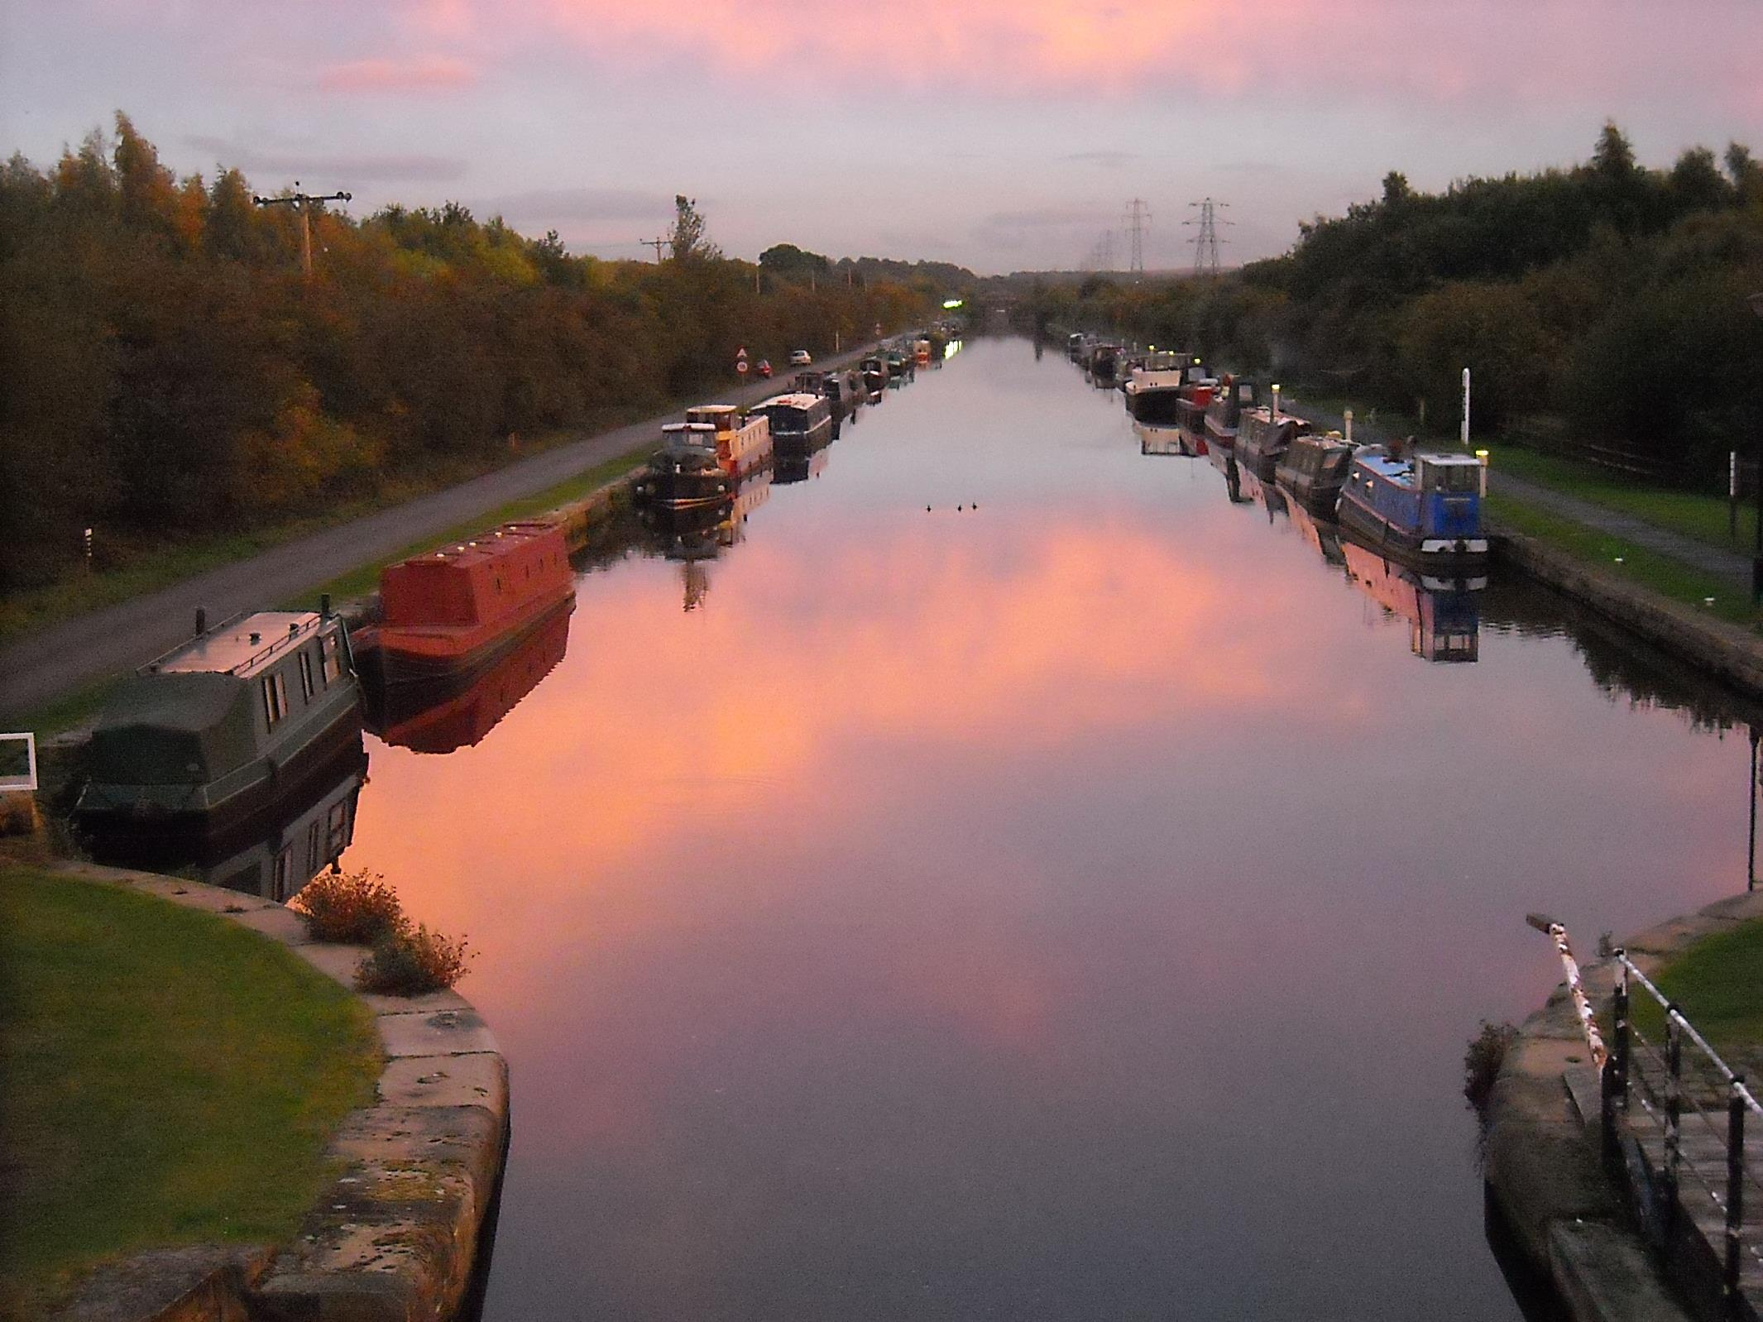
As the sun sinks at Stanley Ferry.

Slide 17
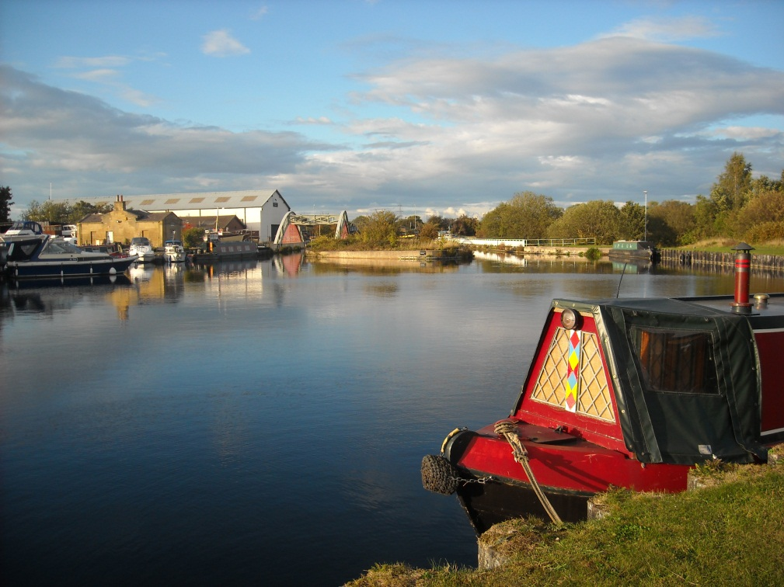
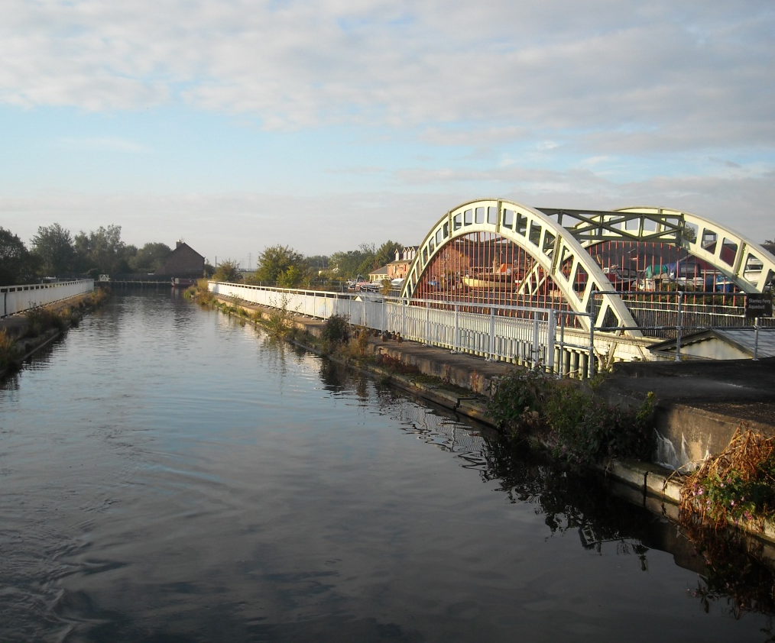
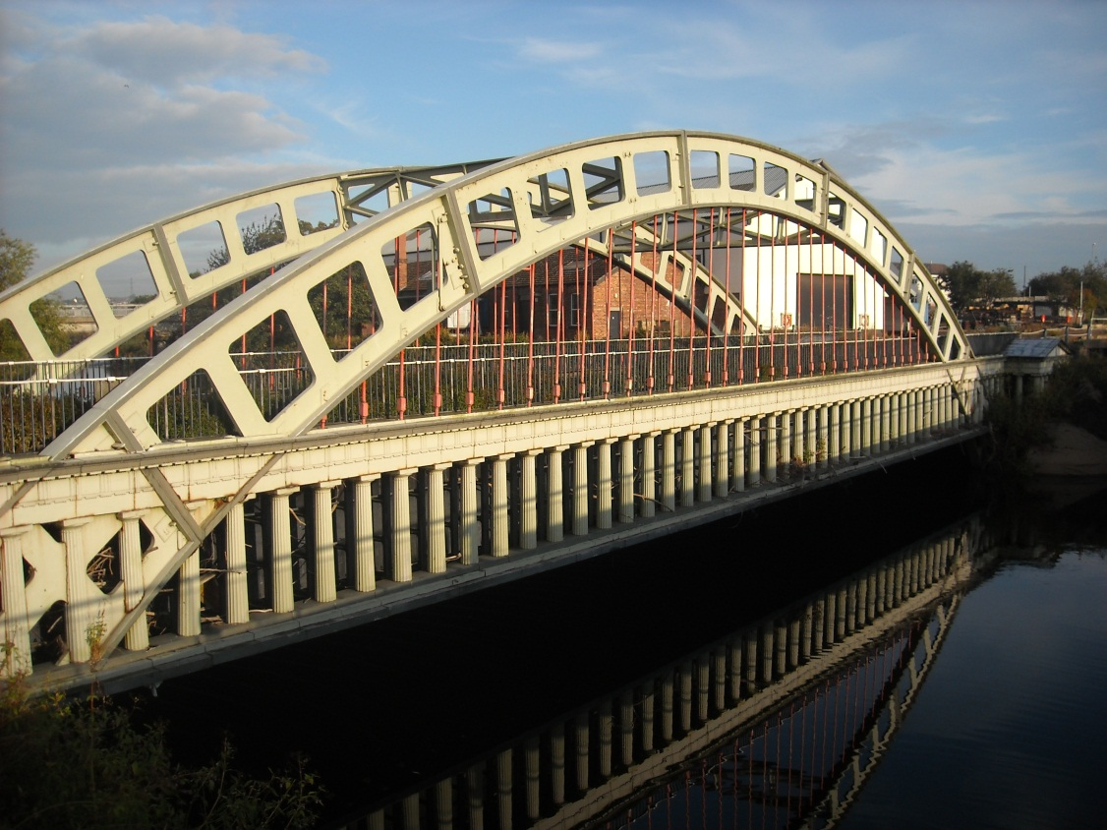
We cross the Calder next morning on a newer, duplicated aqueduct of 1981 and pause to admire the cast iron columns of the 1831 original.

Slide 18
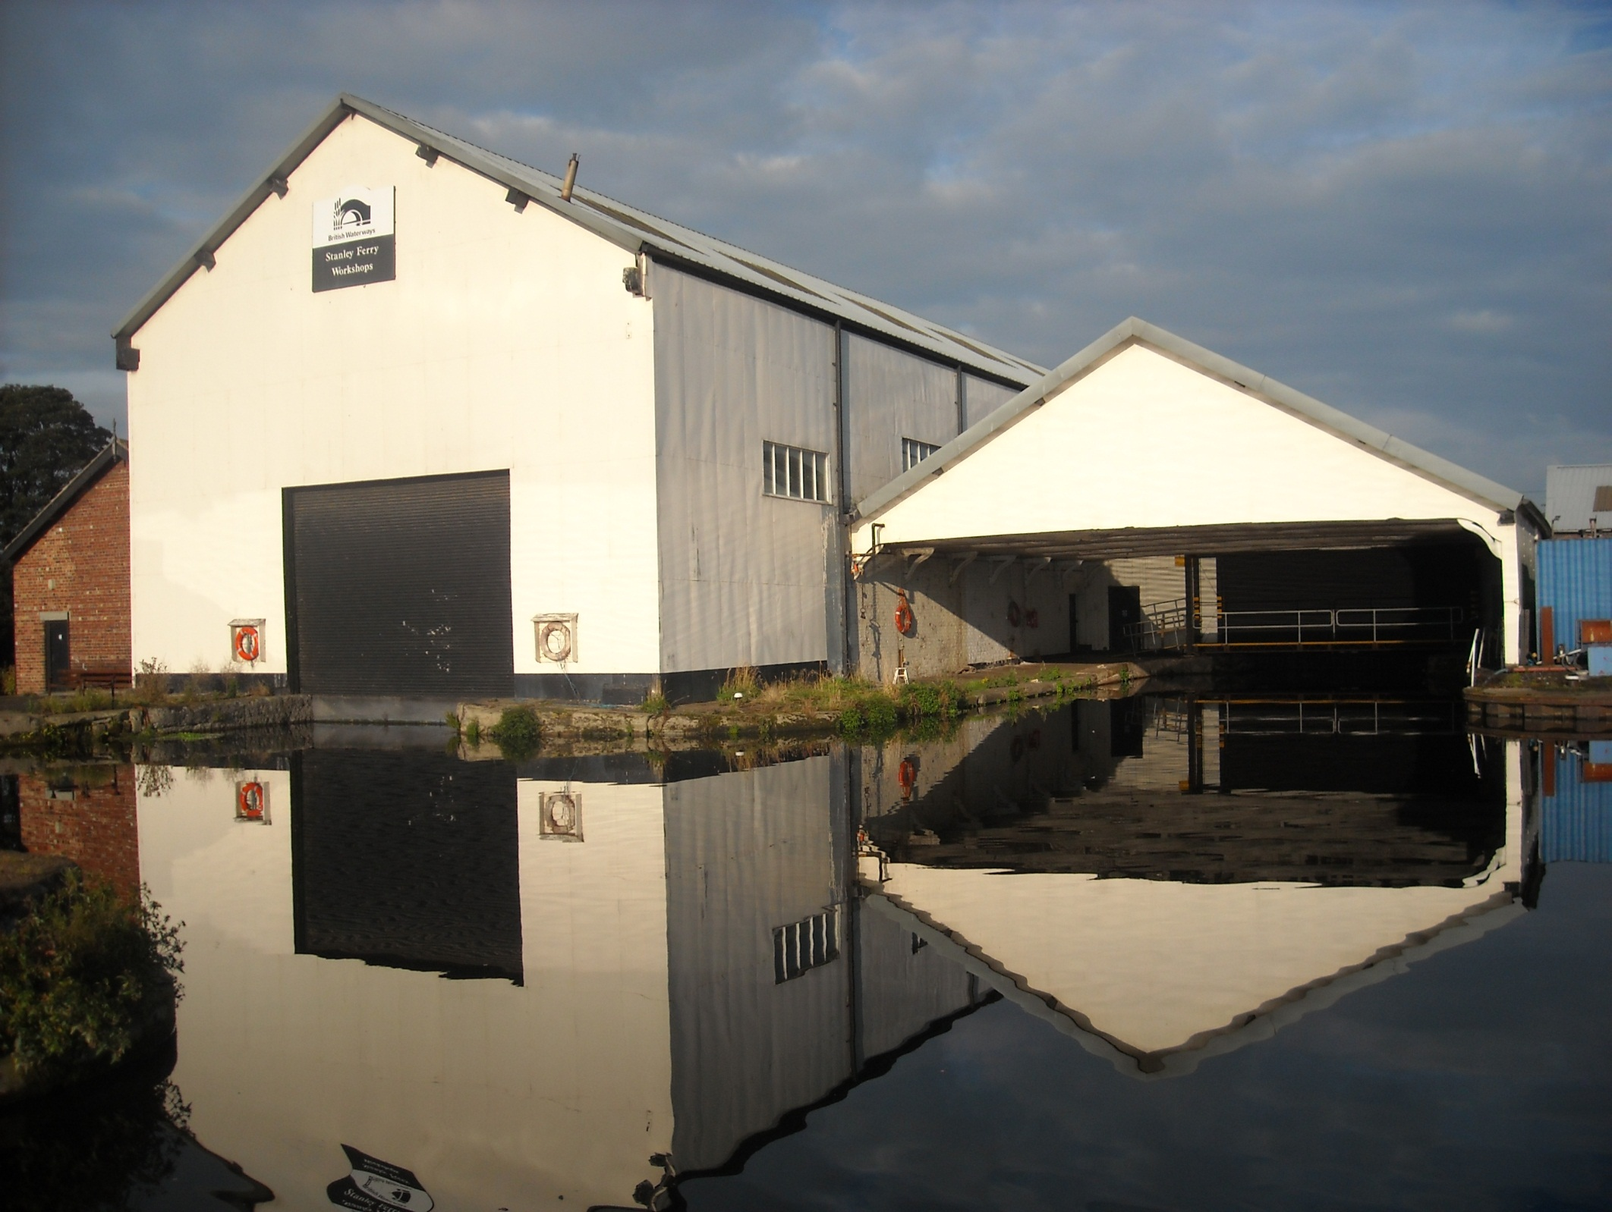
Close by is an attractive but empty, British Waterways yard.

Slide 19
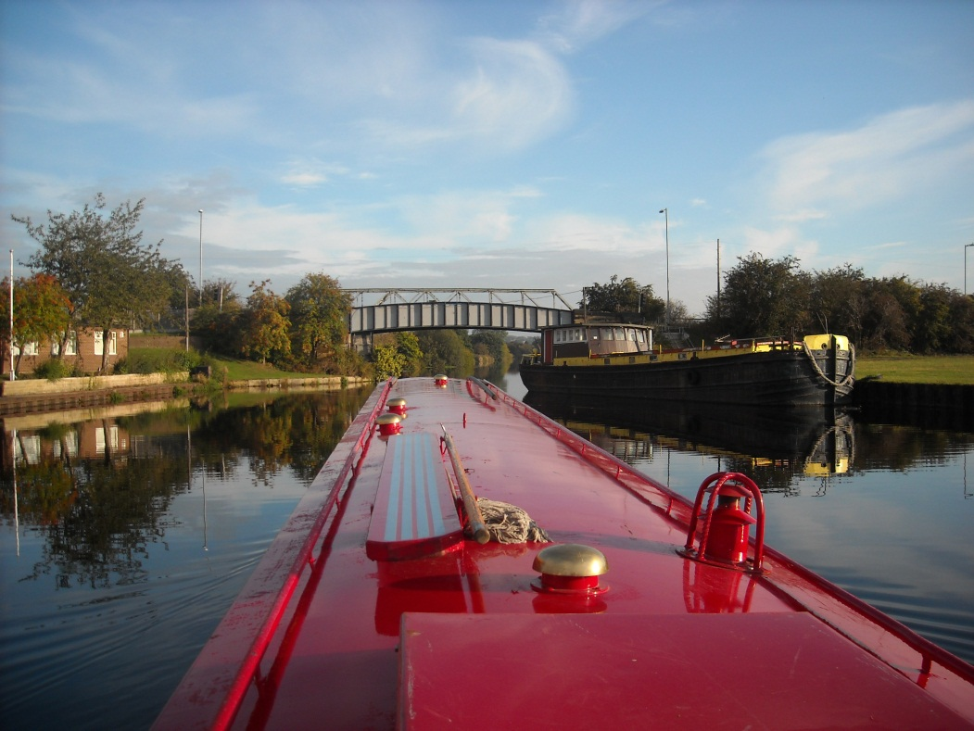
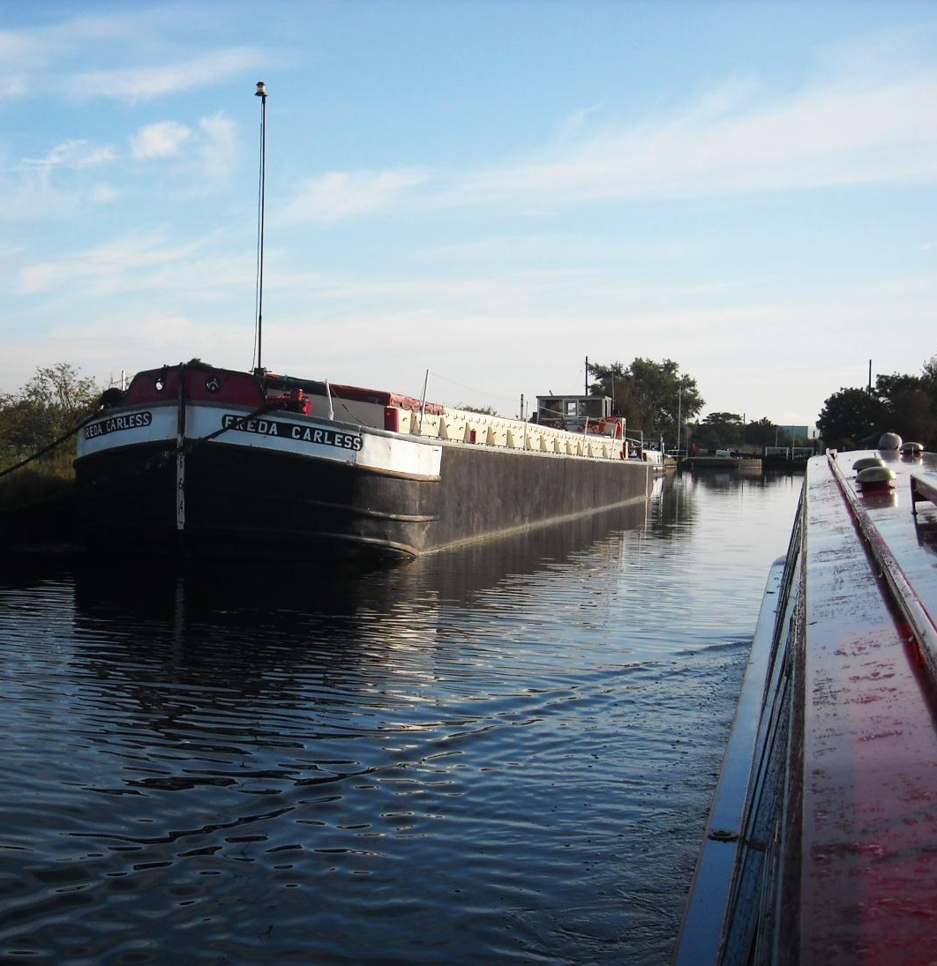
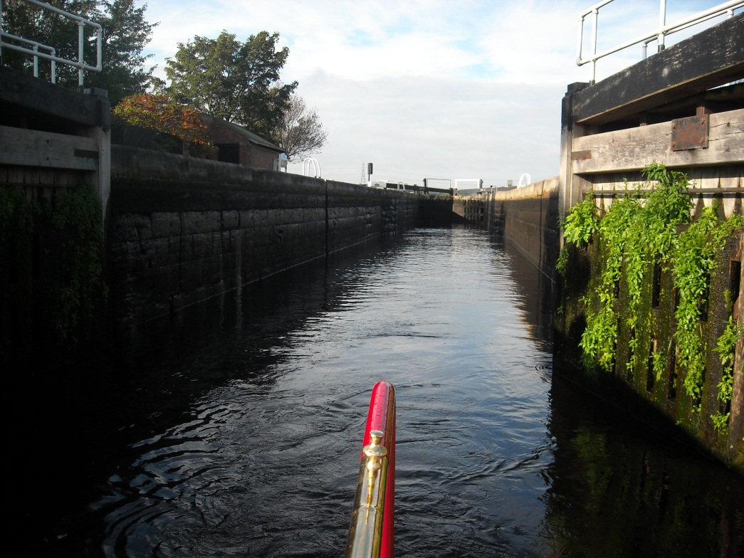
And signs of former commercial activity too as we pass laid up barges.

Slide 20
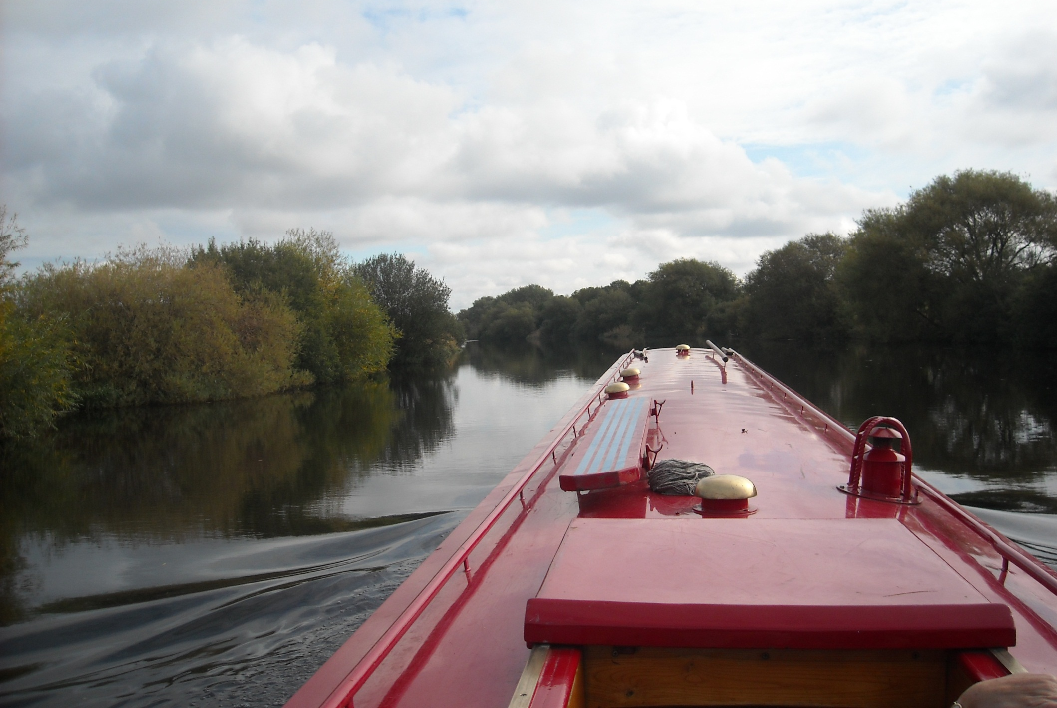
After deep Woodnook Lock the River Calder widens as we near the River Aire.

Slide 21
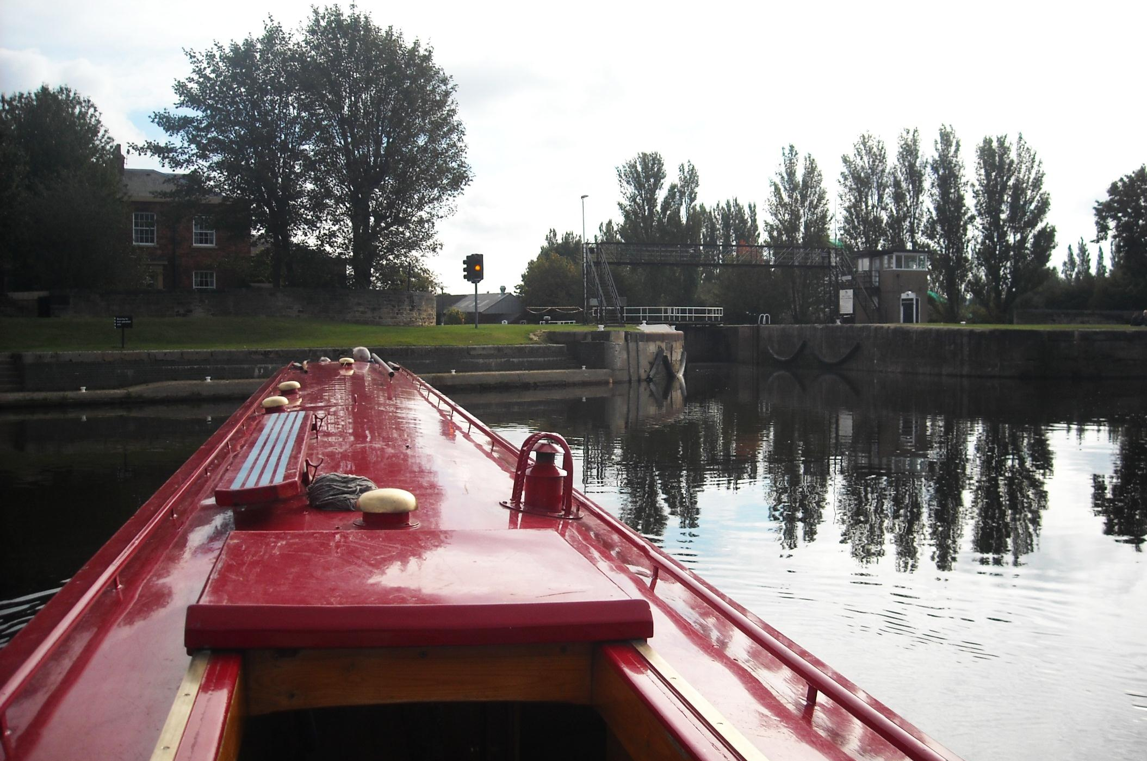
The confluence is here, at Castleford Junction. The weir channel is to the right and this lock approach can be tricky.

Slide 22
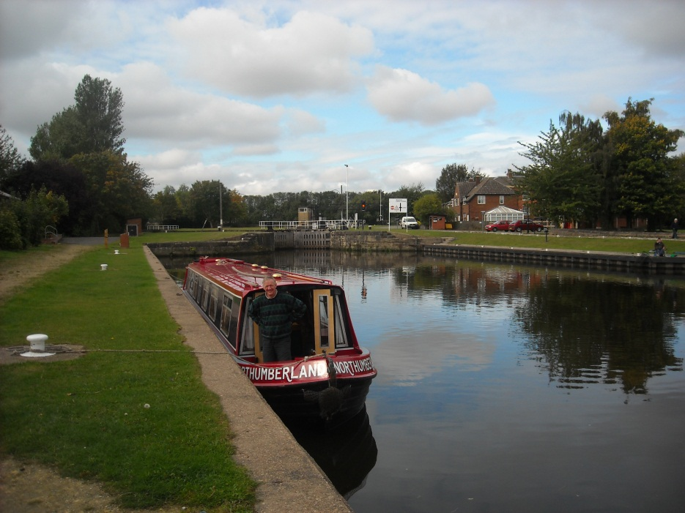
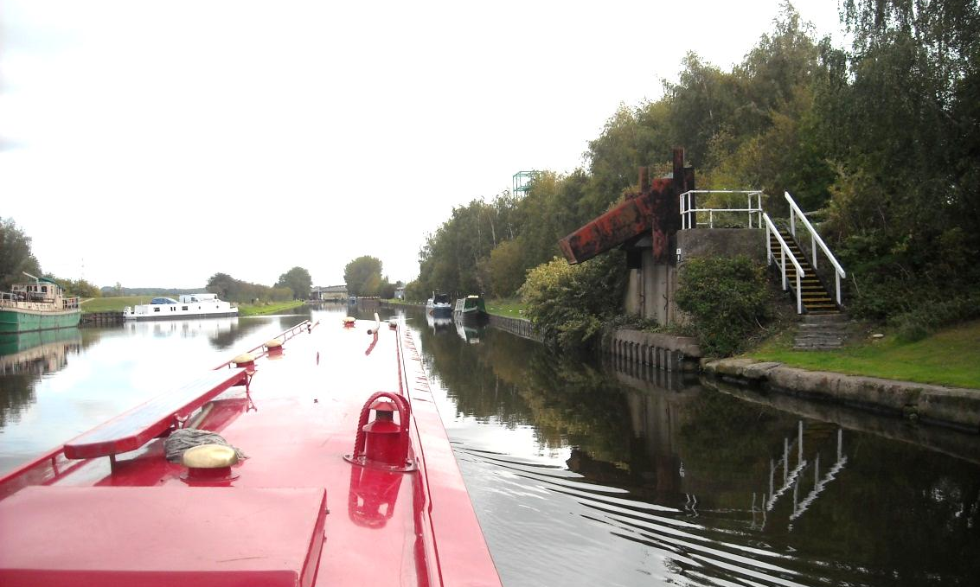
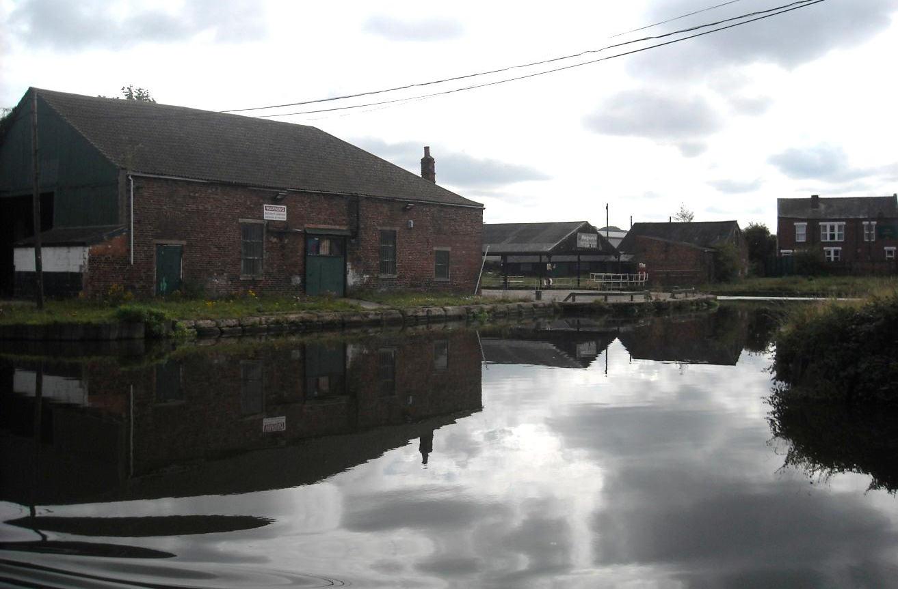
Castleford used to be teeming with the barges, puddings and pans of the coal trade.

Slide 23
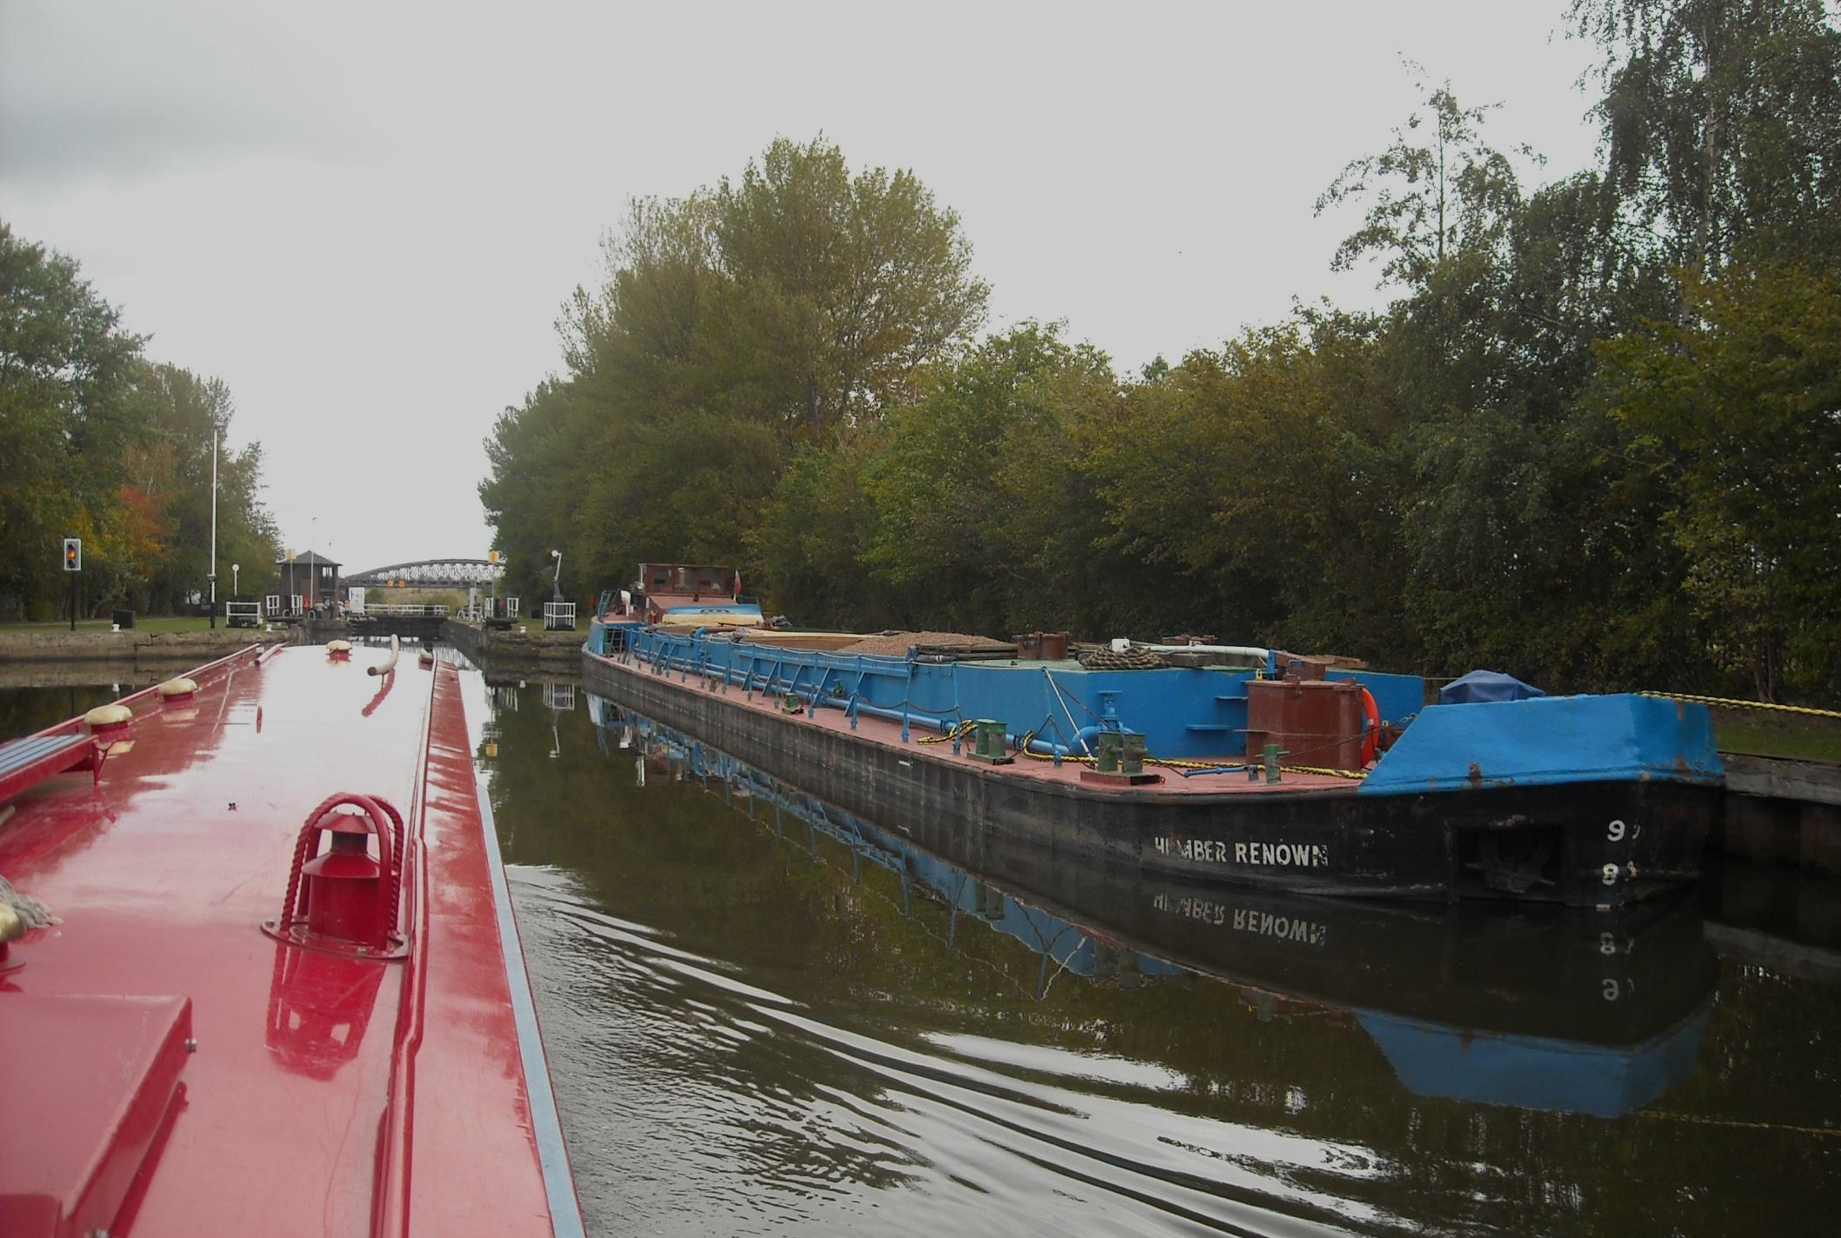
But freight traffic has not totally gone as sand and gravel traffic from quarries by the River Trent is currently healthy.

Slide 24
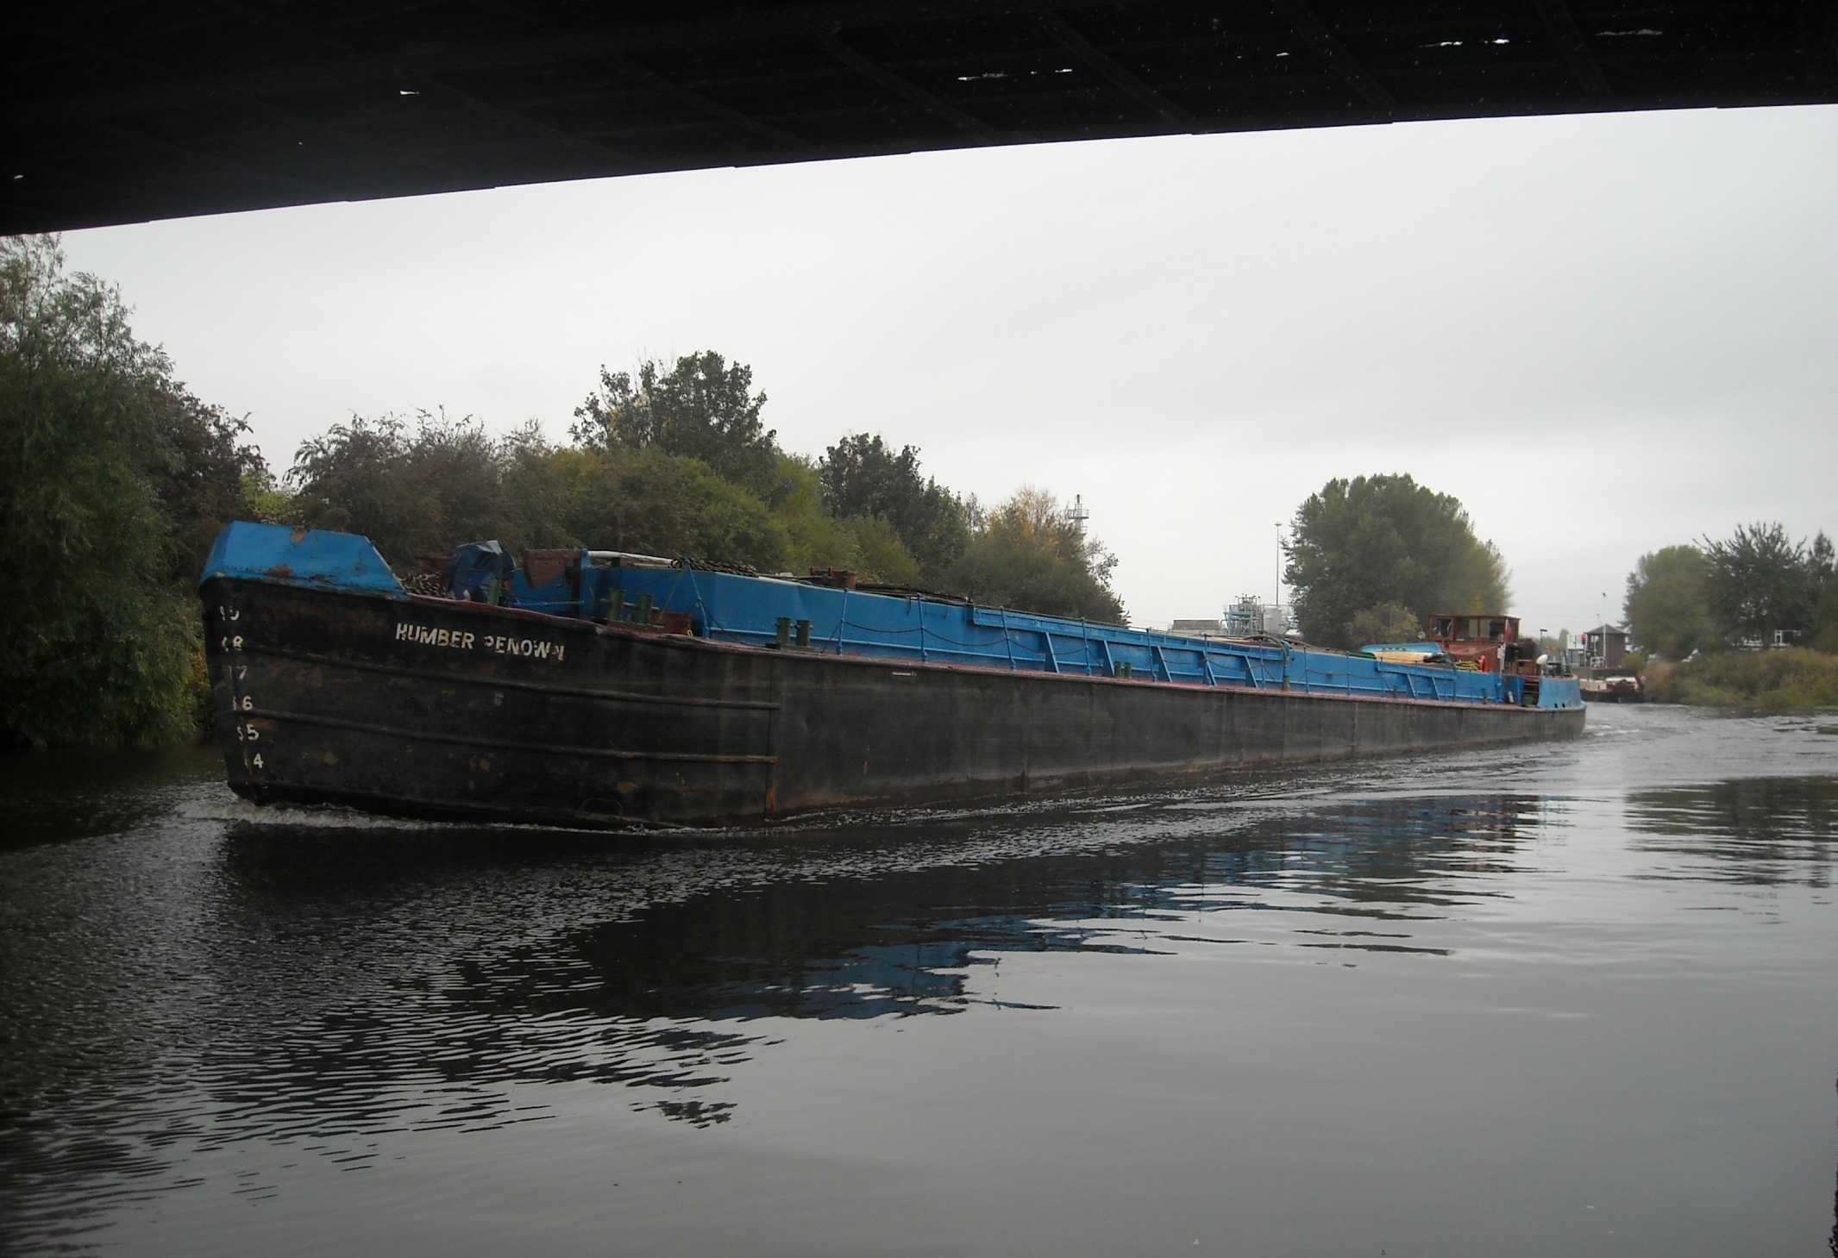
And care is, of course, required, passing barges on the move.

Slide 25
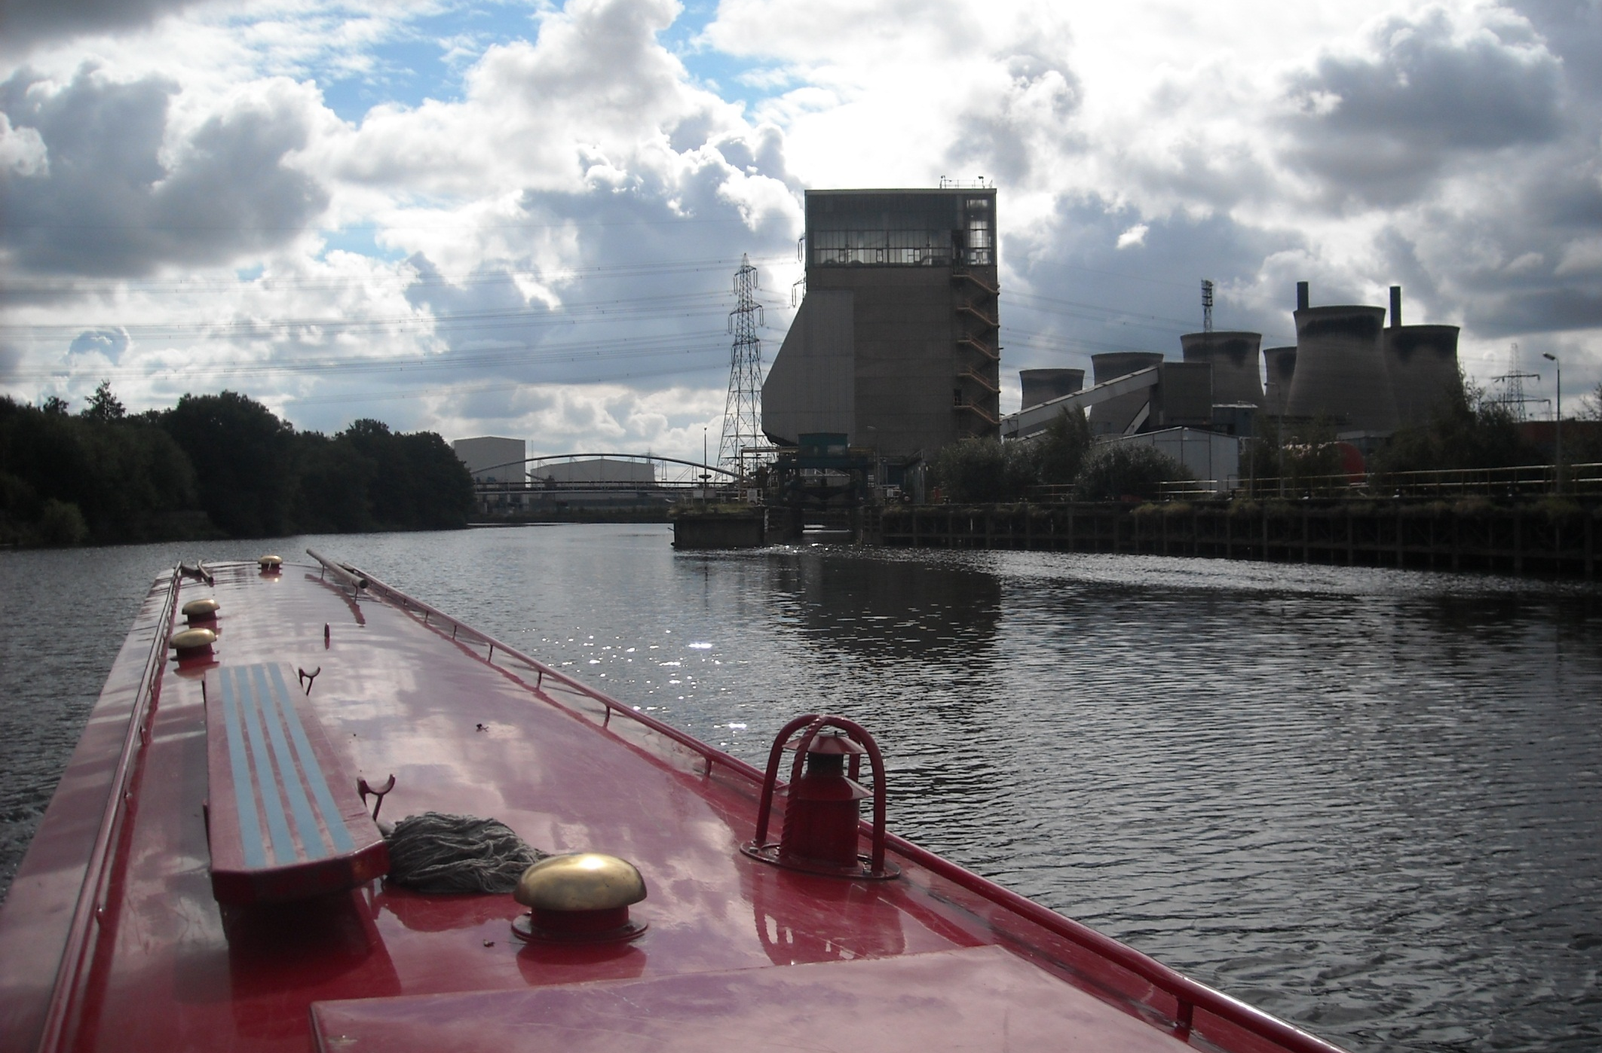
We pass Ferrybridge Power Station on the River Aire, still dominated by its boat hoist.

Slide 26
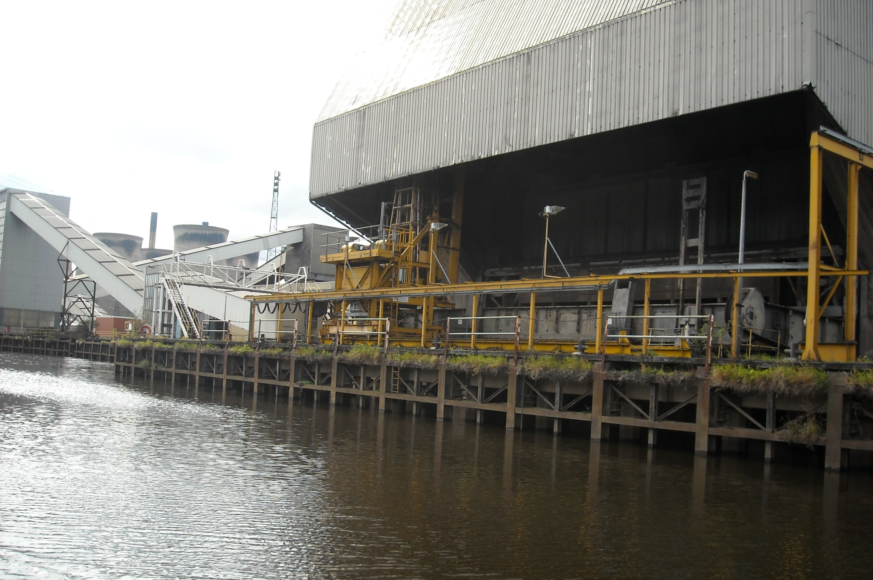
Coal no longer arrives by river and weeds are taking over.
170 ton pans of coal were tipped here.

Slide 27
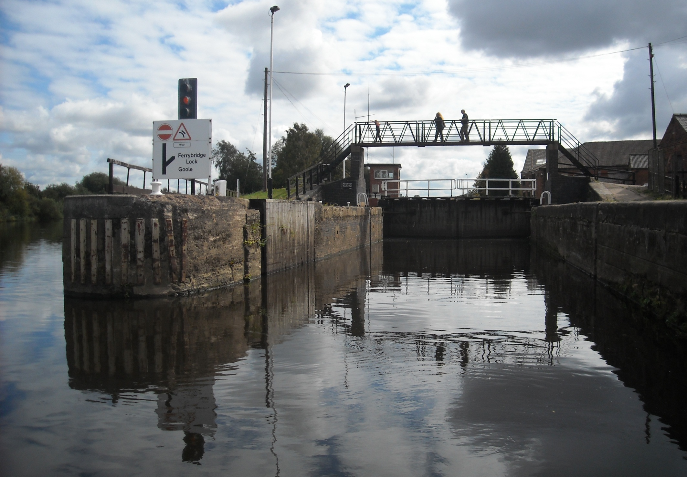
At Ferrybridge Lock we lock out of the River Aire.

Slide 28
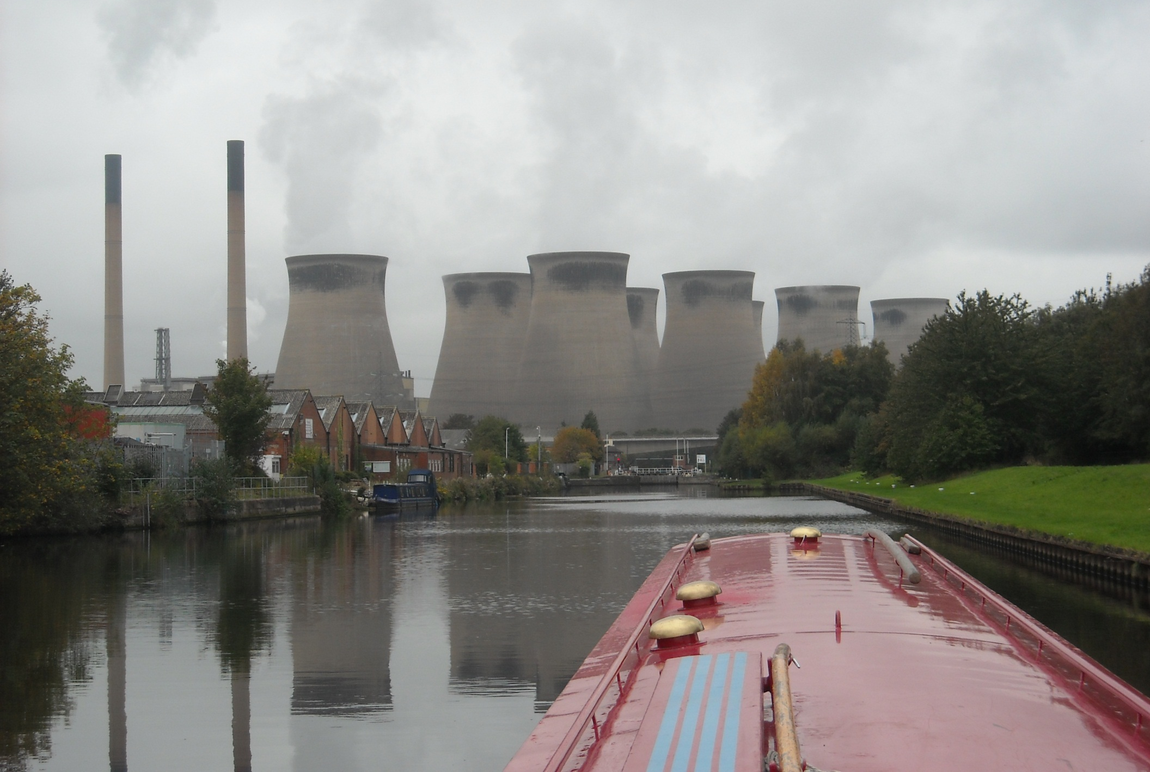
18 miles of deep canal are ahead now as we join what was once one of the most efficient waterways in Europe.

Slide 29
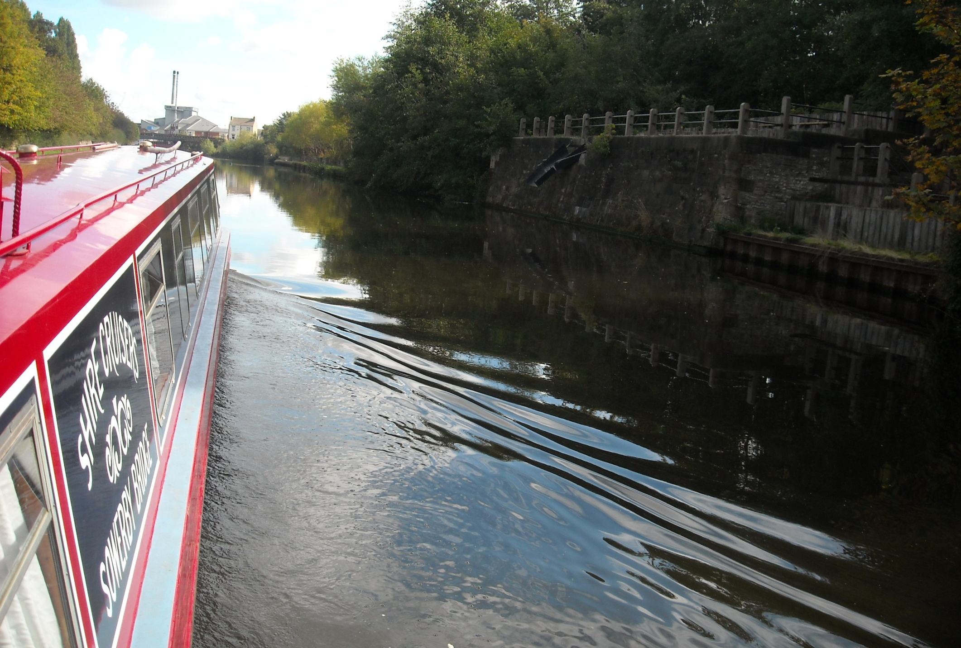
Dozens of coal staithes like this one once loaded compartment boats called Tom Puddings, then towed in long trains to Goole.

Slide 30
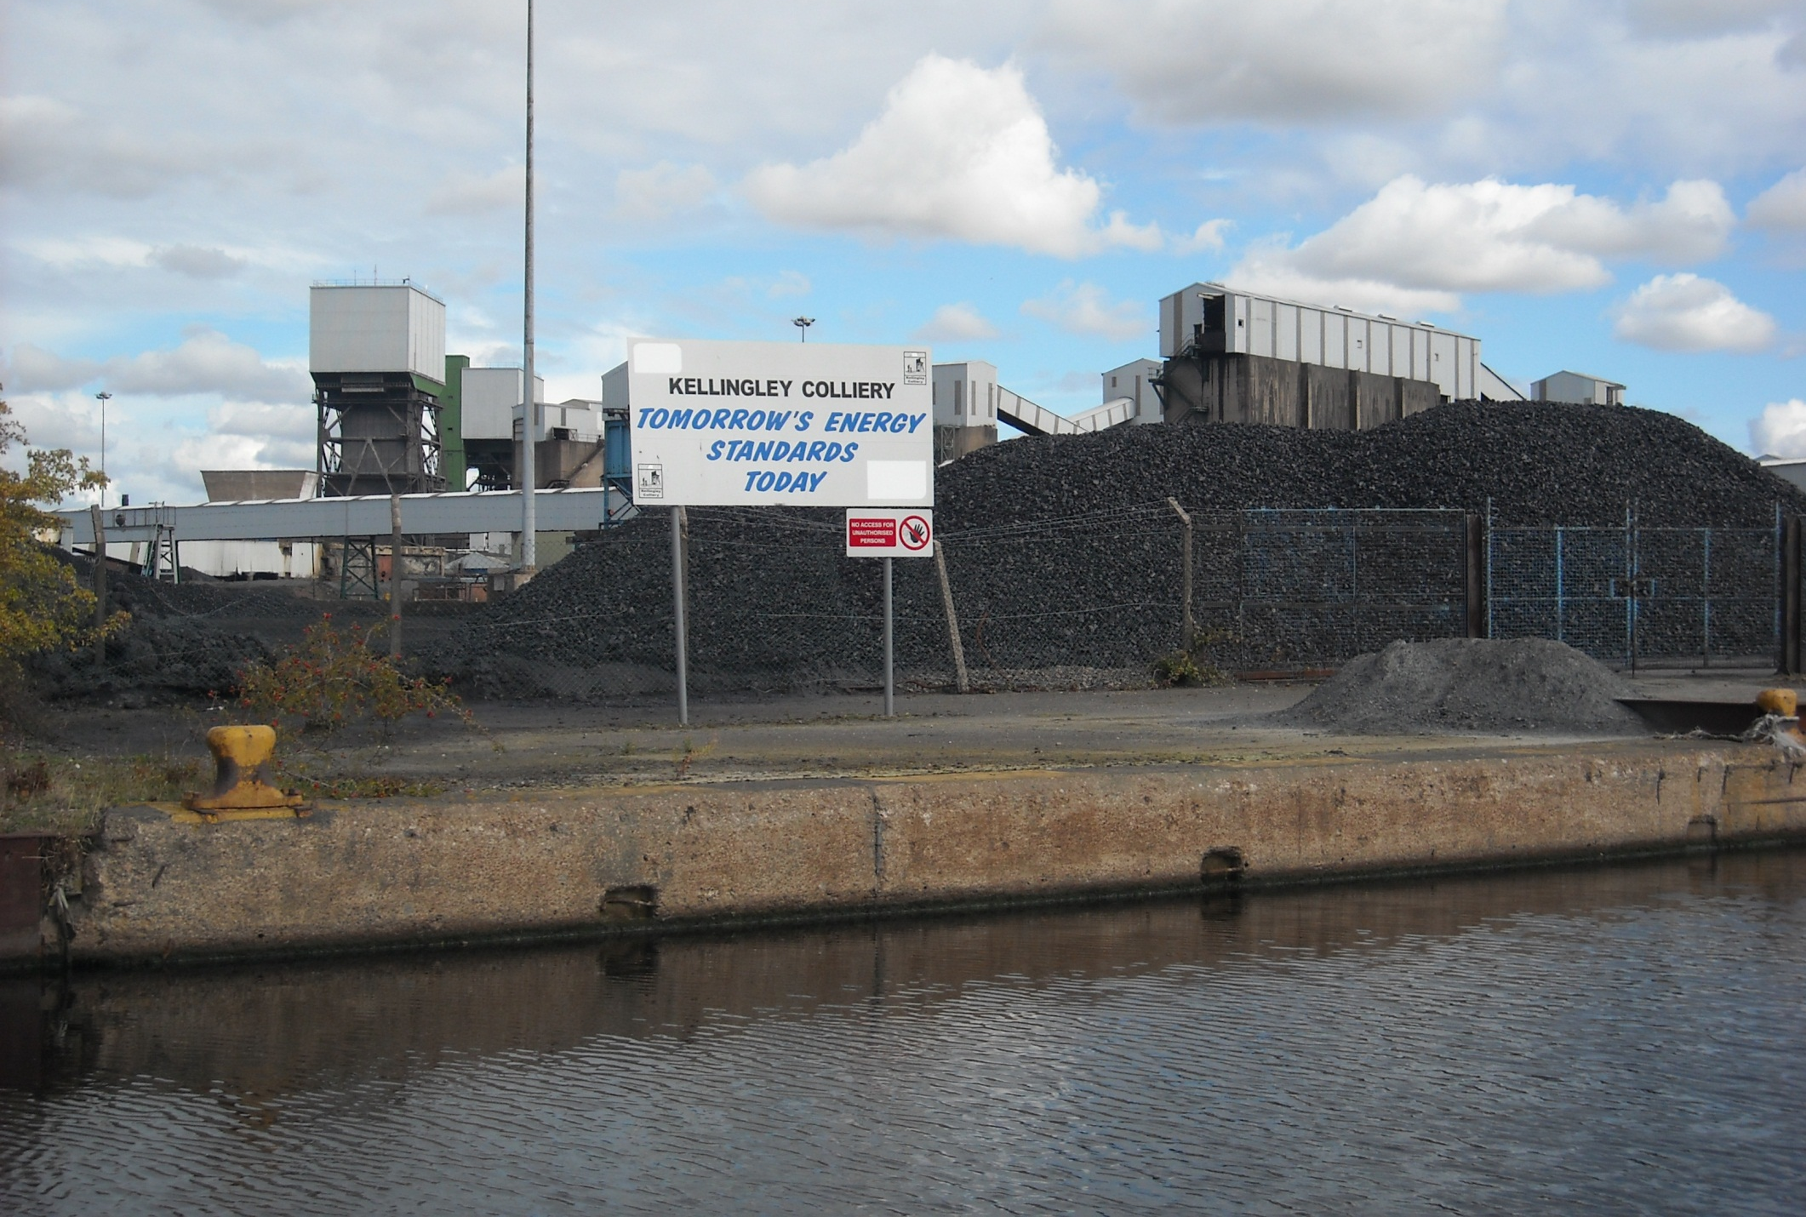
We pass Kellingley Colliery, one of the UK’s three remaining deep mined pits. Sadly the coal wharf is no longer in use.

Slide 31
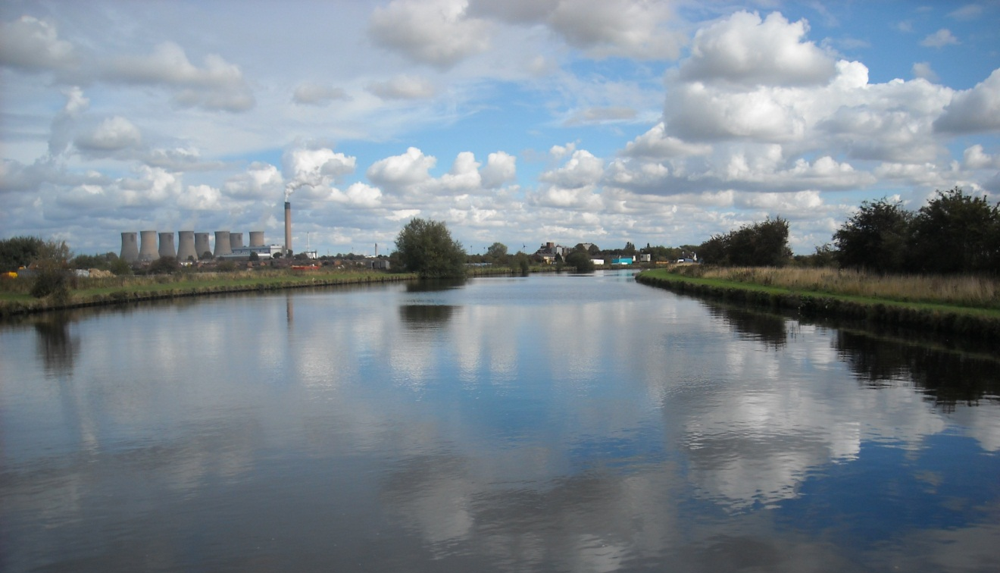
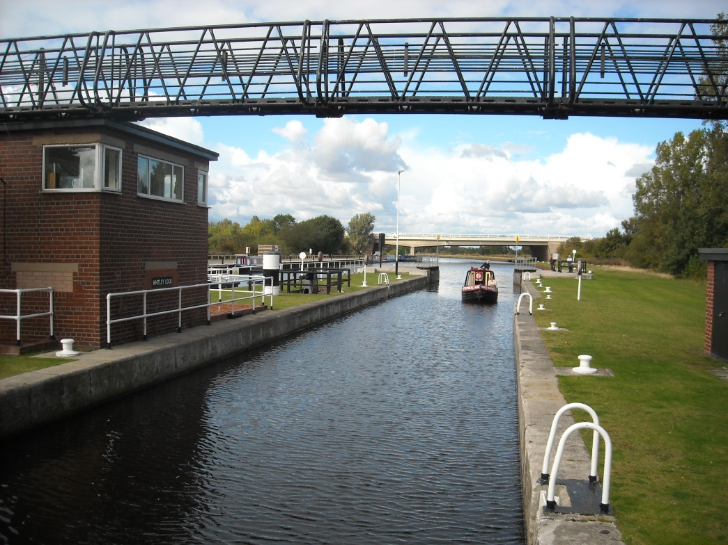
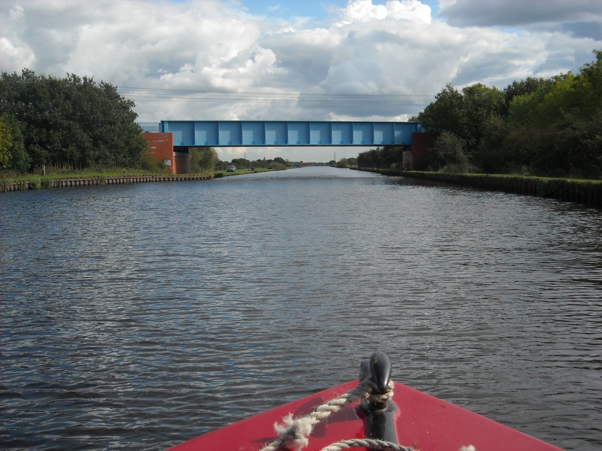
Eggborough next, then Whitley lock, then Pollington.

Slide 32
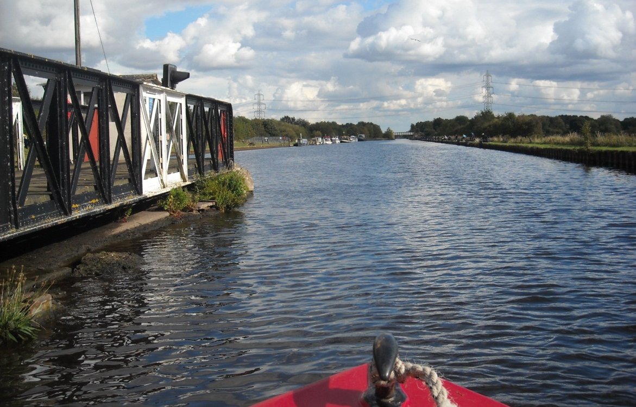
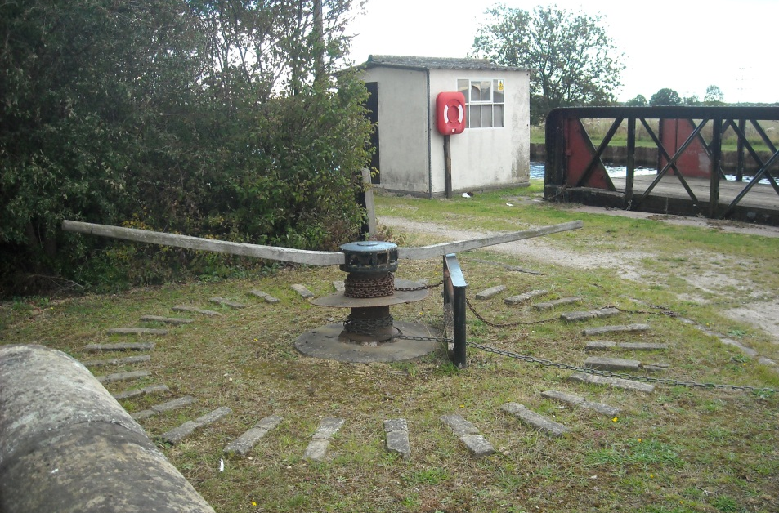
Pollington’s access bridge is now rarely swung and remains powered by its original capstan.

Slide 33
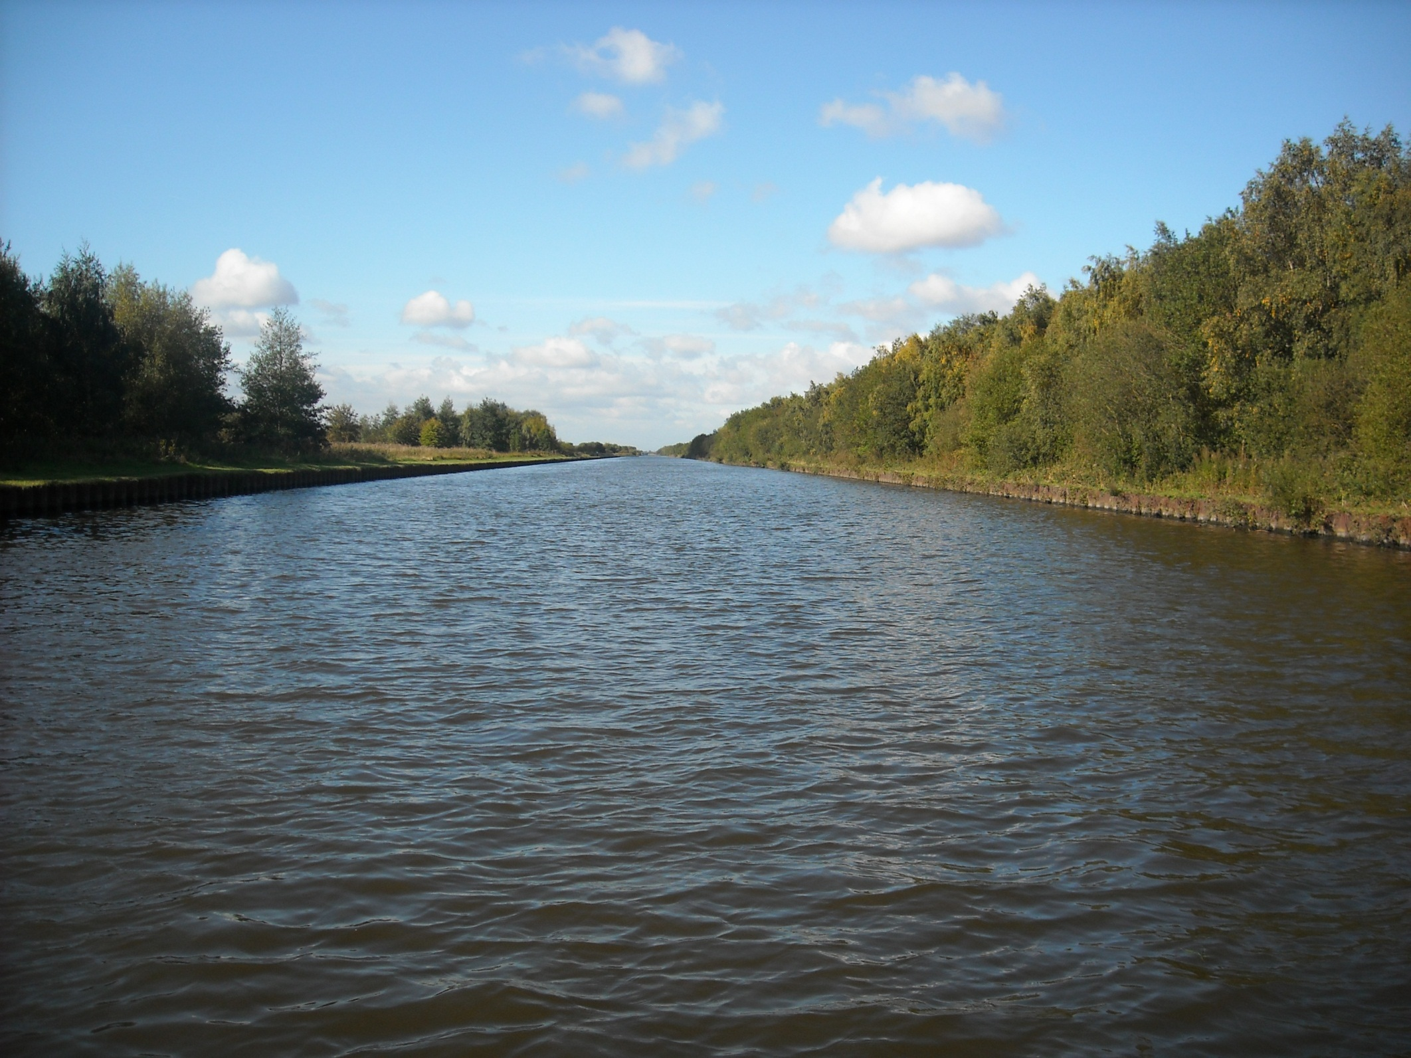
Goole, Britain's most inland port, is 51 miles from the sea.

Slide 34
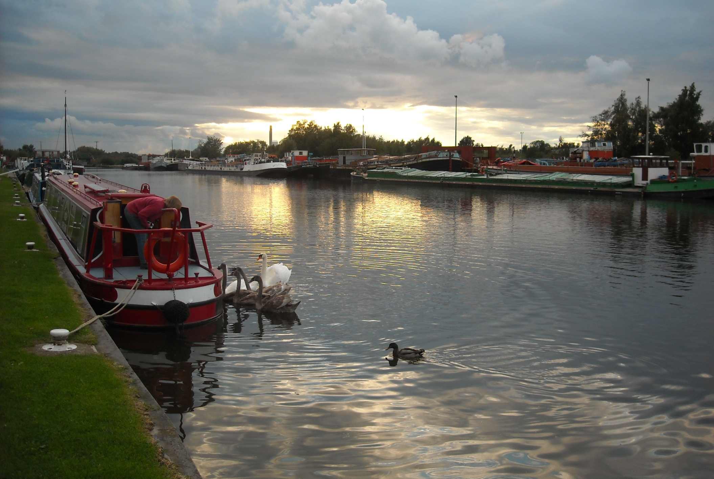
And we moor by the Yorkshire Waterways Museum opposite the impressive line of Goole barges.

Slide 35
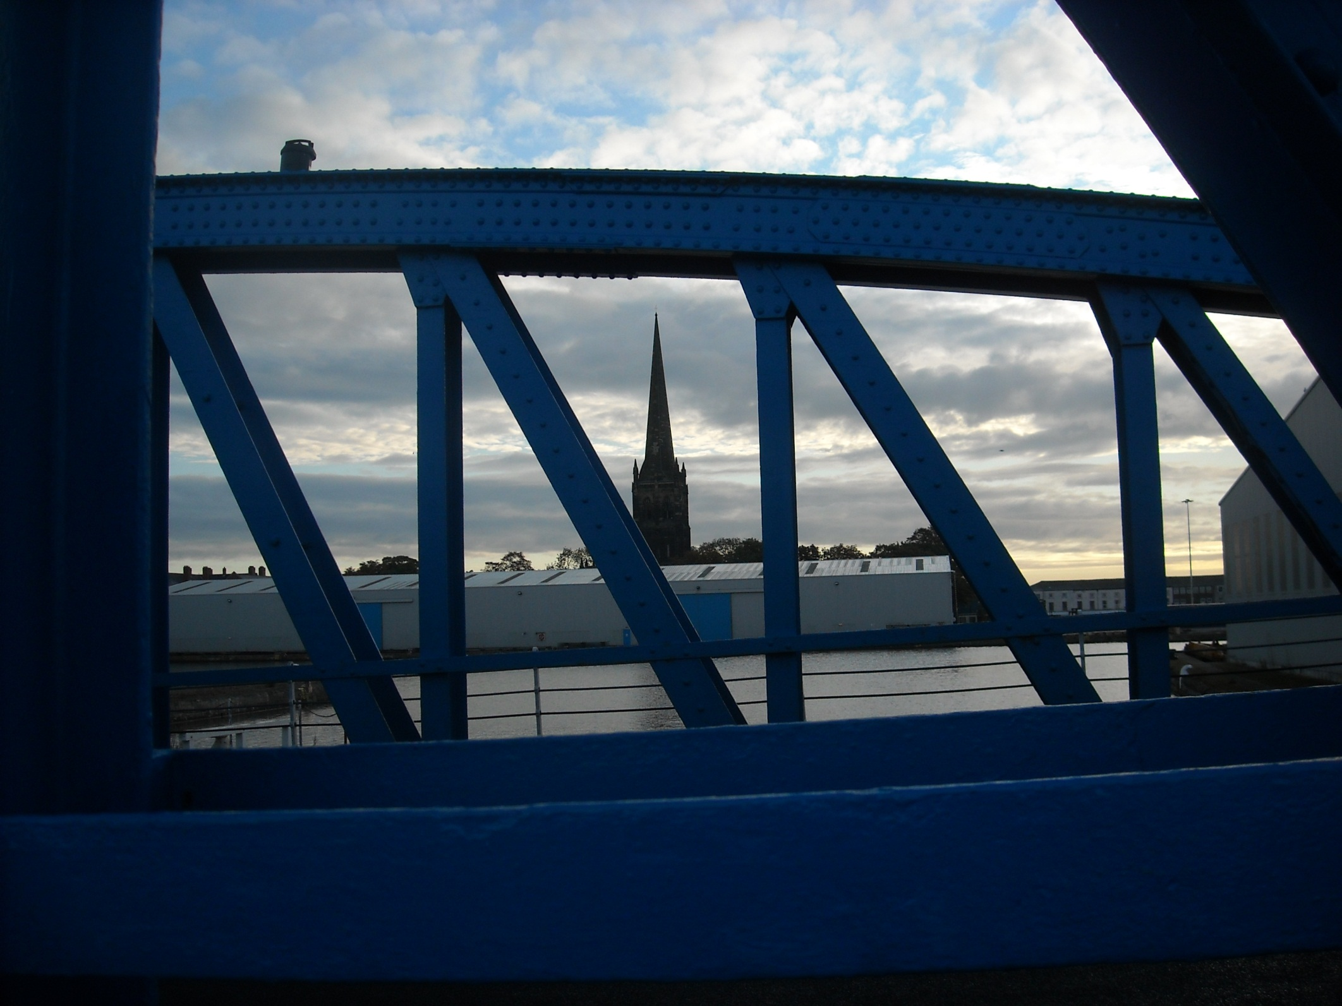
Goole is the ultimate canal town although Goole Docks are now changed from their coal exporting heyday.

Slide 36
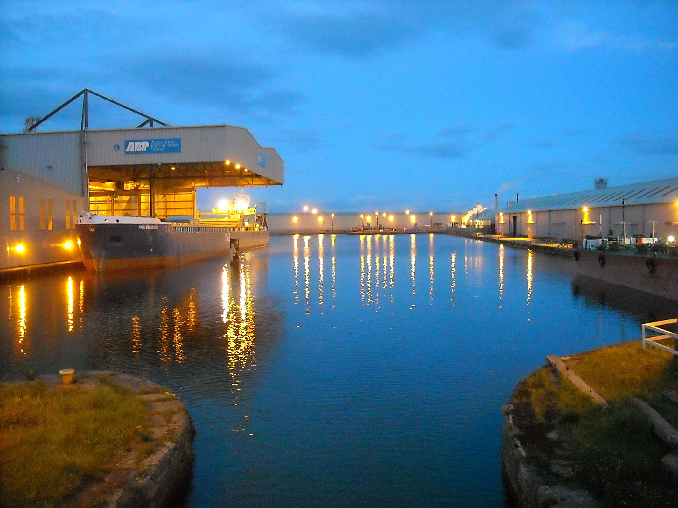
Modern craft do still visit, like RMS Duisberg, unloading steel.

Slide 37
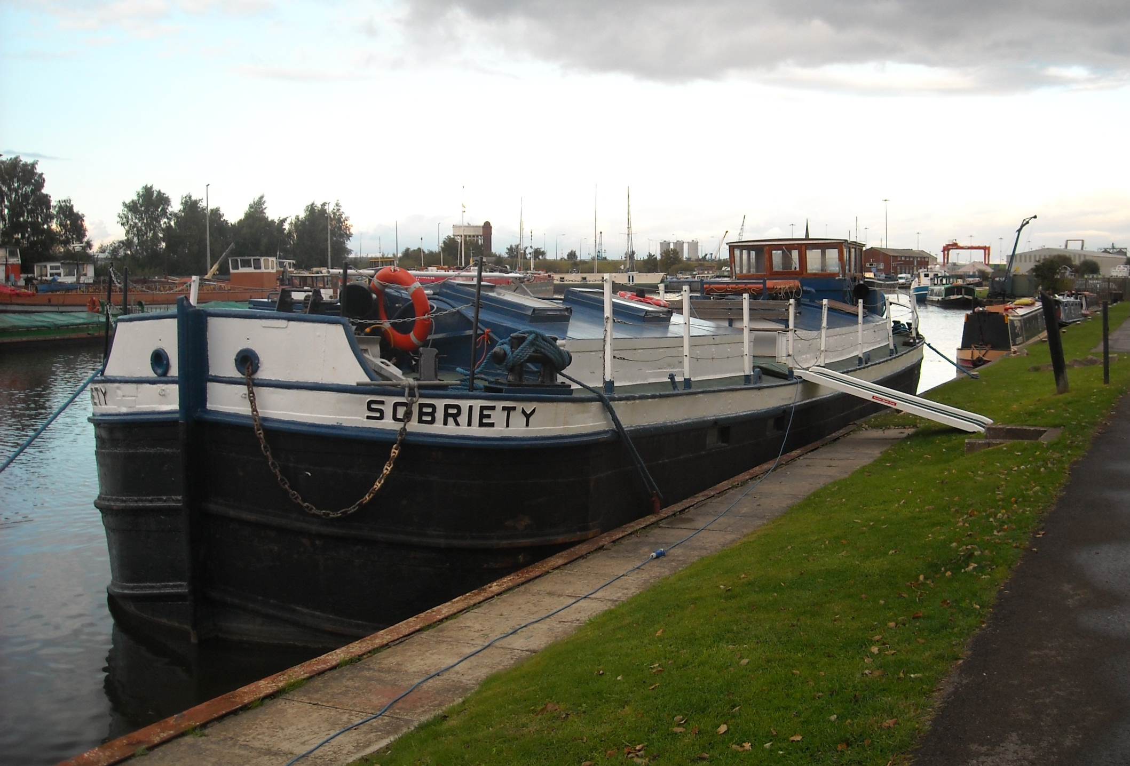
The boats by us include Sobriety, a 100 year old
Humber Keel, once sail powered and now available for hire.

Slide 38
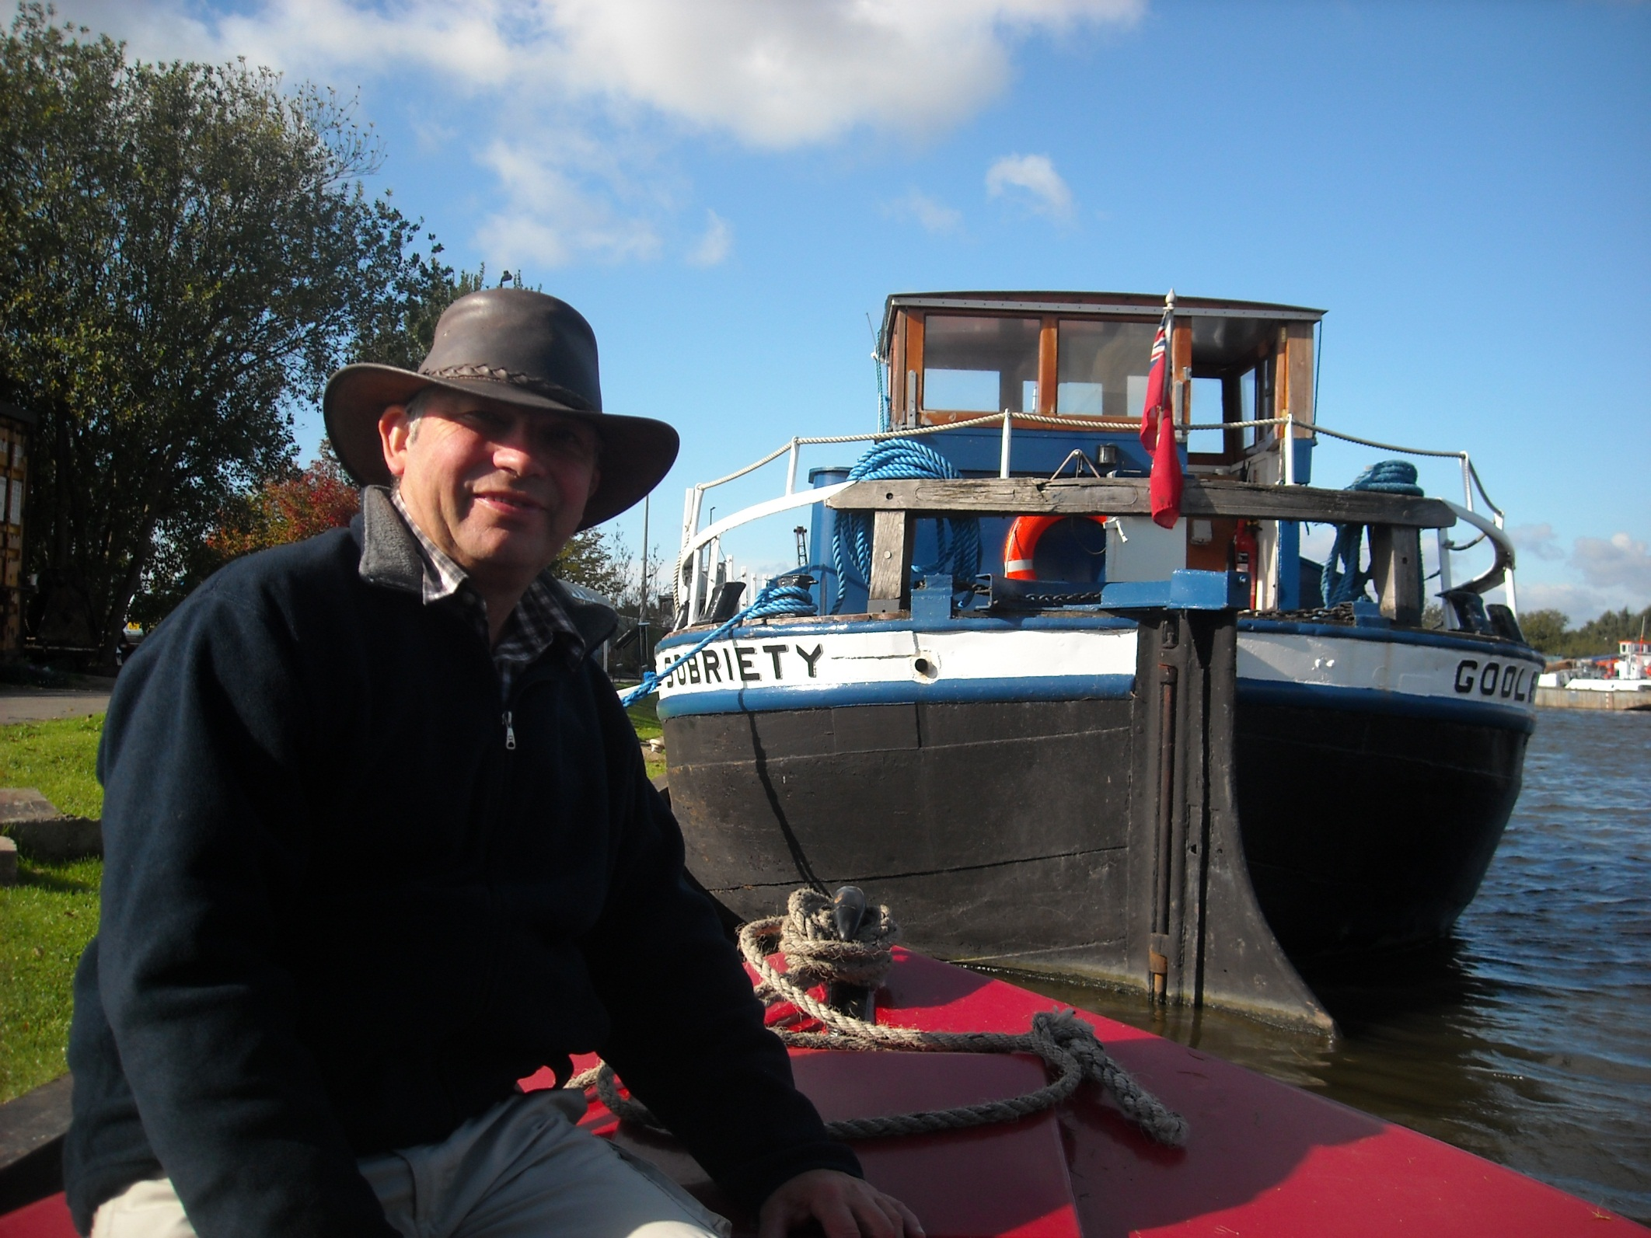
We close our narrowboat trip by Sobriety on 18th September 2011.

Slide 39
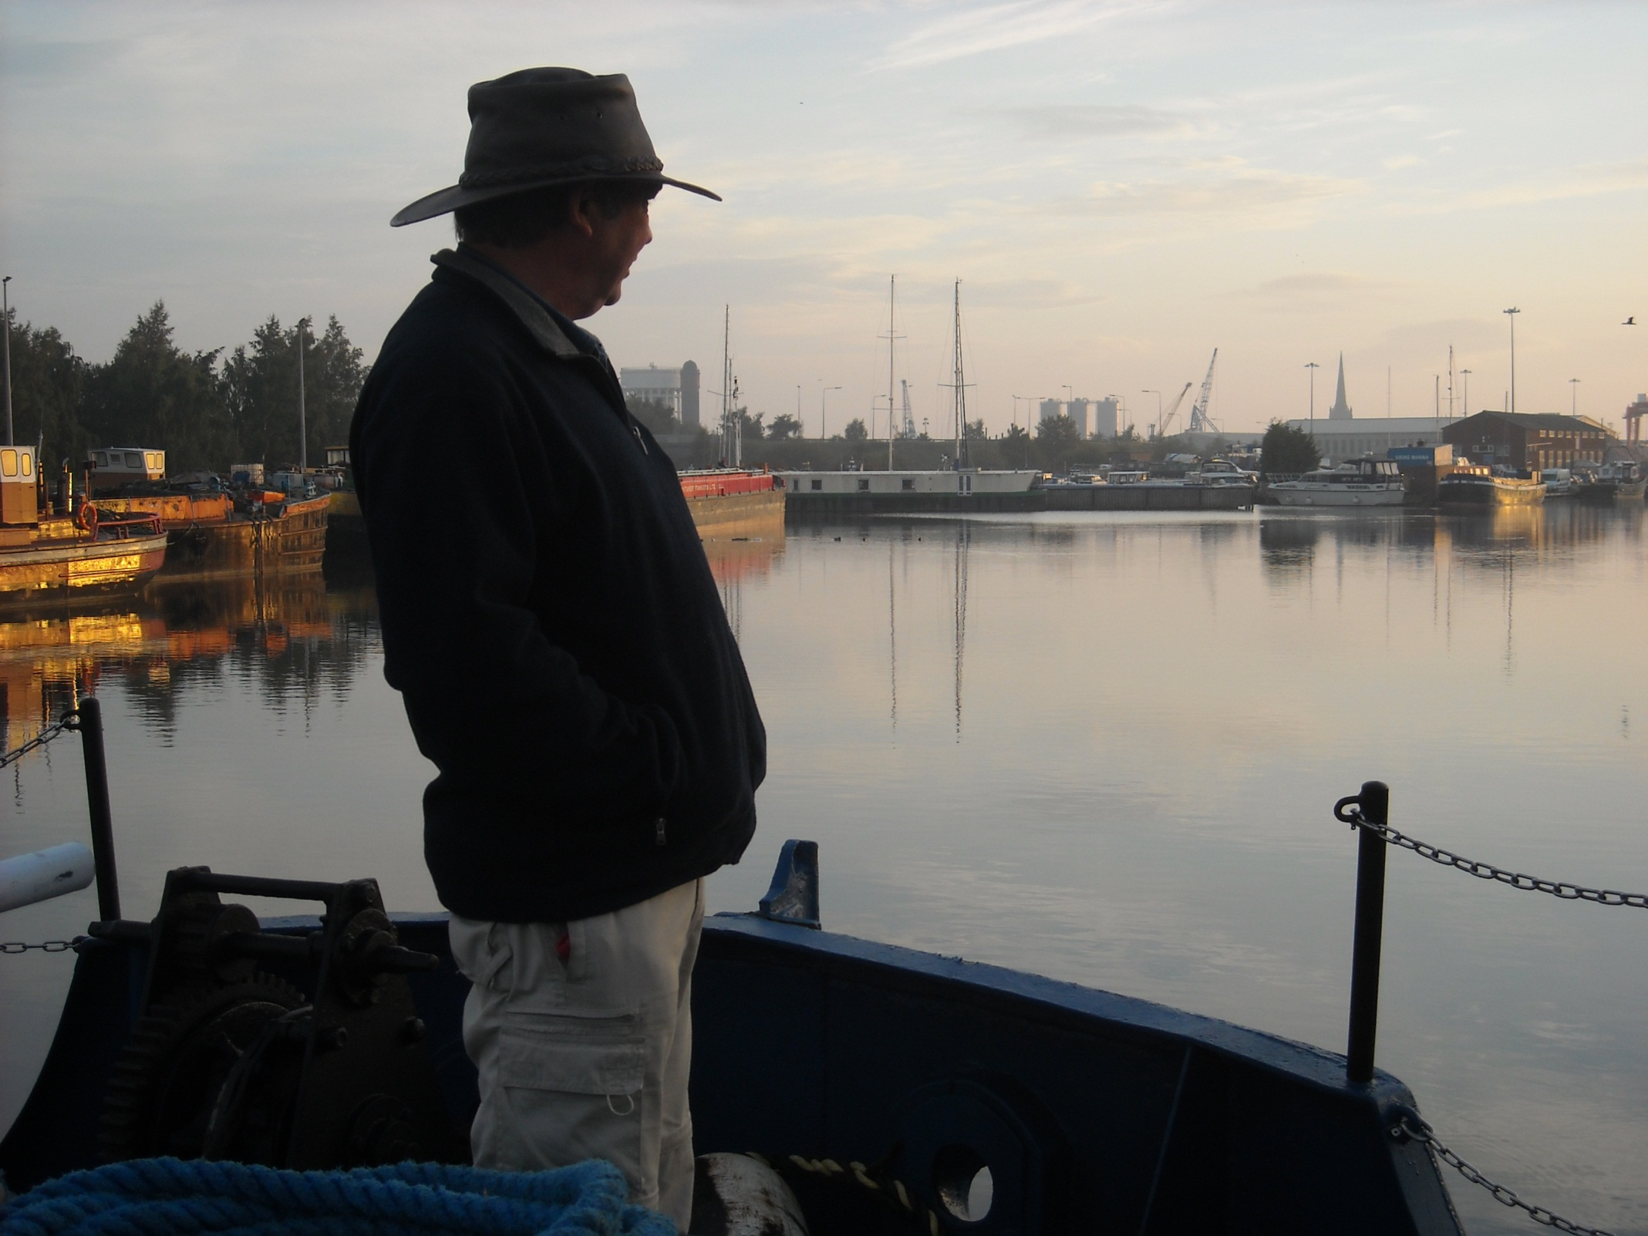
And pick it up again aboard Sobriety on 24th September 2011.

Slide 40

With Chris Sherburn at the wheel. Chris lives on Southcliffe, another Yorkshire Keel. Chris’s father skippered a Pudding Tug.

Slide 41



We pass the last
Tom Pudding hoist, now preserved.
Tom Puddings carried coal from
1864 to 1986.
The restored Pudding Tug Wheldale is shown below.

Slide 42



RMS Riga is visiting Goole today, also unloading steel, as we head for Ocean lock.

Slide 43

Our Ocean Lock departure a few minutes later, as we now join the wide Yorkshire Ouse.

Slide 44

Goole recedes into the distance.

Slide 45

Badger is assisting Chris today on this twisting tidal waterway.

Slide 46

There is little settlement on the banks. This village is Swinefleet.

Slide 47

7 miles downstream is Blacktoft Jetty where coasters moor awaiting the tide.

Slide 48

This is important Trent Falls, the confluence of the Rivers
Ouse and Trent and the start of the River Humber.

Slide 49

The Apex light marks the end of the training wall at Trent mouth.

Slide 50



And a stern view just in case we are forgetting we are aboard another 100 year old boat!
The rudder is chain linked to the ship’s wheel.

Slide 51

Marker buoys appear as we pass Whitton as shifting sandbanks and strong currents demand constant attention.

Slide 52



Many channel markers resemble mini lightships and we follow a line of these across to Brough on the northern shore.

Slide 53

If you bump into one it apparently costs £13,000 to have it repositioned……………Bridge ahoy!

Slide 54

As the helmsman follows the markers past Read’s Island.

Slide 55

Then lines up for the Humber Bridge!

Slide 56



And views from beneath.

Slide 57

The Humber Bridge opened in 1981 was, for the first
16 years of its life, the longest suspension bridge in the world.

Slide 58

We are now approaching Hull and its six miles of riverside quays.

Slide 59

The once busy fish dock now hosts the Pilot Boarding Station.

Slide 60

Then comes “old” waterside Hull and Holy Trinity Church.

Slide 61

Followed by “new” waterside Hull and Holy Trinity Church.
The modern building is an aquarium!

Slide 62



Left hand down a bit towards more old wharves on which Dead Bod is a local celebrity!

Slide 63

Large tonnages are handled by the main docks, quite a lot of it here at modernised King George V dock, as a coaster emerges.

Slide 64

We have now reached the Rotterdam ferry, the next boat in our journey, as we bid Sobriety and crew a grateful farewell.

Slide 65



We board the Rotterdam ferry, Pride of Hull, the following Spring. This overnight ferry is over 700 foot long and has 530 cabins.

Slide 66



The Captain is on the bridge of as we visit before departure.
There are still 25 miles of River Humber to travel to Spurn Head and the North Sea.

Slide 67

And these photos are selected from both the outward and return journeys as our ferry loads at Hull.

Slide 68

Ahead of us a small container ship steers into the entrance lock of King George V Dock.

Slide 69



At 20.35 we begin our Humber passage and soon reach the busy port of Immingham.
Pictured by night…………

Slide 70

……………And pictured by day.

Slide 71

Humberside Grimsby next, also by day.

Slide 72


And two half light photos of the real focus of this trip, Spurn Head and the Humber gateway to the North Sea.
From here our journey is a contrasting sea passage up the east coast.

Slide 73
End of Chapter 7

