Slide 1
Exploring Britain
Boating North
Part 5
Kidsgrove to Ashton-under-Lyne
8th August to 27th September 2010

Slide 2
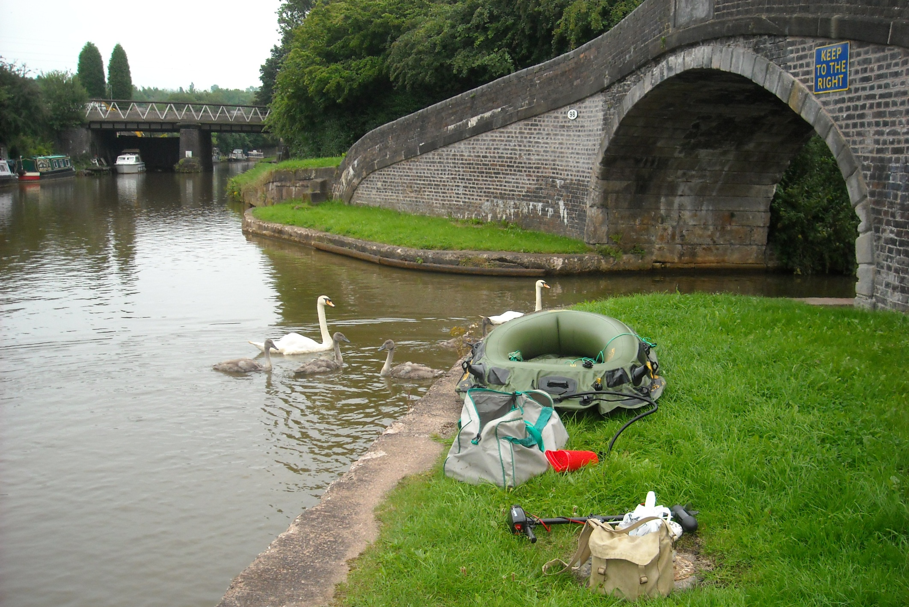
Sunday 8th August 2010 and Kidsgrove once more as we begin our passage of the Macclesfield Canal.

Slide 3
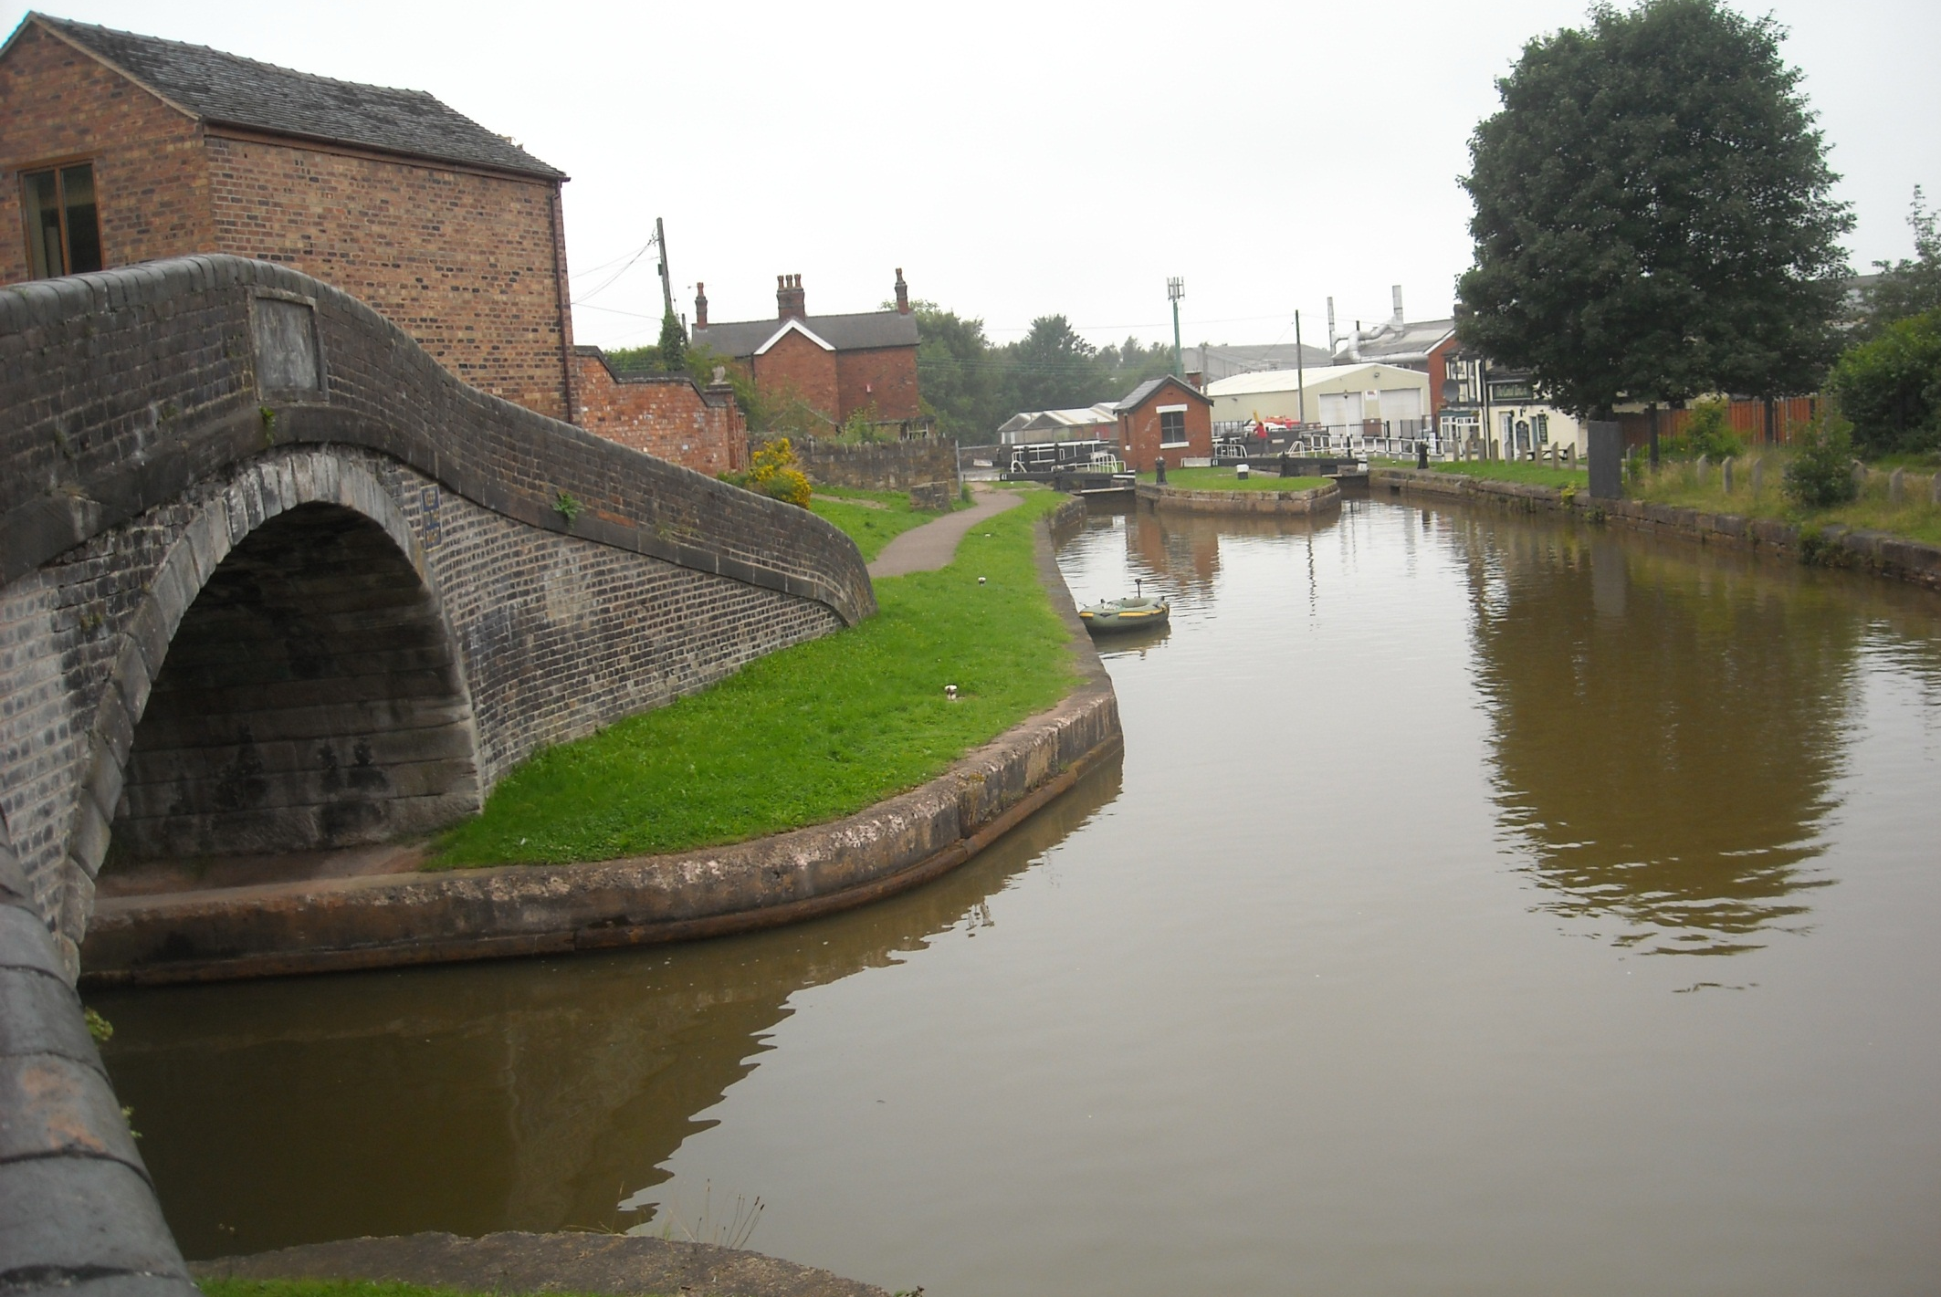
Harding’s Wood Junction, as modern as it got in its day. The Macclesfield Canal should go right here but actually turns left.

Slide 4
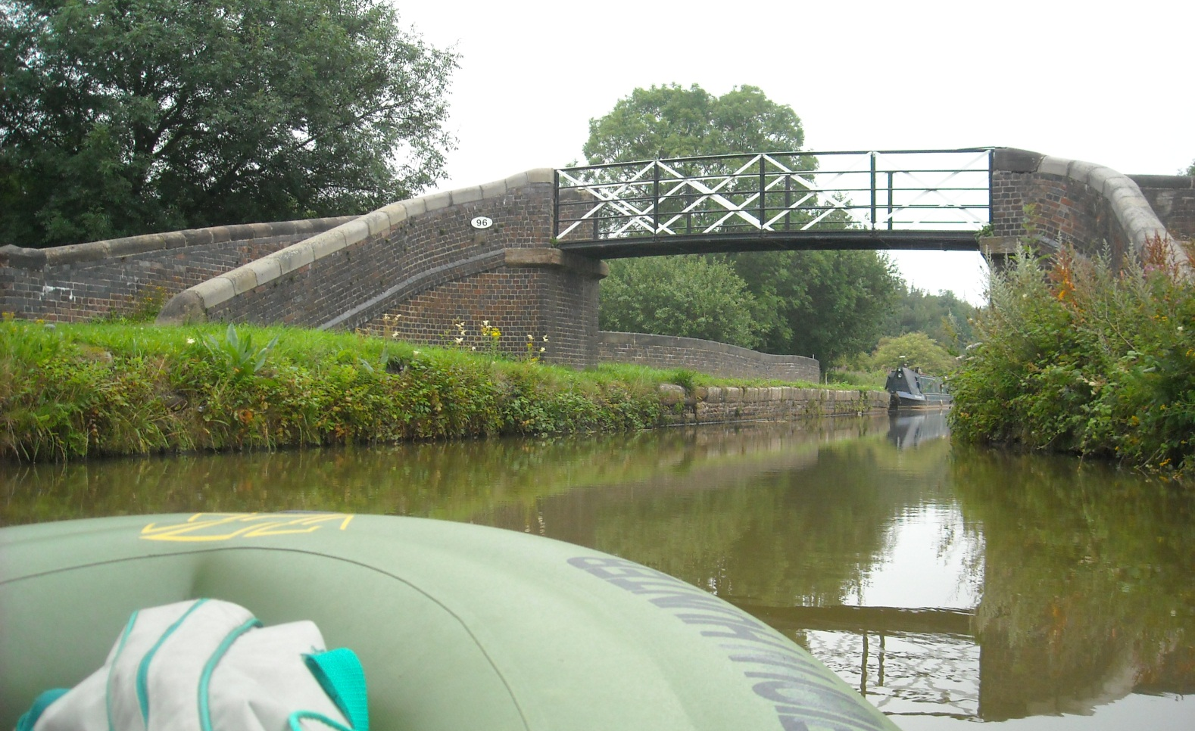
Matters are corrected at nearby Red Bull where an aqueduct returns us, flyover style, back over the Trent and Mersey.

Slide 5
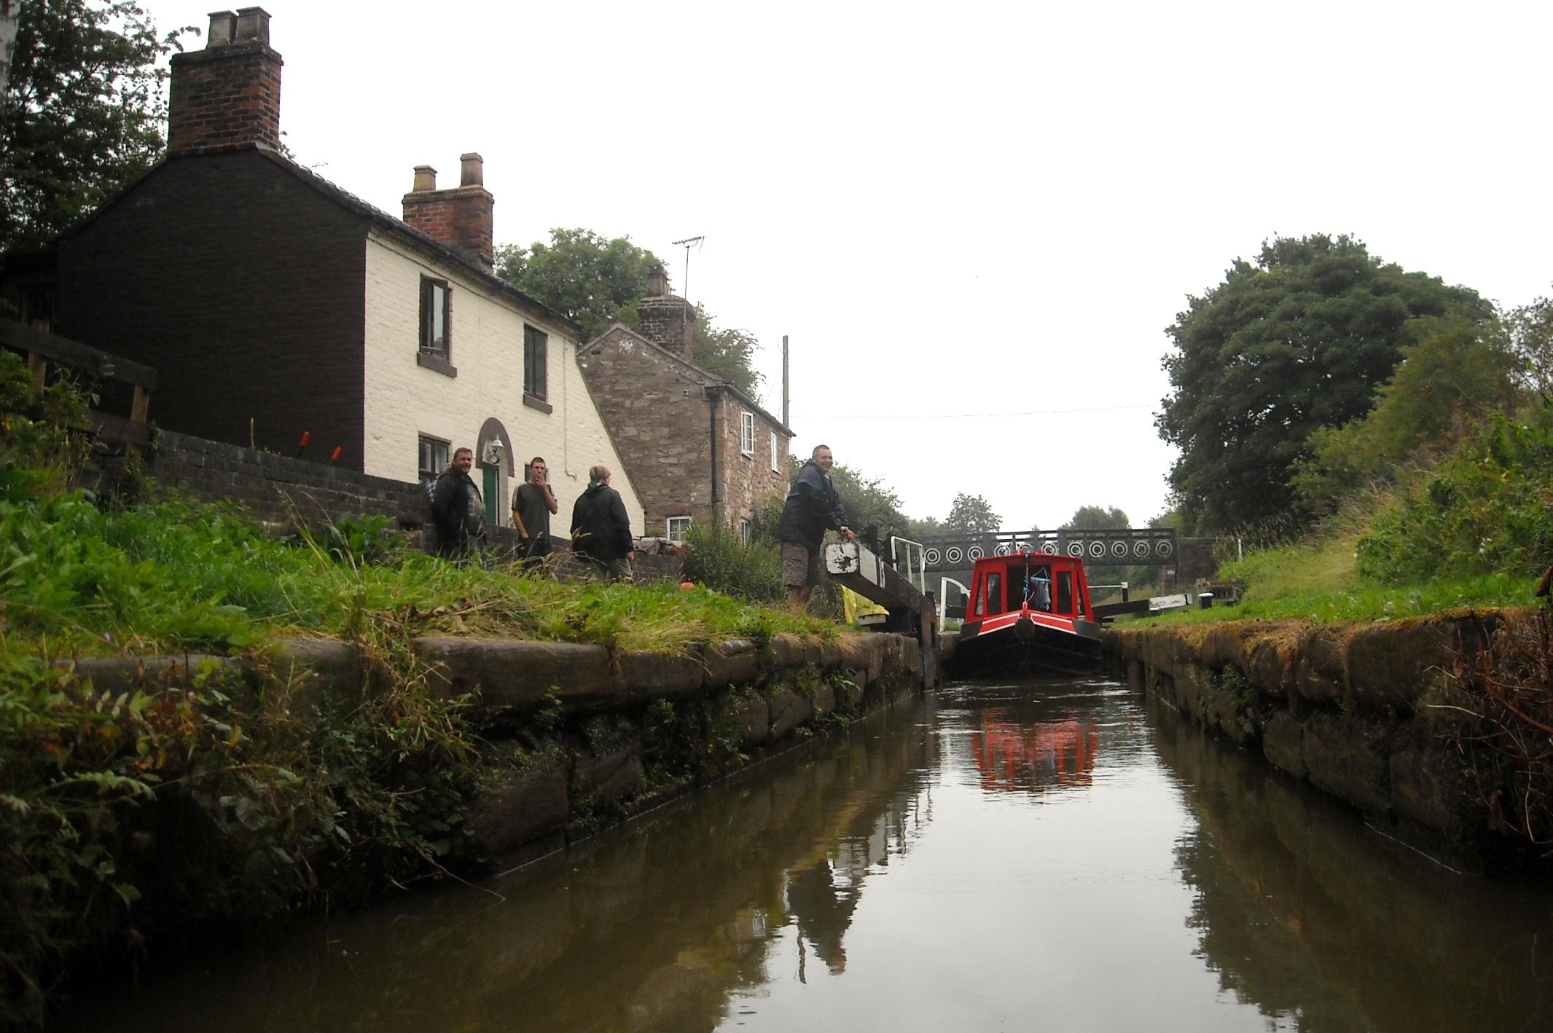
An exciting moment at Hall Green stop lock, the original start of the Macclesfield Canal, now a 6 inch fall to the Trent and Mersey.

Slide 6
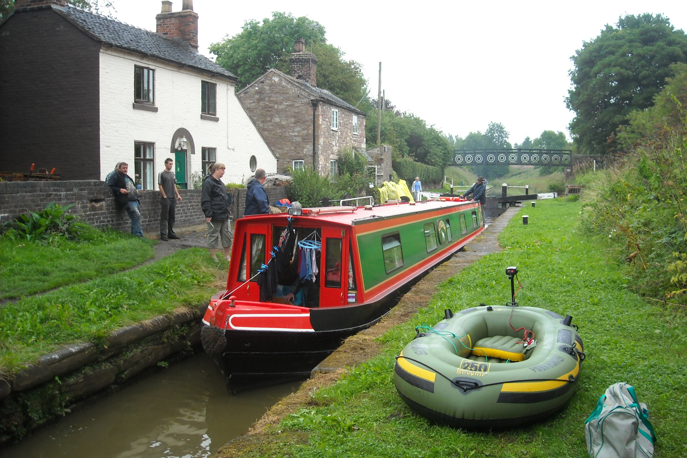
This lower water level provides important additional headroom in still subsiding Harecastle Tunnel.

Slide 7
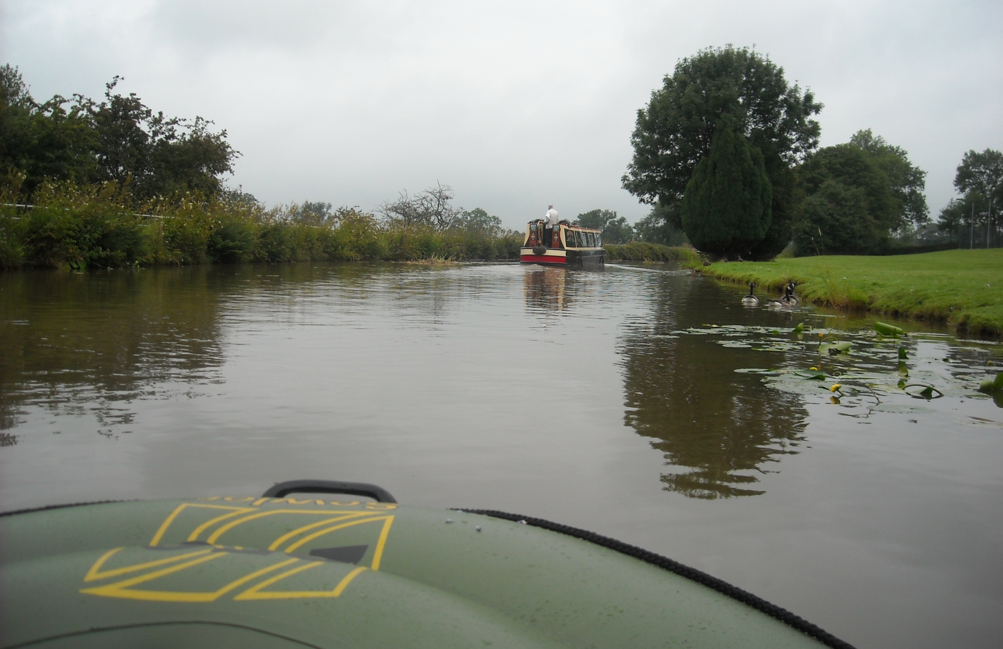
Drizzle today along this rural pound. With full battery power I can just about keep up with narrowboats in the shallow water.

Slide 8
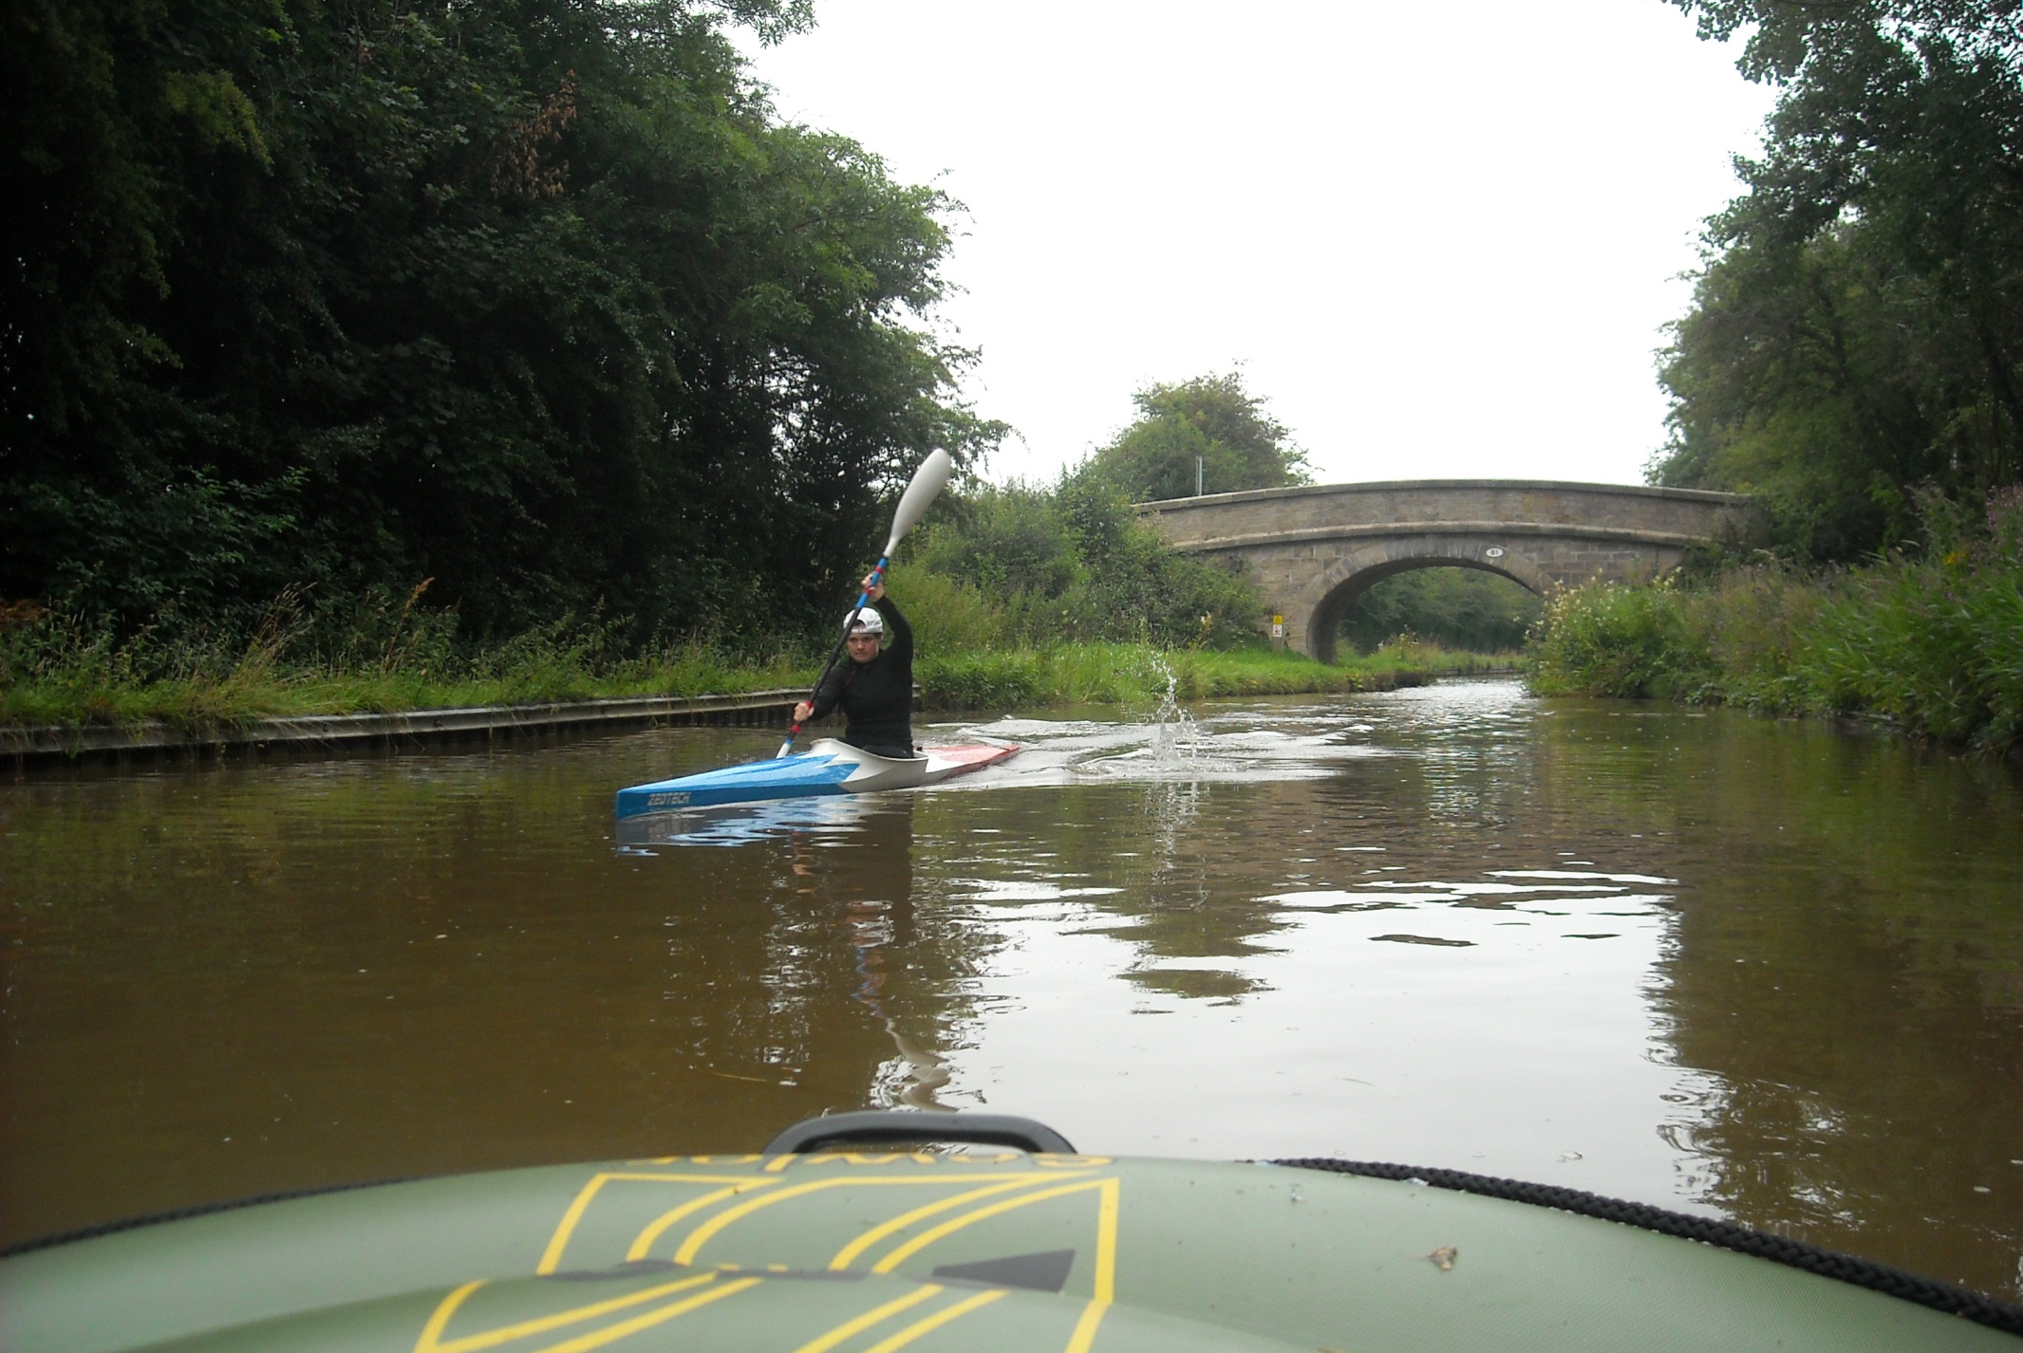
But I can never keep up with canoeists!

Slide 9
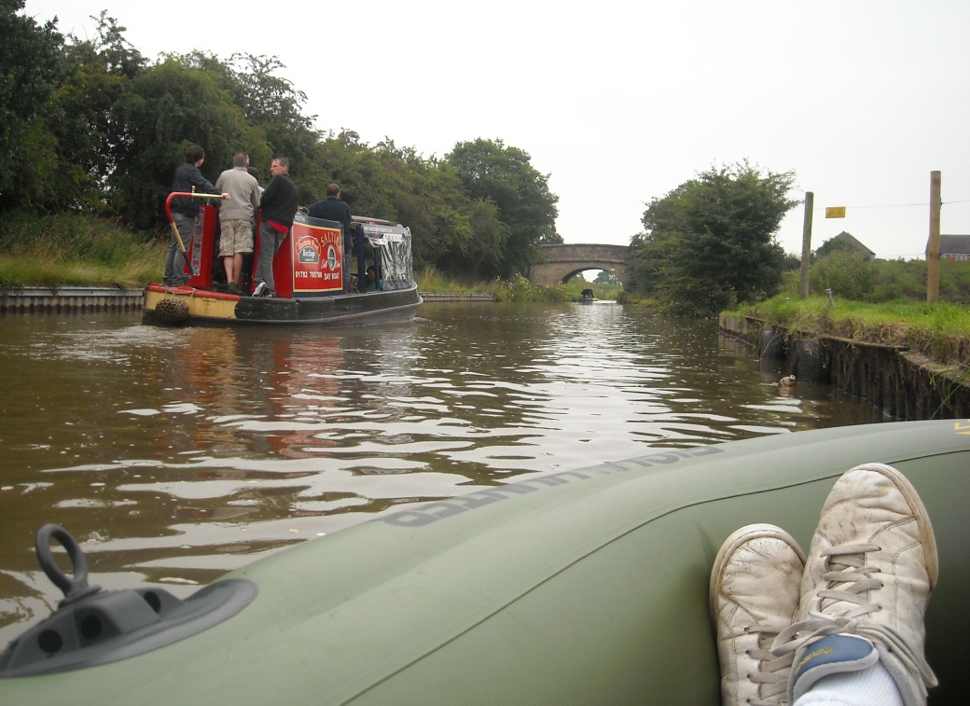
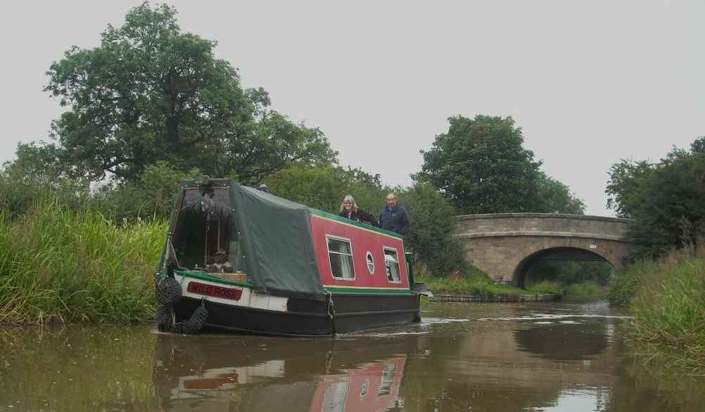
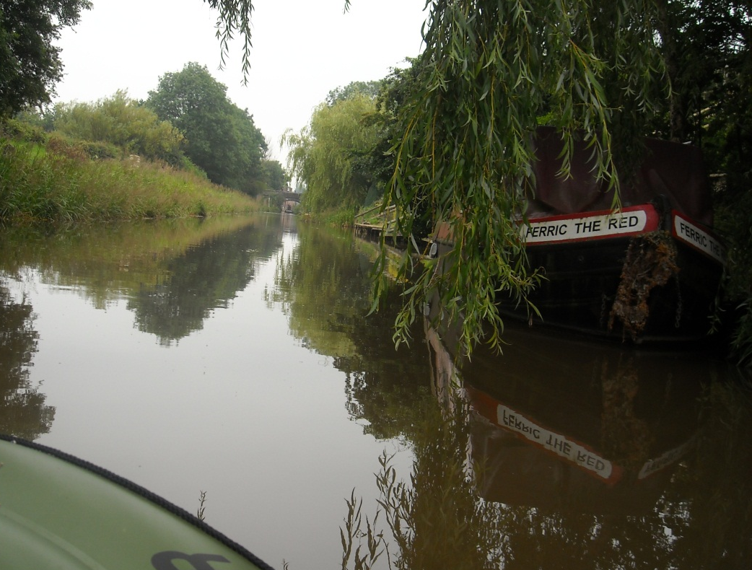
Some character short boats are about today…………
Saltie, a day hire, out with a 50th birthday party.
Then well travelled Wild Rose from Manchester
And, fittingly for canals hereabouts, Ferric the Red!

Slide 10
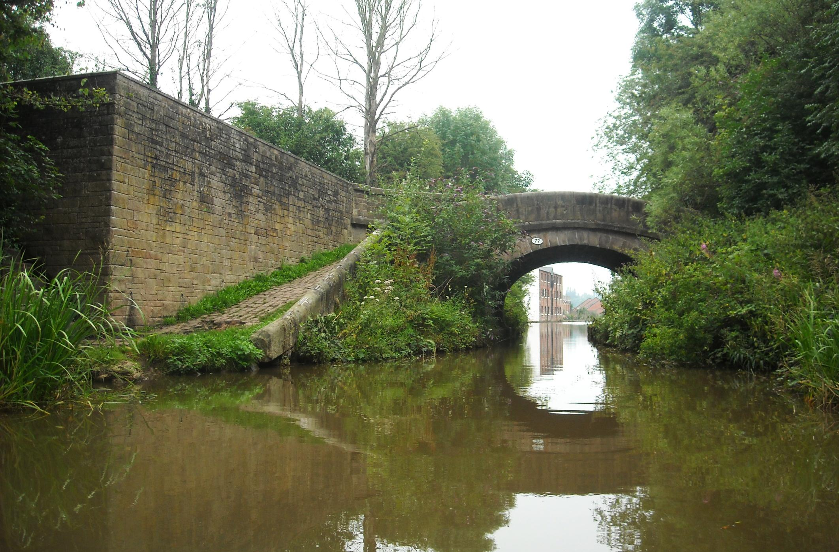
Congleton ahead beneath this overgrown roving bridge, a classic design that lets towing horses cross without unhitching the line.

Slide 11
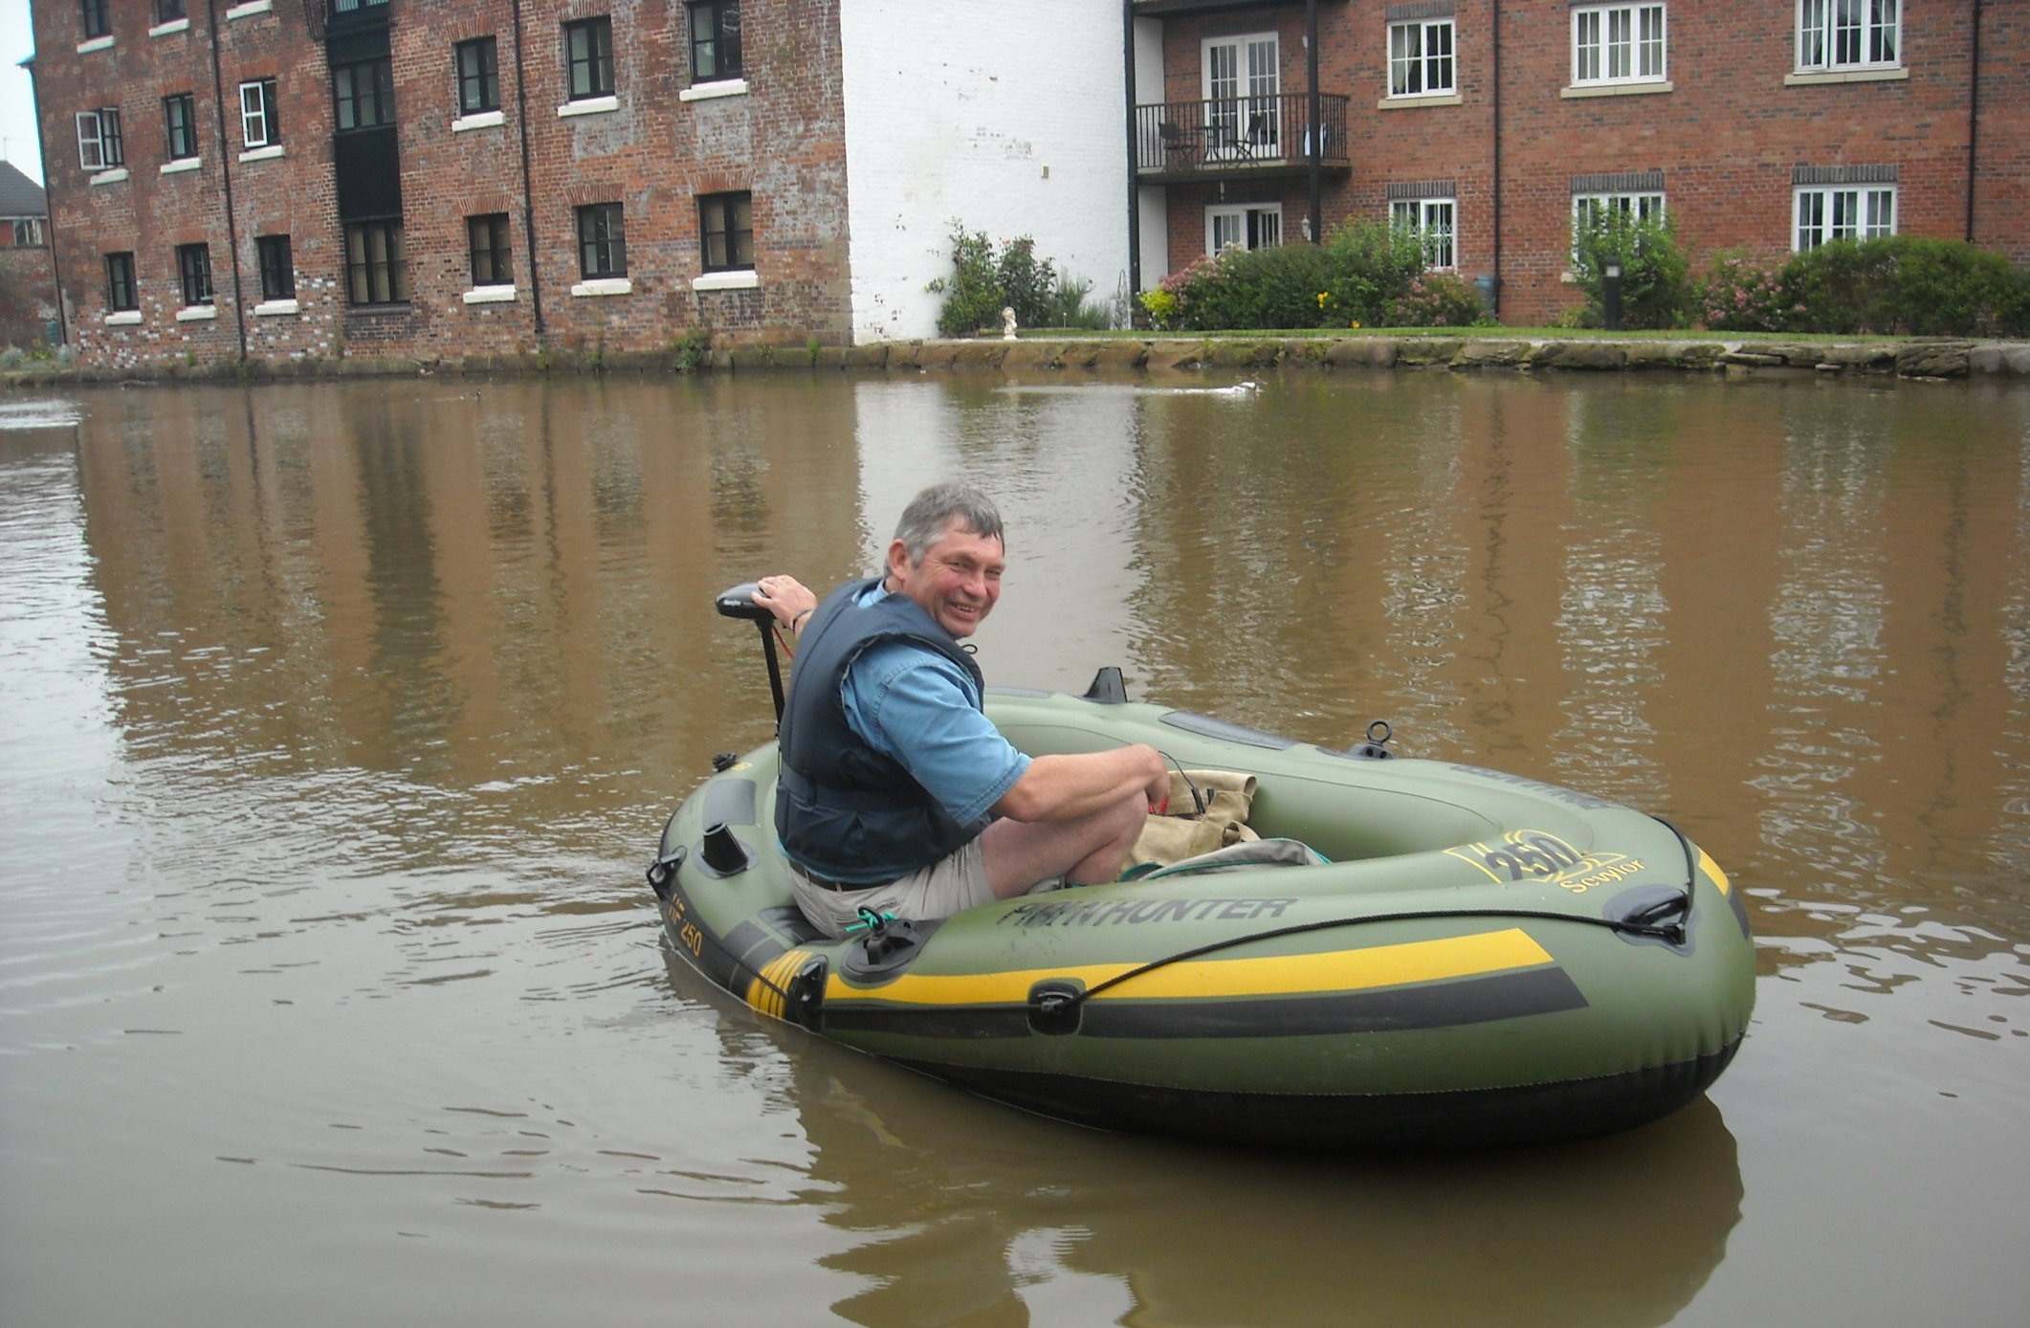
And wide Congleton wharf. The fully BW licenced Plain Hunter has been pleasingly well received by fellow waterway users.

Slide 12
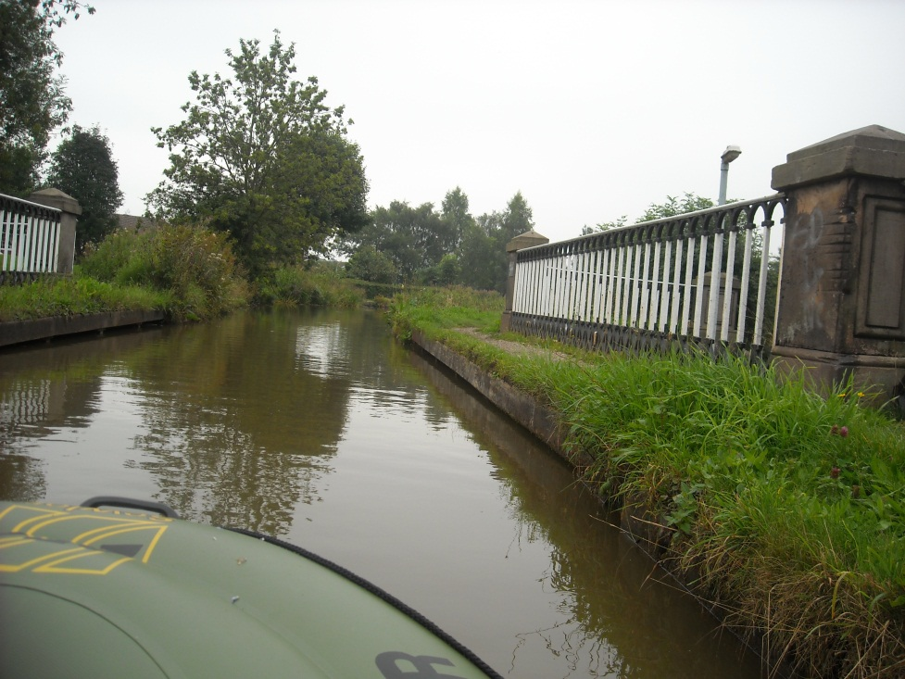
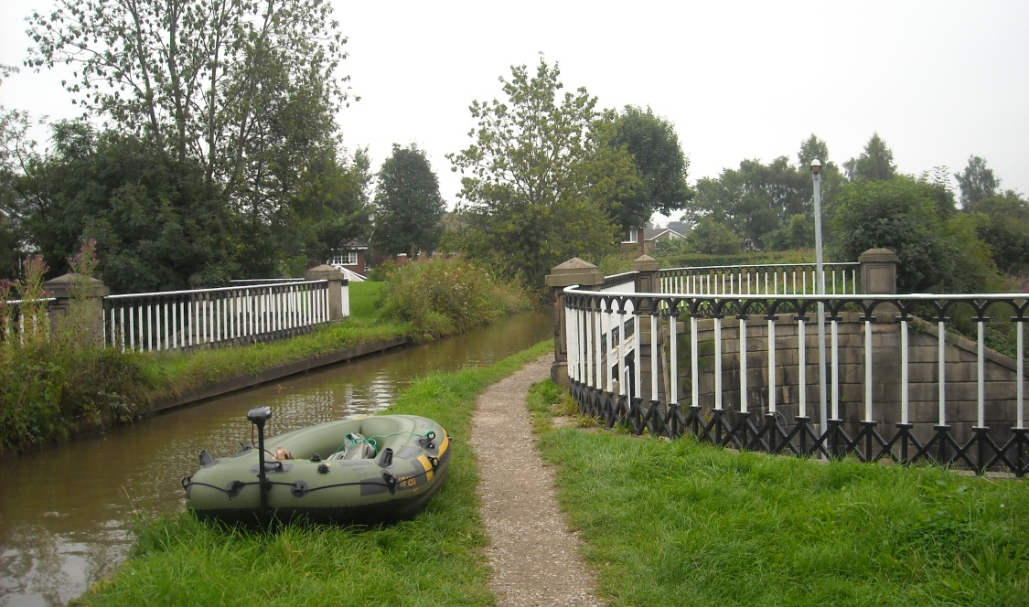
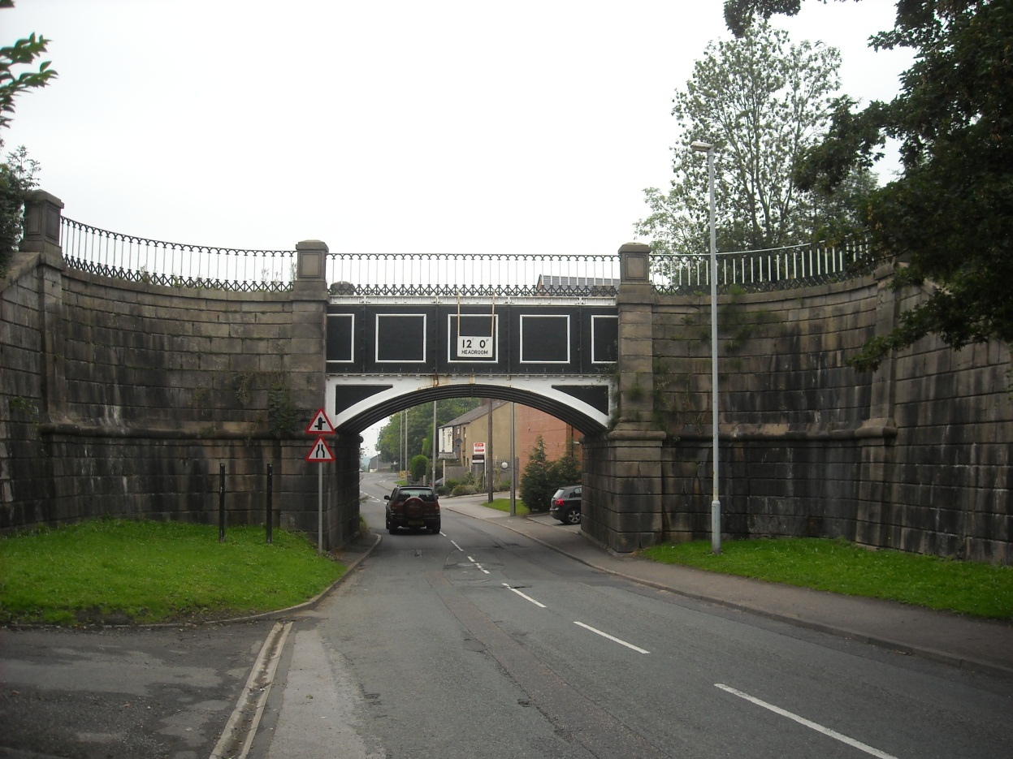
And three views of impressive Dog Lane Aqueduct.
Opened in 1851, the Macclesfield Canal is of Telford design.

Slide 13
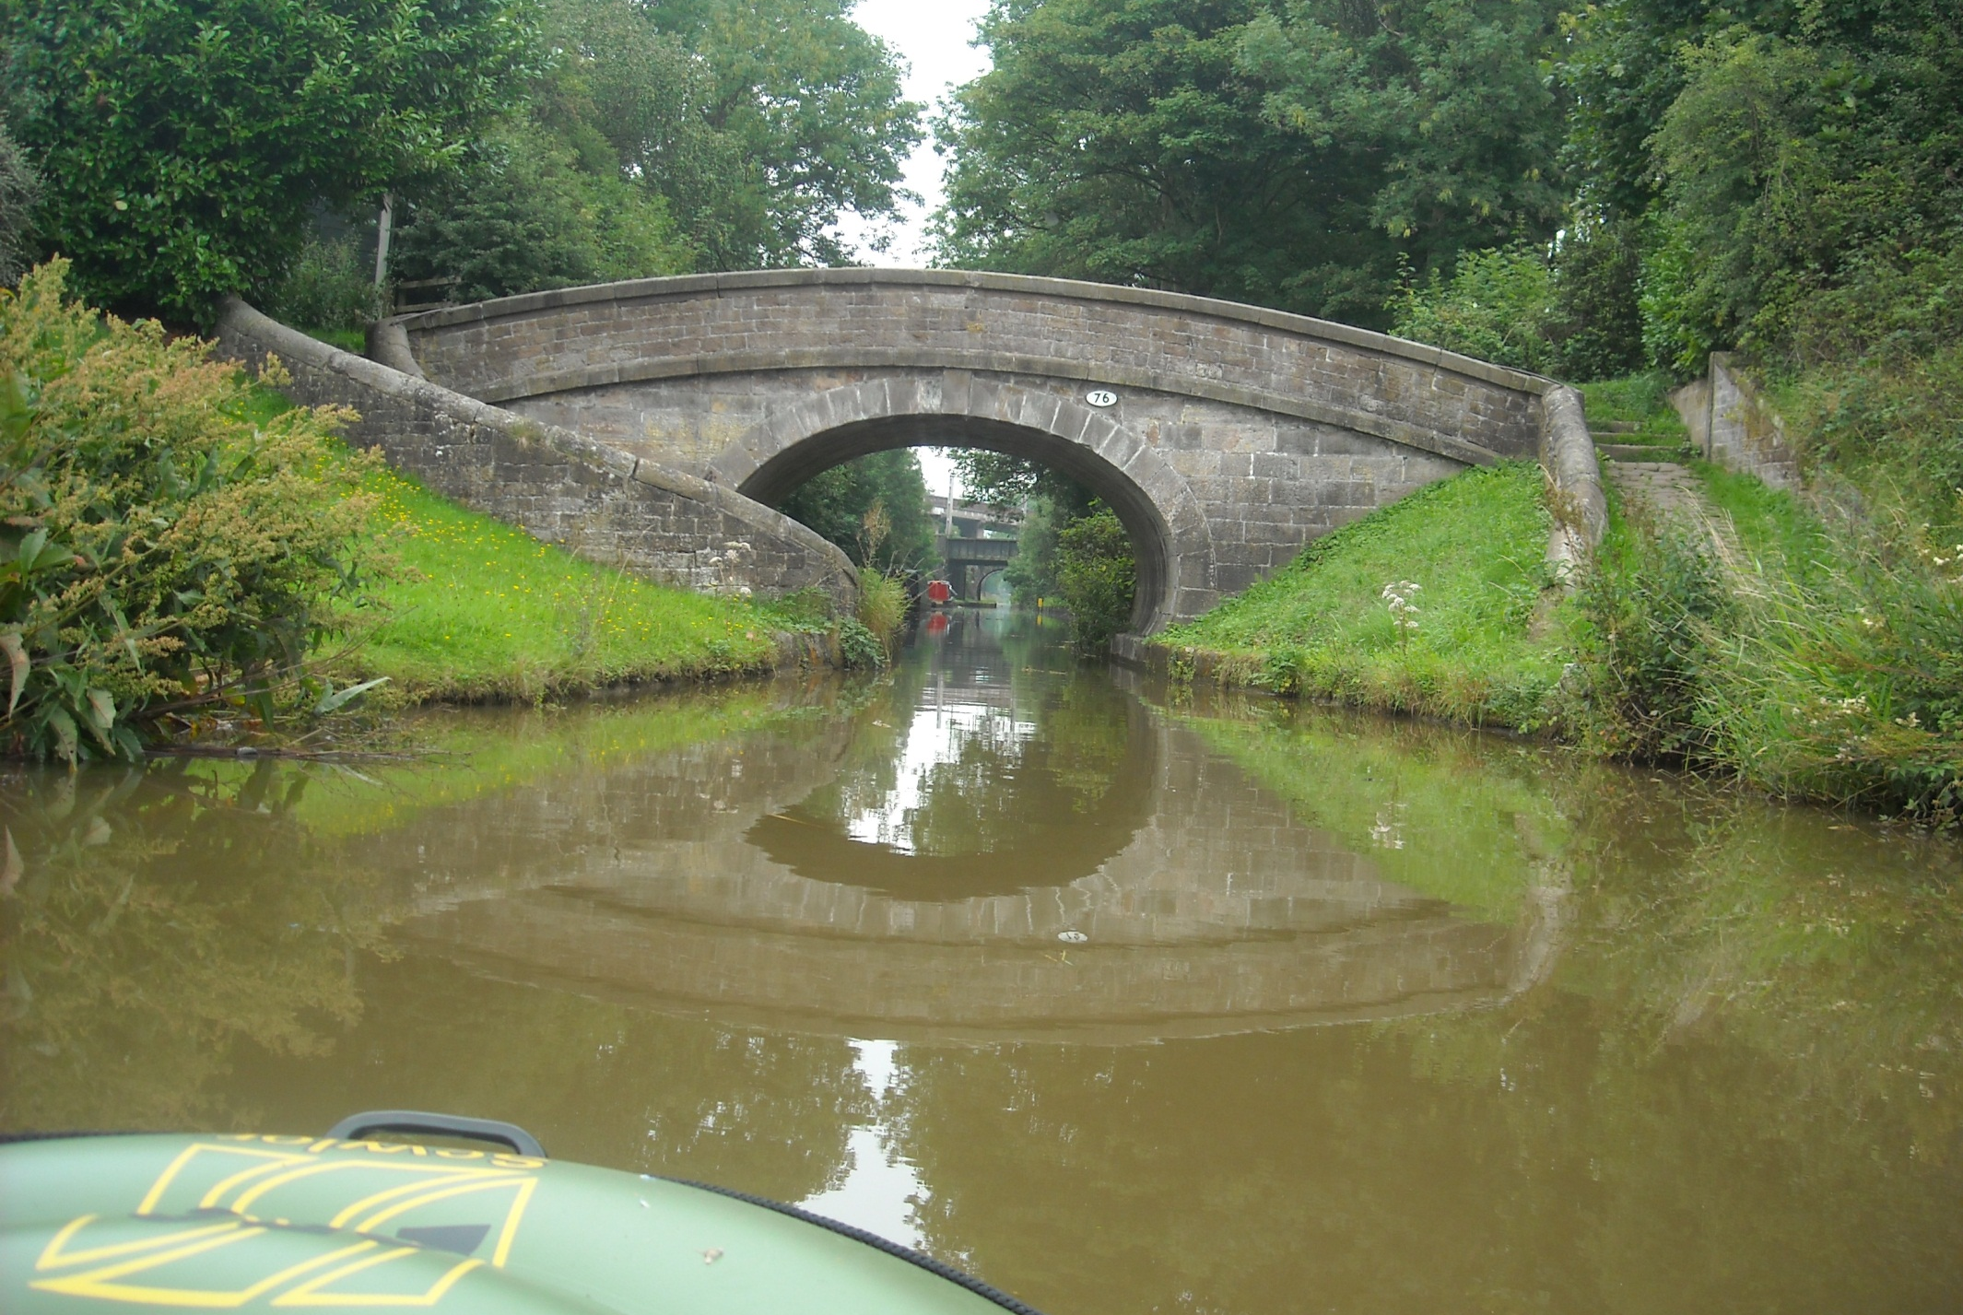
Just past this fine roving bridge is Congleton Station where the Plain Hunter packs away and I return to Kidsgrove by train.

Slide 14
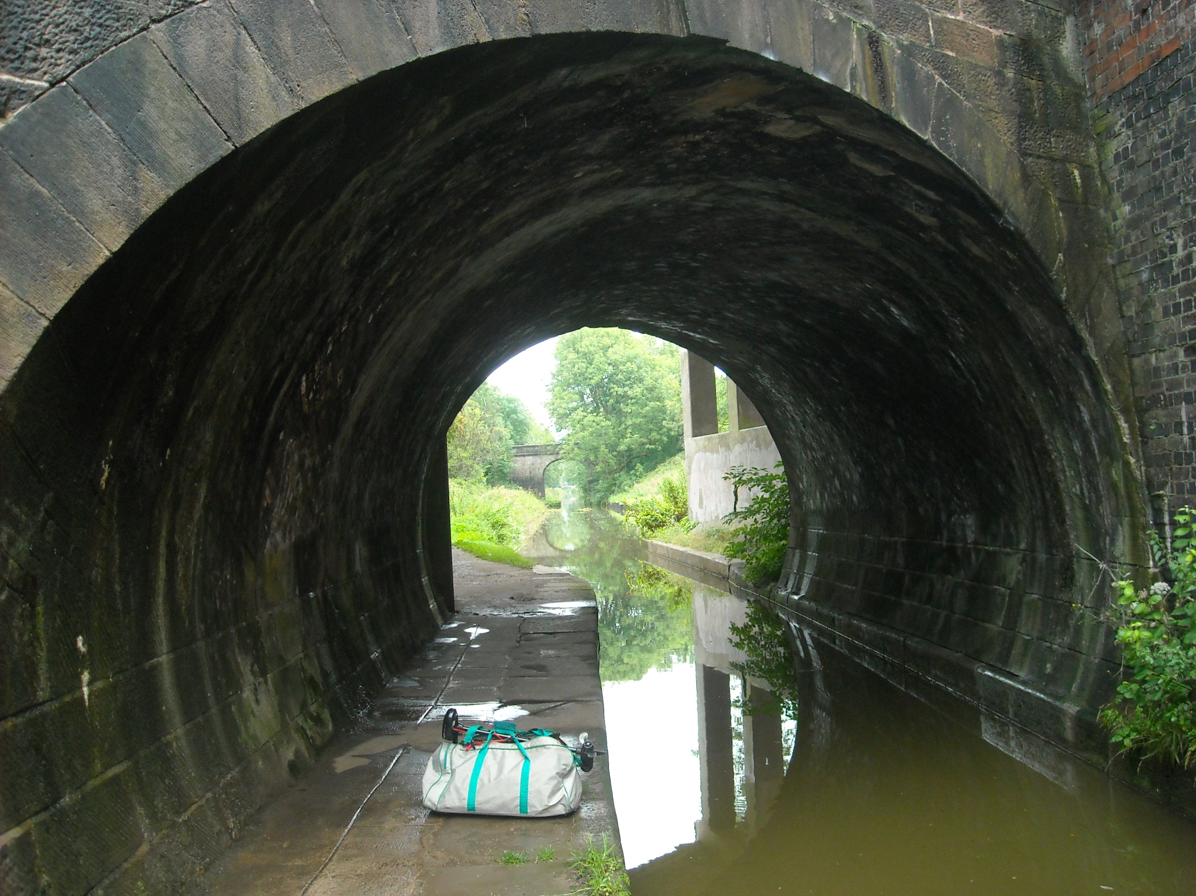
I never imagined when starting this journey that my boat would fit in my kit bag! Congleton Station again, where a lift would help.

Slide 15
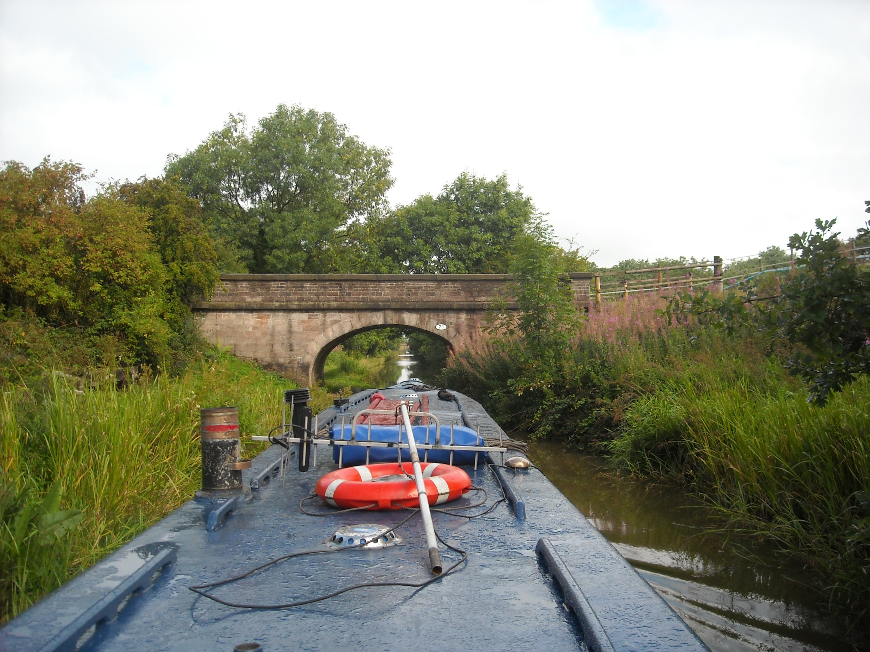
And was kindly offered by Our Choice.

Slide 16
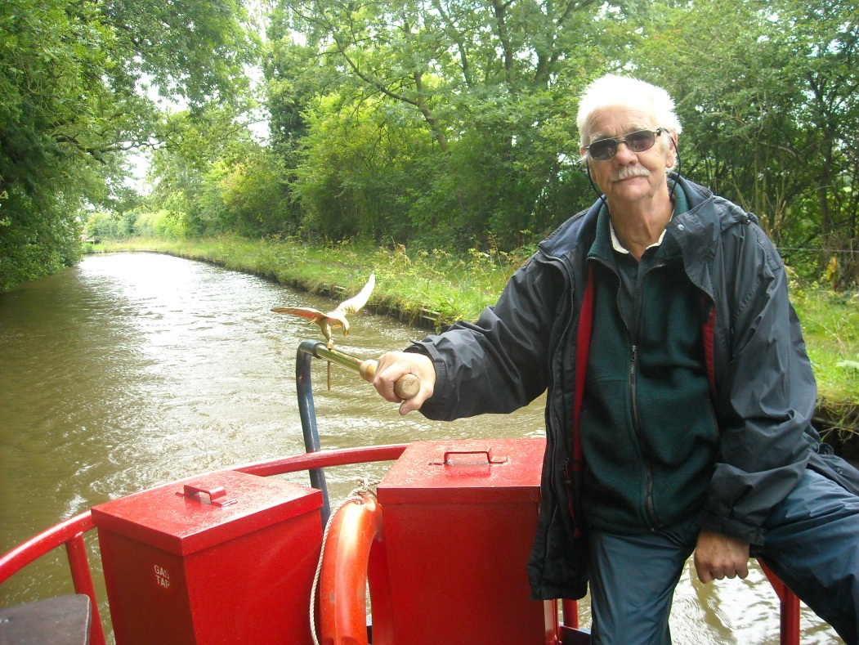
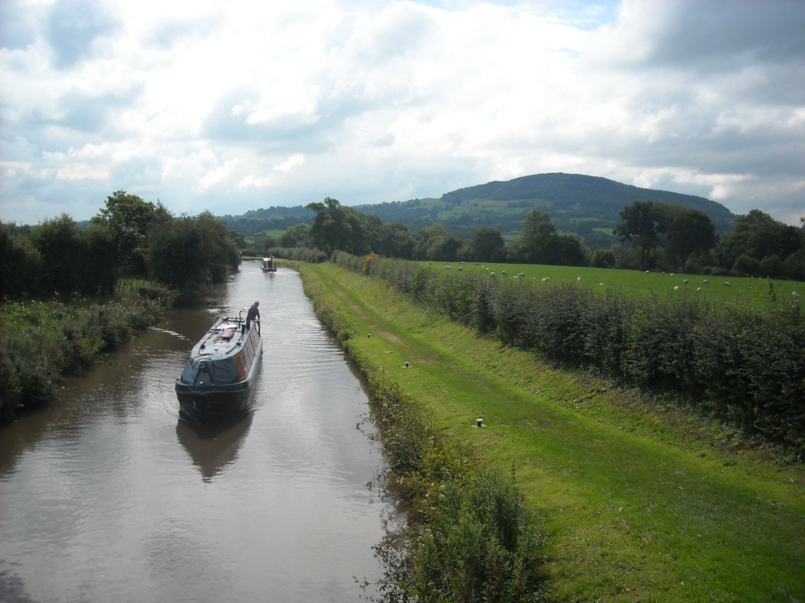
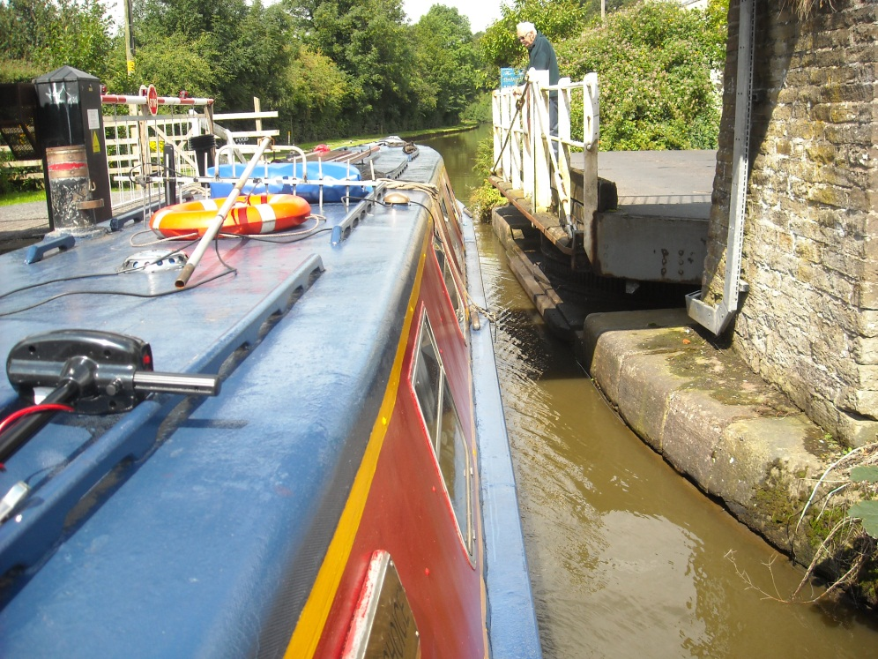
Greg and Elaine, from Stoke-on-Trent, were proud of their boat, once a part of the
Dart Line hire fleet.
It had character!

Slide 17
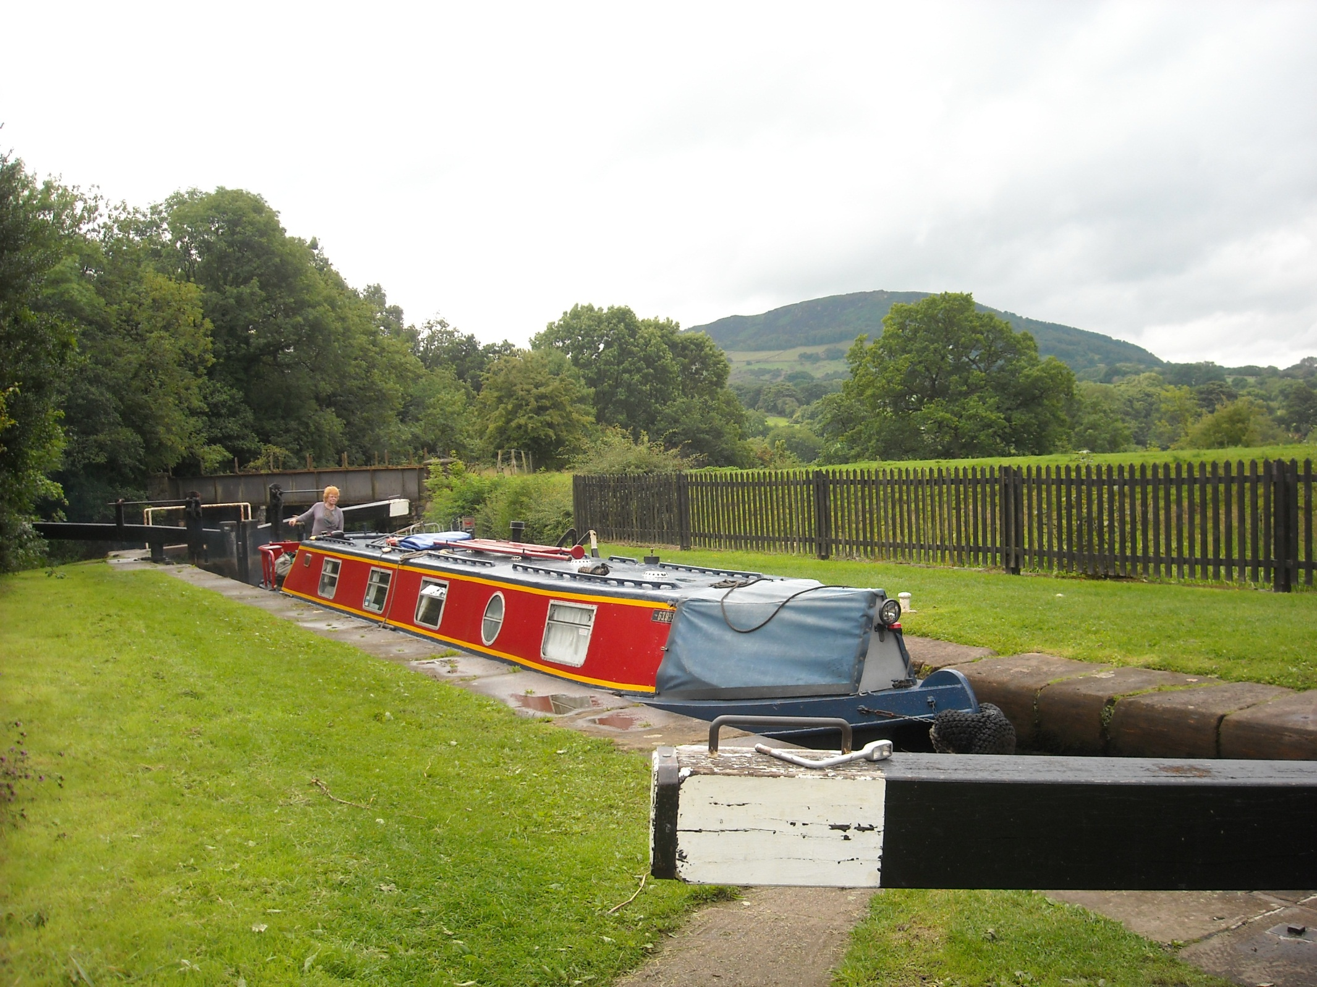
They also gained an extra pair of hands through Bosley Locks.

Slide 18
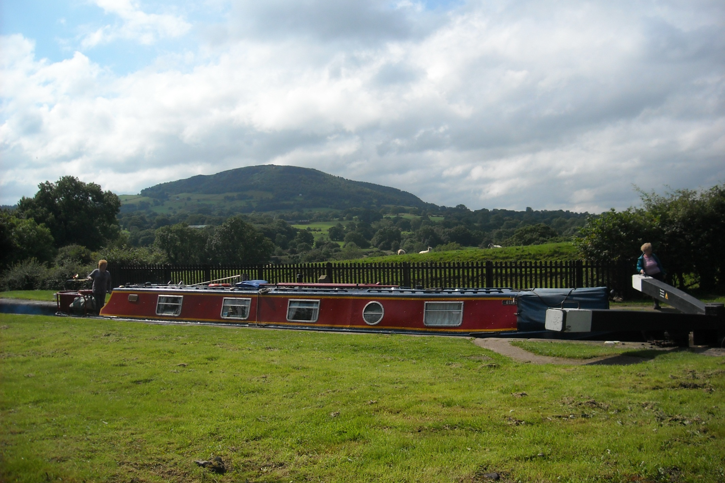
This attractive lock flight is unusual in having mitred gates both ends of the locks.

Slide 19
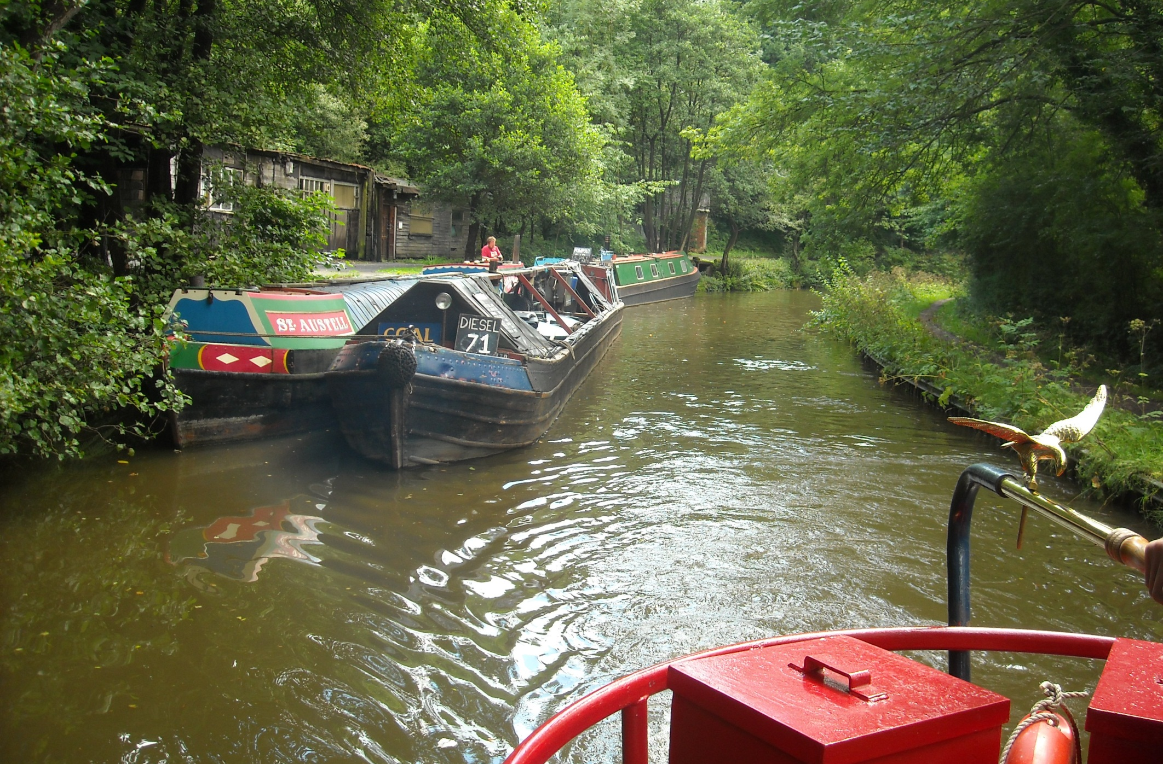
Working pair Alton and St Austell are trading fuel, a good effort on this shallow canal. “We draw 3 foot” was there reply.

Slide 20
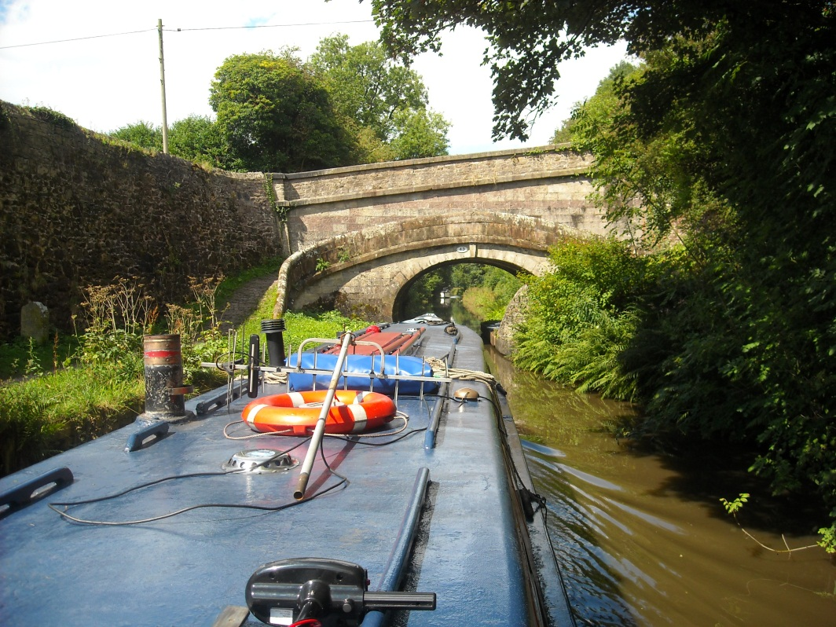
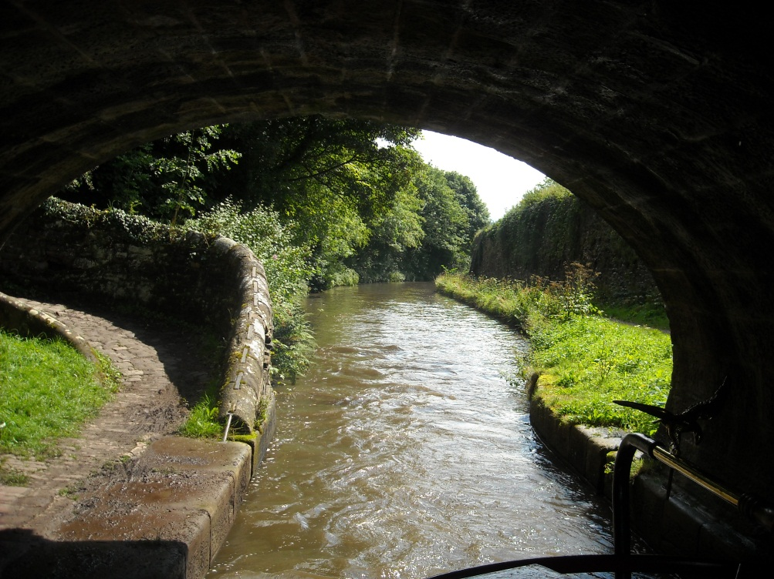
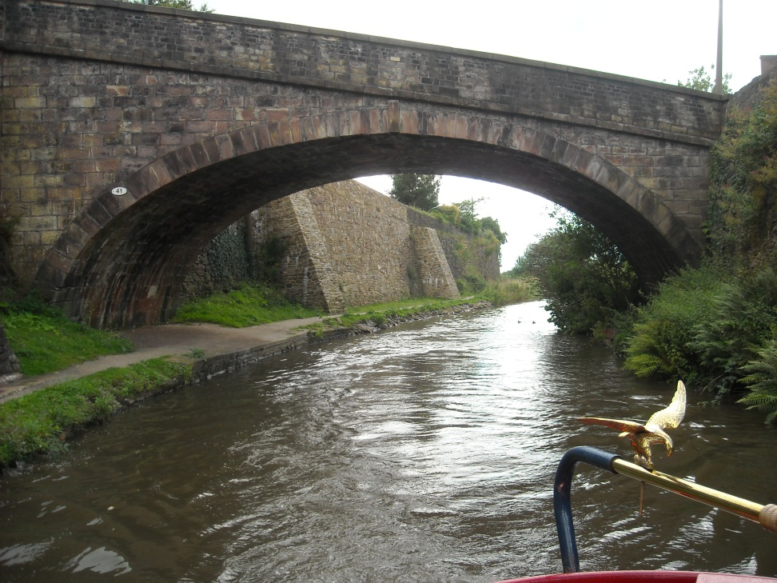
Another roving bridge as the towpath swaps sides again and an uncharacteristically wide bridge brings us into Macclesfield.

Slide 21
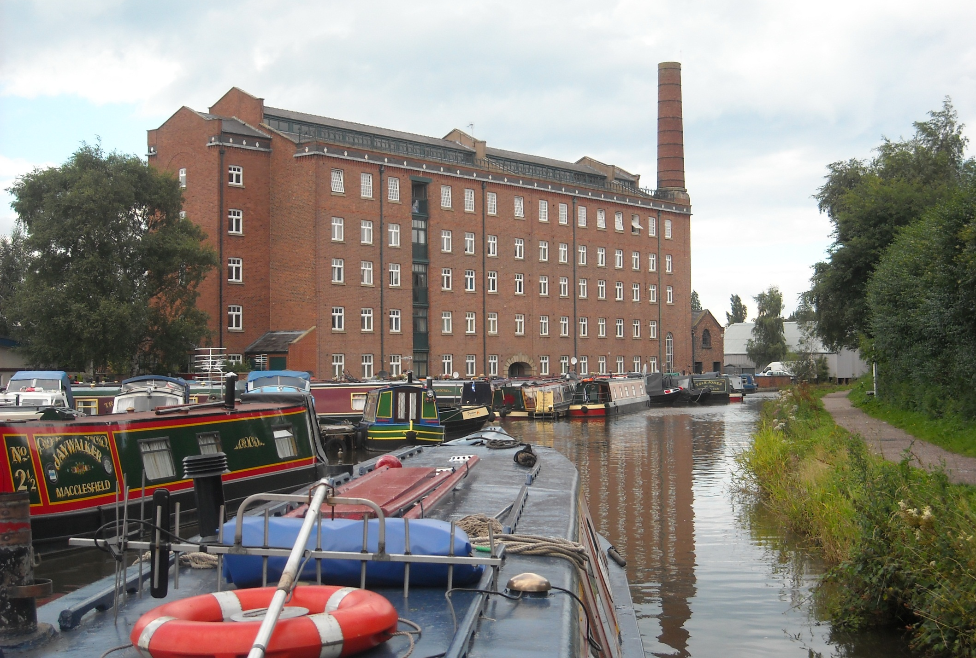
The original Hovis flour mill, opened 1898.

Slide 22
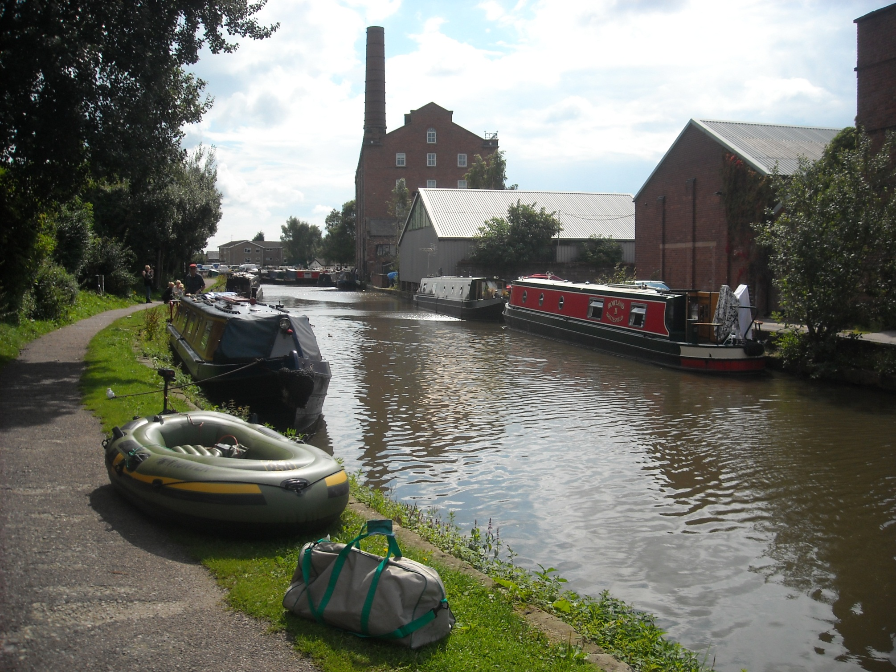
And here Our Choice was mooring and so, out of the bag, comes the Plain Hunter.

Slide 23
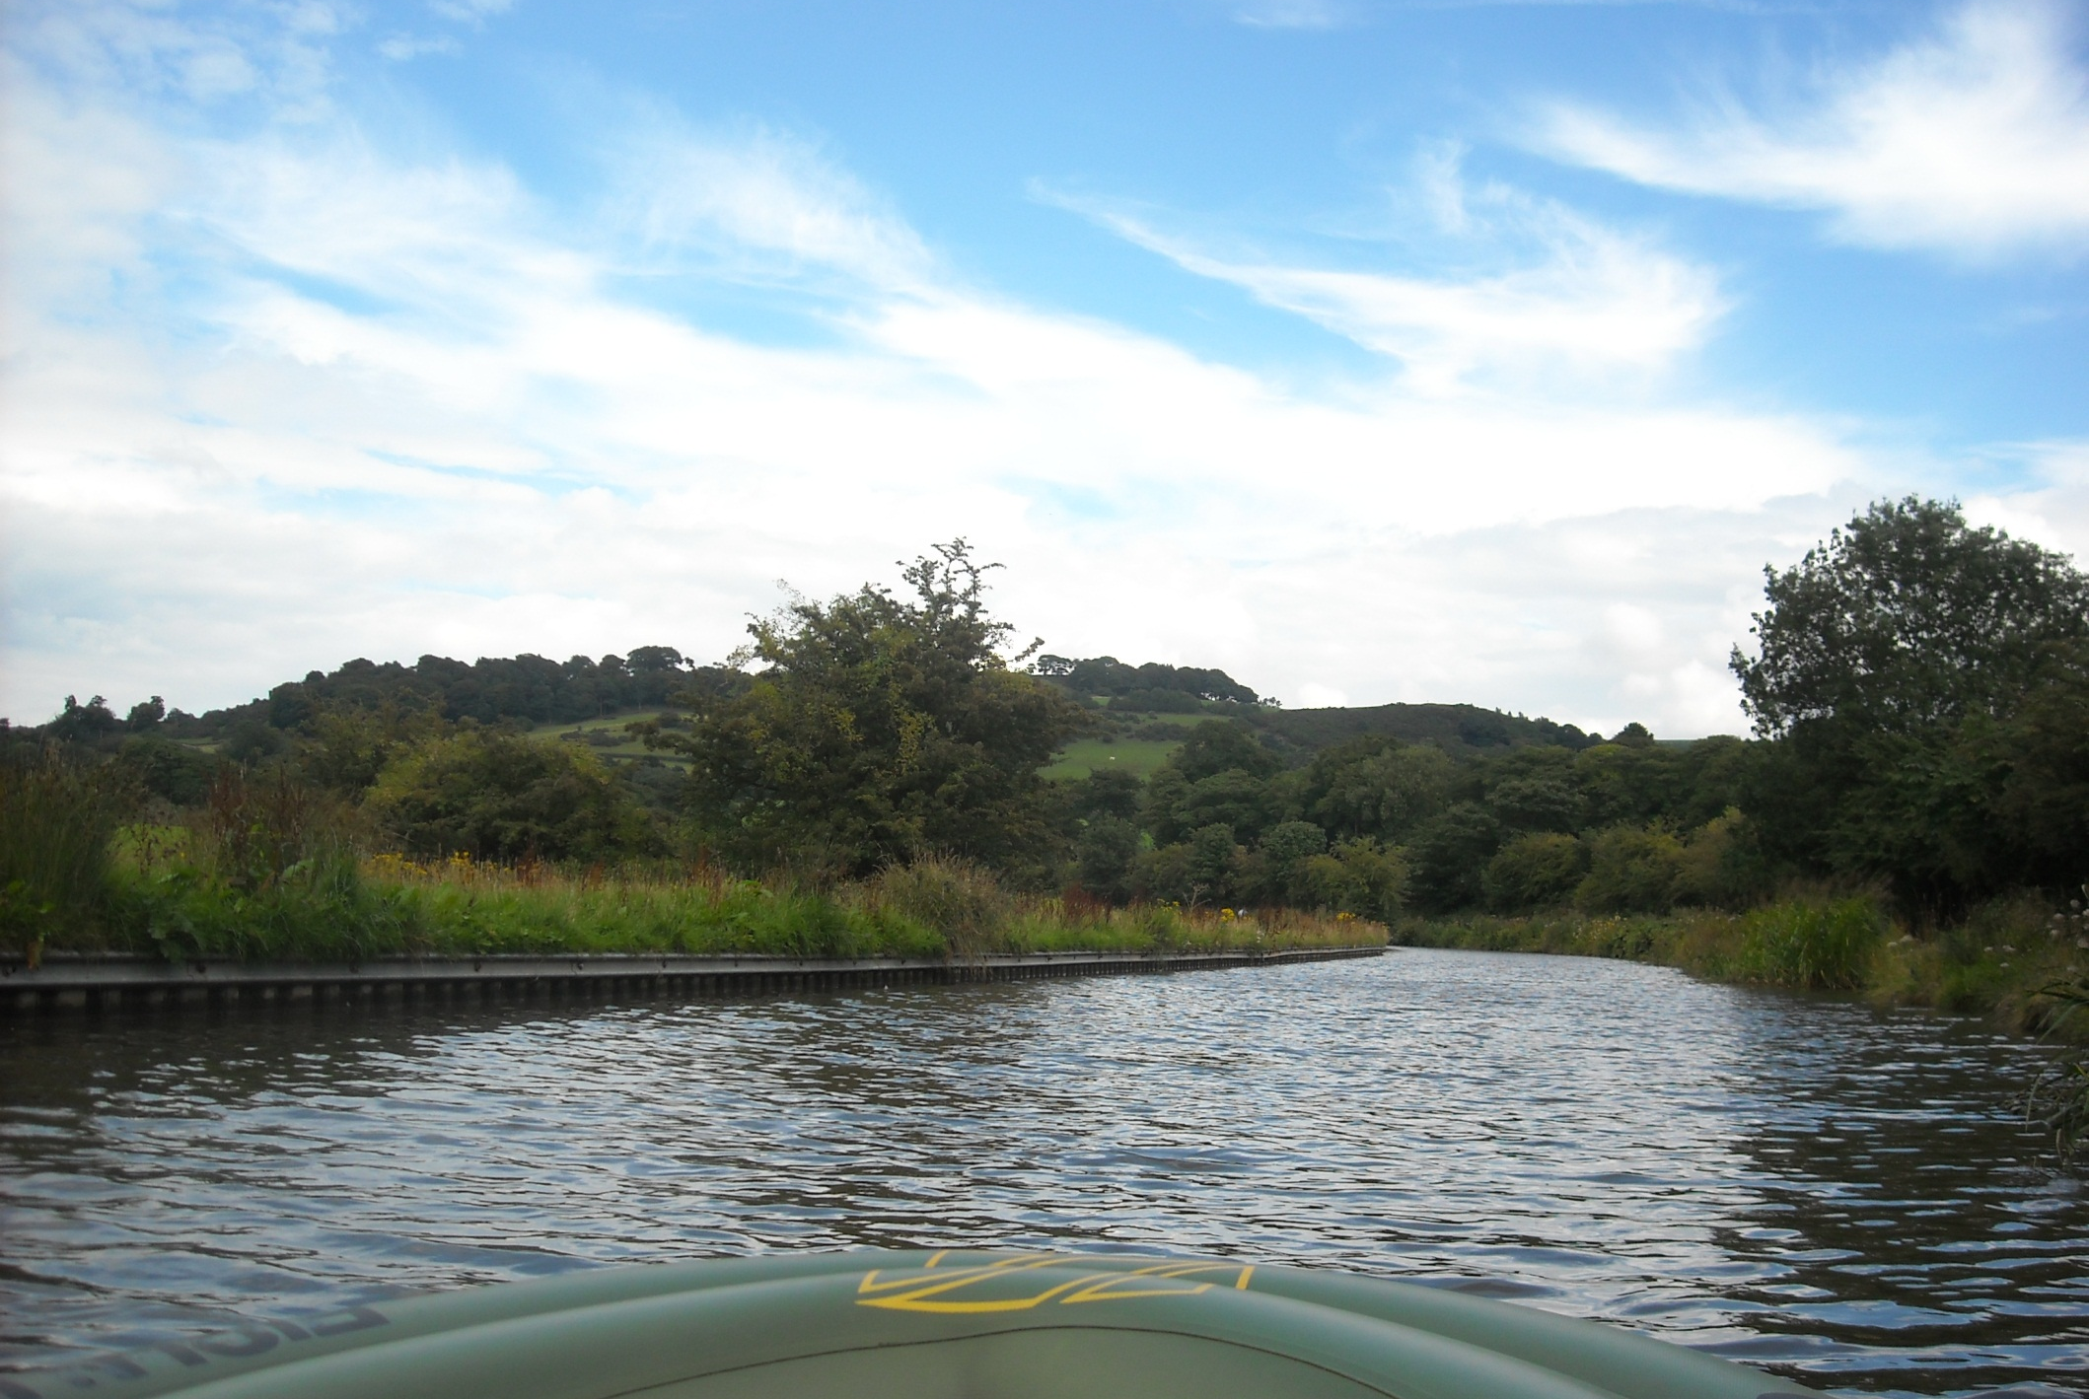
And we are off again, through pleasing Peak District scenery.

Slide 24
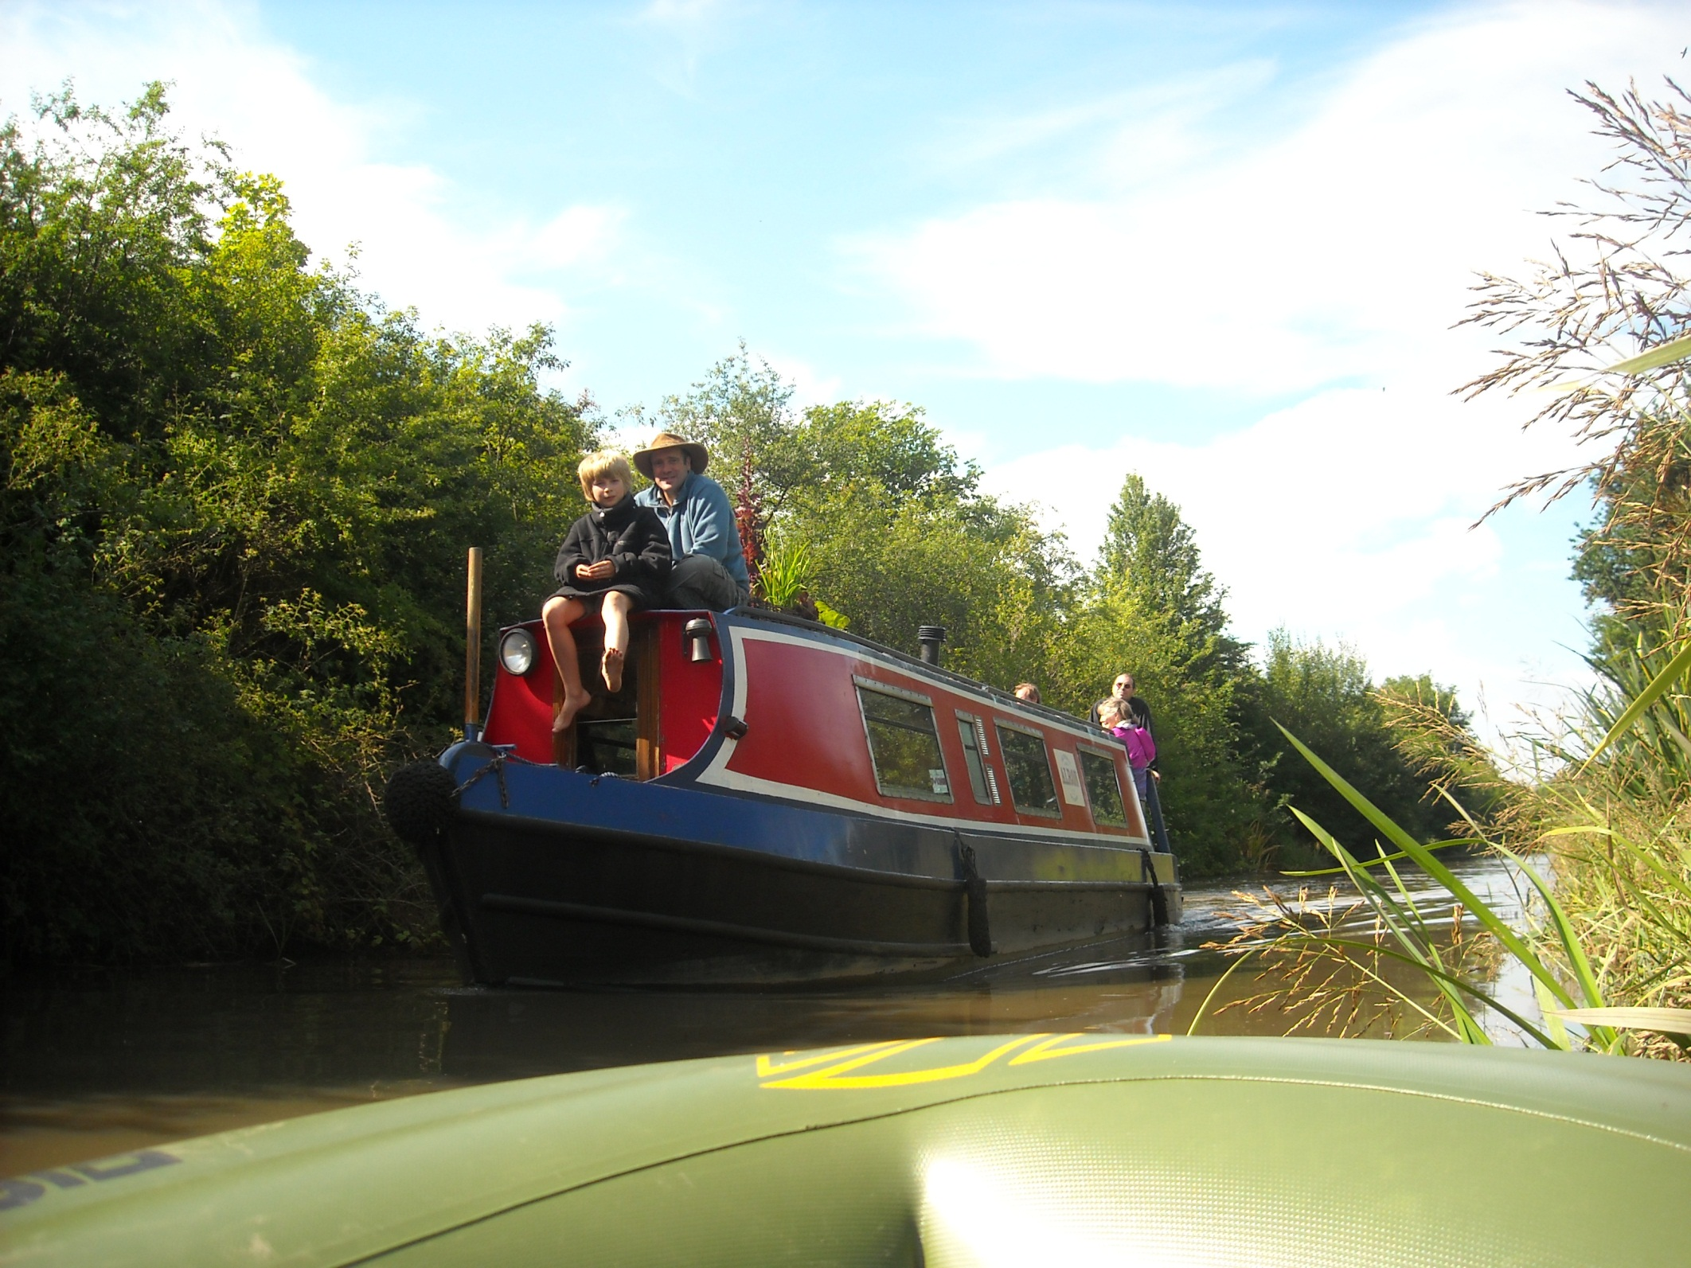
A passing day boat is watched from the reeds!

Slide 25
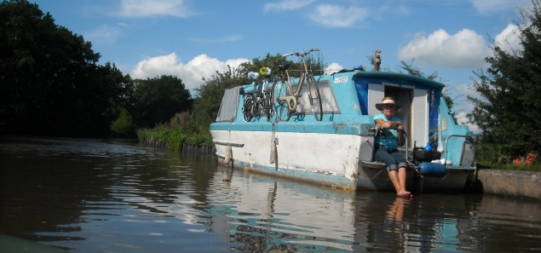
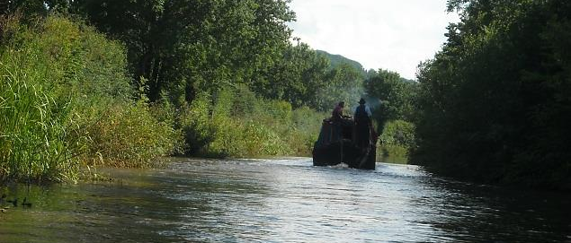
And two other character craft, a well worn friend and the motorised 1936 wooden butty Southall.

Slide 26
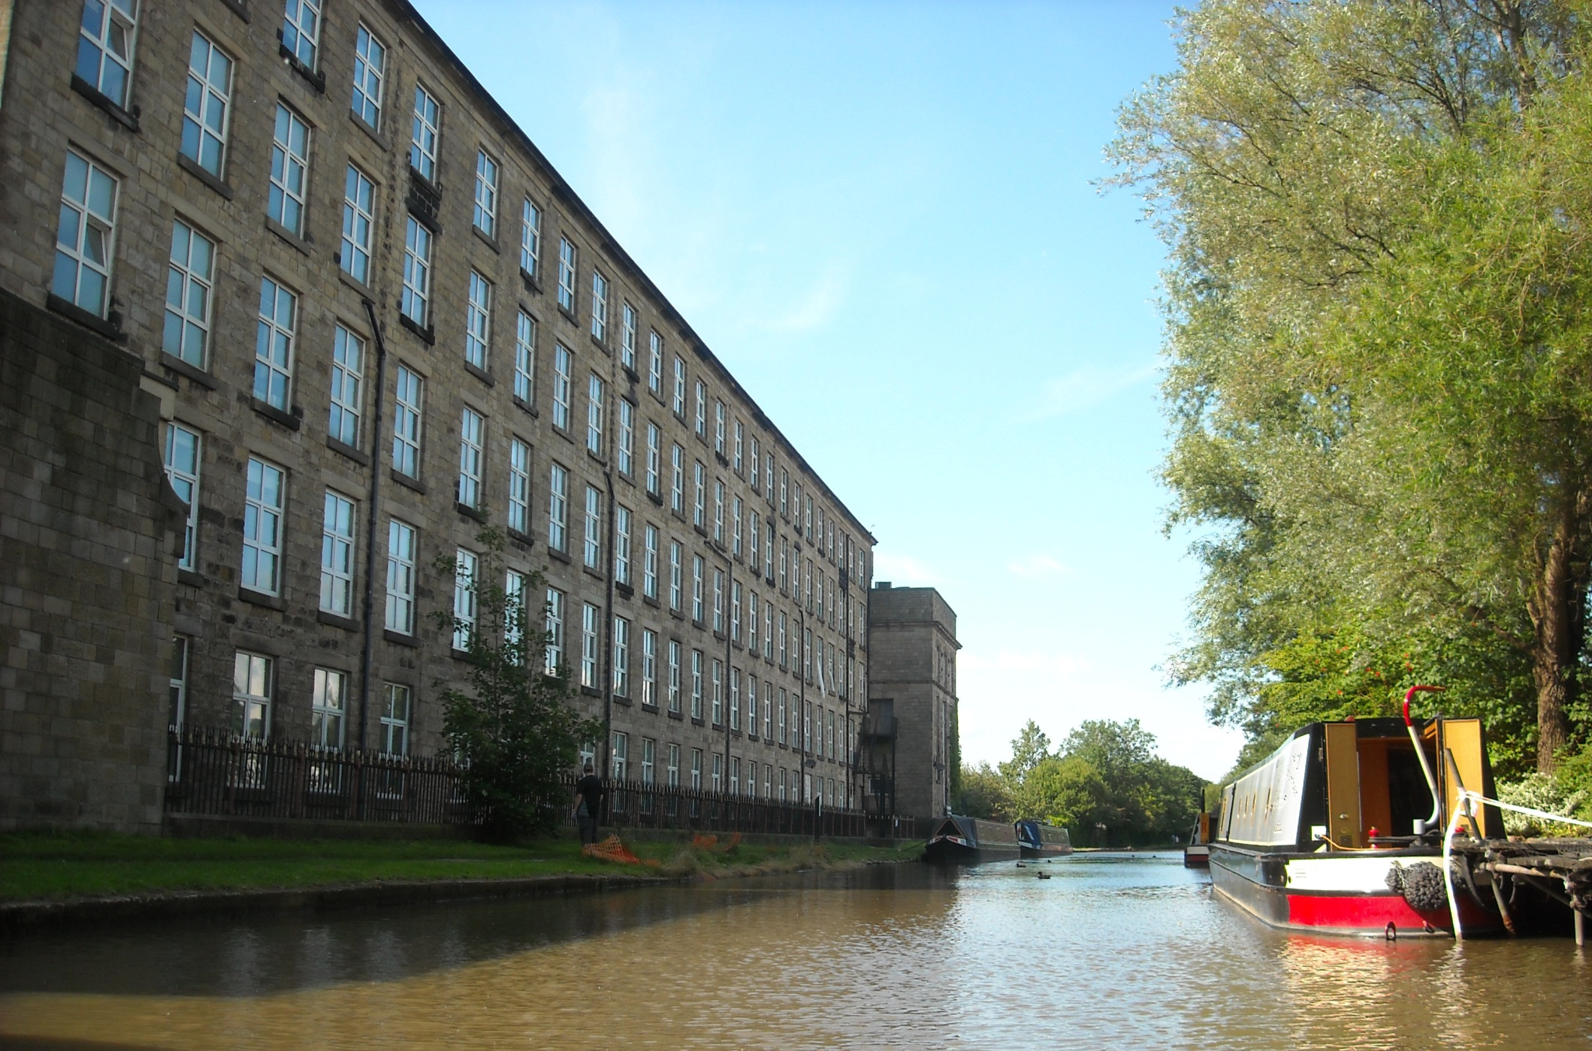
Adelphi Mill, the first of the two large mills in Bollington, now used for offices and industry. It was a silk mill for most of its life.

Slide 27
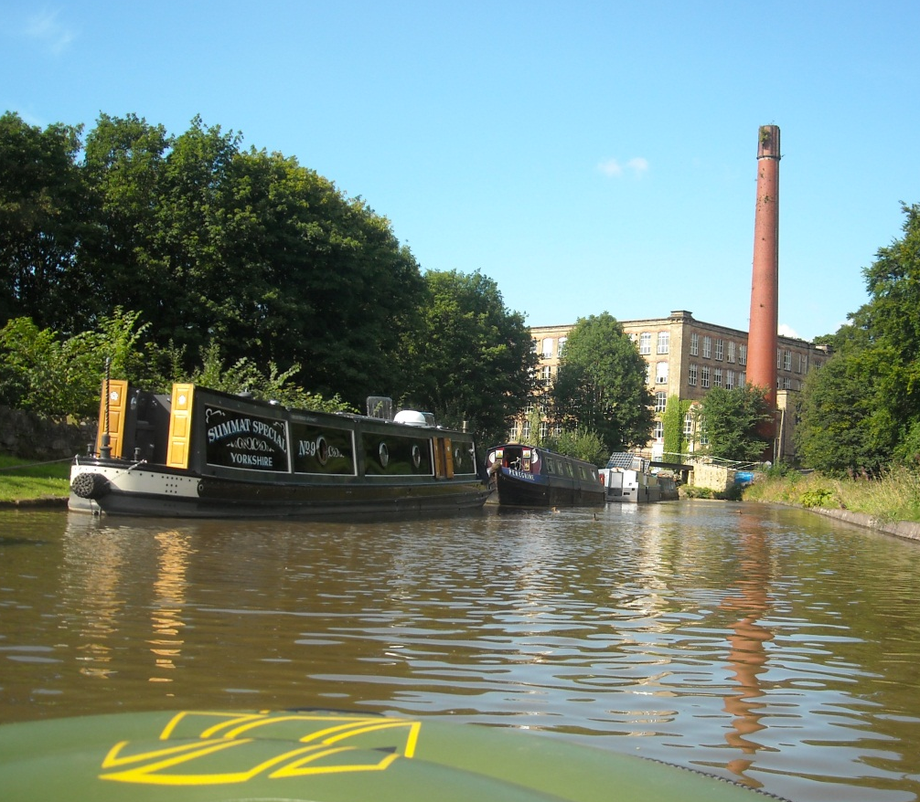
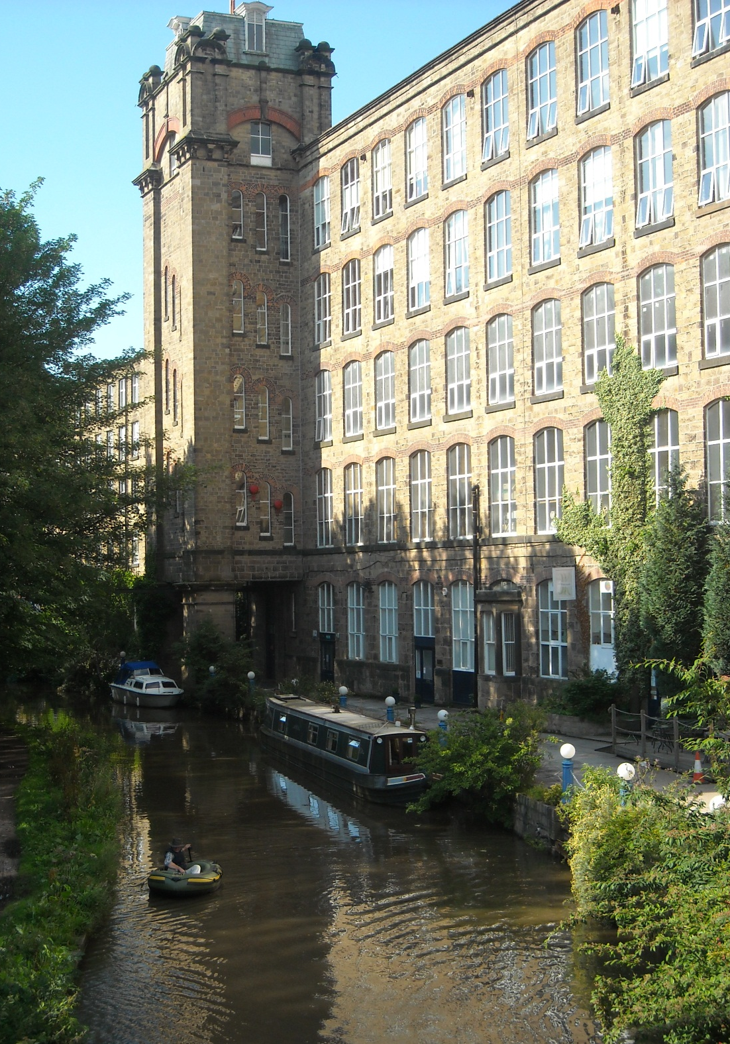
And Clarence Mill, built for cotton but soon also converted to silk. Today Clarence Mill is a residential and industrial mix.

Slide 28
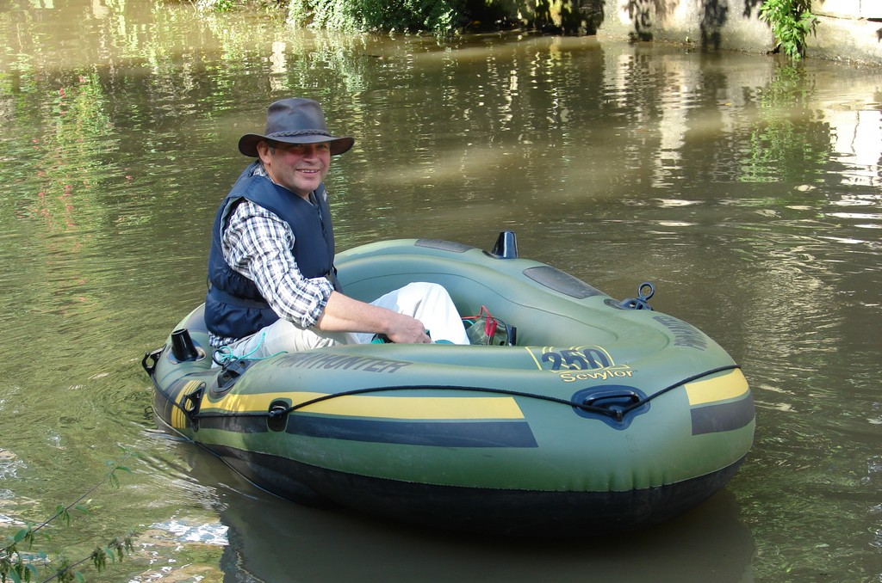
And at Clarence Mill we close this day.

Slide 29
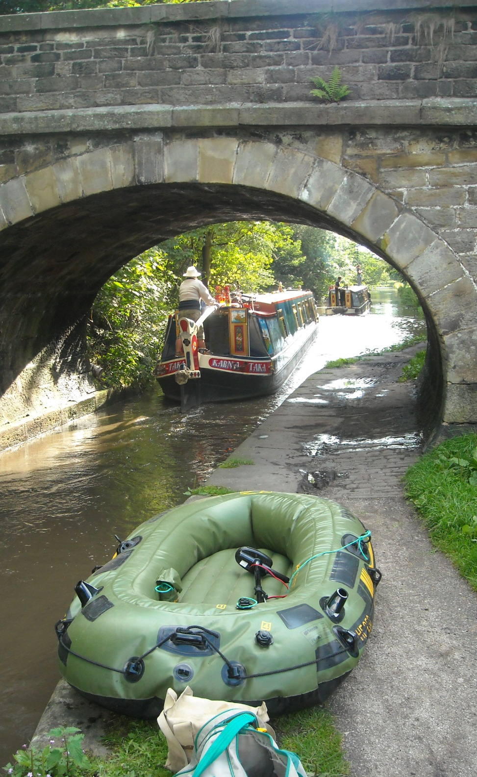
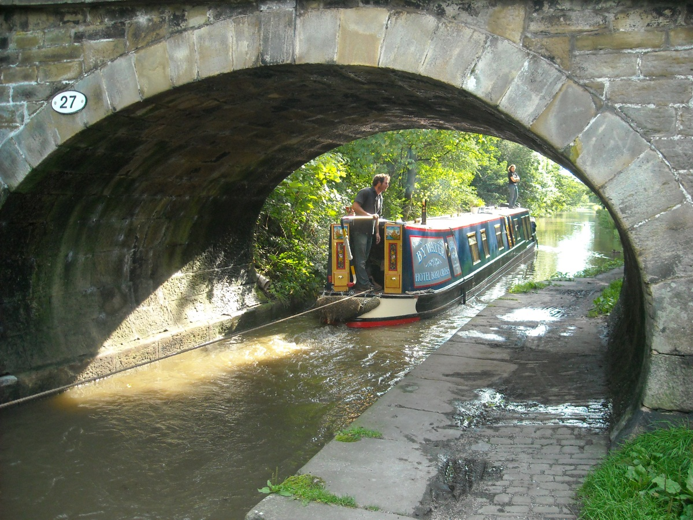
And what comes by as we deflate the boat but the Bywater hotel boat pair again.
What a fine addition to the waterways scene they are.

Slide 30
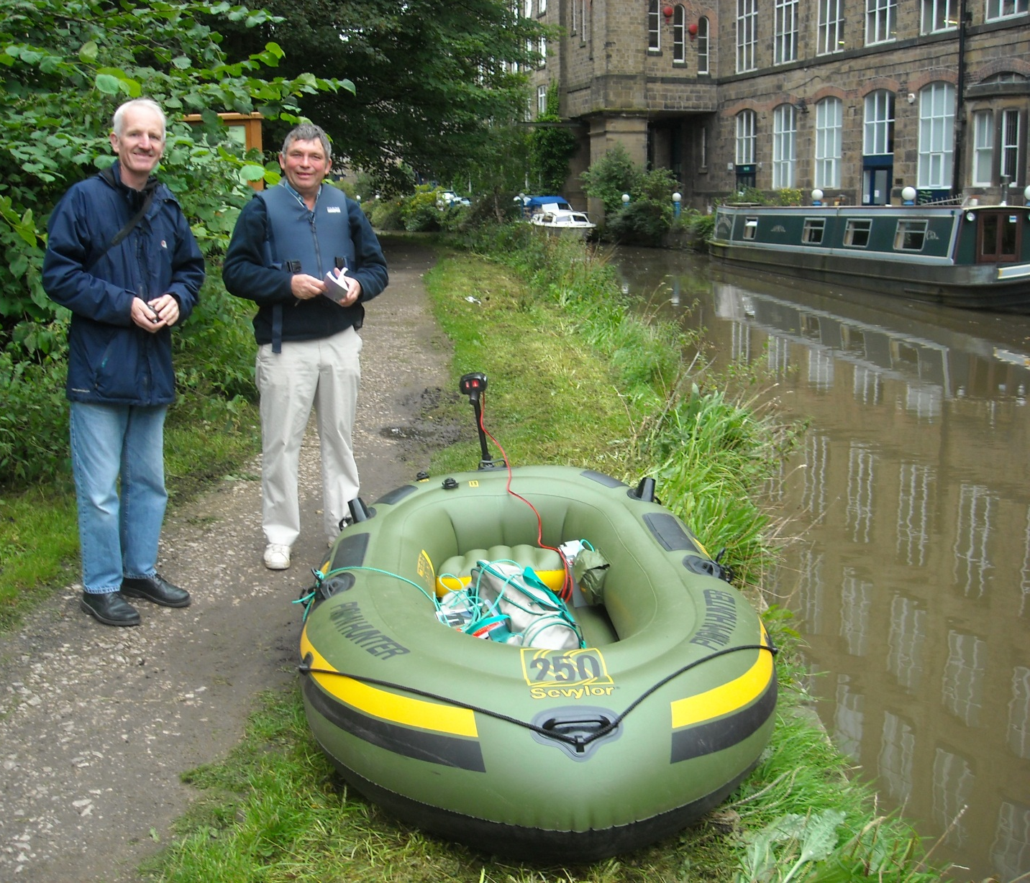
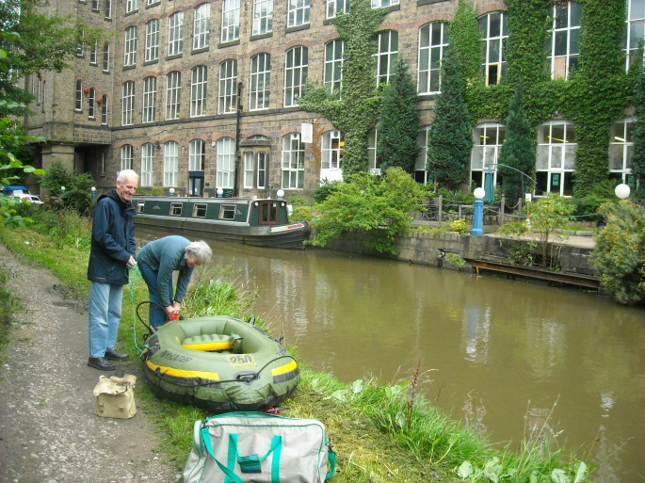
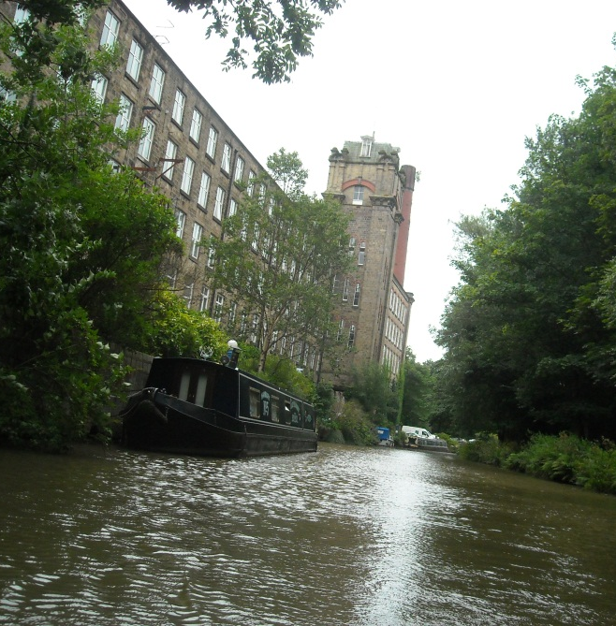
Thursday 26th August 2010 as Kevin and Helen help launch the Plain Hunter for the last 7½ miles of the Macclesfield Canal.

Slide 31
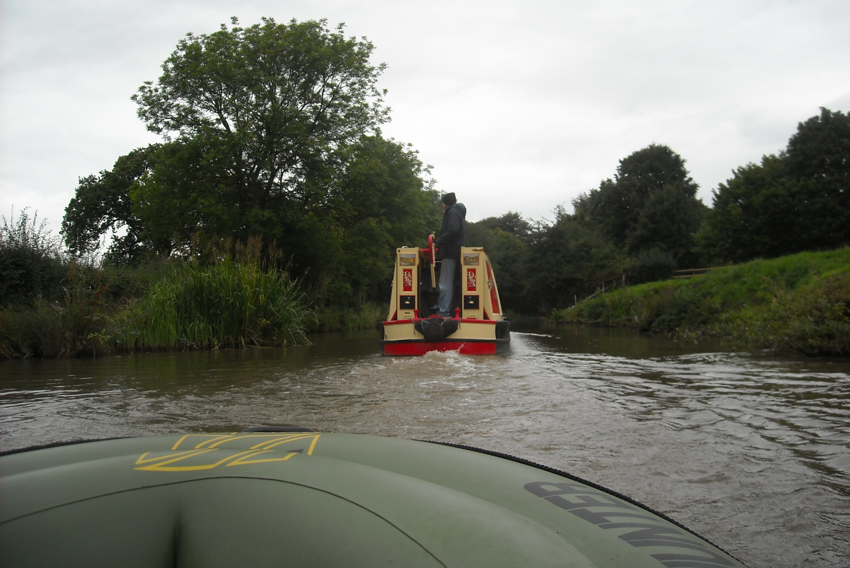
It is a blustery day and boats large and small need to take care.

Slide 32
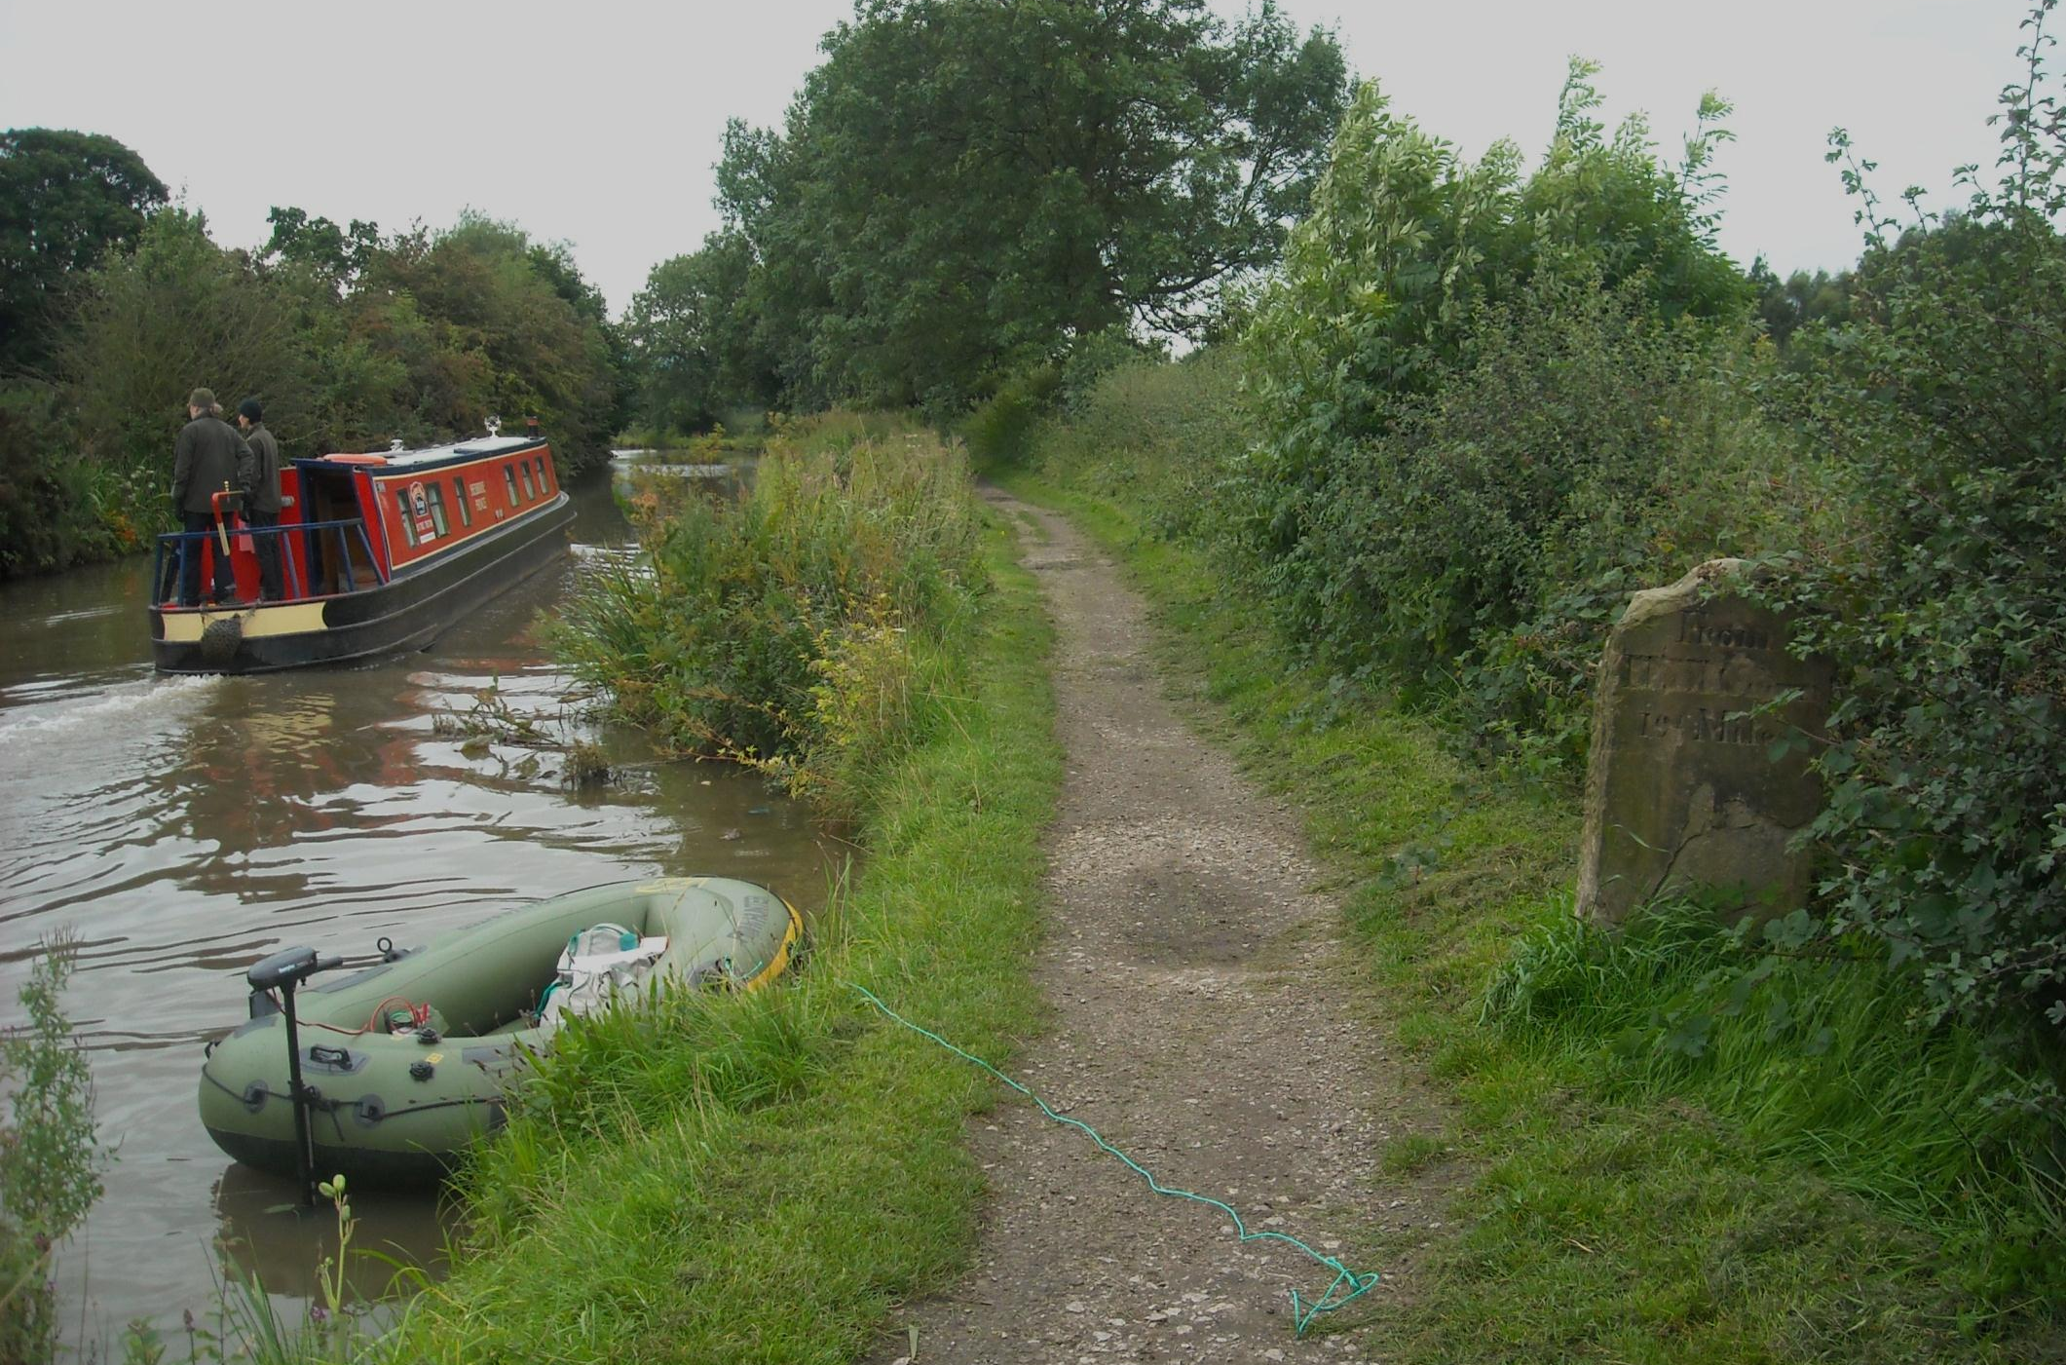
Many interesting milestones line this canal. Most were removed in the war but this one had its place names chiselled off instead!

Slide 33
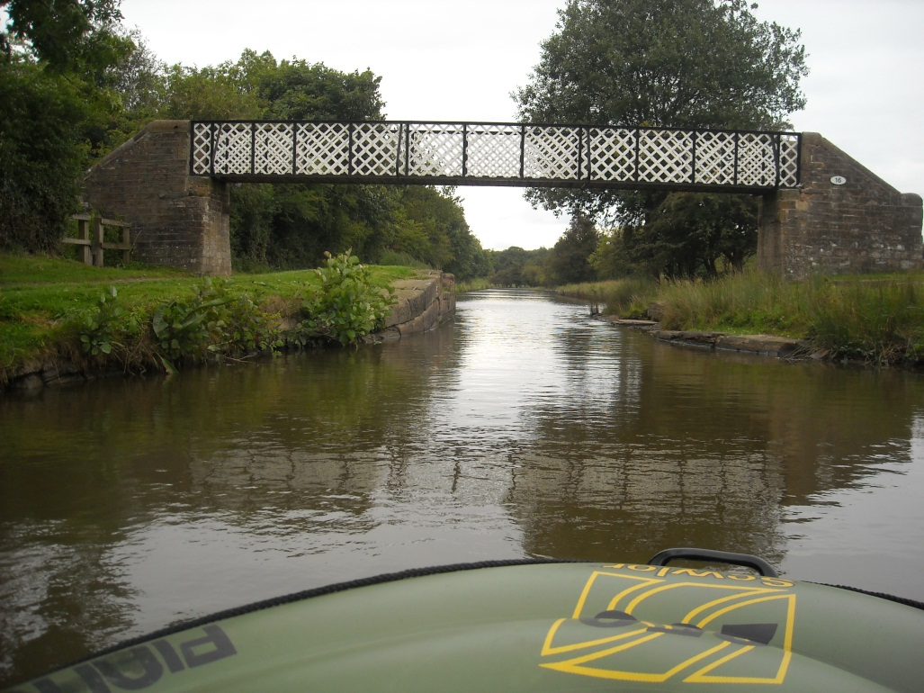
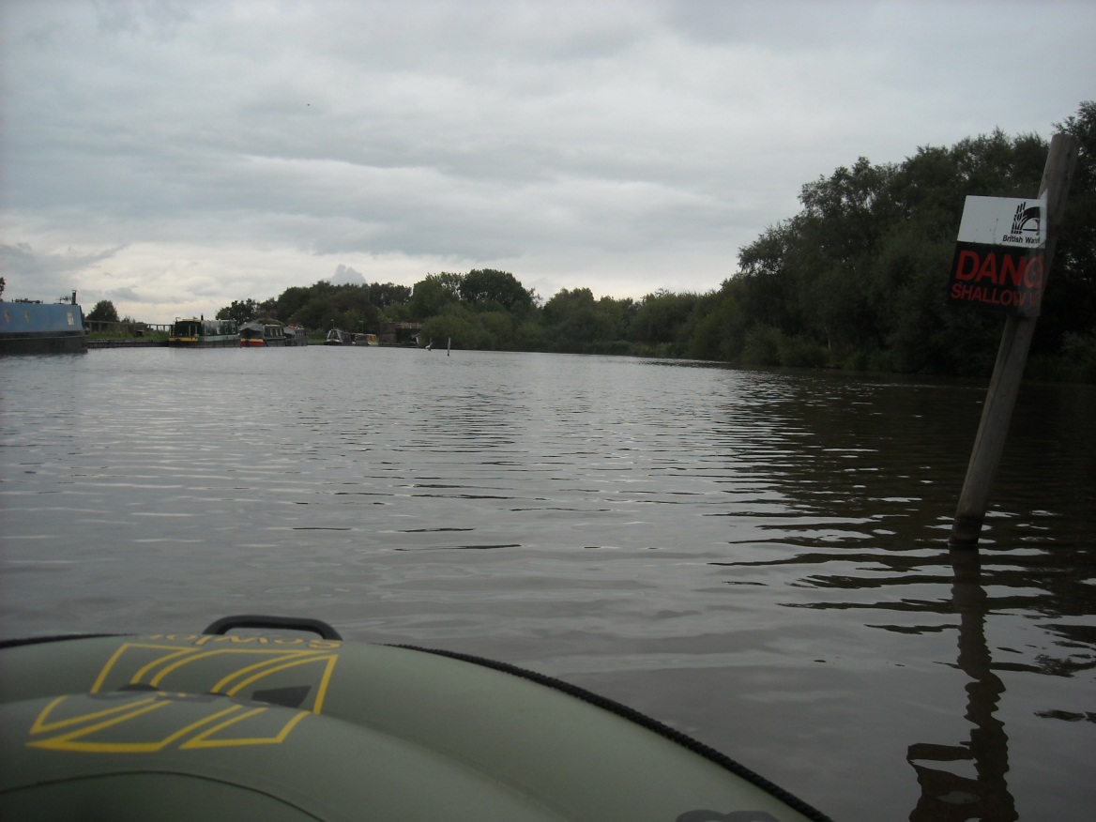
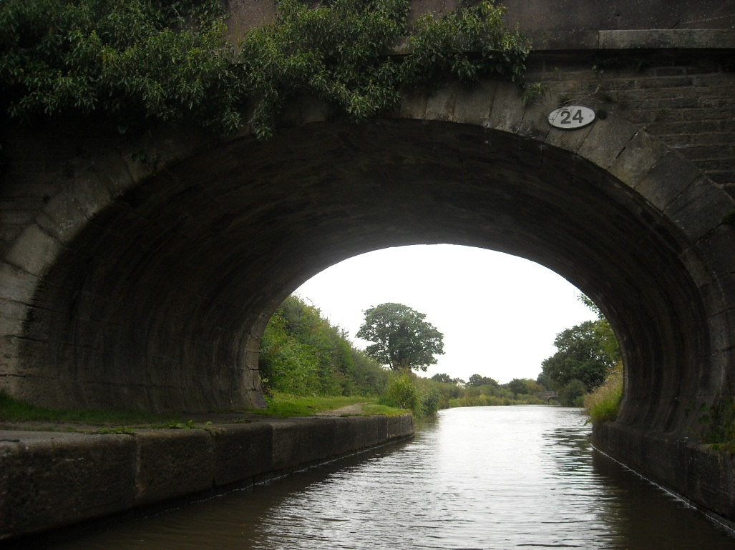
The bridge numbers reduce towards Marple.
No moorings are allowed this side of Higher Poynton in the mining induced shallows.

Slide 34
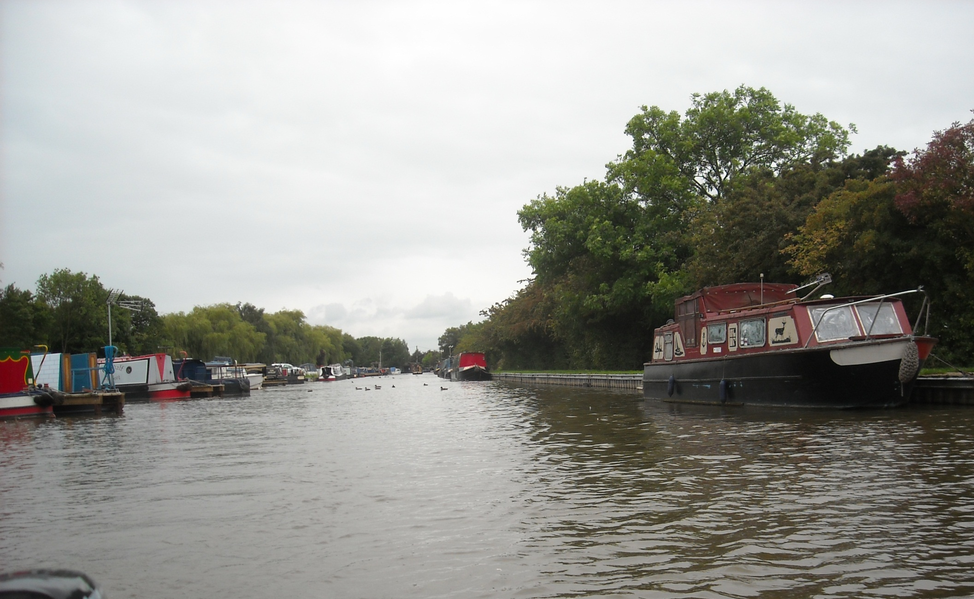
But plenty of room further on in the section that is dredged.

Slide 35
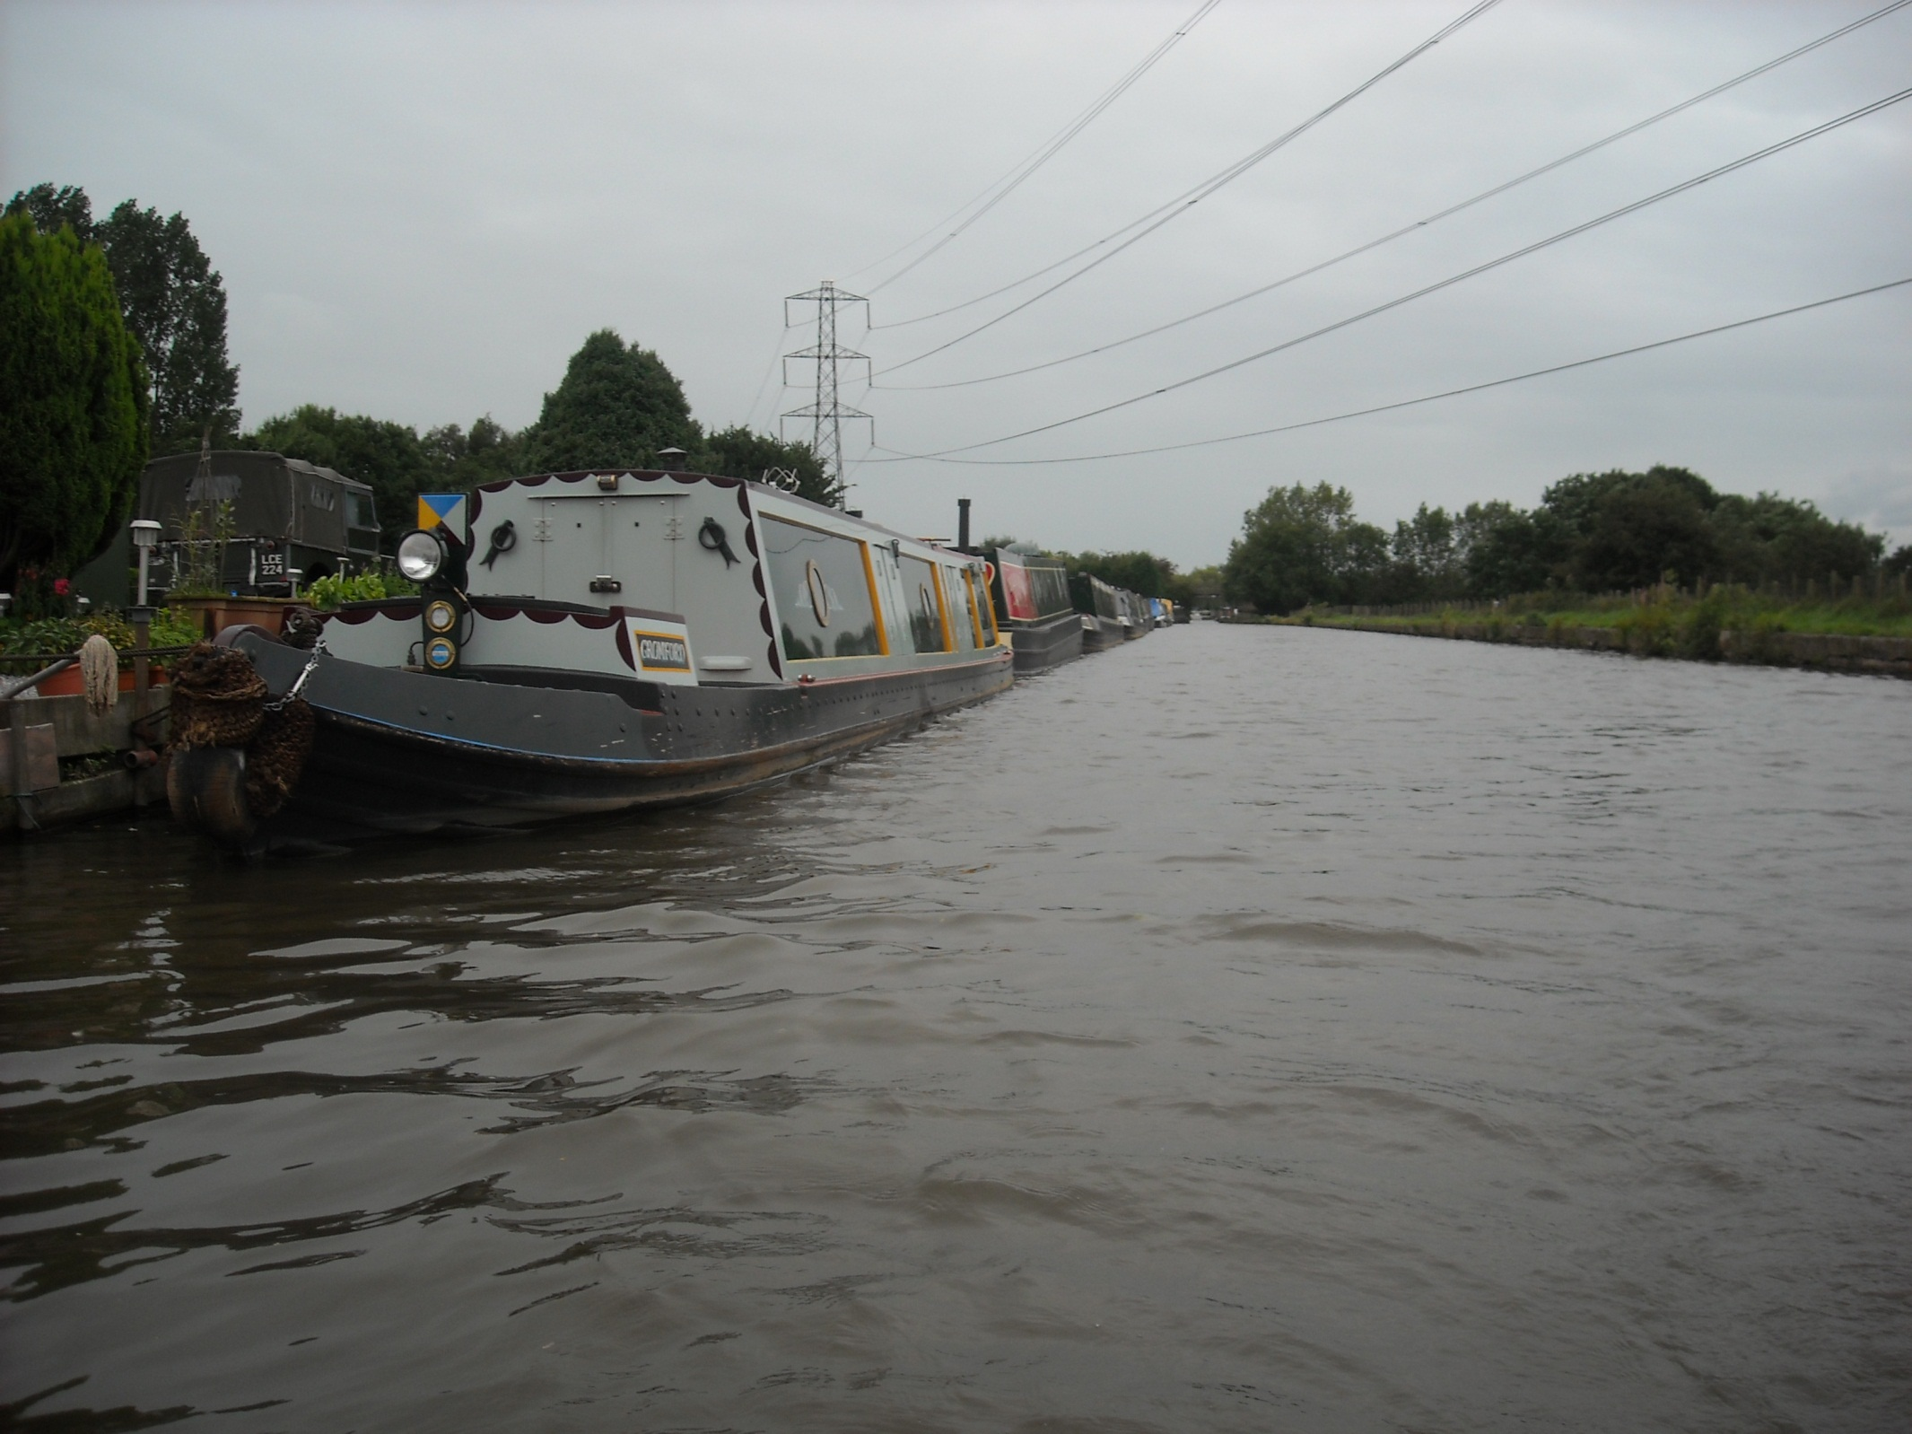
As the wind remains a hazard on this overcast day.

Slide 36
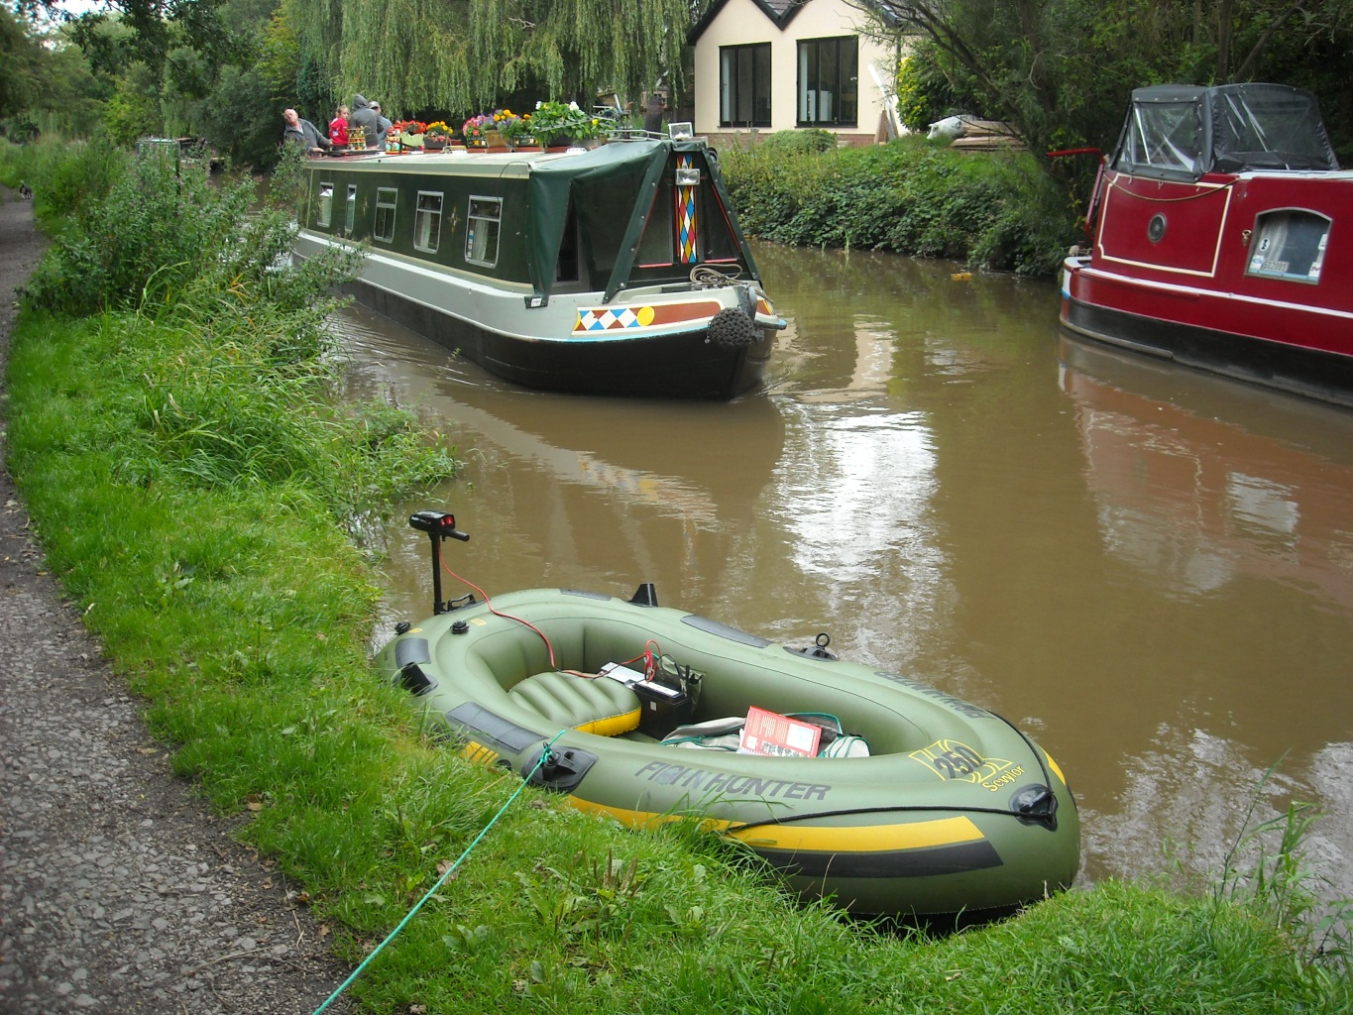


An intact milestone at High Lane.
This was one of those buried during the war and rediscovered by deduction years later.

Slide 37

How many towlines were needed to cut this stonework so deeply?

Slide 38


Huge Goyt Mill, Marple next, still built canalside in 1905.
Spinning cotton until 1956 it is now industrial units.

Slide 39

The old Goyt Mill canal crane is a pleasing survivor.

Slide 40

And Marple Wharf, where a British Waterways maintenance yard still stands guard at Peak Forest Junction.

Slide 41



Here one turns right for Whalley Bridge or left for the 16 Marple Locks down to Manchester.

Slide 42

I let the community trip boat pass then head under the bridge to the junction to finish my day.

Slide 43

The Plain Hunter has navigated 30 of the 80 miles from the Black Country Museum, or 30 of the 50 miles from Great Heywood.

Slide 44

It has been an incredible waterway journey so far
What can possibly follow this?

Slide 45

How about a spot of horse boating aboard Maria?

Slide 46



Maria is an incredible boat, built here, in Marple, in 1854 and the oldest narrowboat afloat.

Slide 47



But the stars of this boating are undoubtable Bilbo and his owner Sue. Here Bilbo makes good use of a horse tunnel beneath a Marple road.

Slide 48

The 16 Marple Locks are absolutely fascinating.

Slide 49


And about halfway down is Samuel Oldknow’s fine warehouse.

Slide 50


With, at the bottom, elegant Marple aqueduct and its paralleling railway viaduct.

Slide 51



There are two tunnels between here and Manchester and the first is Hyde Bank tunnel which, not having a towpath, requires legging through!

Slide 52

Bilbo, arriving first, awaits the boat.

Slide 53

This wooded scene is in Romiley.
Aged 5, I lived a few minutes walk from here!

Slide 54

And real Horse Power as Bilbo clip clops through Romiley.

Slide 55

An amazing meeting of two wooden narrowboats as
Joel of 1918 passes Maria of 1854. Incredible for 2010!

Slide 56


Over a lunchtime break Bilbo’s harness is removed and he is given time to graze the canal bank.

Slide 57



One feature of horse boating is the interest shown by fellow canalside residents!

Slide 58

This was a fine moment as, with a clattering of hooves on slippery sets, Bilbo uses a turnover bridge as designed!

Slide 59

Tricky towpath conditions in Hyde.

Slide 60

And bridge number 1 of the Peak Forest Canal, a metal lift bridge operated by windlass.

Slide 61

And so to Dukinfield Junction, the end of the Peak Forest Canal.

Slide 62

Portland Basin, Dukinfield Junction, junction with the
Ashton Canal to Manchester and the Huddersfield Narrow Canal.

Slide 63

Bilbo and Sue at Dukinfield Junction in 2010.
Hopefully we will cross the Pennines together in 2011.

Slide 64
End of Chapter 5

