Slide 1
Exploring Britain
Boating
Part 3
From Braunston to
Birmingham and Dudley
2nd to 5th June 2010

Slide 2
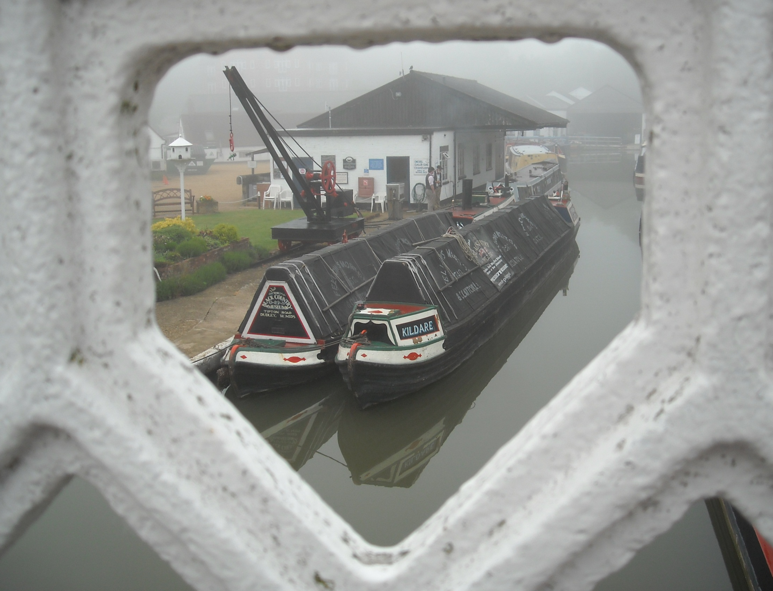

Slide 3
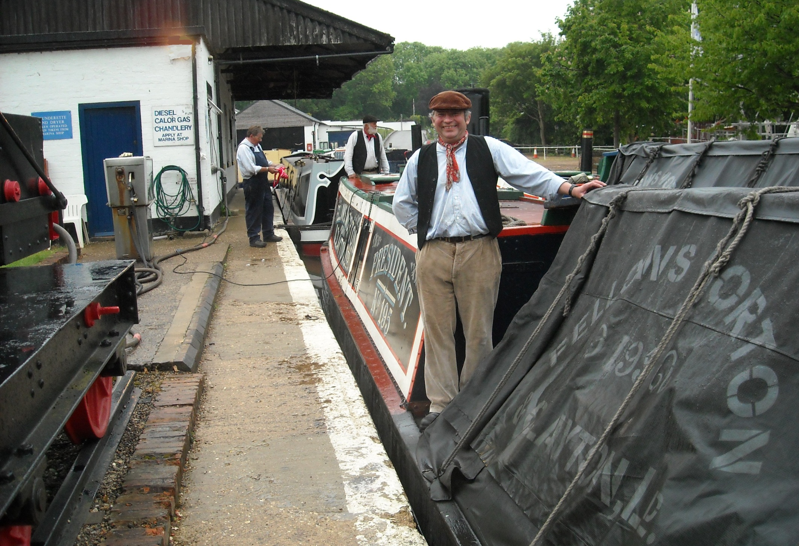
Braunston again, as we overnight with President and Kildare on a run from the Crick Boat Show to the Black Country Museum.

Slide 4
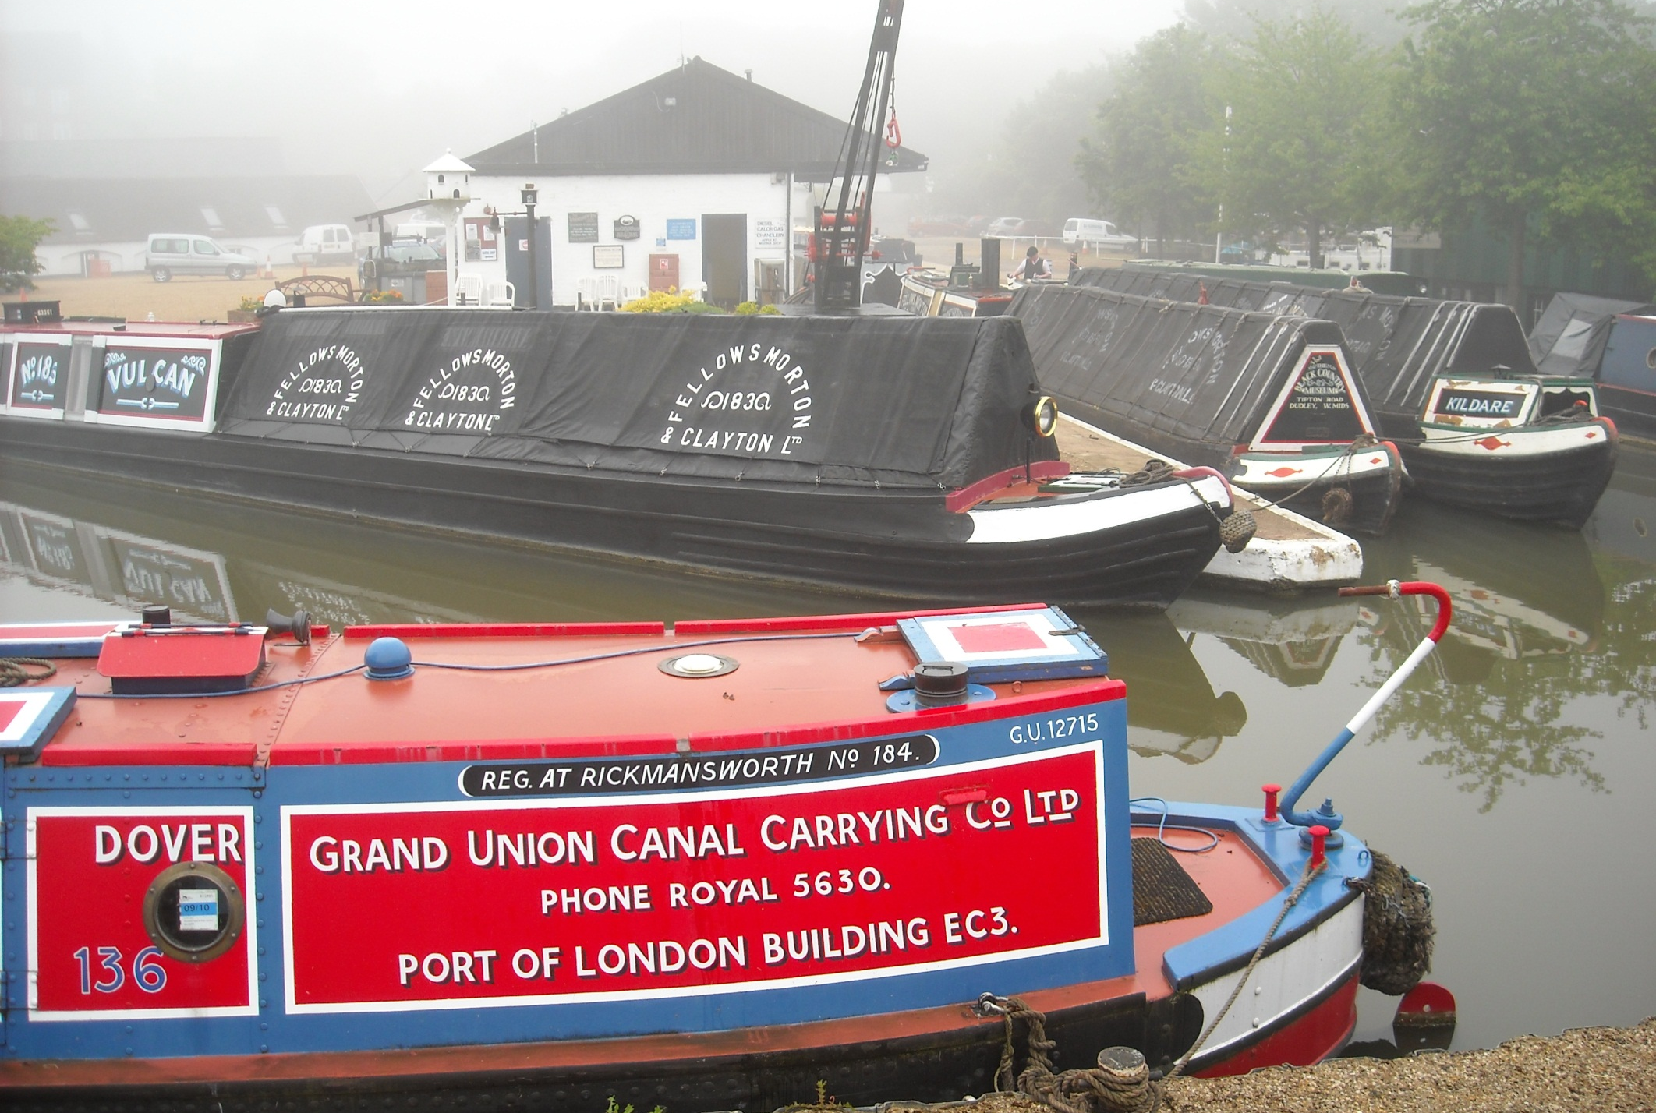
Morning dawns misty over this former FMC depot, the base for many steam narrowboat crews. Vulcan was once also a steamer.

Slide 5
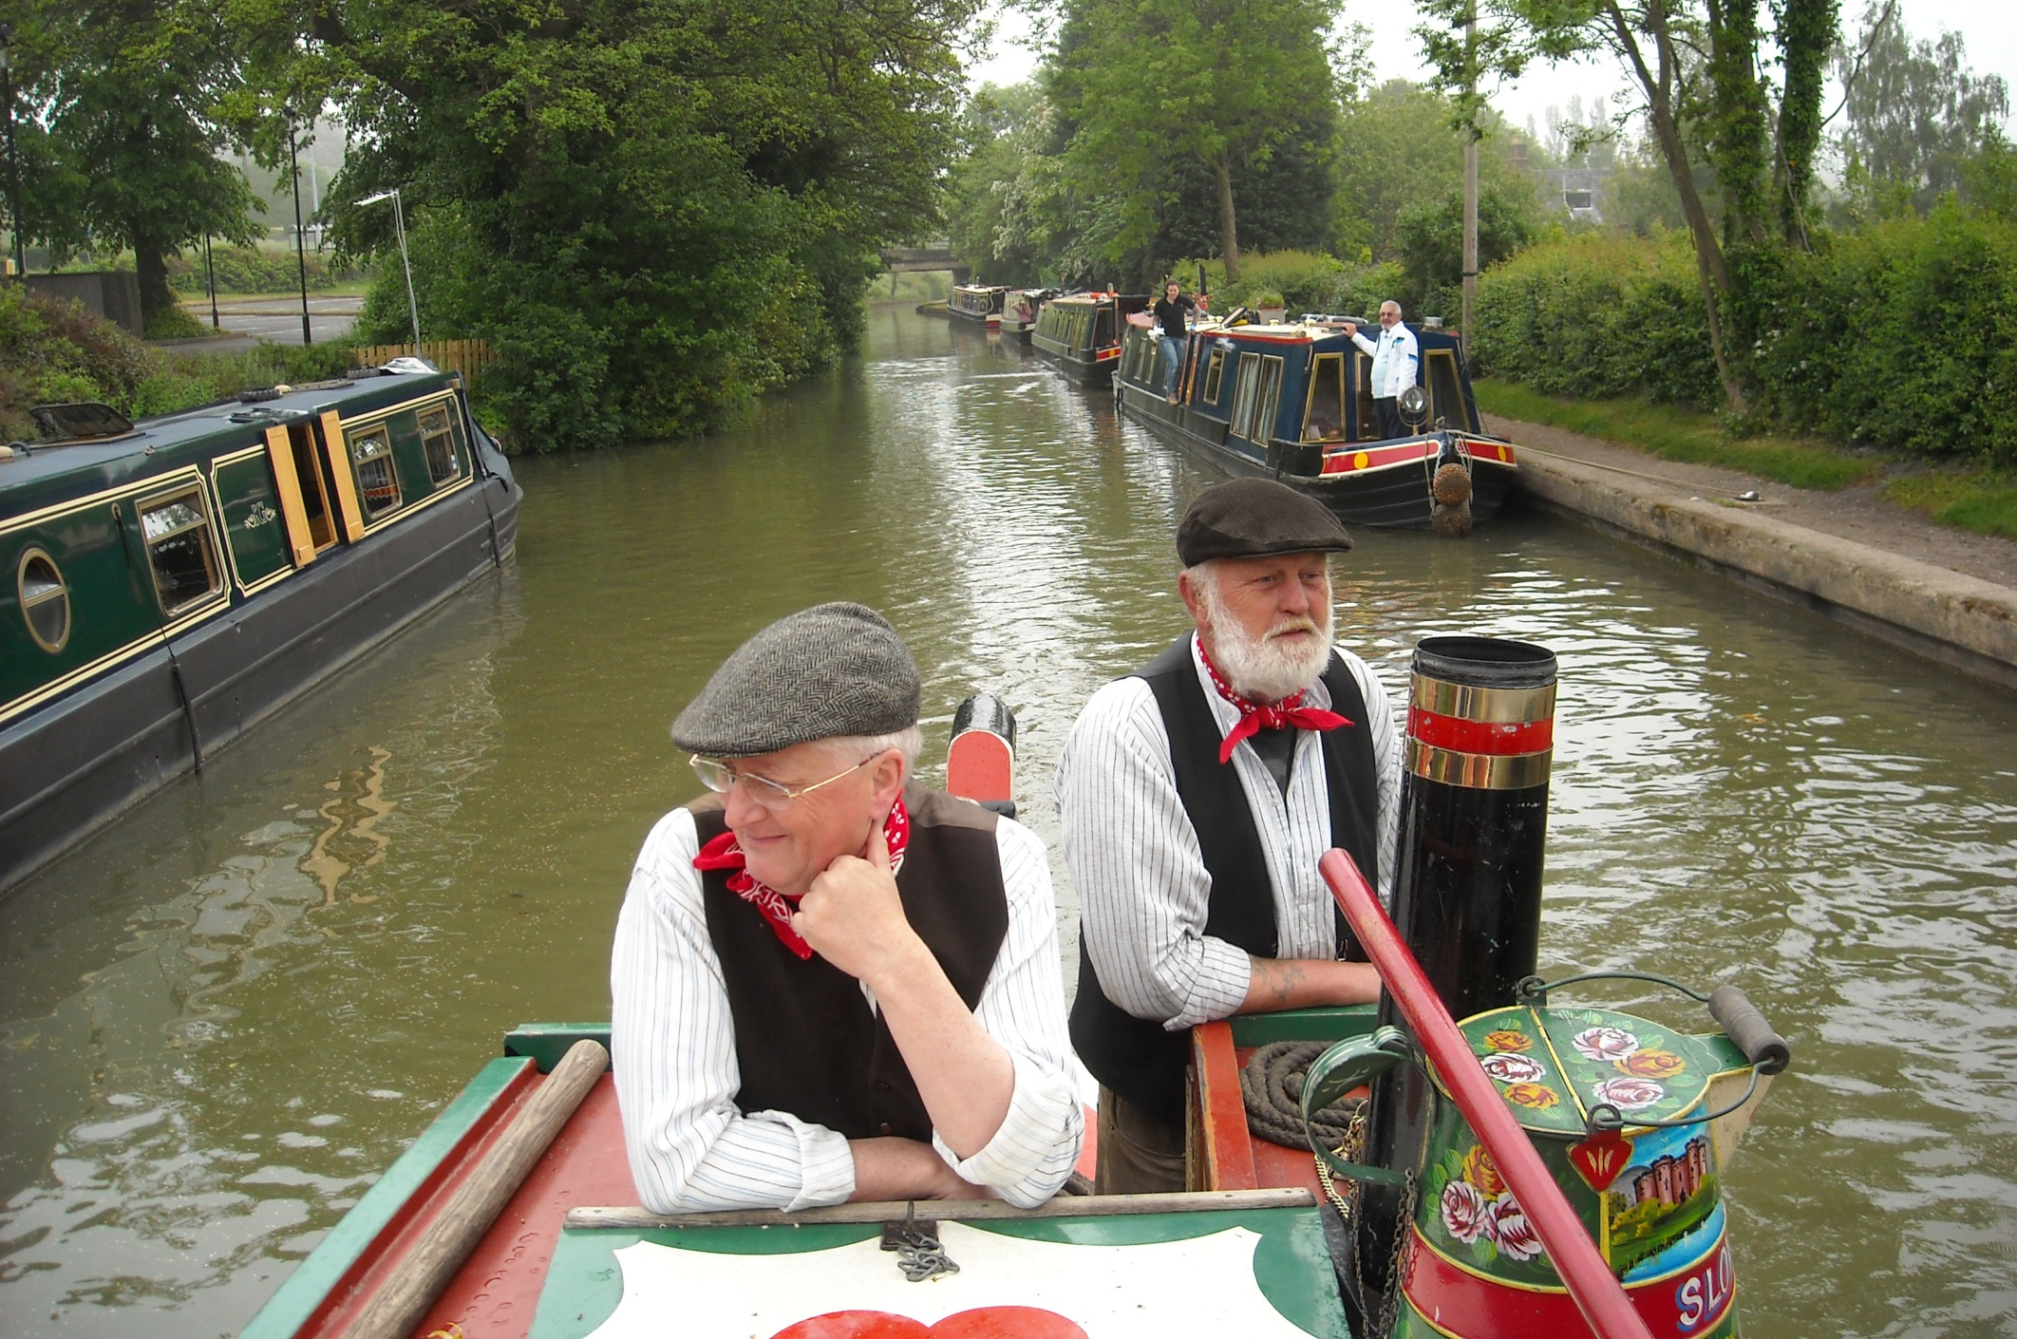
As off we set, with Alan and Chris on Kildare, passing the Bywater hotel boat pair again, this time with customers.

Slide 6
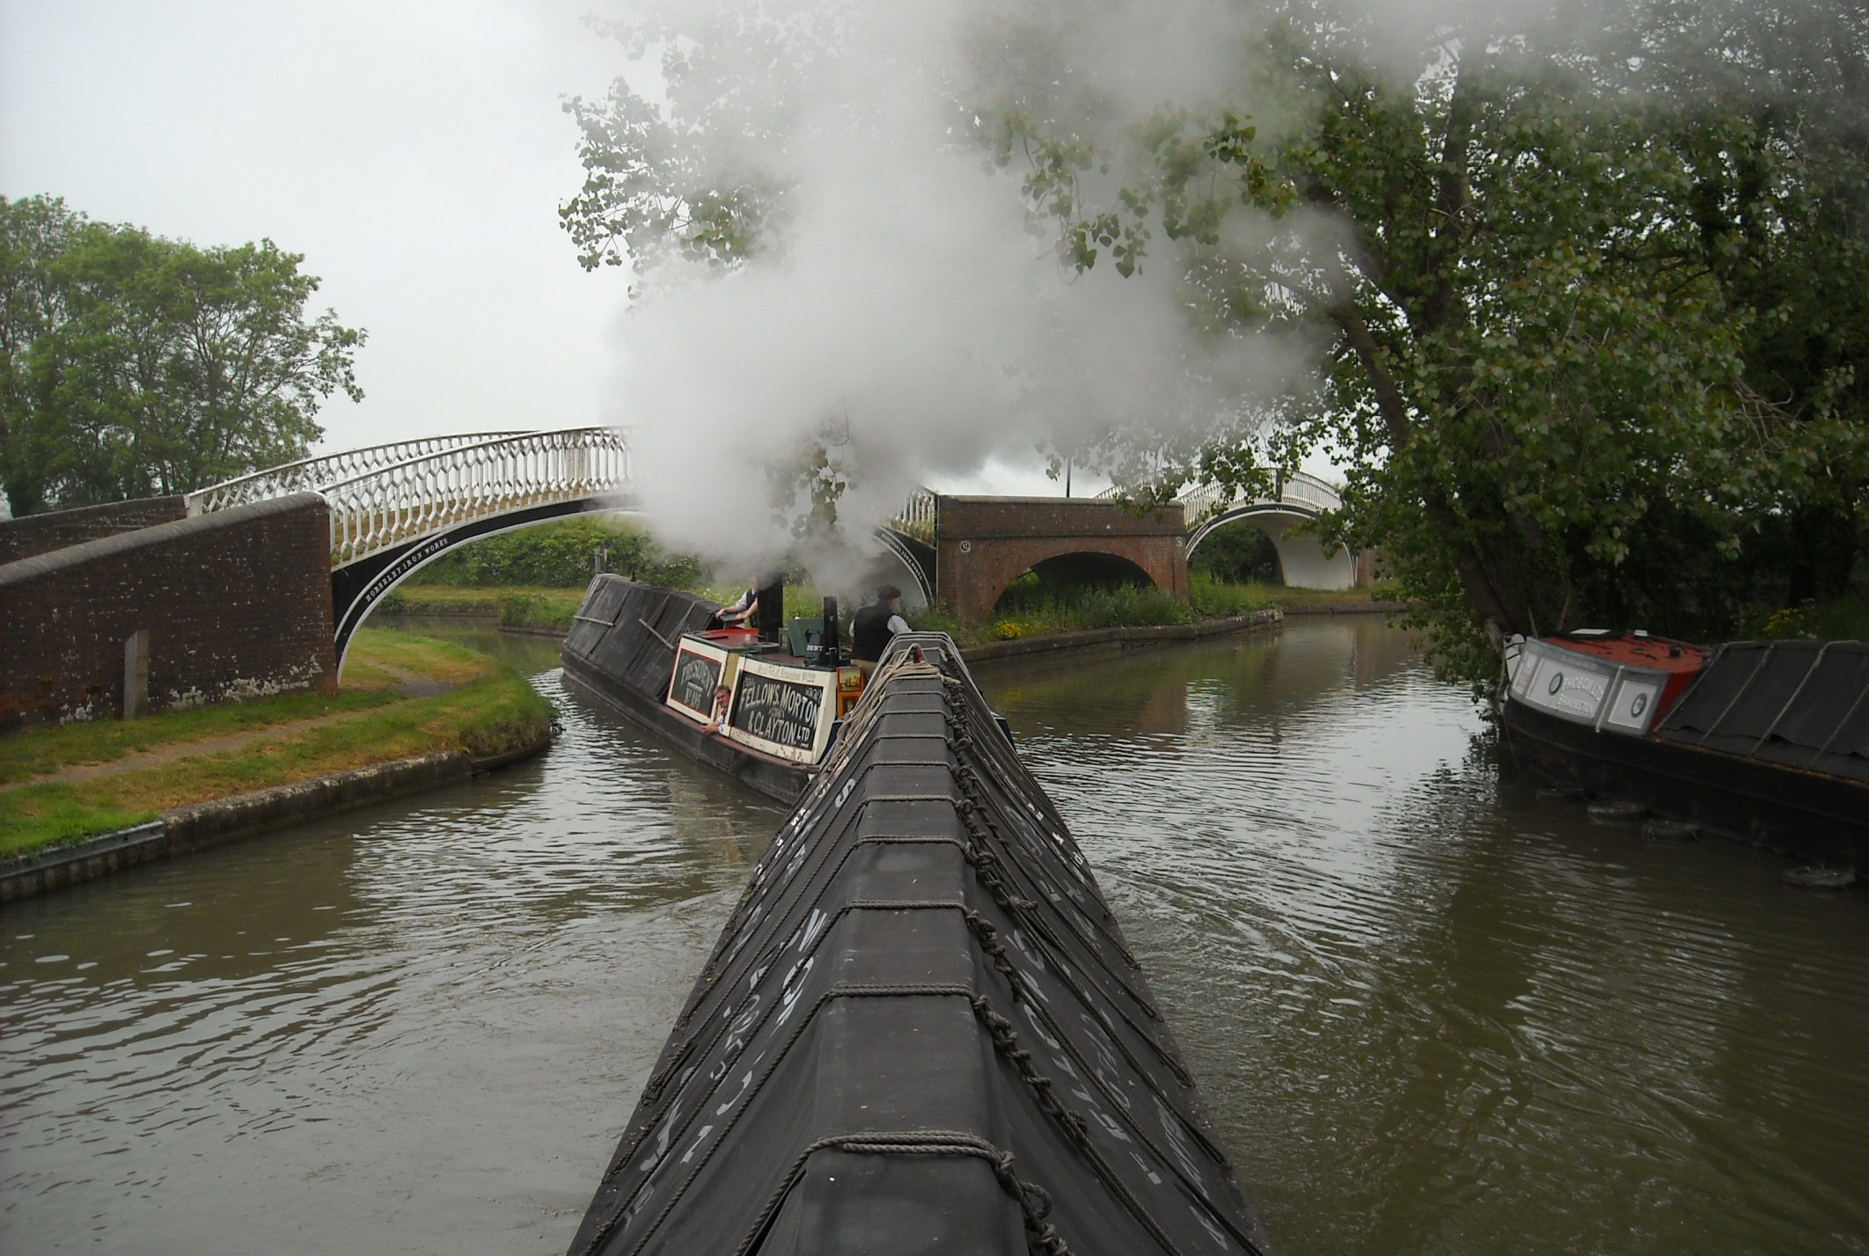
As we retrace our steps down the shared section of Grand Union and Oxford Canal towards Napton Junction.

Slide 7
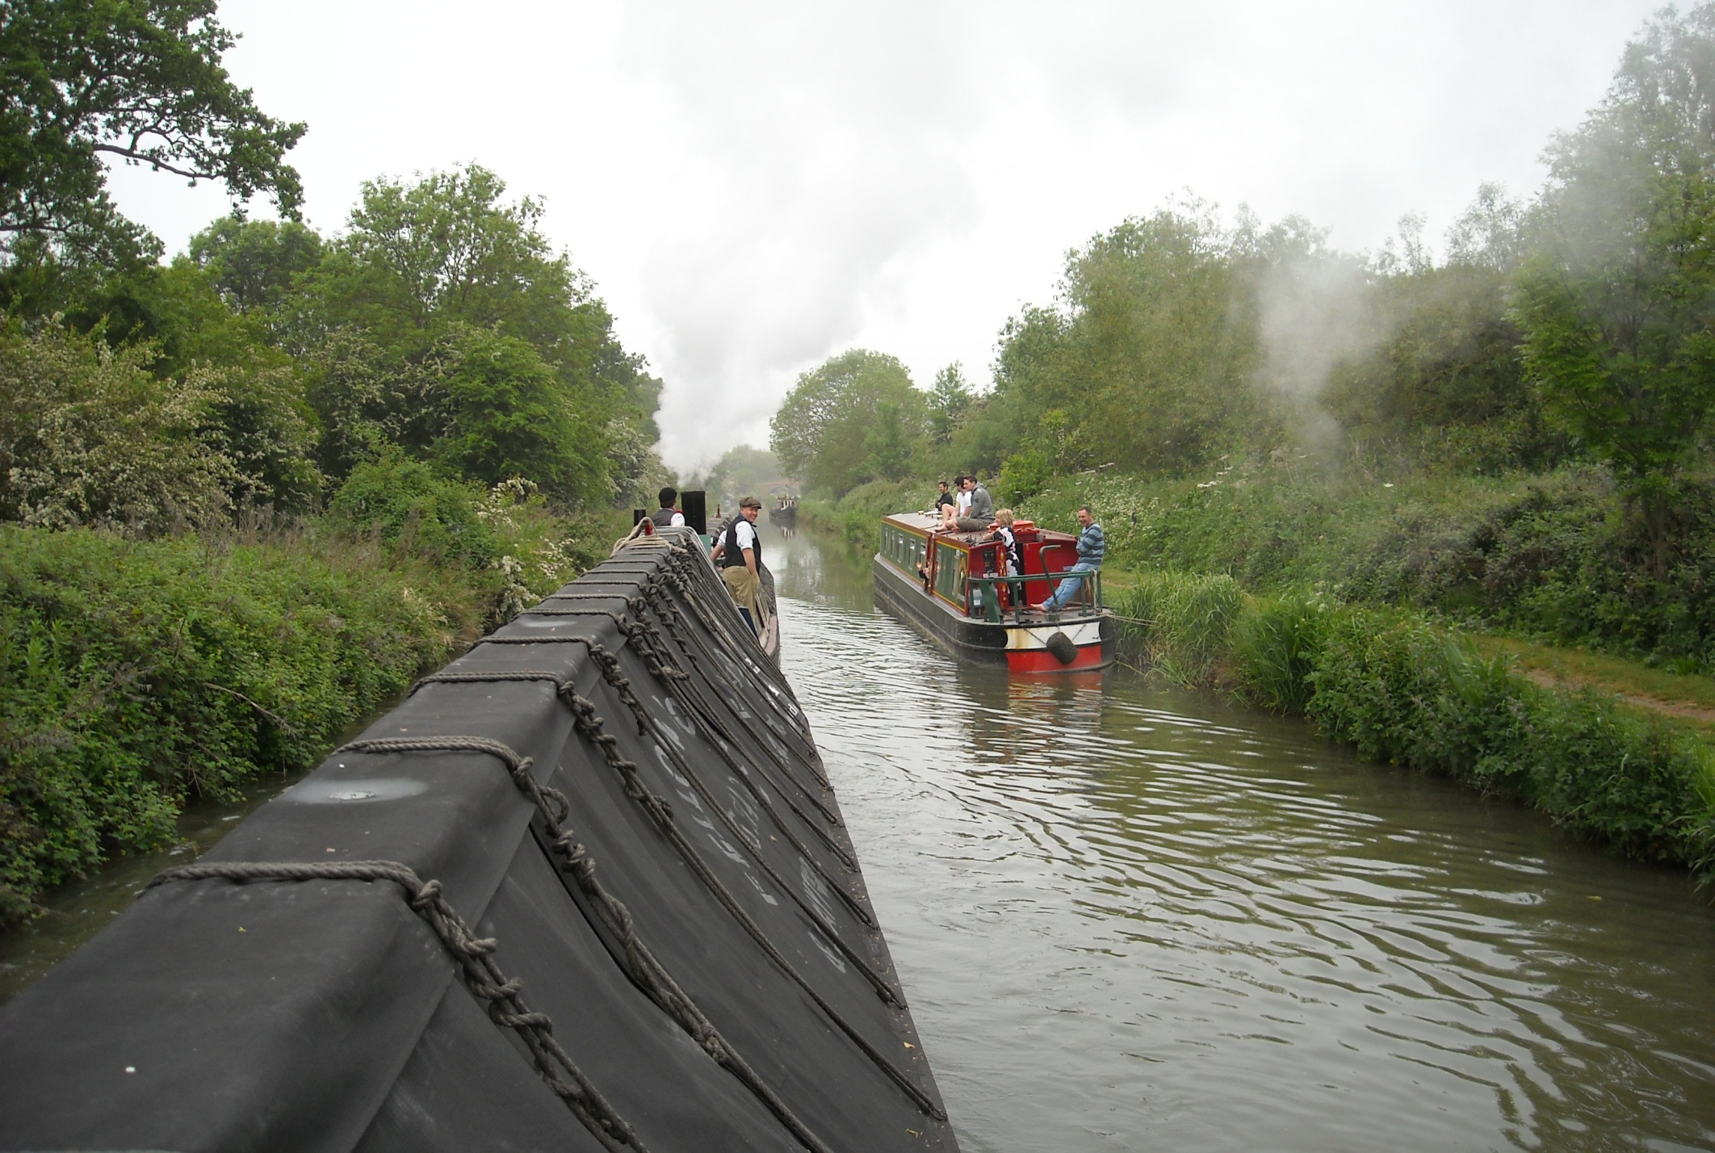
One tends to get used to the admiring glances and all the photos but President and Kildare are indeed an impressive sight.

Slide 8
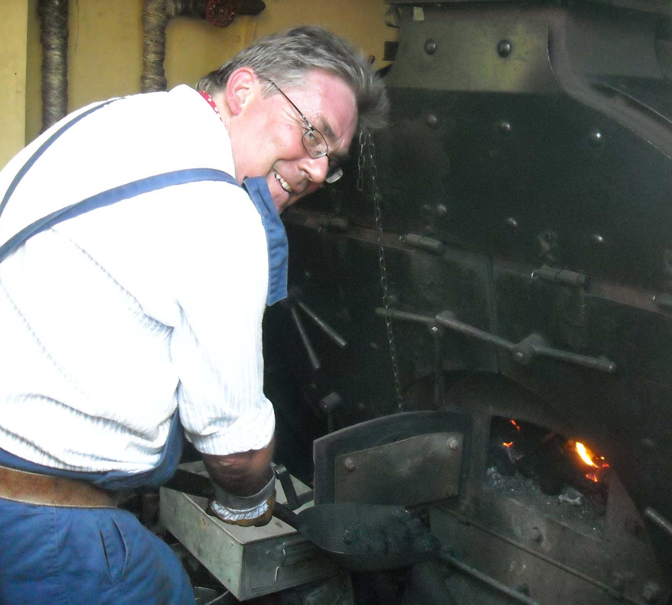
Whilst down in the engine room Malcolm is shovelling away.

Slide 9
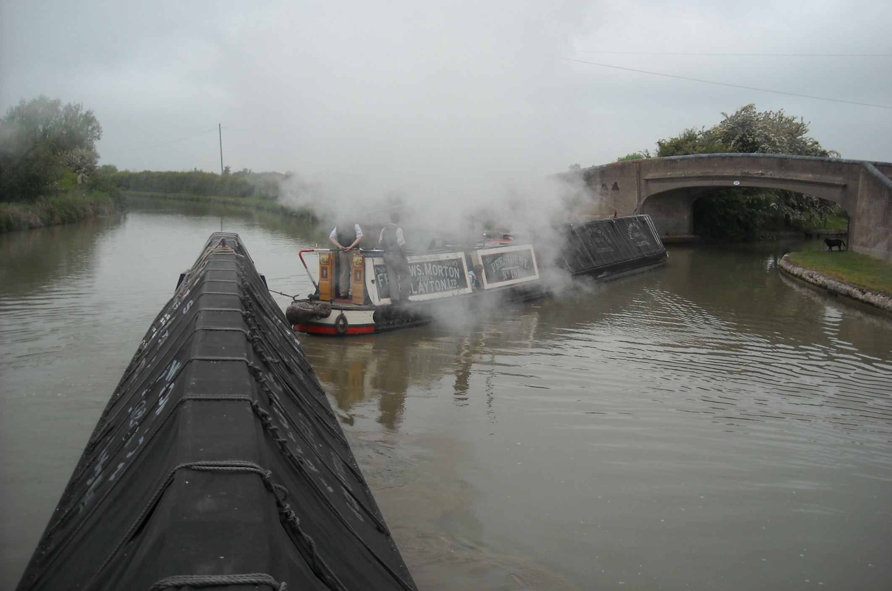
And there is steam to spare as we take the tight Wigram’s Turn that takes the Grand Union towards Warwick and Birmingham.

Slide 10
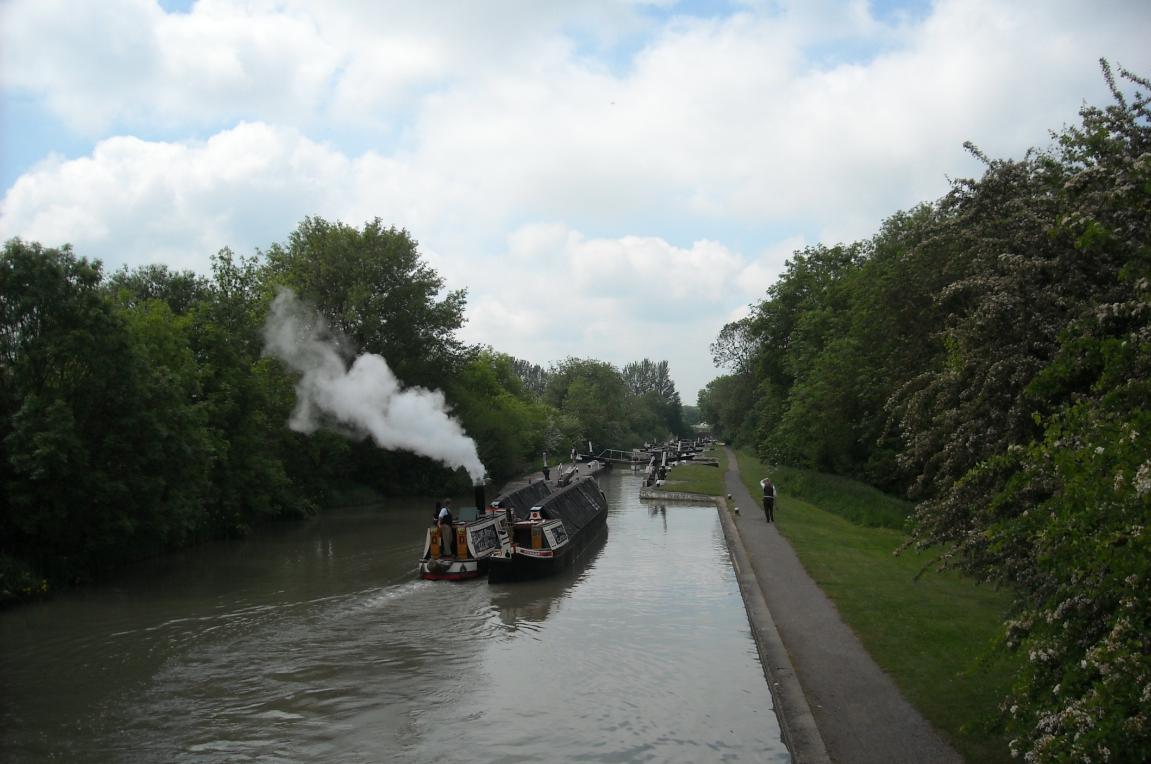
This section was modernised in the 1930’s with faster filling locks that were doubled in width. This is Stockton flight.

Slide 11
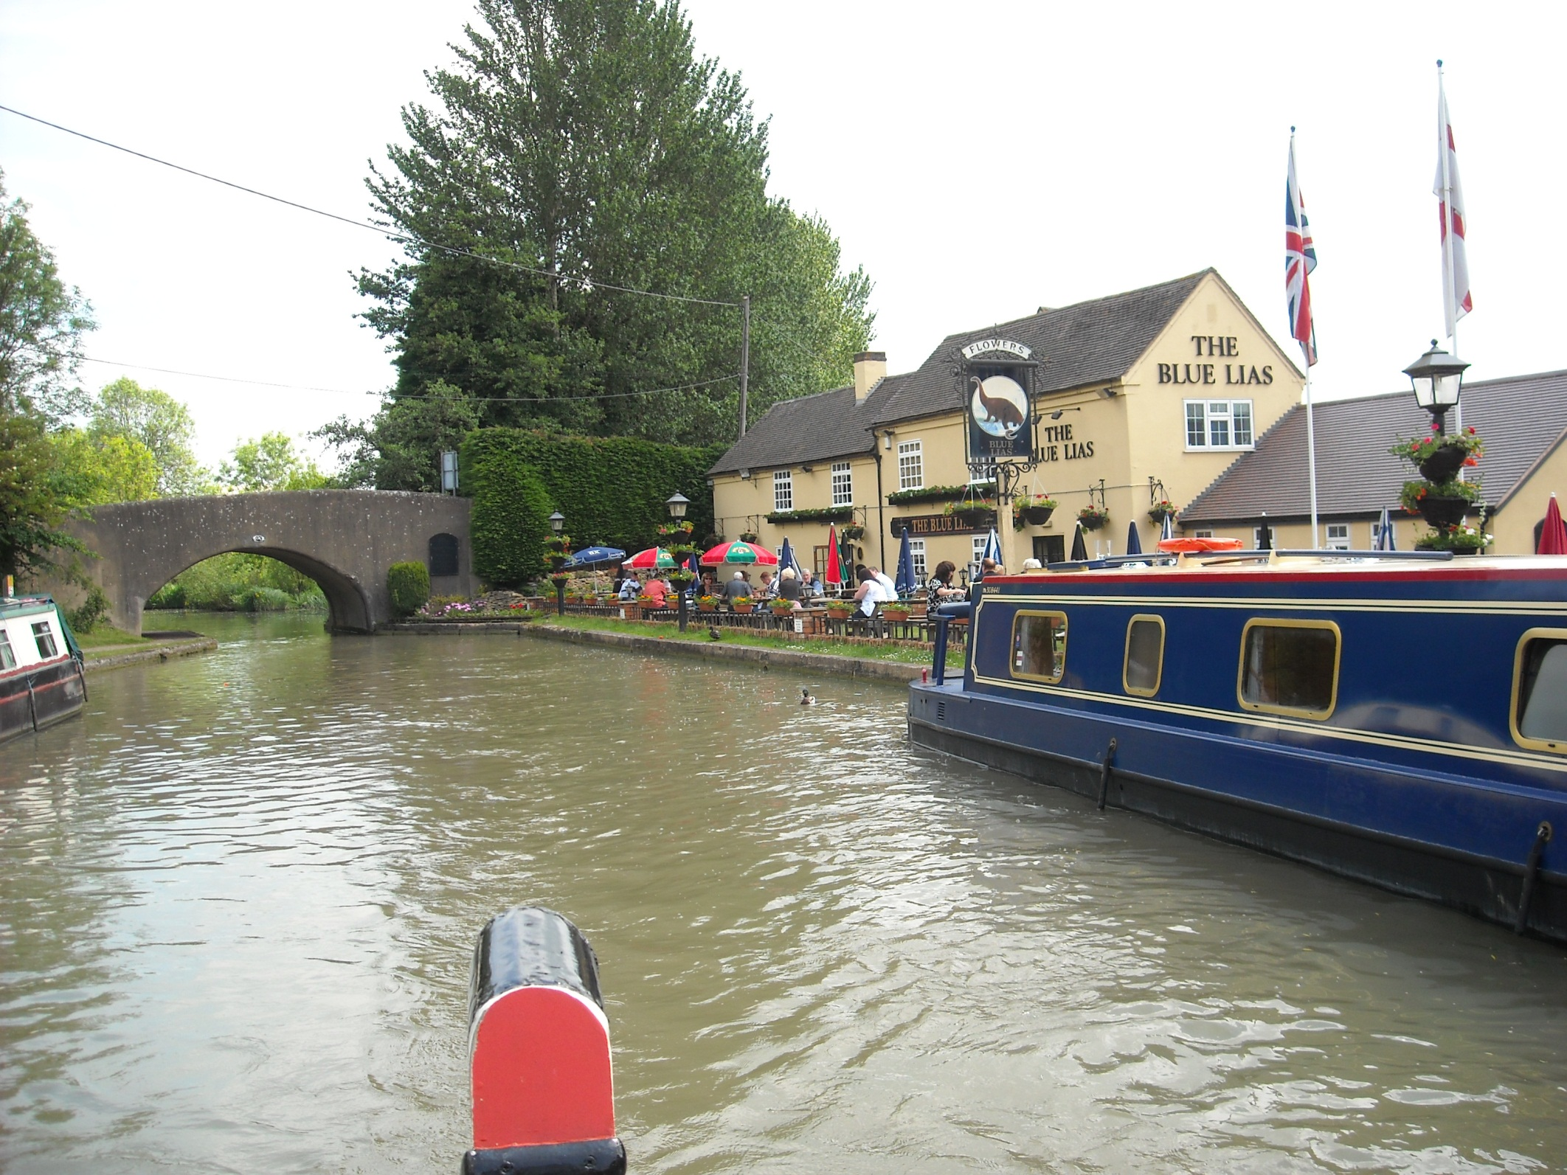
Which has a well known canalside pub at the bottom.

Slide 12
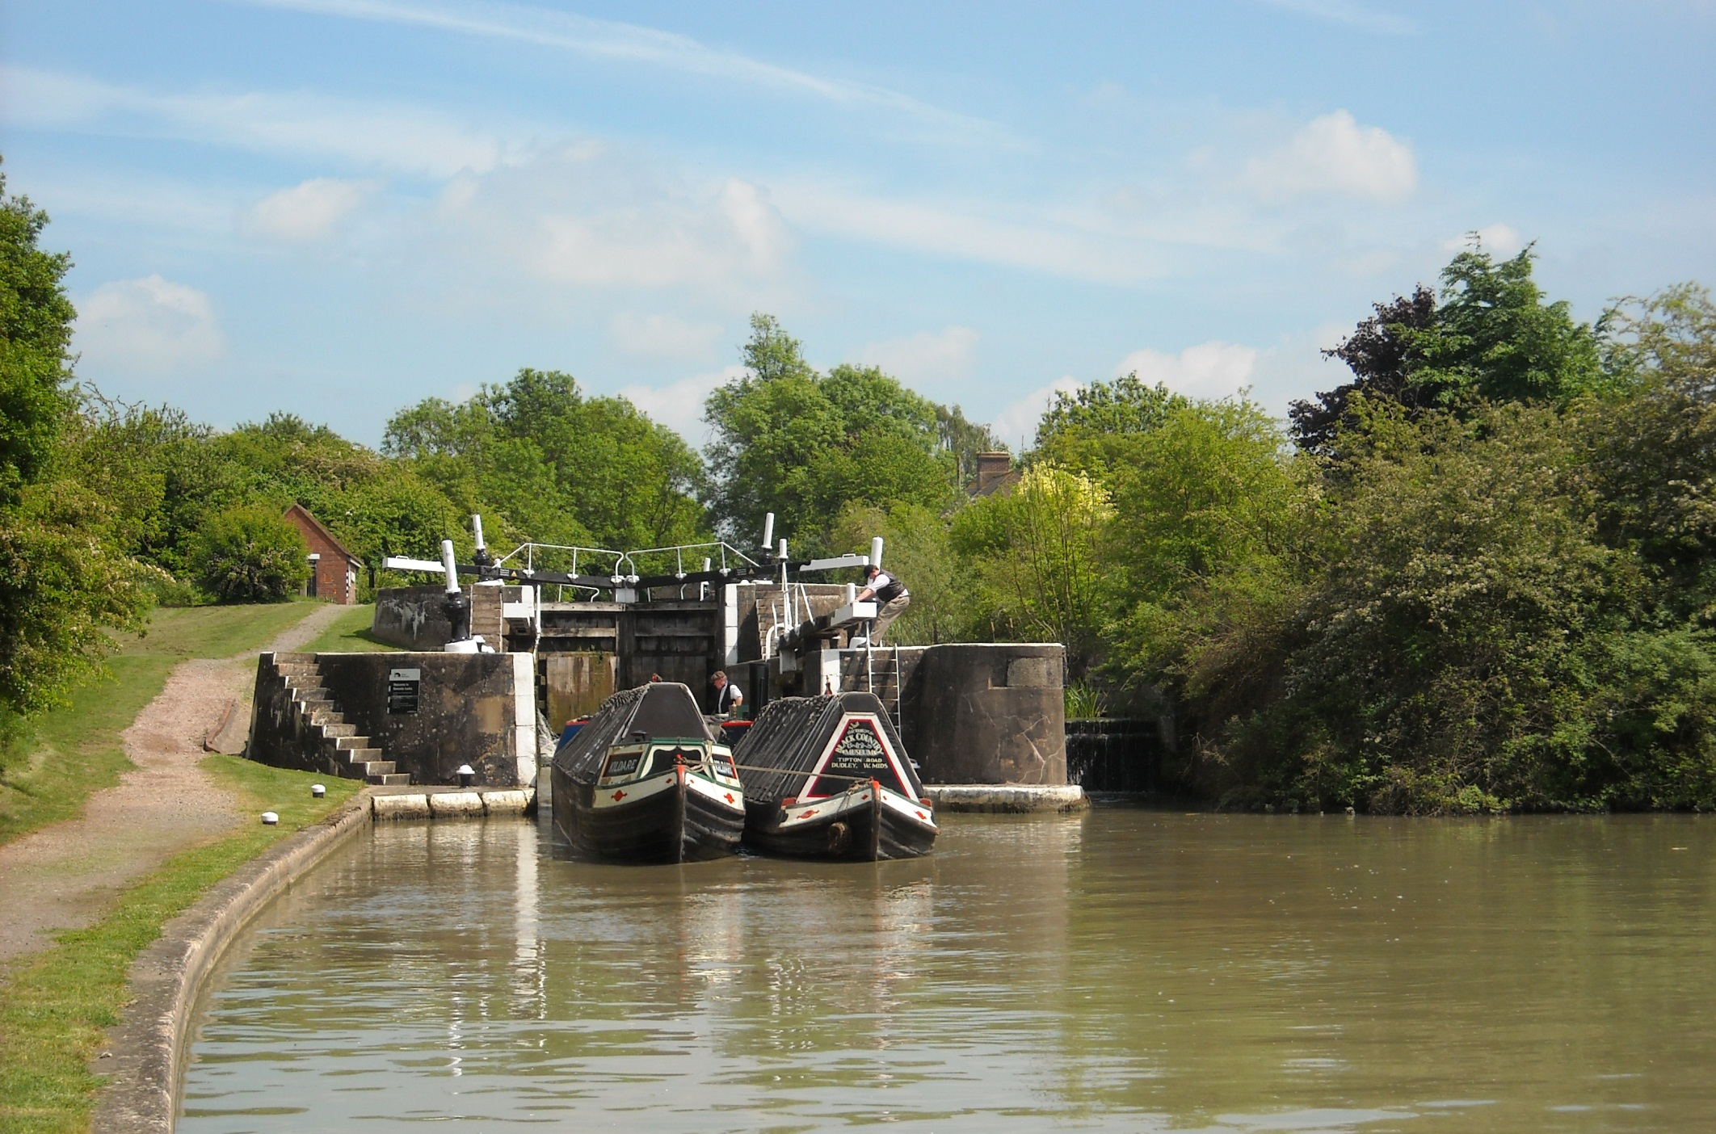
Leaving Bascot staircase now, where the tall bottom gate of the top lock becomes the top gate of the lock below.

Slide 13
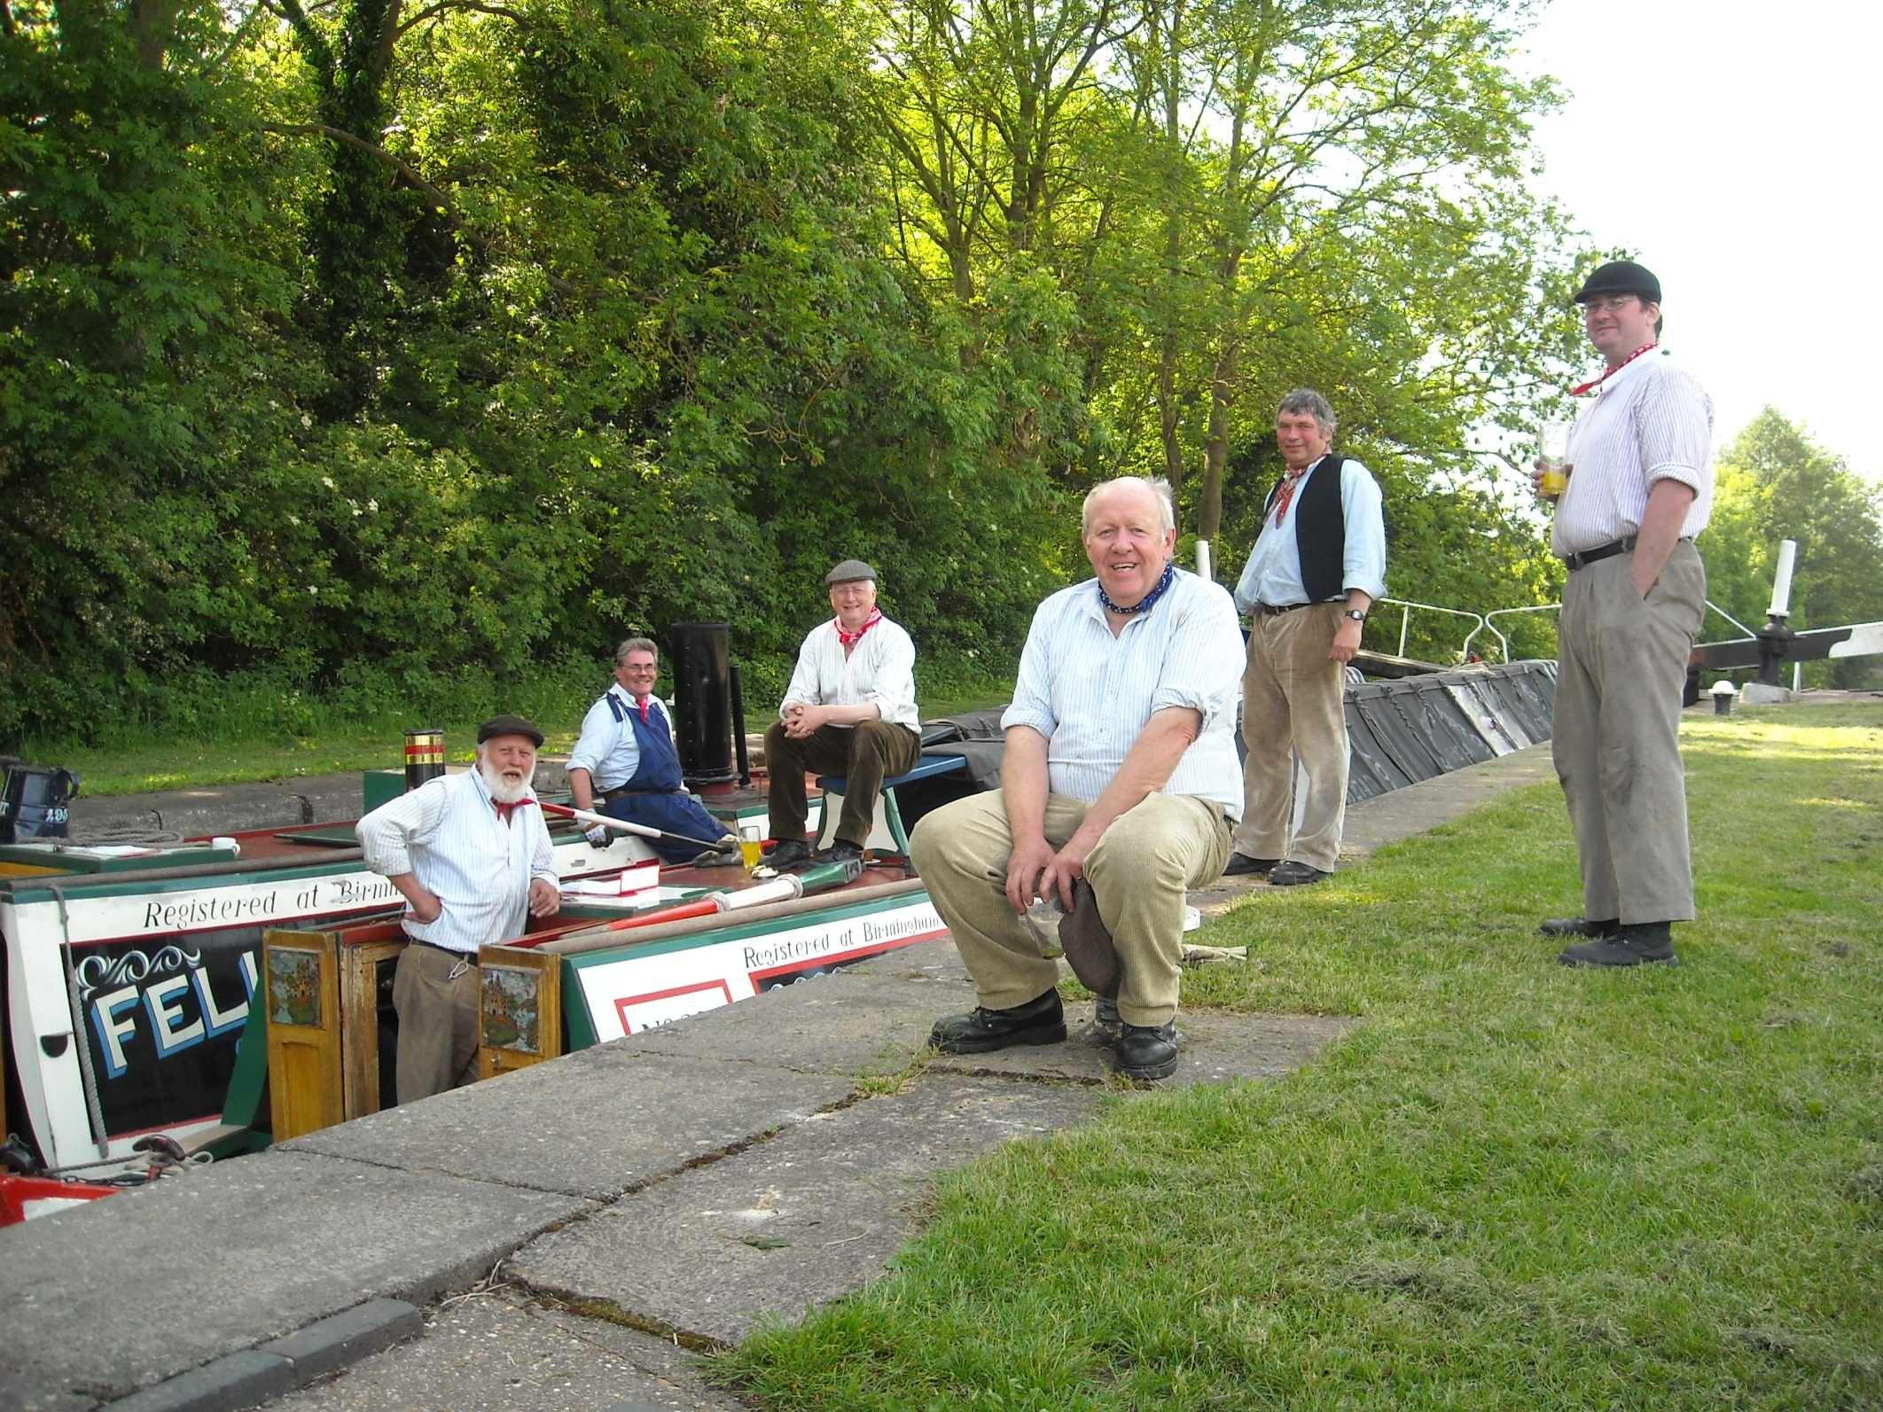
And a lock side break for the crew on this warm day.

Slide 14
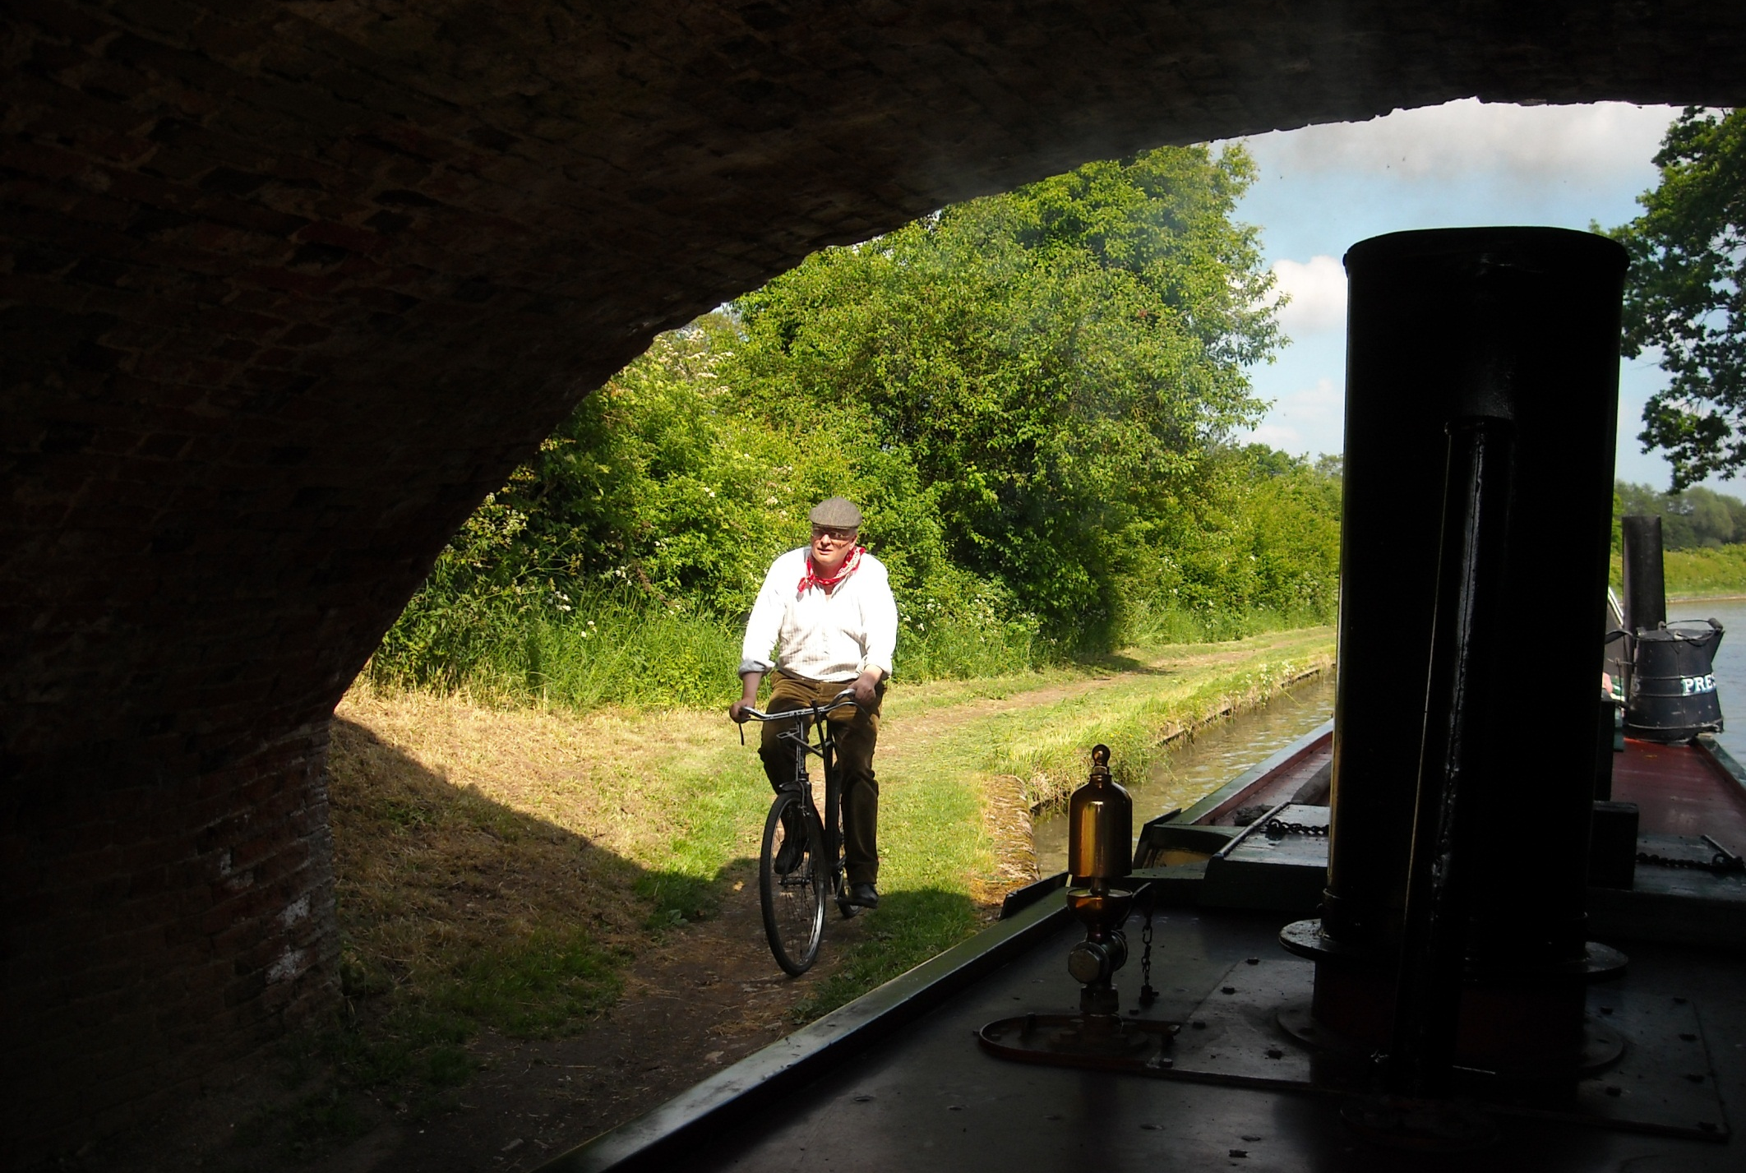
Locks are widely spaced now and President’s bike comes in handy for the lockwheeler.

Slide 15
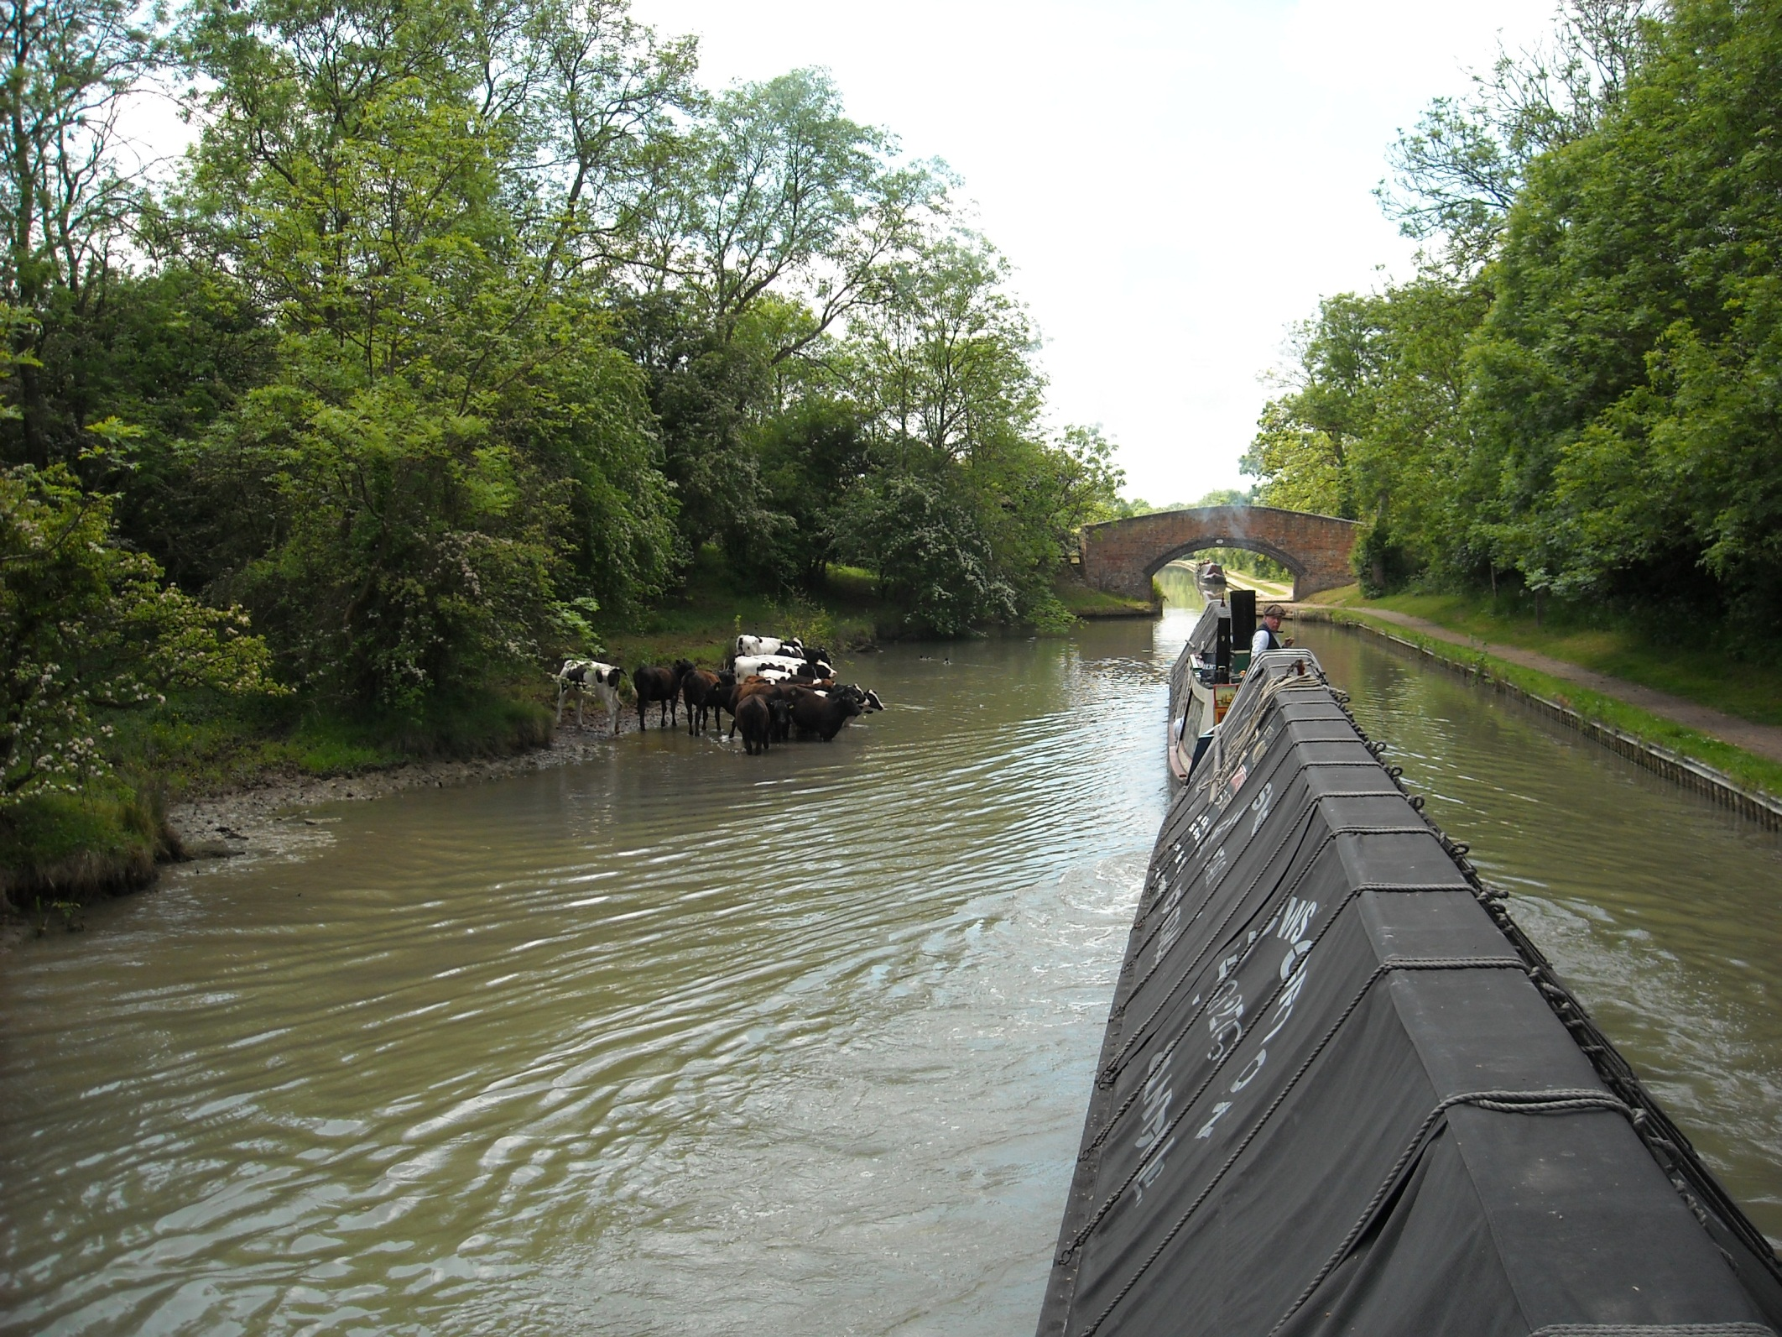
Cows in the cut!

Slide 16
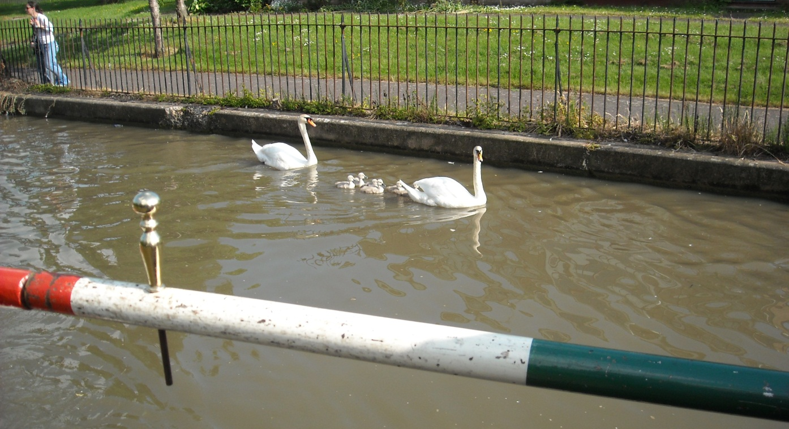
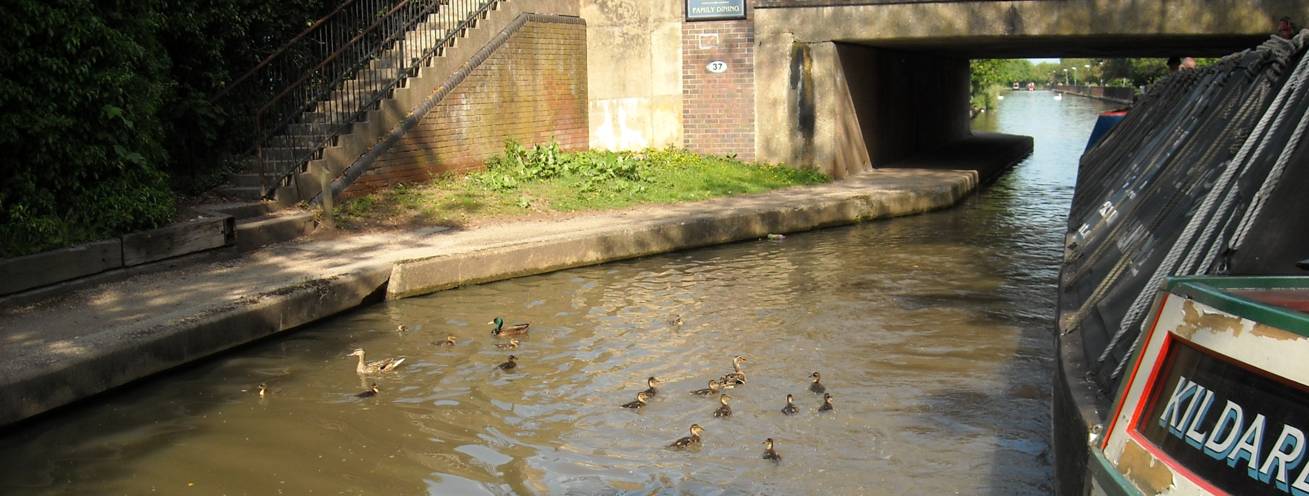
And baby birds in the cut in Leamington Spa.
……………It’s that time of year!

Slide 17
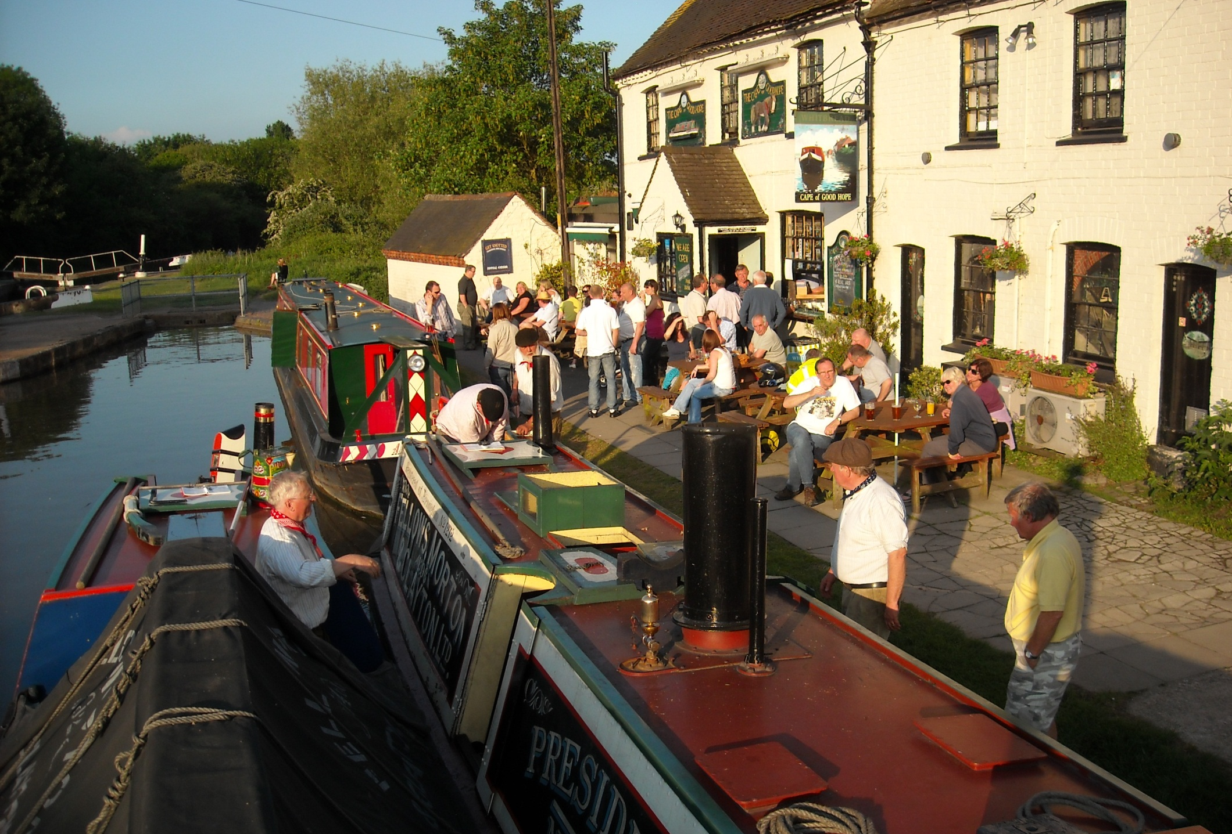
And a great welcome and a perfect overnight mooring by Cape Locks in Warwick.

Slide 18
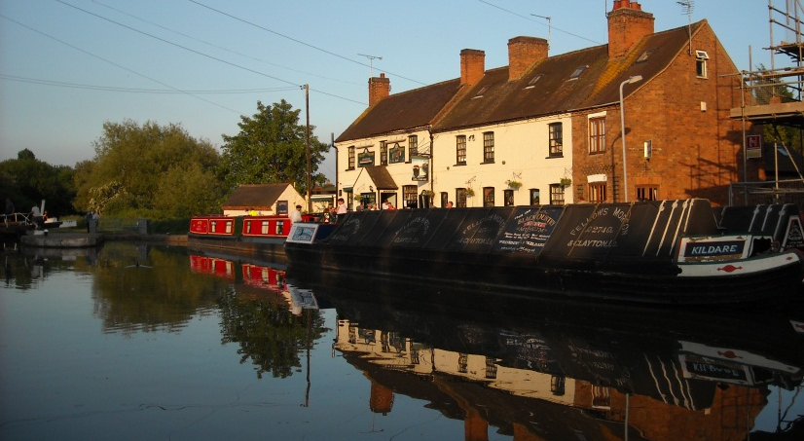
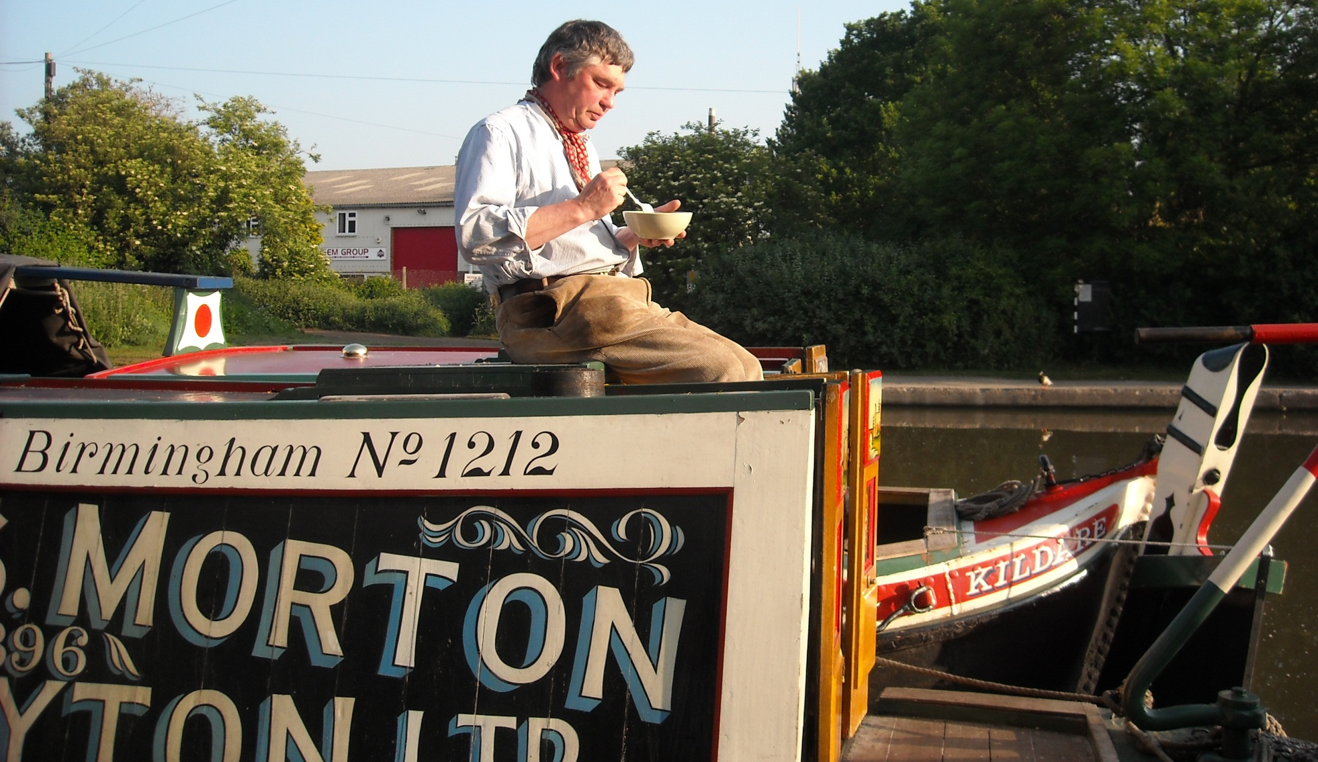
Breakfast at The Cape as another lovely day unfolds.
Today is to be a 40 lock day.

Slide 19
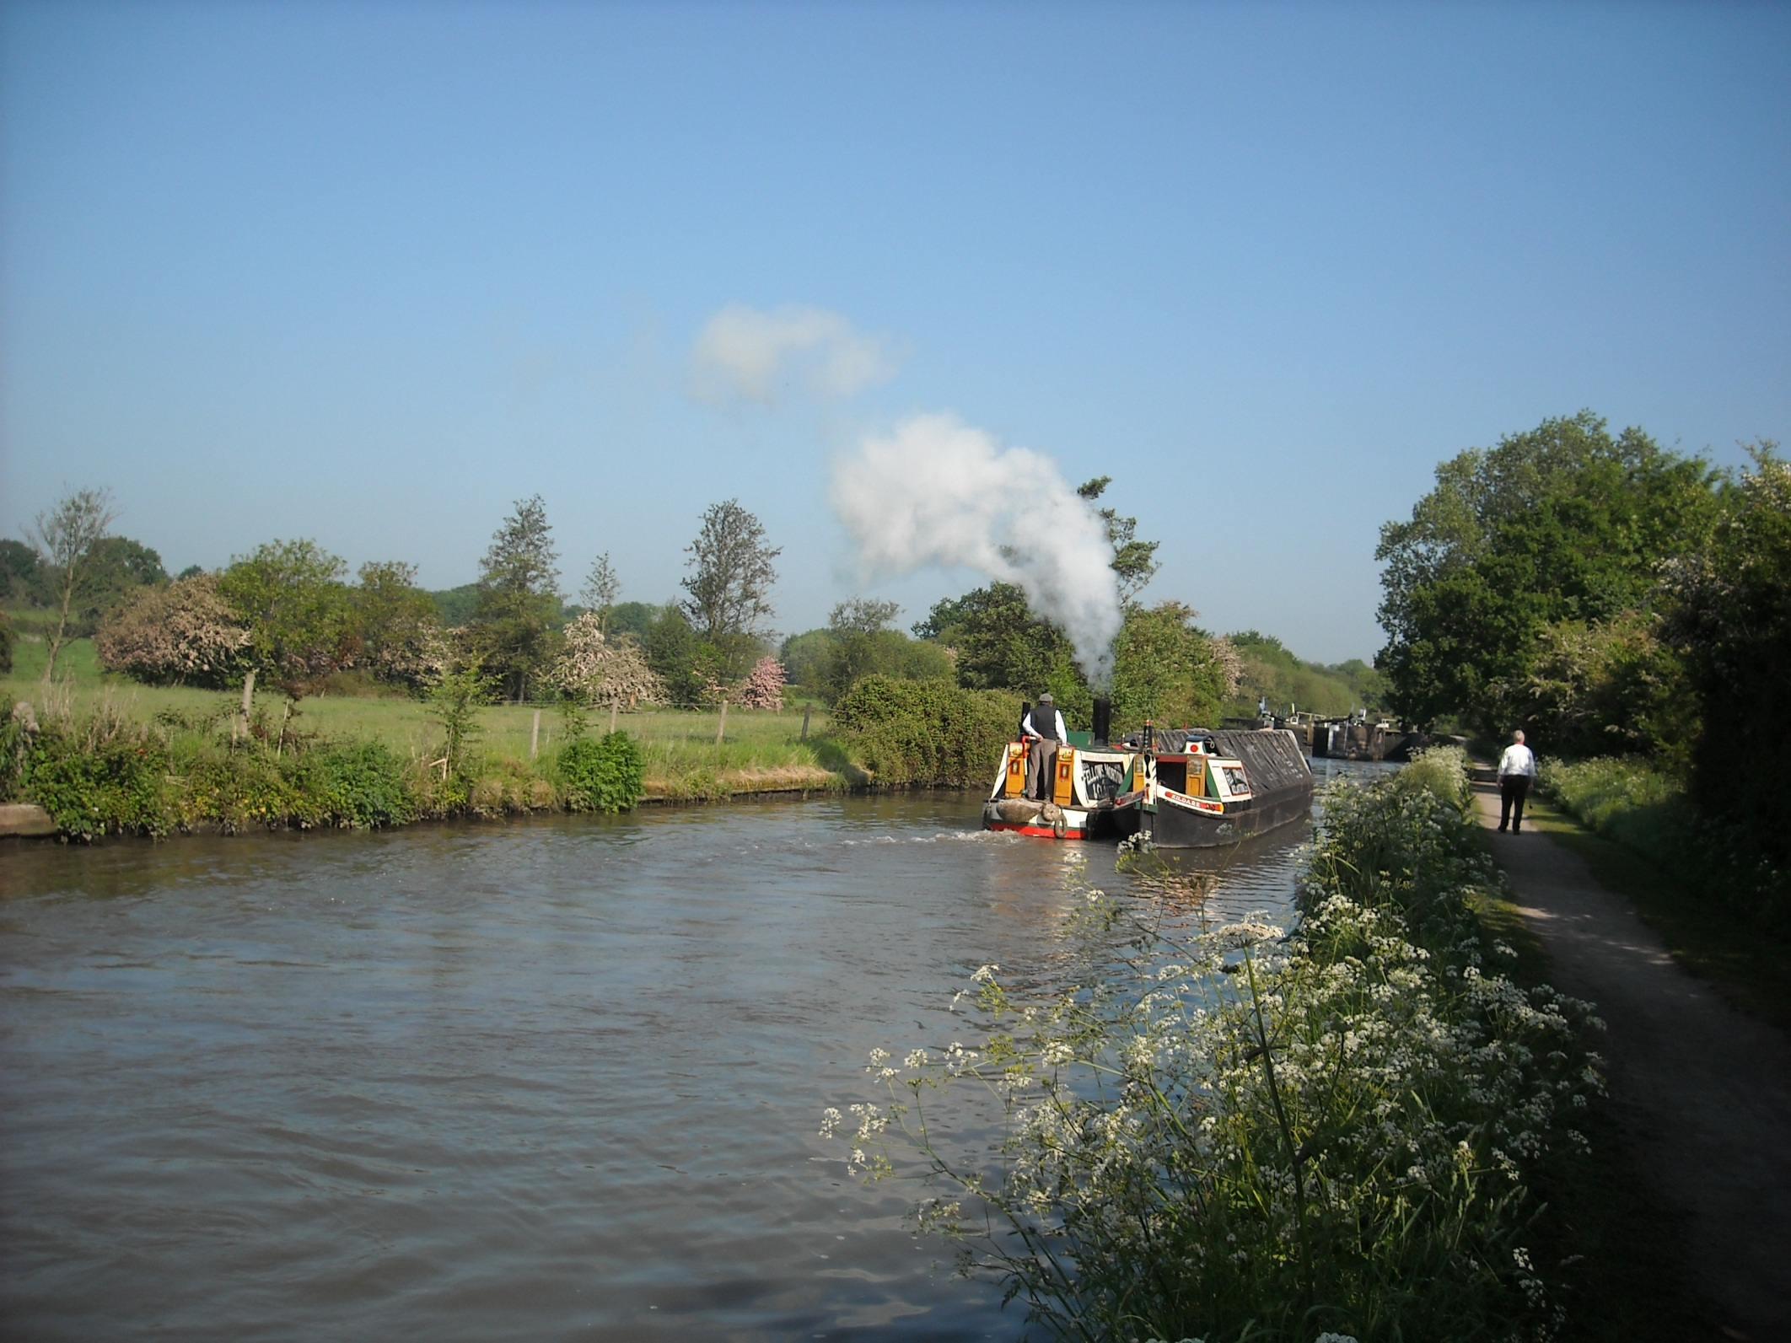
And begins with the 21 locks of the Hatton flight.

Slide 20
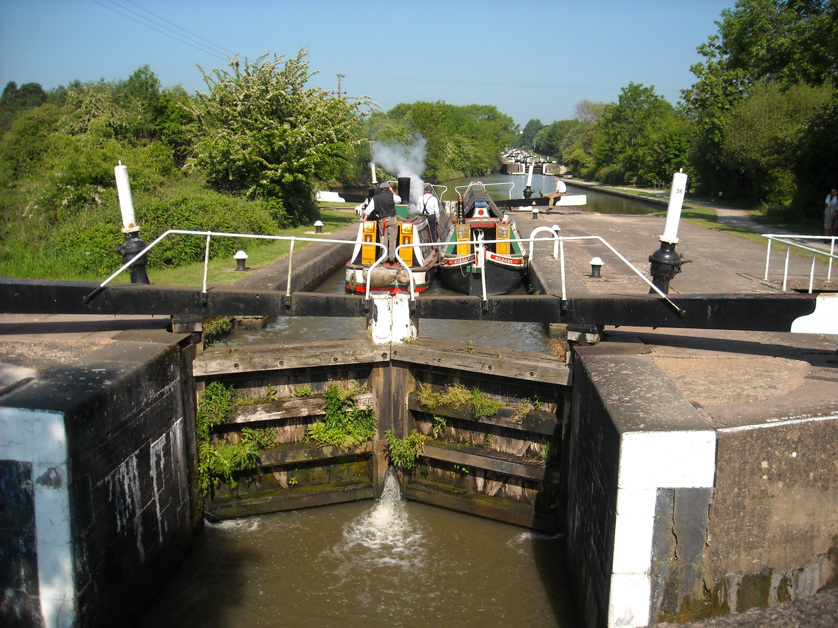
Mostly we have the canal to ourselves.

Slide 21
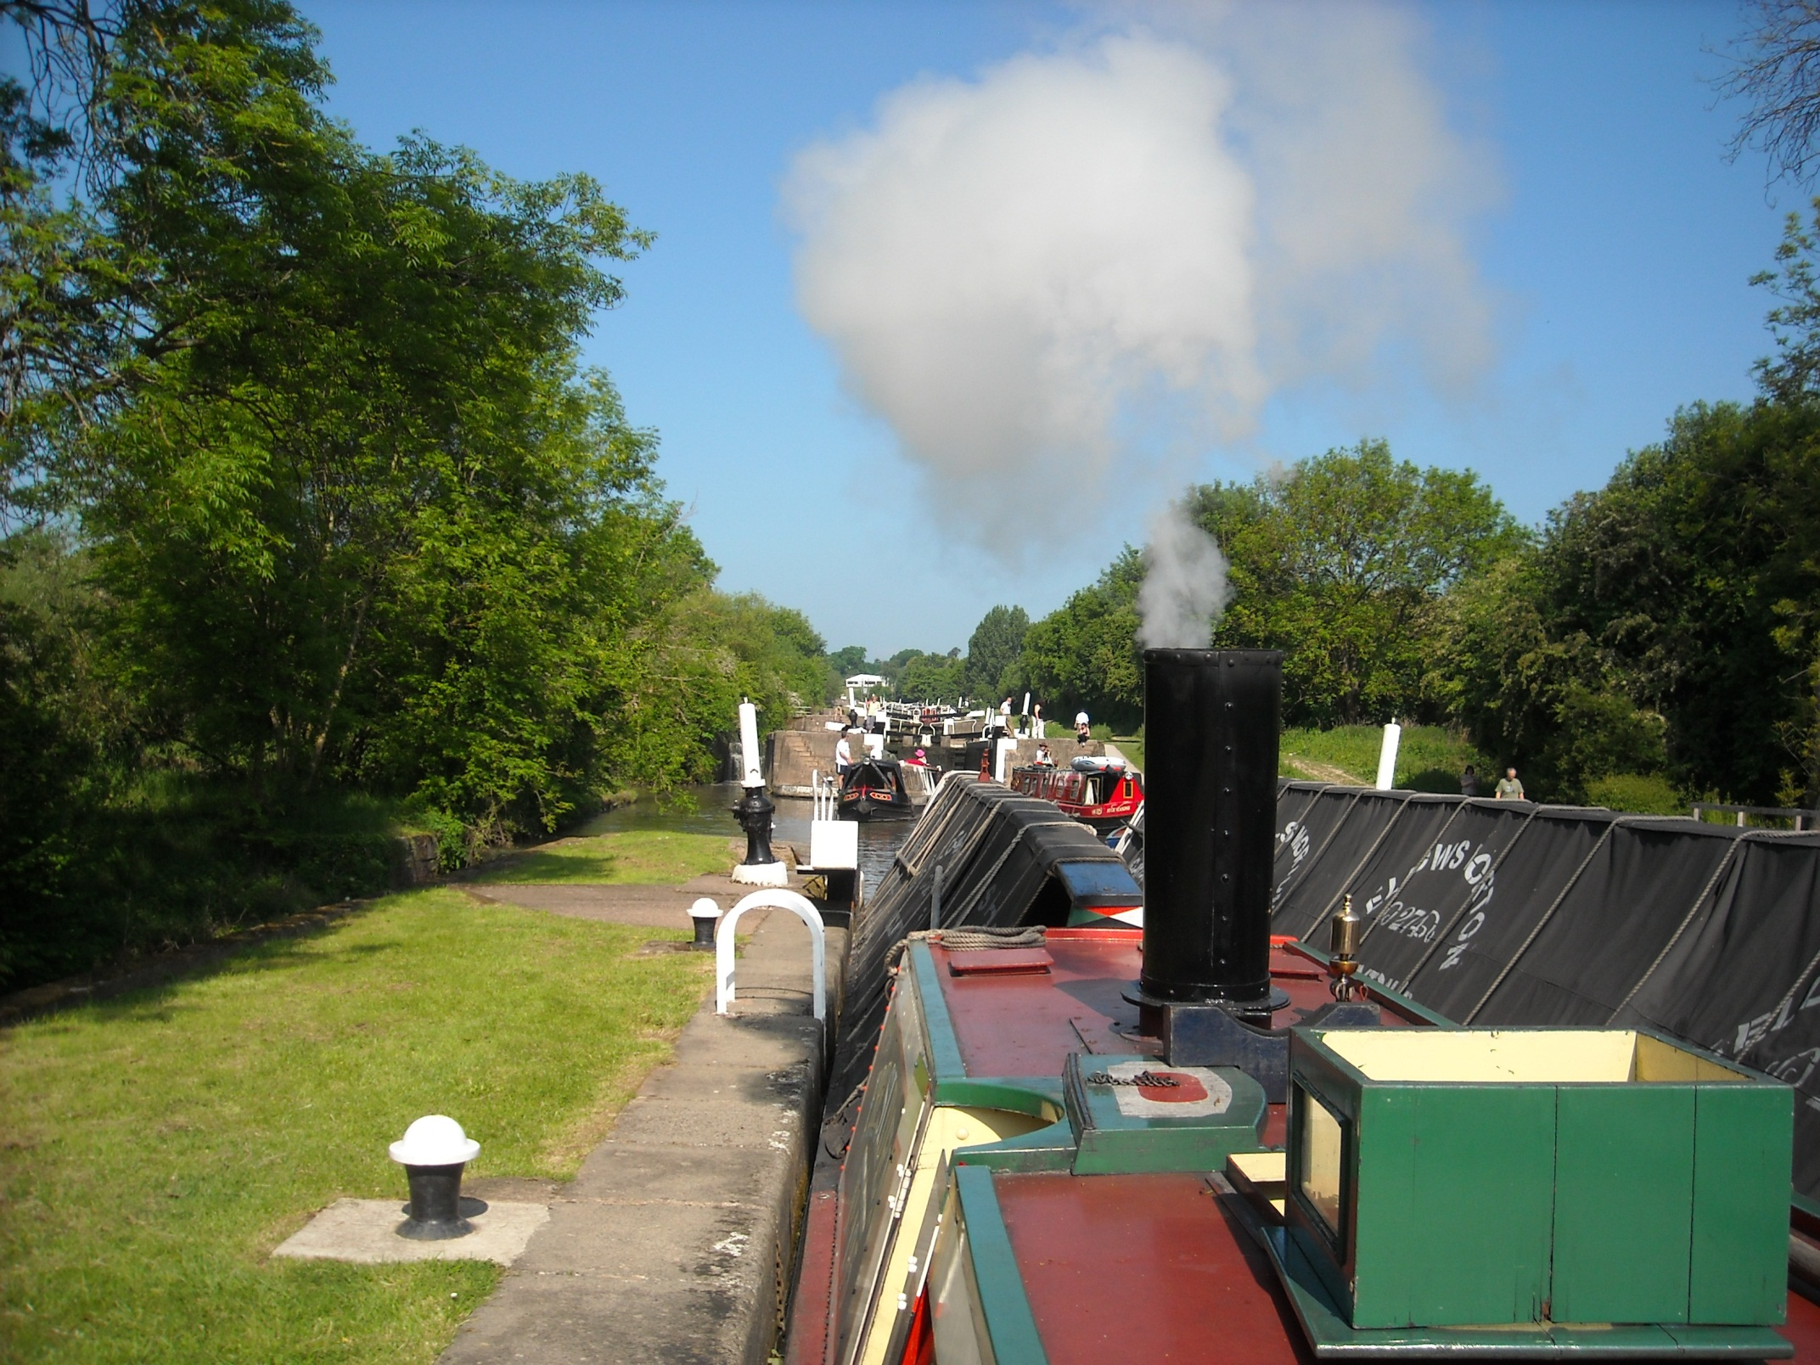
But occasionally do pass in an intervening pound.

Slide 22
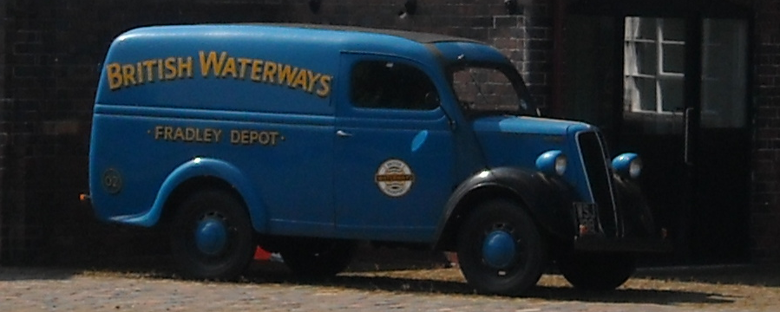
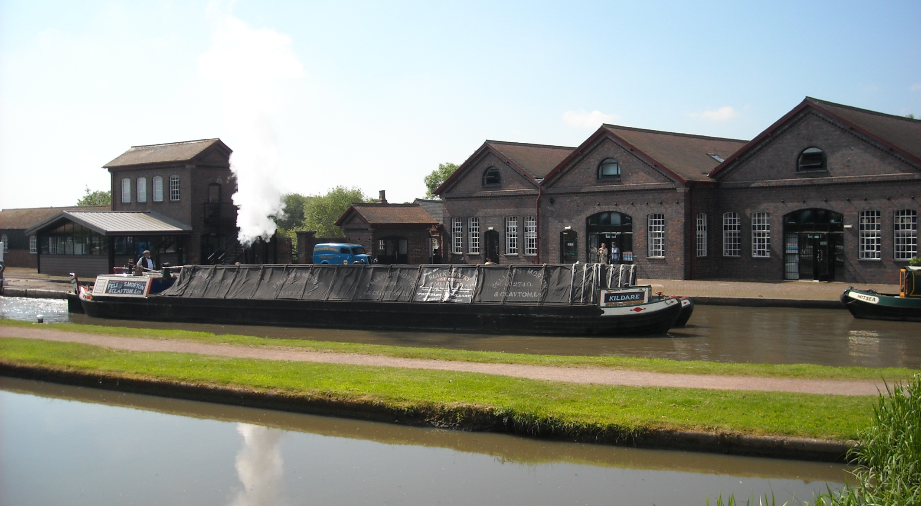
At the top is Hatton yard which has the British Waterways Ford Thames van on display outside.

Slide 23
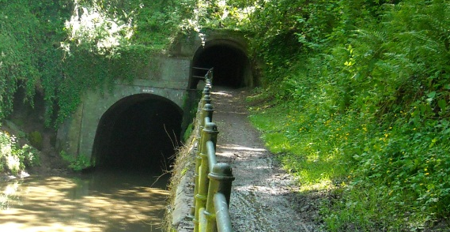
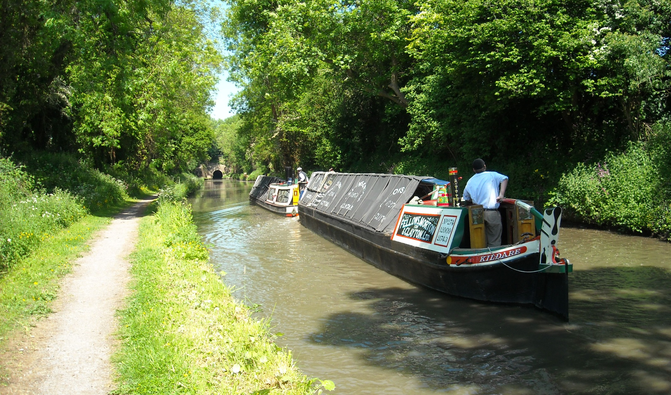
Shrewley Tunnel next, where the last bit of the horse path over the hill has a tunnel of its own.

Slide 24
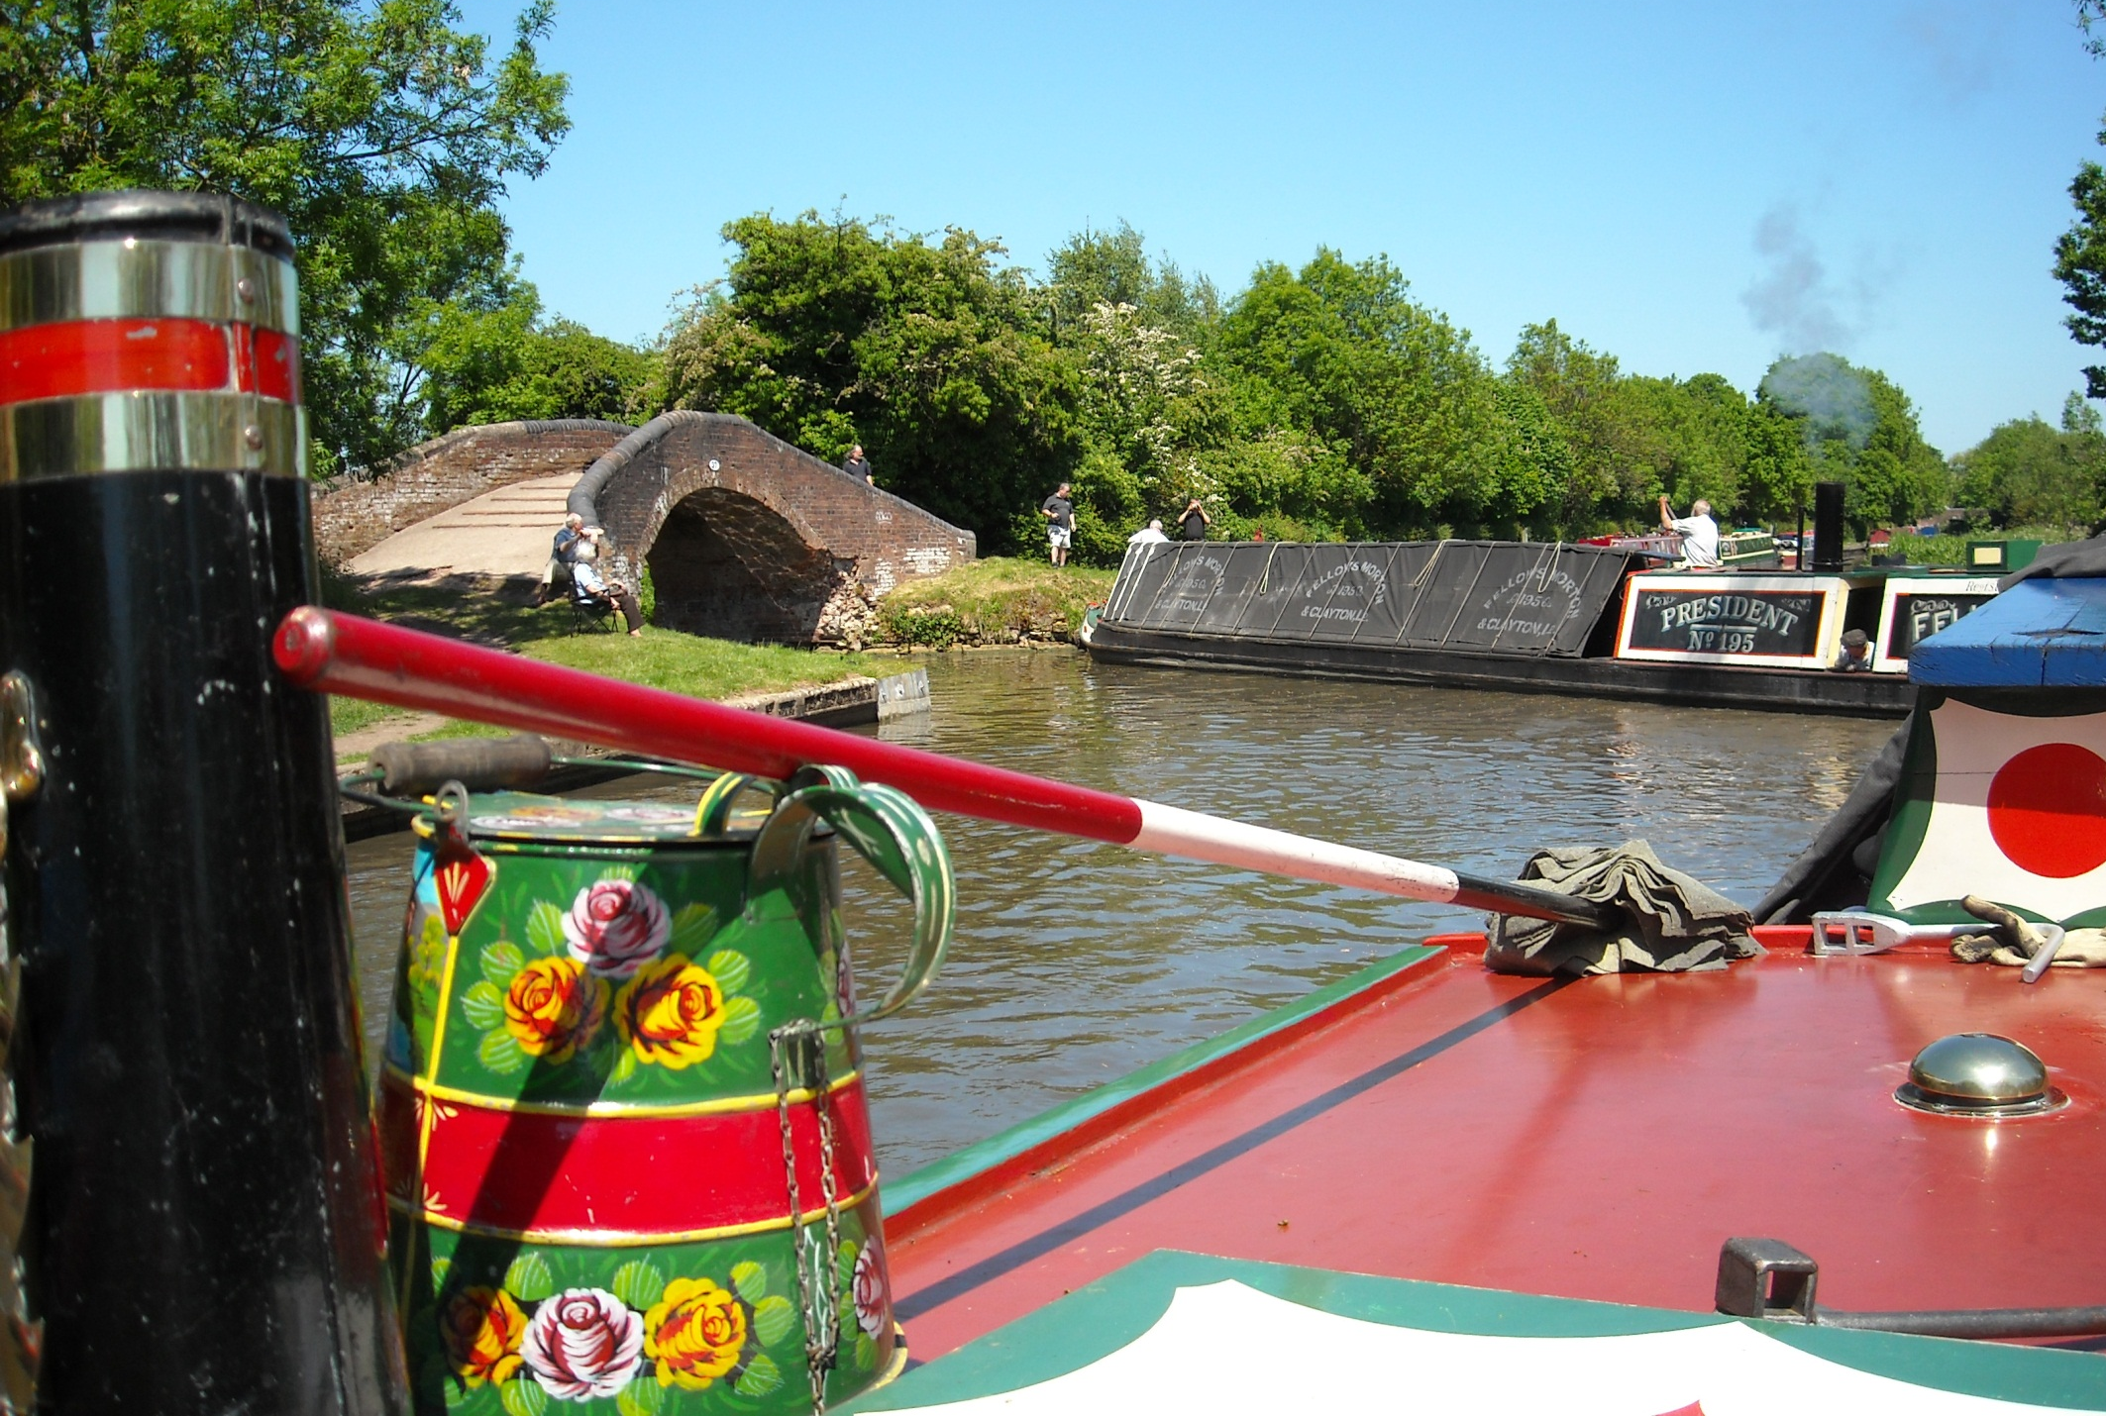
Then came tricky Kingswood Junction. Normally President heads straight on here, keeping to the deeper water Grand Union route.

Slide 25
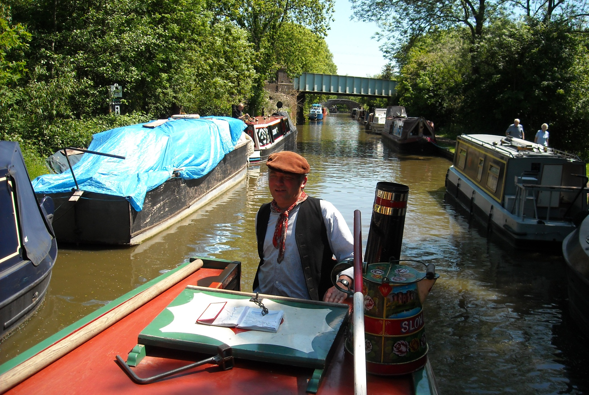
But with a pumping station out of action, British Waterways suggest we take the Northern Stratford Canal instead.

Slide 26
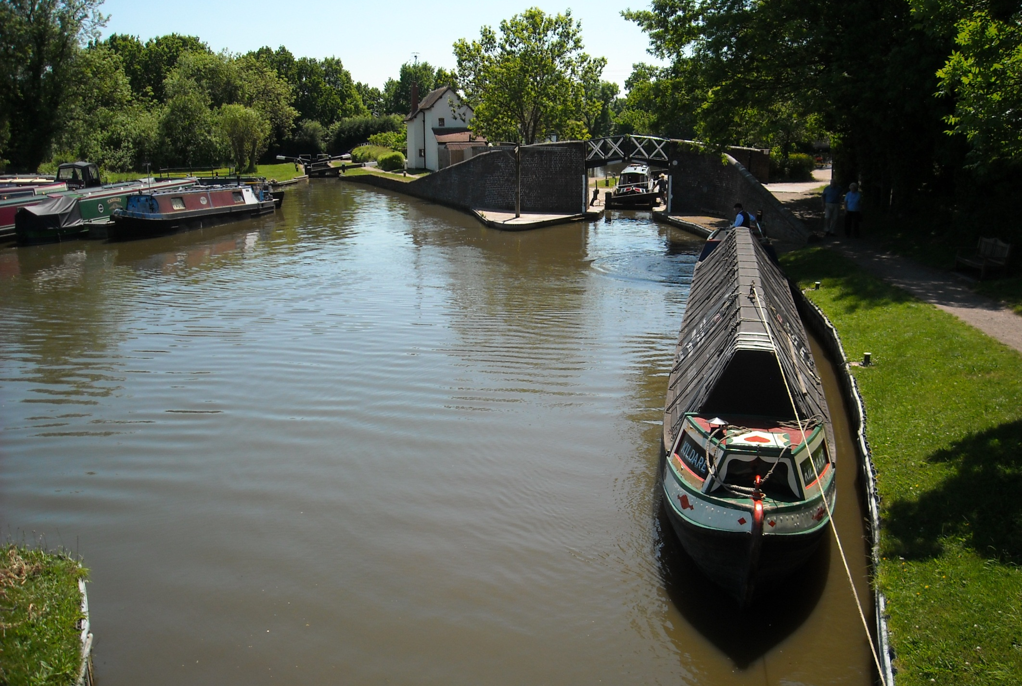
Narrow locks now as Kildare is bow hauled through Lapworth, appropriate propulsion for a 1913 horse boat!

Slide 27
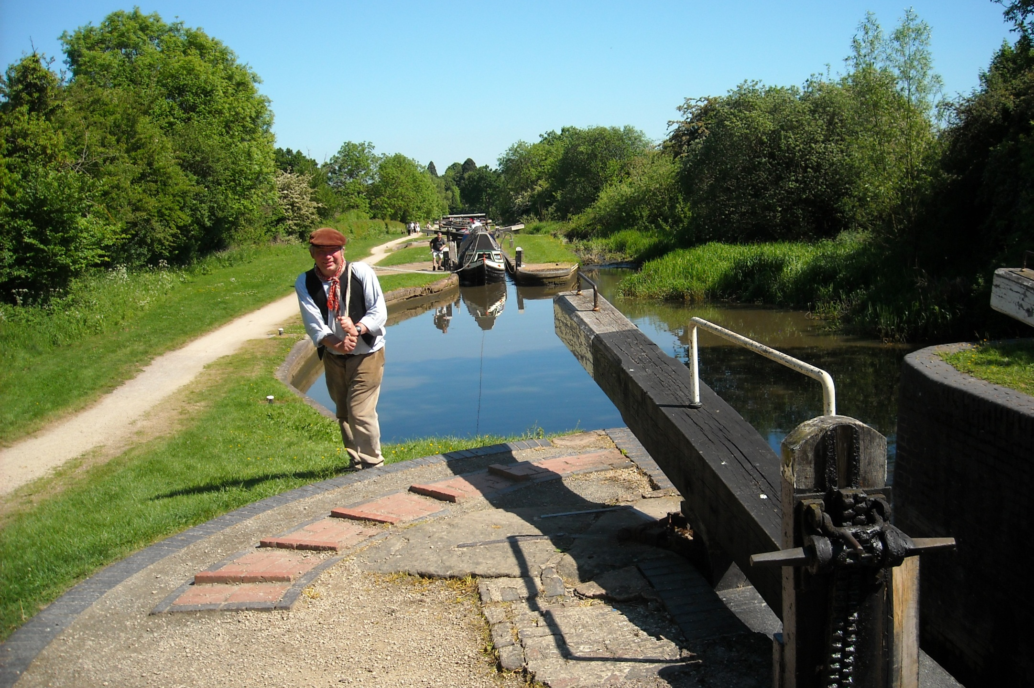
Slowly but surely we ascend the flight. Kildare has crew quarters, neatly fitted out with bunk beds and kitchen equipment.

Slide 28
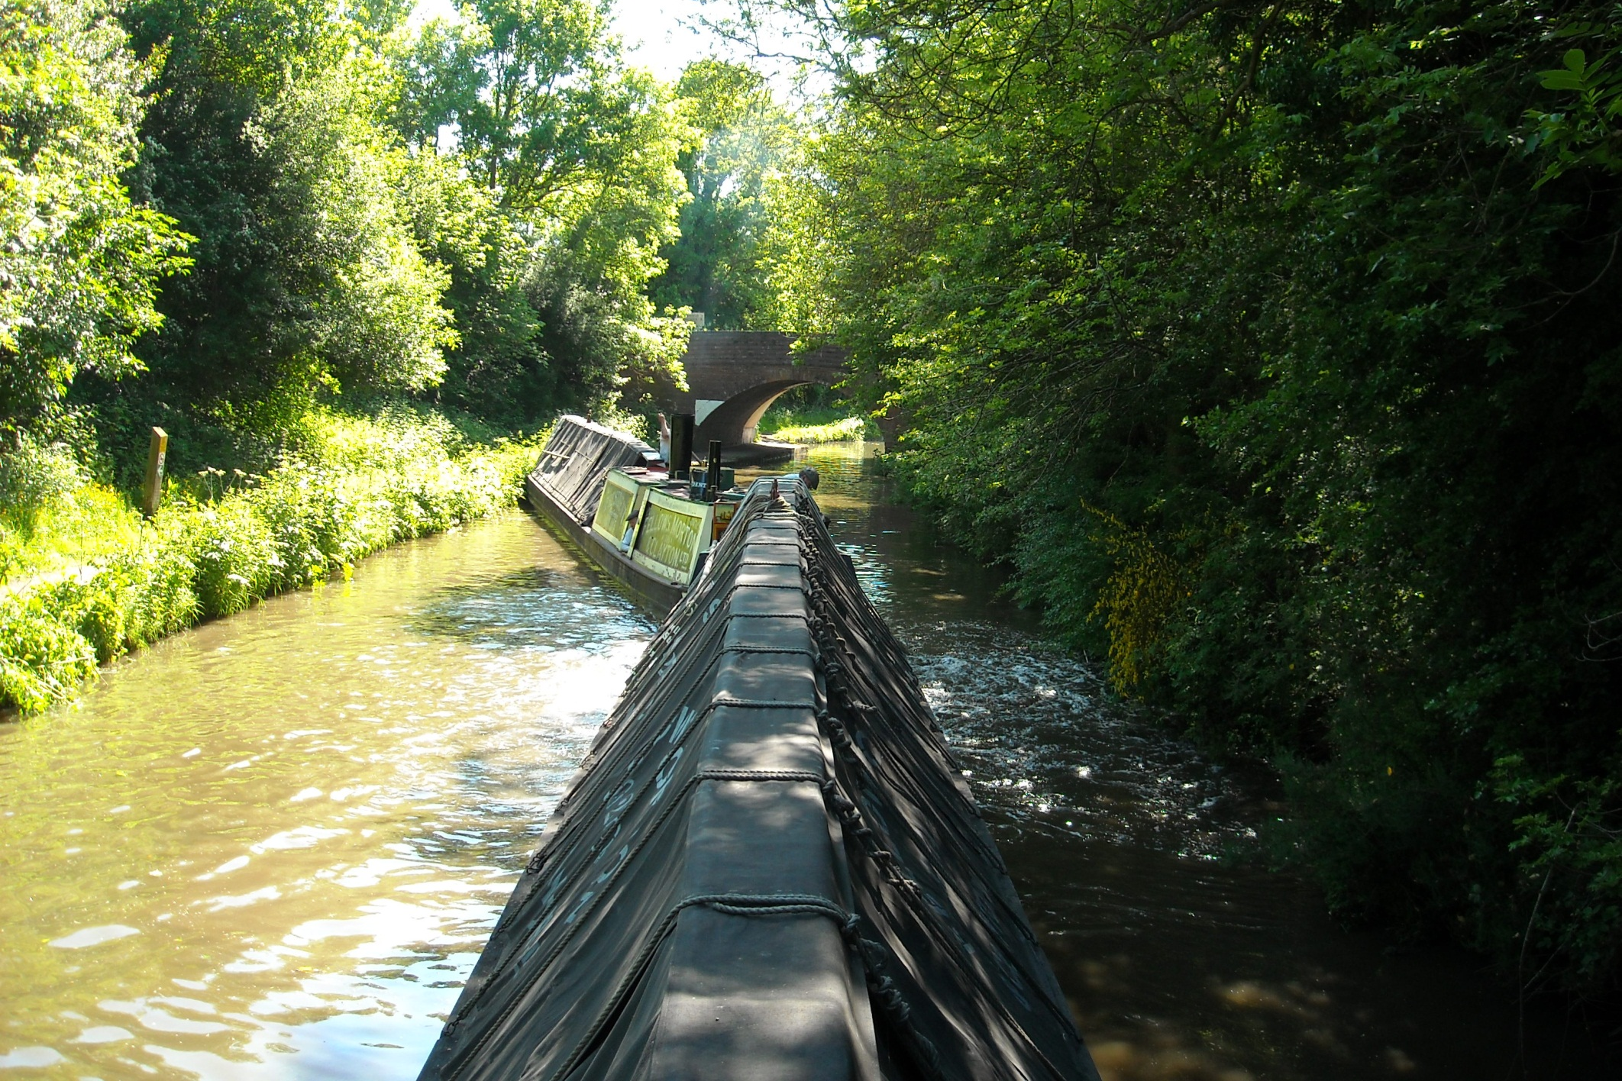
Bridge 31 saw our first difficult shallows. It took an hour and a half to get through this bridge and it needed our Tirfor winch.

Slide 29
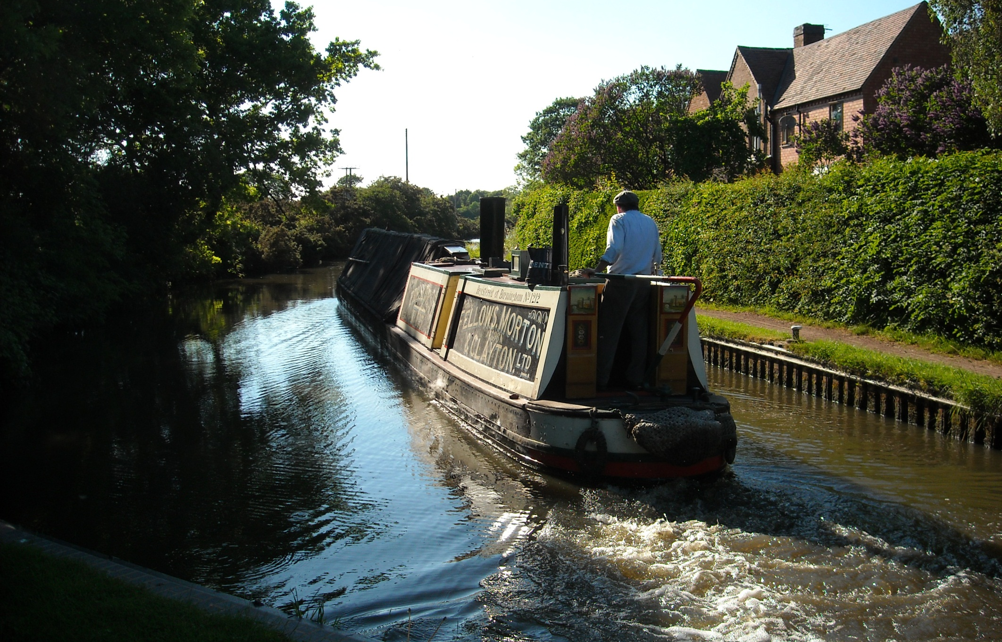
President tackled the final four Lapworth locks alone. Drawing over 3ft President is deep in the water for modern canals.

Slide 30
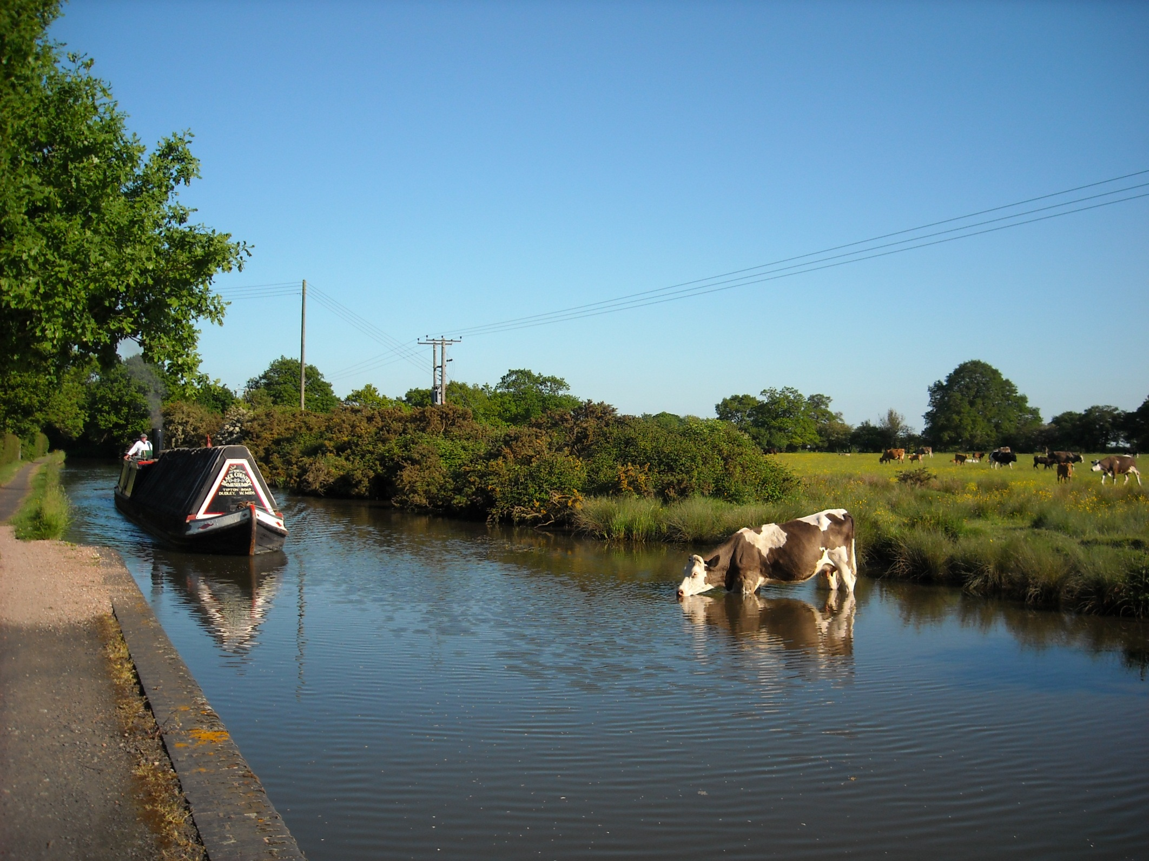
Another cow in the cut.

Slide 31
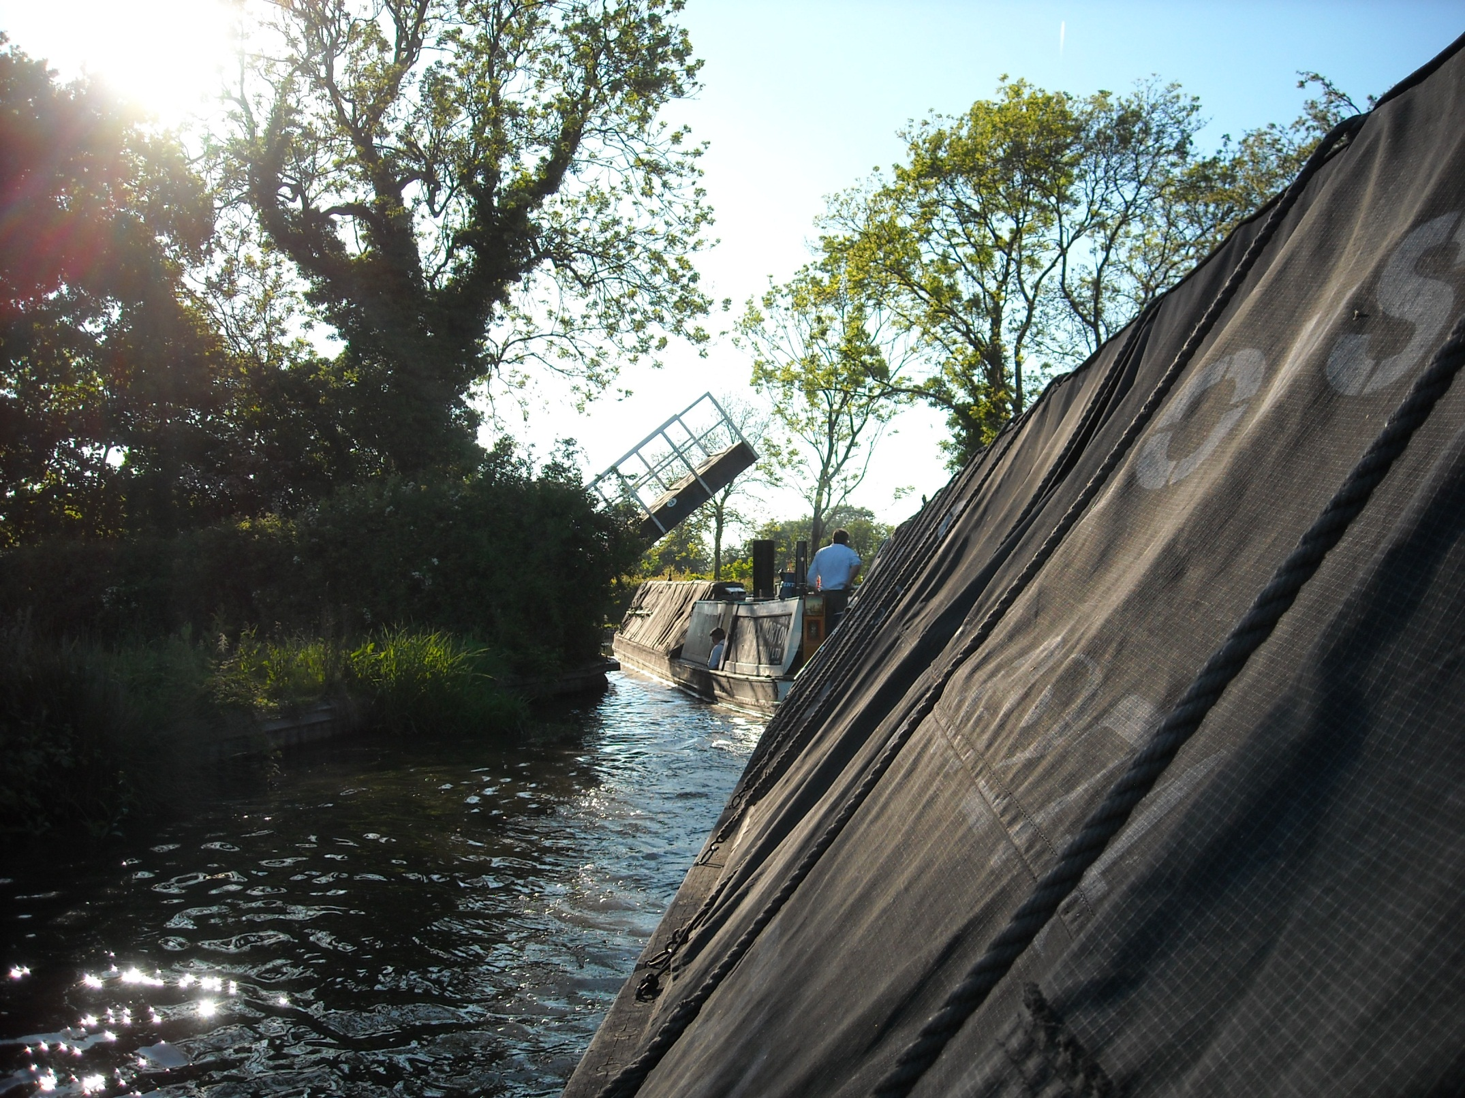
And an attractive end of day lift bridge.

Slide 32
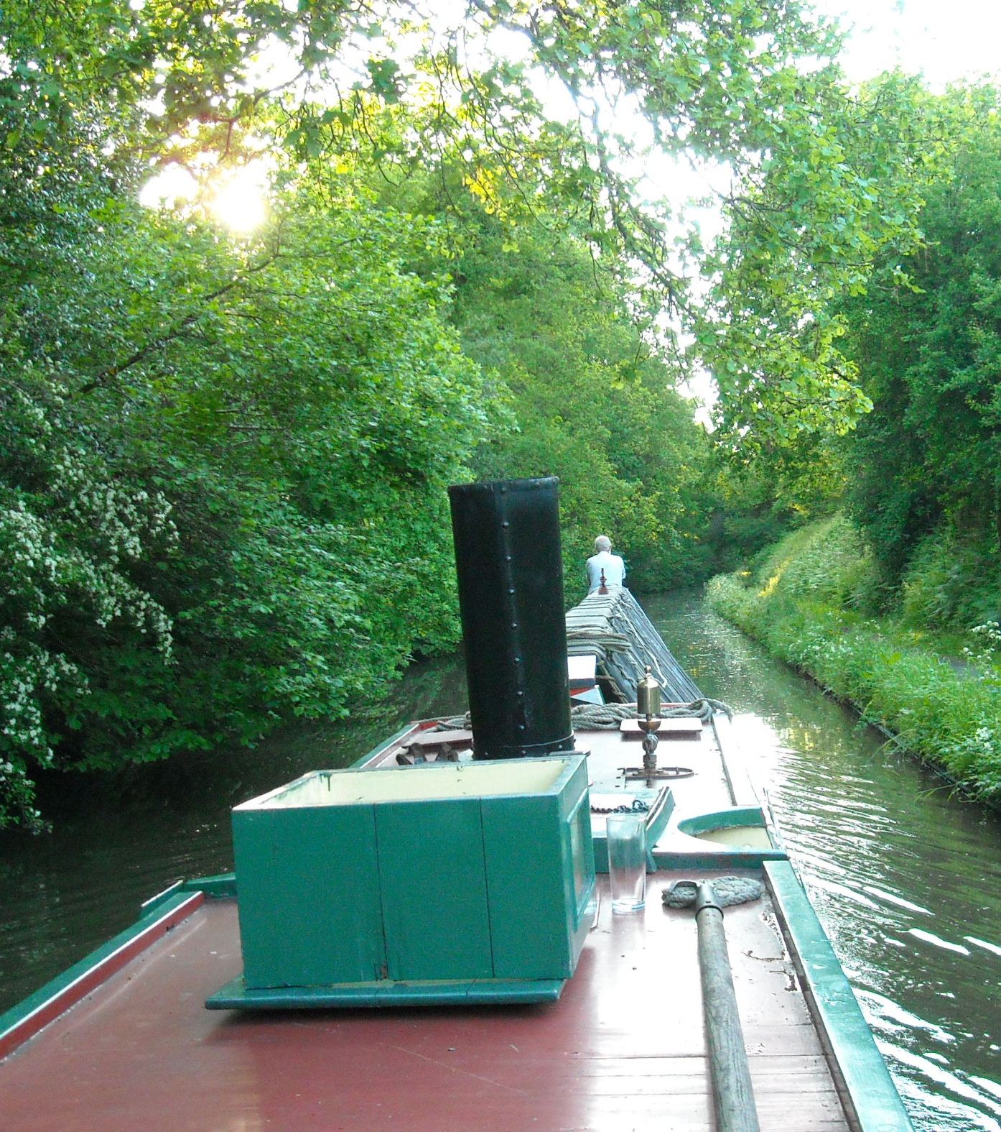
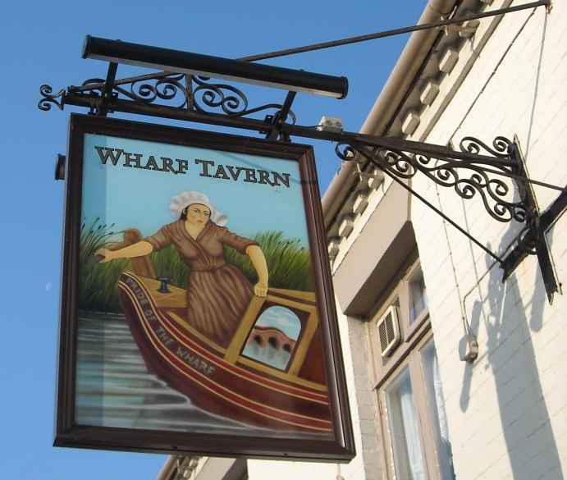
As a shallow cutting brings us to the Wharf Tavern, Hockley Heath, just in time for last orders of pub grub!

Slide 33
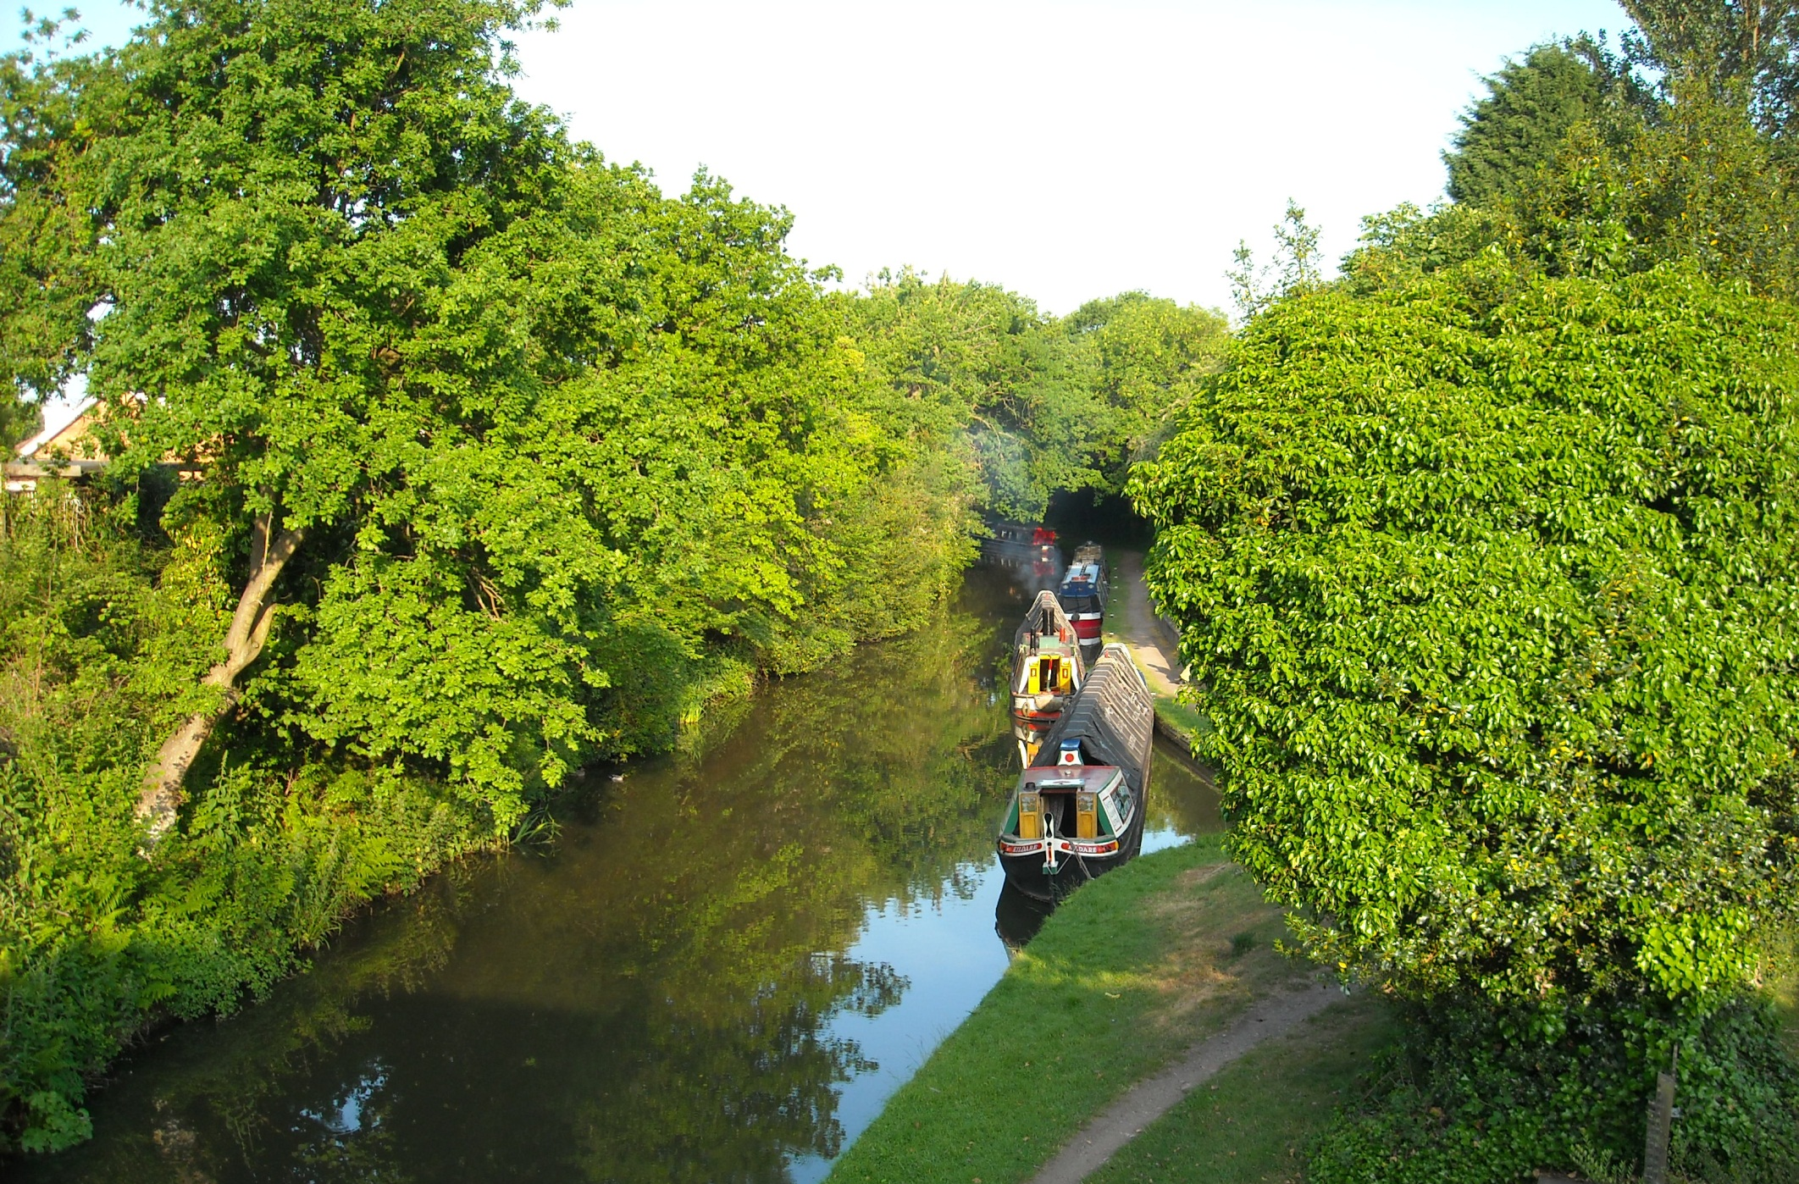
Early morning by the Wharf Inn on Friday 4th June 2010, at the start of a really tough day of President boating.

Slide 34
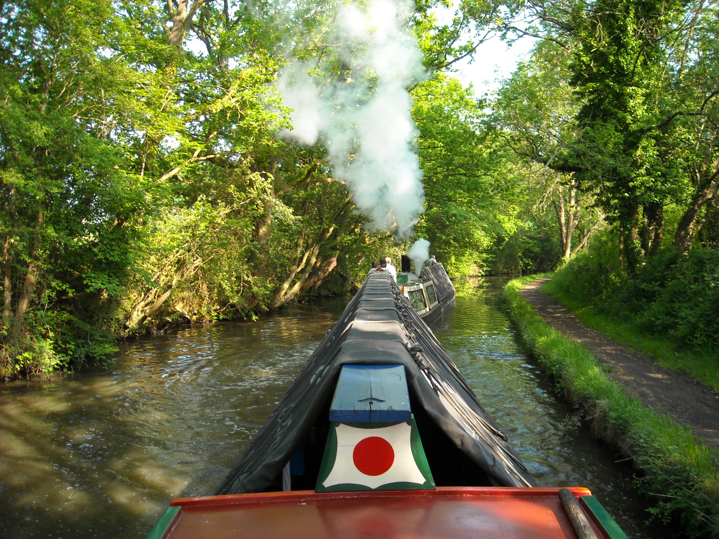
It may look idyllic but this canal is several inches down and as part of the vast Birmingham level this cannot be easily raised.

Slide 35
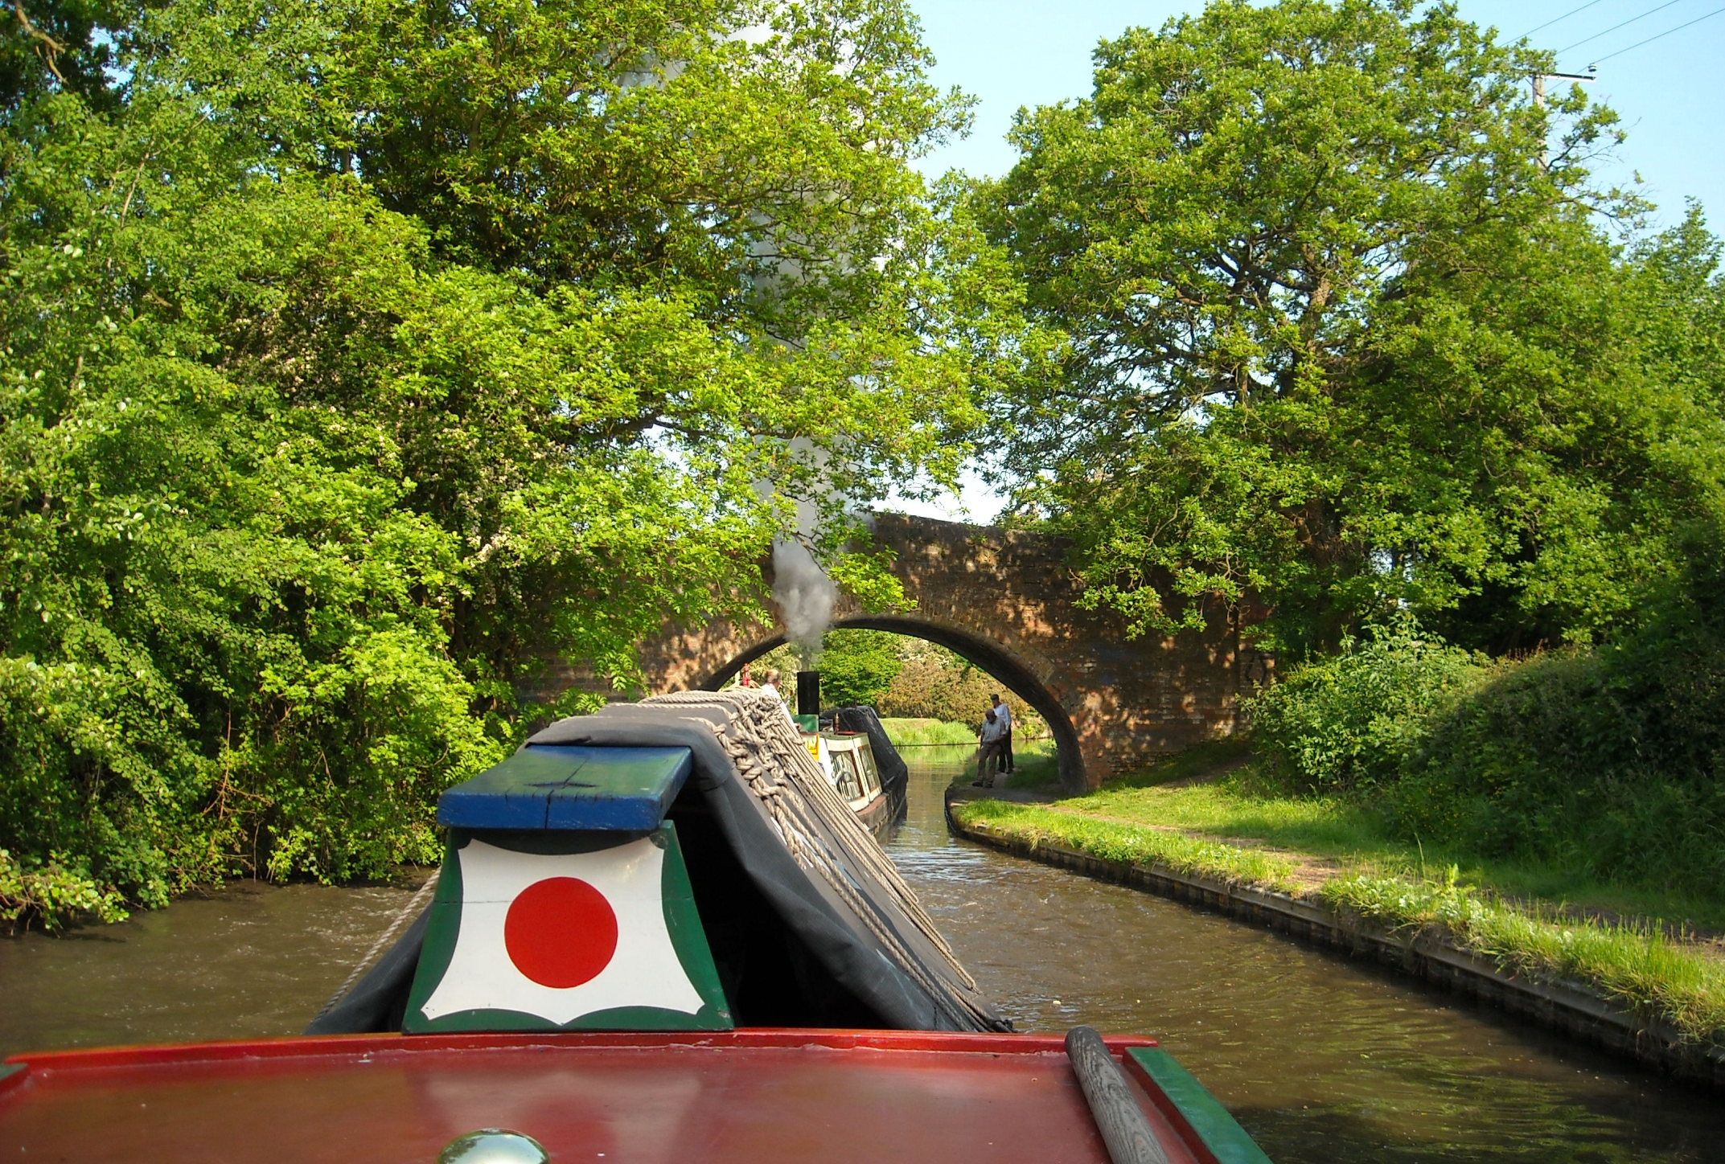
And so, with the canal significantly shallower than should be, our Tirfor winch gets plenty of use!

Slide 36
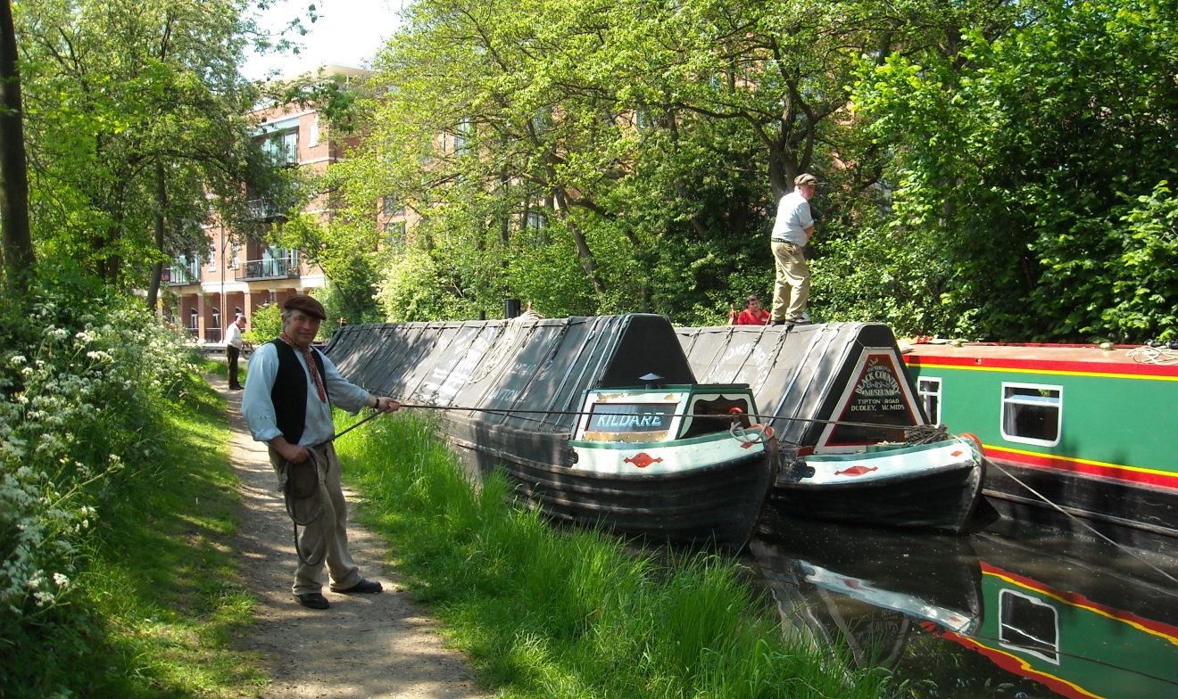
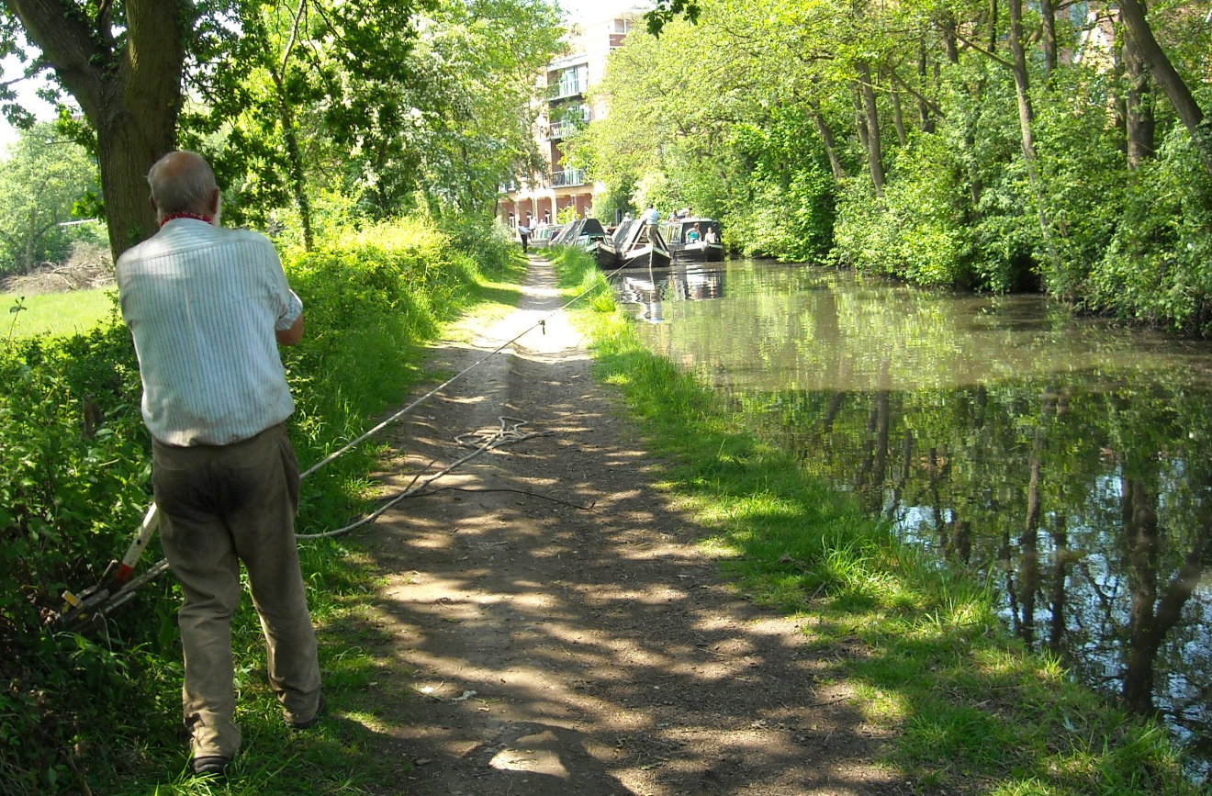
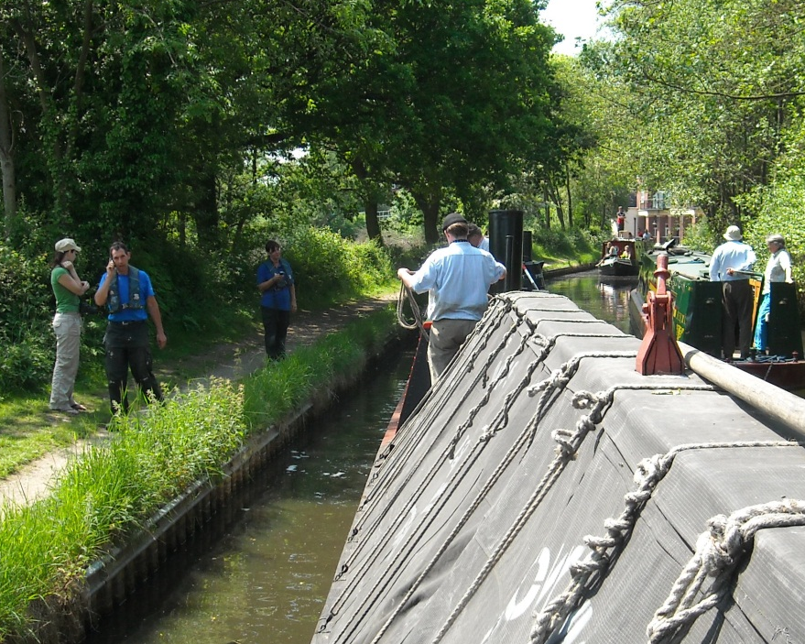
After an hour stuck here, British Waterways appeared on the scene saying they were letting as much water as they could out of Earlswood and Rotton Park reservoirs.

Slide 37
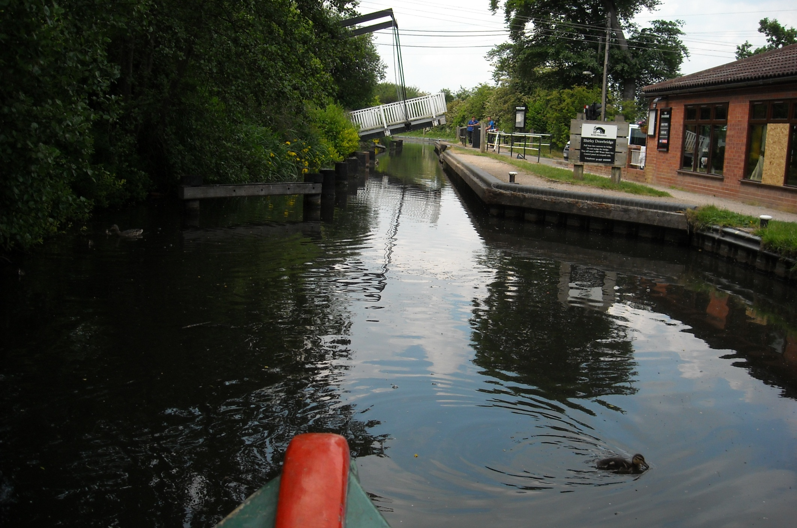
This is Shirley Drawbridge which the BW staff have gone on ahead to lift so that we can, as they put it, “power through”.

Slide 38
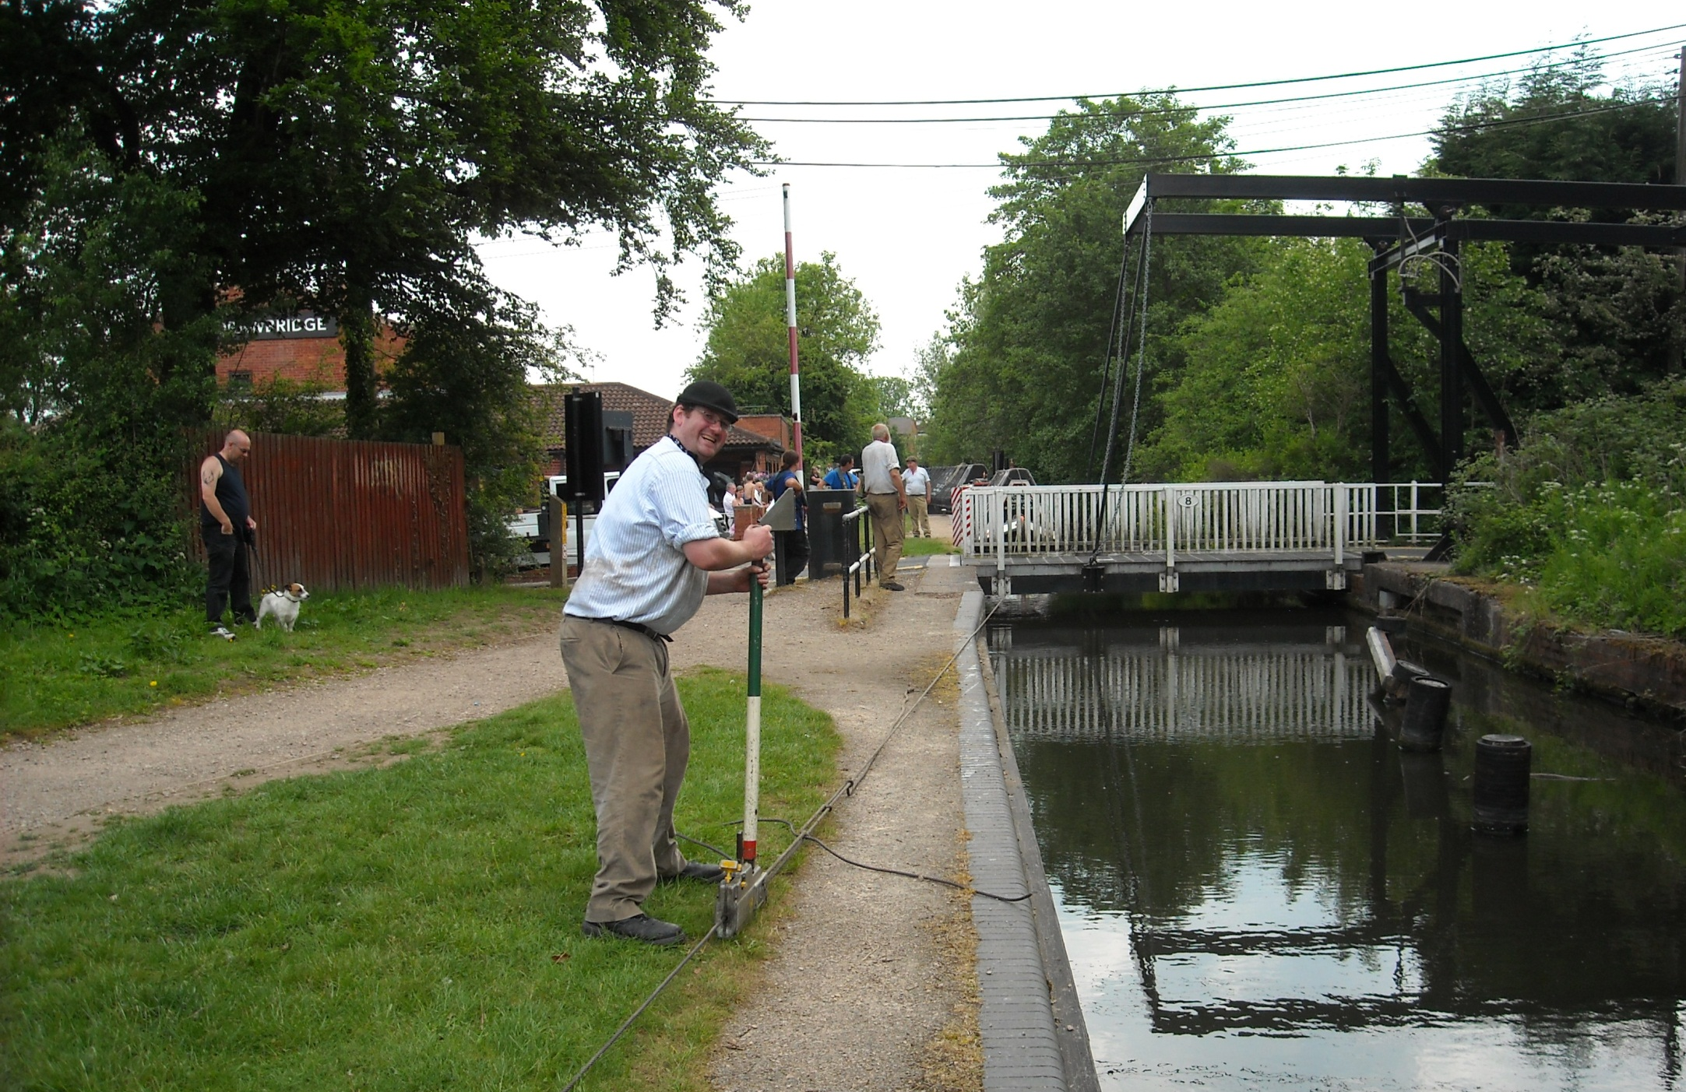
But reality was different as, with the bridge lowered, we winch and inch the boats along. About 7 hours to do 6 miles so far!

Slide 39
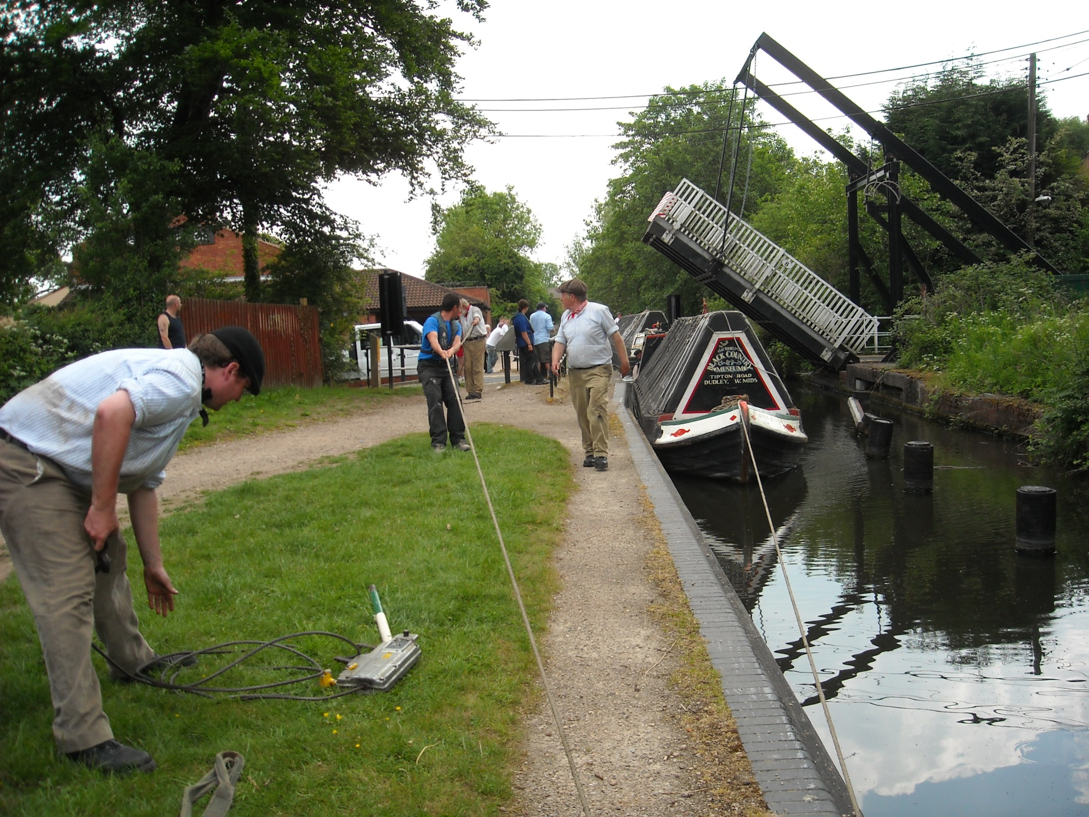
But eventually we made it through and were underway again.

Slide 40
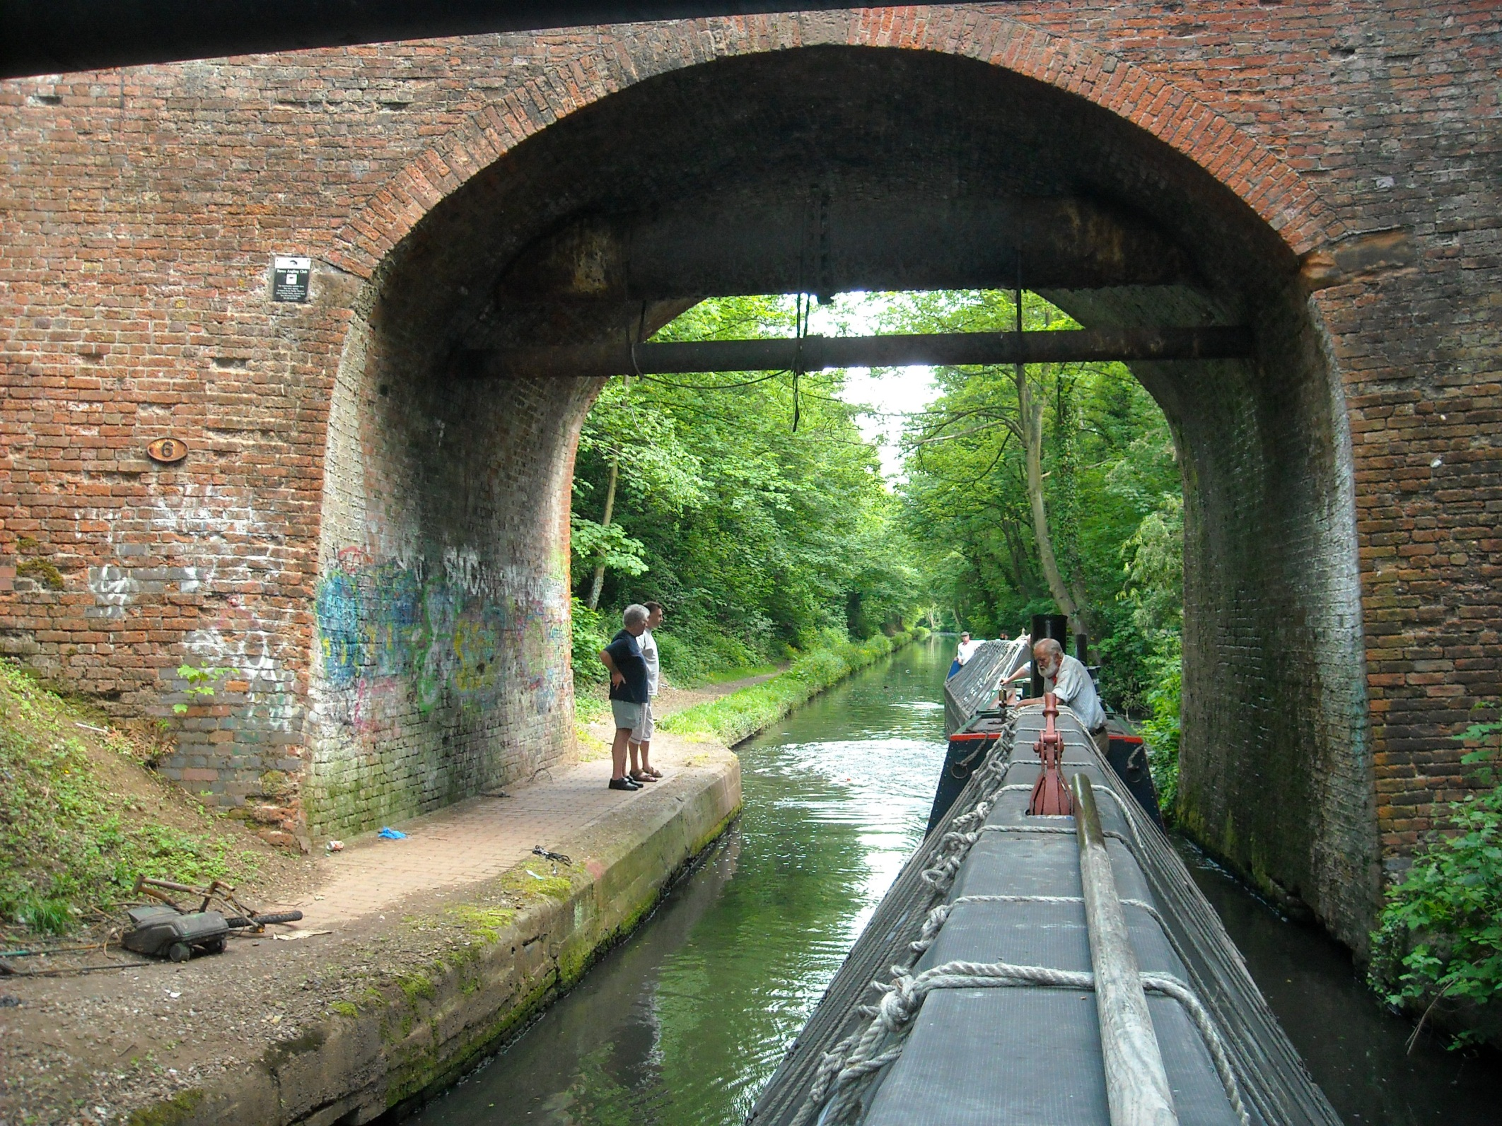
Bridge 6, at Yardley Wood, another tricky spot.

Slide 41
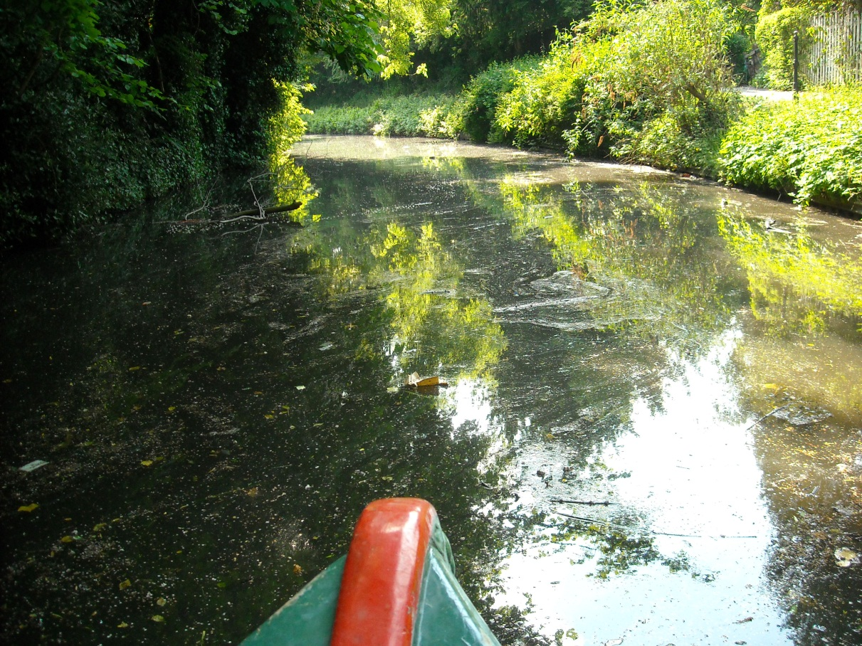
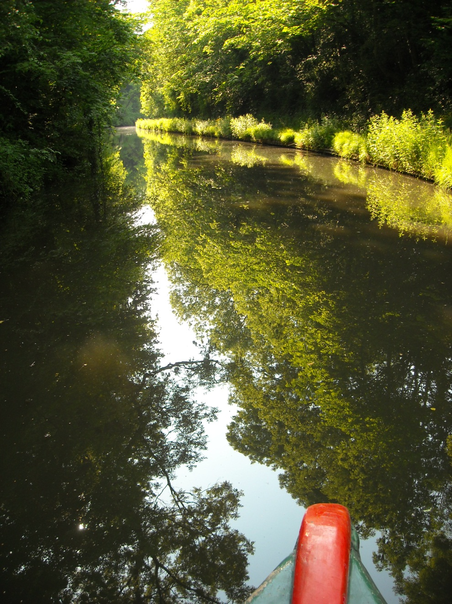
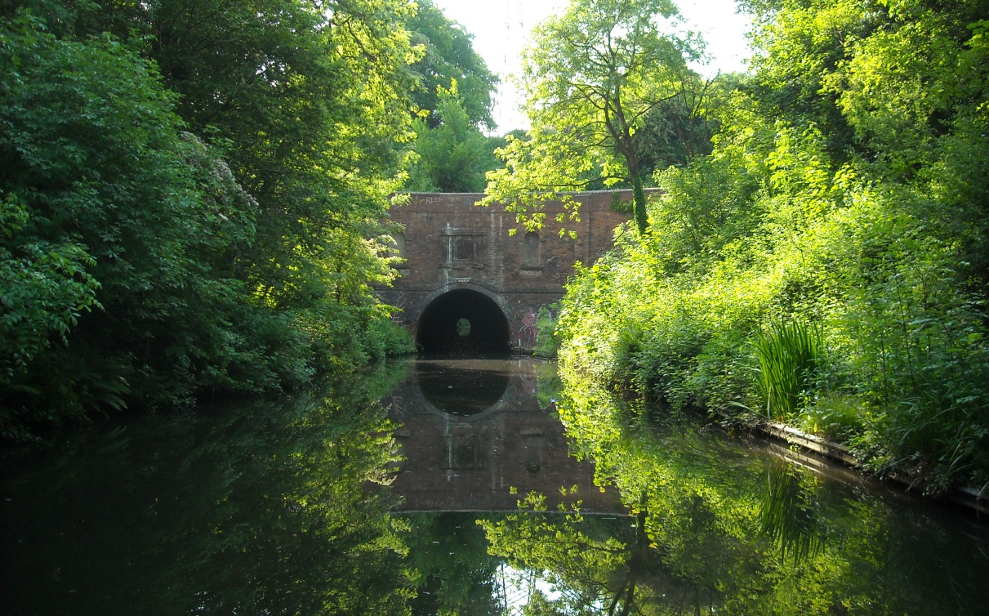
But we then made useful progress to
Brandwood Tunnel.

Slide 42
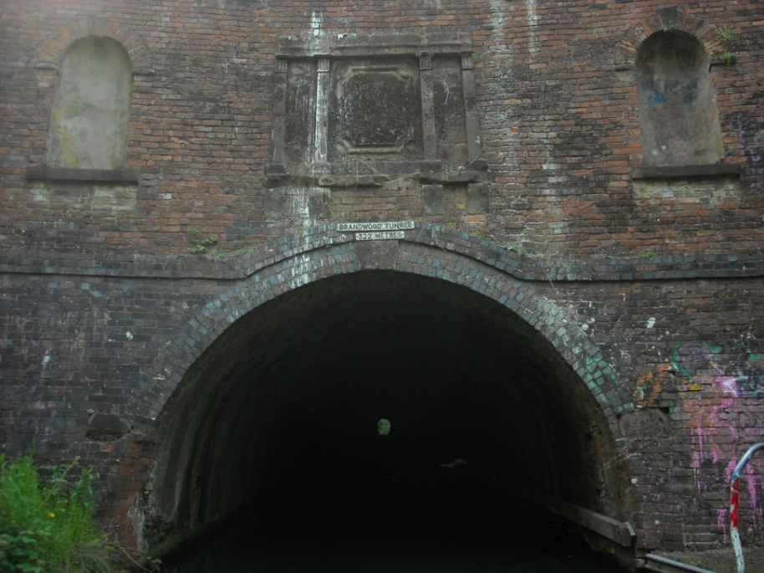


Tunnel time again!

Slide 43

Just the old King’s Norton stop lock to go now before the junction with the Worcester and Birmingham Canal.

Slide 44



But winching was needed to get through here too.
It’s a good job these old narrowboats are so well built!

Slide 45

Then it’s around the turn at King’s Norton Junction.

Slide 46

Although still dragging the bottom at times, we then make reasonable progress towards Birmingham.

Slide 47

This picture shows the effort that has gone into today’s trip although this particular railway bridge actually went quite well!

Slide 48

It was this horrendous obstacle that caused the problems.

Slide 49




A diversion round a new aqueduct for the Selly Oak relief road

Slide 50



Darkness was falling for the last couple of miles into Birmingham city centre.
Today’s 15 lock free miles have taken 13 hours!

Slide 51

But the following day, as we prepare for departure back to the
Black Country Museum, was much easier.

Slide 52

And begins by passing Worcester Bar, the famed transhipment point of old, now stern moorings in Gas Street Basin.

Slide 53



The Worcester Bar also marks the start of the BCN, the waters of the one time Birmingham Canal Navigation Company. Originally a 160 mile network but now down to 100.

Slide 54

The other side is a real contrast – a totally rebuilt Birmingham!

Slide 55

St. Vincent St. bridge by the Oozell Street loop, the end of the current redevelopment.

Slide 56

Some canal side factories still hang on but their days by Telford’s wide, double towpathed, New Main Line, are surely numbered.

Slide 57

This is a former toll island, once graced by a hexagonal toll house.

Slide 58

We turn off the 453ft. level here, Smethwick Junction, to climb the three locks to the 473ft. Wolverhampton level.

Slide 59

Tidy butty work from Kildare on this once busy and at one time duplicated flight of locks.

Slide 60



The Engine Arm, the feeder from Rotton Park reservoir, which comes in above Smethwick top lock on an attractive aqueduct of 1825.

Slide 61

Drivers will be familiar with this spot, the sharp bend on the M5 by junction 1 as the motorway picks up the line of the canal.

Slide 62




The M5 follows the canal for over a mile.

Slide 63

In amongst all of this is low Anchor Bridge, quite a contrast!

Slide 64

Another crossing of the 453ft. Birmingham level now by Netherton Tunnel, over 2 miles long and once gas lit, a marvel in its day!

Slide 65

We reach Dudley with another tunnel ahead and breast up to assist our reverse under the bridges and into the Museum Arm.

Slide 66

With a view of the Black Country Museum Boat Dock from the stern of Kildare as we reverse into the arm.

Slide 67

And close yet another amazing journey.

Slide 68
End of Chapter 3

